Slide 1
HISTOLOGY
EPITHELIAL TISSUE

Slide 2
Epithelial Tissue
Objectives:
Describe the general characteristics of epithelial tissue.
Discuss the microscopic structure and distribution of different types of epithelial membranes.
Classify glandular epithelium according to different parameters.
Mention the functions of epithelial tissue.
Understand the following clinical applications:
Immotile cilia syndrome (Kartagener’s syndrome).
Metaplasia.

Slide 3
EPITHELIAL TISSUE
General characteristics:
Cells are tightly joined with little intercellular space.
The little might be replace with scarce or scanty .
Rest on a basement membrane.
visible in both Light microscopic (L/M) & Electron microscopic (E/M) .
Avascular. ( A means: not )
High power of regeneration.
Classification:
a. Epithelial membranes:
1- Simple epithelium: one layer.
2- Stratified epithelium: more than one layer.
b. Glands (Glandular Epithelium).
FUNCTIONS OF EPITHELIUM :
Protection as in epidermis of skin.
Secretion as in glands.
Absorption as in small intestine.
Excretion as in kidney.
Reproduction as in gonads.
Smooth lining as in blood vessels.

Slide 4
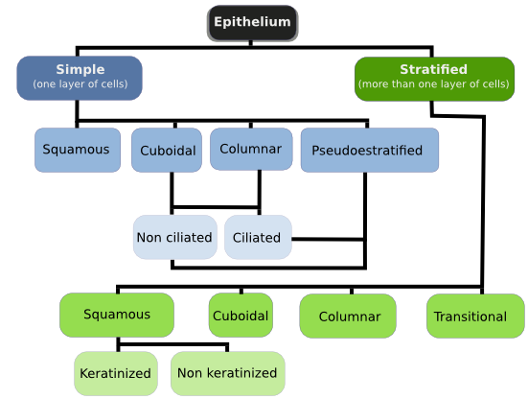

Slide 5
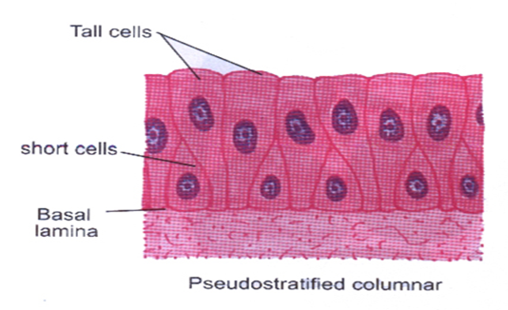
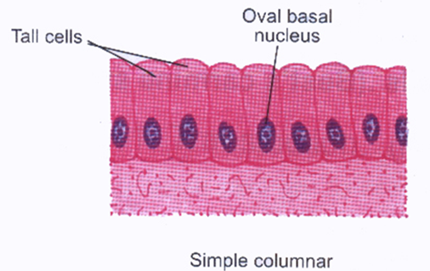
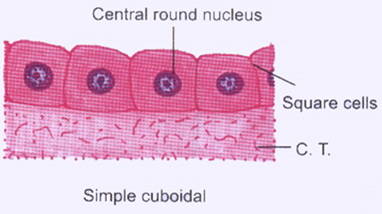
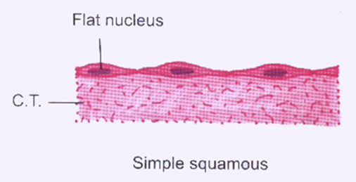
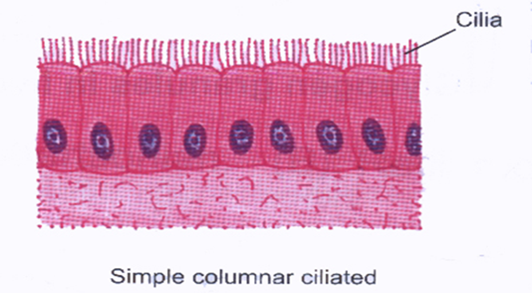
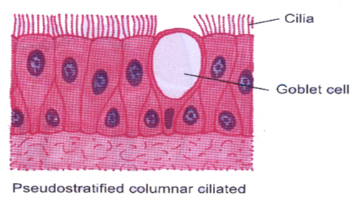
Simple Epithelium
 | 1- Simple squamous / flat | 2- Simple cuboidal | 3- Simple columnar | 4- Pseudo-Stratified Columnar
Cell layers: | One layer |  |  | One layer of cells, they can be tall or short that don’t reach the surface. They rest on a basement membrane.
Nuclei Characteristics: | Flat, provides smooth thin surface. | Central, round | Basal, oval. | appears at different levels
Sites/ Distribution: | 1- Endothelium (lining the CVS) 2- Alveoli of lung. | 1- Thyroid follicles. | Non-ciliated: 1- In lining of stomach 2- intestines (with goblet cells) 3- in gall bladder. Ciliated with cilia on free surface: 1- Fallopian tubes. | Non-ciliated: 1- vas deferens Ciliated with Goblet Cells: 1- trachea 2-bronchi 3-resp.system

Slide 6
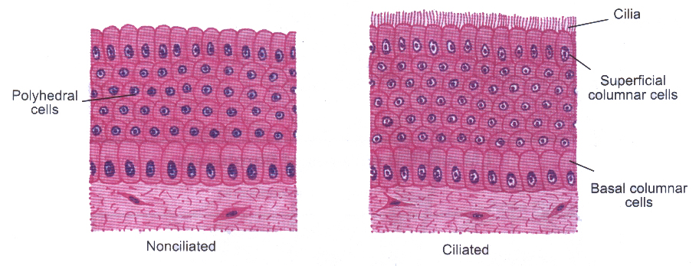
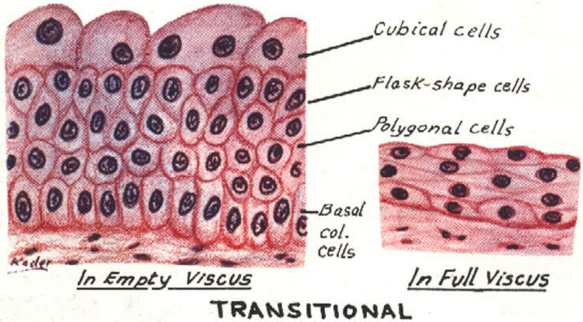
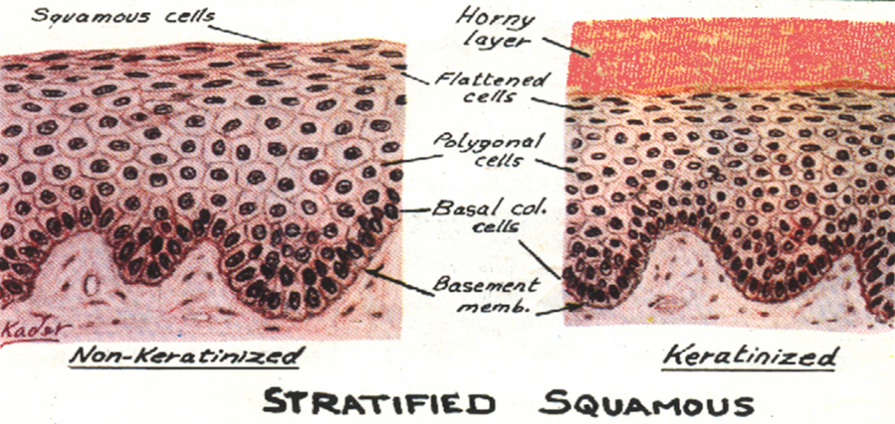
Stratified Epithelium
 | 1-Stratified Squamous: | 2- Stratified Columnar Epithelium: | 3-Transitional:
Cell layers and Nuclei Characteristics: | Basal cells: columnar with basal oval nuclei. Intermediate cells: polygonal with central rounded nuclei. Surface cells: flat with flat nuclei. | Basal cells: columnar. Intermediate cells: polygonal. Surface cells: columnar. | Basal cells: columnar. Intermediate cells: polygonal. Surface cells: large cuboidal with convex free surface, may be bi-nucleated.
Sites/ Distribution: | Keratinized (keratin layer on the surface): 1- epidermis of skin. Non-keratinized: 1- esophagus. | 1- large ducts of glands. | 1- Urinary bladder.

Slide 7
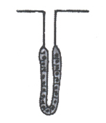
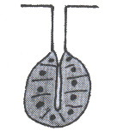
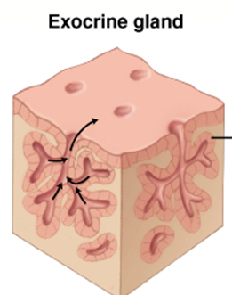
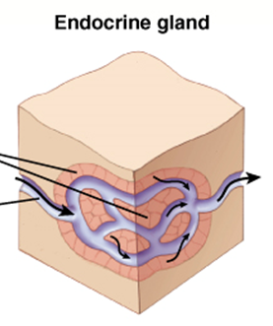
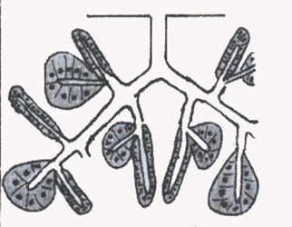
GLANDS (Glandular Epithelium) Classifications:
50% of Epithelial Tissues are Glands
Presence or absence of ducts
Number
of cells:
Mode of
Secretion:
Shape of secretory part:
Nature of secretion:
1- Endocrine:
Thyroid gland
2- Exocrine:
Salivary gland
3- Mixed:
Pancreas
1-Uni cellular:
Goblet cells
2- multicellular:
Salivary glands
1- Merocrine:
No part of the cell
is lost with
the secretion.
salivary glands
2- Apocrine:
The top of the cell
is lost with
the secretion.
mammary gland
3- Holocrine:
The whole cell detaches with
the secretion.
sebaceous glands.
Tubular:
Intestinal gland.
Alveolar (acinar):
Mammary gland
Tubulo-Alveolar:
Pancreas
Serous:
parotid gland.
Mucous:
goblet cells.
Muco-serous: sublingual gland.
Watery:
sweat gland.

Slide 8
Clinical Applications
Immotile cilia syndrome (Kartegener’s syndrome):
Disorder that causes infertility in male and chronic respiratory tract infection in both sexes.
It is caused by immobility of cilia and flagella induced by deficiency of dynein.
Dynein protein is responsible for movements of cilia and flagella.
Metaplasia:
It is the transformation of one type of tissue to another in response to injury. This condition is usually reversible if the injury is removed.
Example: pseudostratified ciliated columnar epithelium of the respiratory passages, e.g. trachea, of heavy smokers may undergo squamous metaplasia, transforming into stratified squamous epithelium.

Slide 9
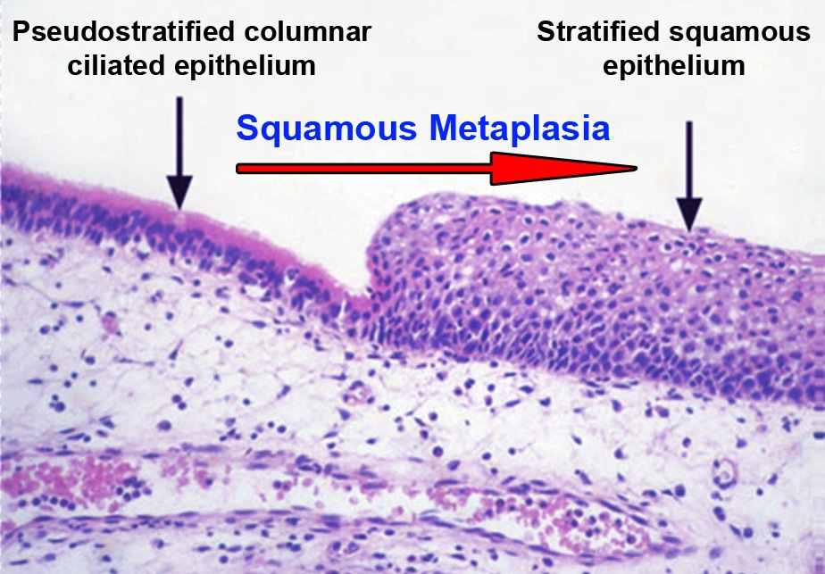
Squamous Metaplasia

Slide 10
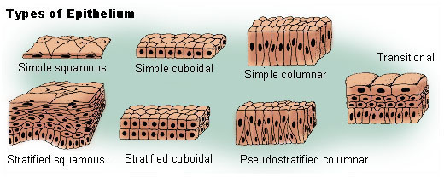
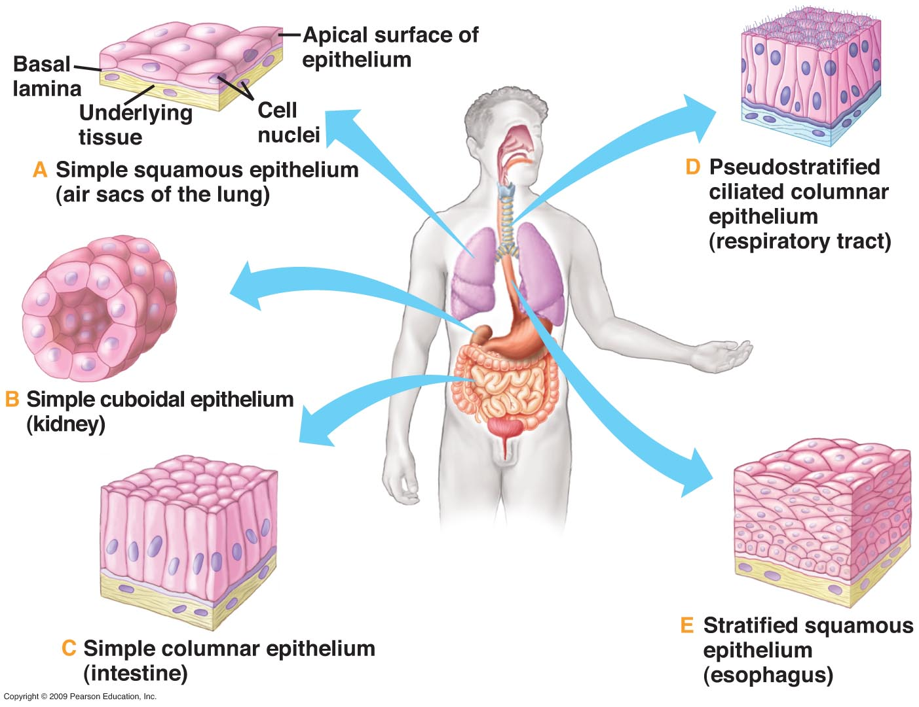

Slide 11
Videos for you to watch:
Epithelium
https://www.youtube.com/watch?v=L1YQaAfAKfs
https://www.youtube.com/watch?v=rSqzvU6vmmg
https://www.youtube.com/watch?v=3LceGFcMtqM

Slide 12
THANK YOU !
Histology team members :
Team Leaders :
Rana Barasain
Reema AlBarrak
Shahad AL Anzan
Doaa Walid Abdulatif
Ghadah Al Muhanna
Amal Al Qarni
Wateen Al Hamoud
Weam Babaier
Ahmed Badahdah
Mutasem Alhasani
Nassir Abodjain
Nawaf Aldarweesh
Mohammed Tawfiq
Reema AlOtaibi
Faisal AlRabaii
Contact us on HistologyTeam436@gmail.com

