Slide 1
HISTOLOGY
CONNECTIVE
TISSUE

Slide 2
CONNECTIVE TISSUE (C.T.)
Objectives:
By the end of this lecture, the student should be able to:
1.Enumerate the general characteristics of C.T.
2.Classify C.T into C.T. proper and special types of C.T.
3.Classify C.T. proper (C.T.P.)
4.Describe the structure (components) and distribution of different types of C.T.P.

Slide 3
Connective Tissue
It is a basic type of tissue, of mesodermal origin, It provides structural and metabolic support for other tissues and organs. (Jelly like, soft)
Characteristics:
Formed of widely separated few cells, with abundant extracellular matrix.
Most C.T. are Vascular.
C.T. components
1.Cells
2.Fibers
3.Matrix
Collagen fibers
Elastic fibers
Reticular fibers
Types of C.T.
(depending on matrix)
Matrix is soft > Connective tissue proper
Matrix is rigid> Cartilage
Matrix is solid > Bones
Matrix is fluid > Blood

Slide 4
C.T. Proper Types
Reticular
Dense Collagenous
Loose (Areolar)
Adipose
Predominance :
Unilocular fat cells
Site:
1- Subcutaneous
(abdominal wall ,
female breast, buttocks)
2- Around kidney
Function:
Storage of fat, heat insulation, supports organs (Kidney)
Most common type.
Contains all of C.T.P components in equal amounts.
(No predominant element)
Site :
Subcutaneous tissue (Under skin)
Elastic
Predominance:
Elastic fibers (sheet or membrane), fibroblasts
Site:
Large arteries (Aorta)
Function:
Stretchable, elastic tissue
Predominance :
Collagen fibers , fibroblasts
Site:
1-Dense irregular
(dermis, capsule)
2-Dense regular
(tendons, ligaments)
Function:
Resists stretch, tough tissue
Predominance:
reticular fibers + reticular cells (specialized fibroblasts).
Site:
Stroma of organs (liver, spleen ,lymph node)
Function:
Structural support

Slide 5
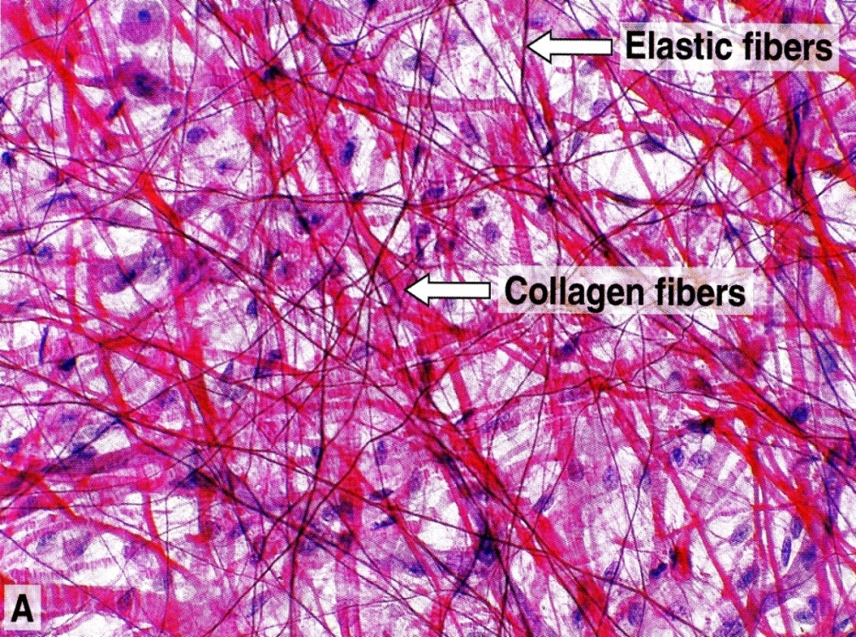
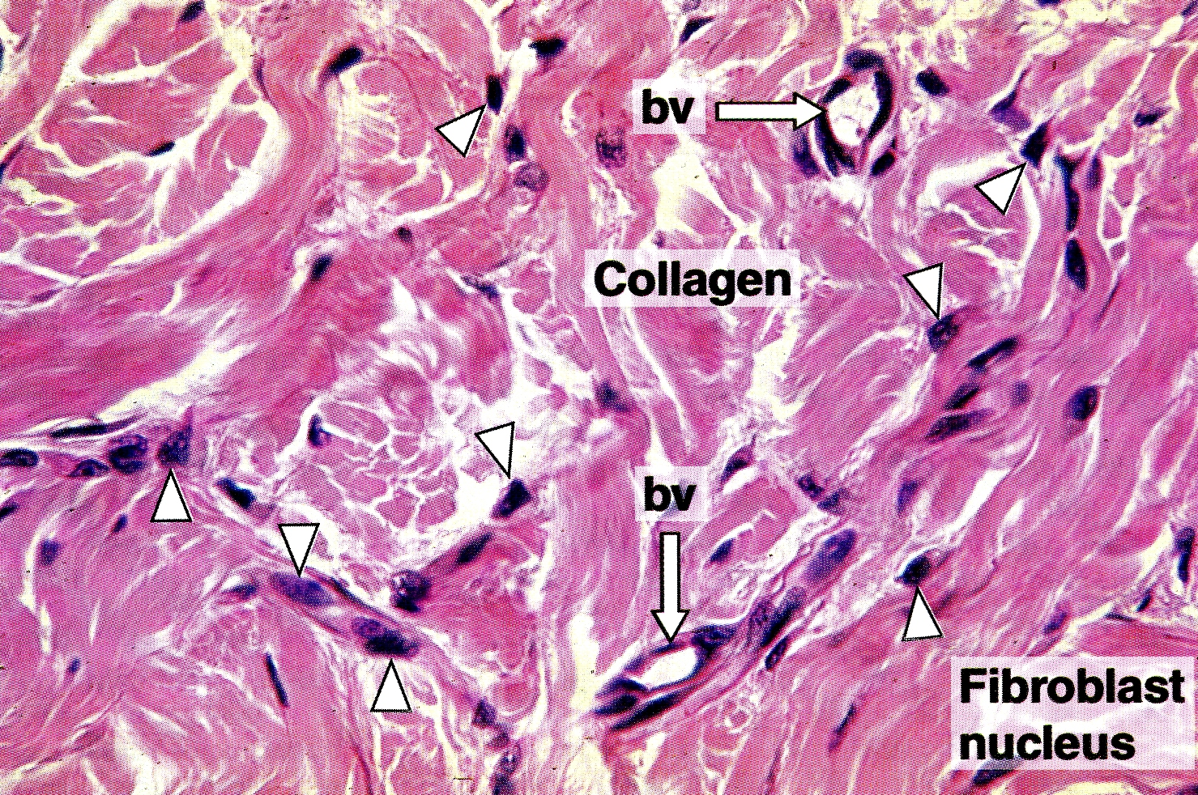
Areolar C.T.
Dense collagenous regular
Dense collagenous irregular
* Note that the dense regular does not have blood vessels (Avascular) unlike dense irregular (Vascular)
So when we have an injury in our tendon the healing duration is slower comparing to an injury in the dermis (skin).

Slide 6
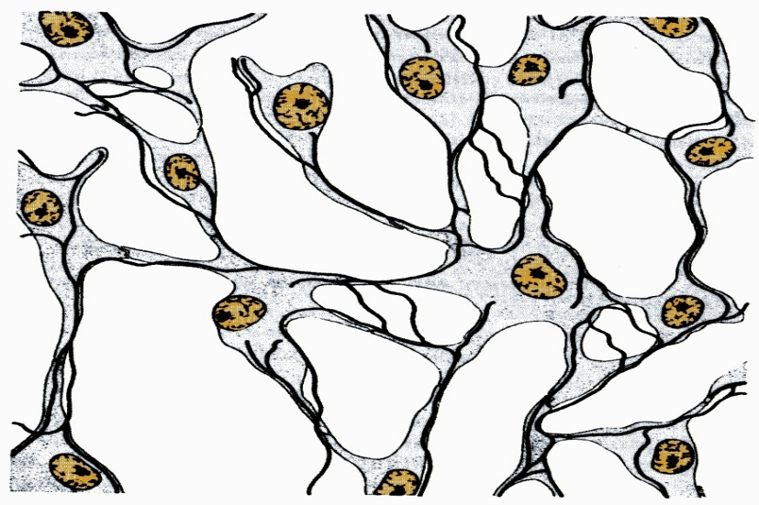
Adipose C.T.
Reticular C.T.
Elastic C.T.

Slide 7
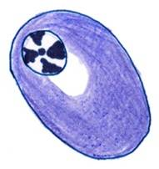
Cells of C.T Proper
NAME | L/M | Function
1) Fibroblasts | Most common cell, nearly found in all types of C.T.P. Flat, branched, spindle shaped. Basophilic cytoplasm. Can divide. Old fibroblasts are called Fibrocytes (They’re activated during growing and wound healing) | Forms proteins of C.T. fibers. Forms the C.T. matrix. Healing of wounds.
2) Macrophages | Basophilic cytoplasm that is rich in lysosomes. Irregular outline. (Because of its movement) Can divide. Originate from blood monocytes (WBC) | Phagocytosis.
3) Plasma cells | Basophilic cytoplasm with a negative Golgi image. Spherical nucleus eccentric with a clock-face appearance of chromatin. Derived from B-lymphocytes. | Secretion of antibodies (immunoglobulins).

Slide 8
4) Mast cells | Cytoplasm contains numerous basophilic cytoplasmic granules. | Secretes heparin (anticoagulant). Secretes histamine (allergic reactions).
5) Adipose Cells | Large spherical, with a single large fat droplet. Thin rim of cytoplasm at the periphery. Nucleus: flattened, peripheral. | Storage of fat.
6) Leucocytes (WBC) for immunity.

Slide 9
Fibers of C.T Proper
Functions of C.T Proper:
Collagen Fibers (Collagen Type I)
-Non Branched, arranged in bundles (The bundles may branch)
-Acidophilic
Reticular Fibers (Collagen Type III)
-Branched, forming a network
-Stained with Silver so it appears black
Elastic Fibers (Elastin)
-Branched
-Stained with Orcein so it appears brown
Supports and connects tissues together and organs.
Nourishes the surrounding structures through it’s blood vessels.
The cells provide different functions:
Healing injured tissues
Producing Heparin and Histamine
Producing antibodies
Storing Fat
Preserving body temperature
Protection against microorganisms
The Fibers provide rigidity or elasticity.

Slide 10
THANK YOU !
Histology team members :
Team Leaders :
Rana Barasain
Reema AlBarrak
Shahad AL Anzan
Doaa Walid Abdulatif
Ghadah Al Muhanna
Amal Al Qarni
Wateen Al Hamoud
Weam Babaier
Ahmed Badahdah
Mutasem Alhasani
Nassir Abodjain
Nawaf Aldarweesh
Mohammed Tawfiq
Reema AlOtaibi
Faisal AlRabaii
Contact us on HistologyTeam436@gmail.com

