Slide 1
HISTOLOGY
LYMPHOID TISSUE

Slide 2
LYMPHOID TISSUE
Objectives:
By the end of the lecture, the student should describe the microscopic structure of the following organs in correlation with their functions:
1- Lymph nodes.
2- Spleen.
3- Tonsils.
4- Thymus.
COLOR CODING:
IMPORTANT

Slide 3
Information might help you : * Lymph : a pale fluid that contains white blood cells and that passes through channels in the body and helps to keep bodily tissues healthy * How does the Lymph form ? The lymph is formed when the interstitial fluid is collected through lymph capillaries. * Lymph sinuses : Channels which allows the free movement of lymphatic fluid

Slide 4
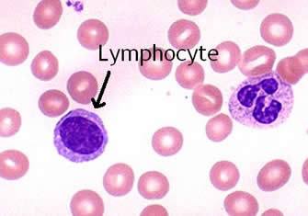
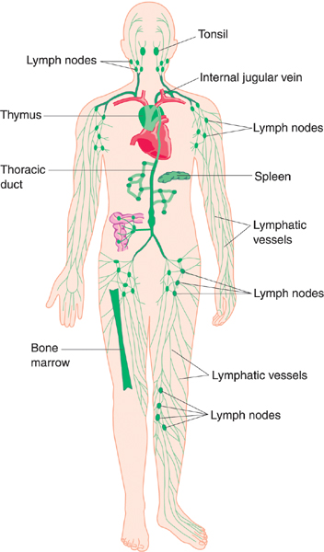
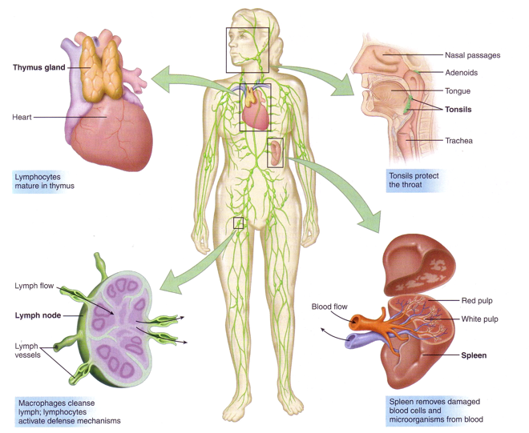
Lymphoid Tissue
Diffuse lymphoid tissue
(free not in organs)
Encapsulated lymphoid organs
Lymph nodes
Spleen
Tonsils
Thymus
NOTES:
red bone marrow and thymus are considered 1ry lymphoid organs.
Bone marrow is a part of lymphoid system because it can make lymphocytes .
B lymphocyte is active , T lymphocytes are immunincompetant .
Lymph nodes work as filters .

Slide 5
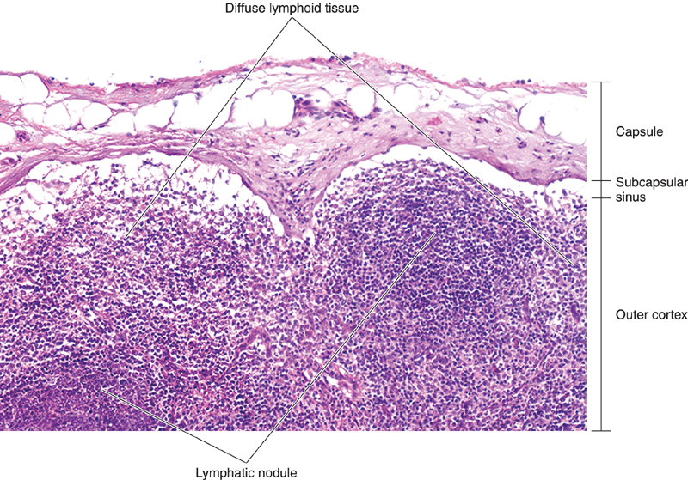
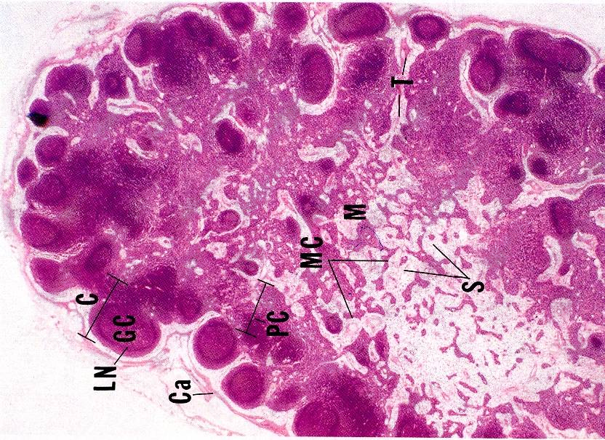
LYMPH NODES
Functions: Production of immunocompetent cells. Filtration of lymph. Stroma: Capsule Trabeculae (septa) (drape like) Reticular C.T(grid like) (B) Parenchyma : (lymphoid tissue + lymph sinuses) | B cells are the major component Cortex of L.N Lymphatic nodules (follicles): 1ry: without germinal center (not active) 2ry: with germinal center: Lighter (active) Cortical lymph sinuses. (sinuses are like capillaries without blood) Paracortex of L.N It is the thymus-dependent zone of L.N. It is composed mostly of T-lymphocytes. Medulla of L.N Medullary cords: are formed of lymphoid cells (B & T lymphocytes, plasma cells, macrophages). Medullary lymph sinuses.

Slide 6
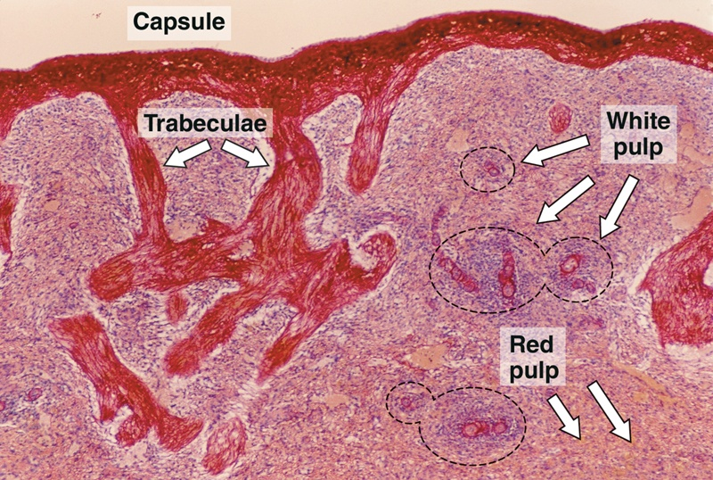
SPLEEN
Functions of spleen: Filtration of blood. Phagocytosis of old RBCs & old blood platelets & invading microorganisms. Production & proliferation of immunocompetent B & T lymphocytes. Production of antibodies. | A. Stroma: Capsule. (made of connective tissue) Trabeculae. Reticular C.T. B. PARENCHYMA: White pulp. RED PULP. N.B. No cortex, No medulla, No lymph sinuses

Slide 7
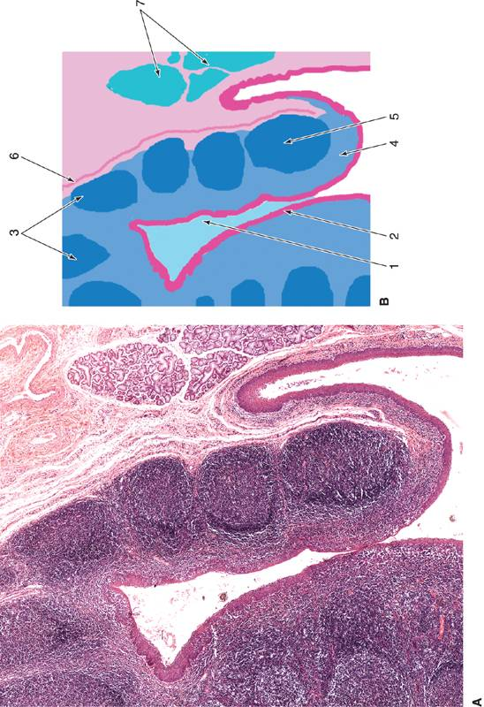
TONSILS
Functions: Production of antibodies. Types of tonsils: Palatine Tonsils. Pharyngeal Tonsil. Lingual Tonsils. Note: Nose lymph infection will cause adenoids | Palatine Tonsils Structure: Epithelium: non-keratinized stratified squamous. Tonsilar crypts. Lymphatic nodules. Capsule: partial.

Slide 8
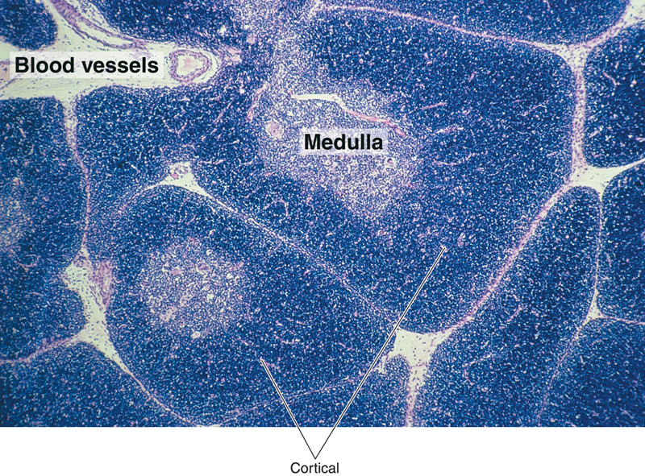
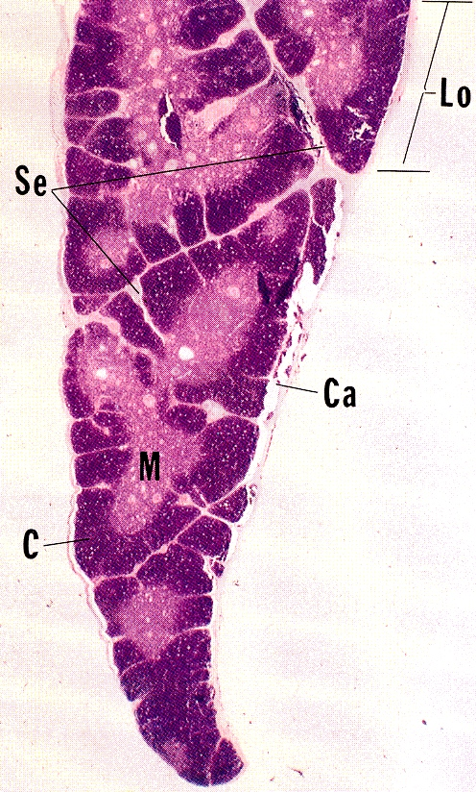
THYMUS
Functions: Maturation of T lymphocytes. (Immunoincompetent T cells → Immunocompetent T cells). Stroma: Capsule Interlobular trabeculae: incomplete (B) Thymic lobule : Cortex Medulla NOTES: *No B cells *Medulla has activated cells *ERC are unique because: Base for cells (like net) Secretes factors that stimulates T cell maturation | Cortex of Thymic Lobule: It contains developing (immature) T-lymphocytes (thymocytes). 98% of thymocytes die Epithelial reticular cells Macrophages.(phagocytosis) *No lymphatic nodules , No plasma cells , No B-lymphocytes Medulla of Thymic Lobule: Hassall’s (thymic) corpuscles : Concentrically arranged epithelial reticular cells in the medulla. ( in medulla only) Mature small T lymphocytes Macrophages. Epithelial reticular cells. *Medulla of adjacent thymic lobules are interconnected - Why? Incomplete trabeculae General notes: No lymphoid nodules , No reticular fibers, No sinuses or sinusoids

Slide 9
Clinical Applications
Rupture of the Spleen | Palpable lymph node
Spleen is a fragile or friable organ, so major trauma to the upper left abdominal quadrant usually leads to rupture of the spleen. Surgical removal of that ruptured spleen is essential. | The presence of antigen or bacteria leads to rapid proliferation of lymphocytes of the lymph node (L.N), leading to increase of L.N. to several times of its normal size, so the L.N. becomes enlarged and palpable to the touch.

Slide 10
THANK YOU !
Histology team members :
Team Leaders :
Rana Barasain
Reema AlBarrak
Shahad AL Anzan
Doaa Abdulfattah
Ghadah Al Muhanna
Amal Al Qarni
Wateen Al Hamoud
Weam Babaier
Ahmed Badahdah
Mutasem Alhasani
Nassir Abodjain
Nawaf Aldarweesh
Mohammed Tawfiq
Reema AlOtaibi
Faisal AlRabaii
Contact us on HistologyTeam436@gmail.com

