Slide 1

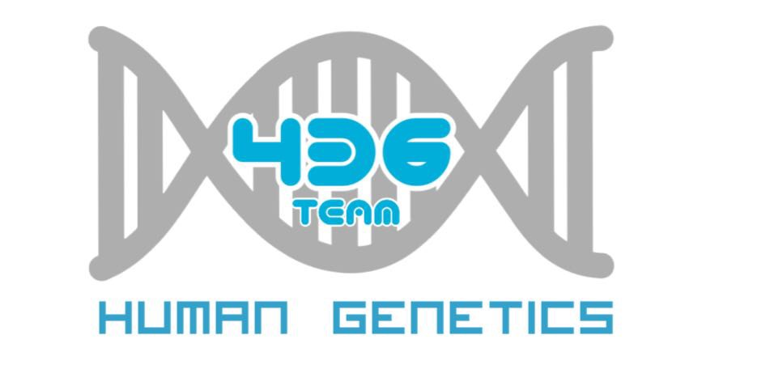
Human genetics:
Human Chromosomes, Human Karyotype
Important
Notes
For revision only

Slide 2
Objectives:
Describe the number, structure, and classification of human chromosomes
Explain what a Karyotype is and how it is obtained.
Describe chromosomal banding and explain its use.
Describe the process of in situ hybridization and the information it provides.

Slide 3
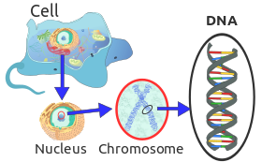
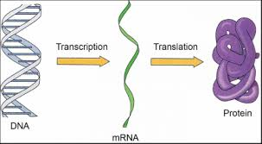
Gene Expression
cell
Nucleus
Chromosome
Gene
DNA
* In transcription Cell machinery copies the code making an mRNA molecule.
* mRNA moves into the cytoplasm
* Translation: Ribosomes read the code and accurately join amino acids together to make protein.
Only folded protein can perform function

Slide 4
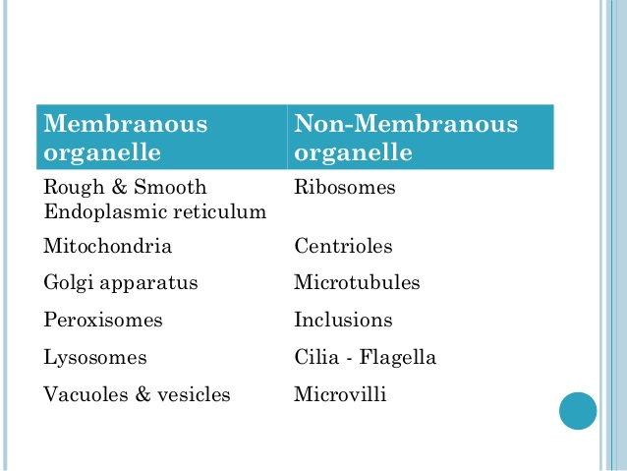
Eukaryotic cells
* Eukaryotic cells present in humans and some other micro-organisms like Parasite and fungi
*There are two types of organelles :

Slide 5
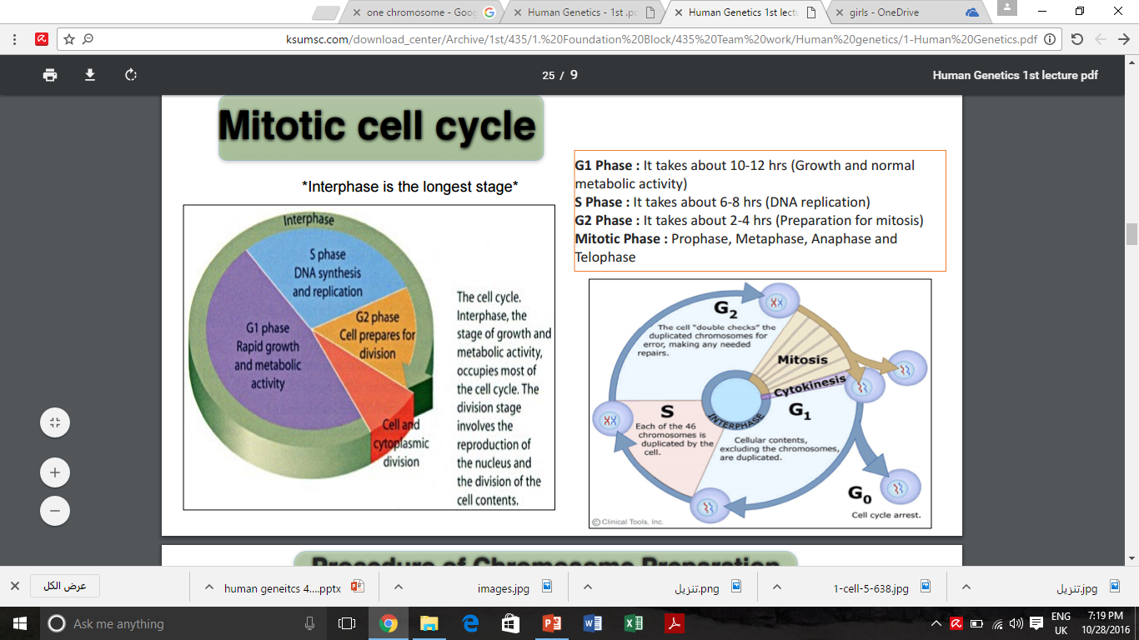
Mitotic cell cycle
Interphase:
G1 Phase : It takes about 10-12 hrs (Growth and normal metabolic activity)
S Phase : It takes about 6-8 hrs (DNA replication)
G2 Phase : It takes about 2-4 hrs (Preparation for mitosis)
Mitotic Phase :
Prophase, Metaphase, Anaphase and Telophase
Interphase is the longest stage

Slide 6
GENETICS
Cytogenetics
the study of the structure , function and behavior of chromosomes during somatic and germline division
Molecular genetics
The study of structure and function of genes at molecular level and how the genes are transferred from generation to generation

Slide 7
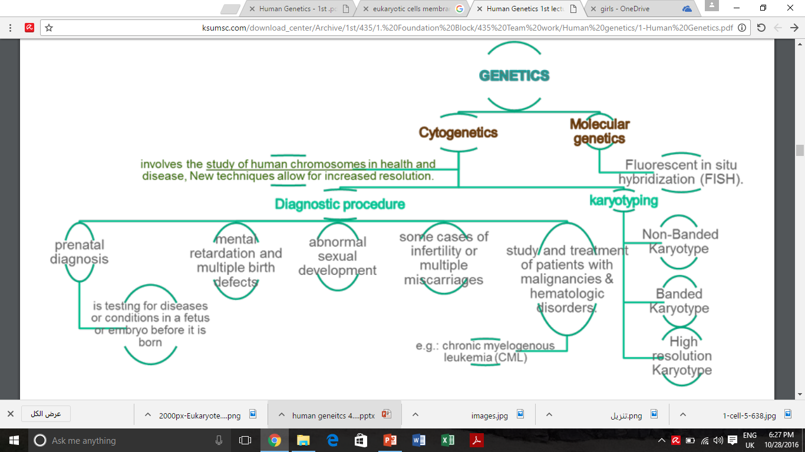
This slide is taken from 435 teamwork

Slide 8
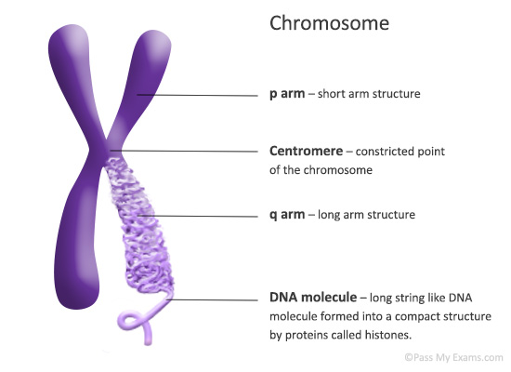
Chromosomes:
1- carry genetic material (On the form of DNA)
2-heredity: each pair of homologues consists of one paternal and one maternal chromosome
3- The intact set is passed to each daughter cell at every mitosis

Slide 9
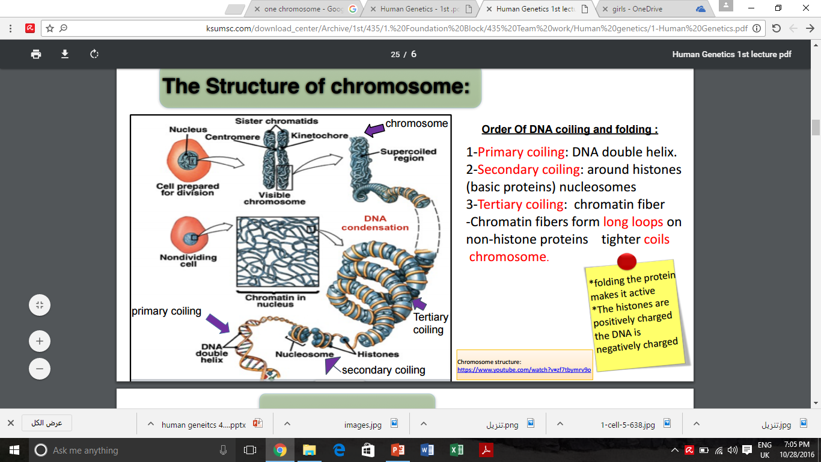
Structure of chromosomes
Order of DNA coiling and folding :
1-Primary coiling: DNA double helix.
2-Secondary coiling: around histones (basic proteins) nucleosomes
3-Tertiary coiling: chromatin fiber -Chromatin fibers form long loops on non-histone proteins tighter coils chromosome.
*folding the protein makes it active
*The histones are positively charged
* the DNA is negatively charged

Slide 10
Chromosomal classification
22 pairs of autosomes, numbered from1 to 22 by order of decreasing length
1pair of sex chromosomes :
- XX in female
- XY in male

Slide 11
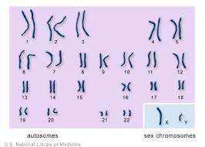
karyotype
The number and appearance of chromosomes in the nucleus of a eukaryotic cell
These are pair of homologous chromosomes :
* One from the father and one from the mother
*They have the same genes arranged in the same order
* Slightly different DNA sequences

Slide 12
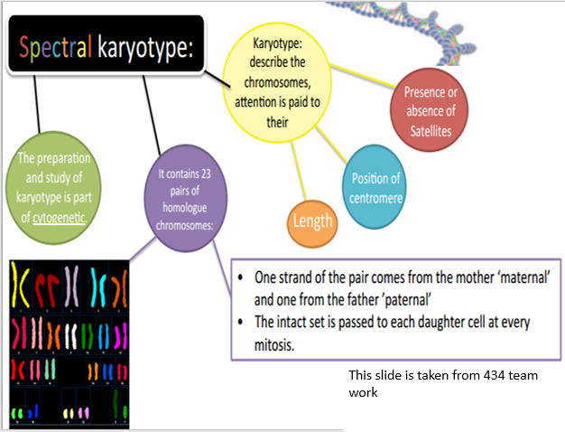

Slide 13
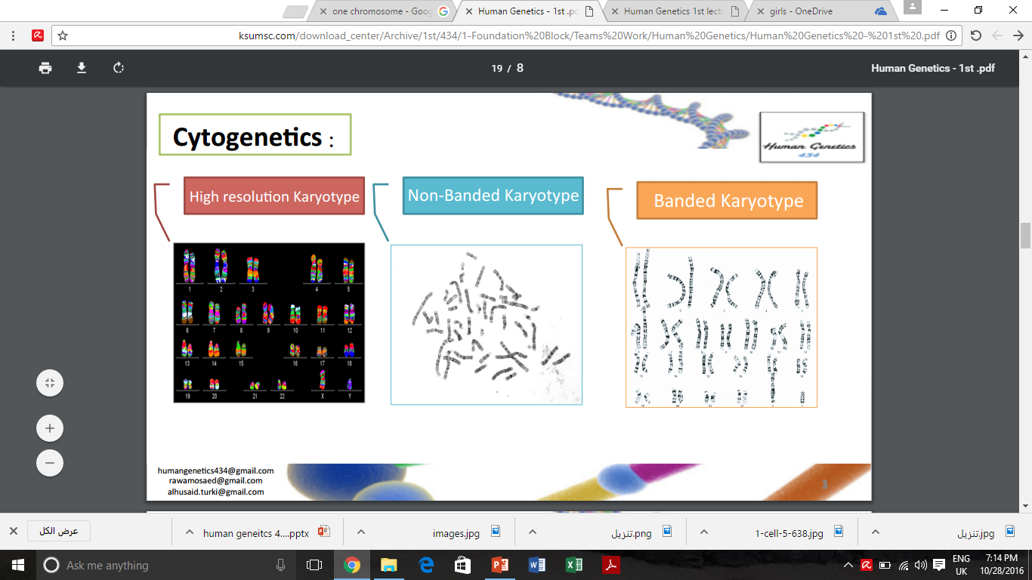

Slide 14
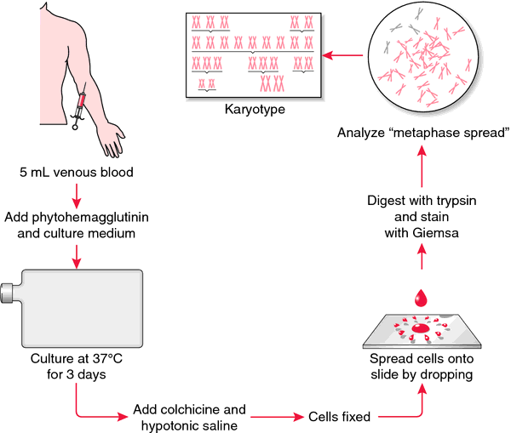
Procedure of Chromosome Preparation from Peripheral Blood
Visual Demonstration For Karyotyping:
https://youtu.be/7ShPzzrCetE
Culture media
contains
Phytohemagglutinin
to stimulate T
lymphocytes to
divide
Prevents formation
of the spindle ->
arrest cell division
during metaphase

Slide 15
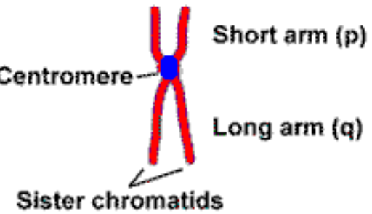
Metaphase chromosomes:
- The 2 sister-chromatids are principally held together at the centromeric region.
- Each chromosome has a centromere (CEN),
region which contains the kinetochore,
- CEN divides the chromosome into two arms:
the short arm (p arm) and the long arm (q arm).
- Each arm terminates in a telomere.

Slide 16
Centromeric position and arm length:
The ratio of the lengths of the two arms is constant for each
chromosome.
This ratio is an important parameter for chromosome identification and allows classification of chromosomes into several basic morphologic types:
i-metacentric ii-sub-metacentric iii-acrocentric
In the human karyotype chromosome pairs 13, 14, 15, 21, 22 are acrocentric

Slide 17
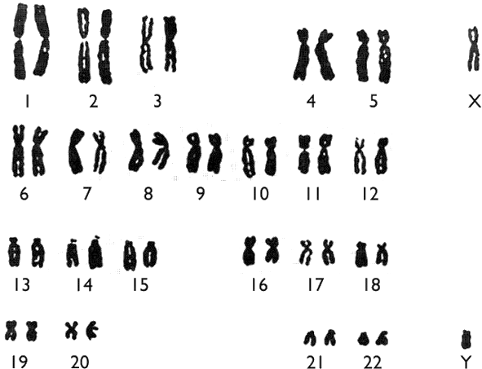
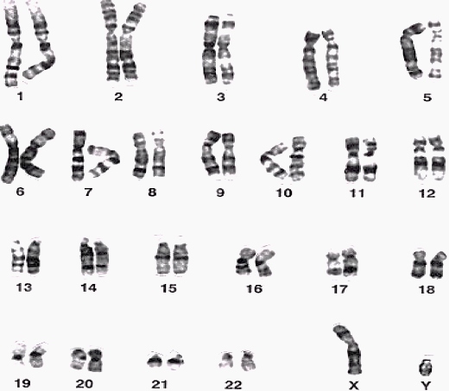
Chromosomes Banding
Banding is using certain “staining techniques” to make the chromosome take on a banded appearance (each arm presenting a sequence of dark and light bands)
Why is banding important?
It allows accurate identification of the chromosomes and accurate longitudinal mapping
And that’s is to: locate gene positions and characterize structural changes (helps us in identifying the location of the gene and if there are any abnormalities such as chromosome breakage, loss, duplication or translocation
Non-banded karyotype (no bands)
Banded karyotype (we can see dark and light bands alternating)

Slide 18
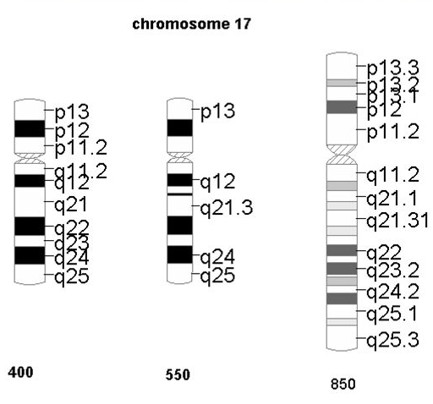
Chromosome Banding (continued):
Banding resolution =
estimate number of light and dark bands per haploid set of chromosomes
400 → 850+
(in the picture the same chromosome with different resolutions)

Slide 19
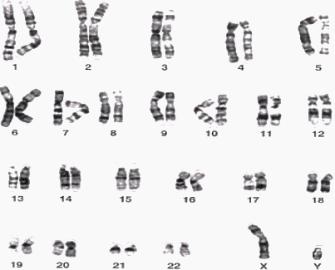

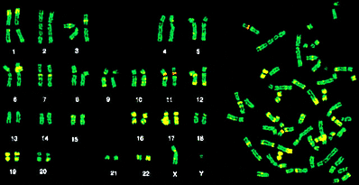
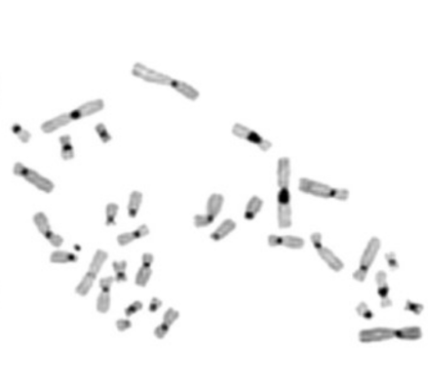
Different protocols for banding:
G- Banding
Treat with trypsin then with Geimsa stain
Q- Banding
Treat with Quinicrine dye giving rise to florescent bands. It requires an ultraviolet fluorescent microscope
C- Banding
Staining of the centromere. Treat with acid followed by alkali prior to G banding
R- Banding
Heat then treat with Geimsa stain
To remember: R-banding bands are Reversed to G-banding bands (light in place of dark)
G-banding karyotype for a normal male
We notice reversed light and dark bands between G and R banding
R-banding karyotype for a normal male
C-banded chromosomes for a female (shows centromere darkness)

Slide 20
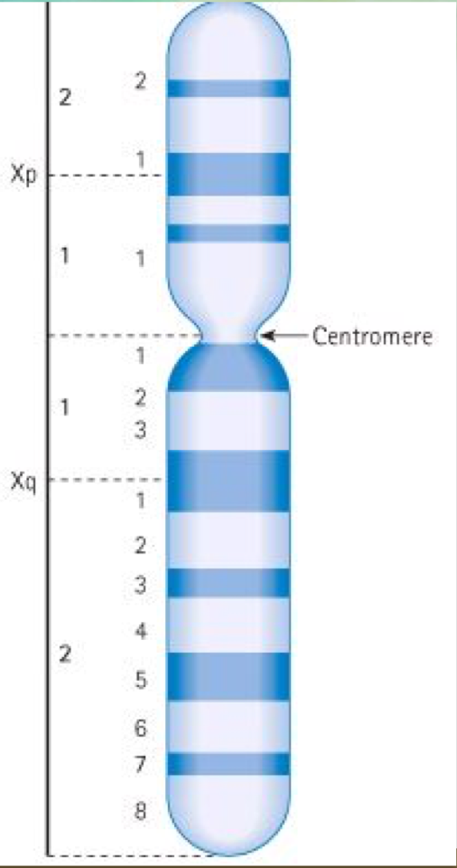
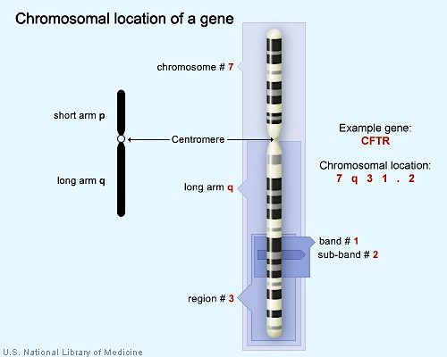
Nomenclature
Example of chromosome 7
(good picture for understanding)
An “X” chromosome showing the short and the long arms (p and q) each subdivided into regions and bands
Remember that:
For each chromosome, patterns are specific and repeatable
Patterns and nomenclature for defining positional mapping have been standardized

Slide 21
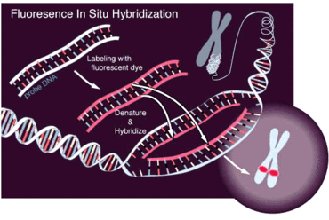
fluorescent in situ hybridization (FISH )
FISH is a cytogenetic technique where a chromosome is labeled with fluorescent tag to create a probe ( a fragment of DNA or RNA which is radioactively labeled ) this probe will only hybridized with a complementary DNA sequence from the patient’s chromosome . the probe will mark the segment being tested , Which can be visualized under a fluorescent microscope .
FISH can be applied to detect genetic abnormalities such as characteristic gene fusions, deletions , translocations , aneuploidy .
They can be used to study chromosomes in metaphase or interphase.
Further Explanation of FISH
https://youtu.be/w5l5SmKvS1o

Slide 22
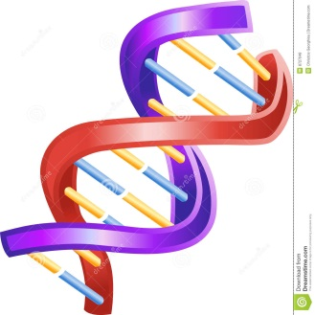
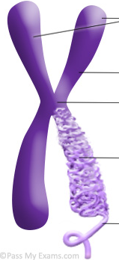
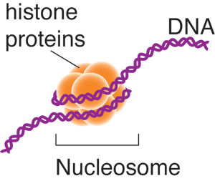
Summary
DNA
double helix
Nucleosomes
Chromatin fibers
Long loops work as tighter
coils
Chromosome

Slide 23
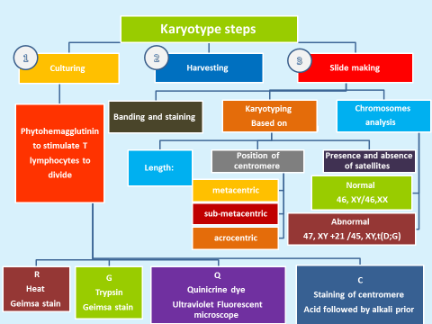

Slide 24
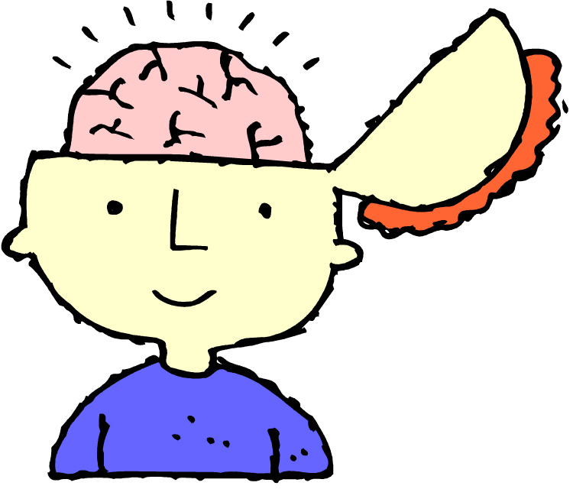
Online Quiz !
https://www.onlinequizcreator.com/human-genetics-1/quiz-219352

Slide 25

Thank You !
Girls team:
Boys team:
Jumana Alghtani (Leader)
Haifaa Saud Bin Taleb
Dania Alkelabi
Nada Alsomali
Leen Altamimi
Nora Almohideb
Abdulrahman ALrajhi (Leader)
Abdulmohsen Alghannam
Abdulmalik Alghannam
Saleh Altwaijri
Abdullah Alharbi
@HGteam46
Email: humangenetics436@gmail.com

