Slide 1
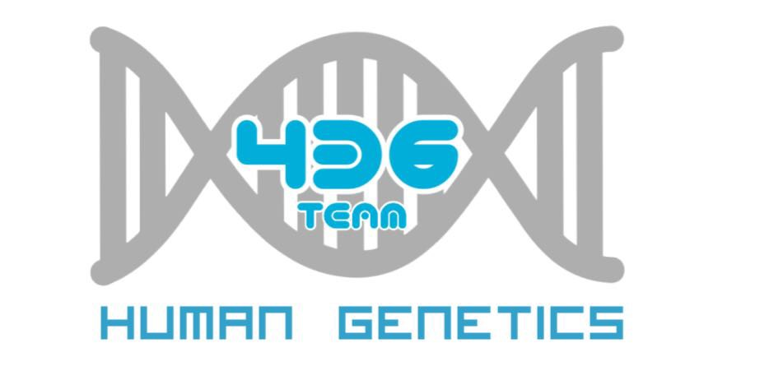
Human genetics:
Chromosome Anomalies
Important
Notes
For revision only

Slide 2
Objectives:
By the end of this lecture, the students should be able to:
Describe and explain the events in mitosis & meiosis.
Define non-disjunction and describe its consequences for meiosis and mitosis.
Classify and sub-classify chromosomal abnormalities
Understand the common numerical autosomal disorders: trisomies 21, 13, 18.
Understand the common numerical sex chromosome disorders: Turner`s & Klinefelter`s syndromes
Recognize the main structural anomalies in chromosomes

Slide 3
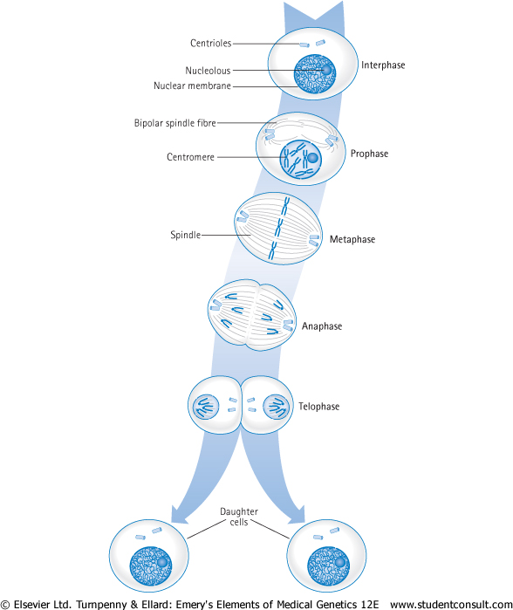
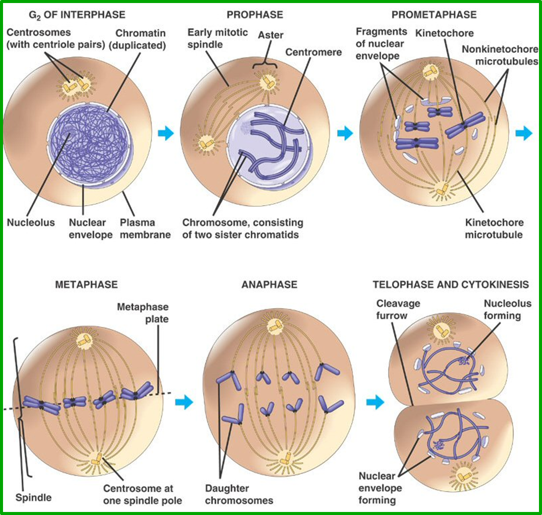
Events of Mitosis

Slide 4
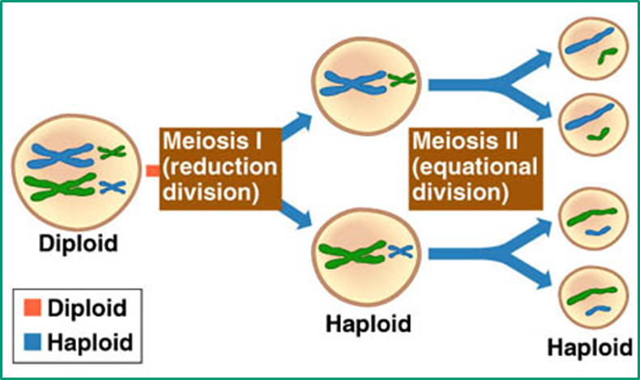
Events of Meiosis
*CHIASMATA

Slide 5
Chromosome Anomalies

Slide 6
Non-disjunction in Meiosis
Nondisjunction ("not coming apart"): is the failure of chromosome pairs to separate properly during meiosis stage 1 or stage 2.
another definition: any change in the normal structure or number of chromosomes; often results in physical or mental abnormalities.
(Nondisjunction, the failure of chromosomes to sort properly during meiosis, it is not uncommon in humans. Its frequency increases with maternal age) .
As a result, one daughter cell has two chromosomes, and the other has none.
The result of this error is a cell with an imbalance of chromosomes (Aneuploidy)

Slide 7
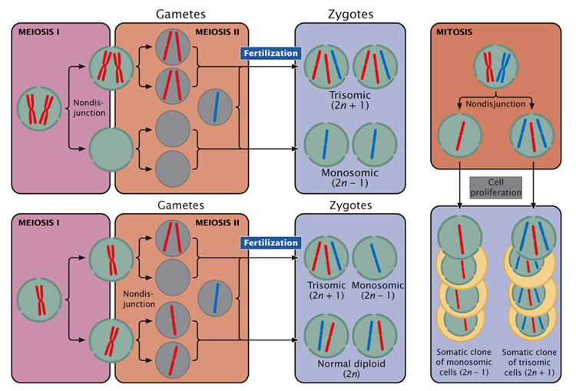

Slide 8
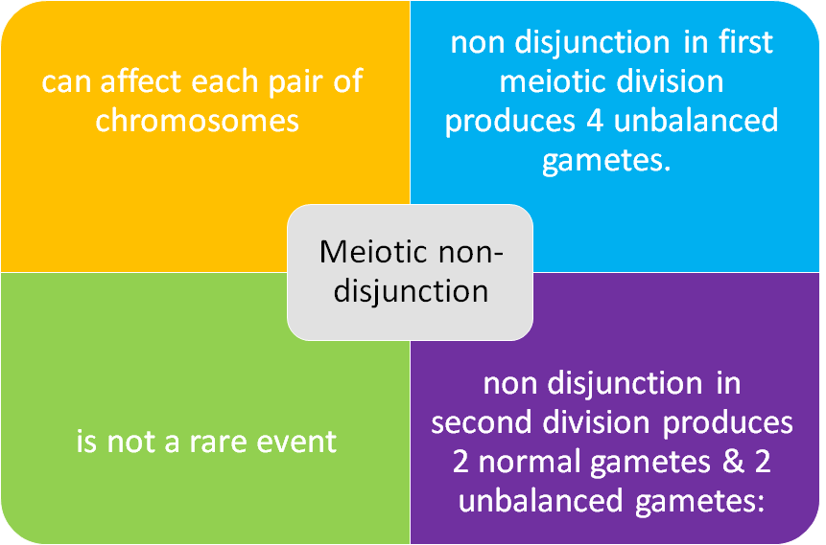
Meiotic non-disjunction
Gamete with an extra autosome
Nullosomic gamete
(missing one chromosome)

Slide 9
Numerical anomalies in AUTOSOMES

Slide 10
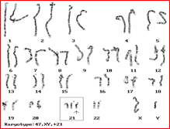
The incidence of trisomy 21 rises sharply with increasing maternal age
Most cases arise from non disjunction in the first meiotic division
The father contributing the extra chromosome in 15% of cases (i.e. Down syndrome can also be the result of nondisjunction of the father's chromosome 21)
A small proportion of cases are mosaic and these probably arise from a non disjunction event in an early zygotic division.
The symptoms include characteristic facial dysmorphologies, and an IQ of less than 50.
Down syndrome, trisomy 21 Karyotype: 47, XY, +21

Slide 11
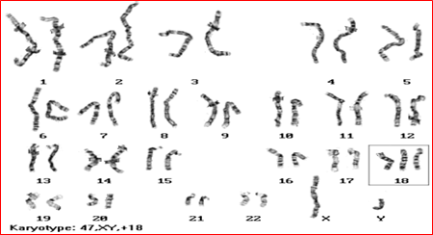
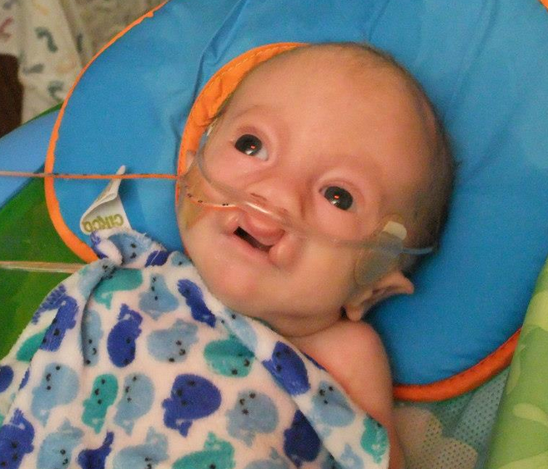
It is the second most common autosomal trisomy, after Down syndrome, that carries to term
It occurs in around one in 6,000 live births and around 80 percent of those affected are female
Most babies die in the first year and many within the first month & has a very low rate of survival
Common anomalies are heart abnormalities, kidney malformations, and other internal organ disorders
Edward's syndrome, Trisomy 18
Karyotype: 47, XY, +18

Slide 12
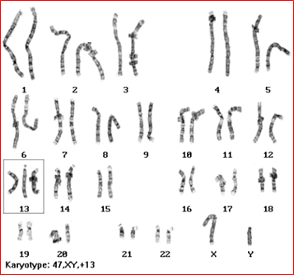
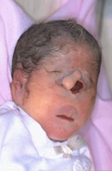
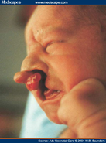
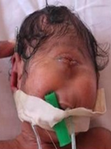
Patau Syndrome, Trisomy 13 Karyotype: 47, XY, +13
50% of these babies die within the first month and very few survive beyond the first year.
There are multiple dysmorphic features.
Most cases, as in Down's syndrome, involve maternal non-disjunction.

Slide 13
Numerical anomalies in SEX chromosomes

Slide 14
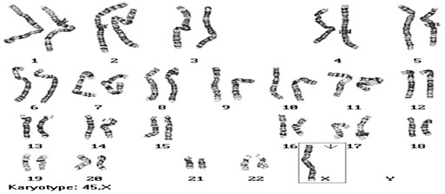
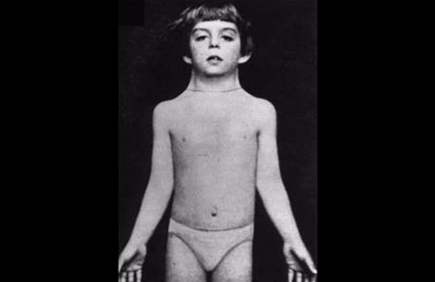
Monosomy X (Turner syndrome):
45, XO Females
´~ Turner syndrome is a genetic disorder that affects about 1 in every 5,000 baby girls and only affects females.
´~ A girl with Turner syndrome only has one normal X sex chromosome, rather than the usual two (XX).
´~ Main characteristics of Turner's syndrome:
1- are shorter than average.
2- have underdeveloped ovaries.
3- The only viable monosomy in humans.
4- Webbed neck, Broad chest, Low hairline.
5- Normal intelligence, normal span life, sterile.

Slide 15
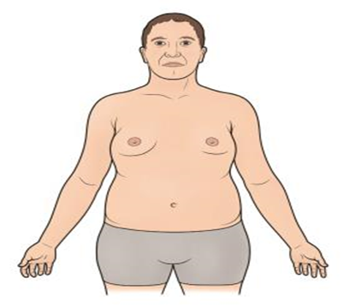
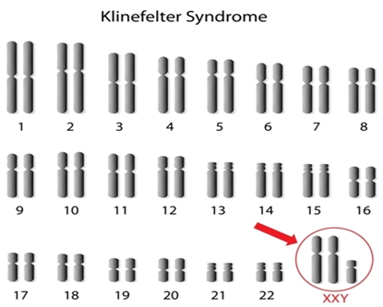
Klinefelter Syndrome: 47,XXY males
´~Klinefelter syndrome is a genetic condition that results when a boy is born with an extra copy of the X chromosome, also known as the (XXY) condition.
´~Affects male physical and cognitive development
´~About one of every 500 males has an extra X chromosome.
´ ~Affected individuals typically have small testes that do not produce as much testosterone as usual.
´~Very rarely more extreme forms of Klinefelter syndrome occur where the patient has 48, (XXXY) or even 49, (XXXXY) karyotype. These individuals are generally severely retarded.
´~Main characteristics of Klinefelter syndrome:
1-Fail to produce normal levels of testosterone.
2-Breast enlargement, normal intelligence, sterile.
3-Patients are taller and thinner than average.

Slide 16
Sex chromosome unbalance of much less deleterious effect
In males (47, XYY)
May be without any symptoms. Males are tall but normally proportioned. 10 - 15 points reduction in IQ compared to sibs .
In females (XXX)
It seems to do little harm, individuals are fertile and do not transmit the extra chromosome. They do have a reduction in IQ comparable to that of Kleinfelter's males .

Slide 17
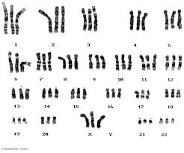
Polyploidy
Numerical anomalies affecting the number of Complete Haploid Set (n) of chromosomes
Cells are polyploid if they contain more than two haploid (n) sets of chromosomes
Triploidies are the most frequent,
-3N=69 chromosomes: e.g 69XXX or 69XYY or 69XXY
-Found in 20% of spontaneous miscarriages
Tetraploidy :
4N=92 chromosomes
* An individual can have normal chromosomal number with numerical chromosomal anomalies .(combination)

Slide 18
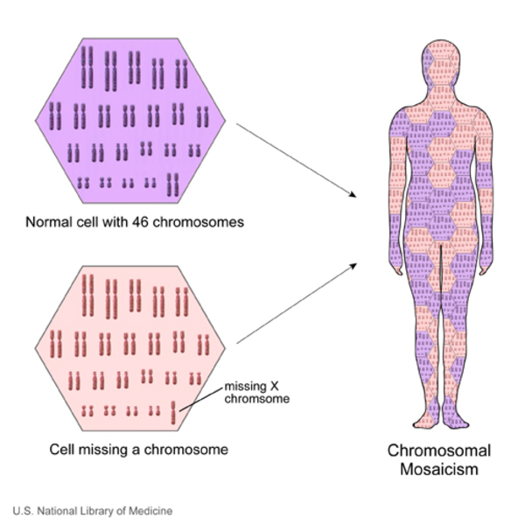
Mosaicism
Mosaicism : describe a situation in which different cells in the same individual have different numbers or arrangements of chromosomes .
It is called “mosaicism” because the cells of the body are similar to the tiles of a mosaic.
A mosaic individual is made of 2 or more cells populations coming from one zygote .
Is denoted by a slash between the various clones observed, e.g. 46,XY / 47,XY,21+) .
Usually due to a mitotic non-disjunction .
Can affect any type of cells, including :
* Blood cells .
* Egg & Sperm cells (gametes) .
A mosaic must not be confused with a chimeras
Chimerism is the presence in an individual of two or more genetically distinct cell lines derive from more than one zygote (e.g. 2 sperms fertilize 2 ova → 2 zygotes that fuse to form 1 embryo

Slide 19
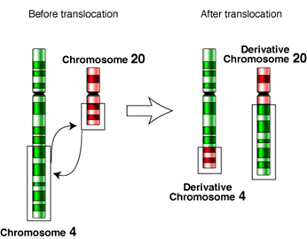
Reciporcal & Deletion
Structural Chromosomal Anomalies:
Reciprocal translocation :
- A mutual exchange between terminal segments from the
arms of 2 chromosomes.
- There is no loss or alteration at the points of
exchange, the new rearrangement is genetically balanced,
and called a Balanced rearrangement .
Deletion :
- Loss of a segment from a chromosome, either terminal or interstitial
- Invariably but NOT always, Results in the loss of important genetic material
- Deletion is an unbalanced rearrangement .
- Recorded as del .
Types of Deletion
Terminal
Interstitial
* Terminal deletion means loss a part of chromosome number 18 .
* Interstitial deletion means loss a part of chromosome number 7 .

Slide 20
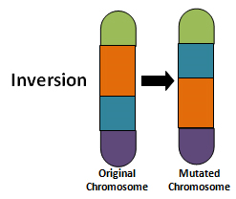
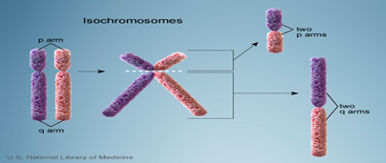
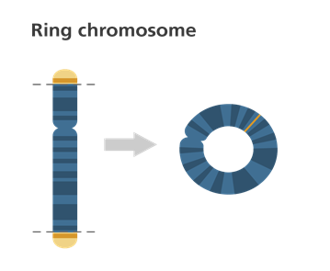
Structural Chromosomal Anomalies:(cont.)
Inversion, Isochromosome
and Ring formation
Inversion :
- Inversion occurs when a segment of chromosome breaks, and rejoining within the chromosome effectively inverts it.
- Recorded as inv.
- Normally only large inversions are detected.
- They are balance rearrangements that rarely cause problems in carriers .
Isochromosome :
- Unbalanced structural abnormality in which the arms of the chromosome are mirror image of each other .
- Isochromosome is that the centromere has divided transversely rather than longitudinally .
Ring Formation :
- A break on each arm of a chromosome a two sticky ends on the central portion a Reunion of the ends as a ring a loss of the 2 distal chromosomal fragments .
- Ring chromosomes are often unstable in mitosis .

Slide 21
Online Quiz
Click Here
For more Knowledge
* Difference between Meiosis & Mitosis Here
* Understanding Chromosomal Translocation Here

Slide 22
Thank You !
Girls team:
Boys team:
Jumana Alghtani (Leader)
Haifaa Saud Bin Taleb
Dania Alkelabi
Nada Alsomali
Leen Altamimi
Nora Almohideb
Abdulrahman Alrajhi (Leader)
Abdulmohsen Alghannam
Abdulmalik Alghannam
Saleh Altwaijri
Abdullah Alharbi
@HGteam46
Email: humangenetics436@gmail.com

