Slide 1
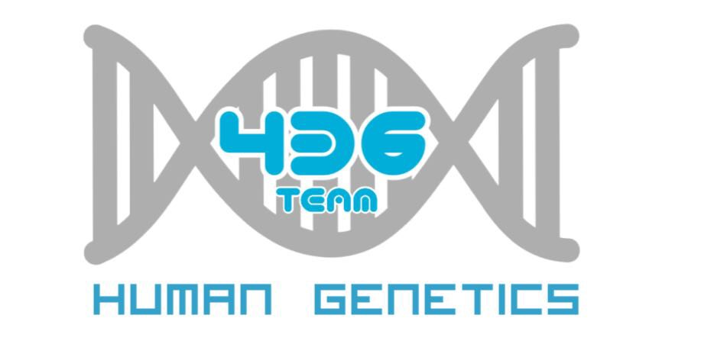
Human genetics:
Mode Of Inheritance
Important
Notes
For revision only

Slide 2
Objectives:
Asses Mendel’s laws of inheritance
Understand the bases of Mendelian inheritance
Define various patterns of single gene inheritance using family pedigree and Punnett’s squares

Slide 3
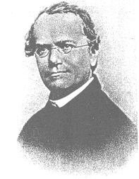
Father of Genetics
Monk and teacher
Discovered some of the basic laws of heredity
Presentation to the Science Society in1866 went unnoticed
He died in 1884 with his work still unnoticed
His work rediscovered in 1900.
Gregor Mendel Monk and Scientist

Slide 4
Mendel’s breeding experiments :
Interpretation of his results
The plant characteristics being studied were each controlled by a pair of factors, one of which was inherited from each parent.
The pure-bred plants, with two identical genes, used in the initial cross would now be referred to as homozygous.
The hybrid F1 plants, each of which has one gene for tallness and one for shortness, would be referred to as heterozygous.
The genes responsible for these contrasting characteristics are referred to as allelomorphs, or alleles for short.

Slide 5
Homozygous dominant: TT
Homozygous recessive: tt
Heterozyous: Tt
Homo : Same
Hetero : Different
Alleles

Slide 6
Mendelian Law Of Inheritance
The traits, later called genes, normally occur in pairs in body cells and separates during the formation of sex cells.
This happens in meiosis, the production of gametes. Of each pair of chromosomes, a gamete only gets one.
When two homozygotes with different alleles are crossed, all the offspring in the F1 generation are identical and heterozygous.
“The characteristics do not blend, as had been believed previously, and can reappear in later generations.”
Father : TT
Punnett square
T
T
Each parent can only contribute one allele per gene These genes are found on the chromosomes carried in the sex cells. Offspring will inherit 2 alleles to express that gene
t
Tt
Tt
Mother : tt
t
Tt
Tt

Slide 7
Law Of Segregation
Definition : The genes determine the organism's traits, and are inherited from its parents. As the pair of chromosomes separate, each gamete only receives one of each allele . Also noted that alleles of a gene could be either dominant or recessive.
Another definition: When an organism makes gametes, each gamete receives just one gene copy, which is selected randomly.

Slide 8
Law Of Independent Assortment
Definition : Alleles of different genes separate independently of one another when gametes are formed. So Mendel thought that different traits are inherited independently of one another.
AnotherDefinition : Mendel's law of independent assortment states that the alleles of two (or more) different genes get sorted into gametes independently of one another. In other words, the allele a gamete receives for one gene does not influence the allele received for another gene
Remember : The second law is only true if the genes are not on the same chromosome. If they are, then they are linked to each other.

Slide 9
COMPLETE DOMINANCE - one allele is dominant to another allele
Punnett Squares
CROSS: Purebred purple female x White male
P1 generation = PP x pp Female gametes
Male gametes
Genotypic ratio =
F1 generation
Phenotypic ratio =
P
P
p
Pp
Pp
p
Pp
Pp
1Pp
1 purple

Slide 10
Punnett Squares
CROSS: Two F1 generation offspring with each other.
F1 generation = Pp x Pp Female gametes
Male gametes
Genotypic ratio =
F2 generation
Phenotypic ratio =
P
p
P
PP
Pp
p
Pp
pp
1PP:2Pp:1pp
3 purple:1 white

Slide 11
Law Of Dominance
Definition : In the cross (of two organisms that differ in one character), one version disappeared.
Another definition : “In a cross of parents that are pure for contrasting traits, only one form of the trait will appear in the next generation. Offspring that are hybrid for a trait will have only the dominant trait in the phenotype.”
- Such a trait is known as a Dominating trait. The suppressed trait is known as Recessive trait. Also, the recessive trait freely expresses itself in the absence of the dominant state. And this is what Mendel’s Law of Dominance is all about.

Slide 12
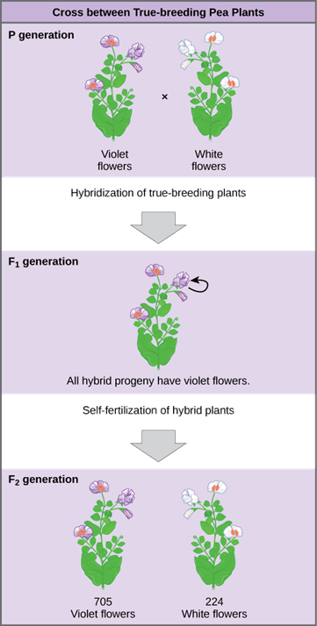
Genotype Versus Phenotype
The F1 crossed produced the F2 generation and the lost trait appeared with predictable ratios.
This led to the formulation of the current model of inheritance

Slide 13
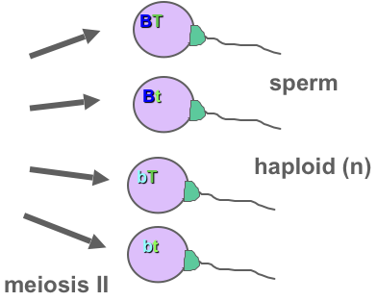
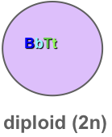
Principle Of Independent Assortment
The alleles for different genes usually separate and inherited independently of one another.
So, in dihybrid crosses you will see more combinations of the two genes.

Slide 14
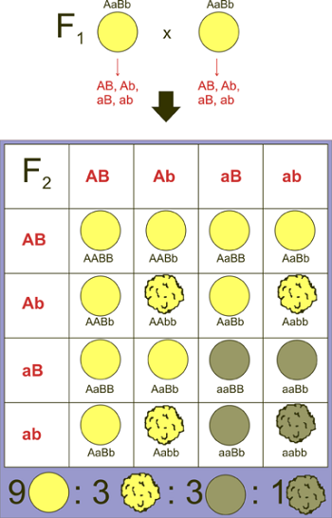
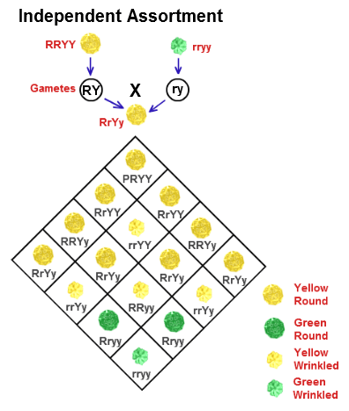
Independent Assortment

Slide 15
Mendelian Inheritance
Over 11,000 traits/disorders in humans exhibit single gene unifactorial or Mendelian inheritance.
A trait or disorder that is determined by a gene on an autosome is said to show autosomal inheritance.
A trait or disorder determined by a gene on one of the sex chromosomes is said to show sex-linked inheritance.

Slide 16
Mode Of Inheritance Of Single Gene Disorder
Autosomal
Sex linked
Recessive
Dominant
Y-Linked
X-Linked
Recessive
Dominant

Slide 17
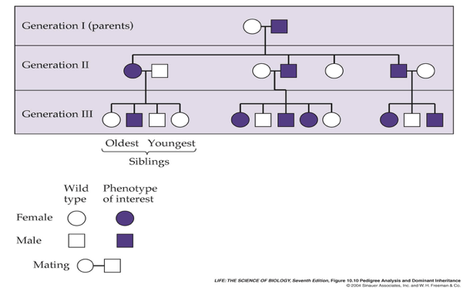
Pedigree Analysis For Diseases

Slide 18
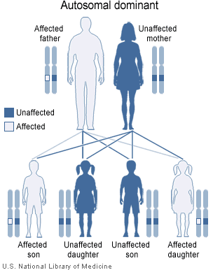
Autosomal Dominant
Mode Of Inheritance
The trait (character, disease) appears in every generation.
Unaffected persons do not transmit the trait to their children.
Examples: Huntington disease, Myotonic dystrophy, Neurofibromatosis type 1, Marfan syndrome etc.

Slide 19
Tree Of an Autosomal Dominant mode of Inheritance
Note: the presence of male to male transmission (I.e. father to son)

Slide 20
Autosomal Recessive
Mode Of Inheritance
The trait is recessive
The trait expresses itself only in homozygous state
Unaffected persons(heterozygous)may have affected children (if the other parent is heterozygous)
The parents of the affected child maybe related(consanguineous)تربطهم صلة قرابة
Males and females are equally affected
Ex : Cystic fibrosis, Phenylketonuria, Sickle cell anemia, Thalassemia etc.

Slide 21
Autosomal Recessive Mode Of Inheritance

Slide 22
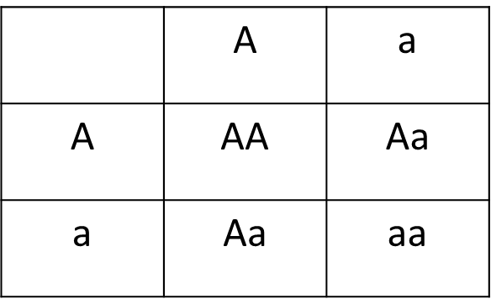
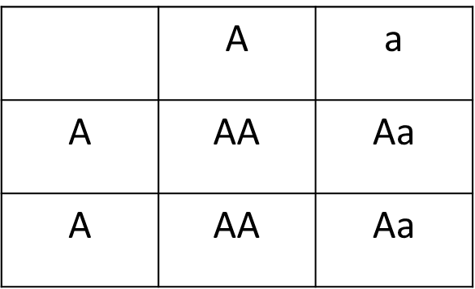
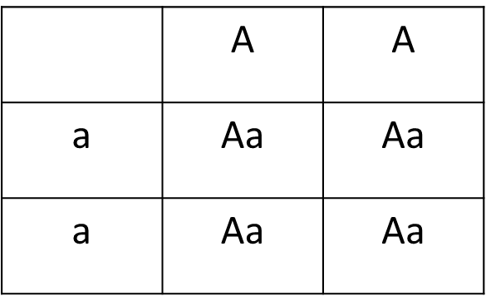
Both parents heterozygous
2. One parent heterozygous
3. Both parents homozygous
25% offspring affected homozygous
50% trait "heterozygous" normal but carriers
25% normal
50% normal but carriers "heterozygous"
50% normal
100% offspring carriers

Slide 23
Sex-Linked Inheritance
•This is the inheritance of a gene present on the sex chromosomes.
•The Inheritance Pattern is different from the autosomal inheritance.
•Inheritance is different in the males and females.

Slide 24
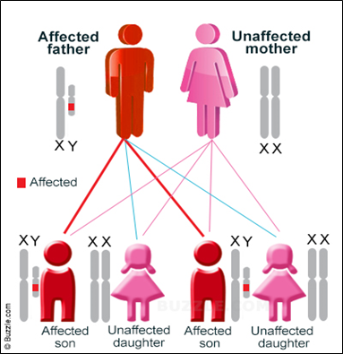
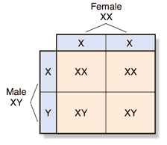
Y-Linked Inheritance
•The gene is on the Y chromosomes
•The gene is passed from fathers to sons only(never in females)
•Daughters are not affected
•Hairy ears in India
•Male are Hemizygous (only 1 copy of each Y-Linked), the condition exhibits itself whether dominant or recessive

Slide 25
X-Linked Inheritance
•The gene is present on the X chromosome
•The inheritance follows specific pattern
•Males have one X chromosome, and are hemizygous
•Females have 2 X chromosomes, they may be homozygous or heterozygous
•These disorders may be : recessive or dominant

Slide 26
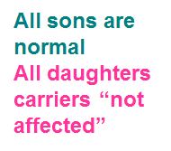
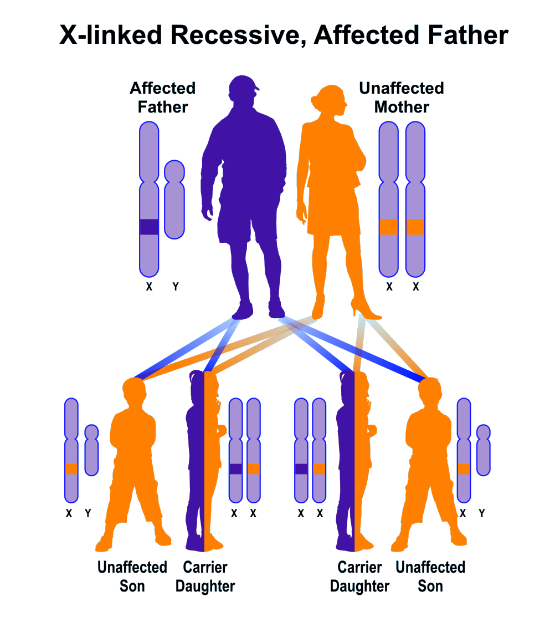
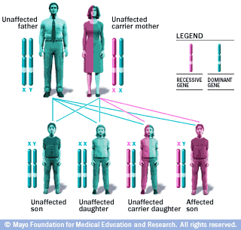
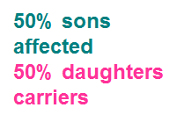
X-Linked Recessive Inheritance
•The incidence of the X-linked disease is higher in male than in female
•The trait is passed from an affected man through all his daughters to half their sons
•The trait is never transmitted directly from father to sons
•An affected women has affected sons and carrier daughters
•X - Linked Recessive Disorders: Albinism, Fragile X syndrome, Hemophilia, Muscular dystrophy, Retinitis pigmentosa

Slide 27
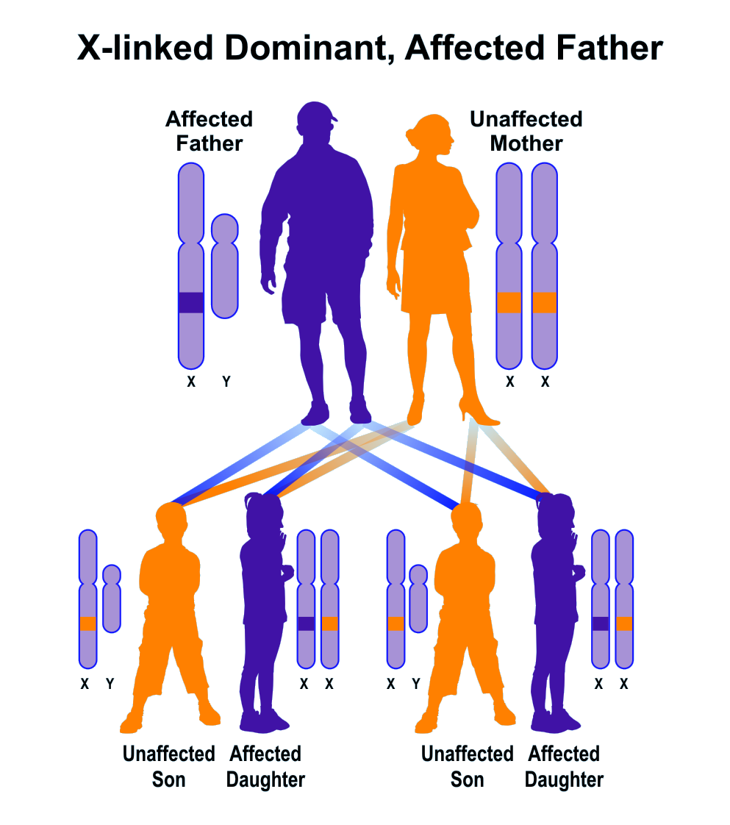
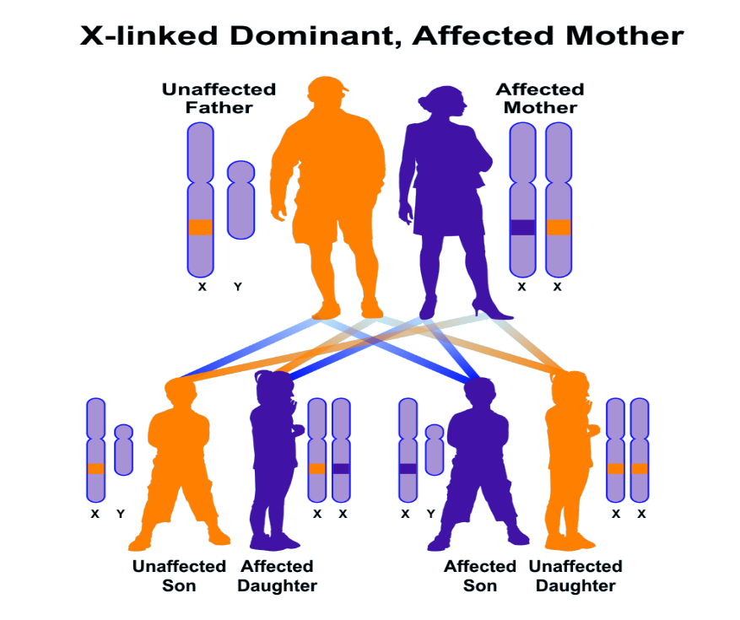
All daughters affected , all sons normal
X-Linked Dominant Disorders
•The gene is on X Chromosome and is dominant
•The trait occurs at the same frequency in both males and females
•Hemizygous male and heterozygous females express the disease.
50% sons , 50% daughters are affected

Slide 28
NOTES
An accurate determination of the family pedigree is an important part of the workup of every patient
Pedigrees for single-gene disorders may demonstrate a straightforward, typical mendelian inheritance pattern
These patterns depend on the chromosomal location of the gene locus, which may be autosomal or sex chromosome-linked, and whether the phenotype is dominant or recessive
Other atypical mode of inheritance will be discussed next lecture.

Slide 29
Online Quiz !
Here

Slide 30
Thank You !
Boys team:
Abdulrahman ALrajhi (Leader)
Abdulmohsen Alghannam
Abdulmalik Alghannam
Saleh Altwaijri
Abdullah Alharbi
@HGteam46
Email: humangenetics436@gmail.com

