Slide 1
Human genetics:
Atypical Patterns of Inheritance
Important
Notes
For revision only

Slide 2
Objectives:
By the end of this lecture, students should be able to appreciate the possibility of atypical patterns of inheritance with special emphasis on:
1. Codominant traits
2. Pseudo-dominant inheritance
3. The mitochondrial inheritance
4. Anticipation
5. Pleiotropy
6. Variable expressivity
7. Heterogeneity
8. New mutation
9. Complex trait: multifactorial/Polygenic

Slide 3
Inheritance of Codominant Alleles
Codominance: two allelic traits that are both expressed in the heterozygous state
Example: Blood group AB: the A and B blood groups are codominant
* This picture shows codominance , you can notice both colors red and blue on the second generation of this fish

Slide 4
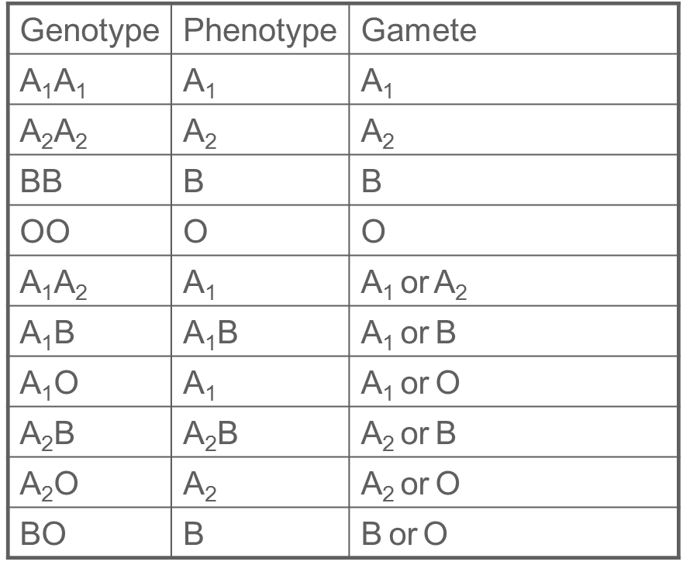
Possible genotypes, phenotypes & gametes formed from the four alleles: A1, A2, B, & O at the ABO locus
A & B are codominant
A is dominant
B is dominant

Slide 5
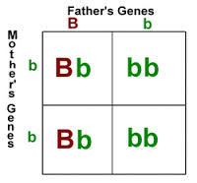
PSEUDODOMINANT INHERITANCE
Pseudodominance: appearance of a recessive phenotype in a heterozygote containing the recessive gene on one chromosome and a deletion or only part of the dominant gene on the corresponding part of the homologous chromosome
A woman homozygous for an autosomal recessive disorder whose husband is heterozygous for the same disorder.
Their children have a 1 in 2 (50%) chance of being affected (homozygous )

Slide 6
What are the situations in which the inheritance of single-gene disorders diverges from typical mendelian patterns?
Anticipation
Maternal inheritance of mitochondrial mutations
Atypical presentation for Autosomal Dominant defects
Pleotropy
Variable expressivity
Reduced penetrance
New mutation
1
2
3
Unusual inheritance patterns due to
Genomic Imprinting
Mosaicism
Somatic
Germline
1
2

Slide 7
Mitochondrial inheritance
Mitochondrial DNA (mtDNA)
Mitochondrial disorders (next slide )
* Each cell contains thousands of copies of
mitochondrial DNA with more being found in
cells having high energy requirement (e.g.
brain & muscle).
*mtDNA is a small circular double-stranded molecule containing 37 genes (coding for rRNA, tRNA, and some of the proteins of the mitochondrial electron transport chain)
*Mitochondria (& their DNA) are inherited from the mother (through ova)

Slide 8
Mitochondrial disorders
* The defective gene is present on the mitochondrial DNA.
* show maternal inheritance:
- Affected mother transmits the disorder equally to all
her children
- Affected father does not transmit the disease to
his children.
* Example of Mitochondrial Disorders:
- Lebers hereditary optic neuropathy (LHON):
It is the rapid Optic nerve death, which leads to blindness in young adult life

Slide 9
Mitochondrial inheritance
*Males cannot transmit the disease as the cytoplasm is inherited only from the mother, and mitochondria are present in the cytoplasm.
*Note that there are no carriers in mitochondrial inheritance, either affected or not.

Slide 10
Homoplasmy vs. Heteroplasmy
Heteroplasmy
The presence of two population of mtDNA in a cell:
The normal mtDNA and the mutant mtDNA
The proportion of mutant mtDNA varies between cells & tissues
Leads to range of phenotypic severity in mitochondrial inheritance
Low proportion of mutant mitochondria
Not associated with disease
Higher proportion of mutant mitochondria
The severity of the disease
Homoplasmy
in most persons, the mtDNA from different mitochondria is identical
mtDNA is the (mitochondrial DNA), which is different than genomic DNA in the nucleus.

Slide 12
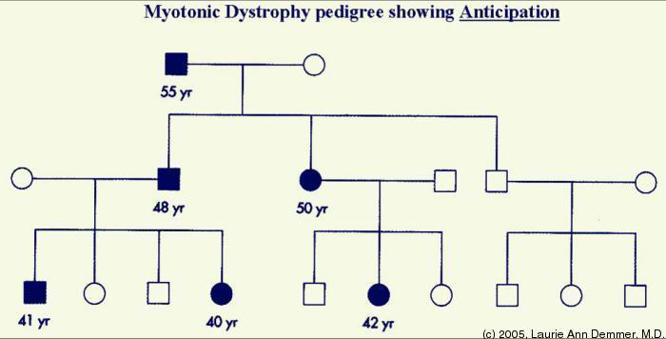
Anticipation
A pattern of inheritance in which individuals in the most recent generations of a pedigree develop a disease at an earlier age or with greater severity than do those in earlier generation.
The reason might be the gradual expansion of trinucleotide repeat polymorphisms within or near a coding gene
Examples of diseases showing anticipation: Huntington disease , Myotonic dystrophy

Slide 13
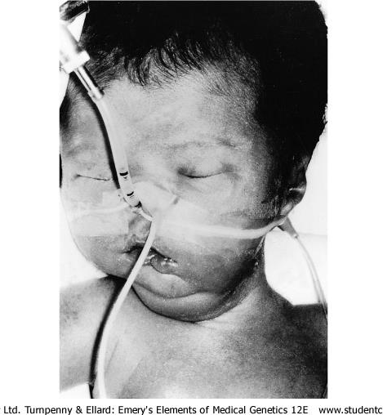
Myotonic Dystrophy
Relatively common
The affected gene is on chromosome 19
Autosomal dominant disease
The mutation is triplet repeat (CTG) expansion in the 3’ untranslated region of the myotonic dystrophy gene
Myotonic dystrophy is a common multi-system disorder that affects the skeletal muscles .
Clinical manifestations:
– Myotonia (Muscular loss & weakness)
– Cataracts
– Testicular atrophy
– Heart disease: arrhythmia
– Dementia
– Baldness
Newborn baby with severe hypotonia requiring ventilation as a result of having inherited myotonic dystrophy from his mother

Slide 14
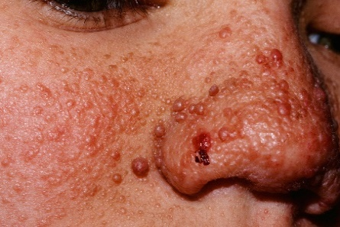
Atypical presentation for Autosomal Dominant defects
It is common for autosomal dominant disorders to manifest in different systems of the body in a variety of ways.
When providing genetic counseling to individuals at risk for autosomal dominant inherited disorders, there are three atypical presentations that need to be taken into account:
1- Pleiotropy: A single gene that may give rise to two or more apparently unrelated effects.
Example: Tuberous sclerosis
when affected individuals can present either: - learning difficulties - epilepsy - a facial rash - or, all features

Slide 15
2- Reduced penetrance: In some individuals heterozygous for gene mutations giving rise to certain autosomal dominant disorder there may be no abnormal clinical features, representing so-called reduced penetrance or “skipping a generation” Reduced penetrance might be due to: * Modifying effects of other genes * Interaction of the gene with environmental factors More Explanation (from 435 team) : Penetrance refers to the proportion of people with a particular genetic change (such as a mutation in a specific gene) who exhibit signs and symptoms of a genetic disorder. If some people with the mutation do not develop features of the disorder, the condition is said to have reduced (or incomplete) penetrance.
3- Variable expressivity: The clinical features in autosomal dominant disorders can show striking variation from person to person, even in the same family.
Example: Autosomal dominant polycystic kidney disease:
some affected individuals develop renal failure in early adulthood
others have just a few renal cysts that do not significantly affect renal function
These two additional pictures are to clarify the difference between reduced penetrance and variable expressivity. Each oval shapes represents an individual. We can notice that in in “reduced penetration” not 100% showed abnormal clinical features. While in variable expressivity all individuals showed phenotype but not the same.

Slide 16
New mutations
In autosomal dominant disorders an affected person will usually have an affected parent. However, this is not always the case and it is not unusual for a trait to appear in an individual when there is no family history of the disorder.
The sudden unexpected appearance of a condition arising as a result of a mistake occurring in the transmission of a gene is called “new mutation”!!
eg. Achondroplasia
A form of short-limbed dwarfism, in which the parents usually have normal stature
Diagnosis/testing:
Characteristic clinical and radiographic finding
Molecular genetic tests: mutation in the FGFR3 gene on chromosome 4p16.3 (coding for fibroblast growth factor receptor 3)…
(continue next slide)

Slide 17
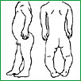
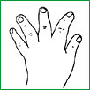
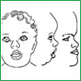
تابع
The offspring of persons with achondroplasia had a 50% chance of having achondroplasia
What other possible explanations for the 'sudden' appearance of achondroplasia?
non-penetrance: One of the parents might be heterozygous for the mutant allele but so mildly affected that it has not previously been detected
Variable expressivity
the family relationships not being as stated, e.g. non-paternity
So, achondroplasia is caused mostly by a new mutation but could be caused from the three reasons above

Slide 18
Complex traits
-What is it?
A condition which are likely to be due to the interaction of more than one gene.
The effects may be additive, one may be rate-limiting over the action of another, or one may enhance or multiply the effect of another
-Examples:
1- Digenic inheritance where a disorder has been shown to be due to the additive effects of heterozygous mutations at two different gene loci.

Slide 19
Complex traits
تابع
2- retinitis pigmentosa:
a disorder of progressive visual impairment, is caused by double heterozygosity for mutations in two unlinked genes ,which both encode proteins present in photoreceptors. Individuals with only one of these mutations are not affected

Slide 20
Multifactorial/polygenic disprders
Human characteristics such as height, skin color and intelligence could be determined by the interaction of many genes, each exerting a small additive effect.
quantitative inheritance is a model that can explain the pattern of inheritance for many relatively common conditions , including :
congenital malformations
such as : cleft lip and palate
late-onset condition
such as:
- Hypertension
-Diabetes mellitus
-Alzheimer disease
The prevailing view is that genes at several loci interact to generate a susceptibility to the effects of adverse environmental trigger factors

Slide 21
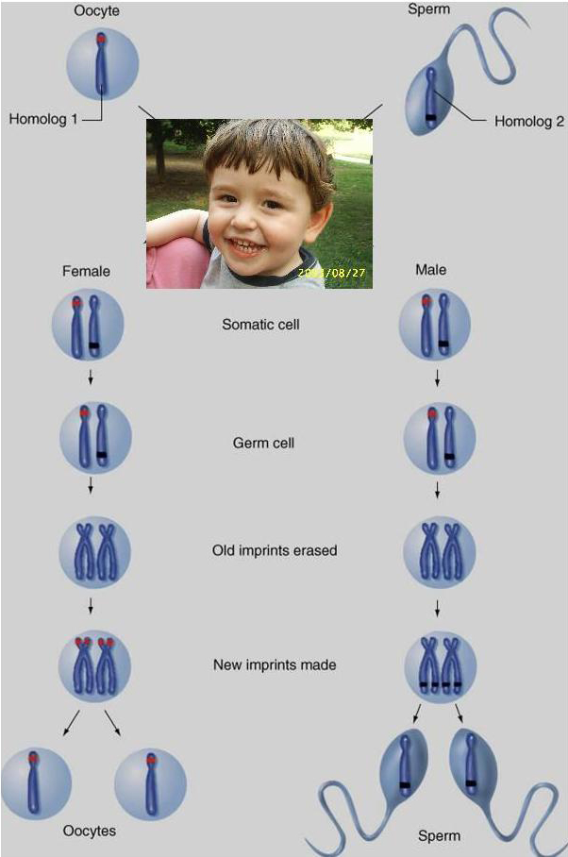
Genomic imprinting an example of non-mendelian inheritance
Certain chromosomes retain a memory or “imprint” of parental origin that influences whether genes are expressed or not during gametogenesis.

Slide 22
Quiz:
what is the phenotype for (A1B)
1- A1B 2- A2B 3-A 4-B
The affected gene in Myotonic dystrophy is on chromosome
1- 21 2- 19 3- 11 4- 9
The sudden unexpected appearance of a condition arising as a result of a mistake occurring in the transmission of a gene is called:
1- Reduced penetrance 2- New mutation 3-Variable expressivity 4- Pleiotropy
Another one!
https://www.onlineexambuilder.com/huaman-genetics-lecture-4/exam-43318

Slide 23
Thank You !
Girls team:
Boys team:
Jumana Alghtani (Leader)
Haifaa Saud Bin Taleb
Dania Alkelabi
Nada Alsomali
Leen Altamimi
Nora Almohideb
Abdulrahman Alrajhi (Leader)
Abdulmohsen Alghannam
Abdulmalik Alghannam
Saleh Altwaijri
Abdullah Alharbi
@HGteam46
Email: humangenetics436@gmail.com

