Slide 1
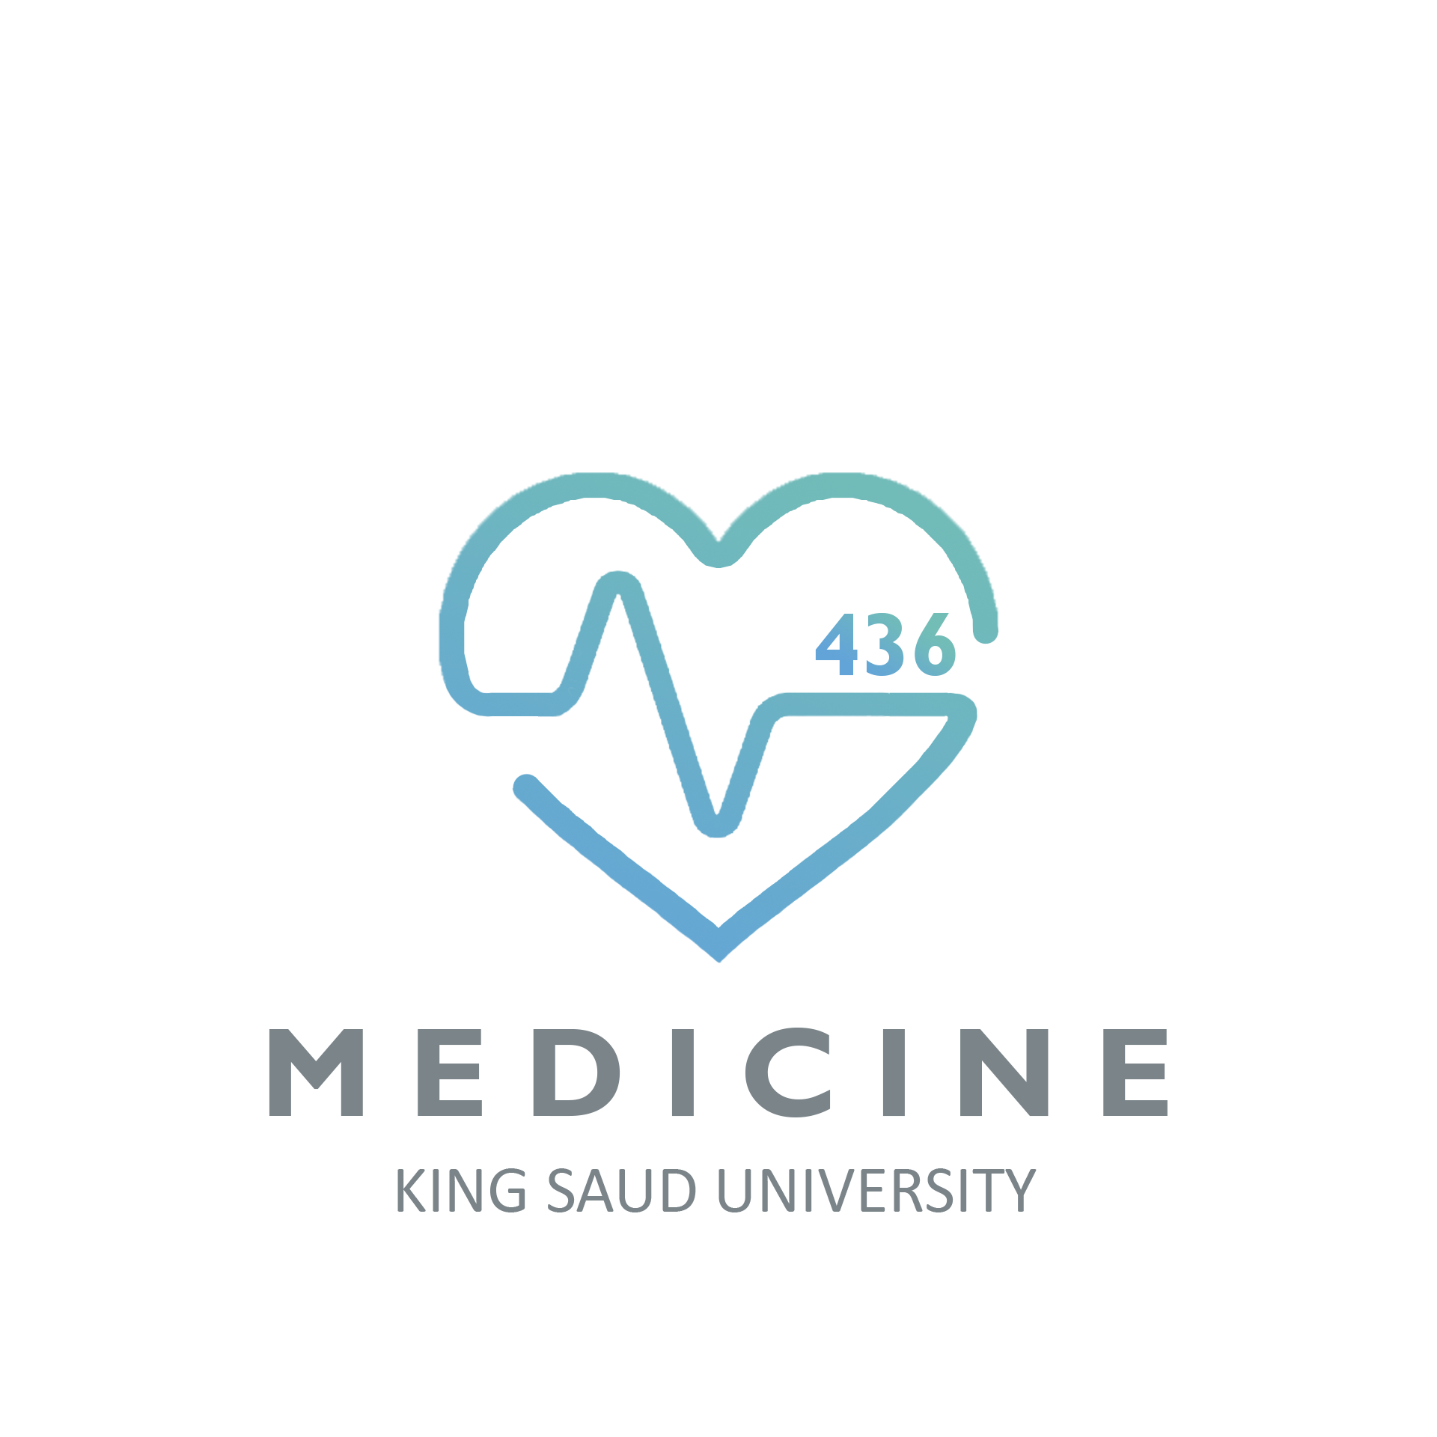
Foundation Block
Lecture Two
Natural defense mechanism
Objectives:
To know first (non-specific immunity) and second (adaptive immunity) lines of defense
To understand the complement system, its activation and how it involves in pathogen killing
To recognize the importance of accumulation of inflammatory cells for clearance of infection
To know the role of cytokines as mediators which regulate inflammation
Important.
Extra notes.
Females notes
Males notes.

Slide 2
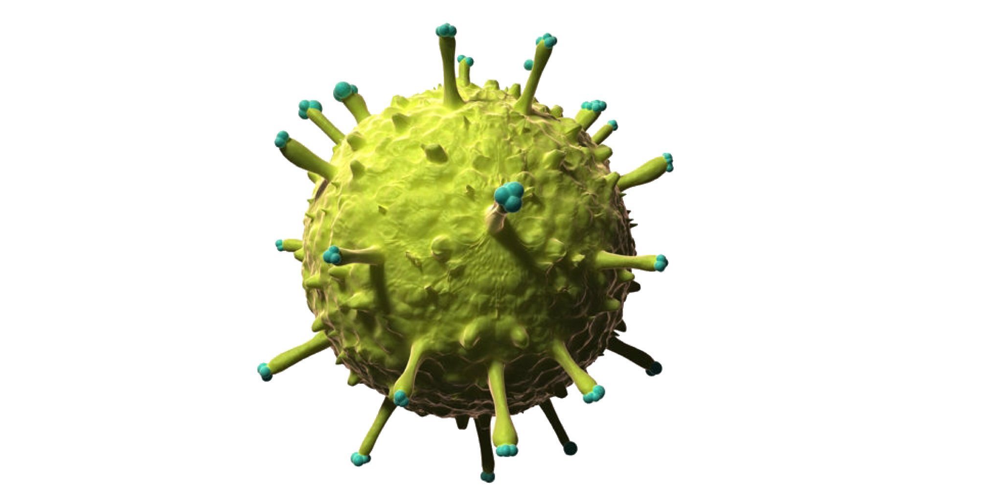
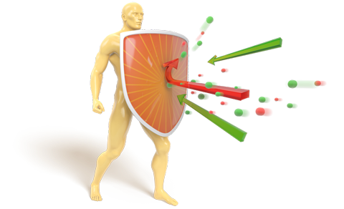
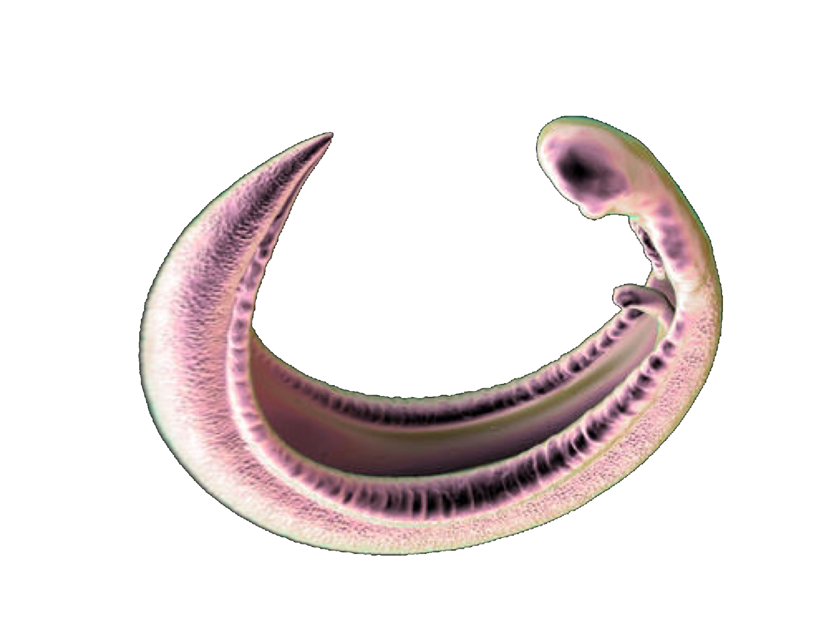
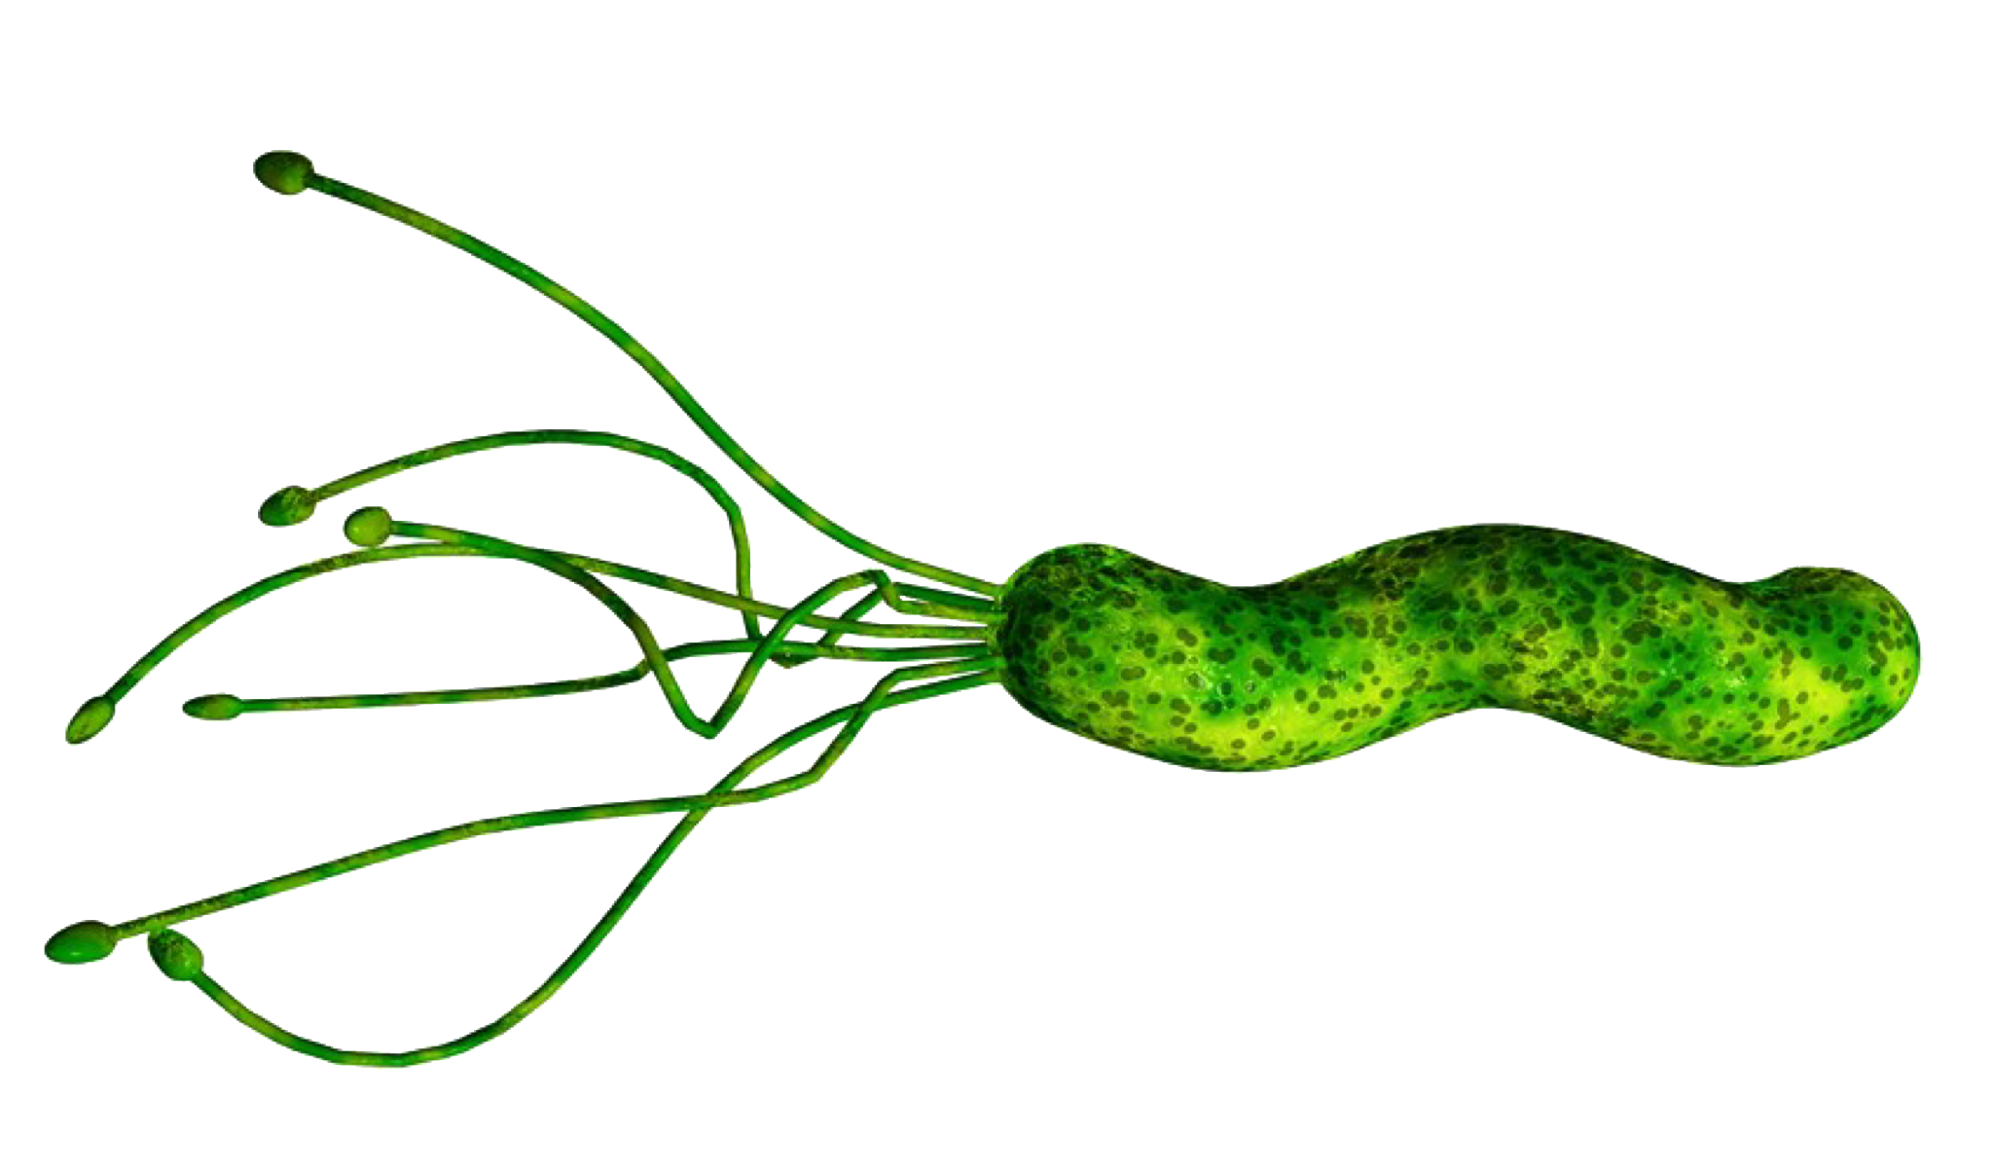
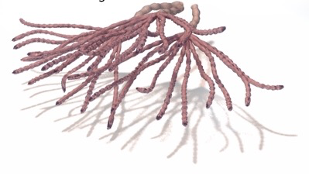
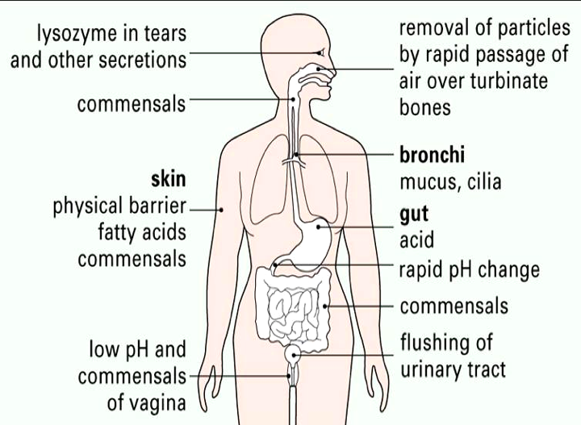
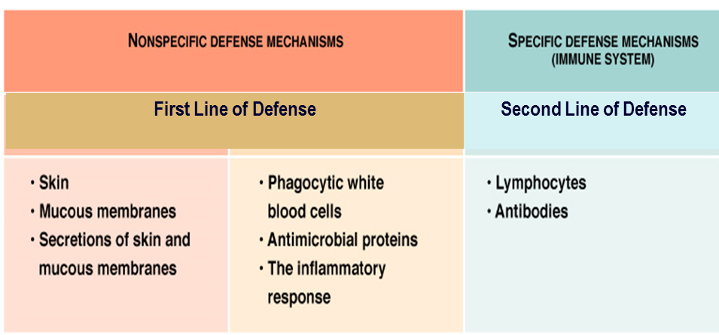
The main function of the immune system is to protect from infections:
Viruses e.g.
Influenza
Polio
Parasites e.g.
Tapeworms
Malaria
Bacteria e.g.
Tubercule bacillus
Staphylococci
Fungi e.g.
Candida
Albicans
* للفهم والاستزادة فقط *

Slide 3
First line of defense
Natural (innate) immunity :
Physical
Skin, impermeable to microbes.
Mucous membranes lining the gastrointestinal, genitourinary and respiratory tracts.
Mechanical
Shedding of outer skin layers.
Coughing and sneezing.
Flushing of urine.
Vomiting.
Mucus and cilia in respiratory tract.
Biochemical barriers
Body secretions contain anti-bacterial substances e.g. saliva, tears and sweat.
Antimicrobial peptides (e.g., defensins, hepcidins)
Normal bacterial flora. (Compete with pathogenic bacteria for nutrients)
Inflammation:
Definition: Inflammation is the first response of the immune system to infection or irritation.
It consist of a series of vascular & cellular changes that occur in response to various stimuli
e.g. infections, injury, radiation etc .
Microbial infections initiate inflammation
As bacteria possess an array of pro-inflammatory molecules:
e.g. Lipopolysaccharides (LPS)
Goals:
Prevent and limit infection and further damage.
Interact with adaptive immune system
For example Monocytes /Macrophages serve as a link between the adaptive and innate immunity by antigen presentation.
Prepare the area of injury for healing.

Slide 4
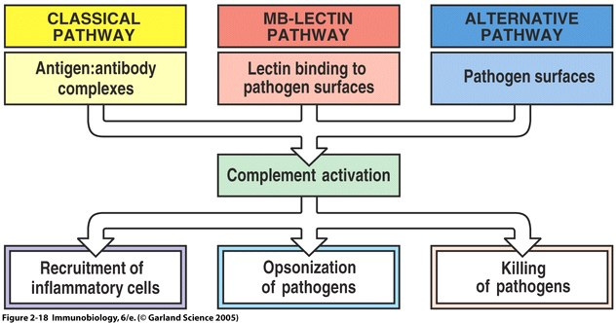
The Complement system:
Consists of a group of serum proteins initially present in inactive form.
> 20 proteins.
Many are pro-enzymes.
Activation occurs in cascade ( one component or more activating another) after enzymatic cleavage.
Once components become activated they produce important biological effects that initiate inflammation.
This system plays an important role in linking Innate & Adaptive immunity.
Initially inactive they are sequentially activated in a cascade.
Key protein is C3 which is activated by C3 convertase.
3 Pathways of activation:
Classical ( Requires antigen-antibody binding )
(C1,C4,C2,C3,C5,C6,C7,C8,C9)
Lectin (Activated by mannan binding protien binding mannose groups of bacterial carbohydrates)
(-C4,C2,C3,C5,C6,C7,C8,C9)
Alternative (Activated by bacterial products)
(- C3,C5,C6,C7,C8,C9)

Slide 5
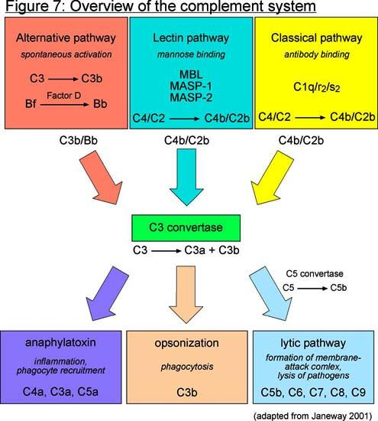
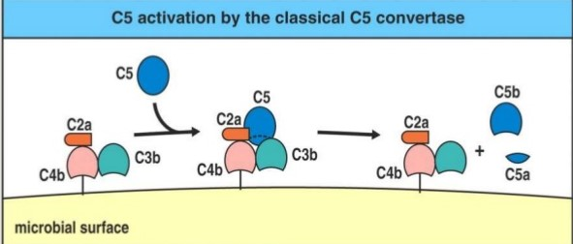
The complement system
Pathways of activation
a
a
C5 activation:
Membrane Attack Complex formation: insertion of lytic complex into cell membrane

Slide 6
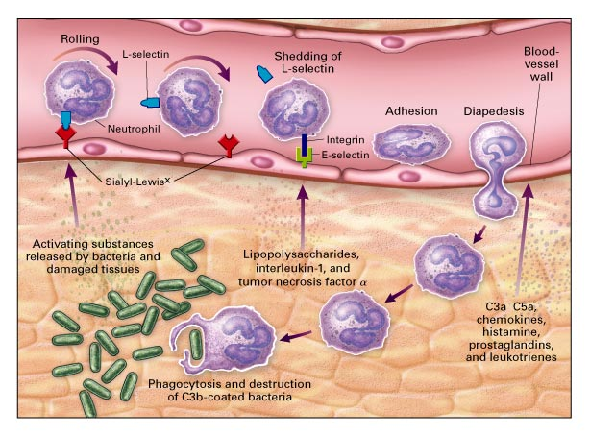
Biological effects of complement activation:
1. Anaphylatoxin functions (e.g. C3a, C5a):
- Trigger degranulation (release of substances) of endothelial cells, mast cells or phagocytes.
- Induce smooth muscle contraction and increased vascular permeability.
- Attract additional inflammatory cells to the site of activation.
2. Opsonization: C3b is the main opsonin and to a lesser extent C4b.
- Coating of bacteria enhances phagocytosis
3. Direct cell lysis: lytic complex
- Destruction of bacteria.
Process of chemotaxis
1- Rolling on vessel wall. 2- Adhesion (attach) 3- Pass through.

Slide 7
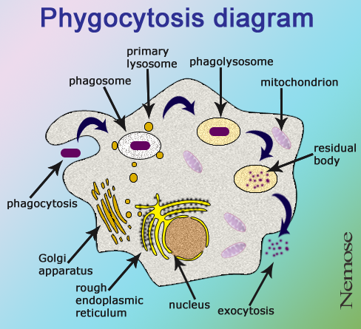
Types of Cells attracted to the site of infection that mediate inflammation:
1- Monocytes: Become Macrophages when they leave the blood and enter the tissues.
2- Neutrophils: (Phagocytic cells).
3- Eosinophils: (Allergy and Parasitic infections).
4- Natural Killer (NK) cells: (Kill tumor cells and virus infected cells).
Phagocytic cells (neutrophils & macrophages) at site of infection start the process of phagocytosis which is the process by which a cell engulf a solid particle such bacteria to form internal vesicle known as phagosome.
Cytokines:
Soluble molecules, produced by different cells, that control cell functions
e.g. differentiation, proliferation activation or inhibition.
Interleukins
Chemokines
Cytokines
Interferons
Tumor Necrosis Factor (TNF)

Slide 8
Interferons
Interleukins
Protects against viral infections
Produced and released by virally infected cells in response to viral infections.
Produced primarily by macrophages and lymphocytes in response to a pathogen
Many types
Examples
IL-1, IL-2, IL-3…
Secreted by macrophages
- Induces fever by acting as an endogenous pyrogen (a substance released from inside the body that produces fever)
Tumor necrosis factor (TNF)
- Increases synthesis of inflammatory serum proteins
- Increase expression of adhesion molecules on endothelial cells and vascular permeability

Slide 9
Take Home messages
Non-specific (innate immunity) acts as first line of defense against invading pathogens
Innate immunity is an important initial step for generation of adaptive immune response
Inflammation is vital for controlling infection and limiting tissue damage

Slide 10
MCQ's
1 - Which of the following physical innate immunity ? a) Vomiting. b) saliva, c) hepcidins) d) Mucous membranes 2- serve as a link between the adaptive and innate immunity ? a) plasma cell b) neutrophile c) Monocytes d) eosinophile 3- which complement system pathway Activated by bacterial products ? A) Classical pathway b ) lectine pathway c) Alternative pathway 4- main opsonin in complement system ? A ) c3a b) c3b c) c5a d) c5b 5- Produced and released by virally infected cells in response to viral infections a) Interleukins b) Interferons c) Tumor necrosis factor (TNF) 6- substance released from inside the body that produces fever its called endogenous pyrogen a) true b) false
1-D
2-C
3-C
4-B
5-B
6-A

Slide 11
Contact us
Email: Immunology436@gmail.com
Twitter: Immunology436
Team Leaders
Ghaida Alsaeed Basel almeflh
Team members
Aroob Alhuthail Abdullah alharbi
aldorah Alhamdi Abdulmajeed almutairi
Ghada Alskait Abdulmajeed alammar
Hanin Bashaikh Basel alanazi
Lara Alsaleem Moayed Ahmed
Rawan Alwadee Mohammed alhammad

