Slide 1
Foundation Block
Lecture Five
Hypersensitivity
Objectives:
To know that hypersensitivity reactions are over and excessive immune responses that can be harmful to body in four different ways
To be familiar with inflammatory processes in type I hypersensitivity reaction that mediates allergic inflammation
To recognize that type II hypersensitivity deals with immune responses against antigens that are integral part of cell membrane and are usually associated with autoimmune disorders
To know that type III hypersensitivity reactions are mediated by immune complexes and cause vasculitis
To describe type IV hypersensitivity is a purely cell mediated immune response associated with chronic inflammation
Important.
Extra notes.
Females notes
Males notes.

Slide 2
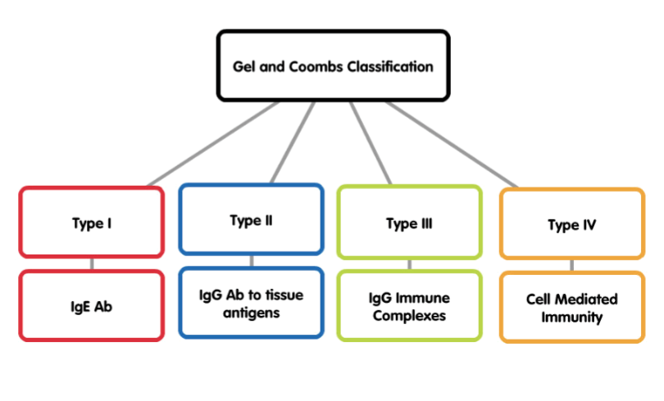
What is hypersensitivity?
Protective immunity: desirable reaction.
Hypersensitivity: undesirable damaging reaction produced by excessive immune reactions.
- Undesirable responses can be mediated by:
- Antibody binding to antigens (Types I-III).
- Cell mediated reaction to chemicals or proteins (Type IV).
Types of hypersensitivity:
4 Types of hypersensitivity responses are classified by
GEL AND COOMBS (names of scientists) according
to the responding mechanisms, NOT the responding
antigens:
Type I:
1- Also termed as:
- Immediate Hypersensitivity.
- Allergic reactions. (e.g. asthma and eczema)
- Anaphylactic reactions: severe and rapidly progressing systemic forms which can be quickly life threatening. …..............(causes.vasodilation and hypovolemia which causes heart stop then death)
2- Most people will not react to these allergens but some individuals “atopic” respond by producing large amounts of IgE in …........response to those otherwise harmless substances.
3- Non-allergic individuals respond to these allergens by producing IgG antibodies.
4- Features:
- Antibody type: IgE
- Cellular components: Mast cells, basophiles & eosinophils
- Antigens: Also known as allergens ( antigens with low molecular weight & highly soluble).
5- (Occurs within minutes to hours).
*From 433 team

Slide 3
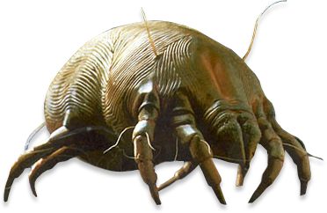
Allergens:
Some of the allergens involved in type I hypersensitivity are:
pollens, dust mite allergens, animal dander, nuts, shellfish, various drugs, etc.
Type I reactions occur in two phases
1- Sensitization
Sensitization phase:
Antigen presenting cell (APC) takes the antigen, processes it, degrades it, then presents it with association of class II MHC.
T Helper 2 comes in contact with the B Cell and turns it into a Plasma Cell or a Memory Cell. Plasma Cells then produce IgE antibodies specific for that type of allergen. Then, the IgE antibody attaches to a Mast Cell which has receptors for this antibody. Mast Cells are said to be synthesized when they are bound to an antibody.
Challenge phase:
Occurs when we have a subsequent encounter with the similar antigen it will bind to the Ig(Antigen) and lead to degranulation of the mast cells making it produce a large amount of its mediators which cause what we see in allergic patient (sneezing, muscle contraction, mucus production,..etc) (subsequent contact with allergens)
First contact with allergens
2- Challenge
Subsequent contact with allergens

Slide 4
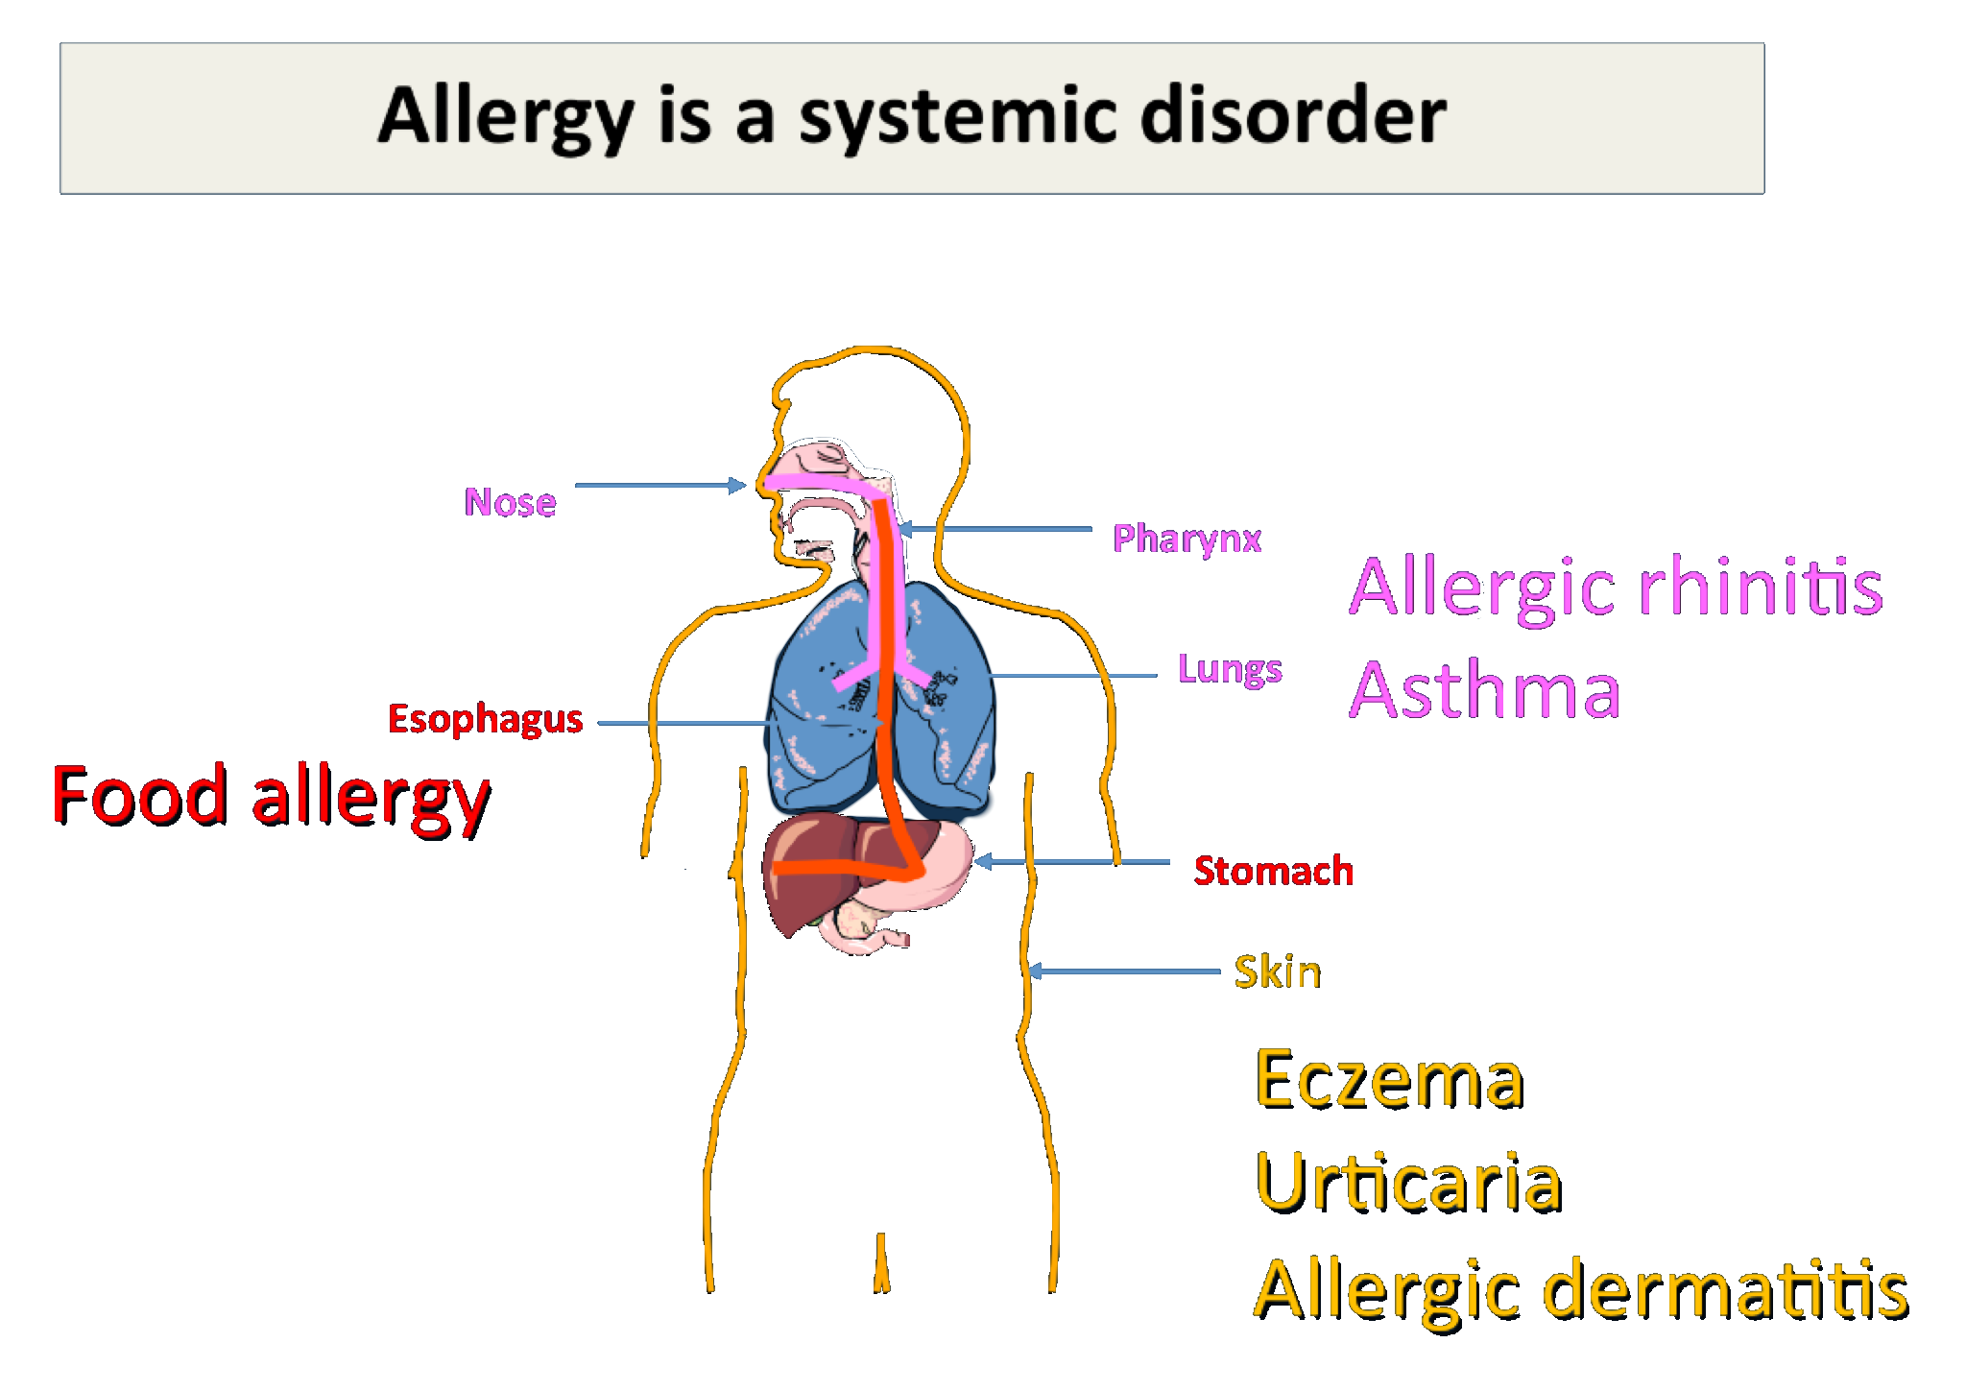
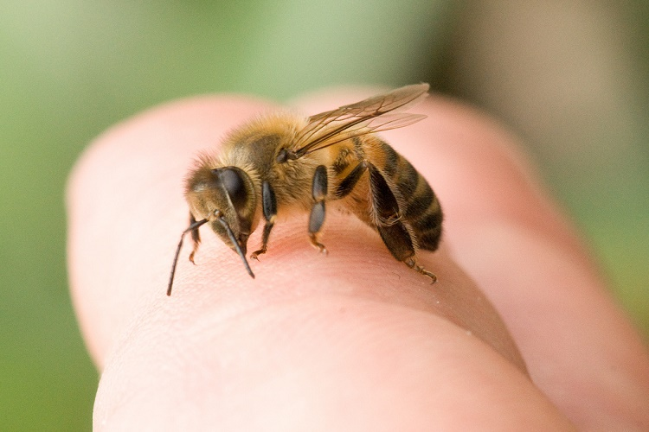
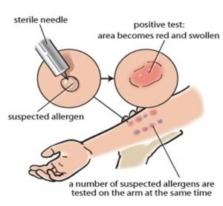
Injected allergens:
Hymenoptera (bees, wasps, ants) sting venom enters the blood stream
→ Systemic inflammation
→ Anaphylactic shock
→ (life-threatening)
Anaphylactoid reactions
Are non - IgE mediated may result from contrast media or local anesthetics
Diagnosis of Allergy:
Skin prick test (SPT) | Specific IgE measurement (RAST) | Elimination / Provocation test (Food allergy)
 | Team435: radioallergosorbent test (RAST) is a blood test used to determine the substances a subject is allergic to. | Team435: أكثر طريقة تأخذ وقت: يستبعد الطبيب أنواع مختلفة من الطعام الذي قد يسبب الحساسية للشخص، ثم يراقب الطبيب نتائج المريض على مدى أسابيع إلى أن يحدث حساسية فيعرف الطبيب ماذا أكل وما سبب الحساسية

Slide 5
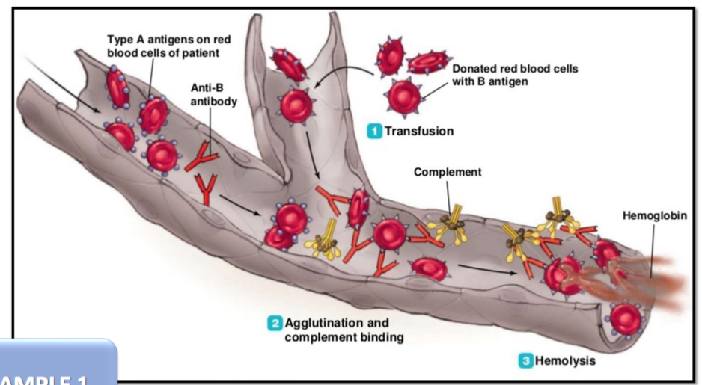
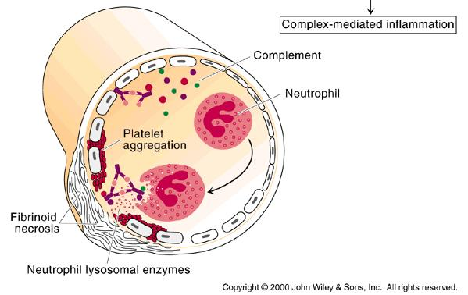
Type II Hypersensitivity Reactions:
Features:
IgG (or IgM)
Antigens:
bound to cell membranes (Self antigens)
Exogenous antigens (microbial)
Complement activation (Invariable)
Clinical examples:
Glomerulonephritis (anti-glomerular basement
membrane)
Mis-matched blood transfusion
Diagnosis:
Detection of antibodies and antigens by Immunofluoresence in tissue biopsy specimens e.g. kidney, skin etc.
Type III: (component of cells)
When an antigen reacts with an antibody the product they form is called an immune complex (antigen (here it’s soluble) + antibody (IgG) + complement (C3a, 4a and 5a) = immune complex = inflammatory response) which is capable of inducing an inflammatory response.
Immune complexes are (found in the zones of filtration) deposited in tissues like kidneys (nephritis), joints (arthritis) or blood vessels (vasculitis).
Features and Mechanism:
Antibody (IgG/ or IgM) + Antigen (soluble)
Immune – Complex formation
Complement activation
Attraction of inflammatory cells

Slide 6
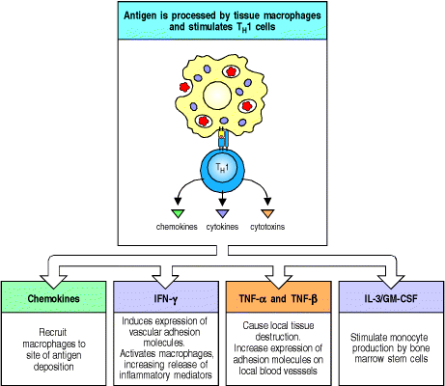
Clinical examples:
- Glomerulonephritis: Rheumatoid arthritis, SLE (systemic lupus erythematosus)
Diagnosis:
Demonstration of specific immune complexes in the blood or tissues by: Immunofluoresence
Type IV hypersensitivity reactions:
Features:
Cell mediated immune response:
- Antigen dependent T cell (CD4 generally and CD8 occasionally) activation via MHC Class I or II.
Activated macrophages.
Delayed onset (2-4 days).
Abnormal cellular response (Granuloma formation).
Mediators released by T_{DTH} cells:

Slide 7
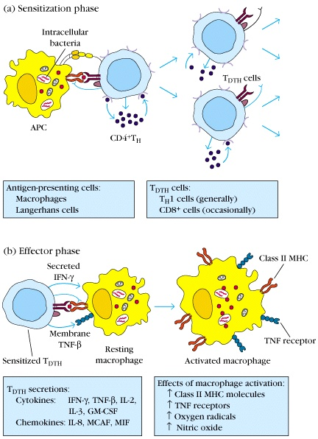
Development of DTH (delayed type hypersensitivity) Response:
1- Sensitization phase: 1-2 week period
2- Effector phase: 24-72 hours
Effector cells (activated macs [The membrane attack complex]) act non-specifically

Slide 8
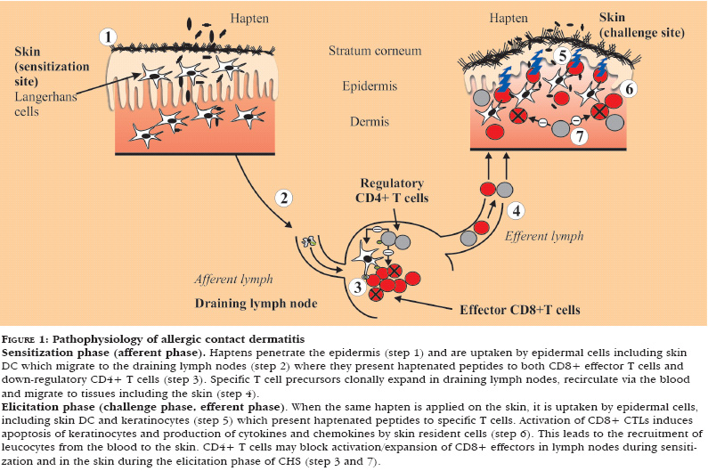
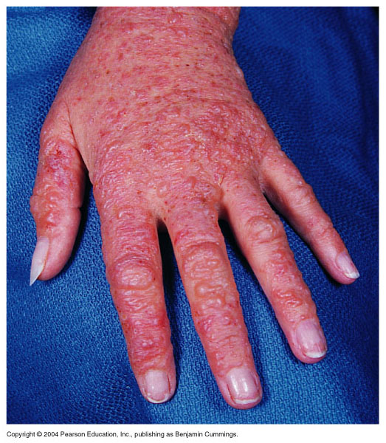
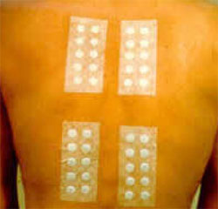
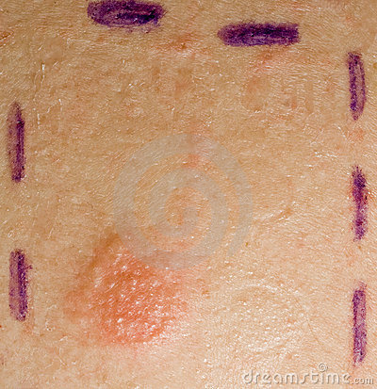
Clinical examples:
Contact dermatitis: (e.g. necklace)
Pathophysiology of contact dermatitis:
(Hapten doesn’t induce immune reaction by itself because it’s very tiny, it has to combine with epidermis protein to be allergen)
2. TB granuloma (persistent antigen)
Diagnosis:
Delayed skin test (Mantoux test)
Patch test (Contact dermatitis) (48-72h)
Lymphocyte transformation test

Slide 9
Take Home Messages
Type I (IgE), II (IgG) and III (IgG) hypersensitivity reactions are mediated by antibodies whereas Type IV hypersensitivity reaction is a cell mediated immune response.
Hypersensitivity reactions are undesirable, excessive, and aberrant immune responses associated with disorders such as allergy, autoimmunity and chronic inflammation.
Useful Videos:
- Type1 Hypersensitivity Videos Animations:
https://www.youtube.com/watch?v=IGDXNHMwcVs
https://www.youtube.com/watch?v=y3bOgdvV-_M&feature%20?.
- Type 1 Hypersensitivity ANAPHYLAXIS :
https://www.youtube.com/watch?v=9Qmzt94rRAw&index=4&list=LLhph2500OUDsKDIf2o-pH0A
- Explanation for Type 1 Hypersensitivity (has additional information but very helpful to understand):
https://www.youtube.com/watch?v=2tmw9x2Ot_Q&index=3&list=LLhph2500OUDsKDIf2o-pH0A
- Type II hypersensitivity:
https://m.youtube.com/watch?v=kLaUz58CBMc
- Explanation for Type 3Hypersensitivity (has additional information but very helpful to understand):
https://www.youtube.com/watch?v=SyxzU2Sl_Yw&index=2&list=LLhph2500OUDsKDIf2o-pH0A
- Type 4 Hypersensitivity Animation :
https://www.youtube.com/watch?v=9v4CBctjQHk&index=1&list=LLhph2500OUDsKDIf2o-pH0A

Slide 10
MCQs:
1- Anaphylactic reactions occur in which type of hypersensitivity ?
a) type I b) type II c) type III d) type IV
2- Rheumatoid arthritis is a Clinical example of which type of hypersensitivity ?
a) type I b) type II c) type III d) type IV
3- type III hypersensitivity is also known as ?
a) Immediate Hypersensitivity b) Cell Mediated Immunity
c) Immunofluoresence d) Immune complex
4- which one of the following is a Feature of Type IV hypersensitivity ?
a) Complement activation b) require Mast cells
c ) Antibody type IgE d) Delayed onset
5- Atopic individuals respond to the allergens by producing ?
a) IgG b) IgE c) IgA d) IgM
6- Which of the following is secondary Mediator of Allergic reactions ?
a) histamine b) heparin c) proteases d) bradykinin
7- Diagnosis of Type IV hypersensitivity by which of the following ?
a ) Skin prick test (SPT) b) Elimination - Provocation test
c) Skin patch test d) Detection of Ab & Ag by Immunofluoresence
8- which of the following Allergies affect the Skin ?
a) Urticaria b) Asthma c) Allergic rhinitis d) none of above
9- Granuloma formation occur in which type of hypersensitivity ?
a) type I b) type II c) type III d) type IV
10- Mis-matched blood transfusion is a Clinical example of which type of hypersensitivity?
a) type I b) type II c) type III d) type IV
1-A
2-C
3-D
4-D
5-B
6-D
7-C
8-A
9-D
10-B

Slide 11
Contact us
Email: Immunology436@gmail.com
Twitter: Immunology436
Team Leaders
Ghaida Alsaeed Basel almeflh
Team members
Aroob Alhuthail Abdullah alharbi
aldorah Alhamdi Abdulmajeed almutairi
Ghada Alskait Abdulmajeed alammar
Hanin Bashaikh Basel alanazi
Lara Alsaleem Moayed Ahmed
Rawan Alwadee Mohammed alhammad

