Slide 1
MICROBIOLOGY
Lecture : 1
Bacterial structure and genetics
IMPORTANT.
DOCTORS NOTES.
EXTRA INFORMATION.

Slide 2
Objectives-Bacterial Structure & function:
Define the cellular organization of bacteria
and know the differences between Eukaryotes
and Prokaryotes.(S 3 +4)
• Know major structures of bacteria and its
Function.(4-6)
• Know the structure of cell wall of bacteria
including the differences between Gram
positive and Gram negative bacteria and main
Functions (S 6-8 ).
• Know the external structures of bacteria with
and functions .(9 - 11)
• Know the cytosol and internal structures of
bacteria .(12 and 13)
• Describe bacterial spores and its application
in the practice of medicine.(12)
Objectives- Bacterial Genetics:
• Know basic information about bacterial genetics and
replication of bacteria .(14)
• Describe plasmids , its origin , types and its
importance in clinical practice.(15 and 17)
• Recalls genetics variations, including ; mutation and
mechanisms of gene transfer and its implication on
bacterial resistance to antimicrobial agents.(18 -25)
أمام كل هدف من الأهداف أرقام السلايدات اللي تتعلق فيه

Slide 3
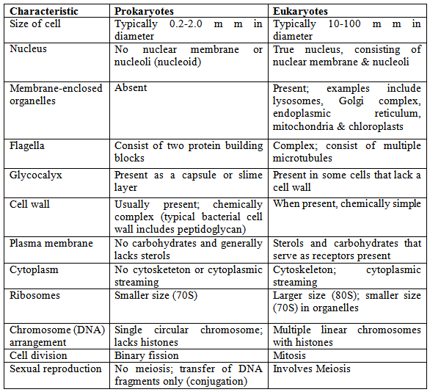
Differences between eukaryotes and prokaryotes
**Cell wall present in all prokaryotes and it consist of peptidoglycan
It present in some eukaryotes ,like , plants and it consist of cellulose in plants
*لم يذكر الفرق في السلايدات الأساسية ولكن مذكورة في الأهداف

Slide 4
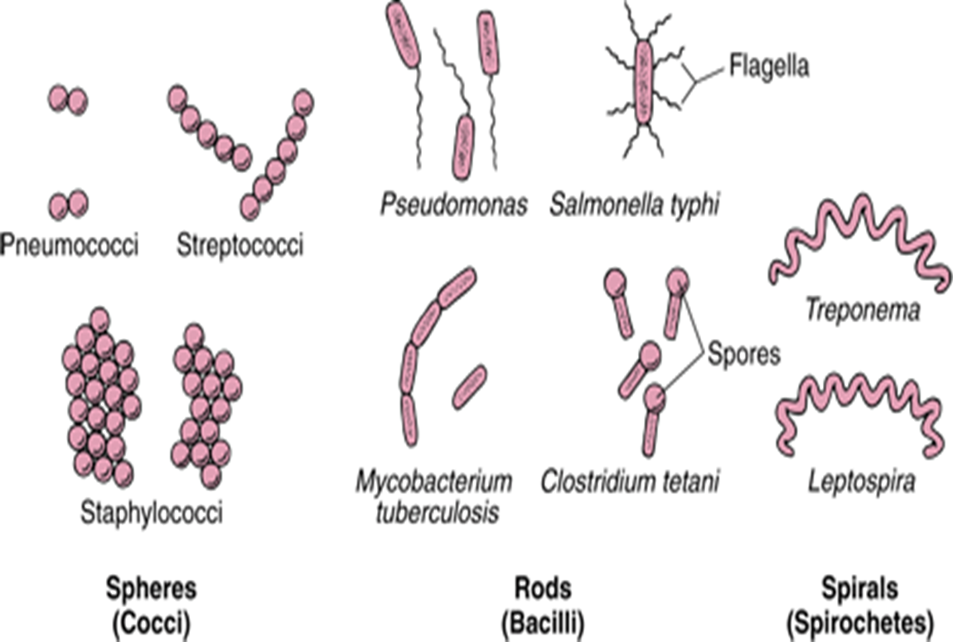
Definition:
Bacteria : Is a heterogenous group of unicellular
organisms , about 1 -8 μm in diameter.All bacteria is a prokaryote.
hetrogenous : two or more things are unlike in substance or nature, as in a heterogenous mixture containing two substances that do not totally combine. (from a dictionary )
Some Characteristics..
Has a primative nucleus
one chromosome
(floating in the cytoplasm)
No nuclear membrane
No mitochondria
No sterols
Bacteria contain PLASMIDES which is extra piece of DNA
Shapes of bacteria
Spherical / Oval .Cocci
Rods . Bacilli
Very short Bacilli Coccobacilli
Tapered end Fusiform
Club-shaped / Curved Vibrio
Helical / Spiral .Spirochaetes

Slide 5
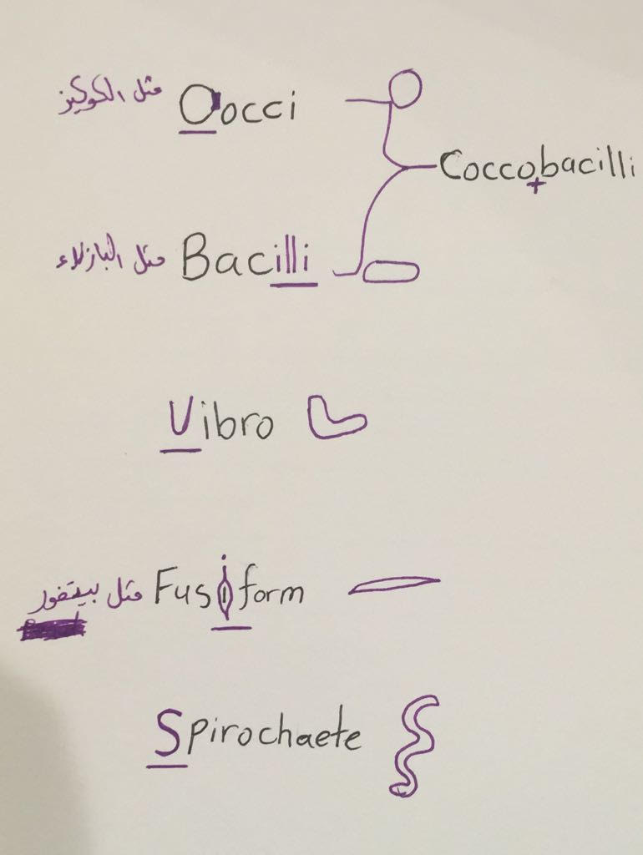
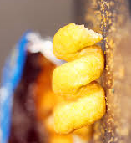
لزيادة الفهم
مثل بطاطس تشيتوس اللولبي
شكر خاص :
لمنيرة الضفيان
و
روان القحطاني

Slide 6
Arrangement of bacteria:
**There is a difference between “cell wall” and “cytoplasmic membrane” !! Cytoplasmic membrane in pro –eukaryotes , while cell wall in prokaryotes and plants and some kind of animals ☺
Pairs………..Diplococci
Clusters…….Staphylococci
Chains………Streptococci
In four……….Tetrad
Palisades…..Corynebacterium
Cell wall of bacteria:
Bacteria are cells with rigid cell wall surround cytoplasmic membrane and internal structures. Functions of cell wall:
*Note : Mycoplasma is a bacteria that is naturally have no cell wall.
Chemical structure of bacterial cell wall:
Peptidoglycan :
Rigid part , mucopeptide composed of alternating strands of N- acetyl muramic acid and N- acetyle glucosamine linked with peptide sub units.
Rigidity because of peptidoglycan
Shapes bacteria
Protection
Porous / permeable to low molecular weight molecules
Cell division
Antigenic determinants
(receptor)

Slide 7
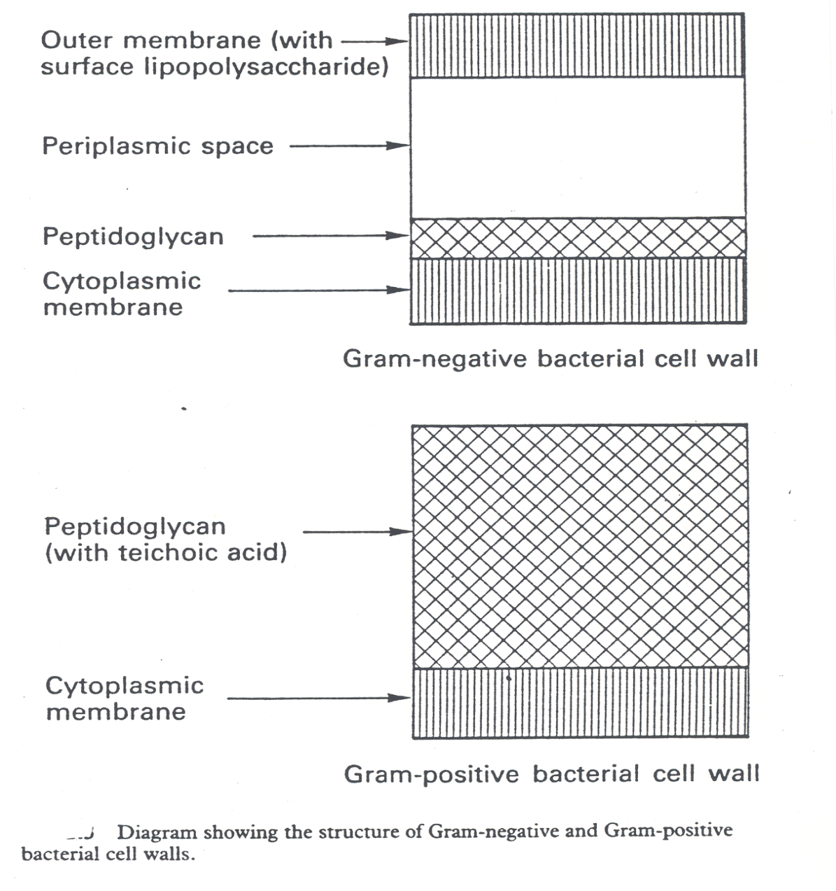
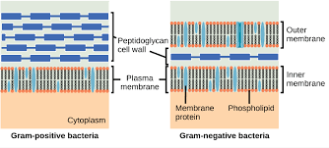
GRAM POSITIVE BACTERIA: stain blue/purple by Gram stain
Peptidoglycan thicker than Gram negative bacteria.
Closely associated with cytoplasmic membrane
Teichoic acid : anchors cell wall to cell membrane , epithelial cell adhesion.
Antigens : *polysaccharides(Lancefield)
*protein(Griffith)
GRAM NEGATIVE BACTERIA: stain red by Gram stain
Thin Peptidoglycan
outer membrane(only in negative) contains: specific proteins (porins) important in the transport of hydrophilic molecules lipopolysaccharide & lipid (ENDOTOXIN)
Thin
Thick

Slide 8
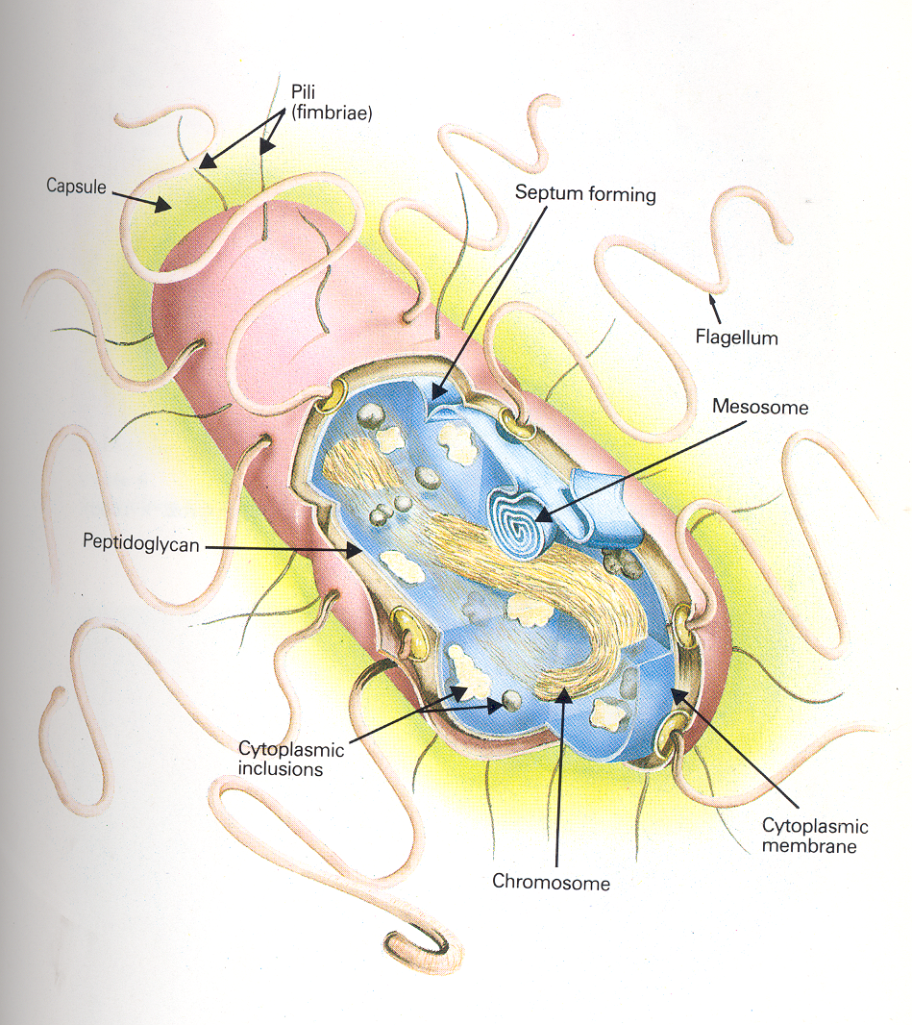
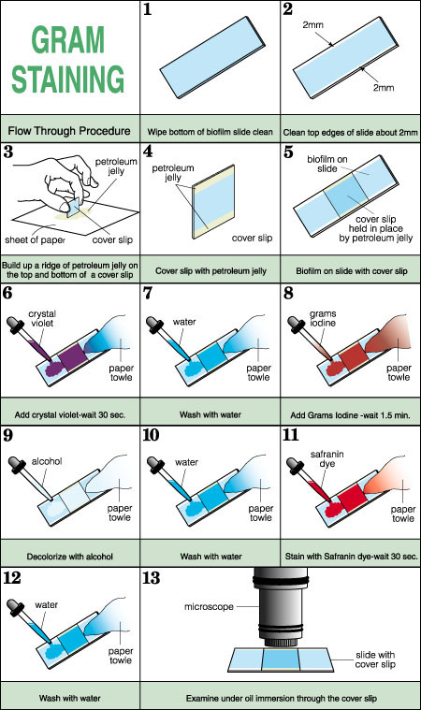

Slide 9
External Structures of Bacteria
External protrude from the cell into the environment.:
1-Pili:
Fine short filaments extruding from cytoplasmic membrane.
Found on the surface of many Gram negative & Gram positive bacteria.
Composed of protein Pilin.
Two classes:
1- Common pili (fimbriae): covers the surface, responsible for: adhesion & colonization(الالتصاق والاستعمار )
2- Sex pili : in some bacteria only, responsible for conjugation((تشارك فيها الجينات))
2-Capsule:
Amorphous material surrounds bacteria.
Usually polysaccharide
Occasionally protein
Function : 1-Inhibits phagocytosis.
2- Acts as Virulence factor in some
bacteria by assessing attachment to the surfaces.
*تختلف كثافة الكابسول من خلية إلى أخرى
3-Flagella
Composed of protein FLAGELLIN.
Helical filaments
Found in Gram positive & Gram negative bacteria
Distribution:
- Peritrichous (حول كل البكتيريا)
- Monotrichous(في طرف واحد)
- Lophotrichous ( من طرفين )

Slide 10
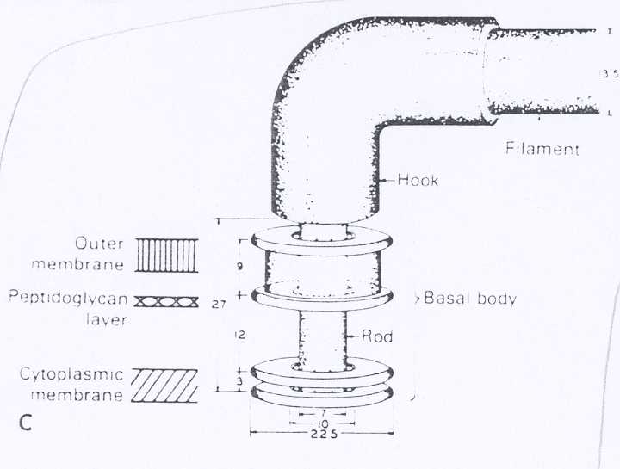
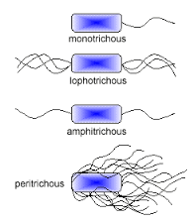
Structure of Flagella:
Basal Body:
a protein arranged as rings on central rod (4 ring in Gram negative, 2 ring in Gram positive).
outer pair of rings: only in Gram negative, pushed through outer membrane.
inner pair of rings : inserted into peptidoglycan & cytoplasmic membrane.
Hook : bent structure -act as joint
Long Filament :Flagellin protein
Function of Flagella : motility & chemotaxis (الاحساس بالخطر والاستشعار كيميائيا)
Structure & Distribution of Flagella
Chemotaxis :is the movement of an organism in response to a chemical stimulus.

Slide 11
Cytoplasmic Membrane
Cytoplasmic membrane (cell membrane):
Double layered structure composed of phospholipid & protein
Site of numerous enzymes involved in active transport of
nutrients &
various metabolic processes
Act as semi- permeable membrane (passive diffusion)

Slide 12
Internal Structures of Bacteria
HOW?
By storing
Genetic material
Core of Bacteria
Spores of Bacteria
Mesosomes
Cytoplasmic inclusions:
Nutritional storage granules examples:
- Volutin
- Lipid
- Starch / or Glycogen
Small ,dense, metabolically inactive , non- reproductive structures produced by Bacillus & Clostridium
Enables the bacteria to survive adverse environmental conditions.
Contain high concentration of Calcium dipicolonate.
Resistant to heat, dissection & disinfectants
Often remain associated with the cell wall
Spores germinate when growth conditions become favorable to produce vegetative cells.
Application in medical practice :spore preparations used for checking the efficacy of Autoclaves, eg. Bacillus subtilis & Bacillus sterothermophilus .
Spores are described as :
convoluted invaginations of cytoplasmic membrane
Nucleoid ( Nuclear Body) :
Circular single stranded chromosome (bacteria genome or DNA)
No nuclear membrane
DNA undergoes semi conservative replication , bidirectional from a fixed point
Function:
Involved in DNA segregation during cell division & respiratory activity
Contain receptors involved in chemotaxis
Permeability barrier (active transport of solutes).
Ribosomes of Bacteria:
Distributed throughout the cytoplasm
Site of protein synthesis
Composed of RNA and protein
Central spores
Sub-terminal spores
Terminal spores

Slide 13
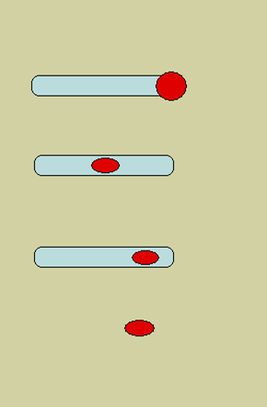
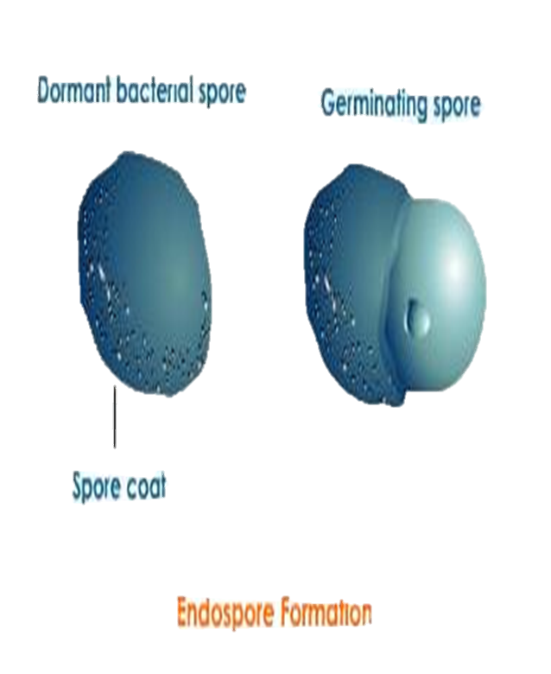
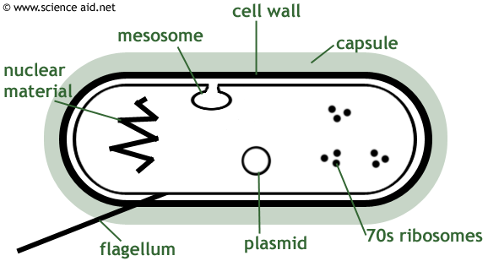
Spores are described :

Slide 14
Bacterial Genetics
Definitions:
Function of genetic material:
Genetics
1- Replication of the genome
2- Expression of DNA to mRNA then to protein. Either functional(for metabolism)
Or structural ((الدعامة للخلية
*كلام الدكتور :يعني البروتين المنتج يستهلك حيويًا وللتدعيم
• Genetics is the study of inheritance and
variation.
• Genetic information encoded in DNA.
Genotype:
Phenotype:
Wild type:
Is the complete set of genetic
determinants of an organism.
Is reference (parent) strain- active.
Mutant: progeny with mutation.
Is expression of specific genetic
Material.
أي كلام باللون الأخضر هو كلام الدكاترة
دائماً متغيرة فبسبب هذا التغير يطلع منها طفرات.

Slide 15
DNA types in the bacteria
Chromosomal
Extra-chromosomal (Plasmid).
• Haploid, circular molecule of double
stranded- DNA attached to cell membrane.
No nuclear membrane (prokaryotes).
• DNA a double helical structure, genetic code in Purine and Pyrimidine bases of nucleotides that makes DNA strand.
(like human A T G C )
• 3 bases comprise one code, each triplet codon codes for one amino acid.
• Replication is semi-conservative.
Types of plasmid:
In the next slide
• Extra chromosomal DNA composed of double stranded-DNA. ( in the cytoplasm)
• Found in most species of bacteria.
• Origin? (un known)
• Govern their own replication•
Application :Genetic exchange, amplify genes. (مثل الهندسة الوراثية)
• Transfer by conjugation
• Unrelated plasmids coexist together only. (في الخلية الوحدة ممكن يكون فيها أكثر من نوع)

Slide 16
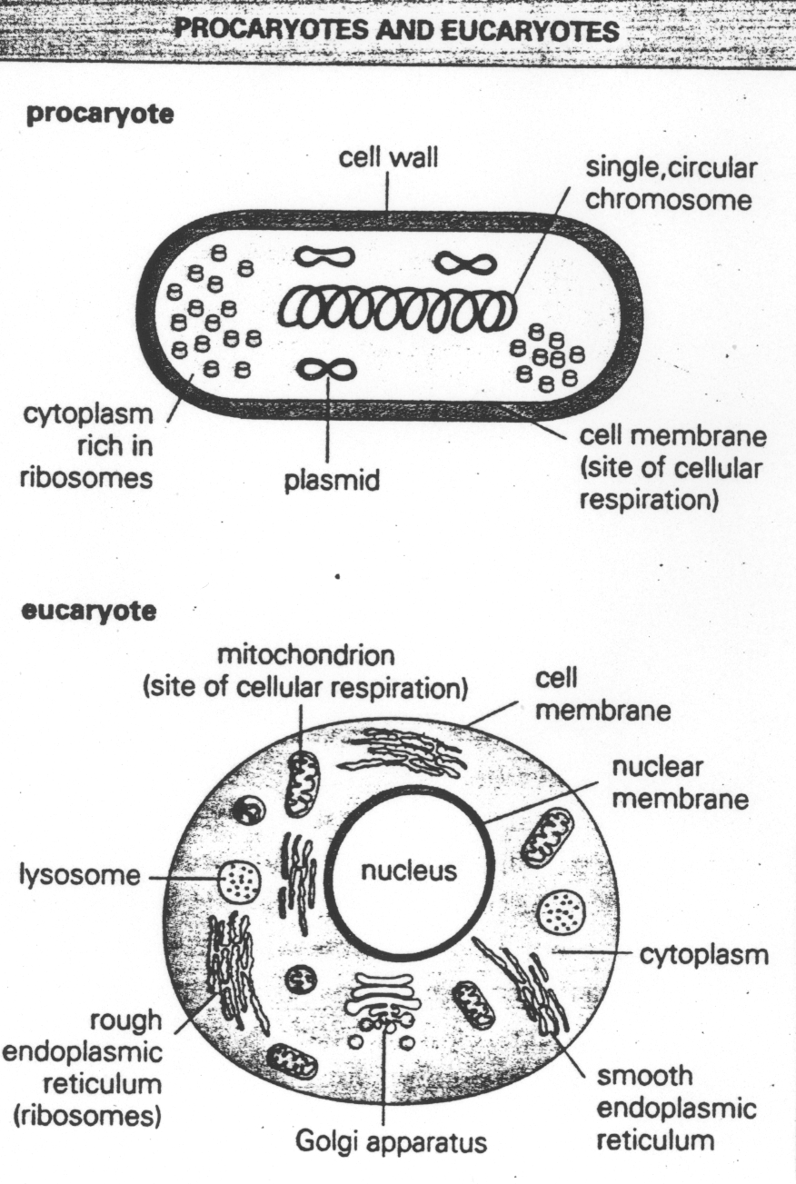
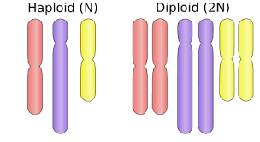
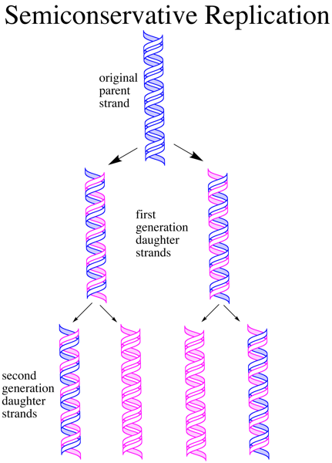
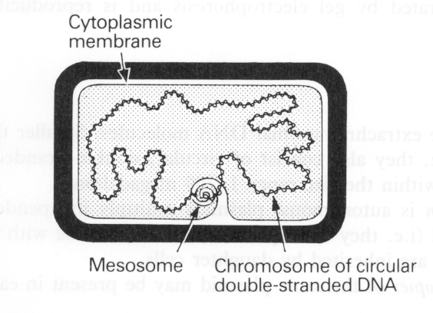
الفرق بين البكتيريا و الخلية
فقط لمعرفة معنى
haploid

Slide 17
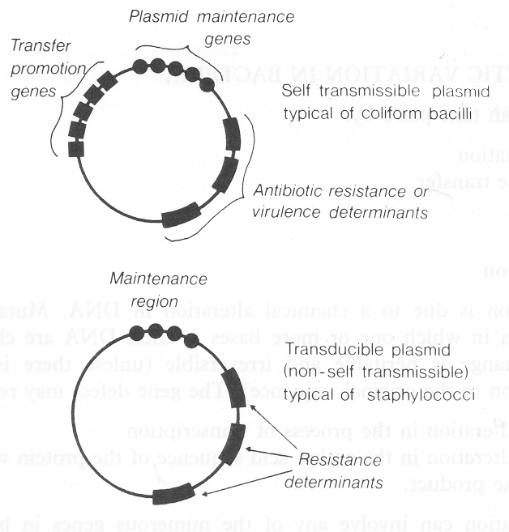
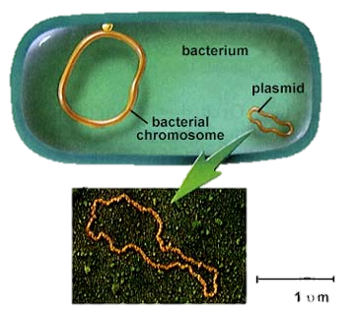
Types of plasmids :
Col-plasmids
F-plasmids
R-plasmids
: genes code for antibiotic
resistance particularly Gram negative bacteria.
R from the word (Resistance).
: in Enterobacteria, codes for extracellular toxins.
:(fertility) factor, transfer of
chromosome during mating .

Slide 18
Genetic variation in bacteria :
Take place by :
Mutations
Gene transfer
• Inheritable changes in the structure of genes (DNA).
• Chemical changes in one or more bases of DNA.
Coming next ….
Classification of Mutation:
Depends on biological sequencing:
Mutation /gene defect leads to alteration in:
• Transcription,
• Amino acid sequence,
• Function eg. Bacteria resistant to antibiotic.
Resistance mutation
affect structure of cell protein.
Auxotrophic mutation:
affect biosynthetic enzyme resulting in a nutritional requirement of mutant cell.
Lethal mutation.
The bacteria die .
Main application in medical practice Bacteria become resistant to antibiotics
من الممكن أن تحدث الطفرة في البكتيريا أو فقط في البلازميد .
الطفرة في البلازميد أخطر لأنها من الممكن أن تنتقل لبكتيريا أخرى

Slide 19
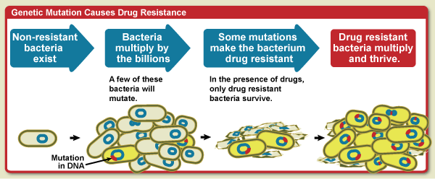
Mutation Causes Antimicrobial Resistance

Slide 20
Gene Transfer Among Bacteria
Transformation
Transduction
Conjugation
A fragment of exogenous naked bacterial DNA are taken up and absorbed into recipient cells.
Common in Haemophilus influenzae & Streptococcus pneumoniae. Bacteria become resistant to Ampicillin.
Phage mediated transfer of genetic information from donor to recipient cells.
Example:
Beta – Lactamase production in Staphylococcus aureus : Bacteria becomes resistant to penicillin.
Toxin production in Corynebacterium diphtheriae.
Major way bacteria acquire additional genes.
Plasmid mediated
Cell contact required and genes reside on plasmid resident within donor cells transfer to recipient cell (mating).
Conjugation is the common way of transfer of genes resistance to antibiotics among bacteria in hospitals.

Slide 21
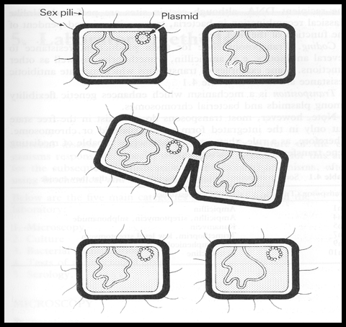
Cont…
conjugation
Mediated by plasmid called F factor (fertility).
Gene encode changes in surface by producing a sex pilus .this facilitates capture of F⁻ cells and the formation of a conjugation bridge through which DNA passes from F ⁺ into F⁻cells.

Slide 22
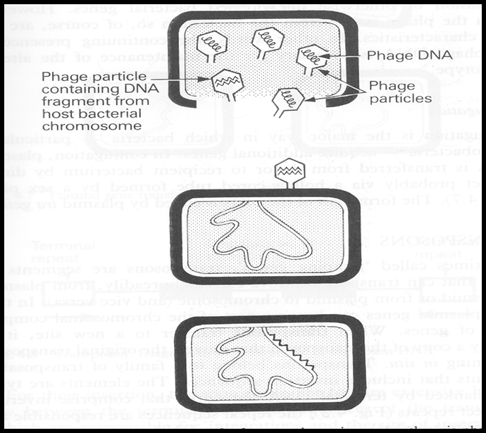
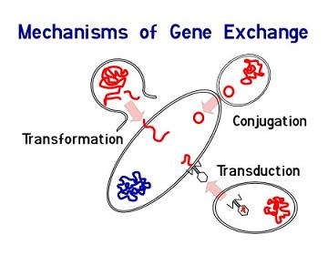
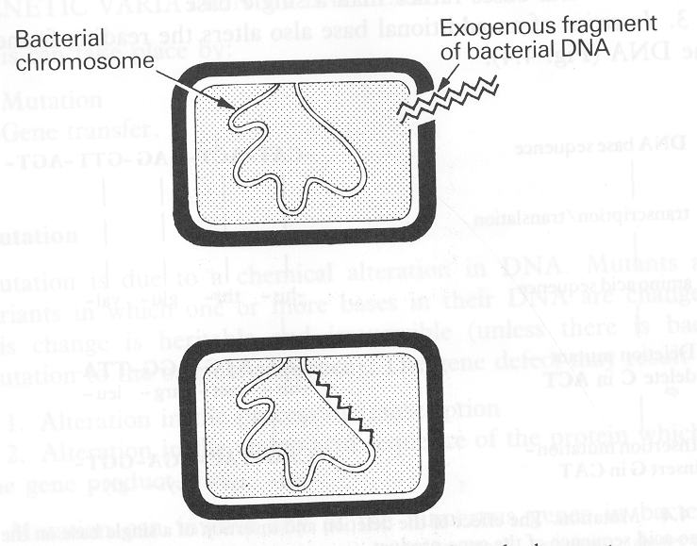
transduction
transformation

Slide 23
Gene Transfer Among Bacteria
Mechanisms: | Transformation | Transduction | Conjugation
 | A fragment of exogenous naked bacterial DNA are taken up and absorbed into recipient cells. | Phage mediated transfer of genetic information from donor to recipient cells | Major way bacteria acquire additional genes. Plasmid mediated Cell contact required and genes reside on plasmid resident within donor cells transfer to recipient cell (mating).
Example: | Common in Haemophilus influenzae & Streptococcus pneumoniae. Bacteria become resistant to Ampicillin. | Beta – Lactamase production in Staphylococcus aureus : Bacteria becomes resistant to penicillin. Toxin production in Corynebacterium diphtheriae. | Conjugation is the common way of transfer of genes resistance to antibiotics among bacteria in hospitals. .

Slide 24
Genetic Recombination
After gene transfer, there are three possible fates:
1-Exogenous DNA degraded by nuclease.
2-Stabilized by circulization and become plasmid.
3- Form a partially hybrid chromosome with segment derived from each source.

Slide 25
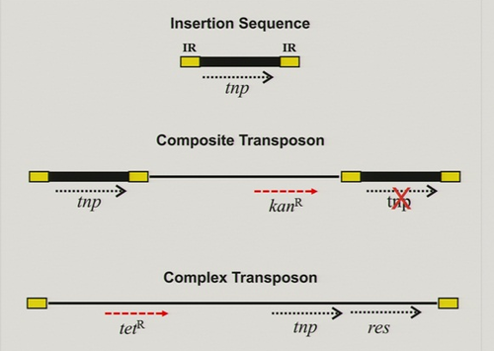
Transposable Elements
Genetic units capable of mediating own transfer from chromosome to another, from location to other on same chromosome or between plasmid and chromosome or phage DNA.
Types: 1- Transposons .
2- Insertion sequence
https://www.onlineexambuilder.com/bacterial-structure-function-bacterial-genetics/exam-35905

Slide 26
THE TEAM :
THE TEAM :
Contact us :
Waleed Aljamal
Ibrahim Fetyanu
Meshal Alhusainan
Hussam Alkhathlan
Faisal Alqumaizi
Shrooq Alsomali
Hanin Bashaikh
Jawaher Alkhayyal
Reem Alshathri
Rawan Alqahtani
Ohoud Abdullah
Ghadah Almazrou
Lama Al-musallm
436microbiologyteam@gmail.com
Twitter :
@microbio436

