Slide 1
microbiology
Lecture:
Fungi and their pathogenesis
IMPORTANT.
DOCTORS NOTES.
EXTRA INFORMATION.

Slide 2
Lecture Objectives..
To describe the general characteristics of fungi and recognize a fungus from all other living organisms ( slide 3)
To establish familiarity with the terminology needed by medical students (slide 3-6)
To know certain fundamental facts about classification reproduction and identification of fungi (5-9)

Slide 3
Or (distinguishing features):
What is Mycology?
feed on dead tissues or organic waste (decomposers)
mutually beneficial relationship between a fungus and another organism
Parasitic
feeding on living tissue of a host. (disease) it can cause a Fungal infection
Saprobic Recycling
Symbiotic
Mycology: Study of fungi
Medical mycology : Study of medically important fungi and the mycotic diseases.
Mycoses: A disease caused by a fungus
Kingdom myceteae = Kingdom fungi
Characteristics of fungi:
What is a Fungus ?
Are bigger than bacteria
Characteristics of fungi:
All Eukaryotic organisms (a true nucleus)
Heterotrophic (does not make their own food) (Saprobic, symbiotic, parasitic)
Do not have chlorophyll (Achlorophyllous)
4. The cell is surrounded by rigid cell wall (It gives it’s shape) made of chitin and complex carbohydrates (Mannan, glucan)
5. Cell membrane: (sterol, ergosterol)
Mannan and Glucan are targets for the diagnosis of fungal infections
What is a fungus?
https://www.youtube.com/watch?v=b5rluxtABGA
What are Fungi ? Types and Characteristics
https://www.youtube.com/watch?v=rB1JUT3nzmM

Slide 4
MORPHOLGY
Yeasts : are unicellular organisms
Filamentous fungi (mold) (Hyphae, mycelium):
Hyhpae are multicellular filamentous structures, constituted by tubular cells with cell walls.
Dimorphic (between yeast and filamentous)
Yeast : Parasitic form, Tissue form, Cultured at 37° C
Filamentous : Saprophytic form, Cultured at 25 C
Dimorphic : Have two forms depending on change in the environmental factors :
Round oval
Basic structure unit is hyphae
Depends on the temperature
Yeast form
Mold form

Slide 5
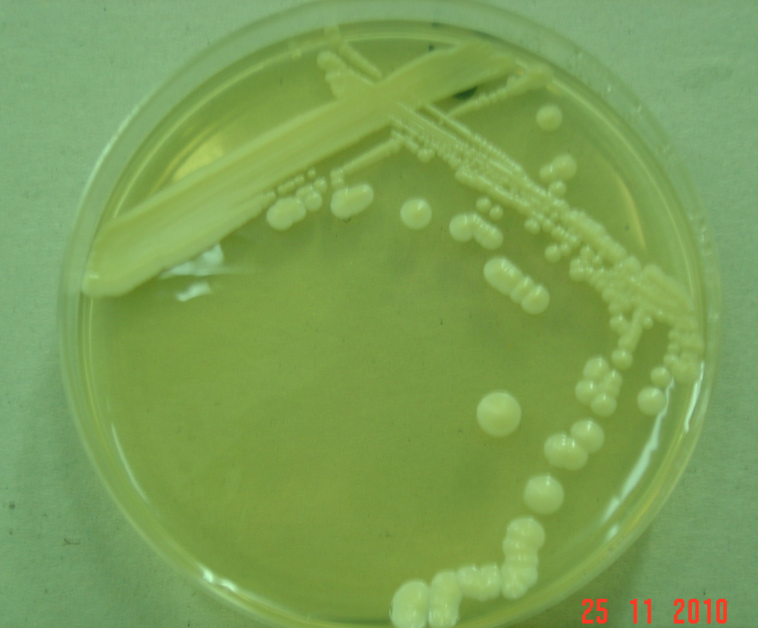
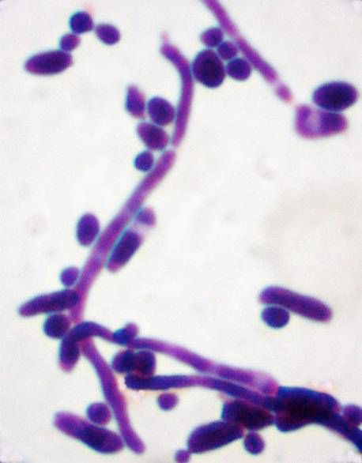
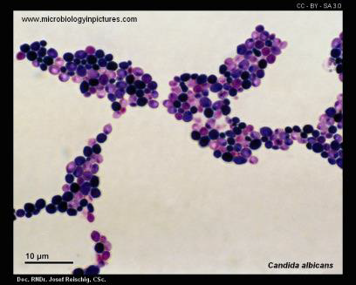
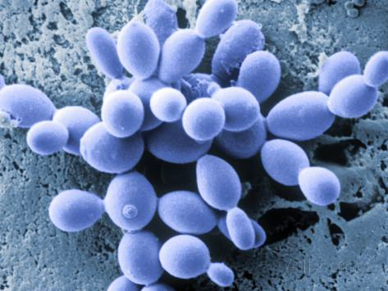
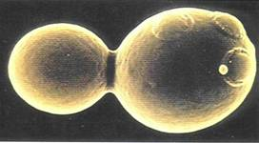
Yeast:
Morphology:
Colony
(culture)
Reproduction::
Budding(Asexually)
Examples:
Saccharomyces cerevisiae
(found in Baking Powder)
Candida albicans
(found as normal flora)
Cell culture:
Small – creamy
In Clinical samples
Budding yeast cells
+/- Pseudohyphae
In the end it well divided and became elongated , and again it's going to attach To another and called pseudohyphae
Candida Albican sstained
Saccharomycescerevisiae
Yeasts budding
Pseudo = not true hyphae but it still a yeast
Budd or daughter cell
Mother
Weakness in this area in the cell wall = groth

Slide 6
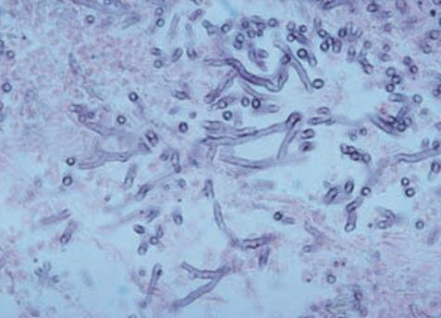
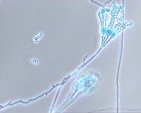
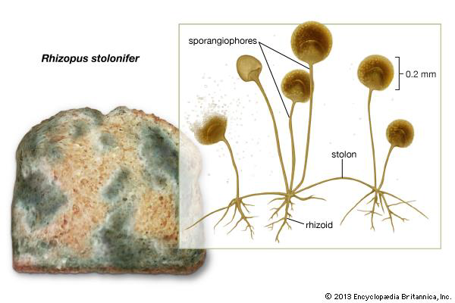
Filamentous (Mold=mould) fungi
A hypha (plural hyphae)
is a long, branching filamentous cell. hyphae are the main mode of vegetative growth.
Mycelium
The intertwined mass of hyphae that forms the fungal colony.
Conidia/ Spore ( It is the origin of the filamentous fungi)
asexual spores borne externally on hyphae or on a conidiophore.
Examples:
Aspergillus
(very common pathogenic filamentous fungi)
Penicillium
(synthesize penicillin)
Rhizopus
(causes Black bread mold)
Spore/ conidia
mycelium
Aspergillus
Penicillium
Rhizopus
Filamentous fungi Hyphal growth from spore

Slide 7
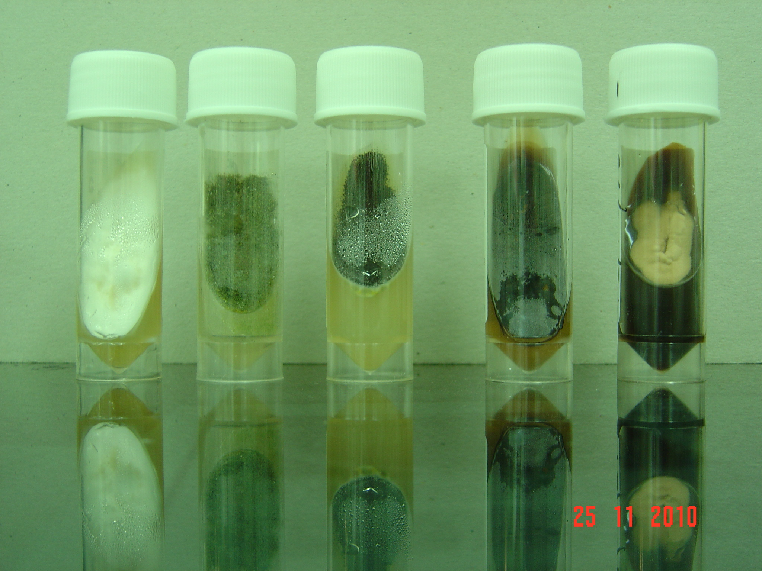
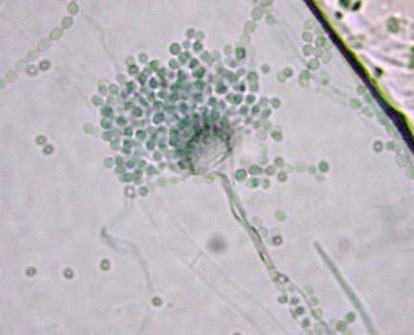
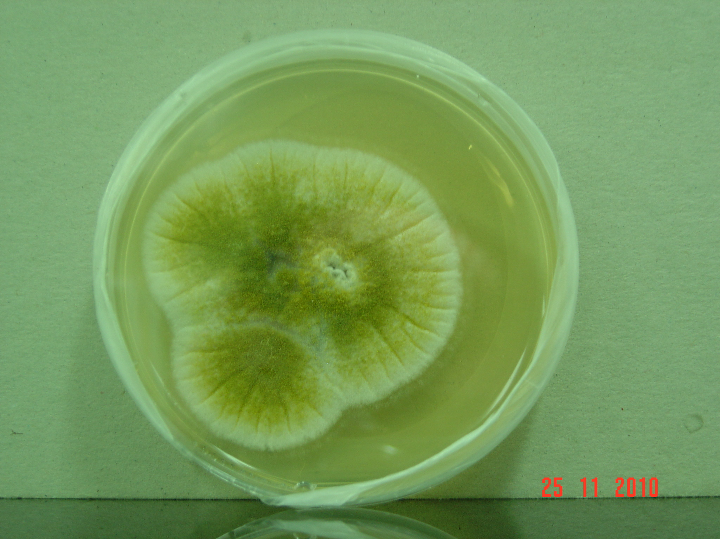
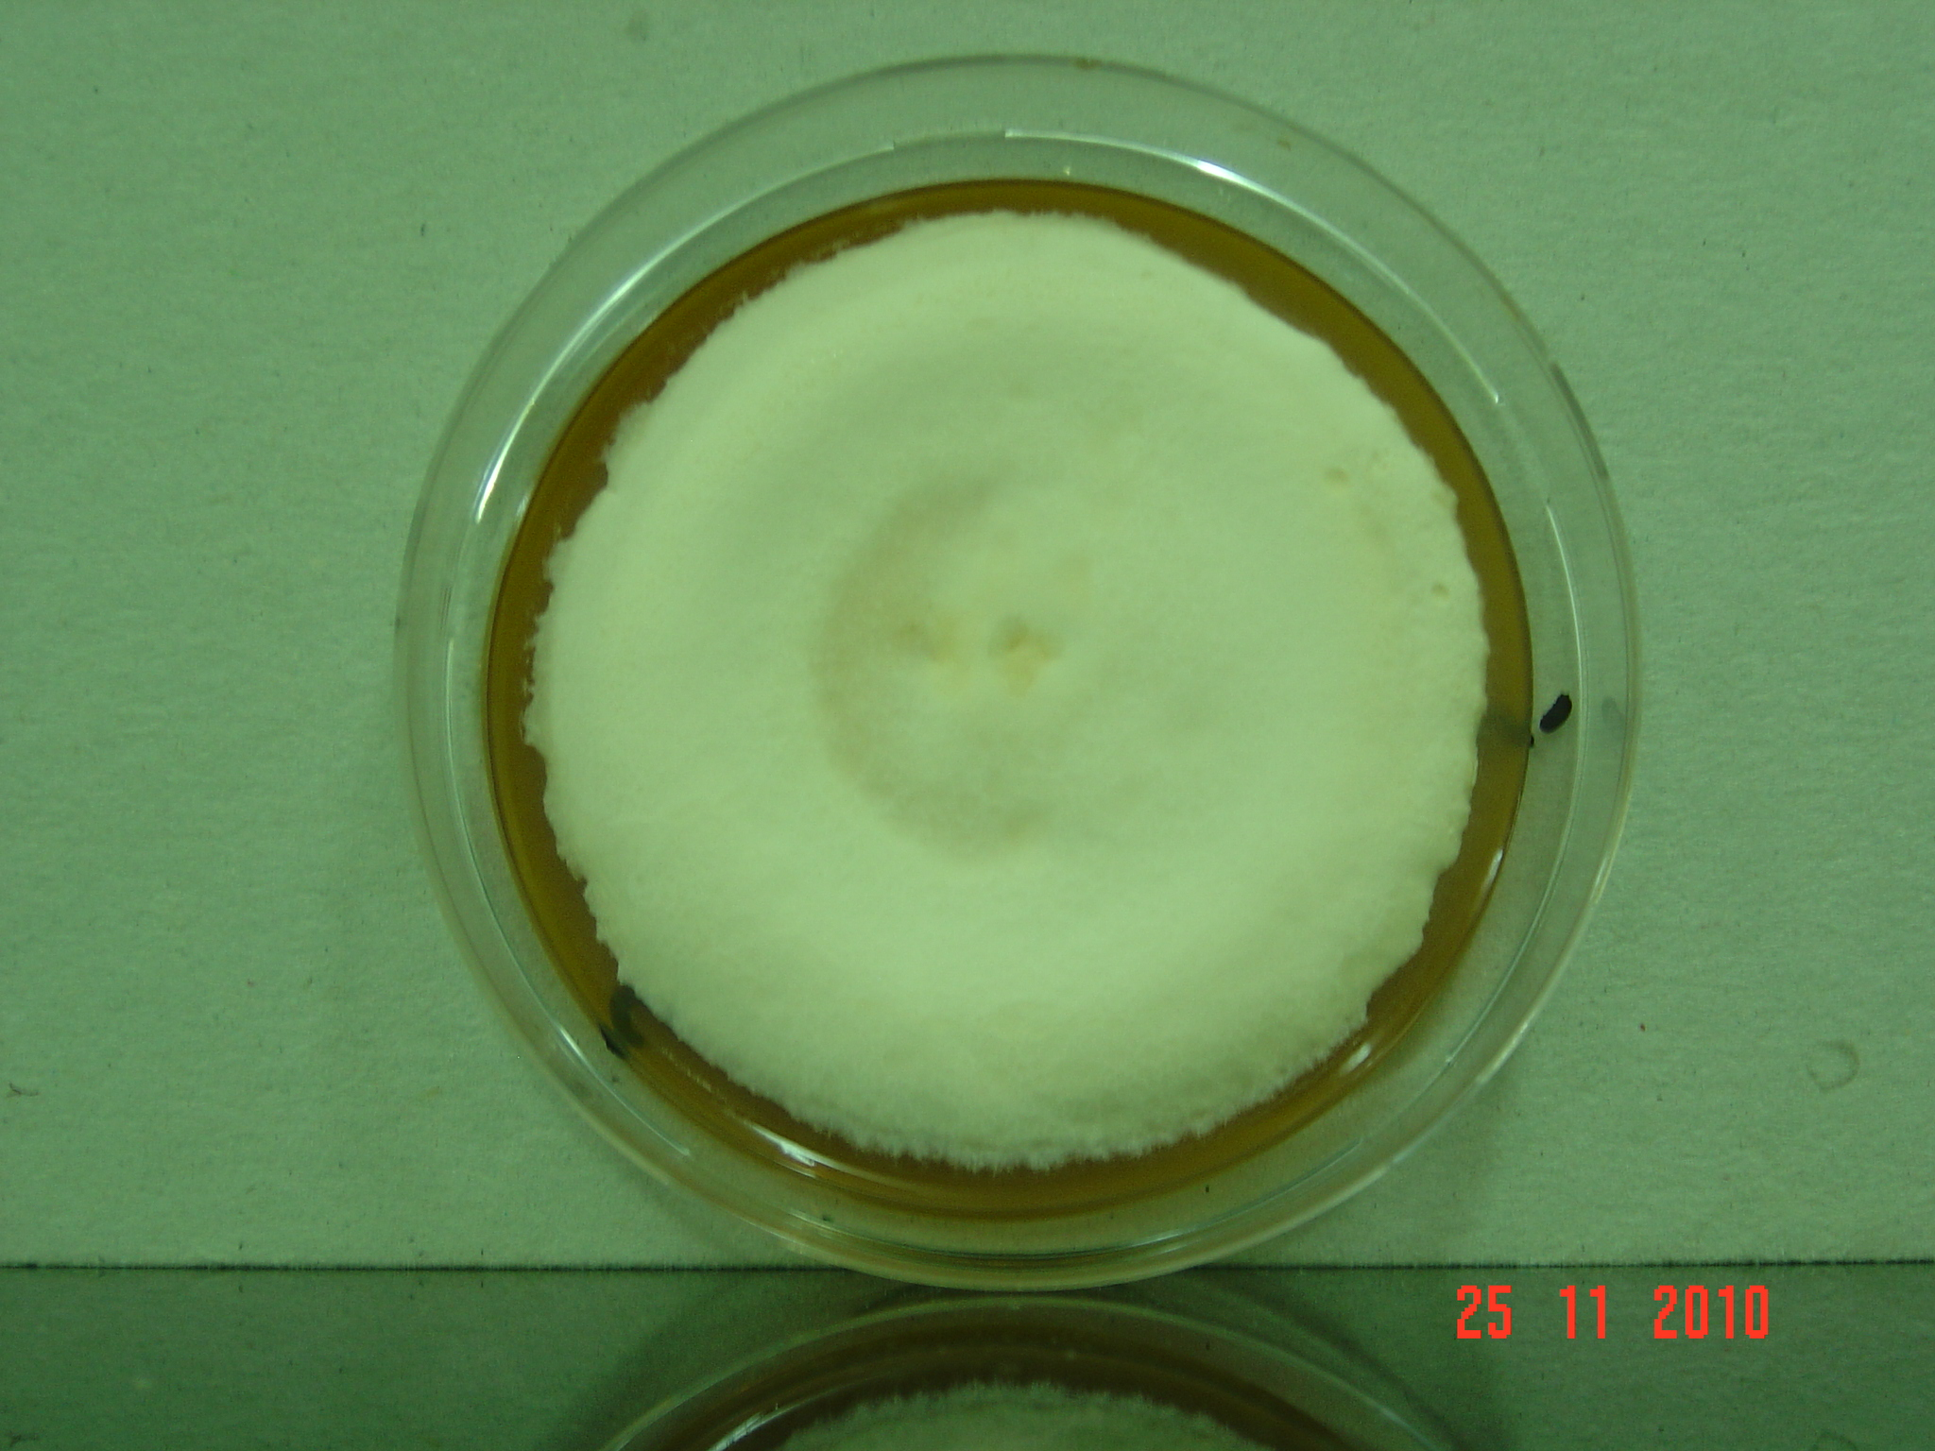
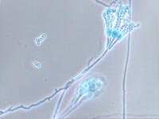
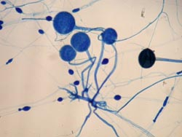
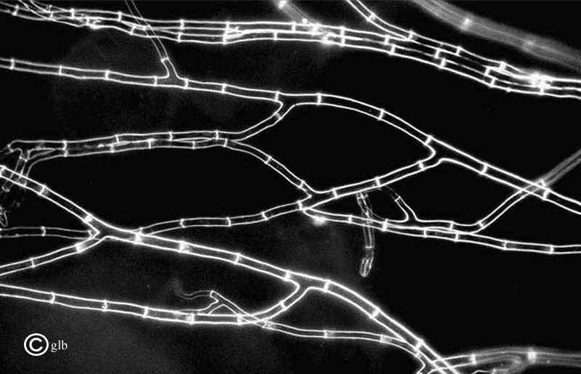
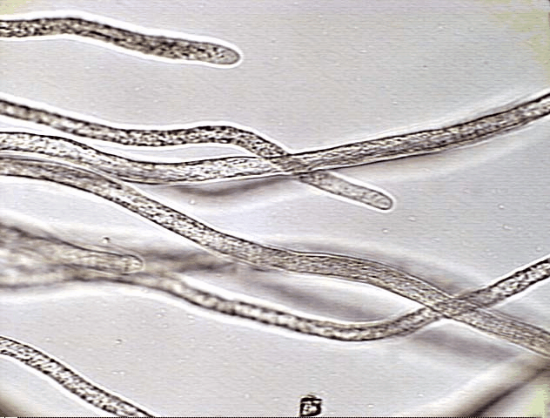
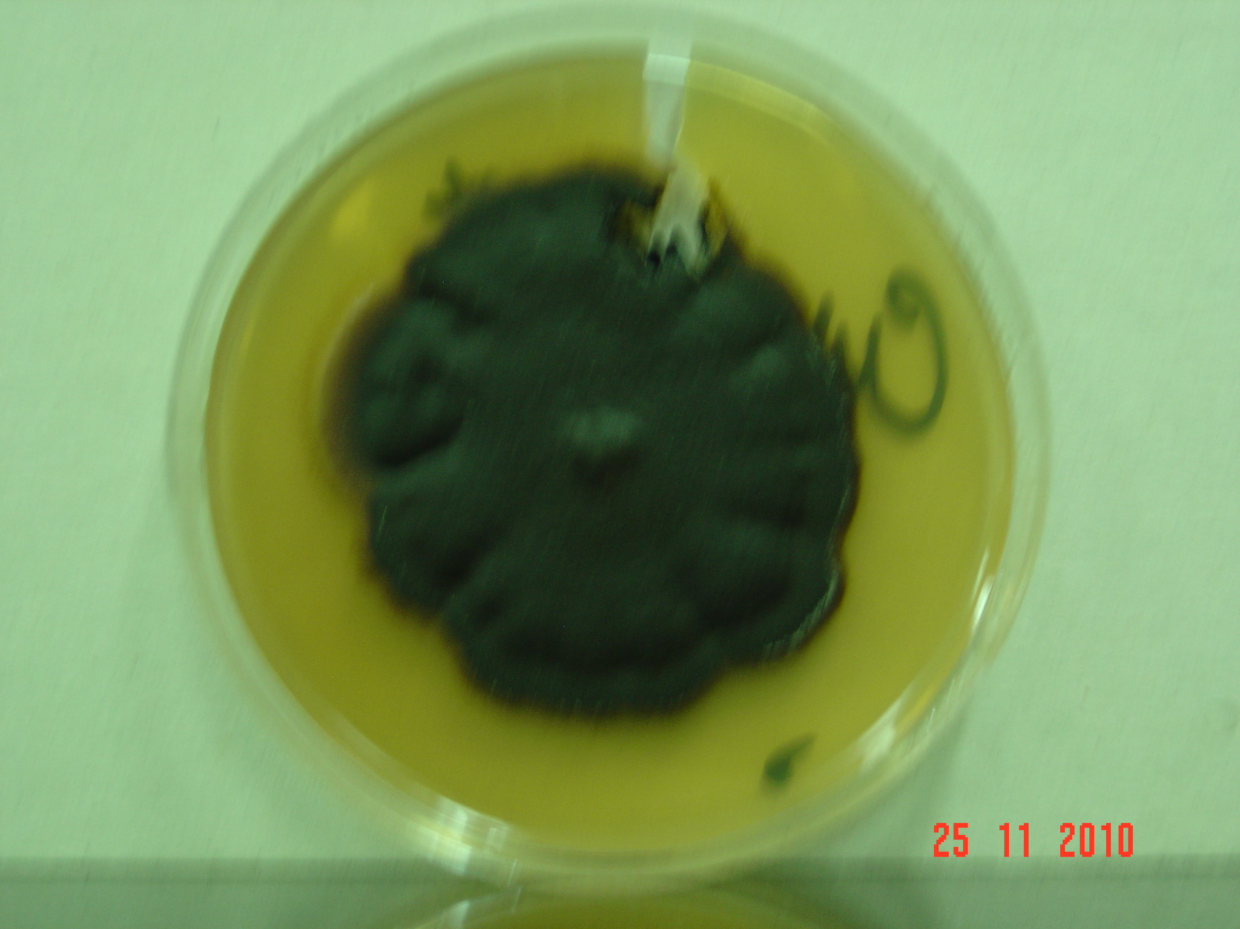
Filamentous fungi
Morphology:
Conidia / spore (singular = conidium): : asexual spores borne externally on hyphae or on a conidiophore.
Molds
a) Moniliaceous molds
hyaline or lightly pigmented conidia or hyphae, colorless
b) Dematiaceous Molds
Are pigmented.
Because of the pigment, the colonies appear dark, brown, or black
a) Cell cultre:
Conidia
Hypha
(tube like)
(big, colored, velvety, powdery) the powder here are the spores.
Septa: (2 types of Hypha)
Septated-hypha: Cross-walls (septa) that divide hyphae into segments.
b) Non-septate: If there are no cross-walls.
b) Light microscope:
a)
b)
Penicillium
Rhiaopus

Slide 8
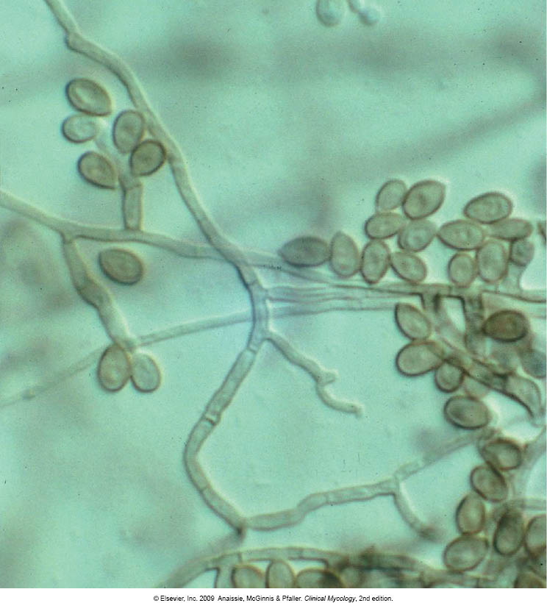
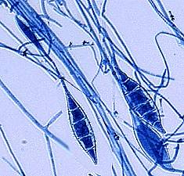
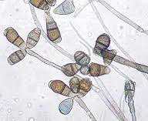
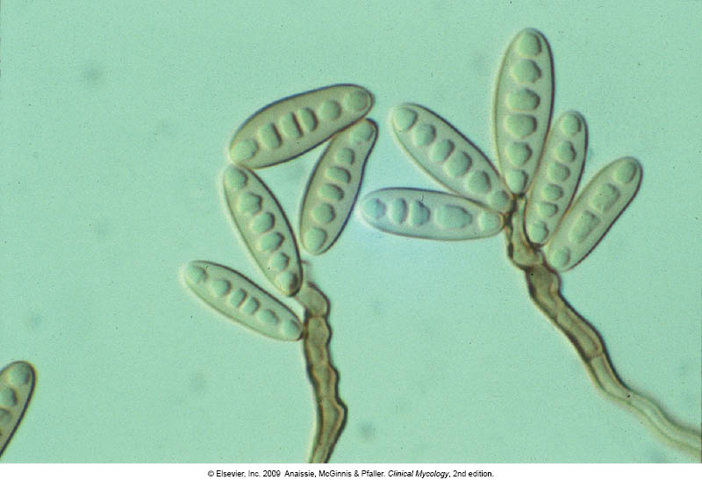
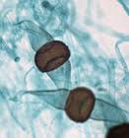
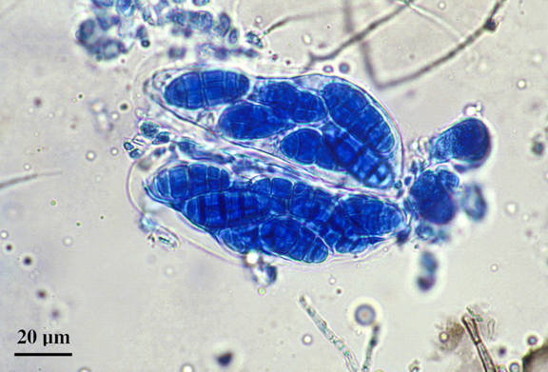
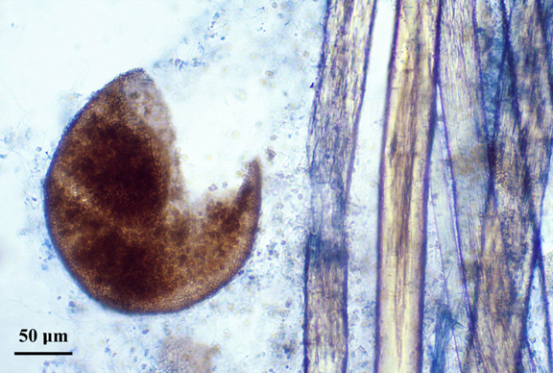
Reproduction in fungi
Spores
-These are the small airborne particles by which fungi reproduce.
They are produced by mitosis and readily disseminate in the air.
I) Asexual: Only mitotic cell division
1) Somatic (production of daughter cell, genetically the same)
a) Yeasts by budding.
b) Molds by hyphal fragmentation
(each haypha will give me a new colony)
2) Spore formation:
a) Sporangiospores in sporangia
b) Chlamydospores in or on hyphae
c) Conidia (conidium) on hypha or on conidiophores
Sexual: Fusion, mitosis, meiosis (+ mates with -,
no male or female here)
الأبواغ تساعدنا في معرفة الفطريات وتمييزها تحت المجهر
- الأبواغ قادرة على العيش في البيئات الصعبة

Slide 9
Pathogenicity of fungi
Fungi are all around us
widely distributed in nature (air, water, soil, decaying organic debris)
However, fungi can cause diseases to human:
Cause superficial infections,
some can cause allergic reactions
Few cause invasive infections
Not all fungi are pathogenic
To cause the disease:
Thermotolerance
Ability to survive in tissue environment
Ability to withstand host defenses
1- fungi clean the environment
2- used in antibiotic
3- food:
Baking Browder
mushrooms

Slide 10
Summary:
Online quiz:
Fungi
https://www.onlineexambuilder.com/microbiology-l5/exam-106234
Characteristic of fungi
Reproduction in fungi
Pathogenicity of fungi
Eukaryotic
somatic
Fungi can causes diseases to humans
A sexual
Spore formation
heterotrophic
fusion
Superficial
infection
Allergic reaction
Invasive infection
Achlorophyllous
sexual
mitosis
meiosis
Not all fungi are pathogenic to cause the disease
Cell wall
chitin
mannan
Cmplix crpohydates
glucan
Thermotolerarce
Ability to survive in tissue environment
Ability to withstand host defenses
sterol
Cell membrane
ergosterol

Slide 11
Contact us :
THE TEAM :
THE TEAM :
436microbiologyteam@gmail.com
Twitter :
@microbio436
Waleed Aljamal
Ibrahim Fetyani
Meshal Eiaidi
Khalid Alhusainan
Hussam Alkhathlan
Faisal Alqumaizi
Shrooq Alsomali
Hanin Bashaikh
Jawaher Alkhayyal
Reem Alshathri
Rawan Alqahtani
Ohoud Abdullah
Ghadah Almazrou
Lama Al-musallam

