Slide 1
MICROBIOLOGY
Lecture :
Classifications of parasites and protozoa
IMPORTANT.
DOCTORS NOTES.
EXTRA INFORMATION.

Slide 2
OBJECTIVES
1. Define common terms describing host-parasite relationship.(3-5)
2. Outline the broad classification of parasites.(6+9)
3. Name examples of protozoan parasites.(9)
4. Describe the life-cycle of Giadia lamblia as an example of intestinal protozoa.(10-12)
5. Describe the main stages of the life-cycle of
Plasmodium as an example of blood and tissue protozoa. (13-16)

Slide 3
Definitions:
Infection
The entry , development and multiplication of an infectious agent in the body of humans or animals. The result may be:
Host:
A human or animal which harbors(تستضيف) an infectious agent under natural conditions .
carrier:
A person or animal that harbors a specific infectious agent in the absence of symptoms and signs of a disease and serves as a potential source of infection
Inapparent
( asymptomatic) infection
(ماتظهر الأعراض)
Manifest
(symptomatic) infection
العوامل اللي تحدد هل بيصير فيه انفكشن أو لا هي إذا كان فيه عند المريض receptors
أو على حسب كمية الباراسايت اللي دخلت ممكن تصير قليلة ولا تسبب انفكشن.
Definitive host (primary host):
A host in which the parasite passes its sexual stage.
Intermediate host (secondary host): A host in which the parasite passes its larval or
asexual stages.

Slide 4
Definition
Pathogenesis
Production and development of disease.
Pathogenicity
Capability of an infectious agent to cause disease in a susceptible host.
Commensalism تكافل
Kind of relationship in which one organism (مثال النورمال فلورا) , the commensal , is benefited whereas t , the host , is not harmed but or even helped by this association.
Parasitism
(تطفل)
A relationship in which an organism (the infectious agent, the parasite) benefits from the association with another organism (the host) whereas the host is harmed in some way.
Note..
Pathogenicity
قدرة العامل المعدي على إنتاج المرض

Slide 5
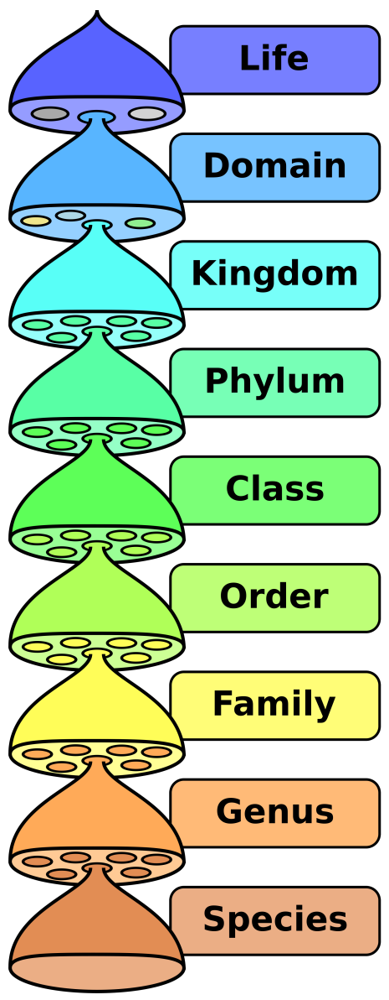
Definitions
Scientific names of parasites follow Zoological Classification:
parasite that lives on the outer surface of its host.
Endoparasite
Parasite that lives inside its host.
zoonosis:
Disease of animals that is transmissible to humans .
Ectoparasite:
Amoebae
Flagellates
Ciliates
Apicomplexa
Protozoa
Round worms (Nematodes)
Flat worms:
1/Trematode 2/Cestodes
Helminths
اخر تصنيفين هم المطلوبين فقط (اللي بالأحمر)

Slide 6
Classification of Parasites
PROTOZOA -Unicellular (Single cell for all functions). | HELMINTHS -Multicellular (Specialized cells).
Amoebae (move by pseudopodia أقدام كاذبة). Flagellates (move by flagella). Ciliates (move by cilia). Apicomplexa (Sporozoa) tissue parasites. | Round worms(Nematodes): - elongated - cylindrical, - unsegmented(قطعة واحدة) Flat worms : - Trematodes: leaf-like, unsegmented.(جسم واحد كالورقة غير مفصلة) - Cestodes: tape-like, segmented(شريطي مفصل)

Slide 7
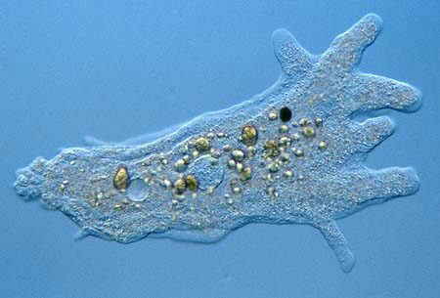
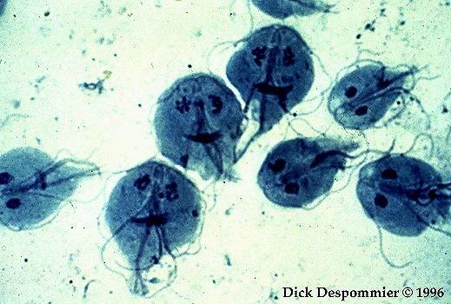
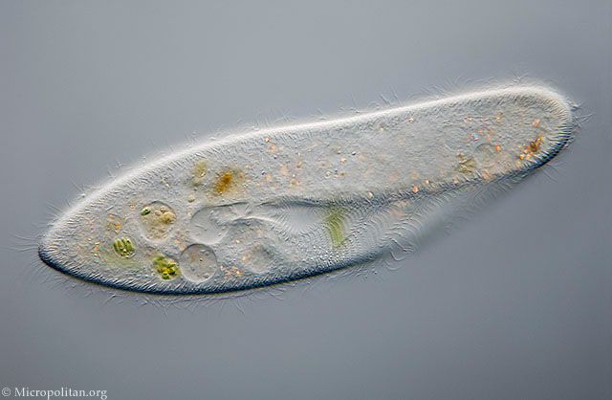
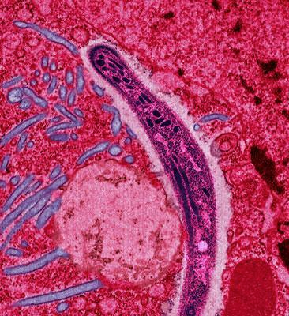
Amoebae
Flagellates
pseudopodia
flagella
Ciliates
Apicomplexa (Sporozoa)
cilia

Slide 8
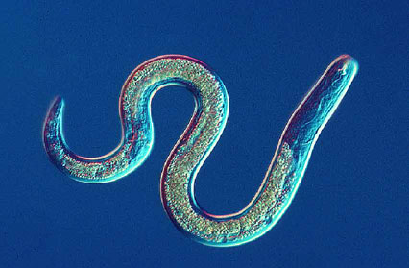
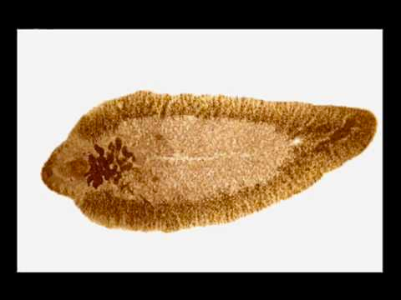
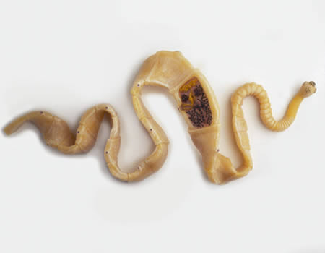
Nematodes
Trematodes
Cestodes

Slide 9
Parasitic Protozoa
Parasitic
Protozoa
location
e.g. Diseases
Intestinal
Blood &
tissues
giardiasis
Parasite cause it
Giardia lamblia
amoebiasis
Entamoeba histolytica
malaria
Plasmodium spp
Cutaneous leishmaniasis
Leishmania major

Slide 10
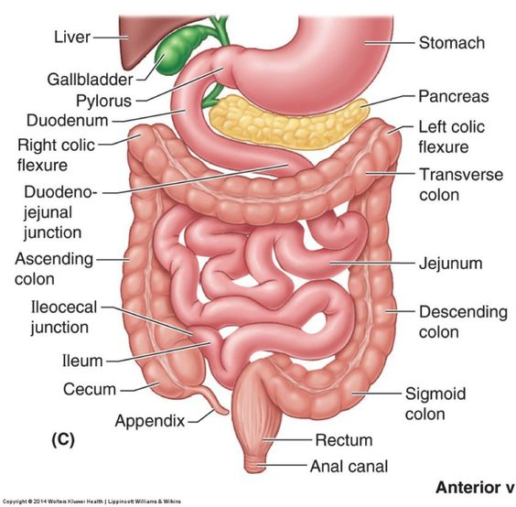
Giardia lamblia (the parasite) giardiasis (the disease)
Can cause
diarrhea
vomiting
loss of appetite
Stomach cramp
poor absorption of the nutrient
giardiasis
infect the cells of the
duodenum
jejunum.
+Person-to-person transmission is possible, Animals can also be infected with Giardia .

Slide 11
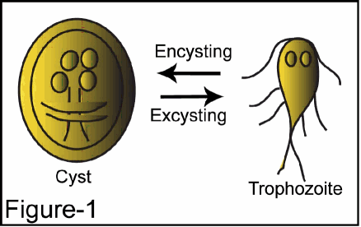
life-cycle of Giardia lamblia
1- cysts are ingested by consuming contaminated food or water, or fecal-orally.
2- the low pH of the stomach ,the acidity produces excystation (Excystation means the releases of trophozoites.)
3- Within the small intestine (duodenum,jejunum), the trophozoites reproduce asexually (binary fission) and either float free or are attached to the mucosa of the lumen.
4- Some trophozoites then encyst in the small intestine (encyst = become cyst).
5- Both cysts and trophozoites are then passed in the feces (but only the cyst is infectious)
*only the cyst is infectious
*Both cysts and trophozoites are exit the body
Excystation----> stomach*
*encystation---> small intestine
*As few as 10 cysts can cause infection → means: high pathogenicity.
They can survive outside the body for several months, and are also relatively resistant to chlorination, UV exposure and freezing.
As few as 10 cysts can cause infection
Each cyst produce two trophozoites
Giardia cysts are the infective stage of Gastro intestinalis.

Slide 12
THE LIFE CYCLE OF GIADIA LAMBLIA
important
أربعة أنوية
نواتين

Slide 13
Examples of Diseases caused by Blood and Tissue Protozoa
parasite
Plasmodium spp
Disease
malaria
Four main species of malaria :
Plasmodium falciparum
Plasmodium vivax
Plasmodium ovale
Plasmodium malariae

Slide 14
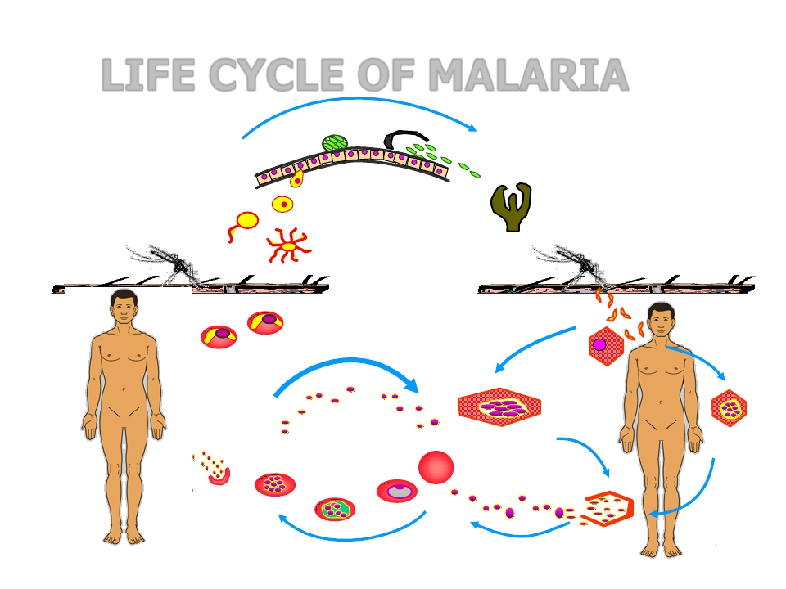
LIFE CYCLE OF MALARIA
Oocyst
Sporozoites
Zygote
Stomach Wall
Salivary Gland
sporozoites
Gametocytes
Erythrocytic
Cycle
Foundation Block, 2016
Pre-erythrocytic
(hepatic) cycle
Exo-erythrocytic
(hepatic) cycle
Hypnozoites
22

Slide 15
A mosquito (anopheles) carrying plasmodium
3
Multiplication in the liver
1
The mosquito sucks human’s blood and give him sporozoits from her saliva
2
The sporozoits enter the body blood liver
Healthy human
( merozoites) Comes out of the liver
To the RBC’S (red blood cells)
Then replication in the cells. then it will burst
merozoites
Become gametocytes : male and female
LIFE CYCLE OF MALARIA
This will lead to severe anemia
Transmit to a healthy mosquito
(when it’s sucks blood from a carrier human)

Slide 16
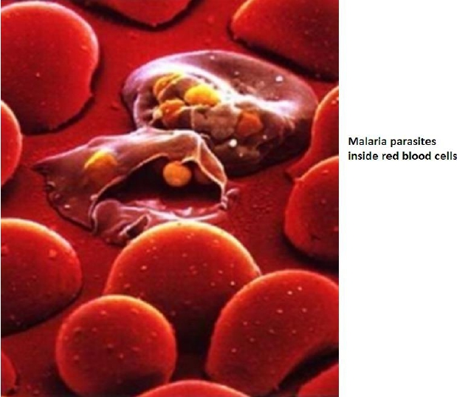
Important notes:
sporozoits = infective stage
Main pathogenic is in the RBC
The replication in the liver
Mosquito is primary (definitive) host :(sexual)
Human is secondery (intermediate) host: (asexual)
Only female anopheles can causes infection because males can not reach the blood
The fertilization happens inside the mosquito between male and female gametocytes = sporozoites
Main pathology of malaria is due to invasion of the RBCs

Slide 17
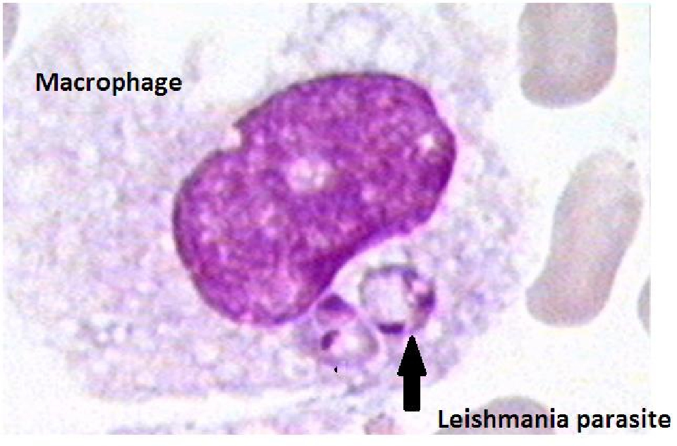
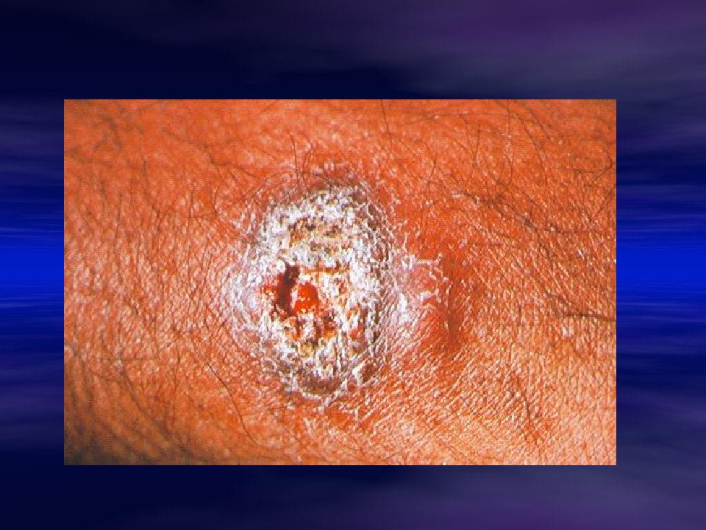
Examples of Diseases caused by Blood and Tissue Protozoa
parasite
Leishmania major
Disease
Cutaneous
leishmaniasis

Slide 18
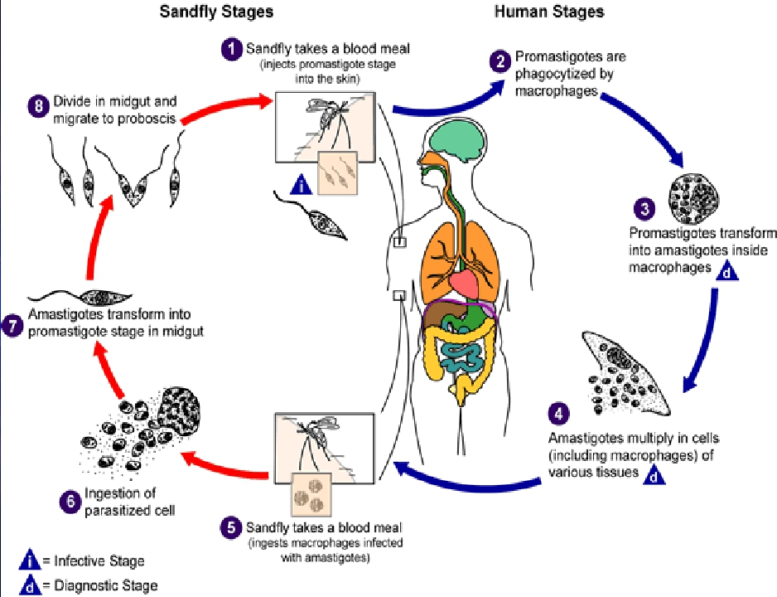

Slide 19
Extra information
•
•
•
•
The natural ecology of malaria involves malaria parasites infecting successively two types
of hosts: humans and female Anopheles mosquitoes. In humans, the parasites grow and
multiply first in the liver cells and then in the red cells of the blood. In the blood, successive
broods of parasites grow inside the red cells and destroy them, releasing daughter
parasites ("merozoites") that continue the cycle by invading other red cells.
The blood stage parasites are those that cause the symptoms of malaria. When certain
forms of blood stage parasites ("gametocytes") are picked up by a female Anopheles
mosquito during a blood meal, they start another, different cycle of growth and
multiplication in the mosquito.
After 10-18 days, the parasites are found (as "sporozoites") in the mosquito's salivary
glands. When the Anopheles mosquito takes a blood meal on another human, the
sporozoites are inJected with the mosquito's saliva and start another human infection
when they parasitize the liver cells.
Thus the mosquito carries the disease from one human to another (acting as a "vector").
Differently from the human host, the mosquito vector does not suffer from the presence of
the parasites
Foundation Block, 2009
2

Slide 20
Life
Extra information
In the life cycle of Plasmodium, a female Anopheles mosquito (the definitive host) transmits a motile infective
form (called the sporozoite) to a vertebrate host such as a human (the secondary host), thus acting as a
transmission vector. A sporozoite travels through the blood vessels to liver cells (hepatocytes), where it
reproduces asexually (tissue schizogony), producing thousands of merozoites. These infect new red blood
cells and initiate a series of asexual multiplication cycles (blood schizogony) that produce 8 to 24 new infective
merozoites, at which point the cells burst and the infective cycle begins anew.
Other merozoites develop into immature gametocytes, which are the precursors of male and female gametes.
When a fertilised mosquito bites an infected person, gametocytes are taken up with the blood and mature in
the mosquito gut. The male and female gametocytes fuse and form a fertilized, motile zygote which develop
into new sporozoites that migrate to the insect's salivary glands, ready to infect a new vertebrate host. The
sporozoites are injected into the skin, in the saliva, when the mosquito takes a subsequent blood meal.
Only female mosquitoes feed on blood; male mosquitoes do not transmit the disease. The females of the
Anopheles mosquito prefer to feed at night.
Foundation Block, 2016
16

Slide 21
These videos are very useful check it out
Malaria
https://youtu.be/dyprqPM1rHI
Giardia lambila
https://youtu.be/-EGTyu8nD34
https://youtu.be/O7A9AuUT3dE
Online quiz
https://www.onlineexambuilder.com/microbioology-l4/exam-102584

Slide 22
THE TEAM :
THE TEAM :
Contact us :
Waleed Aljamal
Ibrahim Fetyani
Meshal Eiaidi
Khalid Alhusainan
Hussam Alkhathlan
Faisal Alqumaizi
Shrooq Alsomali
Hanin Bashaikh
Jawaher Alkhayyal
Reem Alshathri
Rawan Alqahtani
Ohoud Abdullah
Ghadah Almazrou
Lama Al-musallm
436microbiologyteam@gmail.com
Twitter :
@microbio436

