Slide 1
MICROBIOLOGY
Lecture :
HOST PARASITE
RELATIONSHIP
IMPORTANT.
DOCTORS NOTES.
EXTRA INFORMATION.

Slide 2
Objectives
Define the terms:
-Host-parasite Relationship 3
-Pathogenicity 5
-Pathogen 4
-Disease 5
-Resistance 6
-Susceptibility 6
-Infection 7
-Virulence 7
-Transmissibility 8
Know the division of host resistance to parasite. 6
Know the division of Pathogens and examples. 3-4
Know the determinants of pathogenicity. 5-6-9
Differentiate between Exotoxin and Endotoxin 11
Recognize the differences between virulence and pathogenicity and know how virulence is measured. 5-7
Recognize the transmissibility of pathogens. 8
Describe the attributes of pathogenicity and recall examples. 9-12
Know about Koch’s Postulates 13

Slide 3
Host parasite relationship
Only in this slide :
Males slides
Females slides
Human host is in contact with many
microorganisms called normal flora or
commensals but only a small number of these microorganism can cause disease and they called
opportunistic pathogens and primary pathogens).
Host parasite relationship can be discussed under:
1= Primary pathogens : strict pathogens or virulent
Bacteria (خطيرة وممرضة)
2-Non-Pathogenic bacteria:, they will never cause
Disease (غير ممرضة )
-------------------------------------------------------------
1-pathogenicity.
2- normal flora.
• Host-parasite relationships: is
characterized by fighting the organism
to invade the body and the body
defending itself by protective
measures.
يعني العلاقة بيننا وبينهم (المايكرواورقانزم) إما تكون..
علاقة هجوم ودفاع (حرب)
أو
علاقة سلمية وتعايش (معاهدة)

Slide 4
Pathogen : a microorganism having the capacity to cause
disease in a particular host.
Can be divided according to the degree of Pathogenecity
into:
Pathogen
a) Primary pathogens:
-When the organism is able to produce disease even in an
apparently healthy host
-Cause disease in non- immune host to that organism.
e.g. - Bordetella species
- Mycobacterium tuberculosis
b) Opportunistic (secondary) pathogens:
-When the organism causes disease only when the host’s
defenses are impaired
-Having low pathogenicity and infect people with low
immunity.
e.g. -Pseudomonas
فيه فرق بينها وبين
بحيث كلهم تكون ممرضة أحيانا وكلهم بجسم الشخص لكن الأولى تضر الشخص نفسه بمعنى إن ضعفت مناعته تهاجمه هو ، بينما الثانية ما تضر الشخص نفسه بحيث ممكن تكون بجسمه وهو طبيعي جدا وما عليه أعراض لكن ممكن ينقلها لغيره وتمرضه
potential pathogens

Slide 5
Definitions
a)Pathogenicity
Ability of Microorganism to cause a disease
b)Pathogen
A Microorganism having capacity to cause disease in a particular host
c)Infectious Disease: End product of an infectious process.
فيه فرق بين العدوى والمرض .. فالعدوى مجرد دخولهم لجسمنا وممكن تروح بعد فترة.. بس إذا طلع لي أعراض وبدأت تدمر الأنسجة تصير مرض

Slide 6
A Pathogenicity
Host Resistance to Parasite Invasion is Divided into:
a)Non specific resistance: part of natural constitution of the host. e.g.
1.Competition by normal flora: compete over space and nutrients for example. GIT is relatively rich with normal flora compared to other parts of the body.
2.Skin mechanical barrier
3.Lysozymes
4.Ciliated epithelium of respiratory tract
5.Cough
6.Low pH in the stomach
7.peristalsis(movement of intestines):
8.Neutrophils
b)Specific / Acquired resistance to certain organism:
e.g. formation of antibodies
Disease in the host (just some terminology)
Resistance: The ability of the host to prevent establishment of infection by using its defense mechanisms
Susceptibility: Lack of this resistance and establishment of disease.
مثل إن كانت العدوى قد جتنا من قبل فخلاص جسمنا كون لها أجسام مضادة أو عن طريق التطعيمات نفس الفكرة

Slide 7
NOTES
a)Infection
Is simply invasion of cells and multiplication by microorganisms without tissue destruction.
b)Virulence is an ability to Invade and destroy tissue to produce disease
(the degree of pathogenicity)
Virulence is measured by the Lethal Dose 50 (LD50)
LD50: Which is the number of organisms or milligrams of toxins that will kill 50% of susceptible lab animal – usually mice – when injected into such animal. When the LD50 is small, the microorganism is considered highly virulent and when it is high the organism is said to be of low virulence.

Slide 8
Transmissibility
the ability to spread from one host to another. This enables microorganism to maintain continuity of its species in the event of death of original host.
بكل بساطة هي قابلية انتشار الكائنات الدقيقه من مضيف
(سواء كان انسان او غيره) لاخر
وهالشي يساعدها في البقاء والتكاثر في حالة موت المضيف

Slide 9
DETERMINANTS OF PATHOGENICITY
Before causing disease a microorganism should have the ability to:
Adherence (Adhesion, Colonization, Growth)
Surviving (escape) the host natural defense mechanisms
Tissue destruction: It is the ability to overcome host defense invade the tissues and cause destruction to Produce clinical disease = Infectious disease
Invasion Or Toxicity
Multiply to large numbers

Slide 10
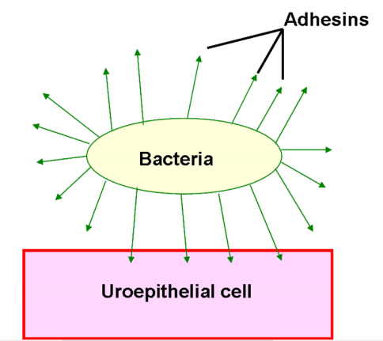
Adherence:
It is the ability to attach firmly to host epithelial surface by the help of pili or other protein surface structures.
Structures on host cells include:
Fibronectin
Proteins and glycopeptide parts
Tissue destruction is produced by:
Toxin production:
Exotoxin
Endotoxin (only in –tive gram )
Invasion by organisms:
Capsulated
Non-capsulated

Slide 11
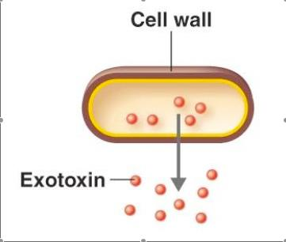
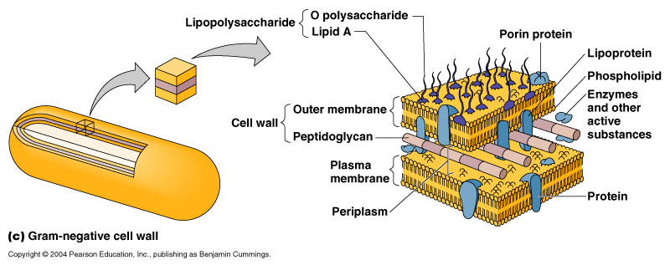
What is the different between exotoxin and endotoxin?
Endotoxin gram (-) | Exotoxin gram (+)
Lipopolysaccharide | protein
Part of cell wall | Soluble
Heat stable | Heat Labile
Non-Specific أخطر | Pharmacologically specific action
Low Immunogenicity | High Immunogenicity
Do not form toxoids | Inactivated by chemicals to toxoids
Induce Fever | No Fever
يعني تهاجم منطقة معينة أو خلايا معينة مثل جهاز عصبي أو هضمي
تصغير سم وهو نفسه اللي يستخدمونه بالتطعيمات

Slide 12
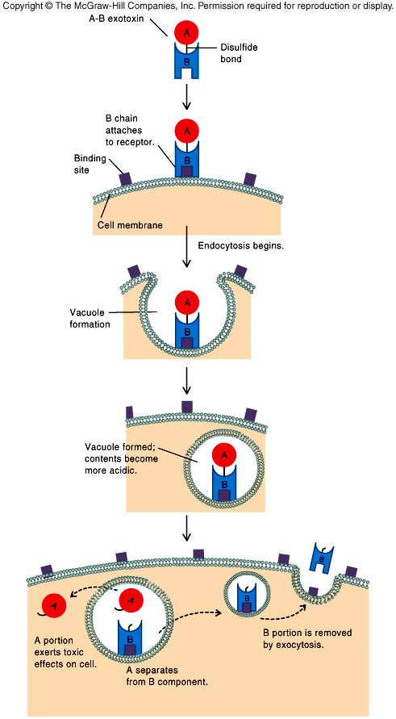
Capsulated/non capsulated organisms
Capsulated organisms: bacterial capsules are all made of polysaccharide except of Bacillus anthracis (made of polypeptide).
Capsule prevent phagocytosis : some organisms are readily (easily) killed once they are phagocytized, these organisms called (extracellular organisms) e.g ( pneumococcus )
Non-capsulated organisms:
resist intracellular killing (Phagocytosis) so called
(intracellular organisms).
E.g Mycobacterium tuberculosis, Salmonella typhi, Brucella species,
The organisms which don’t have capsules, have virulence factors
to stop phagocytosis ,which is:
Exotoxin (toxins):
يعني تعيش برا الخلية
يعني تعيش جوا الخلية
a) Membrane active exotoxin
b) A – B exotoxins e.g. Cholera toxins
A : Active unit B : Binding unit for attachment
e.g. Haemolysin of group
A Streptococci

Slide 13
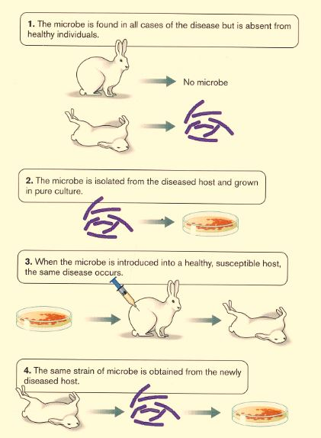
Koch’s postulates
for a microorganism to be accepted as the cause of an infectious disease it must satisfy all or most of koch’s criteria
If a microorganism is the causative ( etiologic agent of and infectious disease ) then it must be
Present in every case of the disease, but absent from the healthy host(non infected)
Isolated and grown in pure culture
Able to cause the disease when a pure culture is inoculated into a healthy host
Re-isolated from the host that was inoculated with the pure culture
مو مهمة ، الدكتور قال ماراح اسأل فيها.

Slide 14
quiz
A -Which of the following is a secondary pathogen?
Bordetella species
Pseudomonas
Mycrobacterium tuberculosis
D-What helps in adhesion on bacterial cells?
Mesosomes
Flagella
pili
E-What is a character of endotoxin:
Heat liable
High immunogenicity
Part of cell wall
No fever
B-The ability of a microorganism to cause a disease is known as :
Pathogen
Pathogenicity
Infectious disease
F-What is a character of exotoxin:
Soluble and diffusible
Do not form toxids
Lipopolysaccharide
Induce fever
C-Which of the following is not a part of Non-specific resisitance:
Lysozymes
High PH in the stomach
Peristalsis
ciliated epithelium of respiratory tract
G-Lack of resistance and establishment of disease is known as:
Susceptibility
Resistance
Virulence
infection

Slide 15
H- Which is the correct statement?
When the LD50 is high , the micro organism is considered highly virulent and when it is low The organism is said to be of low virulence
When the LD50 is small , the micro organism is considered highly virulent and when it is high The organism is said to be of low virulence
When the LD50 is small , the micro organism is considered low virulent and when it is high The organism is said to be of high virulence
I -What is the name of the bacteria the will never cause harm ?
answers
A= 2
B= 2
C= 2
D= 3
E= 3
F= 1
G= 1
H=2
I= NON-PATHOGENIC BACTERIA.

Slide 16
THE TEAM :
THE TEAM :
Contact us :
Waleed Aljamal
Ibrahim Fetyani
Meshal Eiaidi
Khalid Alhusainan
Hussam Alkhathlan
Faisal Alqumaizi
Shrooq Alsomali
Hanin Bashaikh
Jawaher Alkhayyal
Reem Alshathri
Rawan Alqahtani
Ohoud Abdullah
Ghadah Almazrou
Lama Al-musallm
436microbiologyteam@gmail.com
Twitter :
@microbio436

