Slide 1


MICROBIOLOGY
Lecture : 2
Viral structure classification
IMPORTANT.
DOCTORS NOTES.
EXTRA INFORMATION.

Slide 2
Objectives-viral structure and classification:
General characteristics of viruses
Structure and symmetry of viruses
Classification of viruses
Steps of viruses replication
Laboratory diagnosis of viral infections .

Slide 3
Shortcut you MIGHT need..
•Vs: Virus
•NA: Nucleic Acid
•INFs: Interferons
•CPE: Cytopathic effect
•HSV: Herpes Simplex Virus
•EBV: Epstein-Barr Virus
•HPV: Human Pappilomavirus
•HTLV: Human T-lymphotropic
•Virus
•IP: Incubation Period
• AB: Anti Body
• APC: Antigen Presenting Cells • NK: Natural Killer
• VICs: Virus Infected Cells
• IL: Interleukin
• CMI:Cell-MediatedImmunity • IR: Insulin Resistance
• CTCs: Cytotoxic T Cells
• IF: Immunofluorescence
• HAV: Hepatitis A Virus

Slide 4
Properties of microorganisms
Characteristics | Parasites | Fungi | Bacteria | Viruses
Cell | Yes | Yes | Yes | NO
Type of Nucleus | Eukaryotic | Eukaryotic | Prokaryotic | -
Nucleic Acid | DNA and RNA | DNA and RNA | DNA and RNA | DNA or RNA
Ribosomes | Present | Present | Present | Absent
Mitochondria | Present | Present | absent | Absent
Replication | Mitosis | Budding or Mitosis | Binary Fission | Special 1V= million

Slide 5
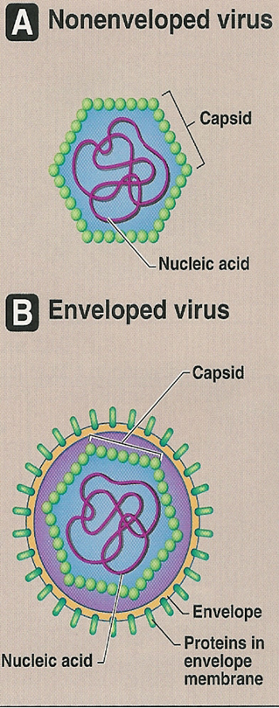
Characteristics of viruses
1- Acellular organisms
2- Tiny particles
  internal core (DNA/RNA)
  protein coat (capsid)
  some viruses have lipoprotein membrane (envelope)
3- Obligate intracellular organisms
4- Replicate in a manner different from cells (e.g. one virus replicate to
Produce many viruses)
Taken from Host.
Not all viruses have envelope
Seen only by EM
note : viruses range in size from 20-300nm {Extra info; way smaller then bacteria 2000-8000nm}

Slide 6

Viral structure
1- Genome
2- Capsid
3- Envelope
1- Viral Genome
Could be RNA or DNA
DNA: deoxyribonucleic acid
All DNA viruses are double stranded except for Parvoviruses.
Single molecule.
OR
RNA: ribonucleic acid
All RNA viruses are single stranded except Reoviruses.
Single/double.
Could have positive or negative polarity.
+ve polarity RNA = Direct protein synthese (has mRNA Ribosome at cytoplasim)
-ve polarity = indiect synthese (go to host nucleus for protein synthesis)
Note: all viruses are haploid except retroviruses are diploid. Example, HIV

Slide 7
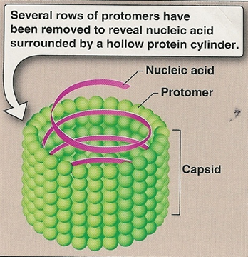
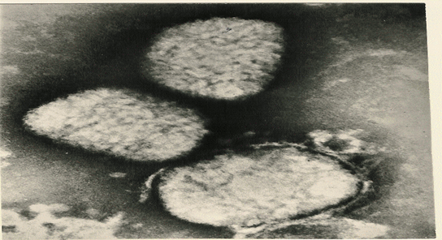
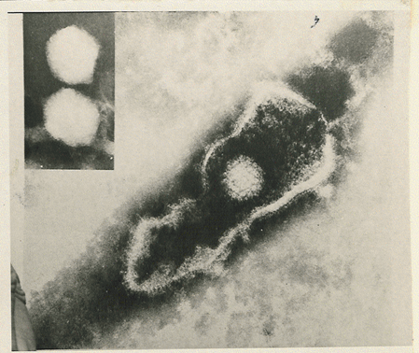
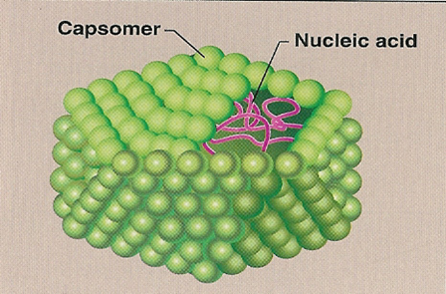
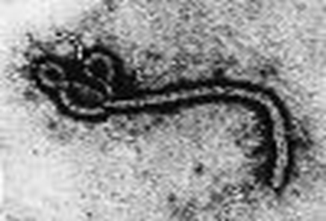
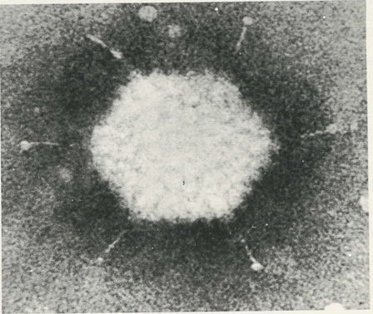
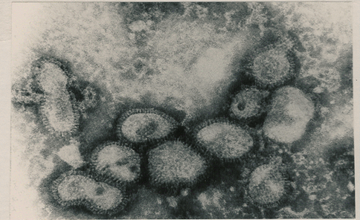
2-capsid
Cubic symmetry
(lcosahederal)
Helical
Complex
(Symmetry based on arrangement of capsomeres)
It’s a protein shell
enclosing the viral
genome.
Capsids are build of a
large Number of
subunits called
Capsomers
Genome (NA)+capsid=
nucleocapsid
Herpes virus envelope
Function;
1-Protect Nucleic Acid
2-Facilitates its entry into cell
Poxviruses
In Non-envelop viruses
Elongated (filoviruses)
NA= nucleic acid
Capsomeres = subunits of capsid
Pleomorphic (influenza v.)
Adenovirus no envelop

Slide 8

3-Viral structure
* It is Lipoprotein membrane
(host lipid + virus specific protein)
It also contain protein and glycoprotein
-During viral budding :
Envelope is derived from cell membrane
except herpesviruses from nuclear mb
-Enveloped Viruses are more sensitive to
heat, dry & other factors than nonenveloped Viruses
-Glycoprotein attaches to host cell receptor

Slide 9
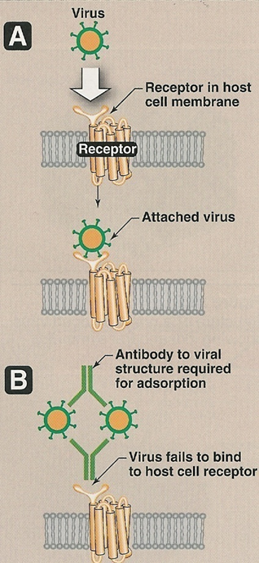
Viral proteins
The outer viral proteins:
-Mediate attachment to specific
Receptors
-Induce neutralizing antibodies
-Target of antibodies
The internal viral proteins:.
-Structural (capsid proteins of
enveloped viruses)
-Nonstructural
proteins(enzymes):
*All ssRNA viruses (-) polarity have
transcriptase
( RNA dependent RNA
polymerase) inside virions.
*Except RetroViruses & HBV contain
reverse transcriptase.

Slide 10
Classification of viruses
❖ Type of Nucleic Acid (DNA or RNA)
❖ The number of strand: Double VS. single-stranded
❖ The polarity of viral genome: Positive (+) or negative (-) stranded RNA
❖ The presence or absence of envelope
❖ Type of symmetry

Slide 11
Medically Important Viruses
1- DNA
Single Stranded | Double Stranded
Non- Enveloped | Enveloped |  | Non- Enveloped
Icosahedral | Complex | Icosahedral | Icosahedral
Parvoviridae | Poxviridae | Herpesviridae | Adenoviridae
2- RNA
Single Stranded |  |  | Double Stranded
Neg-Strand | Pos-Strand |  | Non-Enveloped
Enveloped | Enveloped | Non-Enveloped | Icosahedral
Helical Filoviridae | Helical Coronaviridae Icosahedral Retroviridae | Icosahedral Hepeviridae | Reoviridae
Not important
BUT useful to remember

Slide 12
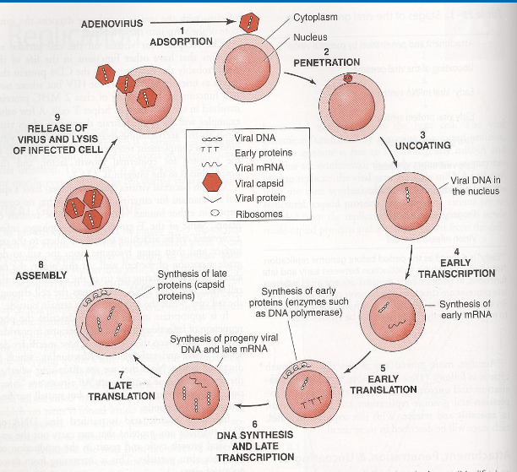
Replication
Adsorption
Penetration
Uncoating
Synthesis of viral components
  mRNA
  Viral Proteins
  Nucleic Acid (NA اختصارها)
Assembly
Release

Slide 13
1- Adsorption
Glycoprotein (if enveloped virus)
Folding proteins in capsid (if non-enveloped virus)
2- Penetration
Fusion التحام : of host cell membrane and viral envelope (if enveloped virus)
Endocytosis: Virus is swallowed by the cell and becomes in an Endocytotic Vesicle (both)
note: the virus tricks to the cell into thinking it is not harmful, so the cell swallows it (endocytosis)
Q- How does the virus get out of endocytotic vesicle?
A- Enveloped: Fuse with endocytotic vesicle membrane.
Non enveloped: Lyse تحلل the endocytotic vesicle membrane.
3- Uncoating
Release of genome in :
Cytoplasm of host cell الخلية المتعرضة للهجوم (Direct synthesis of proteins = +ve RNA polarity)
Nucleus of host cell (Indirect synthesis of proteins = -ve RNA polarity)

Slide 14
4- Synthesis of viral components
To make the viral proteins it needs +mRNA (translatable قابل للترجمة)
https://www.youtube.com/watch?v=ZGE4BLuAkuU&feature=youtu.be للشرح
mRNA
If –RNA virus : viral genome transcription +mRNA (translatable)
If +RNA virus : no need for step (already have mRNA).
B) Viral proteins
+mRNA translation in host cell’s ribosomes Viral Proteins
- enzymes - structural proteins
Directly
C) Viral Nucleic Acid
The virus will replicate and synthesize it’s nucleic acids using the host cell’s resources مواردها
One virus can produce millions of viruses by continuation of this process ( synthesis of viral proteins )

Slide 15
Replication
Assembly:
The viral Proteins + Nucleic acid (DNA or RNA) assemble together = virion*.
Then the virion is released.
*What is a virion?
A virion is a complete virus particles, consisting of RNA or DNA surrounded by a protein shell.
Basically it is the infective form of a virus.

Slide 16
release
It’s the last step of the replication cycle of the viruses.
Enveloped viruses:
The Virion leaves the Cell and creates its Envelope by budding through the host’s cell membrane.
Except Herpes V = budding host’s nuclear membrane
Non-Enveloped viruses:
Cell lyses or rupture

Slide 17
laboratory diagnosis of viral infections:
Light M = See effect of virus on cell Can’t see Virus
Microscopic examination.
Cell culture.
Serological tests.
Detection of viral Antigen.
Molecular method.
Electron M = see SIZE and Morphology of virions
Cytopathic effect
But its Take Time
Costly
IF
Rapid culture
Long
Sensitive to bateria
Some virus don’t grow
= HCV
ELISA
Quick
Detect antigens
No Confirmation needed
Need Confirmation
Used for Diagnosis
Only way to measure viral load كمية الفيروسات

Slide 18
Microscopic examination:
Light microscopy:
Histological appearance “to see what the
virus has done to the cell, without seeing
the virus itself”
Ex. “Inclusion bodies”
Electron microscopy:
Morphology & size of virions . “ to see the virus particle itself”
Ex. Diagnosis of viral gastroenteritis such as Rota, adenoviruses. Diagnosis of skin lesion caused by herpes, or poxviruses.
It is replaced by Antigen detection & molecular tests

Slide 19
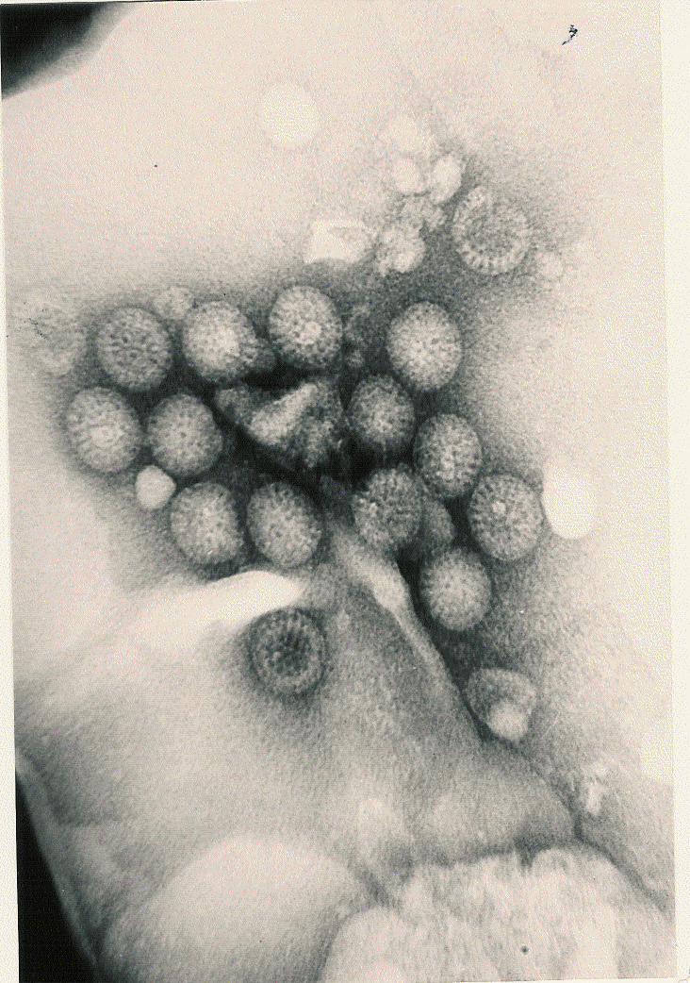


Electron Micrographs:
Rotavirus
Adenovirus
Poxvirus
Herpes virus

Slide 20
Virus cultivation
Laboratory animals
Embryonated eggs
Cell culture

Slide 21
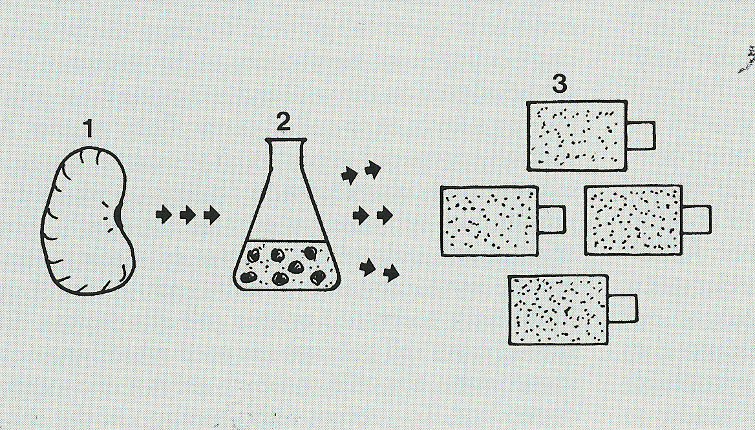
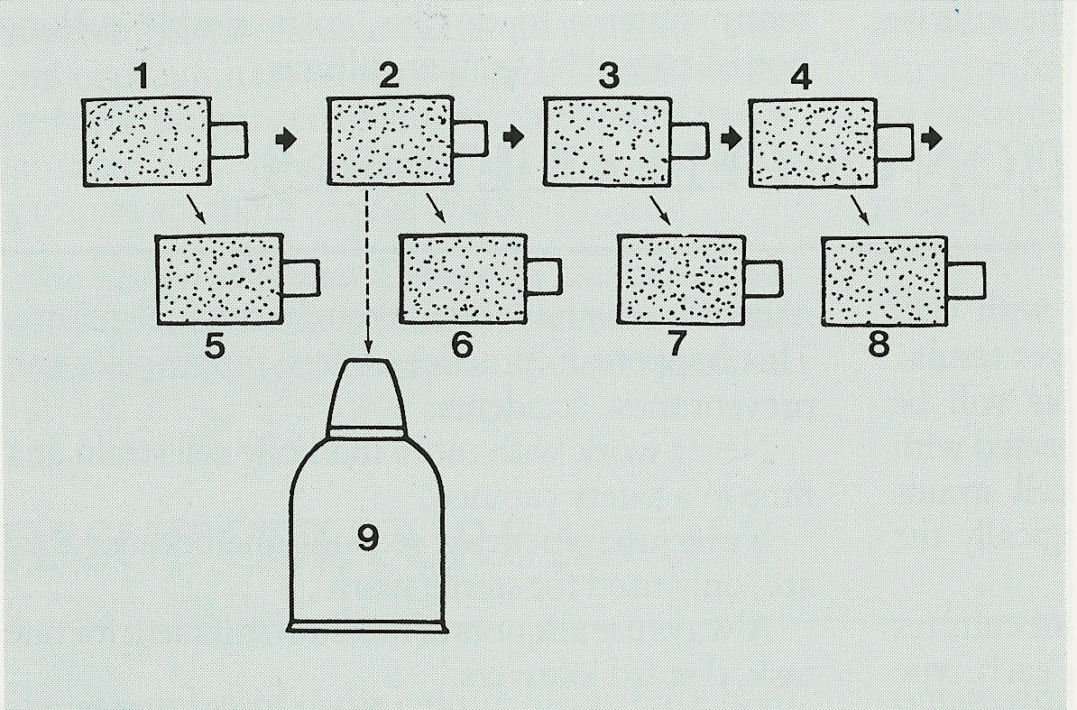
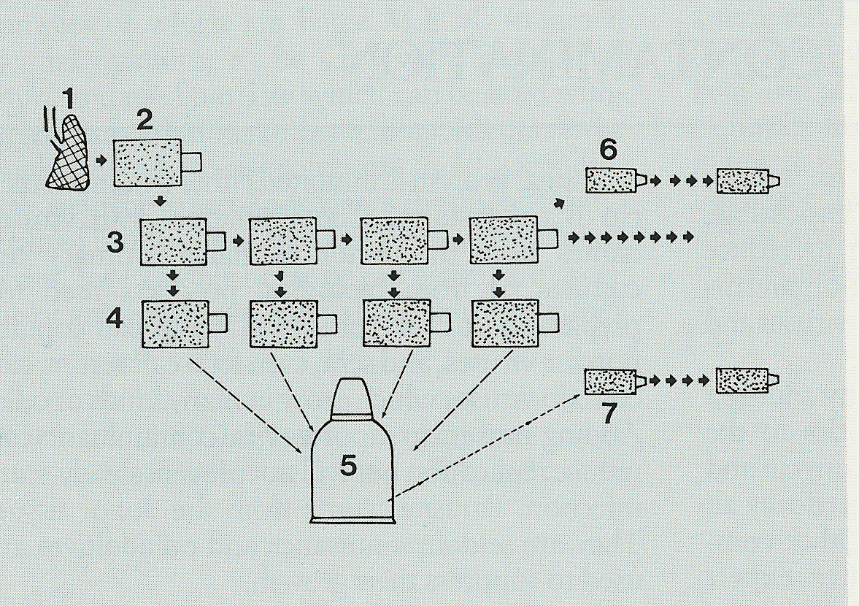
Cell culture
هو تأثير الفيروس على الخلايا خارج بيئتها لتشخيص العدوى الفيروسية
Cell culture refers to the removal of cells to see their subsequent growth under suitable environment.
After isolating the cells from the tissue, it has 3 types of sub passages:
picture | What kind of viruses their are | NO of sub passages | Cell culture
 | Usually RNA | 1 or 2( it lasts for very short period) | Primary cell culture
 | Usually DNA | 20-50(it lasts for few weeks) | Diploid cell culture (semi – continuous)
 |  | Indefinite | Continuous cell line
  Note : there are Variation of Sensitivity of cell cultures to infection by viruses
  يعني الخلايا اللي في العبوات تختلف حساسيتها تجاه الفيروس ، وهذا الشي اللي يحدد كونها
  Primary or diploid or continues

Slide 22
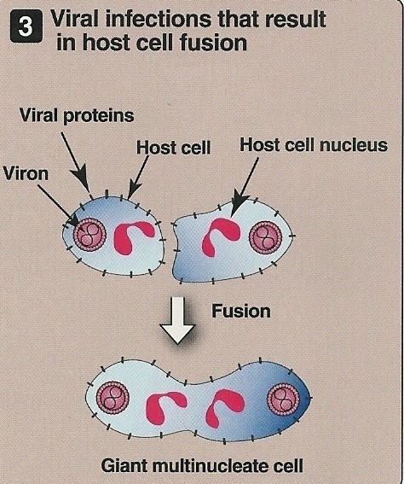
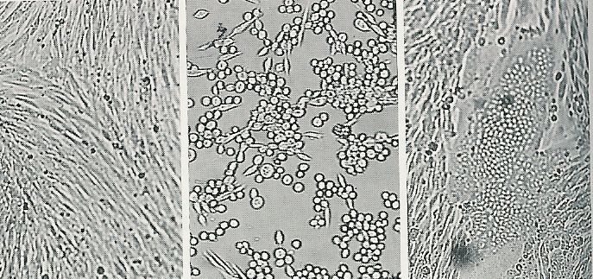
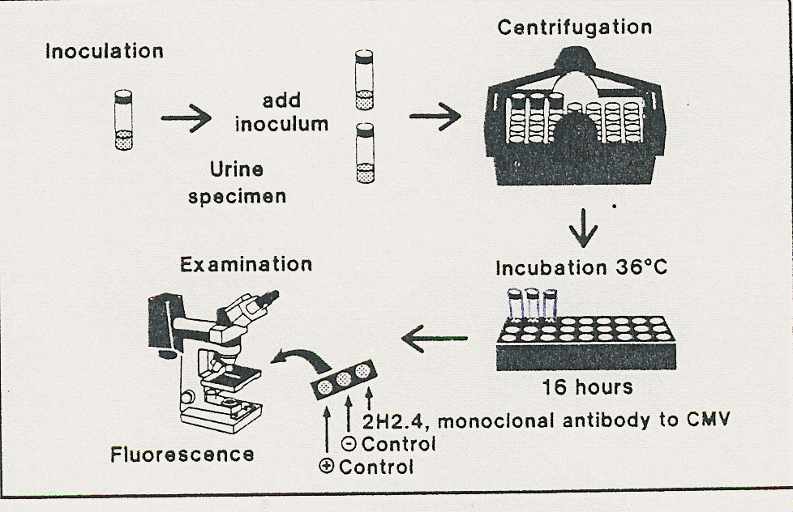
Detection of viral growth
كيف يمدينا نكتشف النمو الفيروسي ووش العلامات اللي تبان على الخلية من خلال العبوّة اللي استخدمناها في cell culture
1- By the cytopathic effects
The affected cell will have “Rounding, shrinkage, aggregation, Syncytium( giant multinucleate cell) and lose of adherence.
by IF ( Immunofluorescence)
Other
Problems with cell culture:
Uninfected
Cell rounding
Syncytium
Long incubation (up to 5 days) can be solved with rapid culture technique
Sensitivity is variable
Susceptible to bacterial contamination ( عرضه للتلوث البكتيري)
Some viruses do not grow in cell culture e.g. HCV
Rapid culture technique :
Shell vial assay
It detect viral antigens within 1-3 days

Slide 23
Serological test
Antigen detection
It is a test that looks for a (anti bodies)from a sample to determine the availability of (antigen)
There are three techniques :
-complement fixation test (CFT)
-Immunofluorescence (IF)
-enzyme-linked immunosorbent assay (ELISA)
ملاحظة : الطرق أحيانا تكون مباشرة وغير مباشرة ، اذا كانت غير مباشرة فهي عن طريق الأنتي بديز واذا مباشرة على طول تكون عن طريق الانتي جين
The virus | The test | The sample
IF | Influenza V | Nasopharyngeal aspirate
IF | HSV | Skin scrapings
ELISA | Rotavirus | Faeces
ELISA | HBV(HBsAg) | Blood

Slide 24
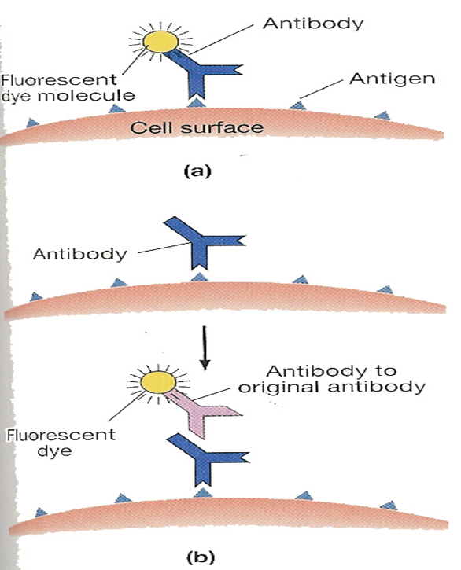
Serological tests
Antibody detection
Immunofluorescence (IF):
using a fluorescent dye
And can be viewed by fluorescence microscope .
Some techniques :
-Complement fixation test (CFT)
-Immunofluorescence (IF)
-Enzyme- linked immunosorbent assay (ELISA)
- Direct
Ag detection;
  Sample (Ag)
- Indirect
Ab detection;
  Sample (Ab)
Molecular Tests :
Enzyme-linked immunosorbet assay (ELISA)
Sample is then viewed using spectrometer.
Polymerase chain reaction (PCR)
  -NA amplification technique.
  -Viral genome
Uses;
  -Diagnosis
  -Only way to measure viral load and monitor response to treatment
-Indirect ELISA for Ab detection ;
coloured wells indicate reactivity
-Direct ELISA for Ag detection or specific IgM, IgG :

Slide 25
Question 1
Which of the following has DNA or RNA ?
Parasite
Fungi
Bacteria
virus

Slide 26
Question 2
Which of the following replicate by budding or mitosis?
Parasite
Fungi
Bacteria
virus

Slide 27
Question 3
What is the range of size of a virus?
200-300 nm
20-300 nm
2-300 nm
20-23 nm

Slide 28
Question 4
All viruses are …… except retroviruses are ……
Deploid ,haploid
Haploid , deploid

Slide 29
Question 5
Which of the following is helical symmtry
Proxvirus
Filoviruses
Adenivrus
Herpes virus

Slide 30
Question 6
All of the following can be used to classify viruses except:
Type of symmetry
Number of strands
The average count of ribosomes
The polarity

Slide 31
THE TEAM :
THE TEAM :
Contact us :
Waleed Aljamal
Ibrahim Fetyanu
Meshal Alhusainan
Hussam Alkhathlan
Faisal Alqumaizi
Shrooq Alsomali
Hanin Bashaikh
Jawaher Alkhayyal
Reem Alshathri
Rawan Alqahtani
Ohoud Abdullah
Ghadah Almazrou
Lama Al-musallm
436microbiologyteam@gmail.com
Twitter :
@microbio436

