Slide 1
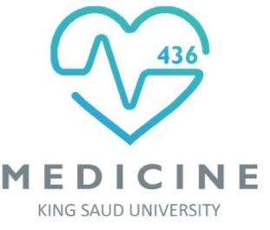
MICROBIOLOGY
Lecture :
Sterilization and disinfection
IMPORTANT.
DOCTORS NOTES.
EXTRA INFORMATION.

Slide 2
Objectives :
1- Define the terms sterilization, disinfectant and antiseptic. 3
2- Classify the different methods of sterilization (physical and chemical methods). 4
3- Know and realizes that heat is the most important method of sterilization and its application in medical practice. 5
4- Know dry heat as applied in hot air Oven and moist heat as applied in autoclaves. 7
5- Know the principles of Autoclave function and monitoring methods of sterilization .6-9
6- Know the importance of non heat sterilization methods and their use for sterilization of heat sensitive objects. 13-15
7-Know the difference between antiseptics and disinfectants. 16
8- Know types and scope of function of the disinfectants and antiseptics and factors affecting their functions. 16
9- Know the medical applications of different disinfections and antiseptics. 16

Slide 3
Definition
complete killing of all forms of microorganisms, including bacterial spores.
Sterilization:
Disinfection:
killing or removing of harmful vegetative microorganisms.
Disinfectant:
chemical substance used to achieve disinfection.
Antiseptic:
disinfectant that can be safely used on living tissues.

Slide 4
Methods of Sterilization
Physical methods:
Chemical method:
(used for heat sensitive equipments)
dry heat
Heat
U.V. Light
Ionizing Radiation
Filtration
moist heat
Ethylene Oxide
Gluteraldehyde
Simplest methods is to sterilize by naked flame

Slide 5
PHYSICAL METHODS
HEAT
Most important should be used whenever possible
types:
A-
Dry heat at temperature of 160˚C for one hour
B-
Moist heat eg. Autoclave at 121 or 134 C for 10 or 15 minutes

Slide 6
PHYSICAL METHODS : Sterilization by Heat (Common methods)
A) Dry Heat:
Dry Heat- kills microorganisms by destroying their oxidative processes.
-Simplest method is exposing item to be sterilized to the naked flame e.g. Bunsen burner- for sterilizing bacteriological loops, knives, blades.
-Hot air oven expose items to 160 °C for 1 hour.
Has electric element in chamber as source of heat plus a fan to circulate air for even distribution of heat in chamber. Oven without fan is dangerous. Used for items that are lacking water such as:
-Metals
-Glassware
-Ointment / Oils/ Waxes /Powder

Slide 7
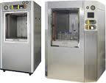
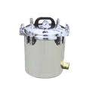
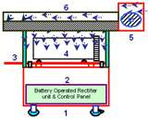
B) Moist Heat very important
Uses hot water. Moist heat kills microorganisms by denaturating proteins.
Autoclaving – standard sterilization method in hospitals (standard method) .
The equipment is called Autoclave and it works under the same principle as the pressure cooker(قدر الضغط) where water boils at increased atmosphere pressure i.e. because of increase pressure the boiling point of water is >100 °C.
The autoclave is a tough double walled chamber in which air is replaced by pure saturated steam under pressure.
من الضروري إن الادوات اللي تستخدم بالمستشفيات تكون معقمة حتى لا تنتقل الأمراض بين المرضى لذا يستخدم جهاز الautoclave
لأن فاعليته قوية ويقتل حتى الspores

Slide 8
B) Moist Heat
يخرج الهواء خارج الجهاز
The air in the chamber is evacuated and filled with saturated steam. The chamber is closed tightly the steam keeps on filling into it and the pressure gradually increases. The items to be sterilized get completely surrounded by saturated steam (moist heat) which on contact with the surface of material to be sterilized condenses to release its latent heat of condensation which adds to already raised temperature of steam so that eventually all the microorganisms in what ever form are killed.
The usual temperature achieved is 121 °C , exposure time of only 15 minutes ( or 134 C for 10 minutes).
ممكن يختلف من جهاز لجهاز

Slide 9
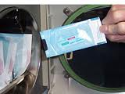
Advantages of Autoclave
Monitoring of Autoclaves
Temp. > 100 C therefore spores killed.
Condensation of steam generates extra heat.
The condensation also allows the steam to penetrate rapidly into porous materials.
Note: for all invasive procedures at operating room or clinics, autoclavable equipments should be used.
1. Physical method: use of thermocouple to measure accurately the temperature.
2. Chemical method: it consists of heat sensitive chemical that changes color at the right temperature and exposure time.
e.g. a)- Autoclave tape
b)- Browne’s tube.
3. Biological method: where a spore-bearing organism is added during the sterilization process and then cultured later to ensure that it has been killed.
هذي الطرق للتأكد من فعالية ال autoclaves
و مو شرط نتأكد كل يوم ممكن نتأكد كل 3 شهور

Slide 10
Moist heat: Other Applications
Pasteurization
Used heat at temperatures sufficient to inactivate harmful organism in milk. The temperatures of sterilization is not achieved .
Temperature may be 74°C, for 3-5 seconds. ( Flash methods )
or 62°C for 30 minutes. ( Conventional method ).
Boiling
quite common especially in domestic circumstances.
Pasteurization of the milk to prevent diseases like :
Typhoid fever
Brucellosis
Tuberculosis
Q fever
Salmonella

Slide 11
Other physical methods
Radiation
Filtration
Ionizing radiation-
Use of membrane filter
Example ; membrane filter made of cellulose acetate. Generally removes most bacteria but viruses and some small bacteria e.g. Chlamydia & Mycoplasma may pass through. Thus filtration does not technically sterilize items but is adequate for circumstances under which is used.
Main use: for heat labile substances e.g. sera, antibiotics.
U.V. light
e.g. Gamma radiation: has greater energy than U.V. light, therefore more effective. Used mainly in industrial facilities e.g. sterilization of disposable plastic syringes, gloves, specimens containers and Petri dishes.
Has limited sterilizing power because of poor penetration into most materials.
Generally used in irradiation of air in certain areas such as operating rooms and tuberculosis labs.
Serum is sterilized by filtration

Slide 12
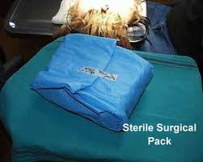
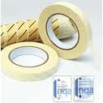
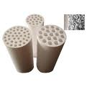
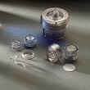
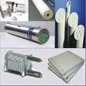
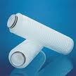
الشريط قبل عملية التعقيم تكون عليه خطوط بيضاء
وبعد التعقيم خطوط سوداء غير متقطعة تدل على أن جميع الأدوات عقمت بشكل صحيح
الأنابيب تكون حمراء قبل عملية التعقيم
وأذا تمت عملية التعقيم بنجاح يصير لونها أخضر
Moist heat
filtration
ممكن يحطون فلاتر في المكيفات لترشيح الهواء من بعض أنواع البكتيريا

Slide 13
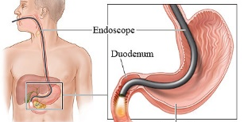
Simple
disinfectants / antiseptic
Strong
chemical substances may be used to achieve sterilization ( kill spores)
Activated alkaline Gluteraldehyde 2%
(يستخدم في عيادات المناظير)
وهو أسهل من Ethylene oxide
Ethylene oxide
(inactivates microorganisms by alkylates DNA molecules)
phenolics,
chlorhexidine,
alcohol,
Chemical Methods:
Used for heat sensitive equipments. e.g. plastics and lensed endoscopes.
Most disinfectant doesn’t achieve full sterilize EXEPT glutaraldehyde 2% can achieve full sterilize
Ethylene oxide may cause explosion if used pure, so it is:
1- mixed with an inert gas.
2- Requires high humidity (50- 60% ).
3- Temperature : 55-60°C
4- exposure period 4-6 hours.
HIV & hepatitis B/C virus
^من أخطر الكائنات التي ممكن تنتقل من مريض لآخر عند استخدام نفس المنظار
Immerse item (endoscopes) in solution (Gluteraldehyde) for:
1- HIV or hepatitis B/C < about 20 m.
2- Mycobacterium tuberculosis or spores < immersion period 2-3 h.
^(غمر)
Notes:
1- extra

Slide 14
Factors influencing activity of disinfectants
.
.
.
1-Activity directly proportional to temperature.
2-Directly proportional to concentration up to a point – optimum concentration. After this level no advantage in further increases in concentration.
(الأمثل)
^إذا ما كان في التركيز المطلوب لن يكون ذا فائدة
عشان كذا ما احط المطهر على الجهاز علطول . لا! لازم اغسله قبل
3- it is inactivated by: A-Dirt. B-Organic matter (Proteins, Pus, Blood, Mucus, Feces). C-Non organic (Cork ,Hard water, Some plastics).
(فلين)
^بعض المطهرات تحتاج تكون في أوعية معينة (فلين/بلاستيك/زجاج..))
4- Time: Disinfectants need time to work (explosion).
Range of action means (affects what type of bacteria?)
5- Range of Action: Disinfectants not equally effective against the whole spectrum of microbes.
e.g. Chlorhexidine: less active against (-Gram) bacteria than (+Gram) cocci.
Hypochlorite & Gluteraldehyde: more active against hepatitis viruses than most other disinfectants.
Notes:
1- 1&2 خلوا الصياغة نفس صياغة سلايد الدكتورة لانها اوضح

Slide 15
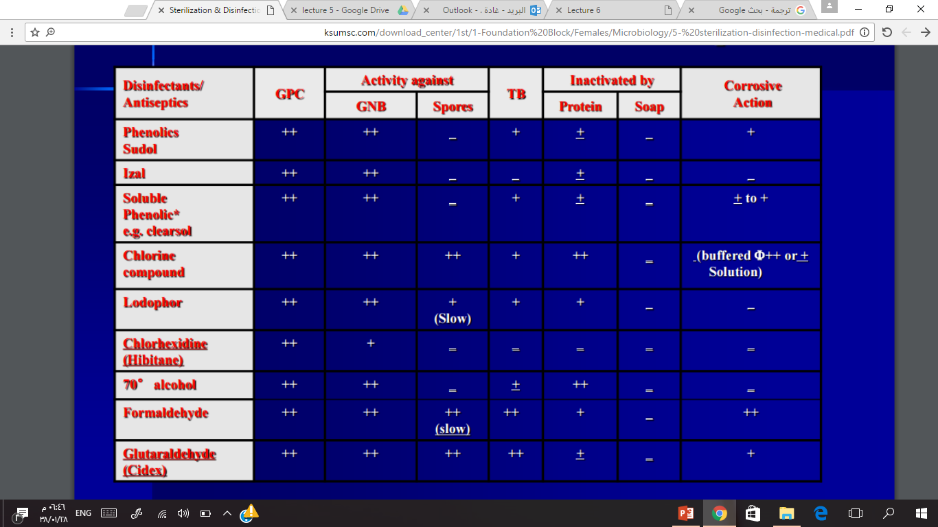
Summary: Disinfectants /Antiseptics
\
Gram positive cocci
Gram negative bacilli
تآكل
Chlorine’s uses include:
-Clorox (diluted form)
-small portions are added to drinking water
-used in swimming pools (esspecially public ones)
-تعقيم رضاعات الأطفال
+ : effective
++: very effective
- : Less effective
:+- maybe
= double negative (less effective)
^you should read all that , you are a doctor ☺ but you need to memorize only the
strong Disinfectants (yellow) most of the strong disinfectants are ++
& daily-use Disinfectants (blue) most of the daily-use disinfectants ars - or =
differ especially in spores

Slide 16
Hospital disinfection methods
*Depends on Hospital‘s Policy
Disinfectant | Article
Phenolics fluids 1-2% | -Floors, walls:
Hypochlorite, Alcohol | -Surfaces tables:
Gluteraldehyde 2% (Cidex) | -Endoscopes:
sub-atmospheric steam
70% Alcohol | -Thermometers:
Antiseptics | Skin:
Chlorhexidine, Iodine alcohol | -Surgeons’ hands:
70% Alcohol, Iodine | -Patient skin:

Slide 17
Important points
Any instrument or item used for sterile body site should be sterile.
Any instrument or item used for non-sterile body site can be disinfected.
Hand washing is the most important to prevent hospital acquired infection.
Online quiz
https://www.onlineexambuilder.com/microbiology-l7-part2/exam-106383

Slide 18
summery
U.V light
Chemical(used for heat sensitive equipments)
Methods of sterilization
Physical
Ionizig radiation
Gluteraldehyde
e.g. Gamma radiation
Ethylene oxide
Heat
Filtration
e.g. Membrane filter
Moist
Dry
e.g. Bunsen burner
autoclave

Slide 19
THE TEAM :
THE TEAM :
Contact us :
Waleed Aljamal
Ibrahim Fetyani
Meshal Eiaidi
Khalid Alhusainan
Hussam Alkhathlan
Faisal Alqumaizi
Shrooq Alsomali
Hanin Bashaikh
Jawaher Alkhayyal
Reem Alshathri
Rawan Alqahtani
Ohoud Abdullah
Ghadah Almazrou
Lama Al-musallam
436microbiologyteam@gmail.com
Twitter :
@microbio436

