Slide 1
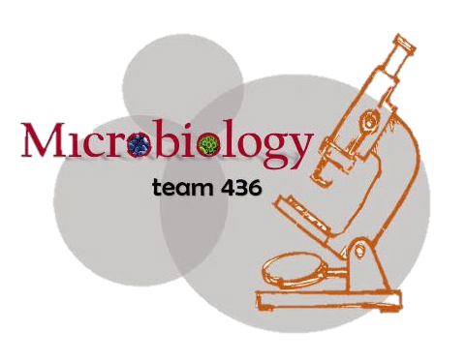

microbiology
Lecture:
Gram positive and negative bacteria
IMPORTANT.
DOCTORS NOTES.
EXTRA INFORMATION.

Slide 2
Objectives:
By the end of this lecture, the student should be able to:
Know the general basic characteristics of bacteria 5
Differentiate between gram positive and gram negative bacteria’s characteristics. 6-7
Know the classes and groups of gram positive bacteria, cocci and bacilli (rods) 11-13
Know the common identification and characteristics of these groups 11-13
Know the common infections and diseases caused by these organisms 11-13
Know the classes and groups of gram negative bacteria, cocci and bacilli (rods) 14-16
Know the common identification methods for these organisms 14-16
Know the most common infections and diseases caused by these bacteria 14-16

Slide 3
*الأمثلة بالأحمر مهمة
Fermentation
قد تكون هوائية أو لا هوائية لكن الأفضل في طريقة التقسيم هنا هو الـ
Gram +ve Bacilli
Gram -ve Bacilli
Fermentative
Non-Fermentative
O₂
An O₂
Oxidase
Oxidase
SF
NSF
+
-
SF
NSF
Clostridium
Eubacterium
E.Coli
+
-
Anthrax
CoryneBacterium
Pseudomonas
Acinetobacter
Latobacillus
Listeria Nocardia
Fusobacterium
*O₂: Aerobic
Also Called (Bacillus Antheresis)
Gram –ve Anaerobic
ما وضح الدكتور تصنيفها لكن اعرف انها
* An O₂: Anaerobic
*Fermentative: تقوم بتكسير الكاربوهيدرات
*NSF: Non Spore Forming
*Non-Fermentative (Non-Fermenting): لا تكسر الكاربوهيدرات
ولكن تستفيد من مواد أخرى
*SF: Spore Forming

Slide 4
Cocci Bacteria
الاختبارات اللي تسويها
عشان تعرف نوع البكتيريا
Chain
Cluster
StreptoCocci
StaphyloCocci
Catalase:
-
+
+
-
Coagulase:
لا يوجد
StaphOrase
Other Staph
Veillonella
Gram –ve Cocci Anaerobic
مالها دخل بالتصنيف فوق ، احفظ انها

Slide 5
Gram positive bacteria
Cocci Bacilli
Aerobic /facltative Anaerobe
Anaerobe Peptostreptococci
Staphylococci (cluster catalase +)
Streptococci (chains catalase -)
Enterococci
Aerobic/facultative anaerobe Anaerobic
Cornybacterium (NSF) Clostridium (SF)
Listeria Nocardia (NSF) Eubacterium (NSF)
Latobacillus (NSF)
Bacillus Antheresis (SF)
NSF=non-spore forming SF=spore forming
Notes:
NSF=non-spore forming
SF=spore forming

Slide 6
Gram Negative bacteria
Cocci Bacilli
Aerobic /facltative Anaerobe
Anaerobe Veillonella
Neisseria
Moraxella
Aerobic/facultative anaerobe Anaerobic
Bacteriodes
Fusobacterium
Fastidious
Oxidase
+ -
Pseudomonas E. coli Bordetella

Slide 7
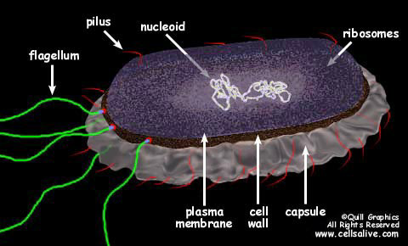
bacteria
1- bacteria are prokaryote
2- the DNA is floating and easily transport to another bacteria (so they easily get resistance to antibiotics)
3- capsule ( antiphagocytic )
4- cell wall ( is the site of some antibiotic action such as penicillin -< destroy the cell wall -< die )

Slide 8
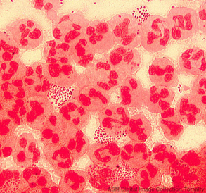
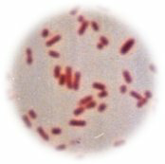
Gram Staining
- Developed in1884 by the Danish physician Hans Christian Gram.
- An important tool in bacterial taxonomy* , distinguishing so called gram positive bacteria , which remain colored (violet) after the staining procedure, from gram negative bacteria *** which do not retain dye(violet) and need to be counter stained (safranin).
- Can be applied to pure cultures (lab culture with a single specimen) of bacteria or to clinical specimens (swaps, feces, urine…).
* Taxonomy : (the branch of science concerned with classification)
** gram positive bacteria : (large amount of peptidoglycan)
Neisseria gonorrhoeae in a smear of urethral pus
(Gram-negative cocci, with pus cells)
Pure culture of E. coli
(Gram-negative rods)
*** gram negative bacteria: (small amount of peptidoglycan)

Slide 9
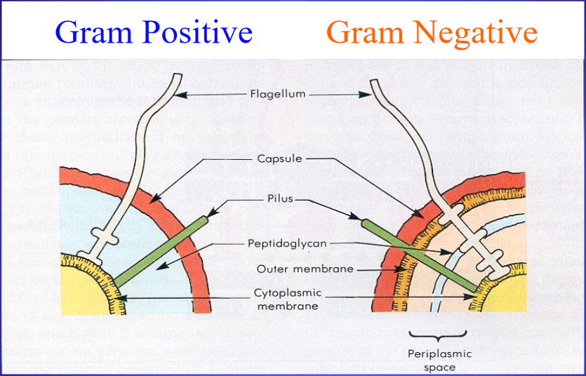
Gram positive cell wall | Gram negative cell wall
Thick, homogenous sheath of peptidoglycan 20-80 nm thick. Tightly bound acidic polysaccharides, including teichoic acid and lipoteichoic acid. Cell membrane. | - Outer membrane containing lipopolysaccharide (LPS). Thin shell of peptidoglycan. Periplasmic space (between the cell wall & plasma membrane). Inner membrane.
Retain crystal violet and stain blue or purple. | Lose crystal violet and stain pink or red from safranin counterstain.

Slide 10
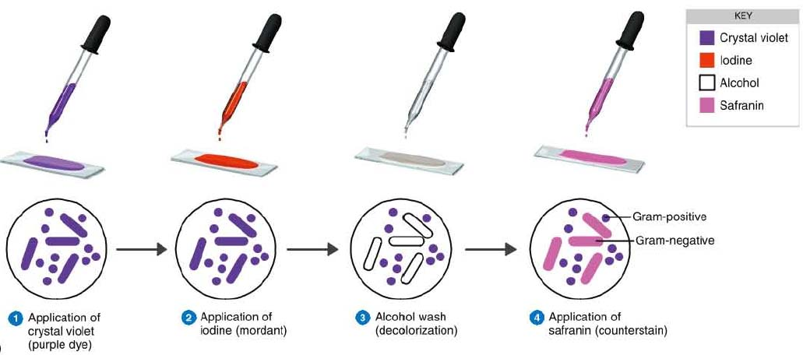
Note: the alcohol is applied to wash the crystal violet stain.
However, unlike the others, it is only applied for 3-5 seconds. So it is not enough time for it to wash the crystal violet out of the peptidoglycan of gram +ve bacteria, which is why they keep the crystal violet stain.
Note: iodine is applied to fixتثبت the crystal violet inside the bacteria

Slide 11
The Gram Stain
Gram's
Crystal
iodine
violet
Decolorise with
acetone
Gram-positives
appear purple
Counterstain with
Gram-negatives
e.g. methyl red
appear pink

Slide 12
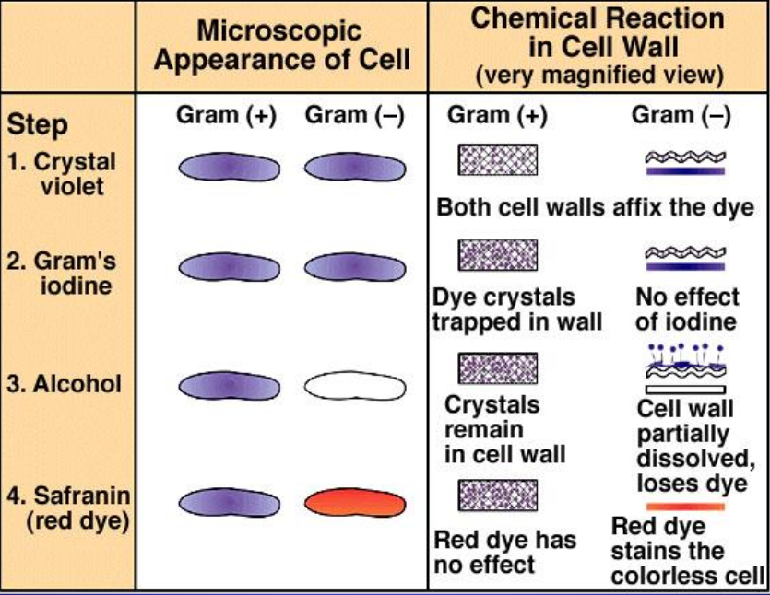
Gram-positive cocci
Gram-positive rods
Gram-negative cocci
Gram-negative rods

Slide 13
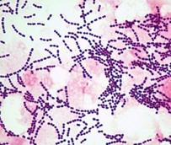
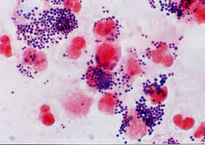
Gram positive Cocci :
Aerobic / facltative Anaerobe :
Note : facltative Anaerobe
Occurring optionally in response to circumstances rather than by nature
1) Streptococcus
Catalase (-) Gram-positive cocci in chains or pairs
Streptococcus pneumoniae | Viridans streptococci | Streptococcus pyogenes
Eg: Gamma haemolytic They cause: - Meningitis -Sinusitis -Otitis -Pneumonia | Alpha haemolytic -oral flora They cause: -infective endocarditis (infection of the inner lining of the heart “endocardium”) | Divided by type of haemolysis: -Group A -Beta hemolytic (most important) -diseases: 1- Pharyngitis (most common) 2-Cellulitis (acute inflammation of subcutaneous tissue) 3-Rheumatic Fever Characterized by: Fever, Migrating polyarthritis , carditis and immunologic cross reactivity 4- Acute Glomerulonephritis Edema, hypertension, hematuria antigen-antibody complex deposition
2) Staphylococci
Catalase : it’s an enzyme produced by the bacteria
catalase (+) Gram-positive cocci in clusters
Coagulase (-) | Coagulase (+)
-Staphylococcus epidermidis -Staphylococcus saprophiticus | -Staphylococcus aureus Most important pathogen
3) Enterococci
ex : Enterococcus faecalis

Slide 14
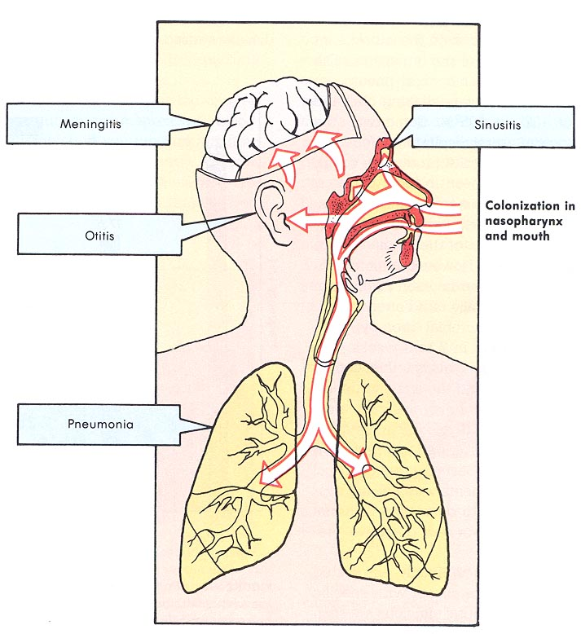
S. pneumoniae

Slide 15
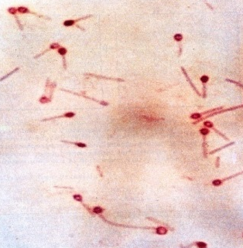
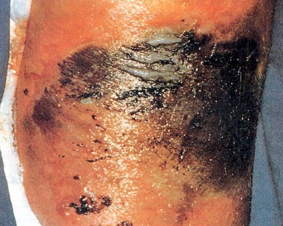
Gram positive bacilli :
ملاحظة : القرام بوستف باسيلاي مقسمة تبعًا لوجود السبورز
بينما القرام بوستف كوكاي مقسمة تبعًا للاختبارات اللي ذكرناها كاتاليز وكواقليز..
Anaerobic
Aerobic / facilitative Anaerobe
Non-spore forming (NSF) | Spore forming (SF)
Eubacterium | C. -----Clostridium -Clostridium. tetani Causing Tetanus. - Clostridium perfringens Causing Gas gangarene -Clostridium botulinum Causing Botulism Descending weakness Leeds to Paralysis Diplopia and dysphagia Leeds to respiratory failure
Non-spore forming (NSF) | Spore forming (SF)
C. --- Cornybacterium : - Corynebacterium diphtheria WHICH CAUSE: Fever pharyngitis cervical LAD (disease of the lymph nodes). thick, gray, adherent membrane Sequelae: airway obstruction, myocarditis | Bacillus Antheresis causes anthracis
C.tetani
Gas gangarene
C. tetani and C. botulinum both anaerobes produce the same toxin but REMEMBER that tetani’s toxin inhibits the inhibitory impulses in the brain otherwise botlulinum’s toxin will inhibit the release of Ach.

Slide 16
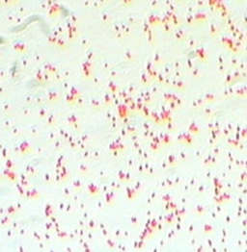
Gram-Negative Cocci
Neisseria gonorrhoeae (السيلان)
  -The Gonococcus
Neisseria meningitidis (It is considered as potential pathogen in the oropharynx)
  The Meningococcus
  Both Gram-negative intracellular diplococci
Moraxella catarrhalis can cause infections of the respiratory system, middle ear, eye, central nervous system, and joints of humans

Slide 17
سلايد إضافيه توضيح للسلايد التالي
Bacilli
rods
البكتيريا ال هي أحد أشكال ال.
ايش معنى و ايش مقصود ب
Fermentation: The metabolic process of converting carbohydrate into acid or alcohol , This process occur in micro-organism such bacteria or fungi.
أهم تصنيف ل هو انها تكون
fermentation (التخمر)
fermentative or not fermentative.
gram-negative bacilli
E.coli is oxidase negative

Slide 18
Gram-Negative Rods
Enteric Bacteria they ferment sugars most important are:
  E. Coli (it’s a normal flora potential pathogens most found in the GIT)
  Salmonella (not a normal flora)
  Shigella
  Yersinia and Klebsiella pneumoniae
  Proteus
Oxidise positive comma shaped and also fermentative most important is Vibrio cholerae that causes cholera which is a disease characterized by severe diarrhea and dehydration.
Non- fermentative i.e. they do not ferment sugars e.g.
Oxidase positive
  Pseudomonas – causes infection in immunocompromised patient.
Oxidase negative
  Acinetobacter species
*الدكتور قال بالنسبه ل gram- negative rods fermentative المهم منها هو E.coli .

Slide 19
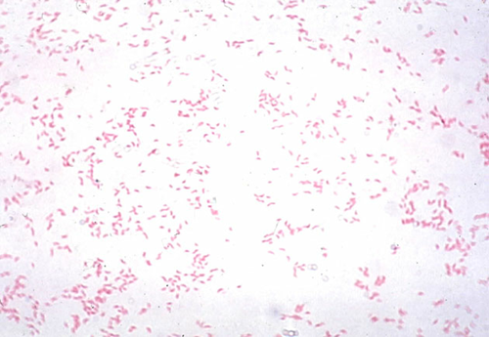
Gram-Negative Rods
Fastidious GNRs
  Bordetella pertussis
  Haemophilus influenza (most in children )
  Campylobacter jejuni
  Helicobacter pylori
  Legionella pneumophila
Anaerobic GNRs
  Bacteroides fragilis
  Fusobacterium
الدكتور يقول مهمه

Slide 20
Non-Gram-stainable bacteria
Unusual gram-positives :
- Spirochaetes.
- Obligate intra-cellular bacteria.
It lacks cell wall so we can’t use antibiotics that destroy the cell wall such as penicillin
-Mycoplasmas:
- No cell wall .
-Smallest free-living organisms.
-E.g.: M. pneumonia,
M.genitalium.
بعض البكتيريا لا نستطيع صبغها لأن لايوجد فيها جدارخلوي

Slide 21
Questions:
5-what remains colored after staining:
A-gram positive B-gram negative
6-an example of gram positive cocci:
A-Corynebacterium B-lactobacillus C-entercocci
7- an example of a gram negative bacili:
A-fusobacterium B-bordetella C-moraxella
8-clostridium perfringens causes:
A-tetanus B-gas gangrene C-botulism
9-what causes clostridium botulism:
A-tetanus B-gas gangrene C-botulism
1)Which of the following is an Aerobic bacilli:
a) Nocardia
b) Latobacillus Bacillus
c) Clostridium
d) Cornybacterium
2)Gram negative has a thick, homogenous sheath of peptidoglycan:
a)True b)false
3)Gram negative has a Lose crystal violet and stain pink:
a)True b)false
4) Which of the following can be an example on gram-positive spore forming bacilli :
A) Clostridium perfringens
B) Bacillus anthracis
C) Clostridium tetani
D) Streptococci
1)C
2)B
3)A
4)B
5)A
6)C
7)A
8)B
9)C

Slide 22
Contact us :
THE TEAM :
THE TEAM :
436microbiologyteam@gmail.com
Twitter :
@microbio436
Waleed Aljamal
Ibrahim Fetyani
Meshal Eiaidi
Khalid Alhusainan
Hussam Alkhathlan
Faisal Alqumaizi
Shrooq Alsomali
Hanin Bashaikh
Jawaher Alkhayyal
Reem Alshathri
Rawan Alqahtani
Ohoud Abdullah
Ghadah Almazrou
Lama Al-musallam

