Slide 1
microbiology
Lecture:
Pathogenesis of viral infection
IMPORTANT.
DOCTORS NOTES.
EXTRA INFORMATION.

Slide 2
OBJECTIVE:
للرموز
Definition and levels of viral pathogenesis.3
Types of viral infections at cellular level.(3- 10)
Pathogenesis at host level. 14
The immune response to viral infection .(16+18)
The stages of viral infection. 18
The types of viral infections at host level. 19
Vs= Virus
RSV = Respiratory syncytial virus
HAV = Hepatitis A virus
HBV = Hepatitis B virus.
HCV = Hepatitis C virus
HIV = Human immunodeficiency virus
HPV = Human papillomavirus
HSV = Herpes simplex virus
HTLV = The human T-lymphotropic (leukemia) virus
YFV = Yellow Fever Virus
VZV = Varicella zoster virus
IP= Incubation Period

Slide 3
Mechanism of the disease Pathogenesis of viral infection
Viral disease at the cellular level
Cytopathogenesis
Viral disease at the host level
Mechanism of the disease
Abortive
Vs not produced
Non-productive
Vs not Produced
Productive
Vs Produced
Persistant infection
Asymptomatic infection
Acute infection
Non-cytolytic
Vs Produced
Cytolytic
Vs Produced
Transformation
Viral NA present
Latent
Viral NA present

Slide 4
Cytopathogenesis
Infection | Types ,Ex | Cause | Result
Abortive Infections |  | -Mutation. -Defective interfering particles. -The action of IFNs (Interferons) | Viruses don’t complete the replication cycle
Productive infection | Cytolytic Infections: | -Viruses replicate & produce progeny. -Inhibition of cellular protein & NA synthesis | Cell death & Cytopathic effects [CPE]
 | Non- Cytolytic infection (Persistant) | -Viruses replicate & produce progeny. (enveloped viruses ) -Identified by hemadsorption & direct IF | Vs released by cell budding & little or no CPE.
Non- productive infection: | Latent infection (pt) | -Vs infect cells that restrict or lack the machinery for transcribing viral genes. -The cell retains its normal properties | -Viral genome is found either integrated into cell DNA or as a circular episome or both.
 | Transformation (pt) | Vs infect cells that restrict or lack the machinery for transcribing viral genes. | -Viral genome is found either integrated into cell DNA or as a circular episome or both.
غالباً تظهر الأعراض
= فيروس ماكث في الجسم
غالباً تظهرلا الأعراض

Slide 5
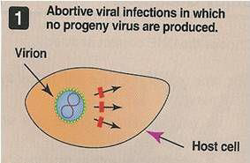
Pathogenesis of viral infection:
Viral disease at the cellular level:
Cytopathogenesis: (The types of viral infections at cellular level):
Abortive Infections
:Viruses don’t complete the replication cycle Due to
Mutation
Defective interfering particles
The action of IFNs (Interferons)

Slide 6
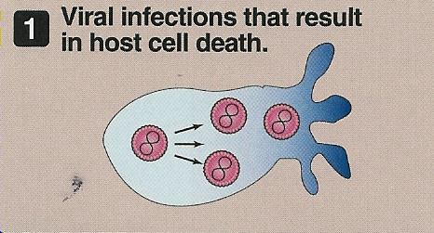
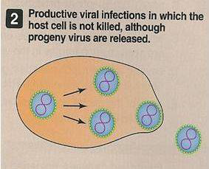
Pathogenesis of viral infection:
Viral disease at the cellular level:
Cytopathogenesis: (The types of viral infections at cellular level):
Productive infection(Two types):
Cytolytic
Non-cytolytic
Cytolytic Infections:
Viruses replicate & produce progeny.
Cell death & Cytopathic effects [CPE]
Inhibition of cellular protein & NA synthesis
Non- Cytolytic infection:
Viruses replicate & produce progeny.
Vs released by cell budding & little or no CPE.
Identified by hemadsorption & direct IF
ما يكون واضح إن الخلية مصابة

Slide 7
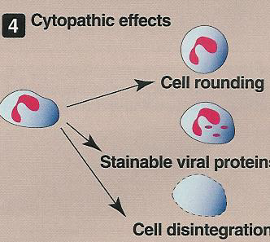
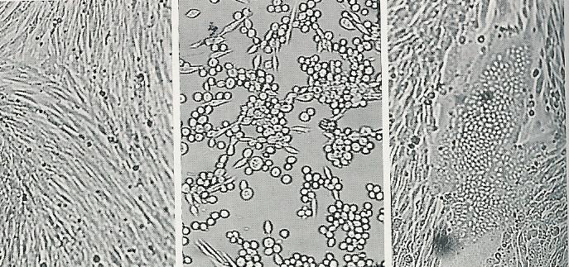
CPE
Cytopathic effect (CPE): Any possible change in the appearance of the infected cell (CPE can take several forms) :
Cell lysis.
Cell rounding.
Syncytium formation.
Inclusion body formation
Uninfected cc: Normal cell culture
Cell rounding: it is a cytopathic effect
Uninfected cc
Cell rounding

Slide 8
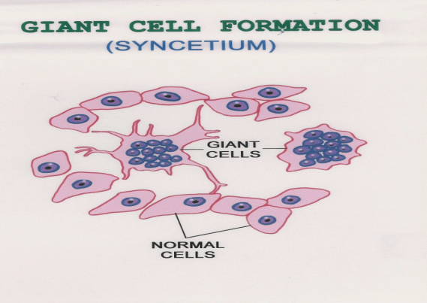
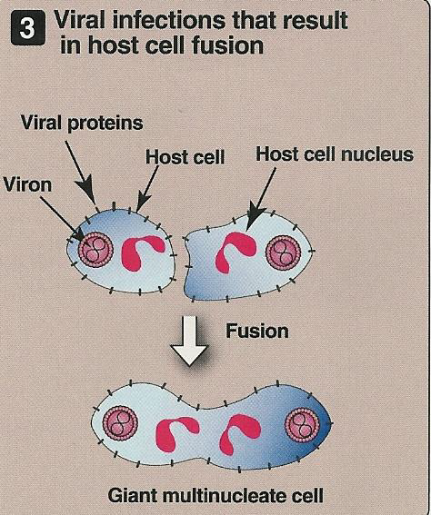
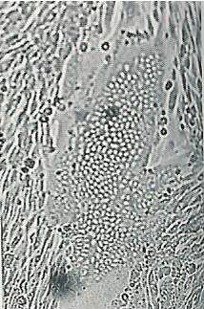
Syncytium formation
Syncytium formation
This is due to insertion of viral protein in the surface membrane.
This occurs in membrane of adjacent infected cells that will fuse together to form large cell (giant cell) with multi nuclei .
Syncytium

Slide 9
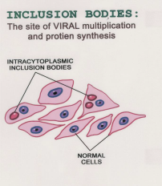
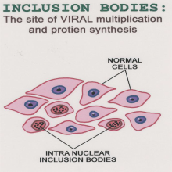
Inclusions bodies formation
These inclusion body have different shapes :
small/large.
Single/multiple.
Round/ irregular.
Inclusions bodies formation (collection of viral protein or particles inside the cells these particles stay inside the(site):
Nuclei (Intranuclear inclusion bodies ) ex [Herpes V.]
Cytoplasm (intracytoplasmic bodies) ex [Rabies V.]
Very important
Owl’s eye bodies
Example of Intranuclear body is owl’s eye inclusion bodies caused by CMV (cytomegalovirus).
Negri bodies
Example of Intracytoplasmic body is :negri bodies which is caused by rabies virus .

Slide 10
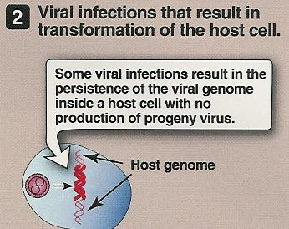
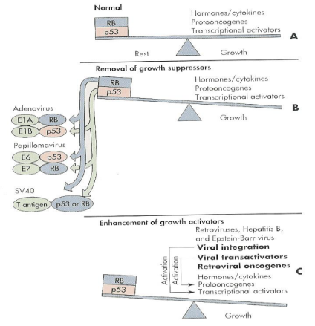
Viral disease at the cellular level:
Non- productive infection:
-Vs infect cells that restrict or lack the machinery for transcribing viral genes.
-Viral genome is found either integrated into cell DNA or as a circular episome or both.
Non- productive infection have two types
Transformation :Cause tumor in animals & Human and can transform cell cultureEx ; EBV, HPV and HTLV
Latent infection : Persistent infection because (there is limited expression of viral genes) Ex: HSV
Vs can stimulate uncontrolled cell growth causing transformation by:
alternating the balance between growth activators & growth suppressors gene products

Slide 11
Doctor's notes
Extra explanation: abortive
Abortive Infections occur when there is no virus progeny(سلالة او ذرية ) produced
The virus infects the cell but
the virus can’t continue its replication cycle
Thus, no virus progeny is produced.
Why did this happen? Due to:
Defective interfering particles is composed of:-protein. -viral genome.
1- Mutation: viral genome mutation which lead to the lost of important function of the virus, therefore the virus can’t complete its replication cycle.
2- Production defective interfering particles : These particles are produced during replication
of the virus and may have:
–mutation in the viral genome. – deletion in the viral genome. –incorrect enzymes.
(Therefore the virus can’t continue its replication cycle).
3-interaction of Interferons: Interferons are cytokines produced by some cells (infected cells)that Protect other cells from infection (or attack) of the same virus.( the virus infect cells but it can’t continue replication so no virus produced and no disease.

Slide 12
Doctor's notes
Extra explanation: Cytolytic infection
1- The cell is killed by replication and releasing of the virus from the infected cell.
2- So the replication of the virus will produce change in the infected cell leading to cell death or lysis, by changing of structure and function of infected cell this is called cytopathic effect.
3-This is mainly due to inhibition of cellular protein and nucleic acid synthesis Which leads to cell death.
4- (Cell death is due to replication of virus and accumulation of virus protein inside the cell this will cause disturbing of the structure and function of the cell leading to disturb of lysosomes resulting to Autolysis or Apoptosis which is programed cell death)
Cytopathic effect is : Any possible change in appearance of the infected cell.
Extra explanation: non-Cytolytic infection
Viruses infecting the cell can continue replication cycle
then the viruses is produced or released without damaging the cell because of (enveloped viruses )
Viruses is released gently by budding through the cell membrane This kind of infection have little or no CPE

Slide 13
Doctor's notes
Extra explanation: Non- productive infection
When the virus infect the cell, the virus can’t complete its replication cycle
cycle so no virus progeny produced
Because the cell lack machinery to transcribe viral genes
However, the virus maintain inside the cell in the form of its genome either integrated chromosome (to DNA ) or non integrated chromosome (in cytoplasm) or both

Slide 14
Pathogenesis at Host Level:(process to tack place in host level)
Transmission of the virus & its entry into the host.
1-Person to person :
Horizontal transmission:
Skin contact , Blood, e.g : cut in the skin
Respiratory route , e.g : inhalation , through the nose
Fecal - oral route , e.g : GIT through food or water
Genital contact
b) Vertical transmission
Replication of the virus
Vs remain localized or spread to other organs
Viral shedding
The immune response as: 1-Host defence
2- Immunopathogenesis ( ability of virus to cause disease through immue system)
2-Animal to person :
Reservoir…………Human (Rabies v. ) داء الكلب بشكل مباشر ينتقل الى الإنسان
Reservoir………..( vector ) Human (YFV) بشكل غير مباشر عن طريق بعوضة
yellow fever virus
: e.g :from mother to baby through breast feeding or During delivery through an infected birth canal

Slide 15
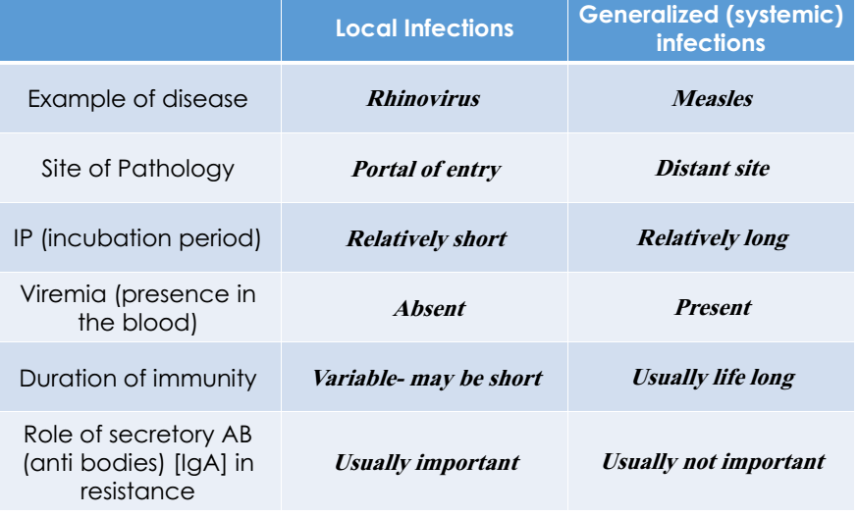
Important features of Acute Viral Diseases
الحصبى
Taken from Med433
Note: local mean it will replicate in primary site

Slide 16
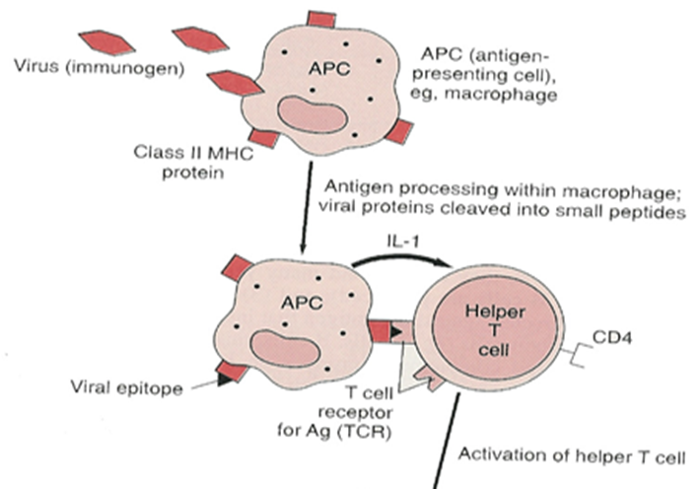
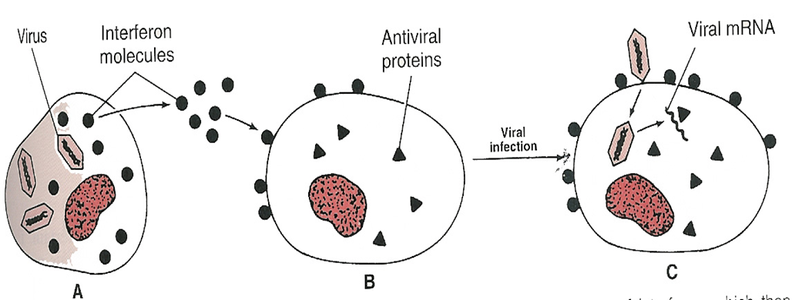
The immune response to virus:
Macrophages: APC, Phagocytosis and cytokines production.
Natural killer cells: Lysis of VICs
Cytokines:(release from virus infected cell)
*Interferons “INF”:
• α, β IFN: inhibit the viral and the host cell mRNA translation
• γ IFN (from lymphocyte) : stimulate phagocytosis and killing by macrophages and NK cells
*Interleukin “IL”:
• Stimulates AB production
• Activate T cells & CMI
• Suppress the IR(Insulin Resistance)

Slide 17
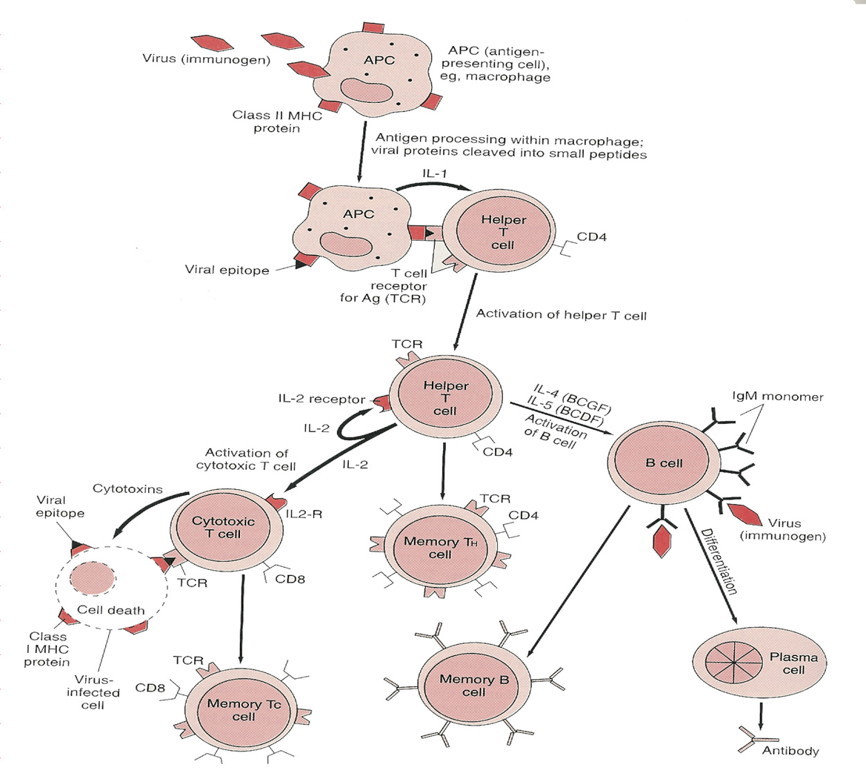
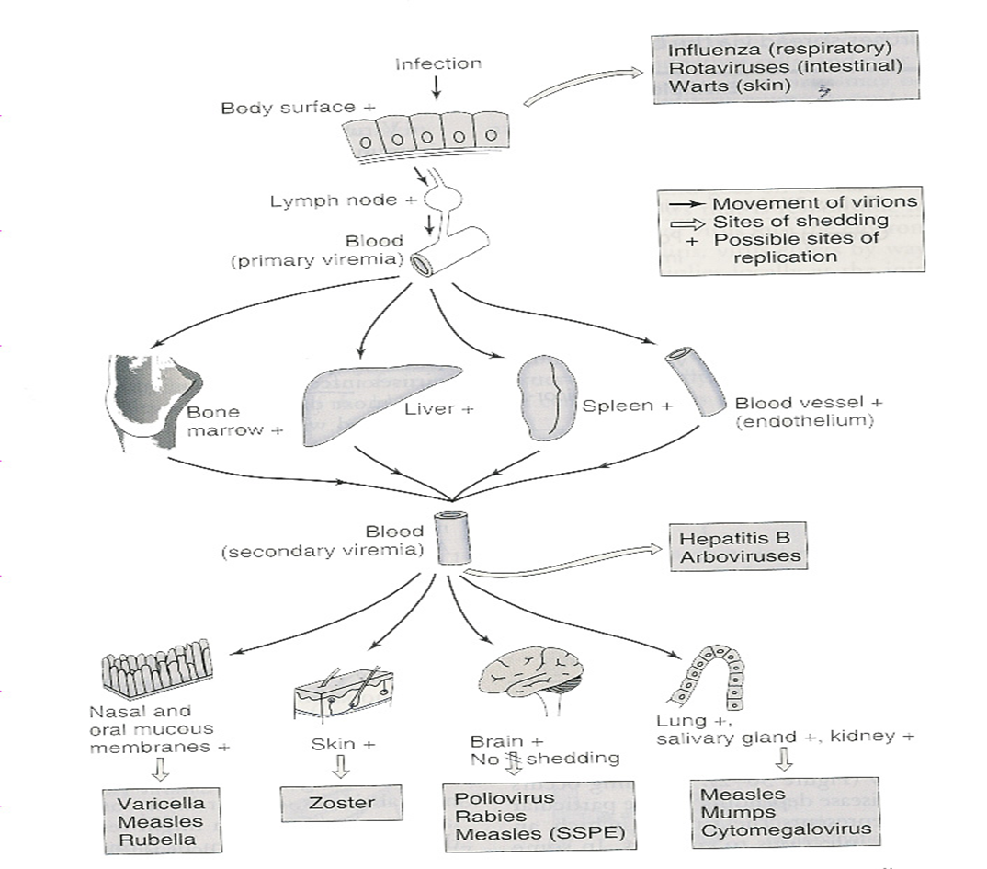
Mechanisms of spread of virus through the body:
The immune response to virus:
B-cell growth factor
virus shedding

Slide 18
The immune response to virus:
CMI: (t-cell)
Effective against intracellular viruses Lysis of virally infected cells by CTCs [CD8]
Humoral Immunity: (b-cell)
Effective on extracellular viruses [viremia]
- Neutralization(Binding to the virus’s receptors so it cannot attach to the host cell)
*Note:The cellular immunity is faster than the Humoral immunity
The stages of a typical viral infection:
The incubation period
Prodromal period
The specific-illness period:
The signs & symptoms of viral diseases are the result of Cell killing by:
A) Inhibition of cellular macromolecular synthesis
B) Immunologic attack ( Immunopathogenesis)
Cytotoxic T cells e.g. Hepatitis (HAV, HBV,HCV)
4-The recovery period
Non-specific illness ( general symptom)

Slide 19
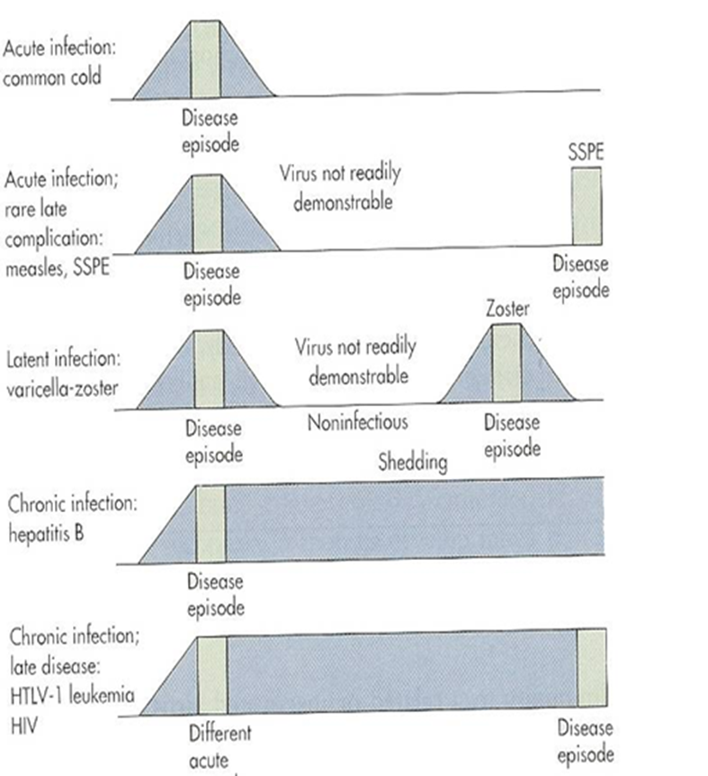
Types of viral infections at host level:
Asymptomatic infection (the most common one)
Acute infection (like common cold)
Persistant infection:
*Late complication of acute infection
*Latent infection(خامل)(herpes virus)
*Chronic infection (like HBV)

Slide 20
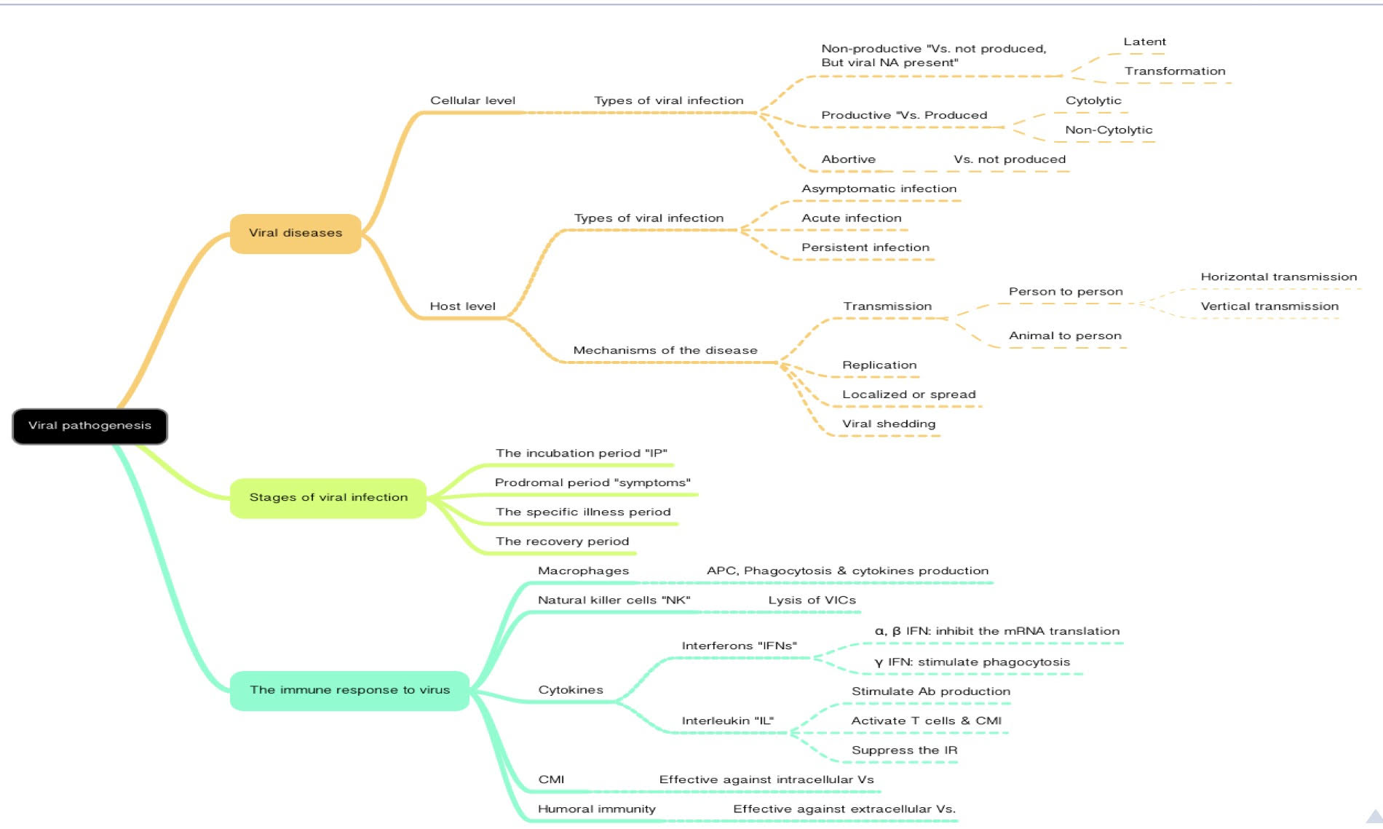
Summary from 434 team
Online quiz:
https://www.onlineexambuilder.com/microbiology-l7/exam-106264

Slide 21
quiz
1-which of the following is related to viral disease at host level ?
a-mechanisms of the disease
b-cytopthogenesis
c-viremia
2-which of the following types viruses don’t complete their cycles ?
a-Abortive
b- productive
c- non-productive
e-a and c
3-non-cytoletic infections cause noticeable Cytopathic effect
a-true
b-false
4-disease transmitted from by mother to newborn
a-horizontal transmission
b-vertical transmissi
7- persistent infection develop into an early complication :
a-true
b-false
8- The signs & symptoms of viral diseases are the result of Cell killing:
a-incubation period
b- Prodromal period
c- The specific- illness period
d- The recovery period
9.Which one is a type of infection at cellular level?
Abortive
b) Productive
c) Non-productive
d) All of the above
10.The number of stages of a typical viral infection is:
a) 6 b) 4 c) 3 d) 2
11.What is the most common viral infection at host level?
a) Asymptomatic infection b) Acute infection c) Persistent infection
12.Negri bodies is caused by:
a) Rabies Virus b) Herpes Virus c) Herpes paramyxo Virus
13.The duration of generalized “systemic” infection is usually life long:
a) T b) F
5-when the virus is found in the blood (viremia) that means the infection is :
a-local infection
b-metastatic
c-generalized or systemic
6- inhibition of the viral and the host cell mRNA translation is by :
a- α IFN
b- β IFN
c- γ IFN d- a and c e- a and b
1)a
2)a 3)b 4)b
5)c
6)e
7)b
8)C
9)D
10)B
11)A
12)A
13)a

Slide 22
TEAM 436
Contact us :
THE TEAM :
THE TEAM :
436microbiologyteam@gmail.com
Twitter :
@microbio436
Waleed Aljamal
Ibrahim Fetyani
Meshal Eiaidi
Khalid Alhusainan
Hussam Alkhathlan
Faisal Alqumaizi
Shrooq Alsomali
Hanin Bashaikh
Jawaher Alkhayyal
Reem Alshathri
Rawan Alqahtani
Ohoud Abdullah
Ghadah Almazrou
Lama Al-musallm

