Slide 1
microbiology
Lecture: Anaerobic
IMPORTANT.
DOCTORS NOTES.
EXTRA INFORMATION.
ملاحظة مهمة جداً :
هذه المحاضرة معتمدة على سلايدز الدكتورة وتيم الأولاد

Slide 2
Objectives
Describe anaerobic bacteria including their sensitivity to oxygen and where they may be found in the environment and the human body.
Differentiate the various types of anaerobes with regard to atmospheric requirement (i.e. obligate anaerobes, Faculative anaerobes and aerotolerent anaerobes.
Describe how anaerobes, as part of endogenous microbiota, initiate and establish infection.
Name the endogenous anaerobes commonly involved in human infection.
Recognize specimens that are acceptable and unacceptable for anaerobic culture.
Give the clues(sign and manifestations) to anaerobic infection, name the most probable etiologic agents of the following(Wound botulism, gas gangrene, tetanus, Actinomycosis, Pseudomembranous colitis and bacterial vaginosis).
Describe the microscopic and colony morphology and the results of differentiating anaerobic isolates.
Discuss antimicrobial susceptibility testing of anaerobes including methods and antimicrobial agents to be tested.
Describe the major approaches to treat anaerobic-associated diseases either medical or surgical.

Slide 3
Why can’t anaerobic bacteria survive in oxygen?
The presence of oxygen leads to the production in cells of the superoxide radical (a negatively charged O2 molecule).
Normally, the superoxide anion is lethal enough to kill almost any organism.
Aerobic organisms and facultative anaerobes have the enzymes superoxide dismutase and catalase.
These enzymes work together to convert superoxide to oxygen and hydrogen peroxide .

Slide 4
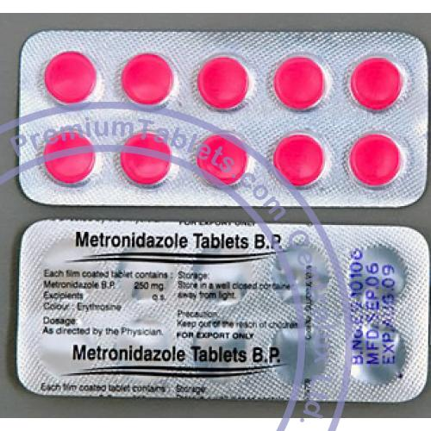
Anaerobiosis
Only in female’s slides
DEFENITION:
-A MICRBE THAT CAN ONLY GROW UNDER ANAROBIC CONDITION
-SENSETIVE TO metronidazole (MTZ)
FAIL TO GROW IN AIR 10 % O₂
Lack cytochrome so they cannot use oxygen as hydrogen acceptor.
Most Lack Catalase & Peroxidase ( Catalase is an enzyme that catalyzes the decomposition of hydrogen peroxide to water and oxygen)
Contain flavoprotein so in the presence of oxygen produce H2O2 which is toxic
They lack an enzyme called superoxide dismutase.
Catalyzes Superoxide O2- radical into oxygen and H2O2
It is an Anti-oxidative
Superoxide O2- are similar to free radical
Highly toxic
Highly reactive

Slide 5
HABITAT
These organism are normal flora in:
Oropharynx eg. 1. Provetella melaninogenicus
2.Fusobacteria
3. Veillonella
B. Gastrointestinal tract
Found mainly in the large colon in large numbers
Total number of anaerobes = 10 ¹¹
While all aerobes (including E. coli) = 10 ¹⁴
examples are (1) Bacteroides fragilis (2) Bifidobacterium species
Female genital tract (mainly in the vagina)
-presence as normal flora also in Skin, Nose, Mouth, throat, Endocervix, Urethra.
Modefied by:
Pathophysiologic states
Antimicrobial agents ,H-Blockers ,antacids
Hormonal changes
Age
المقصد إنها تحول البكتيريا من نورمال فلورا الى ممرضة

Slide 6
CLASSIFICATION
2-NON SPORE FORMINGN {MORE COMMON}
A –GRAM NEGATIVE BACILLI
bacteroides fragilis ( resistant to penicillin)
Prevotella spp
Leptotricha buccalis
fusobacterium spp (The main cause of pharyngitis)
f.nucleatum
Viellonella sp. GRAM NEGATIVE DIPLOCOCCI
1-SPORE FORMING
GRAME POSITIVE BACILLI
CL .perfringens
CL .Septicum
CL .novyi
CL .Histolyticum
CL .Difficile
CL .Tetani
CL .Botulinum
B –GRAME POSITIVE COCCI
Peptococci (staphylococcus)
Peptostreptococci (streptococci)
C –GRAME POSITIVE BACILLI
Propionobacterium propionicum ,p.acne
Bifidobacterium
Euobacterium
LACTOBACILLUS
Actinomyces israelii
D-MICROAEROPHILIC STREPT

Slide 7
Classification of anaerobics:
Usually in the environment
Usually normal flora

Slide 8
Note : the words witch are highlighted in will be explained in red are what the doctor focused on, and it details in next slides
Anaerobic bacteria
Non spore forming
Gram positive
Gram negative
Bacilli
cocci
Bacilli
cocci
Actinomyces causing : actinomycosis
Peptococcus
In cluster
Bacteroides
Veillonella (diploocci)
The only one
Propionibacterium causing : acne
Fusobacterium
Mobiluncus causing : bacterial vaginosis
Peptostreptococcus
In chains causing :
Brain abscess
Prevotella
Lacto bacillus causing :endocarditis
Porphyromonas
eubacterium
bifidobacterium
succinomonas
Butyrivbrio

Slide 9
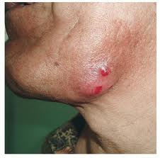
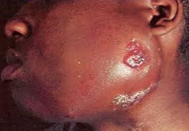
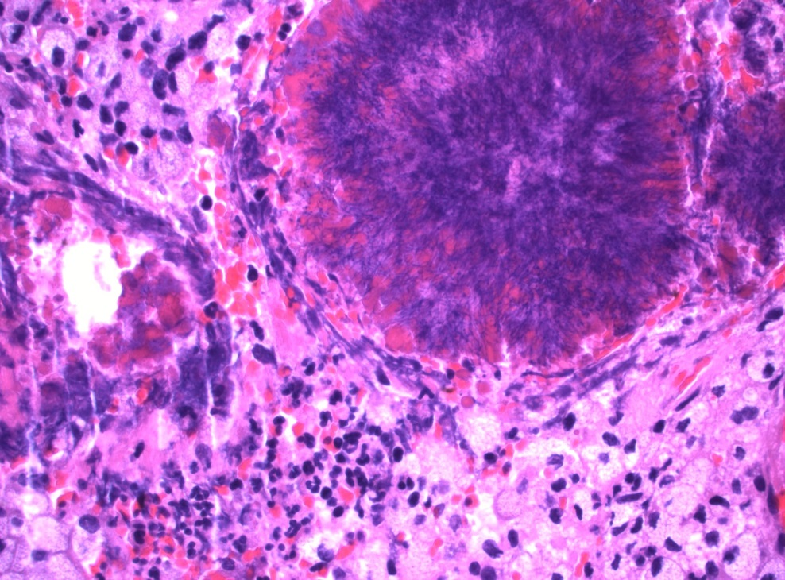
E.g. of non spore forming anaerobic gram (+) bacilli
ACTINOMYCES SPP.
Definition : branching beaded anaerobic “microaerophilic” gram positive bacilli
-It is a normal flora in : oral cavity, GIT, genital track
osteomyelitis
Actinomycosis:
Source of infection is normal flora in normal host cell
Primary site of infection : mouth, lung, appendix, uterus with IUD (chronic infection)
Can spread to the brain, liver, bone and blood
Extra info
An intrauterine device (IUD or coil) is a small contraceptive device, often 'T'-shaped, often containing either copper or levonorgestrel, which is inserted into the uterus. They are one form of long-acting reversible contraception which are the most effective types of reversible birth control.
Pathogenesis
After tooth extraction the normal flora invade the soft tissue
Abscess
Diagnosis : gram stain with sulfur granules and growth of molar tooth colonies
Treatment : penicillin ,tetracycline or clindamycin

Slide 10
E.g. of non spore forming anaerobic gram (-) bacilli
fusobacterium
Bacteroides
It has a fusiform morphology
It is a pleomorphic bacteria (cucco bacilli)
Strict anaerobe : the most resistant anaerobic bacteria
the most anaerobic bacteria causing infection
Normal flora in : oral cavity, GIT
Normal flora in : GIT, vagina, oropharynx
Fusobacterium necrophorum
What does it cause ? Peritonsillar leads to Internal jugular vein thrombosis leading to emboli to the lung
Other than B.fragilis | B.fragilis
B.Vulgaris B.Thetaiotamicron B.Uniformis | Only B.fragilis | Examples
-bile sensitive -resistant to kanamycin only -some pigmented | -account for 1/3 of all isolates -resistant to 20% bile And many antibiotics such as : penicillin, kanamycin, vancomycin, colistin and many more -no pigmentation of colonies or fluorescence | Properties
Treatment : penicillin
Treatment : metronidazole ( flagyl ) is the drug of choice.
Clindamycin can also be used.

Slide 11
EPIDEMIOLOGY:
Almost all infections are indigenous except:
Tetanus
Infant ,wound botulism
Bites
C .difficile {nosocomial (acquired or occurring in a hospital) }
Gas gangrene { some cases }
FEATURES OF ANAEROBIC INFECTIONS:
Infections are always near to the site of the body which are habitat.
Infection from animal bites.
Deep abscesses
The infections are also polymicrobial
Gas formation, foul smell
Detection of "Sulphur granules"' due to actinomycosis
Failure to grow organism from pus if not culture anaerobically.
Failure to respond to usual antibiotics.
Sulphur granules
One of the small yellow bodies found in the pus of actinomycotic abscesses and consisting of clumps of the causative actinomycete

Slide 12
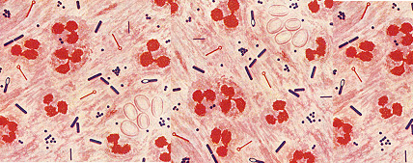
IMPORTANCE:
Dominate the indigenous flora (colonization resistance)
Commonly found in infection
Easy to overlook
special precautions
Slow growth
Mixed infection
Difficult treatment

Slide 13
CHARACTER OF ANAEROBIC INFECTION:
-Suppuration
-Abscess formation
-Tissue destruction{gangrene}
-Septic thrombophlebitis
-Some have unique pathology :
-Actinomycosis
-Psedomembranous colitis
-Gas gangrene
PREDISPOSING FACTORS:
Low O tension {Eh}
Trauma, dead tissue , deep wound
Impaired blood supply
Presence of other organisms
Foreign bodies
Antibiotic therapy
Neoplasm
Cholecystitis
Obstruction
Ulceration
Diabetes mellitus
Pylephlebitis
Diverticula formation
HOW DOES THE INFECTION BEGIN ?
-DISRUPTION OF BARRIERS
Trauma
Operations
Cancerous invasion of tissues
-DISRUPTION OF BLOOD SUPPLY
Drops oxygen content of tissue
Decrease in eh potential
Tissue necrosis

Slide 14
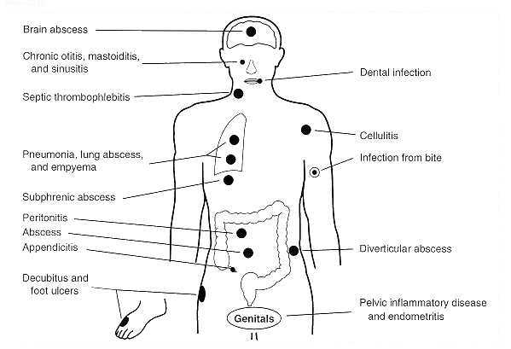
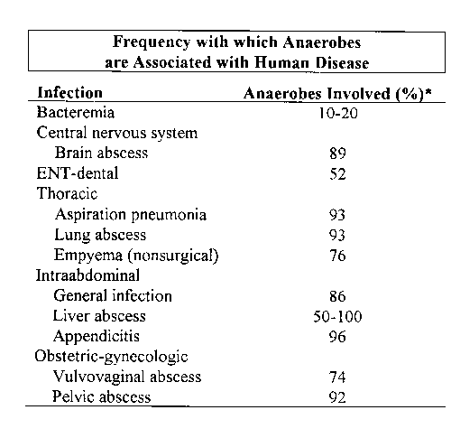
WHAT ARE THE INFECTION CAUSED BY THESE ANAEROBIC ORGANISMS :
Post operative wound infection.
Brain, Dental, Lung abscess.
Intra-abdominal abscess, appendicitis, diverculitis
All these infection can cause bacteremia
Infection of the female genital tract
Septic abortion
Puerperal infection or sepsis
Endometritis
Pelvic abscess
Other infections
a) Breast abscess in puerperal sepsis
b) Infection of pilonidal sinus
c) Infection of diabetic patients (diabetic foot infections).
Only in female’s slides

Slide 15
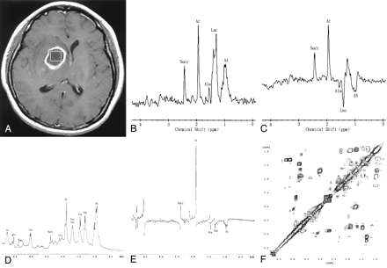
Only in female’s slides
A 43-year-old man with surgically proved pyogenic brain abscess in the right basal ganglion secondary to Eubacterium lentum (obligate anaerobe) infection.
Axial contrast-enhanced T1-weighted MR image shows a ring-shaped cystic lesion and surrounding edema.

Slide 16
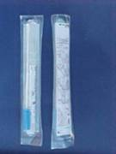
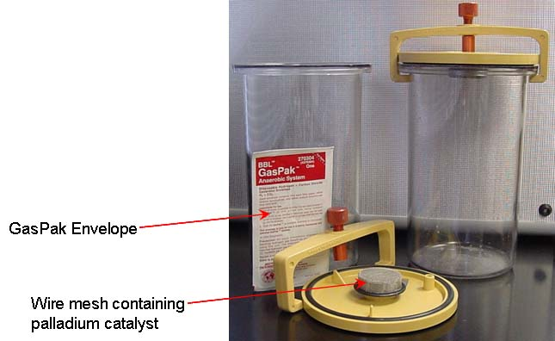
LABORATORY DIAGNOSIS:
When anaerobic infection is suspected:
Specimens have to be collected from the site containing necrotic tissue.
Pus is better than swabs.
Specimens has to be send to the laboratory within 1/2 hour why?
Fluid media like cooked meat broth are the best culture media.
Specimens have to incubated anaerobically for 48 hours.
Because they are slowly growing pathogens
Because they are anaerobic so they need immediately special environment without O2 to survive
TREATMENT:
-Bacteroides fragilis is always resistant to penicillin.
But penicillin can he used for other anaerobes
-Flagyl (metronidazole) is the drug of choice.
-Clindamycin can also be used.

Slide 17
Clostridium Species
Morphology: - Large gram positive rods -Spore forming.
Causative agents (مسببة) for:
1.Gas gangrene : Cl. perfringens and other e.g septicum. 2.Tetanus : Cl. tetani
3.Botulism : Cl. Botulinum 4.Toxic enterocolitis : Cl. difficile (Pseudomembernous colitis)
Usually in the environment
Usually normal flora

Slide 18
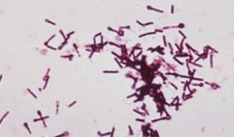
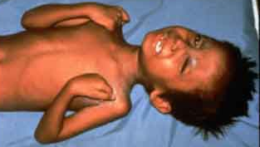
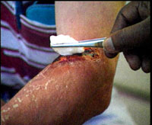
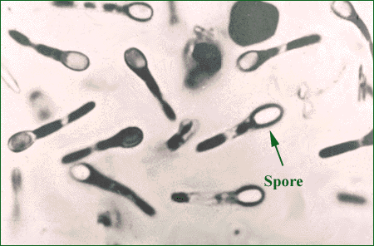
TETANUS
TRIMUS
LOCKJAW 1884
Strict toxigenic disease
Other name for this disease
Cl.tetani (TETANUS)
-Morphology gram +ve bacilli anaerobic with terminal spore. Drum Stick appearance
-Face & neck and upper extremities wounds are more dangerous
SOURCE : Lives in soil and animal feaces. e,g horse and any wound can infected if contaminated by spores
Other sourse
Contaminated wound {minor}
Compound fracture
Narcotic addicts
Unsterile injections
Burns , bites ,avulsions
Umbilical stump

Slide 19
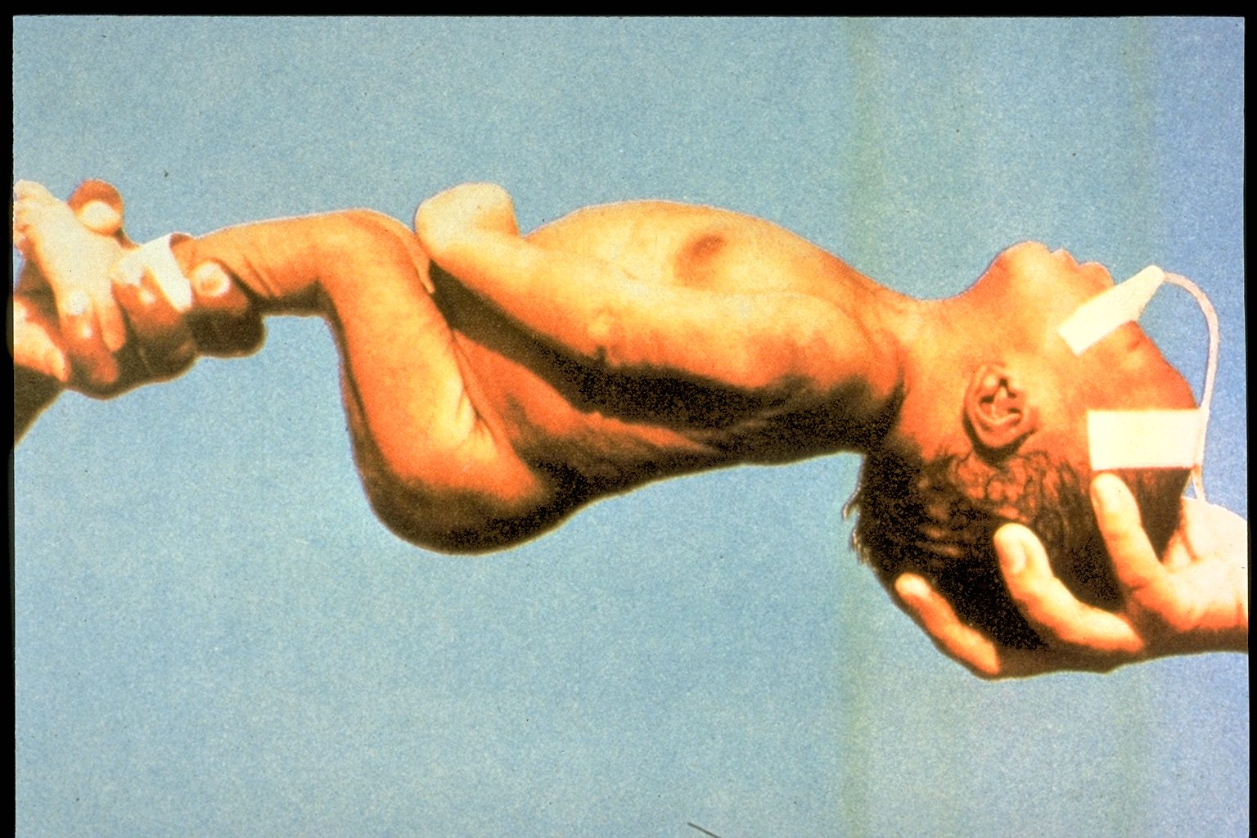
Clinical Features
Incubation period 1-3 weeks= 3-21 days(time from infection to the appearance of symptoms)
Symptoms: local (not common), cephalic (rare), generalized (most common)
Painful muscle spasm around infected wound and Contraction of muscles in the face called Trismus (Lockjaw) , Risus Sardonicus (facial muscle)
Arching of Back - strychnine
Opisthotonus in children. Opistho meaning "behind" and tonos meaning "tension",due to extrapyramidal effect and is caused by spasm of the axial along the spinal column .

Slide 20
EPIDEMIOLOGY:
1 Million/year > 60 yr .injection of drugs {young}
½ due to neonatal tetanus
Cryptogenic t. {23%}
Disease of non-immunized animals and humans {toxoid}
Pathogenesis:
EXTOXIN {TETANOSPASMIN}
Presynaptic terminals of LMN Inhibitory impulses to MNs (motor neurons)
Persistent tonic spasm
Mainly due to tetanospasmin which is powerful exotoxin (protein) .This organism does not lead to invasion or Bacteraemia .
Its function to inhibits transmission of normal inhibitory messages from central nervous system especially lower motor neurons at anterior horn cells of cord.

Slide 21
Diagnosis:
Mainly by clinical.
Laboratory , and it is strict anaerobe very motile spread on agar{minor role}
Prevention:
(by vaccination)
Complete active childhood immunization
Appropriate wound management
Type of wound
Immunization history
Treatment:
Supportive
Airway or Muscle relaxant or Wound care
Antitoxin : TIG {500 UNITS}
Antibiotics :MTZ , PG , penicillin
Cleaning of wound and removal of Foreign body (supportive)
Specific by antitoxin form horse serum but it can lead to anaphylaxis & shock must be tested first or human immunoglobulin.
Antibiotics .like penicillin.
Supportive treatment by keeping the patient in dark pace, fluids and sedative valium

Slide 22
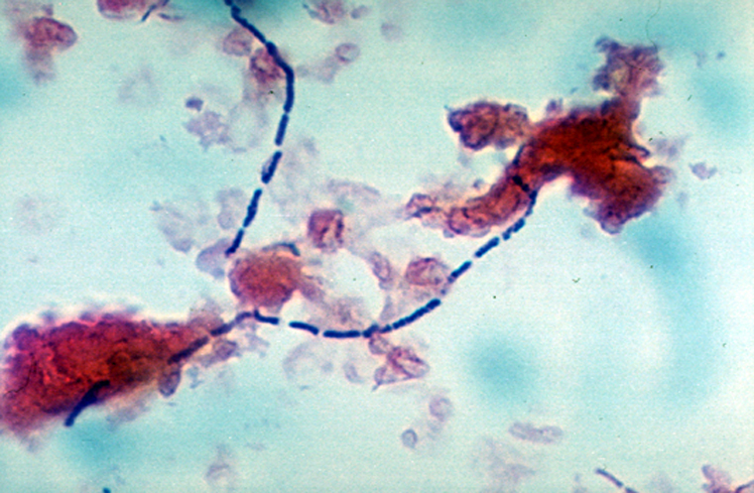
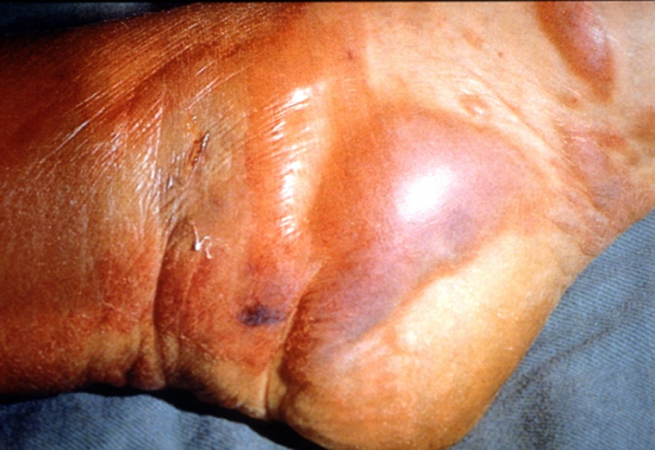
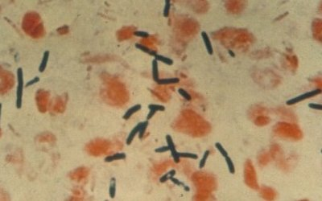
C. Perfringens {C.Welchii}
Histotoxic clostridia
Gas gangrene
Food Poisoning
NATURAL HABITATS:
Soil and intestinal tracts of animals and humans { 10³ 10⁸ }
Widespread occurrence
Vagina of 1-9 % healthy women (as normal flora)
-Morphology: large rods gram +ve with bulging endospores subterminal.

Slide 23
DIAGNOSIS:
Laboratory diagnosis:
CLINICAL
SURGICAL
MICRO. Gram + bacilli
-Gram stain :- G PB , absent leukocytes
-Culture { aerobic and anaerobic }
Exudate , aspirates
Tissue
Blood
Nagler reaction
Smear Gram stain Large Gram positive bacilli with few or no WBCs.
-Blood agar with haemolytic colonies (double zone of haemolysis )
-Cooked meat medium.
-Gives the NAGLAR'S Reaction & toxin neutralization on Egg yolk medium & toxin is a phospholipase.
المقصود ان اختبار ناقلار يفرق بين البيرفرنجنس و غيرها من الكلوستريديم وهو يستعمل فيه صفار البيض
Double zone
Cooked meat medium →

Slide 24
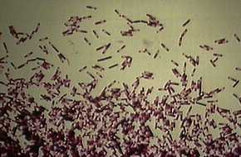
CLINICAL SIGNIFICANCE
Species most commonly isolated from clinical specimens for this disease.
Many clinical settings ranging from :-
Simple contamination of wounds – traumatic or non traumatic myonecrosis
C. Cellulitis
Intra-abdominal sepsis
Gangrenous cholecystitis
Post-abortion infections – septicemia
Bacteremia
Brain abscess
Can leads to the following diseases:
Wound Contamination
Wound infection
Gas Gangrene - most important disease
Gas Gangrene of the uterus in criminal abortion (يقصد بالاجهاض الغير قانوني انه لا ينفذ بالطريقة الصحيحة او بالادوات المناسبة احيانا)
Food Poisoning: Spores are swallowed→Germinate (تتكاثر) in gut after 18 hours(Toxin production)→abdominal pain and diarrhea

Slide 25
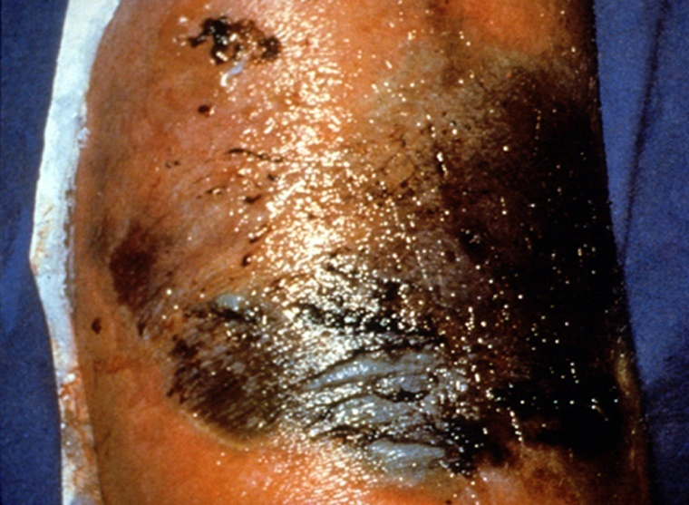
Gas gangrene
Toxin mediated breakdown of muscle tissue
Rapid progression { like Uterus }
Liquefactive necrosis of muscle , gas formation , toxemia.
Fulminant septicemia
Intravascular hemolysis
Hemoglobinuria
Blood cultures positive in 15 % of patients
Clinical picture
ETIOLOGY
Acute progressive pain , edema , skin discoloration
Systemic – fever , tachycardia , hypotension , renal failure , crepitus , pulmonary edema , death
C.perfringens { 80% }
C.Novyi
C.Septicum
C.Histolyticum

Slide 26
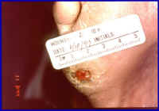
Pathogenesis:
Traumatic open wounds or compound fractures
(كسر يخترق الجلد و يسبب انفيكشن)
lead to muscle damages and contamination with dirt .
Mainly in war wounds, old age, low blood supply and
amputation of thigh (required prophylaxis with penicillin).
(بروفيلاكسيس يعني علاج او اكشن نتخذه في سبيل الوقاية من مرض عادة مرض محدد بذاته)
Caused by the bacteria’s alpha toxin called phospholipase C
5 – Toxins [ A – E ] لها خمس أنواع من السموم
Phospholipase C { alpha toxin }واحد من هالأنواع
Acts on membranes of muscle cells , leukocytes and platelets
Play major role in the pathogenesis of C.myonecrosis
Has necrotizing activity
Other toxins :- collagenase , proteinase , DNAs
TRATMENT:
Prevention and Treatment:
Remove dead tissue , debris and foreign bodies .Penicillin and hyperbaric oxygen (اعطاء المريض اوكسجين نقي و مضغوط) in some cases.
Early and complete surgical excision of necrotic infected tissue { most important }
High dose of :-
Penicillin G IV
Metronidazole
Clindamycin
Management of shock , hemolysis , anemia

Slide 27
FOOD POISONING:
One of most common bacterial causes of food –borne illness
Sporadic cases and outbreaks
Almost all due to type A
Improperly cooked meat or meat product
Ingestion of vegetative cells [ 108 ]
Afebrile Crampy abdominal pain - diarrhea within 7-15 h
Enterotoxin [ SPORULATION ]
Mild illness , recovery after 2-3 days

Slide 28
C.BOTULINUM
BOTULISM
Found in soil ponds and lakes.
Toxin is exotoxin (protein) heat labile at 100 OC and resist gastrointestinal enzymes
It is the most powerful toxin known Lethal dose 1 µg human
and 3 kg kill all population of the world . It dictated for by lysogenic phage
Botulism (يعني التسمم من هذي البكتيريا)
From canned food., sea food e_g. salmon when it is not well cooked (Spores resist heat at 100 oC ) →then multiply and produce toxin يعني باختصار إذا ما تم طهيها بشكل جيّد راح تكوّن سبورز وتنتج توكسين
TRANSMISSION
SPORE → VEGETABLES , MEATS ,FISH →CANNED FOOD →PREFORMED TOXIN

Slide 29
PATHOGENESIS - TOXIN (PHAGE) - MOST TOXIC SUBSTANCE
Ingestion of Spores → germination in the GUT → BLOOD → PERIPHERAL NERVE SYNAPSES → BLOKS RELEASE OF ACETYLCHLINE→ FLACCID PARALYSIS
Attacks neuromuscular junctions and prevents release of acetylcholine that can leads to paralysis
CLINICAL:
DESCENDING PARALYSIS
DIPLOPIA
DYSPHAGIA
RESPIRATORY MUSCLE FAILURE
NO FEVER
WOUND , INFANT BOTULISM ( honey )
Symptoms :
Abnormal eye movement as if cranial nerve affected when bulbar area of the brain affected.
Finally the patient might develop respiratory and circulatory collapse

Slide 30
Laboratory Diagnosis:
clinical (TOXIN ,FOOD SERUM )
Suspected food from the patient Faeces Culture or serum toxin detection
Treatment :
ANTITOXIN : Mainly supportive and horse antitoxin in sever cases
A , B ,E (types of antitoxin)
RESPIRATORY SUPPORT
Prevention :
STERILIZATION OF CANNED FOOD
(Adequate pressure cooking autoclaving and heating of food for 10 minutes at 100 OC)

Slide 31
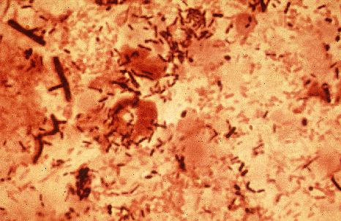
C . Difficile
Pseudomembranous colitis
Antimicrobial associated diarrhea
Hospital acquired diarrhea
EPIDEMIOLOGY:
Overgrowth of Clostridium difficile in the colon, usually after the normal flora has been disturbed by anti microbial chemotherapy
Clostridium difficile causes antibiotic associated diarrhea (AD) and more serious intestinal conditions such as colitis and pseudo membranous colitis .
Pseudomembrane is the clinical manifestation of this disease which composed of bacteria , fibrin , WBCs and dead tissue cells

Slide 32
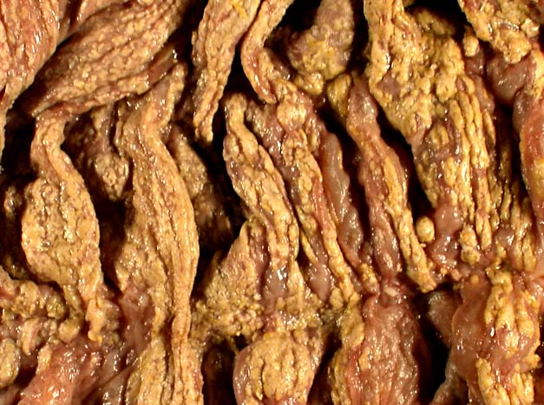
EPIDEMIOLOGY:
CLINICAL PICTURE
Sourse :
Soil
Human and animal feces
Hospital environment {Reservoirs}
Spores acquired
Environment
Fecal – oral { colonized persons }
Intestinal colonization rate
Healthy neonates , young infant [ 50 %]
Children > 2yrs , adults {3 % }
Mild diarrhea , asymptomatic carriage
– Toxic megacolon ,bowel perforation and death
Pseudomembranous colitis
Bloody diarrhea , abdominal cramps,
Fever , systemic toxicity
Colonic mucosa – yellowish plaques
Sever disease – neutropenic , inflammatory bowel disease
Severe dehydration , intestinal obstruction and perforation are some of complication of this syndrome.

Slide 33
PATHOGENESIS
TOXINS that has two components:
a. Subunit TOXIN A (enterotoxin) cause diarrhea.
b. Subunit TOXIN B (Cytotoxic) kill the cells i.e. necrosis and is more potent
. Most strains produce both or no toxins
DIAGNOSIS
TREATMENT
Endoscopy : pseudomembranes and Hyperemic rectal mucosa
Stool : toxins { EIA } , Cell culture to Confirm toxigenic strains
Isolation of C. Difficile { not diagnostic }
PCR (Polymerase chain reaction)
Metronidazole for 7-10 days , oral , IV
Oral vancomycin : {emergence of VRE }
10-20 % relapse rate
Antimotility drugs : contraindicated
Antimicrobial therapy : severe toxicity , persistent diarrhea
Discontinue antimicrobial therapy{clinical significant diarrhea or colitis}

Slide 34
Risk Factors
Exposure to organisms
Disturbed normal gut flora {proliferate – toxin}
Repeated enema
Prolonged NG tube
GI surgery
Bowel stasis
Antimicrobials : penicillins , clindamycin , Cephalosporins
Control Measures
Proper hand washing {contact precautions}
Limiting use of antimicrobial agents
Isolation of patients with diarrhea
Disinfection of pt. rooms

Slide 35
Notes on anaerobic bacteria
Anaerobic bacteria is similar to aerobic bacteria that they both have Gram positive bacilli, Gram negative bacilli, Gram positive cocci.. But the major one is Clostridium ( which is anaerobic, spore forming Gram positive bacilli ).
Gram positive bacilli: can be both aerobic or anaerobic.
The negative type of bacteria Cannot form spores.
Clostridium is like viruses in a way that one Clostridium can cause infection by itself (can cause different clinical presentations by itself)
Any single species of Clostridium can cause totally different clinical presentations
We have 4 major species:
Clostridium tetani ( cause spasm )
Clostridium perfringens ( cause gas gangrene ) , release a toxin called Phospholipase
Clostridium botulinum ( cause paralysis )
Clostridium difficile ( cause diarrhea )
* التيتاني والبوتولينيم عكس بعض بحيث الاول يسبب انقباض للعضلات اما الثاني يسبب شلل

Slide 36
Notes on anaerobic bacteria
Clostridium difficile ( cause diarrhea )
هذي تفرز نوعين من التوكسينز
A enterotoxin which causes diarrhea
B cytotoxic ( kill the cells )
Clostridium are commonly found in soil and are able to survive under adverse conditions
It is common in any infection that their will be an increase in WBC number, but in clostridium perfreingens ( that causes gas gangrene ) we will have low WBC!! Why?
Because they produce leukos…( toxin that kill WBC )

Slide 39
Questions
1- A / 2- B / 3- B / 4- T / 5-C / 6- bacteroides fragilis
7-A / 8- vaccination / 9- cl.difficle ( pseudomembernous colitis)
Treatment of most anaerobic bacteria is: a) Penicillin b) Metronidazole c) Vancomycin
Anaerobic bacteria lack an enzyme called: a) Lactase b) Superoxide dismutase c) Lyase
….. is the most location for anaerobic infection. a) Genital tract b) GIT c) Respiratory Tract
The broad classification of bacteria is based on the types of reactions employ to generate energy for growth. a) T b)F
An example of an anaerobic gram positive bacili non forming spores : A- Clostridia B- Peptococcues C- Actinomyces
What bacteria is always resistant to penicillin: Ans:…………………………………………………………..
Veillonella parvula is always in: A- Gram negative cocci B-gram positive cocci C-gram positive cocci in clusters
Cl.tetani is prevented by: Ans:………………………………………………………….
What cuses toxic enterocolitis : Ans : …………………………………………………………

Slide 40
Contact us :
THE TEAM :
THE TEAM :
436microbiologyteam@gmail.com
Twitter :
@microbio436
Waleed Aljamal
Ibrahim Fetyani
Meshal Eiaidi
Khalid Alhusainan
Hussam Alkhathlan
Faisal Alqumaizi
Shrooq Alsomali
Rawan Alqahtani
Hanin Bashaikh
Jawaher Alkhayyal
Reem Alshathri
Ohoud Abdullah
Ghadah Almazrou
Lama Al-musallm

