Slide 1
Drug administration
and absorption
*مقتبس من تيم ٤٣٥
Objectives:
Know the meaning of pharmacology and its branches.
Discuss the different routes of drug administration.
Identify the advantages and disadvantages of various routes of drug administration.
Know the various mechanisms of drug absorption.
List different factors affecting drug absorption.
Define bioavailability and factors affecting it.
Titles
Very important
Extra information
Terms
The roots of education are bitter, but the fruit is sweet

Slide 2
Pharmacology
Pharma: drug , logy: science
A science that deals with the drugs regarding classification, pharmacokinetics, pharmacodynamics, side effects and uses.
Pharmacokinetics:
(what the body does to a drug?)
Pharmacodynamics
(what the drug does to the body? And what is the other action for the drug)
Pharmacodynamics:
1.Mechanismsof drug action 2.Pharmacological effects of drugs
Drug
Administration
Pharmacokinetics(ADME) :
Absorption
Absorption
Distribution*
Metabolism
Excretion**
Blood
* the drug distribute all over the body, which will give the wanted effect and unwanted effect (side effect)
** usually in urine from kidney or faces from the liver
distribution
Difference organs & tissue
Site of action
Routes of drug administration:
Enteral via gastrointestinal tract GIT (Oral –Sublingual –Rectal)
Inhalation
Parenteral(Injections)
Topical application
Metabolism
Excretion
Contact us : Pharma436@outlook.com
@Pharma436

Slide 3
Routes of drug administration:
1- Enteral via gastrointestinal tract (GIT):
 | Advantage | Disadvantage
Oral | Common Easy Self use convenient Cheap No need for sterilization. | Slow effect, GIT irritation. Destruction by pH and enzymes. Food - drug interactions. (if there is food inside the stomach) Drug-drug interactions. (if the patient use more than 1 drug) First pass effect. No complete absorption. (because of the pH, enzymes, food-drug interaction) Low bioavailability. (the conc. of drug in blood). Not suitable for vomiting and unconscious patient and emergency (because it has slow effect) and bad taste drugs.
Sublingual | Rapid effect can be used in emergency (direct absorption) High bioavailability No first pass effect. (direct absorption) No GIT irritation No food drug – interaction Dosage form: friable tablet (easily breaks and dissolves) | not suitable for : Irritant drugs Frequent use
Rectal | Suitable for children, vomiting, unconscious patients Irritant & bad taste drugs less first pass metabolism (50%) Dosage form suppository or enema | Irritation of rectal mucosa Irregular absorption & bioavailability
Contact us : Pharma436@outlook.com
@Pharma436

Slide 4
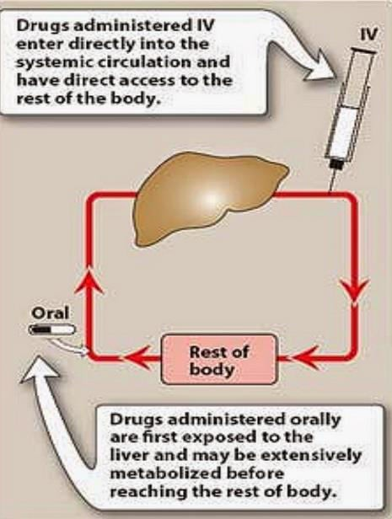
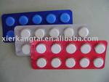
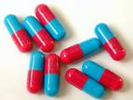
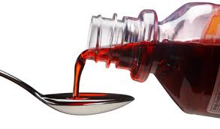
First pass effect:
Drugs given orally
via portal
circulation
taken to the liver and metabolized (first metabolism)
reaching to the blood to be distributed to body compartments
أي بمعنى لمن ناخذ الدواء orally على طول يروح للكبد ويصير له تكسر (first metabolism ) فبالتالي نخسر جزء من الدواء فراح يقل الbioavailability، بعد ما يخلص من الكبد يروح للدم (Absorption)
First pass metabolism results:
Low bioavailability (low conc. of drug in blood).
Short duration of action (t ½).
drugs with high first pass effect should not be
given orally but parenterally.*
*لأن راح يتكسر جزء كبير من الدواء و ماراح يضل جزء كافي إنه يعطيني التأثير
Where it occur:
Liver (mainly).
GIT Wall.
GIT Lumen.
Oral Dosage Forms “oral formulations”:
Tablets: Coated tablets: sugar-coated to mask bad taste
Enteric coated tablets: dissolve only in intestine
Capsules: Hard gelatin capsules: (contain powder ’solid’)
Soft gelatin capsules: (contains liquid)
Syrup: (e.g. Cough syrups)"كمية قليلة من الدواء مذابة في محلول السكر عشان تحسن الطعم خصوصًا للأطفال”
Suspension: “mixture of solid in liquids’’ e.g. antibiotics
Contact us : Pharma436@outlook.com
@Pharma436

Slide 5
Routes of drug administration:
2- Inhalation:
 | Advantage | Disadvantage
Inhalation | Rapid absorption (due to large surface area) Immediate Effects limited systemic effect (because it is in one place or Local Effect) Ideal For Gases Effective Local action Dose Can Be Titrated Suitable For Emergency Fewer Side Effects No first pass effect Dosage form: volatile gases e.g. anesthetics liquids given by aerosol, nebulizer for asthma treatment | addictive route patients may have difficulty using inhalers patients may have difficulty regulating dose Not suitable for irritant drugs Only few drugs can be used
3- Parenteral (injection):
 | Advantage | Disadvantage
Parenteral | No first-pass metabolism Have Highest Bioavailability No food-drug / drug-drug interaction No gastric irritation Suitable for Vomiting, unconscious ,Irritant & bad taste drugs. | Need skill Pain, tissue necrosis or abscess (I.M) Anaphylactic reaction (I.V)
Type of Parenteral:
Intradermal (I.D) (into skin) | Subcutaneous (S.C) (Under skin) | Intramuscular (I.M) (into muscle) | Intravenous (I.V) (into veins)
Intra-arterial (I.A) (into arteries) | Intrathecal (I.T) (cerebrospinal fluids) | Intraperitoneal (I.P) (peritoneal cavity) | Intra-articular (Synovial fluids)
Contact us : Pharma436@outlook.com
@Pharma436

Slide 6
Parentral
 | Advantage | Disadvantage | Volume
Intradermal (I.D) | suitable for vaccinations sensitivity test (sensitivity of some medications or food) | Not suitable for large volumes. | 0.1 ml
Subcutaneous (S.C) | Used for sustained release effect (راح يأخذ وقت عشان يمتص فيجلس بالجسم فترة طويلة فما يحتاج آخذه أكثر من مرة باليوم) Suitable to poorly soluble suspensions & for Instillation of slow-release implants e.g. insulin zinc preparation | Not suitable for large volumes | 0.1ml –1ml
Intramuscular (I.M) | prolonged duration of action oily preparations* or poorly soluble substances can be used | Not suitable for irritant drugs pain, abscess, tissue necrosis may happen | 3-5ml
Intravenous (I.V) | Large volume Rapid action (emergency) High bioavailability 100% (becase it will go directly to the blood stream) No food-drug interaction No first pass metabolism No gastric irritation Suitable for Vomiting, unconscious ,emergency, Irritant & bad taste drugs. | used only for water soluble drugs (because the blood is water soluble, so we can’t use oily preparations ) Infection Anaphylaxis Sterilization Expensive Not suitable for oily solutions or poorly soluble substance Must inject solutions slowly as a rule | 500ml
* oily preparation: drug dissolved in oil solvent which won't be mixed with bloodstream so we inject it in muscle
Contact us : Pharma436@outlook.com
@Pharma436

Slide 7
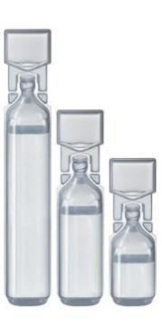
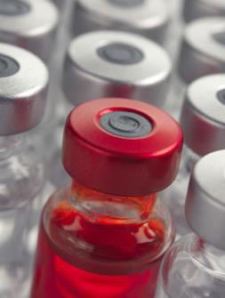
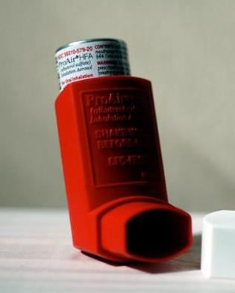
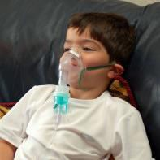
Topical application
Drugs are mainly applied topically to produce local effects. They are applied to
Skin (percutaneous) e.g. allergy test, topical antibacterial and steroids and
local anesthetics.
Mucous membrane of respiratory tract (Inhalation) e.g. asthma
Eye drops e.g. conjunctivitis
Ear drops e.g. otitis externa
Intranasal e.g. decongestant nasal spray
Transdermal patch:
Is a medicated adhesive patch that is placed on the skin to deliver a specific dose of medication through the skin and into the bloodstream. Girl’s definition: are medicated adhesive patch applied to skin to provide systemic effect ‘all around the body’ (prolonged drug action)
e.g. the nicotine patches (quit smoking).
e.g. Scopolamine (vestibular depressant, antiemetic for motion sickness).
Ampoule
(single use)
Vial (repeated use)
Atomizer
Nebulizer
(Parenteral Dosage Forms)
(Inhalation Dosage Forms)
Contact us : Pharma436@outlook.com
@Pharma436

Slide 8
Drug Absorption
DEFINITION: the passage of a drug from it’s site of administration to site of action across cell membranes.
EXCEPTION: Except for intravenous administration, all routes of drug administration require that the drug be absorbed from the site of administration into the systemic circulation (blood).
(I.V. administration requires no absorption)
Mechanisms of drug absorption
Simple Diffusion
(Passive Diffusion)
Facilitated Diffusion
Active Diffusion
Pinocytosis
Endocytosis: uptake of membrane-bound particles
for high molecular weight drugs such as peptides
high polar substances such as vitamin B12(combines with intrinsic factor) &iron (combines with transferrin)
Exocytosis: expulsion of membrane-bound particles
Aqueous Diffusion
low molecular weight & water soluble drugs diffuse through aqueous channel or pores in cell membrane (filtration).
Lipid Diffusion
low molecular weight & lipid soluble drugs diffuse through lipid cell membrane.
Passive Diffusion | Active Diffusion | Carrier-Mediated Facilitated Diffusion
ALONG Concentration Gradient | AGAINST Concentration Gradient | ALONG Concentration Gradient
No Energy & Carrier | Requires Energy & Carrier | No Energy But Requires Carrier
Common | Uncommon | ______________
Not Saturable | Saturable | Saturable
Non Selective | Selective (Specific) | Selective
DEPEND ON Lipid Solubility | E.G. Absorption of Sugar & Amino Acid | Similar to Entry of Glucose into Muscle (GLUT 4)
DEPEND ON Pka of Drug & pH of the Environment (It can be fluid of the cell body, blood, urine) | Uptake of Levodopa by Brain (treatment of Parkinsons) | ______________
Contact us : Pharma436@outlook.com
@Pharma436

Slide 9
pka effect & pH
pKa (dissociation/ionization constant): pH at which half of the substance is ionized & half is unionized.
The lower the pKa value (pKa < 6) of the acidic drug, the stronger the acid ,e.g Asprin (Pka= 3.0)
The higher the pKa value (pKa >8) of a basic drug, the stronger the base, e.g propranolol( pKa= 9.4)
Drugs can exist in 2 forms in equilibrium :
ionized (polar) > water soluble
unionized (nonpolar) > lipid soluble
Most drugs are weak basic or weak acid
Only UNIONIZED form is absorbable (because it is lipid soluble and can soluble easily in cell membrane which has lipid bilayer)
Ionization of drugs reduces passage of drugs across cell membranes. (because it is water soluble and can’t soluble easily in cell membrane which has lipid bilayer)
The degree of ionization of drugs is determined by their pKa and pH of the surrounding.
Affects degree of ionization of drugs:
Weak Basic drugs are best absorbed in the intestine. (because the intestine is a basic medium, so the drug won’t ionized and will be unionized or lipid soluble, so it will easily absorbed)
Weak Acidic drugs are best absorbed in the stomach. (because the stomach is an acid medium, so the drug won’t ionized and will be unionized or lipid soluble, so it will easily absorbed)
Contact us : Pharma436@outlook.com
@Pharma436

Slide 10
Factors affecting absorption:
Route of administration | Dosage forms (depending on particle size and disintegration, ease of dissolution) (solution > suspension > capsule > tablet) | Molecular weight of drug Small molecular absorbed better than large molecular
Lipid and drug solubility (aqueous preparation better than oily, suspension preparation) | Degree of ionization Less ionized better absorbed | Chemical instability in gastric pH Penicillin and insulin
Surface area available for absorption (small intestine has large surface area than stomach due to intestinal microvilli) | Blood flow to absorptive site (greater blood flow increases bioavailability) (intestine has greater blood flow than stomach) | Intestinal motility (transit time) (Diarrhea reduces absorption)
Gastric emptying (drugs that increase gastric emptying enhances absorption ‘metoclopramide’). emptying enhance absorption (metoclopramide)) | Drug interactions | Food (Slow gastric emptying, generally slow absorption ) e.g. Tetracycline, aspirin, penicillin V (A fatty meal increases the absorption of fat soluble antifungal drug (e.g. griseofulvin, )
Contact us : Pharma436@outlook.com
@Pharma436

Slide 11
Quick quiz
Videos :
‏
The First Pass Effect of the Liver
‏Bioavailability
Contact us : Pharma436@outlook.com
@Pharma436

Slide 12
Pharmacology Team :
Boys | Girls
عبدالرحمن ذكري | اللولو الصليهم
عبدالعزيز رضوان | روان سعد القحطاني
عبدالرحمن المالكي | أميرة نيازي
فيصل العابد | جواهر أبانمي
فارس النفيسة | رانيا العيسى
خالد العيسى | غادة المزروع
معاذ الفرحان | لمى الفوزان
محمد الاسمري | نورة الشبيب
محمد خوجة | أسيل ناصر بادخن
عمر التركستاني | أنوار نجيب العجمي

