Slide 1
Tolerance and
Adverse drug reactions
Objectives:-
Distinguish difference between tolerance and desensitization (tachyphylaxis) and reasons for their development.
Recognize patterns of adverse drug reactions (ADR).
Titles
Very important
Extra information
Terms
ALMOST DONE

Slide 2
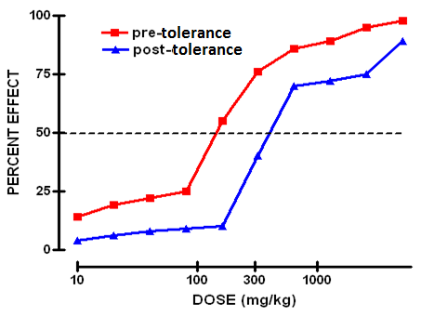
Phocomelia:
it's a disease caused by Thalidomide crisis (drug) was marketed in 1958 in West Germany as a hypnotic & for morning sickness during pregnancy).
In 1961 a report of out break of phocomelia in the newborn babies (40000-100000 cases)
This is called:
Iatrogenic disease
(caused by doctor’s mistake).
Diminution of a response
Tolerance
Tachyphylaxis / Desensitization
Gradual in the course of few days to weeks
Rapid, in the course of a few minutes
Resistance
loss of effectiveness of antimicrobial agent
In tolerance and desensitization , the dose is no longer enough to produce the desired effect.
Contact us : Pharma436@outlook.com
@Pharma436

Slide 3
Tolerance & Desensitization
Males: Phenomenon of variation in drug response, whereby there is a gradual diminution* of the response to the drug when given continuously or repeatedly.
Females: a need for markedly increased amounts of the substance to achieve intoxication or desired effect.
Or
markedly diminished effect with continued use of the same amount of the substance.
*:تناقص تدريجي
Reasons for Development of Tolerance:
1. Pre-receptor Events
2. Events at Receptors
3. Post Receptor Events
Pre-receptor Events | Post Receptor Events
↓ drug availability at the relevant receptors due to pharmacokinetic variables Drug becomes: 1-More metabolized or excreted 2-Less absorbed altered distribution to tissues. e.g. Barbiturates (enzyme inducers) increase metabolism of Contraceptive pills which means the availability will reduce. ↓ | Nullification (Remove - Cencel) of drug response by a physiological adaptive homeostatic response. e.g. Antihypertensive effects of ACEIs become nullified by activation of renin angiotensin system (RAS) by NSAIDs ↓
They both Loss the therapeutic efficacy (Refractoriness)

Slide 4
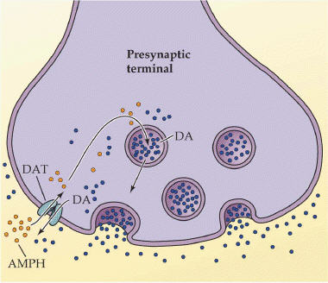
Events at Receptors
1-Exhaustion of mediators : e.g Depletion of mediator stores by amphetamine | 2-Binding alteration Phosphorylation of R by ß-adrenoceptors which will Reduce the activation of AC (Adenyl Cyclase) to related ionic channel [functional defect] | 3-Down regulation ↓ number of receptors. Isoprenaline activation to b receptors which will Increase the receptors recycling by endocytosis [structural defect]
Down Regulation and Binding Alteration:
G protein-coupled receptor kinases (GRKs) : regulate the activity of GPCRs by phosphorylating their intracellular domains after their associated G proteins have been released and activated.
Arrestin is a protein that prevent the re-association of the G proteins with their receptors, thereby preventing reactivation of the signaling pathway.
BINDING ALTERATION
DOWN REGULATION
Contact us : Pharma436@outlook.com
@Pharma436

Slide 5
Addiction
Only in female’s slides
The initial decision to use drugs is voluntary.
Definition: a chronic, relapsing brain disease.
Characterized by:
Compulsive مجبر behavior of a person (loss of control)
Continue taking drugs despite their many adverse health and negative consequences
Craving: dysphoric مكتئب.
Addiction components
Psychological dep)endence (craving اشتهاء
Physical dependence (withdrawal symptoms*), neurons adapt to the repeated drug exposure and only function normally in the presence of the drug
Drugs of addiction :
Stimulants
stimulate the central nervous system
amphetamines, cocaine, nicotine
Depressants مثبطات
depress the CNS
alcohol, barbiturates, benzodiazepines (sedation)
Analgesics مسكنات (depress the CNS, and produce Euphoria سعادة)
powerful painkillers
from opium poppy , morphine, heroin
Hallucinogens مهلوسات
dramatically alter perception الإدراك
LSD, cannabis, Marijuana
*: similar to end of use ADR, e.g. tachycardia, flushing, and muscle cramps
Contact us : Pharma436@outlook.com
@Pharma436

Slide 6
Types of ADRs
Type A
(Augmented)
Type B
(Bizarre)
Type C
(Continuous)
Type D
(Delay)
Type E
(End-of-use)
ADRs are harmful or seriously unpleasant effects occurring at doses intended for therapeutic effects.
1-Type A (Augmented)
80% of ADRs
Predictable (يمكن التنبأ به)
A consequence but in excess of the primary pharmacological effect of the drug.
(يعني السايد ايفيكت للدواء عبارة عن زيادة تأثير الشي اللي نبغى الدواء يسويه)
e.g. bleeding from warfarin
e.g. Hypoglycemia from
hypoglycemic drug
2. Type B (Bizarre)
occur rarely and unpredictably
Occurs different to known drug pharmacological effect [idiosyncratic or heterogenous] Usually due to patient’s genetic defect or immunological response and qualitative nature.
(السايد ايفيكت هنا ما يعمل نفس عمل الدواء , يعمل شي مختلف وغريب)
e.g. * Penicillin Anaphylactic shock
* Thrombocytopenia  Quinine
it has Immunological Predisposition :-
The drug or its bi-product [protein macromolecules or haptens] react as antigens and provoke immune response that results in damage to the tissue Hypersensitivity Reaction
1st exposure to a drug  Sensitization
Repeated exposures  HYPERSENSITIVITY REACTION
Contact us : Pharma436@outlook.com
@Pharma436

Slide 7
Comparison between type A & B
 | Type A Augmentation | Type B Idiosyncratic
Pharmacological predictability | Yes | No
Nature | Quantitative [ extension of pharmacology effect ] | Qualitative [ immune or genetic base]
Dose- dependent | Yes (dose response relationship present) | No (dose response relationship absent)
Onset of symptoms | Usually Rapid | Usually delayed
Incidence and morbidity | High | Low
Mortality | Low | High
Treatment | Dose adjustment or Substitute by > selective + Antagonize unwanted effect of 1st drug | Stop drug + Symptomatic treatment
Example | Bradycardia β- ADR Blockers Hemorrhage Warfarin | Apnea succinylcholine Thrombocytopenia Quinine
Examples of TYPE A & B
Drug Type A Type B
Chlorpromazine Sedation Cholestatic jaundice
Naproxen GIT haemorrhage Agranulocytosis
Phenytoin Ataxia Hepatitis, lymphadenopathy
Thiazides Hypokalaemia Thrombocytopenia
Quinine Tinnitus Thrombocytopenia
Warfarin Bleeding Breast necrosis
Contact us : Pharma436@outlook.com
@Pharma436

Slide 8
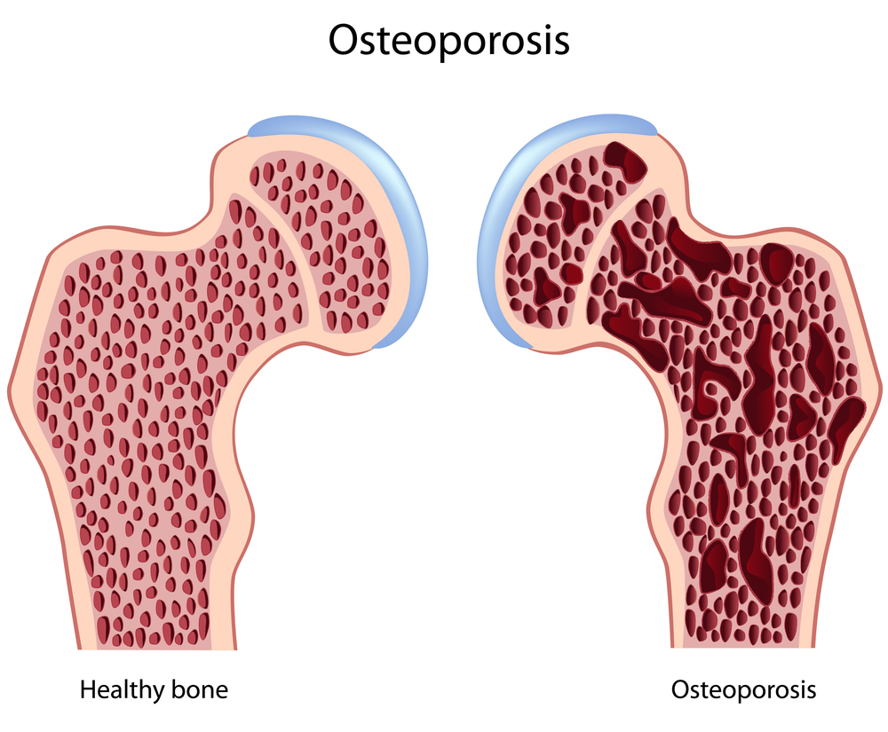
3. Type C (Continuous)
Occurs during chronic drug administration
e.g. * Osteoporosis secondary to chronic corticosteroid intake.
*Dependence
a. Psychological [Craving] as by cannabis
b. Psychological [Craving]
+ Physical withdrawal
manifestations (syndrome)
= Addiction as by morphine
Type D (delayed)
Occurs after long period of time even after drug stoppage.
Examples:
Teratogenicity after retinoids.
Carcinogenicity after tobacco smoking.
Teratogenic drugs: A teratogen is an agent that can disturb the development of the embryo or fetus.
Type E (End of use)
-Occurs after sudden stoppage of chronic drug use due to existing adaptive changes
e.g. Patients on stoppage of
- Clonidine develop rebound hypertension
Morphine develop withdrawal syndrome
Diazepam develop anxiety and insomnia
Contact us : Pharma436@outlook.com
@Pharma436

Slide 9
Classification of hypersensitivity
Type I: Anaphylactic
Type II: Cytotoxic
Type III: Cytotoxic
Type IV: Cell mediated
Type I : Anaphylactic
-is an allergic reaction provoked by re-exposure to a specific antigen
-response occurs in minutes, The reaction usually takes 15 - 30 minutes from the time of exposure to the antigen.
-The reaction is mediated by IgE antibodies and produced by the immediate release of histamine, serotonin, leukotrienes from tissue mast cells or blood basophils
-The reaction may be either local or systemic. Symptoms vary from mild irritation to sudden death from anaphylactic shock.
examples:
1-Allergic asthma. 2-Allergic conjunctivitis.
3-Allergic rhinitis. *hay fever* 4-urticarial. *hives*
5-anaphylaxis.
May be caused by Penicillin, streptomycin.
Type II : Cytotoxic
Antibody-dependent.
The antigens may be endogenous or exogenous chemicals (haptens) which can attach to cell membranes.
The antibodies (IgM or IgG) produced by the immune response bind to antigens on the patient's own cell surfaces that is perceived by the immune system as foreign, leading to cellular destruction.
The reaction takes hours to a day.
Examples: Drug-induced haemolytic anemia , thrombocytopenia.
may be caused by Penicillin, Quinidine.
Contact us : Pharma436@outlook.com
@Pharma436

Slide 10
Type III : Immune complex
Soluble immune complexes (aggregations of antigens and IgG and IgM antibodies) form in the blood, are not completely removed by macrophages and are deposited in various tissues (typically the skin, kidney and joints).
The reaction takes hours to days to develop.
Example: Serum sickness (fever, arthritis, enlarged lymph nodes, urticaria)
Can be caused by Sulphonamides, Penicillin, Streptomycin.
Type IV : Cell-mediated
also known as delayed type hypersensitivity as the reaction takes two to three days to develop.
Unlike the other types, it is not antibody- mediated but rather is a type of cell-mediated response.
Cytotoxic T cells cause direct damage whereas helper T cells secrete cytokines that attracts inflammatory cell infiltrate
Example : Contact dermatitis by local anesthetics creams, anti -histamine creams, topical antibiotics.
Contact us : Pharma436@outlook.com
@Pharma436

Slide 11
435
Hypersensitivity Reactions
Characteristics | Type-1 (Anaphylactic) | Type-2 (cytotoxic) | Type-3 (immune complex) | Type-4 (Cell mediated /delayed type)
Antibody | IgE- mediated | Antibody- dependent IgG, IgM | IgG, igM | Not antibody- mediated
Antigen | Re-exposure by a specific antigen (exogenous) | On patient’s own cell surface that is perceived as foreign, leading to cellular destruction | Soluble in the blood, so they’re not completely removed by macrophages | Tissue and organs
Response time | FAST- Occurs in minutes (15-30 minutes) | Hours to a day | Hours to days | Two to three days
Histology (Type of the cell) | Basophil & Mast cells | - | - | T-cells (cytotoxic & helper)
Cell-mediators | Histamine, serotonin, leukotrienes | - | - | It is cell mediated response
FURTHER INFORMATION | 1-The reaction can be local or systemic 2-In severe cases, It might lead to death | - | It get deposited in various tissue (typically the skin, kidney and joints) | cytotoxic T cells cause direct damage whereas T-helper secrete cytokines
EXAMPLE | Allergic asthma, high fever, rhinitis, and Anaphylaxis (Most Severe) | Drug-induced haemolytic anemia, thrombocytopeni a | Serum sickness (fever, arthritis, enlarged lymph nodes, urtcaria) | Contact dermatitis
CAUSED BY | Penicillin, streptomycin | Penicillin, Quinidine | Sulphonamides, penicillin, streptomycin | Local anesthetic creams, anti- histamine creams &topical antibiotics
Contact us : Pharma436@outlook.com
@Pharma436

Slide 12
Pharmacology Team :
Boys | Girls
عبدالرحمن ذكري | اللولو الصليهم
عبدالعزيز رضوان | روان سعد القحطاني
--------- | أميرة نيازي
فيصل العباد | جواهر أبانمي
فارس النفيسة | رانيا العيسى
خالد العيسى | غادة المزروع
معاذ الفرحان | لمى الفوزان
عبدالرحمن الجريان | نورة الشبيب
محمد خوجة | أسيل ناصر بادخن
عمر التركستاني | أنوار نجيب العجمي

