Slide 1
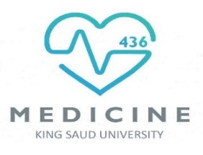
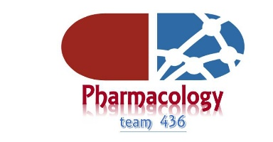
Bioavailability and Distribution
Objectives:
Major body fluid compartments.
Concept of compartment.
Apparent volume of distribution.
Plasma protein binding.
Tissue binding.
Titles
Very important
Extra information
Terms
Don’t study with a fear of failing. Study with the hope of succeeding.

Slide 2
Bioavailability
Is the amount of unchanged drug that enters systemic circulation after administration and becomes available to produce pharmacological actions
(rate and extent of active reaching systemic circulation)
Factors affecting Bioavailability:
1. Same factors affecting Absorption MW, dosage forms, drug solubility, etc.
2. First Pass Metabolism (decreases bioavailability.)
I.V. provides 100% bioavailability i.e. F= 1 , because it goes directly to the circulation without being metabolized .
Subcutaneous, intramuscular, oral, rectal, and other extra vascular routes of administration require that the drug be absorbed first, which can reduce bioavailability .
Bioavailability
(F) = AUC (oral)/AUC (I.V.) X 100
AUC = Area Under Curve
Bioavailability
1- Absolute bioavailability:
-Comparing between the I.V bioavailability as a standard formulation and the bioavailability of the same drug taken by any other route.
2- Relative bioavailability:
- Determined when two products are compared to each other, not to an intravenous standard.
e.g Tylenol (paracetamol 500 mg) compared to Panadol (paracetamol 500 mg).
Dosage adjustment is required when changing formulation or routs of administration.
The importance of the relative bioavailability:
1- To determine that the generic formulation is bioequivalent to another formulation .
2- To get an idea of how different formulations or a different routes of administration could change thebioavailability.
Contact us : Pharma436@outlook.com
@Pharma436

Slide 3

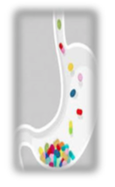
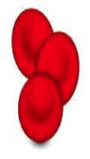
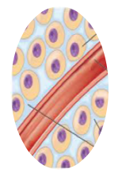
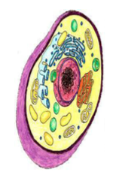
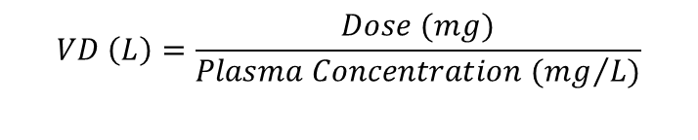
Bioavailability
Bioequivalence:
We use this term when the rate and the extent of bioavailability of active ingredients in two products are the same.
.
Factors affecting Bioequivalence:
1- Same factors controlling drug absorption. 2- First pass effect.
Distribution
Definition: The process by which drugs leave blood circulation and enters the interstitial and/or the cells of the tissues.
Drug Administration
Extracellular
Intracellular (Lipid soluble)
Absorption
Blood (Plasma)
Apparent Volume Of Distribution (VD)
Definition: It is the ratio of drug amount in body (dose) to the concentration of drug in blood.
$$VD \left(L\right)=\frac{Dose (mg)}{Plasma Concentration ({mg}/{L)}}$$
VD Importance:
- Calculation of the loading dose
- Prediction of the duration of action:
  High VD means long duration of action.
  Low VD means short duration of action.
Contact us : Pharma436@outlook.com
@Pharma436
3

Slide 4
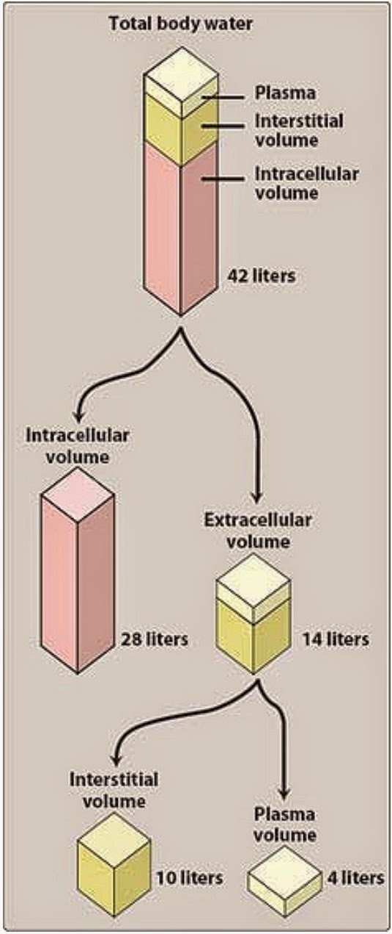
The major body fluid compartments
Extracellular fluids(22%)
Intracellular fluids(35%)
-plasma (5% of body weight=4liters)
fluid present inside all cells in the body (28 L)
-Interstitial fluid (16 % = 10 liters)
Total body fluids
(70% of body weight in 70-kg individual)
Plasma volume (4 L)
+
Interstitial volume (10 L)
+
Intracellular volume ( 28 L)
=
Total body fluid
(42L)
Volume of distribution
Contact us : Pharma436@outlook.com
@Pharma436

Slide 5
Volumes of some compartments of the adult human body in relation to Vd:
• Total body water 0.6 L/Kg Body Weight
• Intracellular water 0.4 L/Kg Body Weight
• Extracellular water 0.2 L/Kg Body Weight
• Plasma 0.04 L/Kg Body Weight
Total Body Water = 0.6 x Weight
Drugs may distribute through:
One compartment
Plasma compartment
Two compartment
Extracellular compartment
Multiple compartment
Intracellular compartment
Contact us : Pharma436@outlook.com
@Pharma436

Slide 6
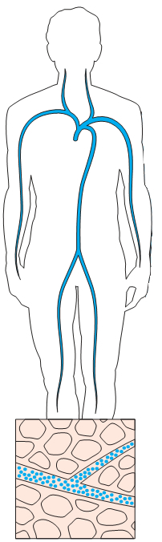
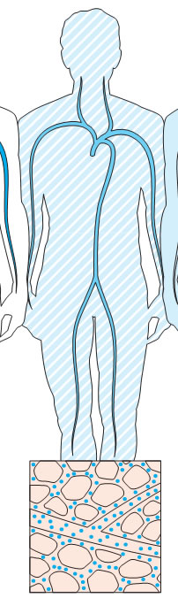
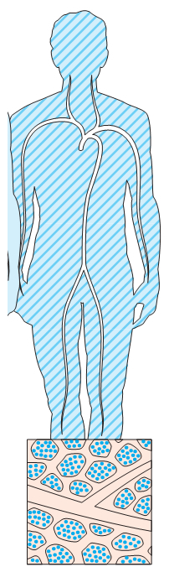
Distribution
 | Plasma (one compartment) | Extracellar (Two compartments) | Intracellular (Multi-compartments)
VD | 4 L | 4-14 L (10+4) | Vd = Total body water ( 42) | Vd > Total body water (42)
Characteristics of the drug | Very high molecular weight drugs Or Drugs that bind to plasma proteins (البروتين يقيد حركته) | Drugs that have a low molecular weight But Are hydrophilic. | Lipid soluble drugs. | Drug that binds strongly to tissues
Distribution | Can not moves across endothelial cells (lining layer) of capillaries So Drugs are trapped in blood | Pass endothelium into interstitial fluids But can not cross cell membranes to intracellular fluids | Pass the cell membrane And enters the cell
Examples | Heparin: (Anticoagulant) 4 L | Atracurium: 11 L | Ethanol: 38 L (34-41) | Digoxin:385 L
Pictures
Note:
Digoxin binds strongly to tissues so that it’s volume of distribution is higher than TBW.
Contact us : Pharma436@outlook.com
@Pharma436

Slide 7
Con.
Drugs with low Vd | Drugs with high Vd
distributed in extracellular compartments (plasma & interstitial fluid) | Distributed intracellularly and Have higher concentrations in tissues than in plasma
-Polar or lipid insoluble drugs. Examples: gentamycin, atracurium. -High molecular weight. Examples: heparin – insulin. -High plasma protein binding. Examples: warfarin (anticoagulant). | -Lipid soluble. Examples: digoxin, phenytion, morphine.
Do not cross BBB or placental barriers (because of low lipid solubility) BBB = Blood Brain Barrier Placental barrier = الحاجز المشيمي للجنين | May distribute across BBB and Placenta
Contact us : Pharma436@outlook.com
@Pharma436

Slide 8
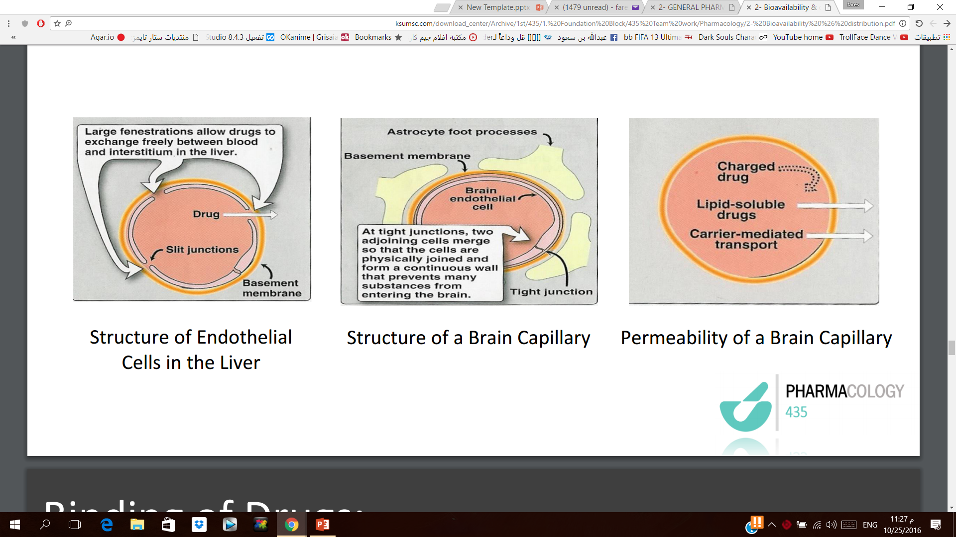
Factors affecting Distribution
1. Cardiac output and blood flow . The greater the blood flow to tissues, the more distribution that occurs from plasma to interstitial fluids. (Drugs distribute more rapidly to brain, liver and kidney than skeletal muscles & fat)
2. Physical & Chemical properties of the drug:
  - Molecular weight - Pka - Lipid solubility
  - Most lipid soluble drugs (unionized, uncharged, nonpolar) cross biological membranes .
  - Hydrophilic drugs (ionized, charged, polar) do not readily cross membranes but go through slit junctions in endothelial cells of capillaries.
3. Capillary Permeability . Endothelial cells of capillaries in tissues other than brain have wide slit junctions allowing easy movement, permeation and distribution. (Brain has tight junction Blood Brain Barrier (BBB)).
4. Plasma protein binding 5. Tissue binding
Blood Brain Barrier (BBB) :
• Only lipid soluble drugs or actively transported drugs→ can cross BBB.
• Hydrophilic (ionized , polar drugs)→ can’t cross BBB .
However, Inflammation as in meningitis increase permeability to hydrophilic drugs.
For example :-penicillin and gentamycin
Placental barrier:
Lipid soluble drugs can cross placental barrier and enter the fetal blood.
Contact us : Pharma436@outlook.com
@Pharma436

Slide 9
Extra notes
Lippincott’s corner
Capillary permeability:
Capillary permeability is determined by capillary structure and by the chemical nature of the drug. Capillary structure varies widely in terms of the basement membrane that is exposed by slit junctions between endothelial cells. In liver and spleen, a large part of the basement membrane that is exposed due to large, discontinuous capillaries through which the plasma protein can pass. This is in contrast to the brain, where the capillary structure is continuous and there are no slit junction. To enter the brain, drugs must pass through the endothelial cells of the capillaries on the CNS or be actively transported. For example, a specific transporter for the large neutral amino acid transporter carries levodopa into the brain. By contrast, lipid soluble readily penetrate into the CNS because they can dissolve in the membrane of the endothelial cells. Ionized, or polar drugs generally fail to enter the CNS because they are unable to pass through the endothelial cells of the CNS, which have no slit junctions. These tightly juxtaposed cells form tight junctions that constitute the so-called BBB (Blood Brain Barrier).
Contact us : Pharma436@outlook.com
@Pharma436

Slide 10
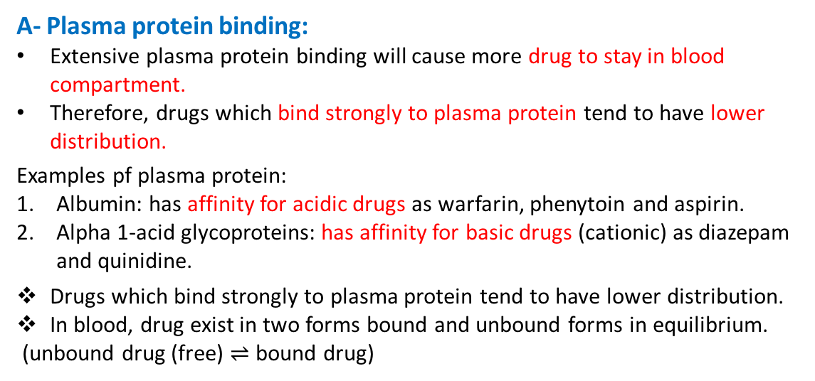
Binding of drugs
A- Plasma protein binding
B- Tissue protein binding
A- Plasma protein binding:
Extensive plasma protein binding will cause more drug to stay in blood compartment.
Therefore, drugs which bind strongly to plasma protein tend to have lower distribution.
Examples pf plasma protein:
Albumin: has affinity for acidic drugs as warfarin, phenytoin and aspirin.
Alpha 1-acid glycoproteins: has affinity for basic drugs (cationic) as diazepam and quinidine.
Drugs which bind strongly to plasma protein tend to have lower distribution.
In blood, drug exist in two forms bound and unbound forms in equilibrium.
(unbound drug (free) $⇌$ bound drug)
Unbound (free) drugs tend to have high volume of distribution.
Bound drugs tends to have low volume of distribution.
B- tissue protein binding drugs:
Drugs can bind to specific tissues and will have high volume of distribution.
example: tetracycline bind to bone
Contact us : Pharma436@outlook.com
@Pharma436
Notes:
Add ** the

Slide 11
Lipincott’s corner
Extra notes
Binding of drugs to plasma Proteins and tissue
Binding to plasma protein
Binding to tissue protein
Hdrophobicity
Reversible binding to plasma proteins sequesters drugs in a nondiffusible form and slows their transfer out of the vascular compartment. Binding is relatively nonselective regarding chemical structure and take place at sites on the protein to which endogenous compounds, such as bilirubin, normally attach. Plasma albumin is the major drug-binding protein and may act as a drug reservoir ( that is, as the concentration of the free drug decreases due to elimination by metabolism or excretion, the bound drug associates from protein). This maintain the free-drug concentration as a constant fraction of the total drug in the plasma. | Numerous drugs accumulate in tissues, leading to higher concentration of the drug in tissues than in the ECF and blood. Drugs may accumulate as a result of binding to lipids, proteins or nucleic acid. Drugs may also be actively transported into tissues. These tissue reservoirs may serve as a major source of the drug and prolog its action or, on the other hand, can cause local drug toxicity. [ for example, acrolein, the metabolite of cyclophosphamide is toxic to the kidney because of its accumulation in renal cells.] | The chemical nature of a drug strongly influences its ability to cross cell membranes. Hydrophobic drugs readily move across most biologic membranes and. Therefore, permeate the entire cell’s surface. The major factor influencing the hydrophobic drug’s distribution is the blood flow to the area. By contrast, hydrophilic drugs do not readily penetrate cell membranes and must pass through the slit junctions.
Contact us : Pharma436@outlook.com
@Pharma436

Slide 12
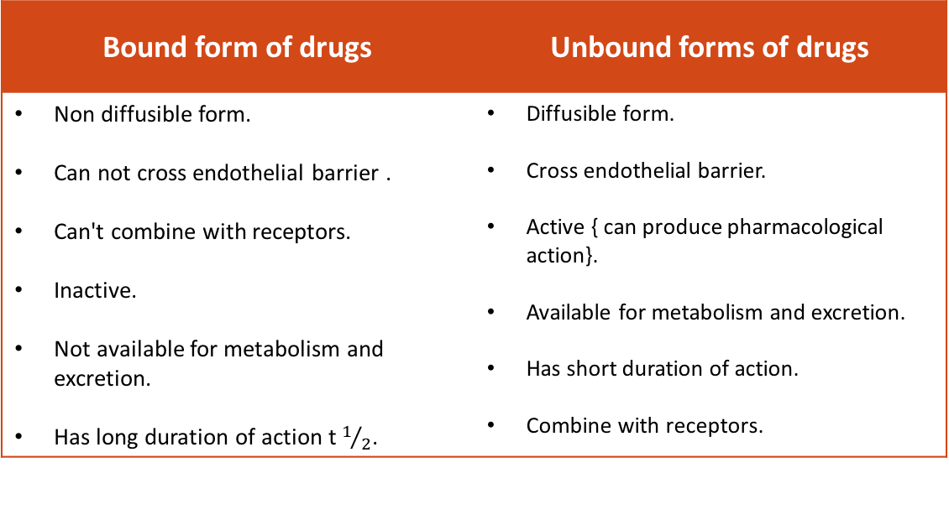
Bound and Unbound Forms
Bound form of drugs | Unbound forms of drugs
Non diffusible form. Can not cross endothelial barrier . Can't combine with receptors. Inactive. Not available for metabolism and excretion. Has long duration of action t $1/2$. | Diffusible form. Cross endothelial barrier. Active { can produce pharmacological action}. Available for metabolism and excretion. Has short duration of action. Combine with receptors.
Characters and consequences of binding:
Usually reversible. ( when unbound form of drug in consumed, bound form is converted or reversed into unbound form).
Determines volume of distribution.
Slows drug metabolism and excretion.
Prolongs duration of action.
Result in clinically important drug interactions.
Contact us : Pharma436@outlook.com
@Pharma436
Notes:
1- add ** combine with receptors
2- t1/2

Slide 13
Extra notes
Lippincott’s corner
Effect of volume of distribution on drug half life:
A large volume of distribution has an important influence on the half-life of a drug, because drug elimination depends on the amount of drug delivered to the liver or kidney (on other organs where metabolism occurs) per unit time. Delivery of drug the organs of elimination depends not only on blood flow, but also on the fraction of the drug in the plasma. If the volume of distribution for a drug is large, most of the drug is in extra-plasmic space and is unavailable to the excretory organs. Therefore, any factor that increases volume of distribution can lead to an increase in the half-life and extend the duration of action of the drug.
[Note: an exceptionally large volume of distribution indicates considerable sequestration of the drug in some tissues or compartment.]
Contact us : Pharma436@outlook.com
@Pharma436

Slide 14
Displacement:
Competition for the same binding site on the plasma proteins may occur between two drugs leading to displacement of one drug & increasing its concentrations & effects.
Aspirin + Albumin-warfarin Albumin-aspirin + free warfarin bleeding
NOTE:
Aspirin has a higher binding capacity than the warfarin.
Free form of the drug is what causes the side effects. (In this case bleeding).
Contact us : Pharma436@outlook.com
@Pharma436
Notes:
Delete displacement cause it is repeated

Slide 15
Quick quiz
https://www.onlineexambuilder.com/bioavailability-and-distribution/exam-103316

Slide 16
Pharmacology Team :
Boys | Girls
عبدالرحمن ذكري | اللولو الصليهم
عبدالعزيز رضوان | روان سعد القحطاني
فيصل العباد | جواهر أبانمي
فارس النفيسة | رانيا العيسى
خالد العيسى | غادة المزروع
معاذ الفرحان | لمى الفوزان
محمد الاسمري | نورة الشبيب
محمد خوجة | أسيل ناصر بادخن
عمر التركستاني | أنوار نجيب العجمي
عبدالرحمن الجريان | أميرة نيازي

