Slide 1
3- Drug Metabolism
Objectives:
Recognize the importance of biotransformation
Know the different sites for drug metabolism
Define the major phase I and phase II metabolic reactions.
Describe the modulation of liver microsomal enzymes by inducers and inhibitors
Mention two drugs that are known as enzyme inducers and inhibitors.
Know the impact of first pass metabolism on drug bioavailability.
Work until no longer you have to introduce your self
Contact us : Pharma436@outlook.com
@Pharma436

Slide 2
Drug Metabolism:
It is the chemical reactions which occur in the body to change drugs from nonpolar lipid soluble forms to polar water soluble forms that are easily excreted by the kidney.
Importance:
Inactivation or termination of drug action (most drugs).
Detoxification Biotransformation is required for protection of body from
toxic metabolites.
Activation of prodrug* (convert inactive form of drug to active form)
e.g. levodopa - carbidopa, prednisone – prednisolone
*an inactive substance that is converted to a drug within the body by the action of enzymes or other chemicals.
Organ sites of drug metabolism:
1- Liver (the major site).* 2- kidney 3- skin 4- lung
5- Intestinal Mucosa and Lumen:
Gut Mucosa: MonoAmine Oxidase (MAO) .
Gut lumen (bacterial flora): Glucouronidase.
6- Plasma:
*because it is a large organ, and there are high concentrations of most drug-metabolizing enzyme systems
Enzymes (in the plasma) | substrate
Catechol O-Methyl Transferase (COMT) | catecholamines (e.g. adrenaline)
Esterases | Esters (acts on drugs as Local Anesthetics)
Amidases | amides (act on drugs as Local Anesthetics)
Contact us : Pharma436@outlook.com
@Pharma436

Slide 3
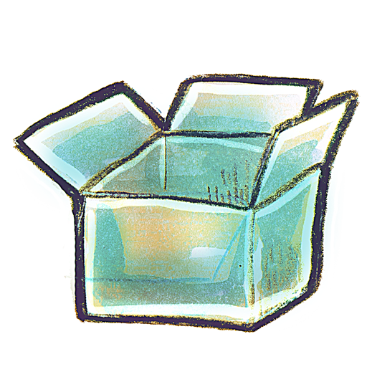
Cellular sites of drug metabolism
CYTOPLASM*
MITOCHONDRIA
MICROSOMES*
LYSOSOMES
REMEMBER THERE IS AN ORGAN SITE AND A CELLULAR SITE. BE CAREFUL.
e.g. Alcohol dehydrogenase**
(NAD⁺ → NADH) (boy’s slides)
(oxidation of alcohol).
Alcohol → Aldehyde → Acid
Ethanol → acetaldehyde → acid
CH₃CH₂OH → CH₃CHO → CH₃COOH
*Is the material or protoplasm within a living cell, excluding the nucleus. So we will find there a lot of enzymes that play a role in the drug metabolism and one
**(ADH) (EC 1.1.1.1) are a group of dehydrogenase enzymes that occur in many organisms and facilitate the interconversion between alcohols and aldehydes or ketones with the reduction of nicotinamide adenine dinucleotide (NAD+ to NADH).
There are several chemicals in this organelle that plays an important role in the drug metabolism, those are:
1- N-acetyl transferase*:
Introduction of acetyl group (CH3COO- ) .
2- Monoamine oxidase enzyme **(MAO):
oxidation of catecholamines as adrenaline.
*an enzyme that catalyzes the transfer of acetyl groups from acetyl-CoA to arylamines.
**a family of enzymes that catalyze the oxidation of monoamines neurotransmitter. They are found bound to the outer membrane of mitochondria in most cell types in the body.
Microsomal enzyme system = Cytochrome P-450.
There are more than 20 families CYP1, CYP2, CYP3
Sub-families are identified as A, B, and C etc.
In human: only 3 isoenzyme families are important CYP1, CYP2 and CYP3
Oxidation – Cytochrome P-425:
CYP 3A4/5 carry out biotransformation of the largest number (30-50%) of drugs.
Expressed in the liver and intestine (responsible for first pass metabolism at this site).
Contact us : Pharma436@outlook.com
@Pharma436

Slide 4
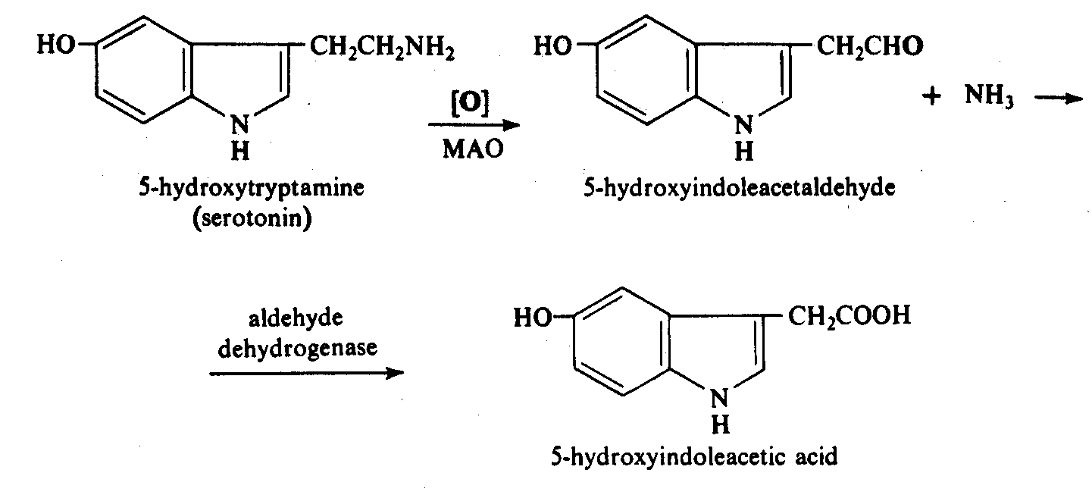
Catechol o-methyl transferase (COMT)
Any drug has the catechol ring will metabolize by the COMT enzyme. This enzyme will add Ch₃ on one of the OH and remove H, so it will transfer Ch₃ to O atom
Monoamine oxidase (MAO)
aldehyde group
Amine group
1
acid
2
1- The MAO enzyme will oxidize the amino group (NH₂) by remove NH₂ and add O instead, this will give me aldehyde
2- another enzyme (aldehyde dehydrogenase) will add another O to the aldehyde group to make acid
Types of hepatic metabolic reaction:
Two phases of hepatic metabolism reactions:
Metabolism
Phase I
* Oxidation
* Reduction
* Hydrolysis
Phase II
Conjugation
After Phase I: (The metabolites)
Active = lipid soluble > Phase II
Inactive = water soluble (excreted)
After Phase II: (The metabolites)
Inactive = water soluble (excreted)
Contact us : Pharma436@outlook.com
@Pharma436

Slide 5
Oxidation
Addition of oxygen or removal of hydrogen
Most important drug metabolizing reaction
Microsomal
Occurs in microsomes
E.g. cytochrome P450 enzyme, NADPH, and oxygen
Nonmicrosomal
Occurs in cytosol or mitochondria
Dehydrogenases
Are required for oxidation of alcohols.
E.g Alcohol dehydrogenase (alcohol → aldehyde)
E.g. Aldehyde dehydrogenase (aldehyde → acid)
Oxidase
Monoamine Oxidase (MAO)
Responsible for the metabolism of catecholamines as adrenaline and serotonin
E.g. Moclobemide (MAO inhibitor used as an antidepressant drug by increasing serotonin in the brain)
Xanthine Oxidase
Required for the oxidation of xanthine.
Hypoxanthine → xanthine → uric acid → accumulation of uric acid → GOUT
E.g. Allopurinol (inhibitor of xanthine oxidase used in treatment of gout)
Contact us : Pharma436@outlook.com
@Pharma436

Slide 6
Reduction:
Removal of oxygen or addition of hydrogen.
May be microsomal or non-microsomal
E.g.: levodopa
DOPA- decarboxylase
Levodopa(DOPA) Dopamine
Hydrolysis
Occurs by addition of water molecules in presence of enzymes as (esterase & amidases)
All are non microsomal
Amid bond
Esterase
hydrolyze drugs that are esters
Amidases
hydrolyze drugs that are amides
Ester + H₂0 → Acid + Alcohol
e.g. Esters as acetylcholine (neurotransmitter).
Acetylcholine → acetate + choline.
المقصود هنا إن فيه دوا يصير له تكسر من خلال أنزيم اسمه استريز وهذا الأنزيم خاص للأدوية اللي فيها استر (حمض + كحول) والأنزيم راح يكسر الدوا من خلال إضافة ماء على الدوا ويحوله إلى حمض + كحول (المكونات الأساسية للإستر)
Amide + H₂0 → Acid + amine
e.g. Amides as lidocaine (used as local anesthetic)
بعض الأدوية راح يصير لها تكسر بواسطة أنزيم اسمه أمايديز وهو خاص للأدوية اللي تتكون من أمايد (أمين + كحول) ولمن يكسرها الأنزيم من خلال إضافة ماء إلى الدوا راح تتحول إلى حمض + أمين
Contact us : Pharma436@outlook.com
@Pharma436

Slide 7
Phase I result in:
Activation of pro-drug e.g. levodopa to dopamine.
Inactivation of drug (termination of action).
Conversion of active drug to active metabolite.
Conversion of nontoxic drug to toxic metabolite.
Paracetamol hepatotoxic metabolite (hepatic necrosis)
Product might undergo phase II
Conjugation:
coming from (phase I) with endogenous substance as methyl group, acetyl group, sulphate, amino acid or glucuronic acid to produce conjugate that is water soluble and easily excreted in urine or bile.
Types of conjugation reaction:
Conjugation reaction | Enzyme required
glucouronide conjugation | Glucouronyl transferase
Acetylation (CH₃COO⁻) | N-acetyl transferase
Sulphation (SO₄²⁻) | Sulfo transferase
Methylation (CH₃) | methyl transferase
Amino acids conjugation | Glycine Transferase
Phase II metabolic reactions:
All are non microsomal except glucouronidation
Glucouronide conjugation is a microsomal process (the most common of phase II reactions).
Deficieny of glucouronyl transferase enzyme in neonates may result into toxicity with chloramphenicol (Gray baby syndrome).
Contact us : Pharma436@outlook.com
@Pharma436

Slide 8
Characteristics of Phase II product:
Usually pharmacologically inactive.
Polar
more water soluble.
Easily excreted in urine.
Factors affecting metabolism :
Genetic polymorphism : Metabolism may vary from population to another due to the existence of different forms of the metabolic enzymes. E.g. Isoniazid (anti- tuberculosis drug)
Slow acetylator phenotype → results in decrease in isoniazid metabolism & accumulation of isoniazid with risk of peripheral neuropathy
the enzyme which will metabolize the drug (isoniazid) has genetic problem so the rate of metabolism is slow that will lead to accumulation of the drug and causes disease (peripheral neuropathy)
Rapid acetylator phenotype → results into excess metabolites produced with risk of hepatitis
the enzyme which will metabolize the drug (isoniazid) has genetic problem so the rate of metabolism is high which will accumulate the drug in the liver and toxics the liver then cause hepatitis
The factor | The rate of metabolism
AGE | Decrease (↓) in neonates & elderly.
DISEASES | Decrease (↓) in liver diseases.
Degree of Protein Binding | Decrease (↓) in binding protein
Concurrent use of drugs | increase (↑) in the Induction | decrease (↓) in the Inhibition
Nutrition | Decrease (↓) in malnutrition
Enzyme Induction & inhibition:
Liver microsomal enzymes inducers :
drugs that increase activities of liver microsomal enzymes & increase the metabolism of drug itself and other drugs taken with the inducer at the same time.
Liver microsomal enzymes inhibitors :
drugs that decrease activities of liver microsomal enzymes & decrease the metabolism of the drug itself and other drugs taken concurrently
Contact us : Pharma436@outlook.com
@Pharma436

Slide 9
Enzyme inducers
Enzyme inhibitors
Enzyme
Alcohol
Cigarette smoking
Phenobarbitone (hypnotic)
Phenytoin (antiepileptic)
Rifampicin (Anti TB)
Grape fruits
Erythromycin (antibiotic)
Cimetidine (anti-ulcer)
Ketoconazole (antifungal)
Enzyme Induction*
Enzyme induction may result in:
•↑ the metabolism and excretion of the inducer drug itself and co-administered drugs.**
•↓ the action of the inducer drug itself & co-administered drugs.
•Tolerance: decrease in the pharmacological action of the drug by continuous or repeated administration .
Drug interactions: decrease in action of one drug by administration of another drug.
e.g. oral contraceptives & phenytoin (An enzyme inducer)
(Failure of oral contraceptive (birth control pills) may lead to pregnancy if combined with phenytoin)
Enzyme Inhibition:
Enzyme inhibition may result in:
•↓ Delay the metabolism and excretion of the inhibitor drug and co-administered drugs.
•↑ Prolong the action of the inhibitor drug & co-administered drugs.
e.g. warfarin & erythromycin (inhibitor).
(inhibition of warfarin metabolism may lead to increase its anticoagulant effect ‘risk of bleeding’ )
Notes:
*An enzyme inducer is a type of drug that increases the metabolic activity of an enzyme.
**There’s a difference between metabolism & action of the drug.
Explanation: in inhibition, we are blocking the thing that breaks the drug down,
#therefore increasing the action of the drug.
Co-administered: taken at the same time.
Contact us : Pharma436@outlook.com
@Pharma436

Slide 10
Extra notes
Lippincott corner
The kidney cannot efficiently eliminate lipophilic drugs that readily cross cell membranes and are reabsorbed in the distal convoluted tubules. Therefore, lipid-soluble agents are first metabolized into more polar (hydrophilic) substances in the liver via two general sets of reactions, called phase I and phase II.
Phase I
Phase I reactions convert lipophilic drugs into more polar molecules by introducing or unmasking a polar functional group, such as –OH or –NH2. Phase I reactions usually involve reduction, oxidation, or hydrolysis. Phase I metabolism may increase, decrease, or have no effect on pharmacological activity.
Phase I reactions utilizing the P450 system:
The phase I reactions most frequently involved in drug metabolism are catalyzed by the cytochrome P450 system (also called microsomal mixed-function oxidases). The P450 system is important for
(1) the metabolism of many endogenous compounds (such as steroids, lipids) and (2) the biotransformation of exogenous substances (xenobiotics).
Cytochrome P450, designated as CYP, is a superfamily of heme-containing isozymes that are located in most cells, but primarily in the liver and GI tract.
CYP3A4 (3 = family / A = subfamily / 4 = specific isoenzyme)
Considerable amounts of CYP3A4 are found in intestinal mucosa, accounting for the first-pass metabolism of drugs.
Phase I reactions not involving the P450 system:
These include:
Amine (histamine, catechol) oxidation,
Alcohol dehydrogenation (ethanol oxidation) [remember oxidation means adding an oxygen or removing a hydrogen],
Esterases (metabolism of aspirin in liver),
Hydrolysis (procaine)
Contact us : Pharma436@outlook.com
@Pharma436

Slide 11
Extra notes
Lippincott corner
Phase II
This phase consists of conjugation reactions. If the metabolite from phase I metabolism is sufficiently polar, it can be excreted by the kidneys. However, many phase I metabolites are still too lipophilic to be excreted. A subsequent conjugation reaction with an endogenous substrate (such as glucuronic acid, acetic acid, or an amino acid) results in polar, usually more water-soluble compounds that are often therapeutically inactive.
Glucuronidation is the most common and the most important conjugation reaction.
[Note: Drugs already possessing an –OH, -NH2, or –COOH group may enter phase II directly and become conjugated without prior phase I metabolism.]
The highly polar drug conjugates are then excreted by the kidney or in bile.
Contact us : Pharma436@outlook.com
@Pharma436

Slide 12
Qick Quiz
https://www.onlineexambuilder.com/pharmacology-l3/exam-106298
Helpful video
https://www.youtube.com/watch?v=cKzBpkiOrZg
Contact us : Pharma436@outlook.com
@Pharma436

Slide 13
Pharmacology Team :
Boys | Girls
عبدالرحمن ذكري | اللولو الصليهم
عبدالعزيز رضوان | روان سعد القحطاني
عبدالرحمن المالكي | أميرة نيازي
فيصل العباد | جواهر أبانمي
فارس النفيسة | رانيا العيسى
خالد العيسى | غادة المزروع
معاذ الفرحان | لمى الفوزان
عبدالرحمن الجريان | نورة الشبيب
محمد خوجة | أسيل ناصر بادخن
عمر التركستاني | أنوار نجيب العجمي
Contact us : Pharma436@outlook.com
@Pharma436

