Slide 1
mechanism of drug action
Objectives:
Identify different targets of drug action
Differentiate between their patterns of action; agonism versus antagonism
Elaborate on drug binding to receptors
Success consists of going from failure to failure without loss of enthusiasm
Contact us : Pharma436@outlook.com
@Pharma436

Slide 2
What is Pharmacodynamics?
Pharmacodynamics is a branch of pharmacology that deals with the study of the biochemical and physiological effects of drugs and their mechanisms of action at cellular and organ level .
the mechanisms of drug action :
What are targets for drug binding ?
1- Binding with a biomolecule (receptor- mediated mechanisms) | 2- Non receptor-mediated mechanisms
Biomolecules = Targets=Receptors Mostly protein in nature (protein target). | Physiochemical properties of drugs.
Protein targets for drug binding : Structural protein Regulatory proteins Physiological receptors Enzymes Ion channels Carriers | Chemical action E.g. Neutralization of gastric acidity by antacids. Physical action E.g. Osmotic diuretics. Purgatives used in treatment of constipation e.g. MgSO4
Drug
receptor- mediated mechanism
Non receptor-mediated mechanisms
Drug actions
Contact us : Pharma436@outlook.com
@Pharma436

Slide 3
Protein (target)
structural
Regulatory (regulate specific process inside the cell)
enzyme
Carrier molecule
Ion channel
receptor
Binding forces between Drugs and Receptors:
Ionic Bond
Van-Dar-Waal
Hydrogen Bond
Covalent Bond (the strogest bond)
Protein
Structural protein
e.g. tubulin which is required for microtubules formation
Tubulin is a target for
anticancer drug
e.g. Vincristine (anticancer agent )
Vincristine kills cancerous cells by inhibiting microtubule formation and cell division
Anti gout drugs
E,g, Colchicine (used in treatment of gout )
Colchicine binds to tubulin and inhibits the formation of microtubules, preventing neutrophil motility and decreasing the inflammation.
Contact us : Pharma436@outlook.com
@Pharma436

Slide 4
Receptor-mediated mechanisms:
Receptors : Is a special macromolecule that binds the drug and mediates its Pharmacological action responsible for selectively sensing and binding of a stimulus (ligand) And its coupling to a response via a set of signal transduction machinery
location of the receptors: | cell membrane cytoplasm nucleus
Enzymes : The drug competes with the natural endogenous substrate for the enzyme E.g. Anticholinesterases.
reversible : Neostigmine reversibly compete with ACH for acetyl cholinesterase enzyme at motor end plate (neuromuscular junction) | Irreversible: Organophosphates irreversibly competes with ACH for acetyl cholinesterase
Ion channels : Drugs bind to alter channel function (by opening or blockade). Channels are responsible for influx or out-flux of ions through cell membranes along their concentration gradients They are activated by alteration in action potential and are controlled by gating mechanisms
Blockers : Local anesthetics (block the pain during operation on the patient) Block Na influx through Na channel in Nerve fibers. They are Na channel blockers | modulation : Sulfonylurea drugs (use for treatment type 2 diabetes To secrete insulin Block K⁺ out-flux via the K channels in pancreatic cells. They are K channels modulator .
Carrier molecule: The drug binds to such molecules altering their transport ability Responsible for transport of ions and small organic molecules between intracellular compartments, through cell membranes or in extracellular fluids. e.g., Na⁺ , K⁺-ATPase inhibitor
Digoxin: blocks Na efflux via Na pump; used in treatment of heart failure. | Cocaine: blocks transport or reuptake of catecholamines (dopamine) at synaptic cleft The dopamine transporter can no longer perform its reuptake function, and thus dopamine accumulates in the synaptic cleft.
Contact us : Pharma436@outlook.com
@Pharma436

Slide 5
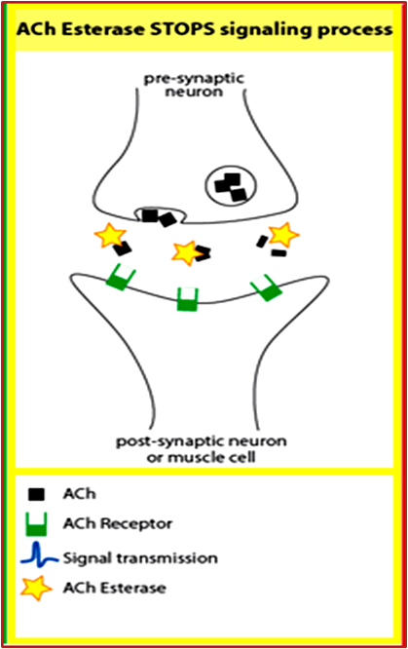
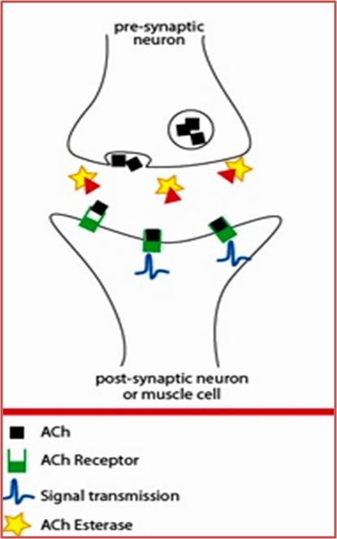
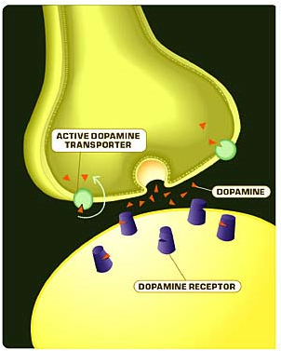
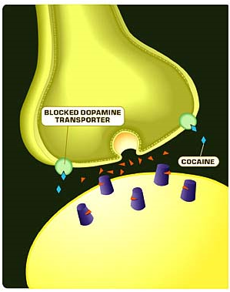
Pictures for more understanding:
Anticholinesterases (antiacetylase)
Effect of cocaine
In the normal, the Ach leaves the pre-synaptic neuron to post-synaptic of muscle cell, at the synapse there is enzyme (Ach esterase) will metabolize some of the Ach and degenerate it, when we use drug which is Anticholinesterases it will bind to the Ach esterase and inhibit it, so there will be accumulation of the Ach
In the normal, the dopamine leave the neuron and some of the dopamine binds with the receptor (the Purple in the picture) and produce effect, and some of the dopamine will reuptake by the transporter (the green in the picture) . If the patient uses cocaine the cocaine will inhibit the transporter so the dopamine will not reuptake and all the receptors will be bind with dopamine which will give high dopamine effect
Contact us : Pharma436@outlook.com
@Pharma436

Slide 6
Terms definition:
The term | The definition | Other definition | Explanation
Affinity | Ability of a drug to combine with the receptor. | is the capacity of a drug to form a complex with the receptor(DR complex) | D + R → D-R complex → Effect. * *D = drug , R = receptor
Efficacy (Intrinsic Activity) | Capacity of a drug receptor complex (D-R) to produce an action. is the maximal response produced by a drug (E max). | the ability of the drug once bound to the receptor to trigger response | The value of intrinsic activity (eﬃcacy) ranges from 0 to 1 ( the intrinsic activity of antagonist drugs is 0 e.g. atropine)
Agonist | is a drug that combines with receptor and elicit a response (affinity + efficacy). | - | كأنها قفل ومفتاحين، كل المفتاحين لهم نفس الشكل، لكن واحد هو المفتاح الأصلي والثاني مو المفتاح الأصلي، كلهم بيدخلون بفتحة القفل لكن الأصلي راح يفتح القفل واللي مو أصلي ما راح يفتح القفل لكن بيمنع المفتاح الأصلي من إنه يدخل بالقفل ويفتحه
Antagonist | is a drug that combines with a receptor without producing responses. It blocks the action of the agonist (has affinity but no or zero efficacy). | having full affinity to the receptor but no intrinsic activity(0) e.g. atropine
Full agonist | having a full affinity to the receptor and Affinity is the capacity of a drug to form a maximal intrinsic activity (1) e.g. acetylcholine | - | -
Partial agonist | having a full affinity to the receptor but with low intrinsic activity (<1) e.g. pindolol | - | -
Contact us : Pharma436@outlook.com
@Pharma436

Slide 7
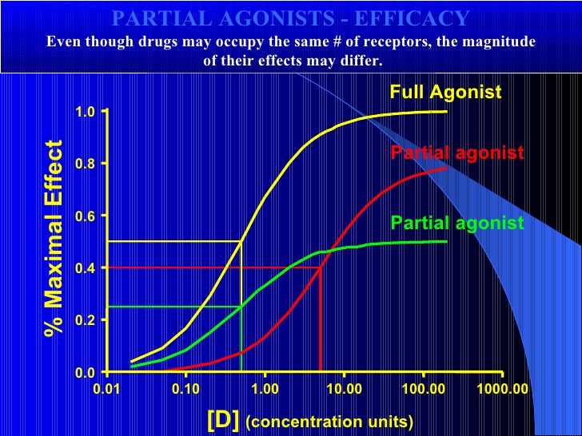
Agonist
Full agonist | Partial agonist
A drug that combines with its specific receptor to produce maximal effect by increasing its concentration (affinity & high efficacy). e.g.ACh | combines with its receptor & evokes a response as a full agonist but produces submaximal effect regardless of concentration (affinity & partial efficacy). e.g. pindolol •a beta blocker which is a Partial agonist produce less decrease in heart rate than pure antagonists such as propranolol.
The value of intrinsic activity (eﬃcacy) ranges from 0 to 1 ( the intrinsic activity of antagonist drugs is 0 e.g. atropine)
The full agonist has the maximal effect (1), and after it reaches to the maximal effect there will be no increasing in the effect (constant(
The partial agonist will have effect (Efficacy ) but it will not reach to the maximal effect (1) but it has its own maximal effect, and when the partial agonist reach to its own maximal effect there will be no increasing in the effect (constant(
Contact us : Pharma436@outlook.com
@Pharma436

Slide 8
Quick exam
https://www.onlineexambuilder.com/pharmacology-l5/exam-109362
Contact us : Pharma436@outlook.com
@Pharma436

Slide 9
Pharmacology Team :
Boys | Girls
عبدالرحمن ذكري | اللولو الصليهم
عبدالعزيز رضوان | روان سعد القحطاني
عبدالرحمن المالكي | أميرة نيازي
فيصل العباد | جواهر أبانمي
فارس النفيسة | رانيا العيسى
خالد العيسى | غادة المزروع
معاذ الفرحان | لمى الفوزان
عبدالرحمن الجريان | نورة الشبيب
محمد خوجة | أسيل ناصر بادخن
عمر التركستاني | أنوار نجيب العجمي
Contact us : Pharma436@outlook.com
@Pharma436

