Slide 1
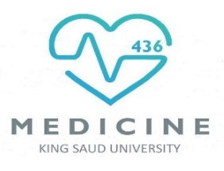

Quantitative aspects of drugs
Objectives:-
Determine quantitative aspects of drug receptor binding.
Recognize concentration binding curves.
Identify dose response curves and the therapeutic utility of these curves.
Classify different types of antagonism.
Titles
Very important
Extra information
Terms
Wake up with determination, go to bed with satisfaction

Slide 2
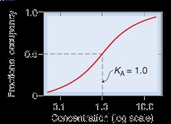
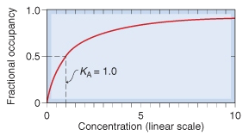
Dose Response Curve | Concentration-Binding Curve
Relate concentration [C] of Drug used (x-axis) to the response produced (y-axis) | Relate concentration [C] of Drug used (x- axis) to the binding capacity at receptors (y-axis)
potency is a measure of drug activity
(afficacy,efficacy).
Concentration-Binding Curve:-
The relationship between drug binding & drug concentration is expressed mathematically by the following equation:
(Bmax xC) /(Bmax C+ KD5)
Bmax (the binding capacity):-
is the total density of receptors in the tissues.
KD50:-
is the concentration of drug required to occupy 50% of
receptors at equilibrium.
The affinity of drug for receptor:-
The higher the affinity of D for receptor the lower is the KD i.e. inverse relation ( Binding Potential= Bmax/KD ).
Contact us : Pharma436@outlook.com
@Pharma436

Slide 3
Dose -response curves:-
- Used to study how response varies with the
concentration or dose.
- Is a correlation between drug concentration [D]
used (x- axis) and drug response [R] (y-axis).
i.e. relation between concentration & Response
Type of Dose-response curves
Graded dose-response curve
Quantal dose-response curve (all or none).
Graded dose-response curve:-
Response is gradual.
Gradual increase in response by increasing the dose
(continuous response).
Curve is usually sigmoid in shape.
e.g. ↓blood pressure, heart rate, blood glucose level, cholesterol,…
Contact us : Pharma436@outlook.com
@Pharma436

Slide 4
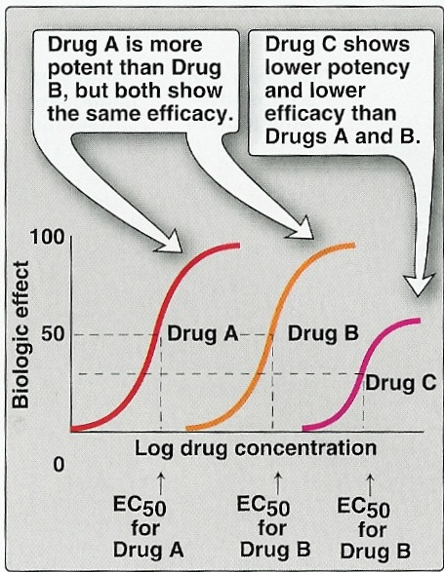
100
Max effect = E_{max}
80
60
As C ↑ response ↑
% of Maximal Effect
40
20
0
0
200
400
600
800
[C]
Graded dose-response curves are used to calculate :-
Efficacy: is a drug's capacity to produce an effect.
Emax: is the maximal biological response produced by a drug.
EC50: The dose of the drug required to produce half the maximal effect (Emax).
Potency: the concentration of drug required to produce a specified response (EC50 is the international parameter)
Potency is inversely proportional to EC50.
(lower concentration → higher potency.
higher concentration → lower potency).
In this diagram:
The potency of drug A is more than drug B & C.
The efficacy of drug A & B are the same and they are more efficacy than drug C.

Slide 5
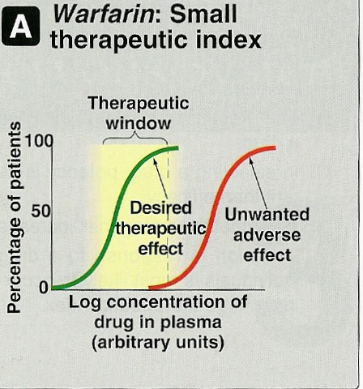
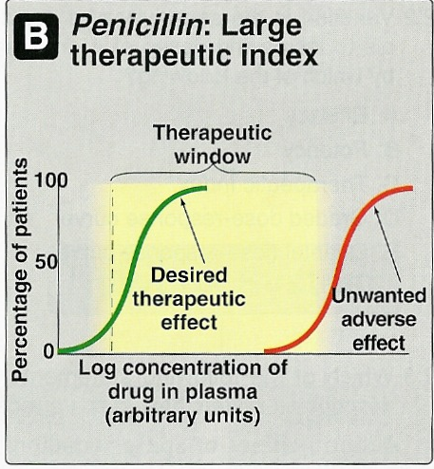
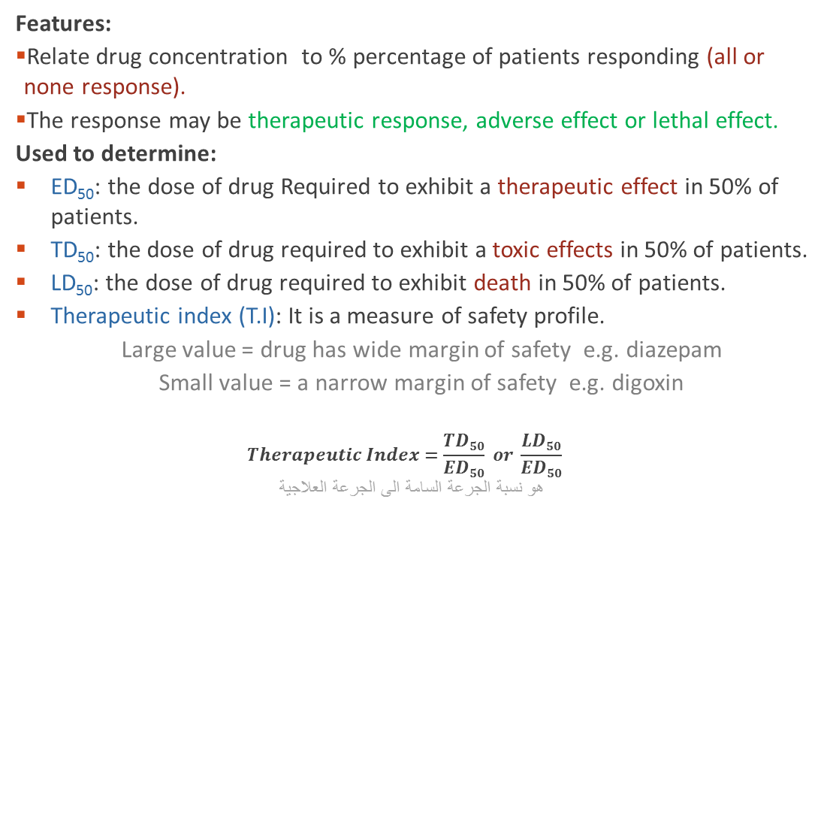
Quantal Dose-Response Curves:-
Features:
    Relate drug concentration to % percentage of patients responding (all or none response).
    The response may be therapeutic response, adverse effect or lethal effect.
    Used to determine:
    ED₅₀: the dose of drug Required to exhibit a therapeutic effect in 50% of patients.
    TD₅₀: the dose of drug required to exhibit a toxic effects in 50% of patients.
    LD₅₀: the dose of drug required to exhibit death in 50% of patients.
    Therapeutic index (T.I): It is a measure of safety profile.
      Large value = drug has wide margin of safety e.g. diazepam
      Small value = a narrow margin of safety e.g. digoxin
      $$Therapeutic Index=\frac{TD50}{ED50} or \frac{LD50}{ED50}$$
    هو نسبة الجرعة السامة الى الجرعة العلاجية
*note the difference in T.I.
Contact us : Pharma436@outlook.com
@Pharma436

Slide 6
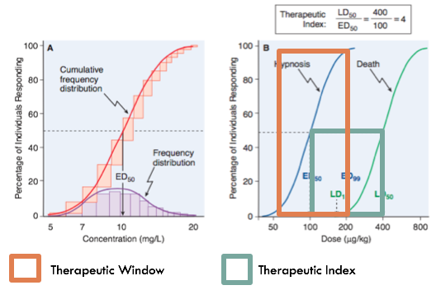
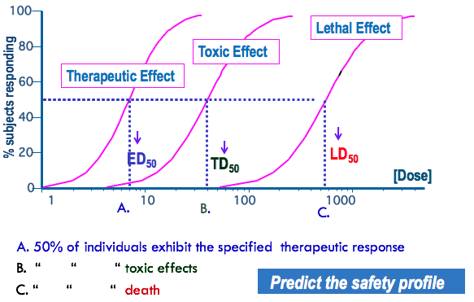
Contact us : Pharma436@outlook.com
@Pharma436

Slide 7
Antagonism :-
It is the decrease or the complete abolishment of the effect of one drug in the presence of another.
Types of antagonism
Physiological
Chemical
Pharmacokinetics
Pharmacodynamics
  Physiological antagonism:
  Two drugs act on different receptors to produce different physiological effects. e.g. Histamine & Adrenaline.
  Adrenaline → Vasoconstriction (↑ BP) & bronchodilation.
  Histamine → vasodilatation (↓BP) & bronchoconstriction.
  Chemical antagonism:
  Simple chemical reaction & loss of activity
  No receptor.
  e.g. Dimercaprol reduces heavy metal toxicity (as in lead toxicity).
  Pharmacokinetic:
  The antagonist effectively reduces the concentration of the active drug at the site of action.
  e.g. Phenobarbitone accelerates hepatic metabolism of warfarin.
Contact us : Pharma436@outlook.com
@Pharma436

Slide 8
Pharmacodynamic antagonism (Receptor-blockade antagonism)
1- Competitive Reversible:
الانتاقونست هنا بينافس الدواء على نفس الريسبتور , فيغطي تأثير الدواء جزئياً او كلياً.
بس الانتاقونس ما يستمر مربوط بالدواء فينفصل عنه.
Two drugs compete for the same receptor.
The antagonist partially or completely prevents the pharmacological effect of agonist.
Antagonist dissociate rapidly from receptor.
Antagonism can be overcome by increasing the concentration of the agonist.
Parallel shift of the curve to the right, without any change in slope or maximum
e.g. acetylcholine and atropine
اذا زدنا كمية الدواء فاننا نقدر نلغي تأثير الانتافونست .
عشان كذا نلقى في الرسم البياني ان ماكسموم تأثير الدواء نفسه عشان زدنا الكمية .
2- Competitive Irreversible:
Two drugs compete for the same receptor.
Antagonist forms stable, permanent chemical bond with receptor.
The original response can not be overcome even by increasing the dose of the agonist.
No parallel shift and a decrease in slope and a reduced maximum are obtained.
e.g. phenoxybenzamine and noradrenaline.
الانتاقونست هنا بينافس الدواء على نفس الريسبتور .
الانتاقونس هنا يكون رابطة كيمائية قوية ما تنفك عكس الأول .
مهما زدنا كمية الدواء فاننا ما نقدر نلغي تأثير الانتافونست .
في الرسم البياني ان ماكسموم تأثير الدواء يقل .
Contact us : Pharma436@outlook.com
@Pharma436

Slide 9
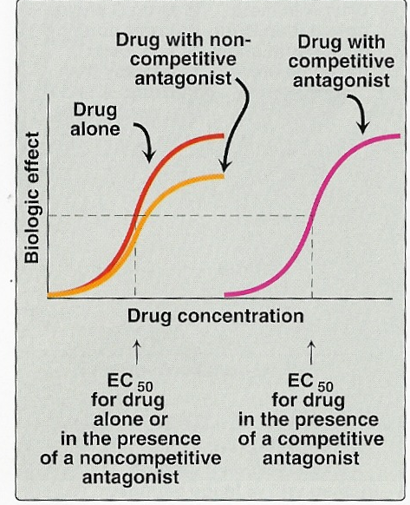
Con.
3- Non-Competitive:
Antagonist block at some point the chain of events that stimulate the response of agonist.
Agonist and Antagonist can be bound simultaneously (because it is Non-competitive).
Antagonism cannot be overcome by increasing concentration of agonist
e.g. verapamil and noradrenaline.
فيقلل قوة الدواء
What about EC100?
As the concentration (X) goes up, the dose-response equation computes the response (Y) as getting closer and closer to the Top plateau. But it never reaches it. When a drug binds to a receptor with mass action rules, the fraction occupancy equals D/(D+K), where D is the concentration of drug (that you vary) and K is the equilibrium binding dissioction constant, which is a fixed property of the drug and receptor. As D gets higher and higher, the fractional occupancy gets closer and closer to 1.0, but never reaches it. Therefore, there can be no EC100. And no EC0.
هنا يوضح كيف انه مستحيل يوصل الدواء ل ماكسيموم افيكت 100% في جسم الانسان , لكن توصل قريب منها .
Contact us : Pharma436@outlook.com
@Pharma436

Slide 10
Quick exam
Contact us : Pharma436@outlook.com
@Pharma436

Slide 11
Pharmacology Team :
Boys | Girls
عبدالرحمن ذكري | اللولو الصليهم
عبدالعزيز رضوان | روان سعد القحطاني
عبدالرحمن المالكي | أميرة نيازي
فيصل العباد | جواهر أبانمي
فارس النفيسة | رانيا العيسى
خالد العيسى | غادة المزروع
معاذ الفرحان | لمى الفوزان
عبدالرحمن الجريان | نورة الشبيب
محمد خوجة | أسيل ناصر بادخن
عمر التركستاني | أنوار نجيب العجمي

