Slide 1
7- Receptors families
Objectives:
Classify receptors into their main super families
Recognize their different transduc5on mechanism
Iden5fy the nature & 5me frame of their response
Success is falling nine times and getting up ten
Contact us : Pharma436@outlook.com
@Pharma436

Slide 2
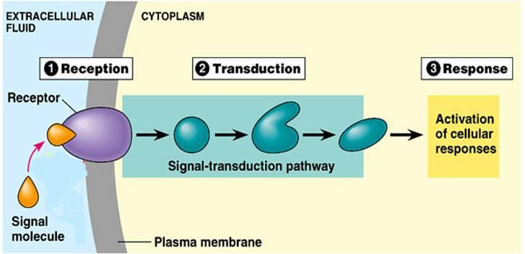
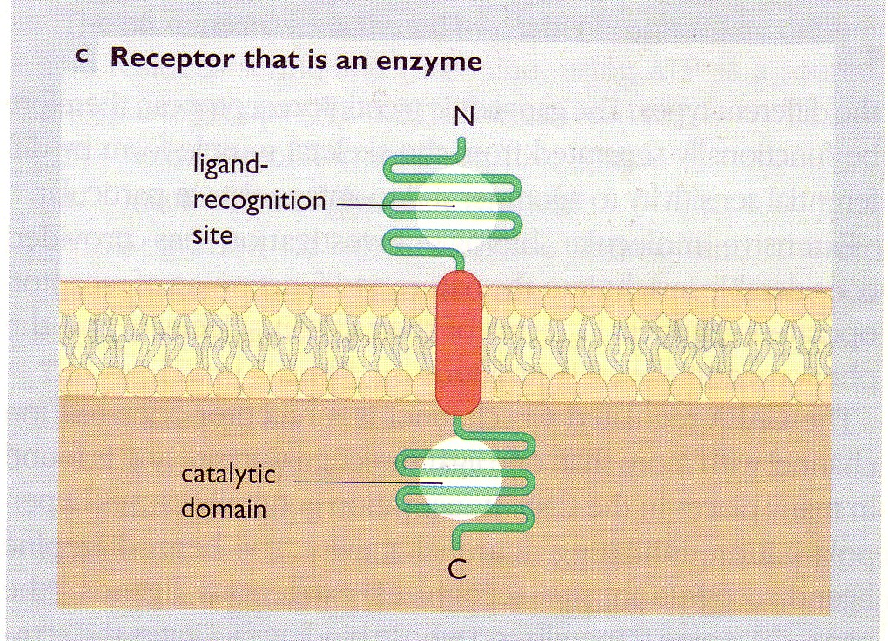
Receptors:
1. Recognition 2. Reception 3. Transduction 4. Response
Receptor structure:
1- Ligand recognition site
2- Inner catalytic domain
↑
Coupler Transduction 
Receptors families
Type I (Ion Channel-Linked receptors)
Type III (Enzyme-Linked receptors)
Type IV (Receptors linked to gene transcription)
Type II (G-Protein coupled receptors)
Contact us : Pharma436@outlook.com
@Pharma436

Slide 3
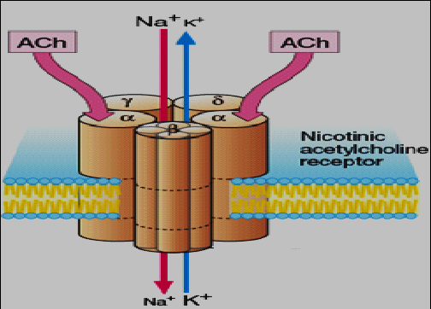
Type I: Ion channel-Linked receptor – (Ligand gated ion channel) – (Ionotropic receptor)
Located at cell membrane (as it is on the cell membrane, it does not require to be lipid soluble)
Directly activated by ligand binding
Directly related to ion channels. (when the drug starts produce its effect, the effect will directly change the ion channel ‘open or close the channel)
Involved in very fast synaptic transmission.
Response occurs in milliseconds
e.g. nicotinic acetycholine receptor that is activated by occupancy of a ligand as acetycholine.
Contact us : Pharma436@outlook.com
@Pharma436

Slide 4
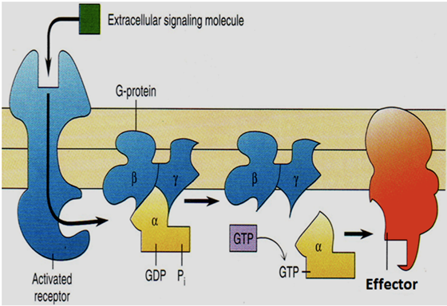
Type II: G-Protein coupled receptors - Metabotropic Receptor
What is it ?
It is a receptor (Located at cell membrane ) Cause changes in intracellular effector (especially in metabolic reaction) via G protein.
Other name ?
it’s also called Metabotropic Receptor :while tropic = changes in ions
^ سبب التسمية : لأنها تُحدث تغيرات في الأيونات وهذه التغيرات تسبب تغير في الأيض
The largest family that accounts for many known drug targets
Located at cell membrane
Coupled to intracellular effectors via G-protein
Response through ion channels or enzymes. (the effect is not direct, first the drug binds with the receptor, then G protein take the drug then go to the ion channel or enzyme, ‘the drug will not effect the ion channel or the enzyme’)
Involved in rapid transduction
Response occurs in seconds. (it is not in milliseconds so that it is not very rapid)
E.g. Muscarinic receptors of Ach
E.g. Adrenergic receptors of Noradrenaline (alpha and beta receptors)
-Its effector could be enzyme or ion channel :
Inactive form
active form
Targets for G-proteins
enzyme
Ion channel
AC
Adenyl cyclase enzyme. It acts on Cyclic AMP system (cAMP)*
PLC
Phospholipase C enzyme. It acts on Inositol phosphate system (IP3+DAG)**
Ach
e.g.:
Adrenergic receptors
e.g.:
muscarinic receptors in heart
Ach acts upon muscarinic receptors by opening of K-channel and increase K efflux (hyper-polarization) to produce decrease in heart rate
*cAMP= cyclic adenosine monophosphate
** IP3 = inositol triphosphate
DAG= diacylglycerol
Contact us : Pharma436@outlook.com
@Pharma436

Slide 5
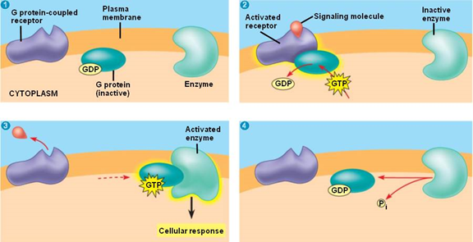
G protein: it is a Regulatory protein found in the cell membrane , Comprise of three subunits (αβγ) (where α subunits possess (يمتلك) GTPase activity) , It is an intermediary (وسيط) between the receptor and the effector.
The story is:
the ligand bind to the receptor
the receptor undergo conformational change
G-protein bind to the receptor
+ α subunit become active(has GTP molecule) & dissociates (تنفصل) from βγ
<before step.1 α subunit was inactive(has GDP molecule)
then α subunit is free to activate an effector , by hydrolyzed the bound GTP to GDP
hydrolyzation of GTP to GDP also allow α-subunit to recombine with (βγ) and returns to its inactive state.
Contact us : Pharma436@outlook.com
@Pharma436

Slide 6
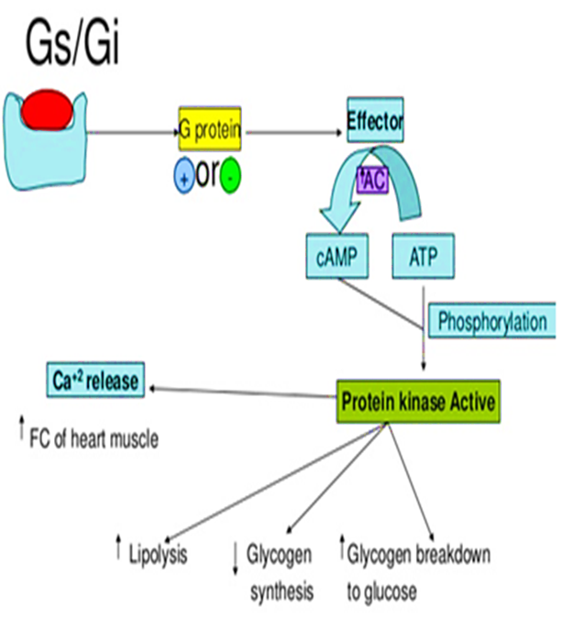
Cyclic AMP system (cAMP):
G-protein
Adenyl cyclase enzyme
cAMP
Phosphorylation of Protein kinase A (PKA)
Active protein kinase A
The effect of increasing of kinase A:
↑ lipolysis
↑ breakdown of glycogen to glucose
Inositol phosphate system:
G-protein
Phospholipase C
Phosphoinositol diphosphate (PIP2)
Inosito triphosphate IP3
Diacylglycerol
(DAG)
Increase intracellular calcium*
Protein kinase C (PKC)
Secretion of endocrine gland
Increase in heart rate
Smooth muscle contraction**
Ion channels
Smooth muscle contraction
The G-protein will affect on the Phospholipase C and produce 2 substances: IP3 AND DAG, and both of these substances will increase the calcium level in the cell
* The endothelium reticulum storage the calcium, and the IP3 will affect on the endothelium reticulum and make it release the calcium, that will increase the Ca level inside the cell
** stick with this rule: whenever there is increasing in the Ca level inside the cell, there will be contraction
Contact us : Pharma436@outlook.com
@Pharma436

Slide 7
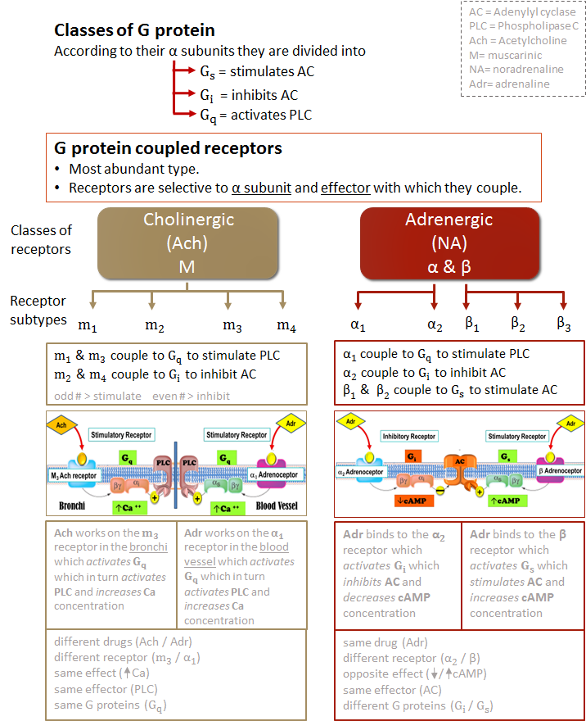
Contact us : Pharma436@outlook.com
@Pharma436

Slide 8
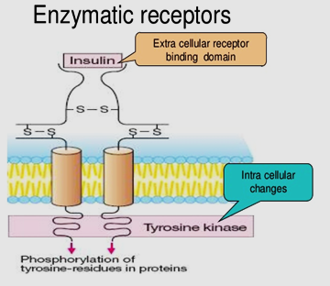
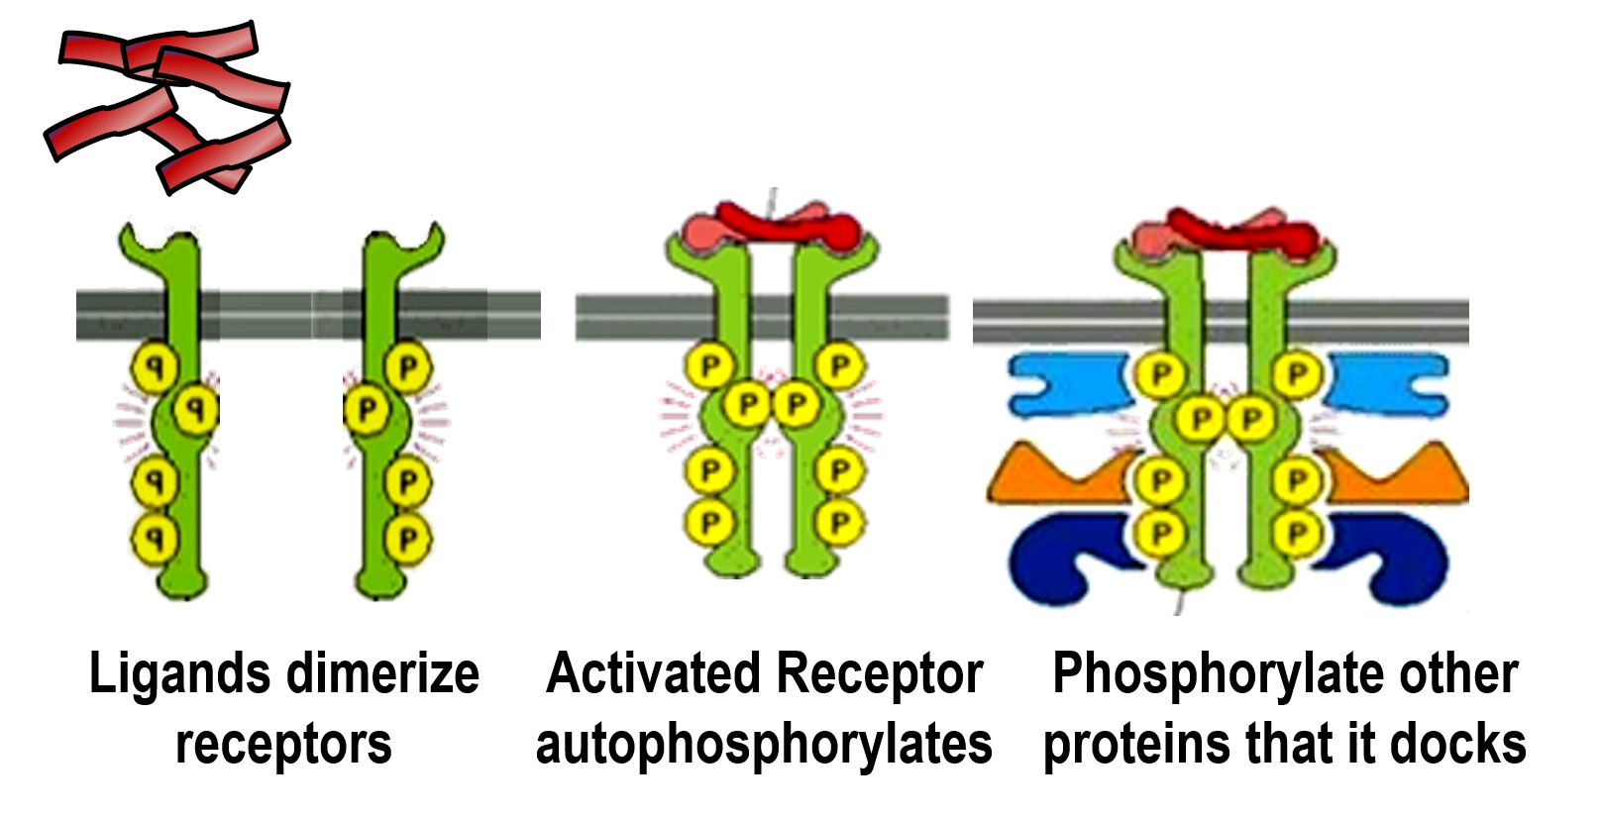
Type III (Enzyme-Linked receptors) – (Tyrosine Kinase-linked receptor):
Located at cell membrane
Linked to enzyme (with intrinsic enzymatic activity)
Response occurs in minutes to hours.
Involved in response to hormones, growth factors.
They control many cellular functions as metabolism and growth.
Activation of Type III receptors results in :
Activation of kinases as tyrosine kinase with phosphorylation of tyrosine residue on their substrates and activation of many intracellular signaling pathways in the cell*
E.g. Insulin receptors
* Kinase enzyme make phosphorylation (adding phosphate) to the tyrosine. Tyrosine located in the intracellular protein, like enzyme
Example: Insulin receptors
Phosphorylated docked proteins
response
Contact us : Pharma436@outlook.com
@Pharma436

Slide 9
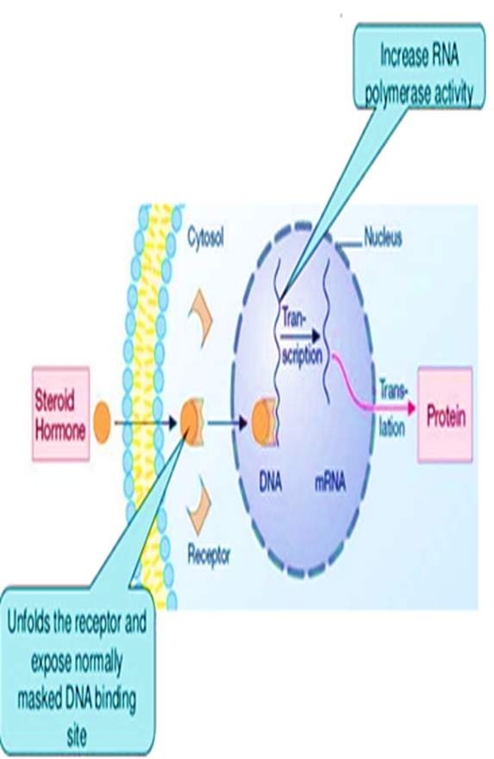
Type IV: Gene transcrip5on receptors – (Nuclear receptors
):
Located intracellularly (so that the drug has to be lipid soluble)
Directly related to DNA (Gene transcription).
Activation of receptors either increase or decrease protein synthesis
Response occurs in hours or days and persists longer.
Their natural ligands are lipophylic hormones; steroids, thyroids, estrogen.
They possess an area that recognizes specific DNA sequence in the nucleus which can bind it. This sequence is called a Responsive Element [RE] . (the place where the drug will bind is the DNA, especially in some sequence of the DNA which we called it Responsive Element)
This means that the activated receptors are acting as TRANSCRIPTION FACTORS [TF] →
expressing or repressing target genes.
Transcription
Translation
Contact us : Pharma436@outlook.com
@Pharma436

Slide 10
Summary:
 | Type I | Type II | Type III | Type VI
Location | Membrane | Membrane | Membrane | Nucleus
Coupling | Direct | G-Protein | Direct | Via DNA
Synaptic transmission | Very Fast | fast | slow | Very slow
Response | milliseconds | Seconds | minutes | Hours or days
Examples | Nicotinic receptors | Muscarinic receptors Adrenergic receptors | Insulin receptors | Estrogen Steroid receptors
Effectors | channels | Channels/ enzymes | Enzymes | DNA
Contact us : Pharma436@outlook.com
@Pharma436

Slide 11
Quick exam
https://www.onlineexambuilder.com/pharmacology-l9/exam-110846
Contact us : Pharma436@outlook.com
@Pharma436

Slide 12
Pharmacology Team :
Boys | Girls
عبدالرحمن ذكري | اللولو الصليهم
عبدالعزيز رضوان | روان سعد القحطاني
عبدالرحمن المالكي | أميرة نيازي
فيصل العباد | جواهر أبانمي
فارس النفيسة | رانيا العيسى
خالد العيسى | غادة المزروع
معاذ الفرحان | لمى الفوزان
عبدالرحمن الجريان | نورة الشبيب
محمد خوجة | أسيل ناصر بادخن
عمر التركستاني | أنوار نجيب العجمي
Contact us : Pharma436@outlook.com
@Pharma436

