Slide 1
Autacoids
Objectives:
To describe the synthesis, receptors and functions of histamine, eicosanoids ,nitric oxide , angiotensin, kinins & 5-HT.
To study the agents which enhance or block their effects.
Titles
Very important
Extra information
Terms
Whoever guards his mouth preserves his life.

Slide 2
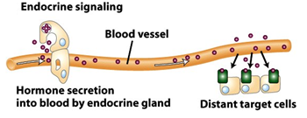
Autacoids features
-Self remedy.
-Produced , act & metabolized locally.
-Have different biological actions including :
1-modulation of the activity of smooth muscles.
2-glands.
3-Nerves.
4-platelets and other tissues.
-They have autocrine or paracrine effects :
Paracrine:
Secreted by one cell & acts upon adjacent cells or surrounding extracellular matrix.
Autocrine :
Secreted from a cell and acts on the same cell.
Contact us : Pharma436@outlook.com
@Pharma436

Slide 3
They include
Amino acid
derivatives
-Histamine
-serotonin
Endogenous peptides
-Kinsin
- Angiotensin
Fatty acid
Derivatives
-eicosanoid
Gas
-NO
Histamine :
It is an amine synthesized from L- histidine.
L- histidine. → | Decarboxylase → (Removing of CO2) | Histamine
It is stored in: 1- Mast cells 2- Basophils 3- Lungs 4-Intestinal mucosa
Release by 2 ways: 1-During allergic reaction 2- Inflammatory reaction
Histamine receptors :
Receptor Type | Major Tissue Locations | Major Biologic Effects
H₁ | smooth muscle, endothelial cells, brain | acute allergic responses
H₂ | gastric parietal cells, Cardiac muscle, mast cells, brain | secretion of gastric acid
H₃ | central nervous system | neurotransmission
H₄ | mast cells, eosinophils, T cells | regulating immune responses
Contact us : Pharma436@outlook.com
@Pharma436

Slide 4
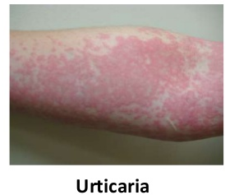
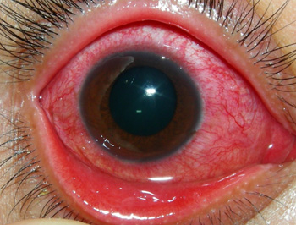
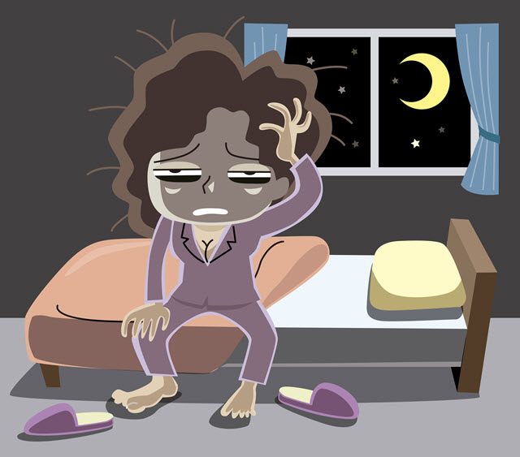
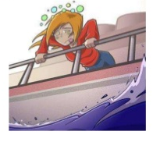
Actions:
Stimulates gastric acid secretion through
H2- receptors.
Stimulation of H1-receptors contract smooth muscles, bronchioles ,uterus.
Increases bowel peristalsis.
Slow IV or SC injection which causes :
1-Flushing of skin.
2-Raise temperature.
3-Increase blood flow to the periphery.
4-Increase heart rate.
Dilation of blood vessels which causes :
1-Fall in blood pressure.
2-An increase in CSF pressure.
3-Headache.
4-Dilation of blood vessels.
Histamine receptor blockers
H1 receptor blockers
generation | First generation |  | Second generation
Name of the receptor blockers | Diphenhydramine cyclizine promethazine |  | Loratidine Citrizine Fexofenadine
effect | Has a Sedating effect |  | Non-sedating effect
Used for the treatment of: | Allergic rhinitis. Urticaria. Insomnia. Motion sickness. |  | Allergic conditions such as:- Allergic rhinitis. Conjunctivitis. Urticaria.
Contact us : Pharma436@outlook.com
@Pharma436

Slide 5
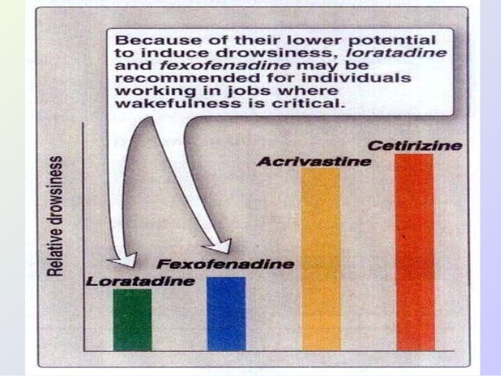
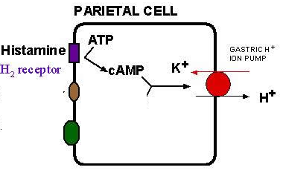
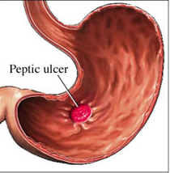
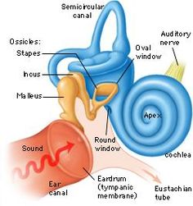
con.
Loratidine and Fexofenadine
هذي النوعين من البلوكرز النعاس اللي تسببه بسيط مقارنة بالباقين عشان كذا تستخدم للأشخاص اللي عندهم أعمال تحتاج إلى تركيز كامل
H2 receptor blockers
Name of the receptor blockers | Cimetidine, ranitidine, famotidine
effect | Histamine plays an important role in the formation and secrtion of HCl (gastric acid) by the activity of H2 receptors SO Blockers of H2 receptors inhibit gastric acid secretion
Used for the treatment of: | Gastritis Peptic ulcers
H3 receptor blockers
Name of the receptor blockers | betahistine
effect | It produces dilatation of blood vessels in inner ear
Used for the treatment of: | Vertigo and balance disturbances (May produce headache and insomnia)
Contact us : Pharma436@outlook.com
@Pharma436

Slide 6
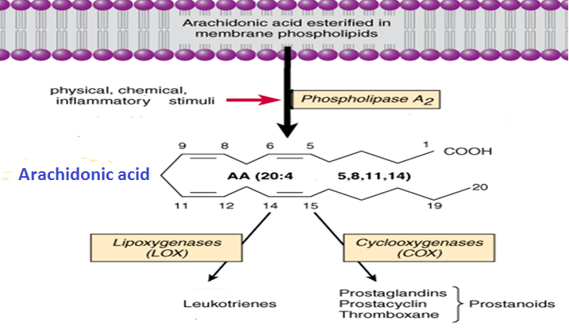
Eicosanoid :
• Signaling molecules
• These are 20 carbon atom faby acids.
• Arachidonic acid (AA) found inside the phospholipids (PL). AA freed from PL by Phospholipase A2.
• Cyclooxygenase (COX) generate the Prostaglandins, Prostacyclins and Thrombaxane A2 (TXA2) from arachidonic acid
• Lipoxygenase (LOX) generate the Leukotrienes from arachidonic acid.
• Corticosteroids inhibit phospholipase A2.
• Zileuton inhibit lipoxygenase.
• NSAIDs inhibit cyclooxygenase

Slide 7
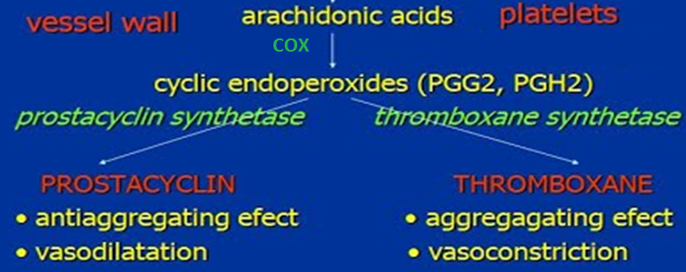
Prostaglandin (PG):
Major Characteristics :
• First found in semen, they have since been found in cells throughout the body and in menstrual fluid.
• Found In Almost Every Tissue In Humans.
• Contains 20 Carbon Atoms.
The Actions of PG :
• Causes Vasodilatation of Vascular Smooth Muscle Cells (Contrac6on of Uterus).
• Inhibit The Aggrega6on of Platelets.
• Sensitize Neurons To Cause Pain
• Induce Labor
• Decrease intraocular pressure, blood pressure
• Acts On Thermoregulatory Center of Hypothalamus To Produce Fever. • Acts On Kidney To Increase Glomerular Filtra6on.
• Acts On Parietal Cells of Stomach To Prevent Gastric Mucosa.
• Control Cell Growth.
• Regulate Hormones, Calcium, Inflammation.

Slide 8
con.
Prostaglandins analogs | Treatment of
Carboprost | Induce abortion in first trimester
Latanoprost | Glaucoma
Misoprostol | Peptic ulcer
Alprostadil | Erectile dysfunction
Zileutonas | lipoxygene inhibitor
Zafirlukast (leukotreine receptor blocker) | Bronchial asthma
Nitric Oxide (NO): Highly diffusible stable gas
L-arginine + O2 NO + Citrulline + H2O
Synthesis:
Nitric Oxide Synthase
(NOS).
Types of NOS:
1. n-NOS: Neuronal NOS
2. i-NOS: Inducible NOS
3. e-NOS: Endothelial NOS
NOS Stimulants & Inhibitors
Activators
Acetylcholine
Serotonin
(5-HT)
Inhibitor
Hemoglobin
Bradykinin
Histamin

Slide 9
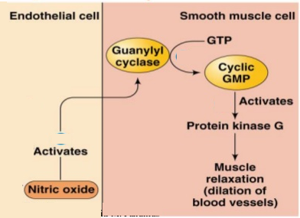
con.
Neuronal NOS (nNOS) | Endothelial NOS (eNOS) | Inducible NOS (iNOS)
Neurons Skeletal muscle | Endothelium Cardiac myocytes Osteoblasts Osteoclasts | Macrophages Kupffer cells Neutrophils Fibroblasts Vascular smooth Muscle
Constitutive Forms (Physiological) |  | Pathological
Action of Nitric Oxide:
1. Vasodilation: (Paracrine)
Diffuse to Vascular smooth muscle cells
Binds soluble GC
Change GTP to cGMP
Activate PKG & inhibit Ca
Inactivate MLCK
Prevent actin myosin cross link
No contraction
RELAXATION
3
2
4
5

Slide 10
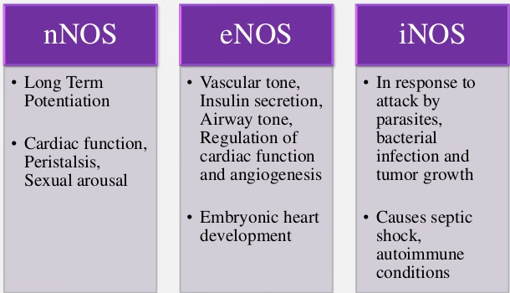
Actions of NO :
Inhibition of platelet and monocyte adhesion and aggregation.*
Inhibition of smooth muscle proliferation.*
Inhibition of angiogenesis
Protection against atherogenesis.*
Atherogenesis: formation of fatty plaques in the arteries.
Synaptic effect in the peripheral and central nervous system.
Potentiation of long-term memory.
Host defense and cytotoxic effect on pathogens.
quantity of NO act as free radical.
Cytoprotection
Actions of NOS:
Classified according to the Isoenzyme producing the effect
iNOS: Inflammatory and immune responses.
*Anti thrombotic mechanisms
Contact us : Pharma436@outlook.com
@Pharma436

Slide 11
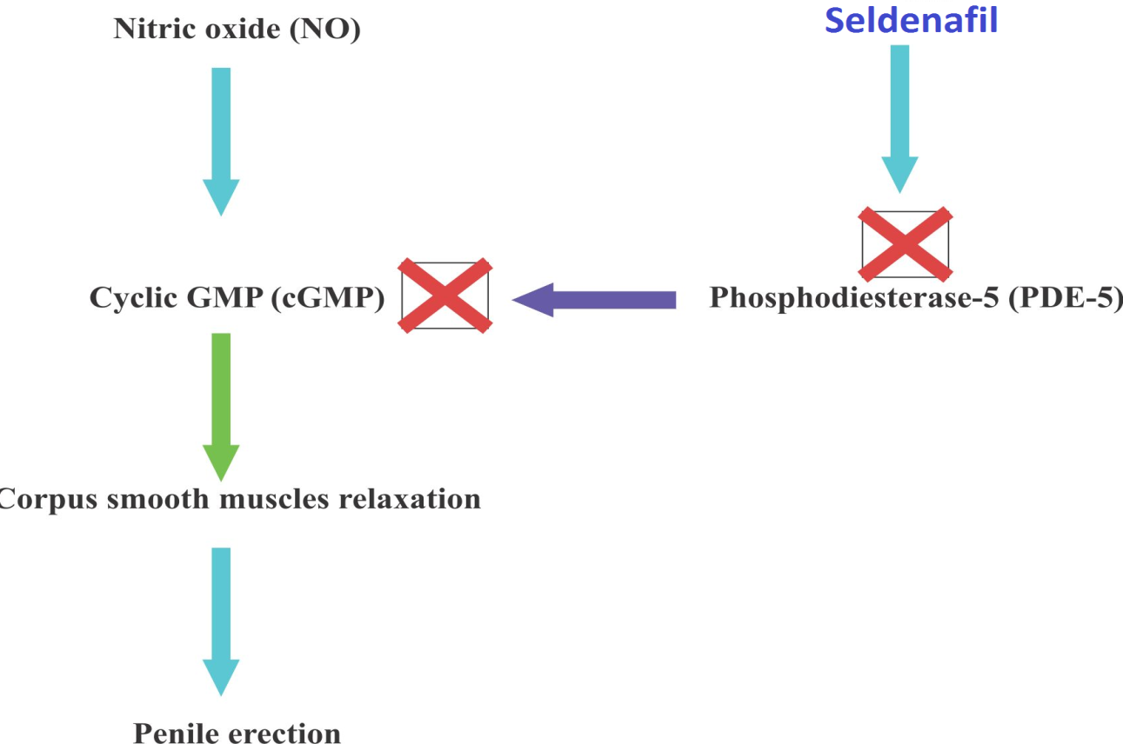
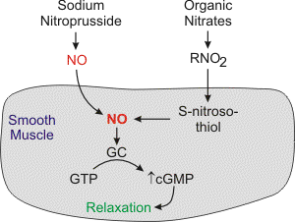
NO in therapeutics:
diabetes, hypertension & atherosclerosis causes reduction of Endothelial NO production.
Overproduction of NO
Causing nerve damage in neurodegenerative diseases e.g. Parkinsonism.
in septic shock causing excessive vasodilatation.
NO is used in critical care to treat pulmonary hypertension in neonates
NO is used in patients with right ventricular failure secondary to pulmonary embolism
NO donors* used e.g. in hypertension & angina pectoris
Sildenafil potentiates the action of NO on corpora cavernosa smooth muscle. used to treat erectile dysfunction
direct
Through enzymes
* Drugs that produce NO
Contact us : Pharma436@outlook.com
@Pharma436

Slide 12
Pharmacology Team :
Boys | Girls
عبدالرحمن ذكري | اللولو الصليهم
عبدالعزيز رضوان | روان سعد القحطاني
--------- | أميرة نيازي
فيصل العباد | جواهر أبانمي
فارس النفيسة | رانيا العيسى
خالد العيسى | غادة المزروع
معاذ الفرحان | لمى الفوزان
عبدالرحمن الجريان | نورة الشبيب
محمد خوجة | أسيل ناصر بادخن
عمر التركستاني | أنوار نجيب العجمي

