Slide 1
9- autocoids
Objectives:
To describe the synthesis, receptors and functions of histamine, eicosanoids ,nitric oxide , angiotensin, kinins & 5-HT
To study the agents which enhance or block their effects
You can, you should, and if you’re brave enough to start, you will
Contact us : Pharma436@outlook.com
@Pharma436

Slide 2
Angiotensin
Biosynthesis:
Renin released from the kidney converts angiotensinogen to Ag I
ACE converts Ag I to Ag II
Actions of angiotensin II
Promotes vasoconstriction directly or indirectly by releasing NA & AD.
Increases force of contraction of the heart by promoting calcium influx.
Increases aldosterone release → sodium & water retention.
Causes hypertrophy of vascular and cardiac cells and increases synthesis and deposition of collagen by cardiac fibroblasts (remodeling).
Angiotensin inhibitors “ACE”
Angiotensin
is a peptide hormone that causes vasoconstriction and a subsequent increase in blood pressure. It is part of the renin-angiotensin system, which is a major target for drugs that lower blood pressure. Angiotensin also stimulates the release of aldosterone, another hormone, from the adrenal cortex.
Those are captopril and enalapril.
Angiotensin receptor blockers “ARBs”
Those are Isoartan and valsartan.
To know the difference between ACE and ARBs, pleases visit this site: http://www.healthcentral.com/high-blood-pressure/c/question/401647/52421/
Contact us : Pharma436@outlook.com
@Pharma436

Slide 3
Angiotensin inhibitors “ACE”
Clinical uses of Angiotensin inhibitors “ACE”
Those inhibitors cause a fall in the blood pressure in hypertensive patients especially those with high rennin levels.
Treating hypertension
In cardiac failure
Following myocardial infarction
Rennin is a hormone. Renin's primary function is therefore to eventually cause an increase in blood pressure, leading to restoration of perfusion pressure in the kidneys. Renin is secreted from juxtaglomerular kidney cells, which sense changes in renal perfusion pressure, via stretch receptors in the vascular walls.
Angiotensin receptor blockers
Angiotensin receptors AT I & AT II
AT 1 receptors predominate in vascular smooth muscle, mediate most of the known actions of Ang, coupled to G proteins & DAG
Similar uses to ACEI
RAAS =Renin angiotensin-aldosterone System(للفهم)
How is RAAS activated?
By binding of the active form Ag2 with AT1 receptor that leads to Aldosterone secretion So Angiotensin is a hormone that stimulates Aldosterone secretion in the kidney As a result, the Sympathetic Nervous System is stimulated and following actions will take place
Blockers :
they will effect on the quantity of renin, and that will lead to decrease of activated the RAAS
Propranolol: B-blocker
Clonidine
Aliskiren(renin inhibitor )
Lisinopril (ACE inhibitor )
Omapatrilat
وهالدواء يأثر على:
Chymase endopeptidase
Candesartan (Angiotensin Receptor Blockers (ARBs))
Spironolactone eplerenone (ADOSERONE Antagonists )
Contact us : Pharma436@outlook.com
@Pharma436

Slide 4
Kinins
Are Bradykinin & kallidin
Bradykinin is formed by proteolytic cleavage of circulating proteins (kininogens)
Bradykinin is a vasodilator
Kallikrein
⊕
kininogen
BRADYKININ
⊕
Kininases I
Kininases II = ACE
Inactive peptides
Contact us : Pharma436@outlook.com
@Pharma436

Slide 5
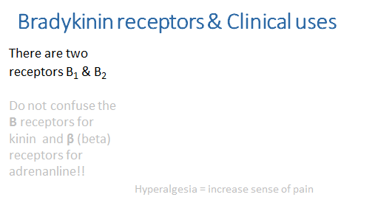
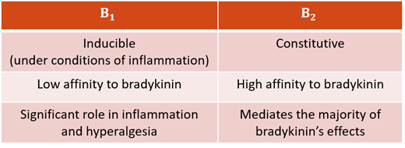
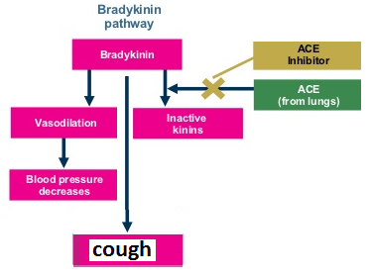
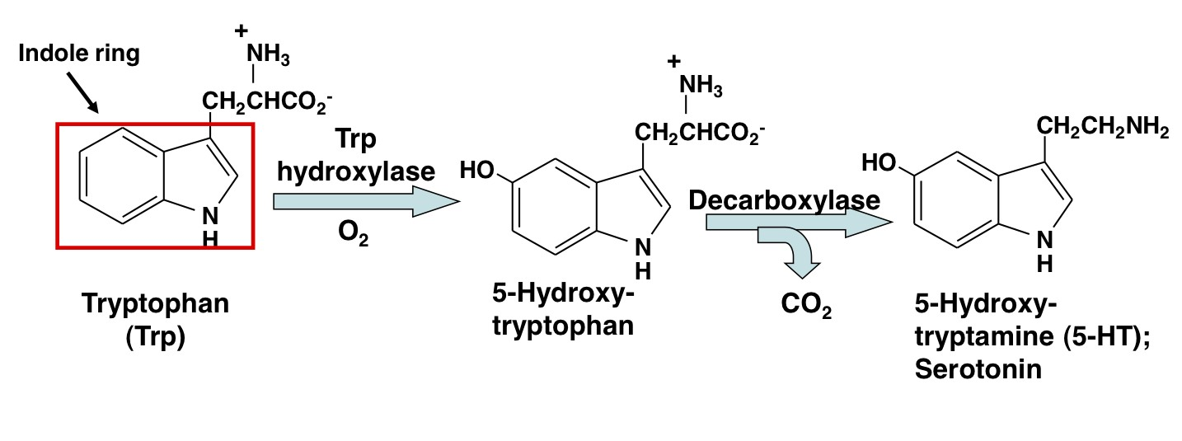
Therapeutic uses:
No current therapeutic use of bradykinin
Increased bradykinin is implicated in the therapeutic efficacy and cough produced by ACEIs
Serotonin [5ht]
Serotonin is synthesized from the amino acid L-tryptophan
Contact us : Pharma436@outlook.com
@Pharma436

Slide 6
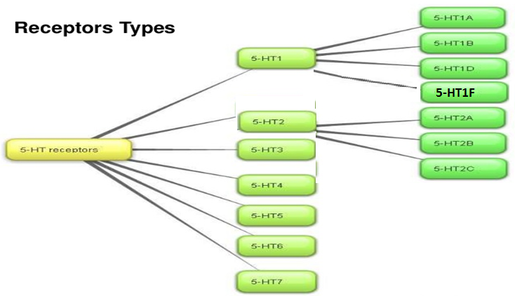
Distribution of Serotonin [5-ht]
بعد تصنيعه اما انه يخزن (في 3 أماكن) أو يحصل له تثبيط سريع (له تفصيل لكن غير مطالبين به الآن) :
1] Intestinal wall
in chromaffin cells ,in neuronal cells in the myenteric plexus
أغلب كمية السيروتونين في الجسم (90%) تكون هنا
2] Blood
in platelets , released when aggregated , in sites of tissue damage
بشكل عام يخزن في الدم ، وين بالضبط ؟ في الصفائح الدموية .
3] CNS
a neurotransmitter ,in midbrain
مسؤول عن النوم والمزاج والشهية والحرارة والضغط والتقيء.
تنظم حركة الأمعاء
وله ارتباط بحالات مثل الاكتئاب والقلق والشقيقة.
بشكل عام وظيفته ترتبط بالتجلط.
بشكل عام نقول يخزن في الأمعاء ، وين بالضبط ؟ في خلايا الكرومافين
Serotonin receptors
* أهم شيء تعرفون أن مستقبلاته 7 أنواع وأن النوع الأول والثاني يتفرعون لأنواع بعد
* مما يدل على أهمية السيروتونين أن له الكثير من المستقبلات وكل مستقبل يقوم بوظيفة مختلفة وموجود في مكان مختلف عن الآخر, فالسيروتونين يقوم بوظائف كثيرة تختلف باختلاف المستقبل الذي يرتبط معه.
* كل المستقبلات من نوع (المعتمد على البروتين جي) إلا المستقبل رقم3 فهو من نوع (المعتمد على قناة أيون)
Contact us : Pharma436@outlook.com
@Pharma436

Slide 7
Actions of 5-ht:
GIT:-5-HT increases motility
Contracts uterus bronchiole ,other smooth muscles
Blood vessels:-
Contracts large vessels by a direct action & relaxes other vessels by releasing NO
Increases capillary pressure & permeability
5-ht actions:
 | The effect
Platelets | causes aggregation ,aggregated platelets release 5-HT
Neuronal terminals | 5-HT stimulates nociceptive neuron endings → pain
CNS | stimulates some neurons & inhibits others , inhibits release of other neurotransmitters
5-ht receptor agonists:
Buspirone
Cisapride
5-HT1A agonist , effective anxiolytic
5-HT4 -receptor agonist, used in gastroesophageal reflux & motility disorders.
Selective 5-HT3 antagonist, Ondansetron
antiemetic action , for cancer chemotherapy
Contact us : Pharma436@outlook.com
@Pharma436

Slide 8
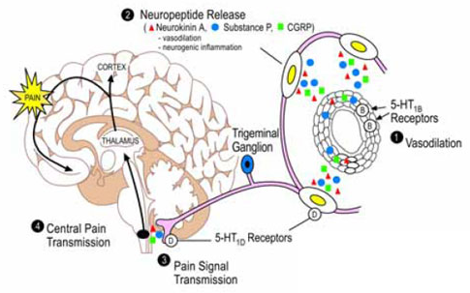
Clinical conditions in which 5-ht is implicated:
1-migraine:
Activation of trigeminal system leads to peptides release promoting an inflammatory reaction. This increases flow of sensory traffic through the brain stem, the thalamus & the cortex
Sumatriptan
5-HT1D, 1B &1F-receptor agonist , effective in acute migraine attack
It binds to 5HT1B , in cranial blood vessels causing vasoconstriction & 1D & 1F in presynaptic trigeminal nerve causing inhibition of pro inflammatory neuropeptide release
2- Carcinoid syndrome:
A malignant tumor of intestinal chromaffin cells
The tumor releases 5-HT, SP, PGs, kinins & histamine causing flushing ,diarrhea, bronchoconstriction & hypotension
Serotonin antagonists (cyproheptadine, 5HT2 antagonist) could be administered to control diarrhea ,flushing & malabsorption
Contact us : Pharma436@outlook.com
@Pharma436

Slide 9
Qick Quiz
https://www.onlineexambuilder.com/pharmacology-l9/exam-110846
Helpful video
https://www.youtube.com/watch?v=fjDgKSVspoU&t=8s
https://www.youtube.com/watch?v=fjDgKSVspoU&t=8s
Contact us : Pharma436@outlook.com
@Pharma436

Slide 10
Pharmacology Team :
Boys | Girls
عبدالرحمن ذكري | اللولو الصليهم
عبدالعزيز رضوان | روان سعد القحطاني
--------- | أميرة نيازي
فيصل العباد | جواهر أبانمي
فارس النفيسة | رانيا العيسى
خالد العيسى | غادة المزروع
معاذ الفرحان | لمى الفوزان
عبدالرحمن الجريان | نورة الشبيب
محمد خوجة | أسيل ناصر بادخن
عمر التركستاني | أنوار نجيب العجمي
Contact us : Pharma436@outlook.com
@Pharma436

