Slide 1


Introduction to Physiology and Levels of Organization
Red: very important.
Green: only found in males’ slides.
Purple: only found in females’ slides.
Gray: notes.
Physiology Team 436 – Foundation block lecture 1
Lecture: If work is intended for initial studying.
Review: If work is intended for revision.

Slide 2
Objectives
Define Physiology.
Understand Physiology’s types
Describe the levels of organization of an organism

Slide 3
Definition
Physio + logy
  Physio : nature
  Logy : science or study of
Physiology : The science dealing with the way a normal organism and their body parts function , and how these functions are maintained in a changing environment.
( Considered as one of the cornerstones of medicine )

Slide 4
Types of Physiology
Cellular physiology
Systems physiology
is the study of the cellular components that primarily determines organ function.
is the study of the coordinated and networked processes that determine whole body function and adaption to change.

Slide 5
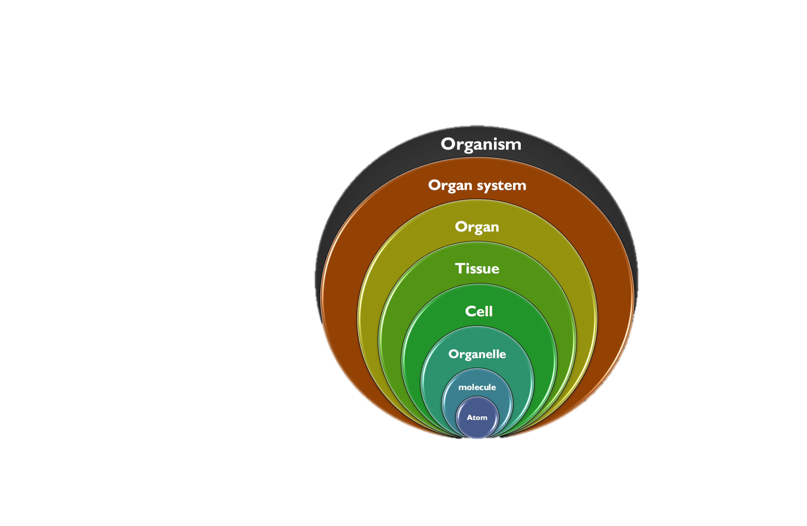
Definition
Anatomy and Physiology
Histology
Cells may differ markedly from one another, but they all share certain basic characteristics.
Biochemistry/Chemistry
Chemistry

Slide 6
The Internal Environment
“Milieu Intérieur” (ECF)
All the cells in the body are continuously bathing in fluid.
Because this fluid is outside the cell, it is called extracellular fluid (ECF).
It is from the ECF that cells get the ions and nutrients needed to maintain life.
All cells in the body live in the same environment i.e. ECF.
(Guyton and Hall Textbook of Medical Physiology. 13th ed. Ch-1)

Slide 7
Extracellular Fluid
Cells receive ions, nutrients and oxygen needed to maintain life from ECF.
All body cells live in the same environment i.e. ECF.
The composition of ECF is almost similar between the different species.
→ it was called the internal environment (milieu interieur) by the French physiologist Claude Bernard.
nutrients
waste
Because this fluid is outside the cells it is called “extracellular fluid (ECF)”
(Guyton and Hall Textbook of Medical Physiology. 13th ed. Ch-1)

Slide 8
Important info.
Fluid body compartments are divided into:
– Intracellular
– Extracellular
The amount of solutes in the two compartments differ. (3rd Lecture)
How is this achieved and maintained? → “Selective permeability” (2nd Lecture)

Slide 9
Thank you!
اعمل لترسم بسمة، اعمل لتمسح دمعة، اعمل و أنت تعلم أن الله لا يضيع أجر من أحسن عملا.
The Physiology 436 Team:
Lina Alwakeel
Dina Aldossary
Rana Barassain
Heba Alnasser
Munira Aldofayan
Sara Alshamrani
Sundus Alhawamda
Ruba Ali
Rehab Alanazi
Norah Alshabib
Nouf Alaqeeli
Buthaina Almajed
Fahad Al Fayez
Ibrahim Al Deeri
Hassan Al Shammari
Abdullah Al Otaibi
Abdullah Al Subhi
Ali Al Subaei
Omar Al Babteen
Foad Fathi
Faisal Al Fawaz
Muhammad Al Aayed
Muhammad Al Mutlaq
Nasser Abu Dujeen
Waleed Al Asqah
Team Leaders:
Qaiss Almuhaideb
Lulwah Alshiha
Contact us:
Physiology436@gmail.com
@Physiology436

