Slide 1


White Blood Cells
(WBC)
Red: very important.
Green: only found in males’ slides.
Purple: only found in females’ slides.
Gray: notes.
Physiology Team 436 – Foundation block lecture 11
Lecture: If work is intended for initial studying.
Review: If work is intended for revision.

Slide 2
Objectives
Recognize the general functions of WBC
Describe different Types of WBC, their formation, and function
Describe genesis and site of formation of WBC.
Describe stages of neutrophil formation
Describe the role of neutrophils in defending the body against infection
Describe the process of phagocytosis.
Describe Reticuloendothelial components and functions
Recognise leucocytosis and leucopenia.
Recognize type of leukaemia

Slide 3
IMMUNITY
(only found in male slides)
Acquired immunity
(specific, adaptive)
Humoral *Antibody-Mediated
*B lymphocytes
Innate immunity
(non specific)
Example:
1-Phagocytes
2- Complement system
3- Barriers
Barriers:
Chemical
Physical
Skin
Trachea (قصبة هوائية)
Cilia
Sweat
Tears
Saliva
Stomach acid
Cell-mediated
*T lymphocytes
Note: Macrophages (large phagocytes) are key components of the innate immunity and activate adaptive immunity by transforming into Antigen Presenting Cells
Humoral (meaning fluid): mediated by macromolecules found in ECF
The complement system: part of the immune system that enhances the ability of antibodies and phagocytic cells to clear microbes, promotes inflammation, and attacks membrane.
Phagocytes:
Include many types of WBC like:
(neutrophils, monocytes, NK, macrophages, mast cells)

Slide 4
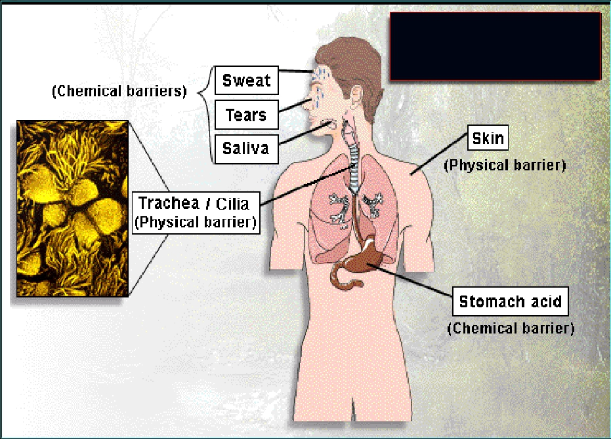
Barriers

Slide 5
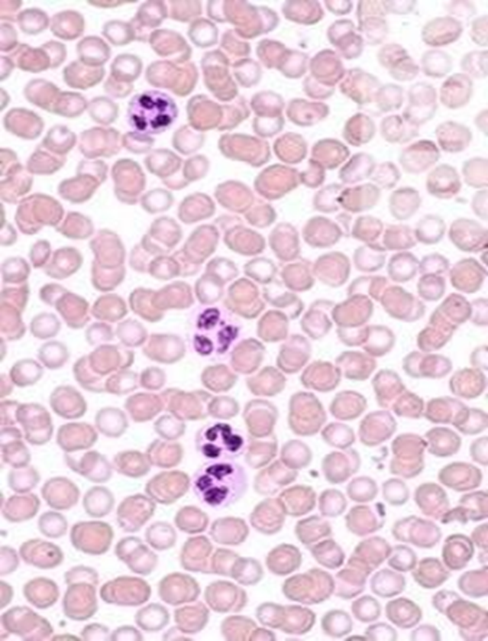
Number of Cells
White Blood Cells
-Also called: leucocytes –
Formed in bone marrow & lymph tissue
1- Recognize the general functions of WBC
General Function:
Protection against infection by:
    Phagocytosis
    Produce (secrete) antibodies
WBC = 4000—11000/ml (Depending on certain factors, ex: region and environment.)
Red Blood Cell (RBC)
White Blood Cell (WBC)
(5-6) million/ml
5000/ml
( WCB )
( RCB )
-This is why blood is red; RBCs are higher in number than WBCs.

Slide 6
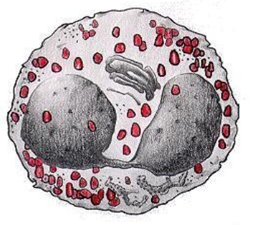
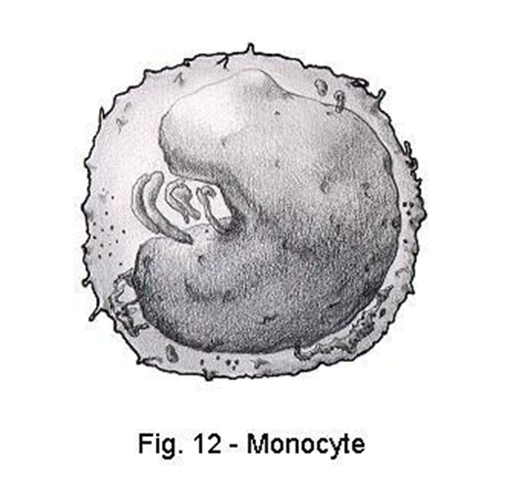
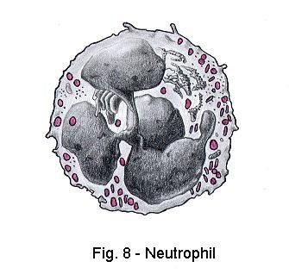
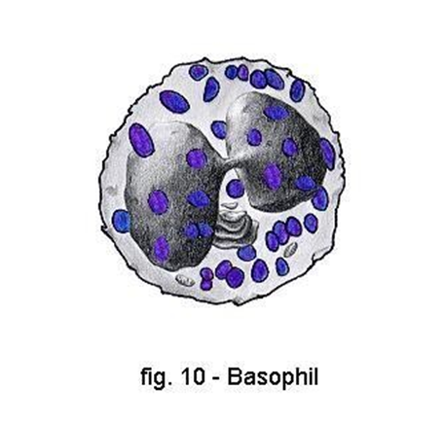
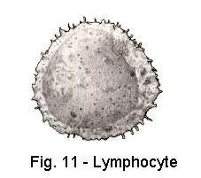
Types of WBC
-in boys’ slides percentages are written in ranges :Neutrophils:50%-70% Eosinophils:1%-4% Basophils:0.4% monocytes:2%-8% Lymphocytes:20%-40%
كرات الدم البيضاء ذات النواة المتعددة الأشكال.
Agranular = A means not
1. Granular (polymorphnuclear PMN )
2. A Granular
Neutrophil
62%
10-16um
Nucleus:
divided into 2-5 lobes (multi-lobed/lobulated nucleus) purple cytoplasmic granules
Eosinophil
2.3%
12-18um
Nucleus:
2 lobes,
coarse red
granules
Basophil 0.4%
-10-14um
Nucleus:
(Segmented nucleus)
-hidden by large round blue granules
Monocytes
5.3%
15-20um
Nucleus:
Kidney-shaped (LARGEST CELL IN WBC)
Lymphocyte 30%
T Lymphocytes
B Lymphocytes
Nucleus:
Round
small (5-8um)
large (9-15um)
-Granular: is categorized by: COLOR. Note: the doctor says that the diameters aren’t very important
-A granular: is categorized by SIZE.

Slide 7
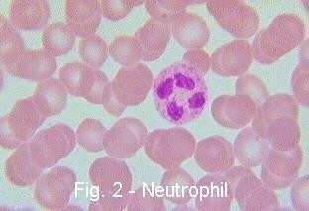
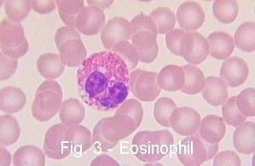
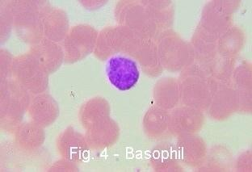
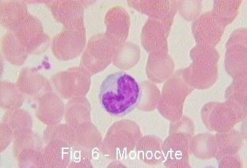
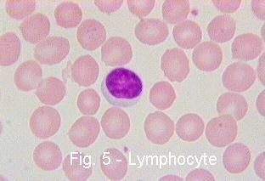
Microscopic Images of WBC

Slide 8
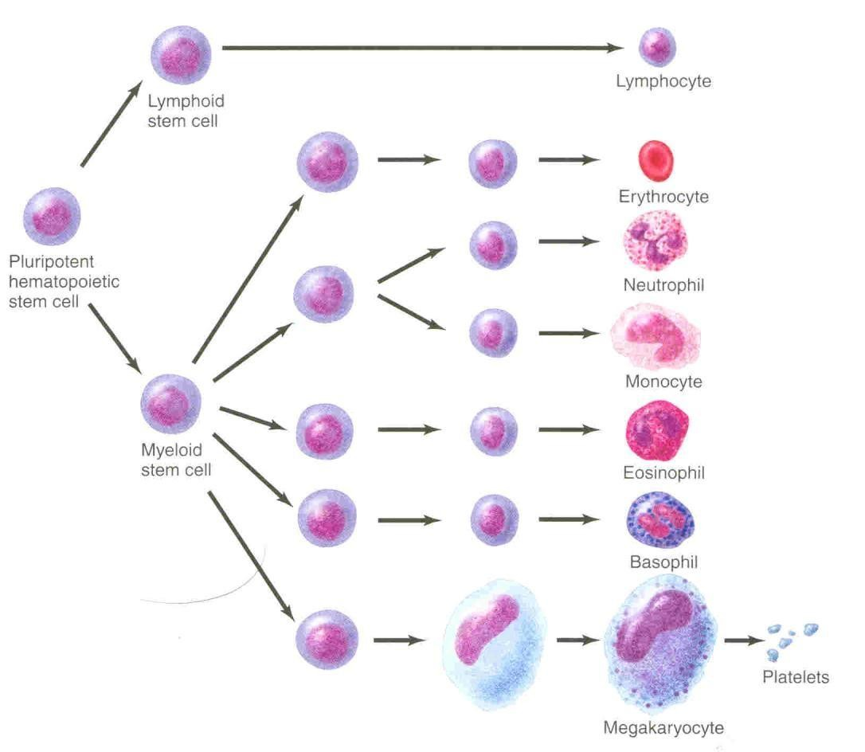
Genesis of WBC
Lineage (line) = الطريق اللي الخليه بتمشي عليه « تتبعه »
Major lineages of WBC:
Myelocytic : All granular & monocytes
Lymphocytic: lymphocytes
مُطالبين فيها
Pluripotent stem cells can potentially produce any cell or tissue the body needs to repair itself. This property is called pluripotency.
Sites of WBC Formation:
Granulocytes: bone marrow
Monocytes : bone marrow
Lymphocytes : bone marrow AND thymus & lymphoid tissues

Slide 9
Life span of WBCs (Teamwork 435)
Note from the male slides:
Life span of neutrophil: 6-8 hours
معلومة إضافية:
Monocyte is the largest blood cell.

Slide 10
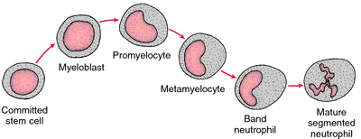
Formation and Maturation of Neutrohils
(Formed in Bone Marrow)
1. Stem cells →
2. Myelo-blast →
3. Pro-myelo-cytes →
4. Neutrophil myelocytes →
5. Young neutrophil meta-myelocytes →
6. Band neutrophil →
7. Polymorphnuclear neutrophil (Mature Neutrphils released to blood)
بالاحمر اللي قالت عليها الدكتوره انها معنا ( حفظًا ) الباقي فهم فقط
Polymorphnuclear neutrophil
neutrophil هي نفسها

Slide 11
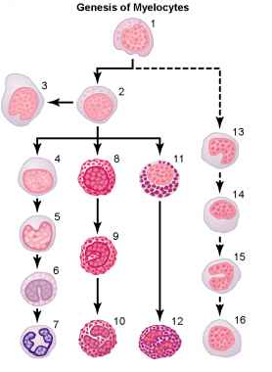
Formation and Maturation of Neutrophils
myeloblast
1-myeloblast
2-promyelocyte
3-megakaryocyte
4-neutrophil myelocyte
5-young neutrophil metamyelocyte
6-"band" neutrophil metamyelocyte
7-polymorphonuclear neutrophil
8-eosinophil myelocyte
9-eosinophil metamyelocyte
10-polymorphonuclear eosinophil
11-basophil myelocyte
12-polymorphonuclear basophil
13-16-stages of monocyte formation.
myelocyte
Mature cells

Slide 12
Formation and Maturation of WBC
Granular |  |  | AGranular
Myelocytic |  |  |  | Lymphocytic
Neutrophils | Eosinophils | Basophils | Monocytes | Lymphocytes
Stem cells | Stem cells | Stem cells | Stem cell | Stem cell
Myeloblast | Myeloblast | Myeloblast | monoblast | lymphoblast
Promyelocytes | Promyelocytes | Promyelocytes | promonocyte | intermediate pyronophilic blast cell
Neutrophil myelocytes | Eosinophil myelocytes | Basophil myelocytes
Young neutrophil meta-myelocytes | Eosinophil meta-myelocytes
Band neutrophil
Polymorphnuclear neutrophil (Mature Neutrphils released to blood) | polymorphnuclear eosinophil (Mature Eosinophil released to blood) | Polymorphnuclear Basophil (Mature Basophils released to blood) | mature monocytes released into blood | lymphocytes
Notice in granular: stem → blast → pro-myelocyte → myelocye → meta (unvailable in basophil) → band (only in neutrpohil)
Table by: Atikah Kadi

Slide 13
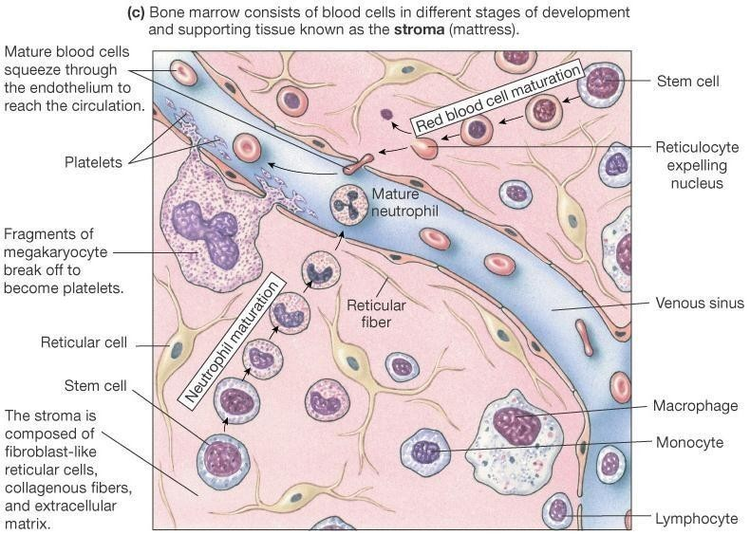
-Read and understand the following image:

Slide 14
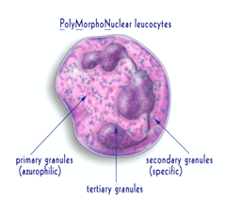
Neutrophil Granules
Primary Granules
(Also called Non Specific, Azurophilic, lysosomes) [33%]:
Acid hydrolases, MPO, HOCl, Defensins
Secondary Granules (Specific ) [67%]:
Lysozyme, Lactoferrin, Alkaline Phaphatase, Gelatinase, Bacteriostatic & Bacericidal products.
Tertiary Granules (help to digest tissues) Collagenase, Hyaluronidase and Gelatinase.
Glycogen granules: for anaerobic glycolysis.
Neutrophil Pools:
Bone Marrow, circulating pool (within blood) and Marginated Pool (of neutrophils adherent to endothelium)

Slide 15
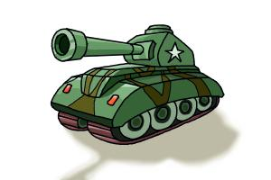



Monocyte => دبابه كبيره تاكل اكثر
Neutrophil => دبابه صغيره تاكل اقل
Neutrophil function
chemotaxis
Ameoboid movement
Engulfing and killing of microbe
margination
diapedesis
Attracting Neutrophil by a chemical stimulus to move toward area of infection
جميع الـ WBCs وليس فقط الـ Neutrophil
Defense against infection: Neutrophil has the ability of engulfing bacteria or organism by a process of phyagocytosis
تصف على الـ Capillary wall
Between capillary wall, it has pores تمر منها وحدة وحدة
زي حركه الاميبا عشان توصل
نحرك الجيش , نصفهم ندخلهم واحد واحد لساحه المعركه ! *تشبيه*

Slide 16
Responses During Inflammation
Macrophage and Neutrophil
1st line of defense – Tissue macrophages & Physical Barriers
2nd line of defense – Neutrophil Invasion of the
inflamed area
3rd line of defense – Monocytes –macrophage
invasion of inflamed area
4th line of defense – Increased production of
granulocytes and Monocytes by Bone marrow

Slide 17
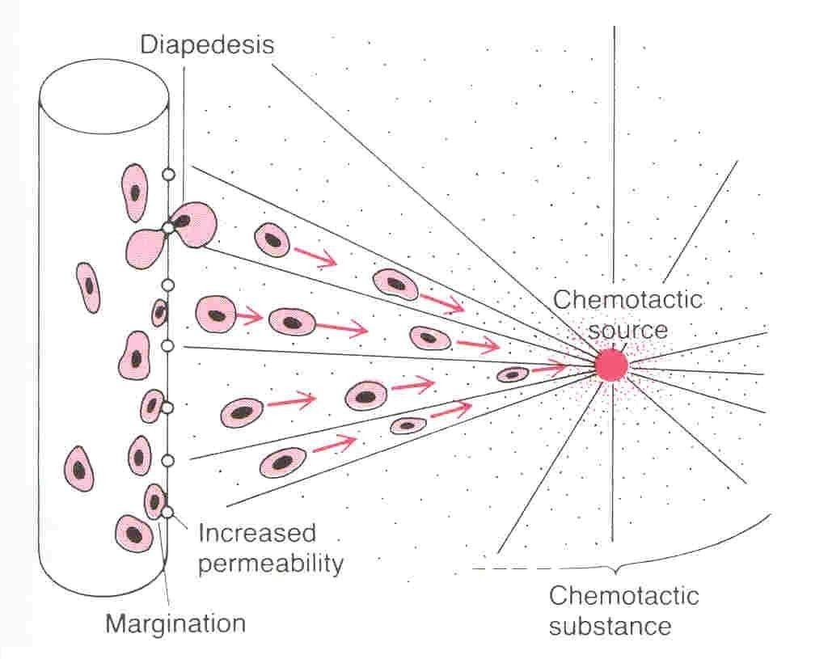
Chemotaxis, Margination and Diapedesis
عندما يكون هنالك جسم غريب داخل الجسم كيف تحاربه الـ Neutrophils؟
الجسم الغريب أو المنطقة المصابة تفرز مواد كيميائية لجذب الـ Neutrophil نحوه وهذه تسمى بالـ Chemotaxis
الآن تم إبلاغ الـ عن وجود الإصابة ومكانها المحدد وهنا تبدأ المعركة !
تبدأ الـ Neutrophilsبجلب جنودها WBC وتجعلها تصطف على الـ wall Vessel ثم تبدأ تدخل بالدور واحدة تلو الأخرى من خلال ثقوب هذه العملية تسمى Diapedesis وبعدها تصل إلى المنطقة المصابة ويحصل الابتلاع.
Dr
Sit
e
lban
a
t
20
1
1

Slide 18
Chemotaxis
The attraction of the neutrophils to inflamed area following chemotactic substances release from infected site:
Bacterial toxin (from bacteria itself)
Reaction product of plasma clotting
Complement system
Degenerative products of inflamed tissue
مثل ما قلنا الـ Chemotaxisهي اللي تجذب الـ Neutrophils
“infected area release substances to attract neutrophils ”
بالنسبة للنقطة الثانية فهي تعني أنه عندما حصل التهاب للنسيج بدأ بالتكسر و التحلل وإفراز مواد وهذه المواد هي اللي تصبحchemotaxis

Slide 19
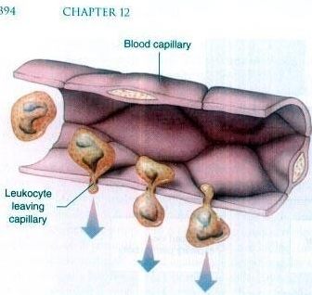
Margination & Diapedesis
Margination: accumulation and adhesion of leukocytes to the epithelial cells of blood vessel walls at the site of injury in the early stages of inflammation
Diapedesis: is the movement of leukocytes out of the circulatory system and towards the site of tissue damage or infection.
Margination: WBC marginate along the wall of blood capillaries
diapedesis: WBC squeezes itself through endothelial holes leaving blood capillaries
WBC move by amoeboid motion towards inflammation area following chemotactic substance released from site of infection
Upon reaching the site of infection neutrophils start to engulf infecting organism

Slide 20
Phagocytosis
phagocytosis => process عمليه الابتلاع
pseudopodia => الاقدام الكاذبه
الحويصله اللي تكونت بعد الـ Phagocytosis
phagosome =>
Selective process: foreign substances are recognized by:
1. Rough surface
2. No protective protein coat, which prevents phagocytosis
3. Marked by certain substance
e.g opsonization: complement 3 or anti bodies mark foreign substances & making them ready for killing as a way to identify it to the phagocyte.
Neutrophils encircle the bacteria with pseudo-podia أقدام كاذبة
And engulf it inside into a vacuole (phagosome), takes 3-20 bacteria
2 Minute video showing the process of Opsonization: https://m.youtube.com/watch?v=6SiqO20ySQc

Slide 21
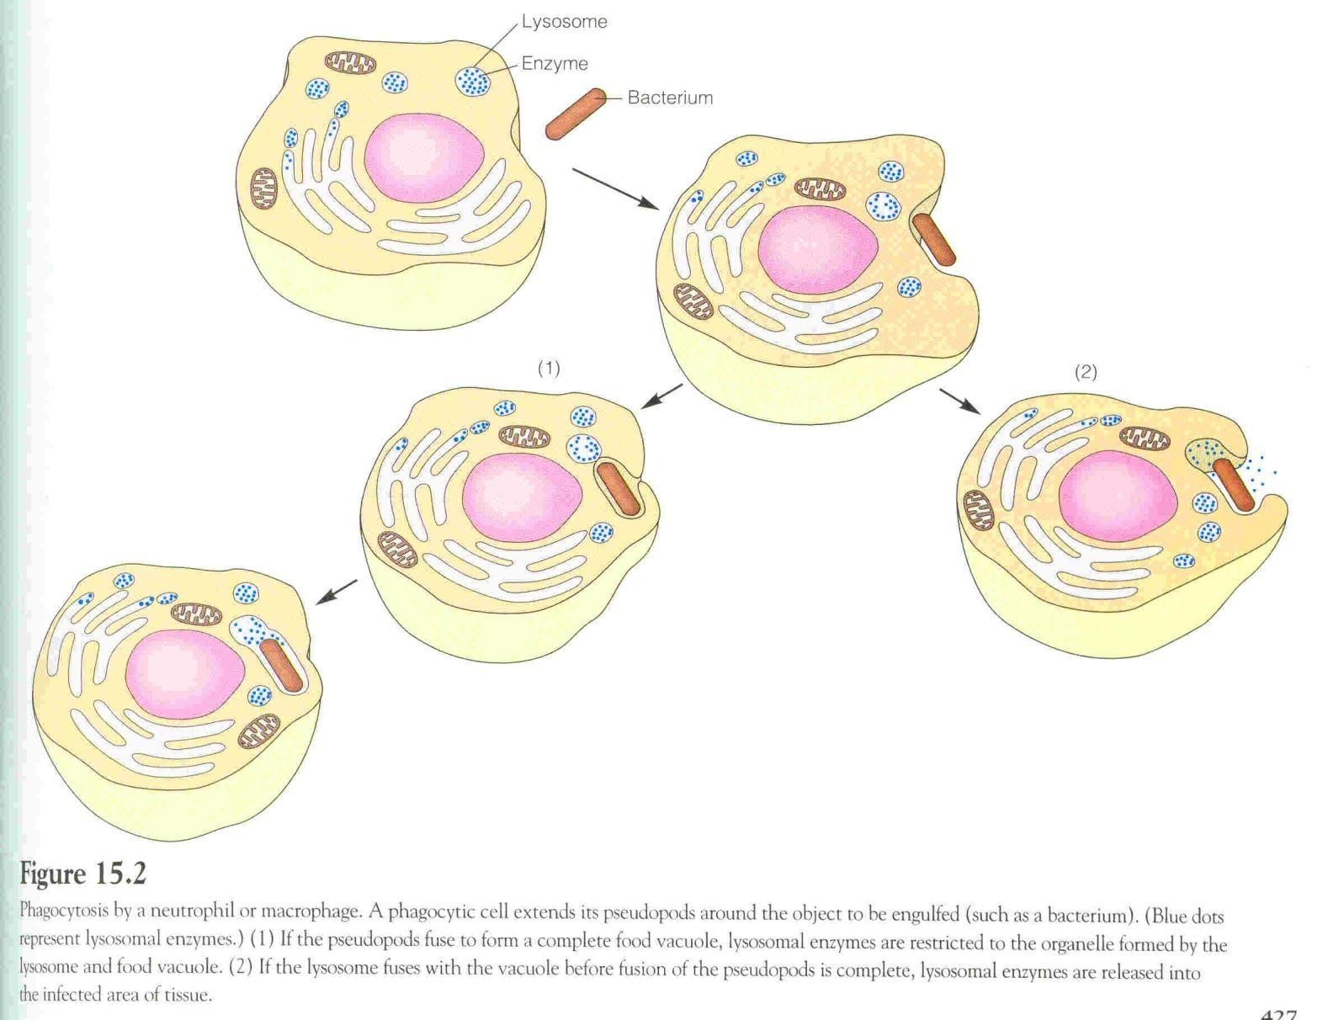

Slide 22
Microbial killing ( قراءة )
Digestion of organism inside the phagosome (vacuole (داخلها البكتيريا
1
Fusion of intracellular lysosomes + phagosome vacuole
2
Lysosomes discharge its proteolytic enzymes such as myeloperoxidase, catalase into the vacuole, killing and digesting the engulfed bacteria
3
Release of bactericidal such as superoxide, hydrogen peroxide to kill the bacteria

Slide 23
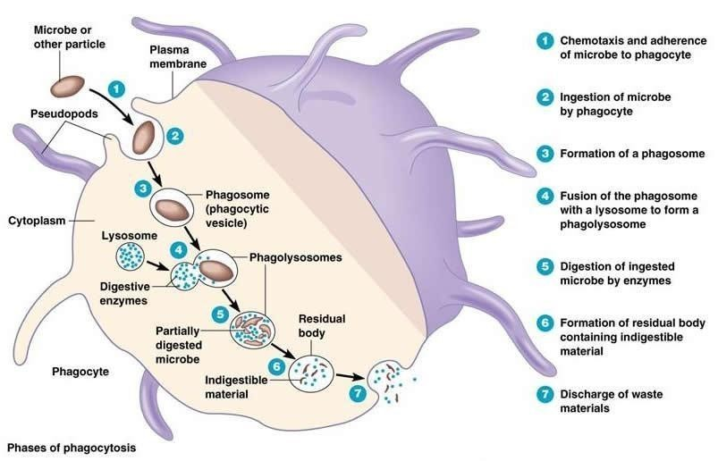

Slide 24
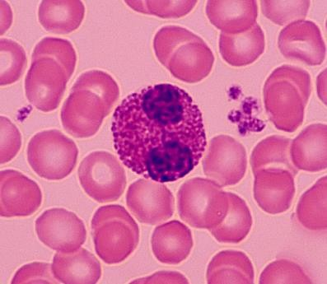
EOSINOPHILS
(only found in males’ slides)
Weak phagocytes
Exhibit Chemotaxis
Attach themselves to the parasite:
(1) by releasing hydrolytic enzymes from their granules (modified lysosomes)
(2) release highly reactive forms of oxygen
(3) release major basic protein (a highly larvacidal polypeptide)
Produced in large numbers during: PARASITIC INFECTIONS
Examples of parastici infection: schistosomiasis, hook worm, Ascaris and
in ALLERGIES eg; asthma & Rhinitis
DRUG REACTIONS and SKIN ALLERGIES.
Neutralizes allergic products such as histamine, 5-HT, Ag-Ab complex, bradykinin (allergic disease of skin & lungs)

Slide 25
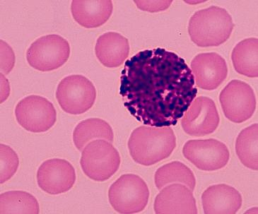
BASOPHILS
Both mast cells and basophils liberate (secrete): heparin (anticoagulant),
bradykinin, Serotonin (5HT), histamine (contribute to inflammation response)
slow-reacting substance of anaphylaxis (a mixture of three leukotrienes) and a number of lysosomal enzymes.
Increased in allergic reactions: immediate-type hypersensitivity (allergic) reactions
The release of those substances cause local and vascular reactions characteristic of allergic manifestation.

Slide 26
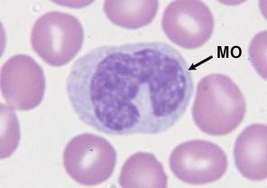
MONOCYTES
(only found in males’ slides)
More efficient than Neutrophils (can phagocytize 100 bacteria vs 3- 20 by Neutrophil)
Can engulf larger particles (like RBCs & malarial parasites)
Life span: 10-20 hours
Two types: Mobile & Fixed
Lysosomes contain lipases unlike Neutrophil.
Acts as Antigen Presenting Cells
After staying 10-20 hours in circulation, they leave the blood to tissues transforming into larger cells, macrophages.
Macrophage life span is up to a few months.

Slide 27
Function of Monocytes and Macrophages
(only found in females’ slides)
Macrophages are a powerful phagocytic cells; first line of defense
– Ingest up to 100 bacteria,
–
–
Ingest larger particles as old RBC
Get rid of waste and survive
Functions: anti-inflamatory
  Directly: phygocytosis of bacteria, dead cells
  Indirectly cooperating with lymphocytes by recognizing foreign body (take in foreign body process it and present it to lymphocytes)

Slide 28
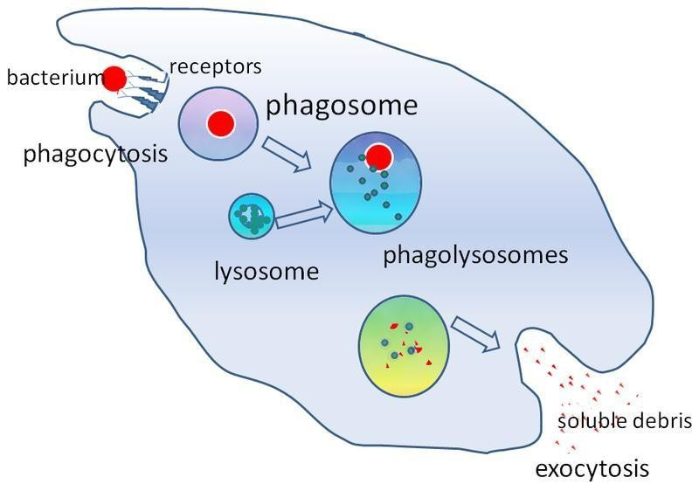
Direct anti Inflammatory
.

Slide 29
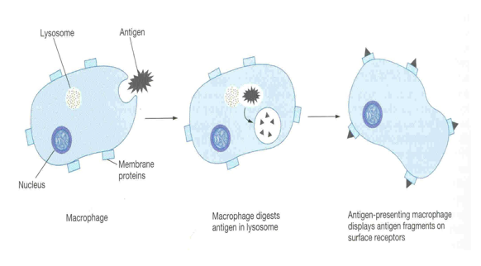
Indirect anti-inflammatory

Slide 30
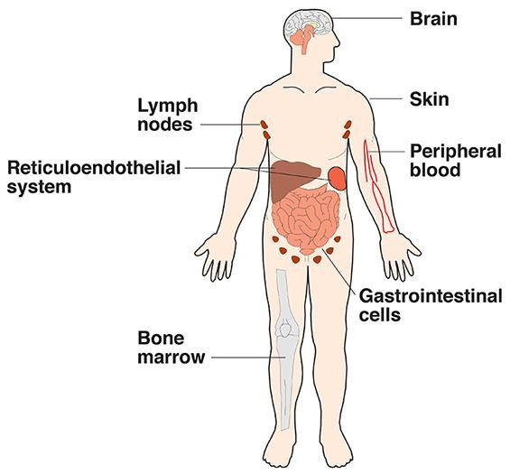
Reticulo-endothelial System
Monocytes/Macrophage System
Consists of Monocytes, Macrophages, and endothelial cells (found in spleen, bone marrow, lymph nodes)
Monocytes → enter the tissues → transform themselves into macrophages
This system of phagocytes is called: Monocye-Macrophage Cell System
It is found in various places in the body:
1.Skin and subcatenous tissues (Histiocytes)
2.Lymph Nodes
3.Alveolar macrophages
4.Liver sinuses (Kupffer Cells)
5. Lung
6. Spleen
7. Bone marrow
8.Microglia in Brain
9.Kidneys (Mesangial Cells)
10.Bone (Osteoclasts)

Slide 31
PMNs (Antimicrobial system)
RESPIRATORY BURST
▪ O2 Free Radicals (O-2, H2O2, -OH)
▪ NADPH-oxidase
▪ Myeloperoxidase
▪ Cl- → HoCl: Hypochlorous acid “very toxic”
REACTIVE OXYGEN METABOLITES
(only found in males’ slides)
Superoxide anion: O2-
Hydrogen peroxide: H2O2
Hydroxyl radical: OH .
Hypochlorous acid: HOCl
Myeloperoxidase = MPO
O2 + e-
2O2- + 2H+
H2O2+ Fe2+
H2O2
O2-
H2O2+ O2
OH + OH- + Fe3+
HOCl + OH-
MPO

Slide 32
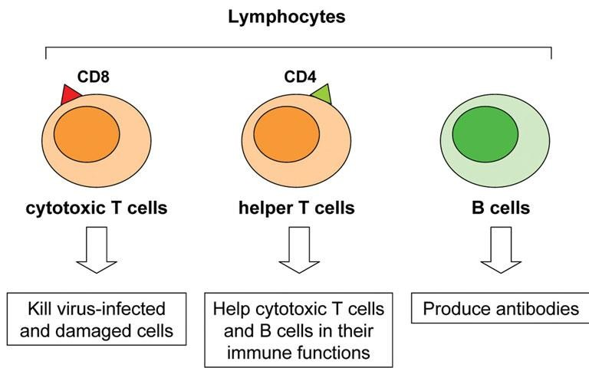
Lymphocytes Formation and Maturation
Formed in :
  stem cells of bone marrow
  Thymus
  lymphoid tissues.
Life Span :
  Range from weeks to months according to its type.(T or B )
It has 2 types:
    1. T Lymphocytes: (thymus-dependent )
    2. B Lymphocytes: (thymus-independent)

Slide 33
T & B lymphocyte
T-Lymphocytes
(Thymus dependent)
B- Lymphocytes
(thymus-independents)
Formed in:
  bone marrow or lymphoid tissue migrate to thymus for maturation
Life spans : 100-130 days. ( long period )
Circulate between :
  blood , tissue lymph
Types :
    T-helper
    T-cytotoxic
    Natural killer
  Functions :
Cellular immunity (graft rejection delayed hypersensitivity )
Role in antibody secretion.
First discovered in Bird Bursa (حويصلات ) (من هنا جائت التسمية )
Formed in:
  Bone marrow , germinal layer of lymph node , red pulp of spleen
Life spans : 2-7 days.
Circulate between :
  blood , tissue lymph
Transforms into :
  large plasma cell (produce antibody)
  Functions :
Humoral immunity. (not Hormonal ! )
  Stimulated by antigen transforming
على سبٌيل المثال :
1- لما تحدث عملٌية نقل لكلٌية أو أي عضو والجسم ٌرفض هذا العضو وتصٌير مضاعفات مٌن اللًي رفض العضو ؟ الـ Lymphocytes-T
2- delayed hypersensitivity ) ) مثال عليها : جرعة منشطة بعد التعقيم
B-lymph
Plasma cells
antibodies
Antigen: anything that stimulates a reaction

Slide 34
Abnormality of WBC numbers
Leucocytosis
Leucopenia
Increased WBC
Physiologic or pathological causes
Physiologic :
  Diurnal (morning : more) (evening: less)
  After physical exercise
  Stress or Adrenaline injection Disease
Pathologic :
  Bacterial infection (tonsillitis, Appendicitis)
  Worm infection
decreased WBC
Causes:
  malnutrition.
  Drugs
  Radiation
  Typhoid fever.
  Decrease B12 &folic acid
Paradox: assuming that fever means high white blood cells
Normal range of WBC: 4000 to 11000

Slide 35
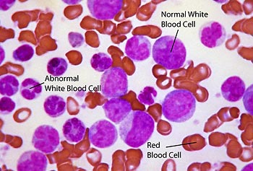
Leukemia
Definition :
    Cancer of white blood cells due to chromosomal abnormality
Caused by :
    chemicals,
    Radiation
    viruses.
WBC more than 50x10³
(ارتفاع في عدد كريات الدم البيضاء الغير طبيعية )
Types of leukemia :
Myeloblast leukemia → myeloid cells
Lymphoblast leukemia → lymphocyte cells
Acute or chronic onset
Accompanied with :
    Anemia
    Bleeding
Lymphoid
Myloid :
Have different causes and age groups

Slide 36
Thank you!
اعمل لترسم بسمة، اعمل لتمسح دمعة، اعمل و أنت تعلم أن الله لا يضيع أجر من أحسن عملا.
The Physiology 436 Team:
Lina Alwakeel
Rana Barassain
Heba Alnasser
Munira Aldofayan
Sara Alshamrani
Sundus Alhawamda
Ruba Ali
Rehab Alanazi
Norah Alshabib
Nouf Alaqeeli
Buthaina Almajed
Alaa Alaqeel
Fahad Al Fayez
Ibrahim Al Deeri
Hassan Al Shammari
Abdullah Al Otaibi
Abdullah Al Subhi
Ali Al Subaei
Omar Al Babteen
Foad Fathi
Faisal Al Fawaz
Muhammad Al Aayed
Muhammad Al Mutlaq
Nasser Abu Dujeen
Waleed Al Asqah
Team Leaders:
Qaiss Almuhaideb
Lulwah Alshiha
Contact us:
Physiology436@gmail.com
@Physiology436

