Slide 1
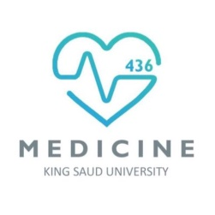
BLOOD GROUPS
Red: very important.
Green: only found in males’ slides.
Purple: only found in females’ slides.
Gray: notes.
Physiology Team 436 – Foundation block lecture 11
Lecture: If work is intended for initial studying.
Review: If work is intended for revision.

Slide 2
Objectives
Describe ABO blood groups types.
Recognize Agglutinin in plasma.
Describe genetic inheritance of Blood groups.
Recognize transfusion reactions.
Describe Rhesus blood groups.
Describe causes of hemolytic disease of the newborn.

Slide 3
Blood Group System
Blood Groups are determined by: Antigens on the surface of RBCs.
Remember: Antigens can stimulate the immune system to produce antibodies.
Examples of antigens:
[glycoproteins, complex oligosaccharides that differ in their terminal sugar.]
About 20 blood group systems are known:
[E.g.ABO System, Rh-System, MNS System, Kell System, Lewis System, Duffy, Lutheran, KIDD]
The two most common blood groups:
ABO Blood group System.
Rh (Rhesus)Blood group System.
Karl Landsteiner is an Austrian scientist that:
Discovered the ABO Blood group system in 1901
Discovered Rh factor in 1930 along with Alexander S. Wiener
Noble prize in Physiology/Medicine in 1930

Slide 4
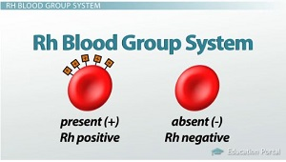
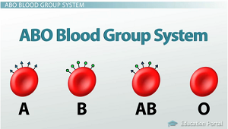
ABO & Rh Blood group systems
ABO System | Rh System
Depends on : the presence of one or both or neither of the two blood antigens (A) and (B) on the surface of the RBC. Four main ABO groups: A, B, AB, O A and B blood groups are dominant over the O blood group. A and B group genes are co-dominant. (Co-dominance: form of dominance in which the alleles of a gene pair in a heterozygote are fully expressed thereby resulting in offspring with a phenotype that is neither dominant nor recessive) Each person has two copies of genes coding for their ABO blood group (one maternal and one paternal in origin) Locus of alleles responsible for the ABO system is on the long arm of chromosome9. | Depends on: the presence or absence of the Rhesus antigen (D) on the surface of RBC. Presence of D (individual is Rh+ve) [85%] Absence of D (individual is Rh–ve) [15%] Rhesus antigens: Dd, Cc, Ee (Clinically most important is D) Locus of alleles responsible for Rh Factor is on the long arm of chromosome 1.
Locus: a particular position or place where something occurs.
They were named Rhesus antigens or Rh antigens because the same antigens are present in the Rhesus monkey.

Slide 5
Definitions
Agglutinogens
It is Blood group Antigens (on RBCs membrane) (A&B)
Agglutinin
It is The respective antibody to antigen
Agglutination
It is a Reaction (clumping) between Agglutinogens on RBC membrane and the respective AntiBody
Or It is Antibodies in serum (In Plasma)
Agglutinins are immunoglobulins (IgM & IgG): Proteins which appear in the plasma or body fluids in response to administration of antigens.
In transfusion reaction If a person with blood group A was transfused with blood of group B which contains anti-A in plasma
The clumped cells plug (block) small blood vessels.
Sometimes causes hemolysis.
The anti-A in plasma of recipient with blood group B will agglutinate the transfused cell (A).
Landsteiner Law (1900):
If an agglutinogen (antigen) is present on the RBC of an individual, the corresponding agglutinin (antibody) must be absent in the plasma of that individual and vice-versa. This law is only applicable to ABO blood grouping system.

Slide 6
Genetic Determination of Agglutinogens
Genotype for each blood group:
A →AA , AO
B →BB , BO
AB →AB
O →OO
Uses of genotypes:
Sorting disputes in paternal dispute
Frequency of ABO has ethnic variation
These are genotypes (طراز جيني)

Slide 7
Agglutinin /Antibodies
Examples of Agglutinins:
Anti-A & Anti-B antibodies.
Naturally occurring antibodies.
Anti-D antibodies.
NOT naturally-occurring antibodies.
Not present at birth, appear 2-8/12 weeks (2 to 8 months) after birth.
Triggered by A & B antigens in food and bacteria.
Acquired by:
Are considered as IgM class.(large molecule)
Are considered as IgG class.
Cannot cross placenta.
Can cross placenta.
Rh-ve pregnancy with Rh+ve faetus.
Transfusion of Rh-ve individual with Rh+ve blood.
Example: if my blood type is B+, I will have antigen B and antigen D, and I will have anti A.

Slide 8
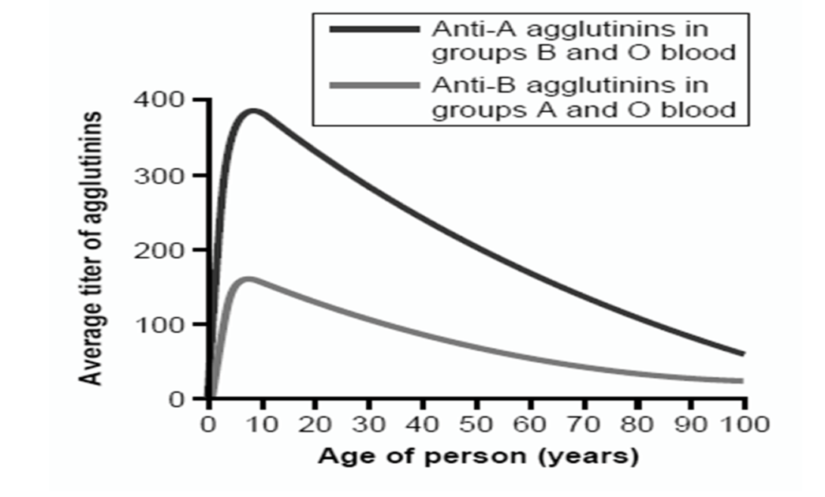
Titer of Anti- A&B Agglutinins at Different Ages
Agglutinin
The Rh immune response
Formation of anti-Rh agglutinin:
Rh +ve blood
Transfused for the first time
Rh –ve person
2 to 8 months after birth, an infant begins to produce agglutinins.
A maximum titer is usually reached at 8 to 10 years of age, and this gradually declines throughout the remaining years of life.
Anti-Rh agglutinins develop slowly (2-4 months).
Once produced they persist for years and can produce serious reactions during 2nd transfusion. (so, it can only be done once).
Titer: the concentration of an antibody, as determined by finding the highest dilution at which it is still able to cause agglutination of the antigen.

Slide 9
Comparing between Agglutinogens & Agglutinin
Blood Group | Agglutinogen )Antigen) | Agglutinin (Antibody)
A B AB O | A B A & B - | Anti-B Anti-A - Anti A+Anti B
Example:
If a baby has blood group (antigen) A, and is infected with a bacteria with antigen A, nothing will happen.
If the baby is infected with bacteria with antigen B, so he will produce antibody Anti B.

Slide 10
Agglutination
If there is agglutination in the blood drop when Anti-A was used that means the patient's blood group is A.
Also: Anti-B → agglutination → blood group B.
If there is agglutination in the blood drop when we used both Anti-A and Anti-B that means the patient's blood group is AB.
If there isn’t agglutination in the drop patient blood when we used both Anti-A and Anti-B that mean patient's blood group is O.
When the antigen and antibody are the same type, it can be dangerous and may lead to anemia.

Slide 11
Agglutination
Girls slide : circles from doctor

Slide 12
Importance of blood groups
In blood transfusion.
In preventing hemolytic disease (Rh incompatibility between mother and fetus)
In paternity disputes (to determine the father)
In medicolegal cases (الجرائم)
In knowing susceptibility to disease:
Group O: duodenal cancer.
Group A: carcinoma of stomach, pancreas & salivary glands.
* Color just to make it clear for the next slides

Slide 13
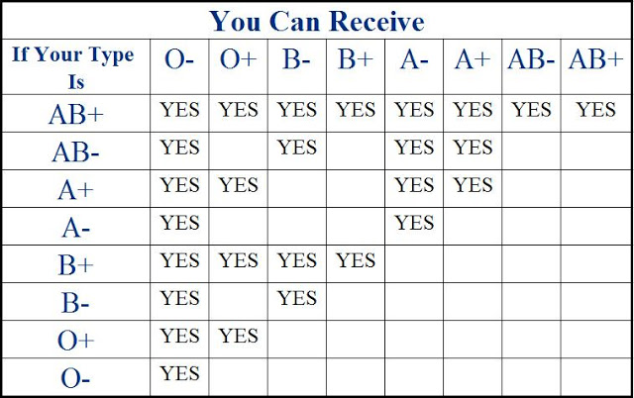
1. Blood Transfusions ( Donors and Recipients )
A drop pf patient RBC
Blood test before transfusion :
Blood group type of patient (recipient)
(next slide)
Cross-matching : donor RBC + recipient’s (patient) serum (plasma)
Anti-A
Anti-B
Anti-D
People with blood group O are called “universal donors”
people with blood group AB are called “universal recipients”.

Slide 14
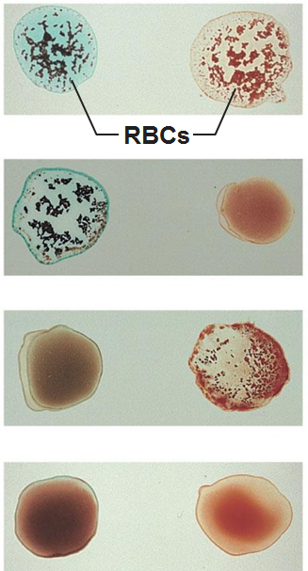
Blood being tested Anti-A Anti-B
Blood group type of patient
serum
Type AB (contains
agglutinogens A and B; agglutinates with both serum)
Type A (contains agglutinogen A; agglutinates with anti-A)
Type B (contains agglutinogen B; agglutinates with anti-B)
Type O (contains no
agglutinogens; does not agglutinate with either serum)

Slide 15
2. Complications of Blood Transfusions
1- Immune reaction: incompatible blood transfusions leading to immediate or delayed reaction, fever, hemolysis, allergic reaction. (appears within 10 to 15 minutes of transfusion)
2- Transmission of diseases: malaria, syphilis, viral hepatitis, and AIDs virus.
3- Iron overload: due to multi-transfusion in case of sickle cell anemia and thalassemia.
4- Acute kidney failure: (reaction to mismatched transfusions )

Slide 16
Hazards (Risks) of Mismatched Transfusions
2 Types:
Immediate:
Agglutination
Hemolysis
Fever
Allergic reaction
Acute renal shutdown
Renal vasoconstriction
Circulatory shock
Tubular blockage
Delayed:
Sensitization
Thrombophlebitis

Slide 17
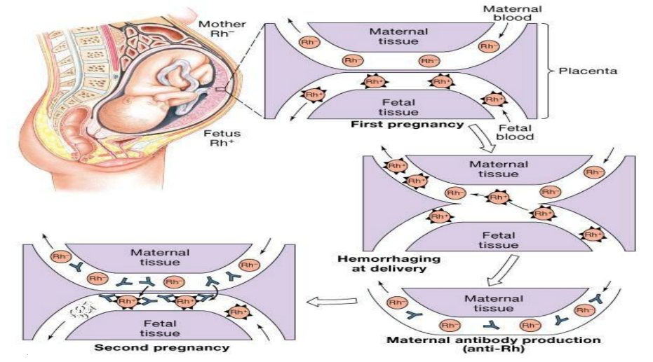
3. Rh incompatibility between mother and fetus
Mother is Rh –ve and the first baby is Rh +ve (has D antigen) :
(father is +ve which is more dominant therefore : baby is +ve)
At delivery:
Fetal Rh +ve RBC cross to maternal blood.
The mother will develop anti-D after delivery.
First child escapes & is safe.
Second fetus (baby): Rh +ve
If Rh +ve: Antibody-D crosses placenta from mom to baby and destroys fetal Rh +ve RBCs.
Outcome:
Hemolytic disease of the newborn.
If it was the opposite: mom is positive and baby is negative, nothing will happen.
If the mother was transfused before with Rh +ve blood before, the first child will be affected.

Slide 18
Extra explanation for the previous slide
الفكرة هنا ان بالولادة الأولى او بنقل الدم الأول للدم المختلف (+ و -) ما يصير شيء لأن الجسم ما قد تعرض لمثل هذا الاختلاف فما كون اجسام مضادة ، لكن بعد ما تعرض لها يكون اجسام مضادة وبكذا لما يتعرض لها من جديد يبدأ يحاربها ولهذا يمر الحمل الأول بسلاسة و الثاني أما يفشل او يسبب مشاكل للأم والطفل . ( لأن جسم الأم كون اجسام مضادة )

Slide 19
2. Rh incompatibility between mother and fetus
الشريحة مجرد توضيح للي ما فهم السلايد رقم 17
1
2
3
4
5

Slide 20
Result
الشريحة مجرد توضيح للي ما فهم السلايد رقم 17

Slide 21
Hemolytic disease of new born (Erythroblastosis fetalis)
1. Hemolytic anemia:
If severe: is treated with exchange transfusion:
Replace baby’s blood with Rh –ve RBC (several times).
2. Hydrops fetalis: (death in utero)
3. Kernicterus
Prevalence of disease:
1st pregnancy: 0%
2nd pregnancy: 3%
3rd pregnancy: 10%
Kernicterus : is a brain damage in newborn with sever jaundice (jaundice : caused by high level of bilirubin in baby’s blood ))
Prevention:
After 1st childbirth : Injecting the mother with antibody-D immediately after 1st childbirth.
Antenatal (during pregnancy) : prophylaxis.

Slide 22
3. Paternity (to determine the father)
Blood groups cant be used to prove paternity, but can be used to disprove it.
Question 1:
Nora: blood type A and Ahmad: blood type B
Have a baby: blood type O. Can Ahmad be the father?
Mother |  | Red : what we are sure about from question Blue: we solved
O | A
 |  | B | Father
Baby OO |  | O
Possible genotypes | Phenotype
AA or AO | A
BB or BO | B
OO | O
Answer 1:
Ahmad can be the father, but not 100% sure
Answer 2:
The father can NOT be type O. Here we disproved paternity.
Red : what we are sure about from the question |  | Mother
 |  | A | O or A
Father | O
 | O |  | Baby B O/B
Question 2:
Mother: blood type A Daughter: blood type B
Can the father be blood type O?

Slide 23
Thank you!
اعمل لترسم بسمة، اعمل لتمسح دمعة، اعمل و أنت تعلم أن الله لا يضيع أجر من أحسن عملا.
The Physiology 436 Team:
Lina Alwakeel
Rana Barassain
Heba Alnasser
Munira Aldofayan
Sara Alshamrani
Sundus Alhawamda
Ruba Ali
Rehab Alanazi
Norah Alshabib
Nouf Alaqeeli
Buthaina Almajed
Alaa Alaqeel
Fahad Al Fayez
Ibrahim Al Deeri
Hassan Al Shammari
Abdullah Al Otaibi
Abdullah Al Subhi
Ali Al Subaei
Omar Al Babteen
Foad Fathi
Faisal Al Fawaz
Muhammad Al Aayed
Muhammad Al Mutlaq
Nasser Abu Dujeen
Waleed Al Asqah
Team Leaders:
Qaiss Almuhaideb
Lulwah Alshiha
Contact us:
Physiology436@gmail.com
@Physiology436

