Slide 1
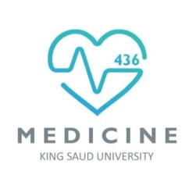
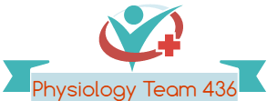
Hemostasis
Red: very important.
Green: only found in males’ slides.
Purple: only found in females’ slides.
Gray: notes.
Physiology Team 436 – Foundation block lecture 12
Lecture: If work is intended for initial studying.
Review: If work is intended for revision.

Slide 2
Objectives
Recognize different stages of hemostasis.
Describe formation and development of platelets.
Explain the role of platelets in hemostasis.
Recognize different clotting factors & cascade of clotting.
Describe the intrinsic, extrinsic and common pathways.
Recognize the role of thrombin in coagulation.
Explain the process of fibrinolysis and function of plasmin.

Slide 3
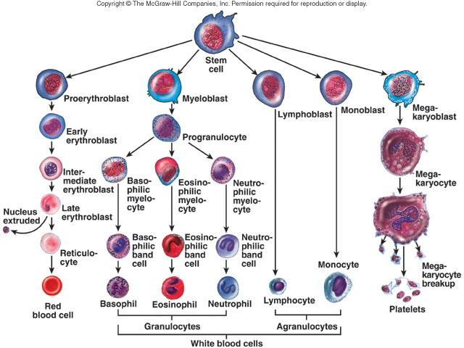
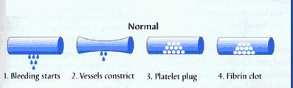
Hemostasis
It is the spontaneous arrest (stop) of bleeding from ruptured blood vessels.
Its mechanism (steps of function):
Vessel wall (Vascular spasm).
Formation of platelet plug.
Blood coagulation & clot retraction.
Fibrinolytic system (Fibrinolysis).

Slide 4
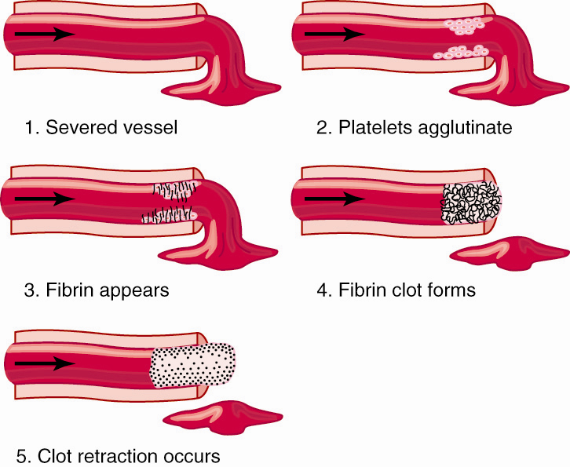
Steps of Hemostasis

Slide 5
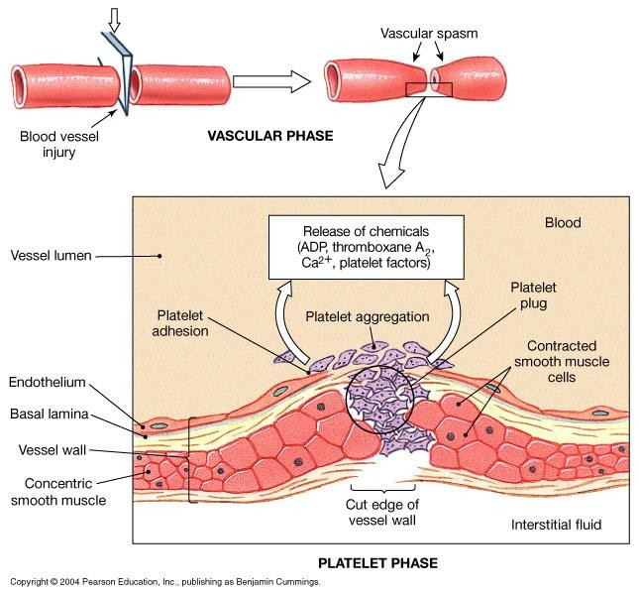

Slide 6
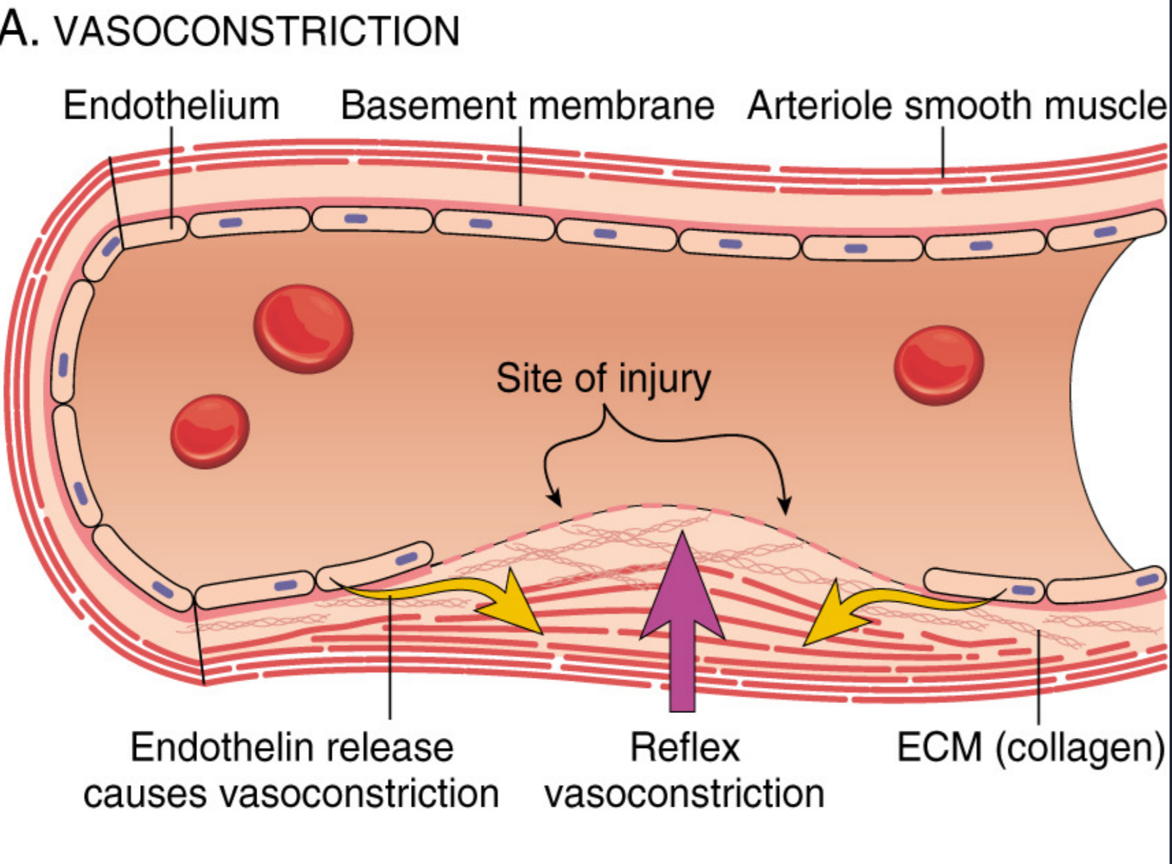
Hemostatic Mechanism
1-Vessel wall.
Immediately after injury there is a localized Vasoconstriction (vascular spasm, in order to decrease blood flow)
Mechanism of vasoconstriction (causative Factor):
Local myogenic spasm (systemic release of adrenaline).
Local release of Thromboxane A2 ]TXA2[ & 5HT” serotonin” by platelets. (humoral factors)
Nervous factors “stimulation for nerve impulses + nerve reflex is vasocontraction”. (reflex action involves simple nervous pathway)
Importance:
Crushing injuries > intense spasm > no lethal loss of blood.
Notes:
Causative Factor: meaning that it is “a cause”
Vasoconstriction is produced by vascular smooth muscle cells, and is the blood vessels first response to injury.
The damaged vessels will constrict (vasoconstrict) which reduces the amount of blood flow through the area and limits the amount of blood loss.
Myogenic contraction refers to a contraction initiated by the myocyte cell. (muscle cell)
Platelets release cytoplasmic granules which contain, ADP, 5HT (serotonin) and thromboxane A2 (TXA2), all of which, increase the effect of vasoconstriction. *will be explained in the next slides*

Slide 7
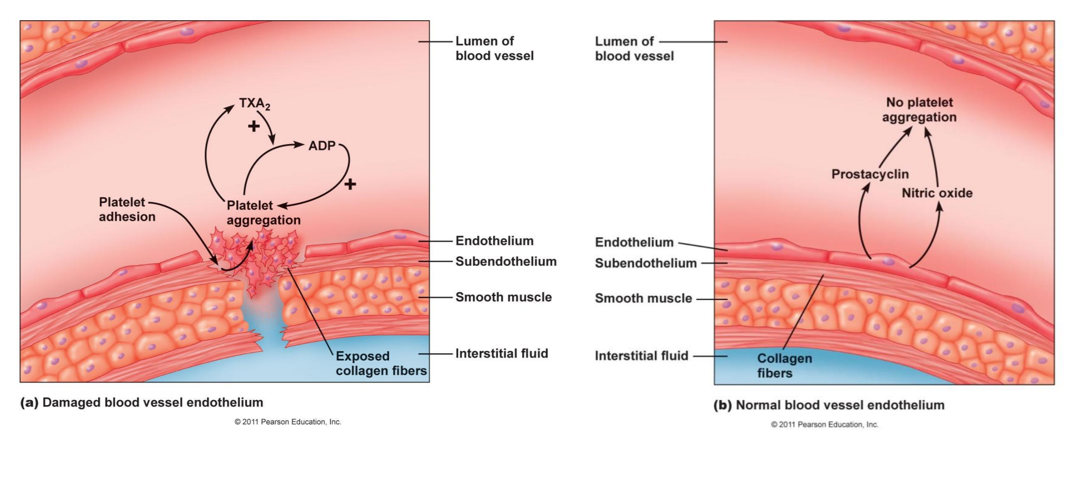

Slide 8
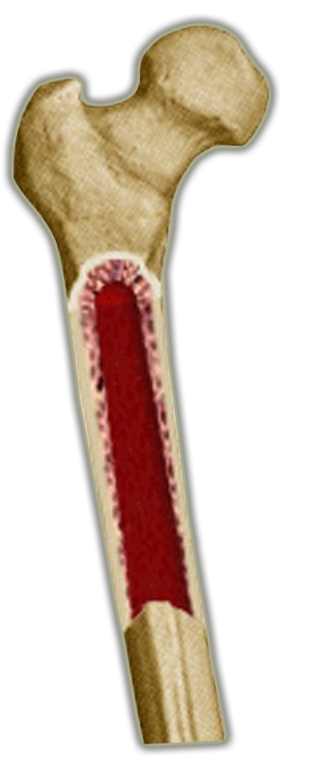


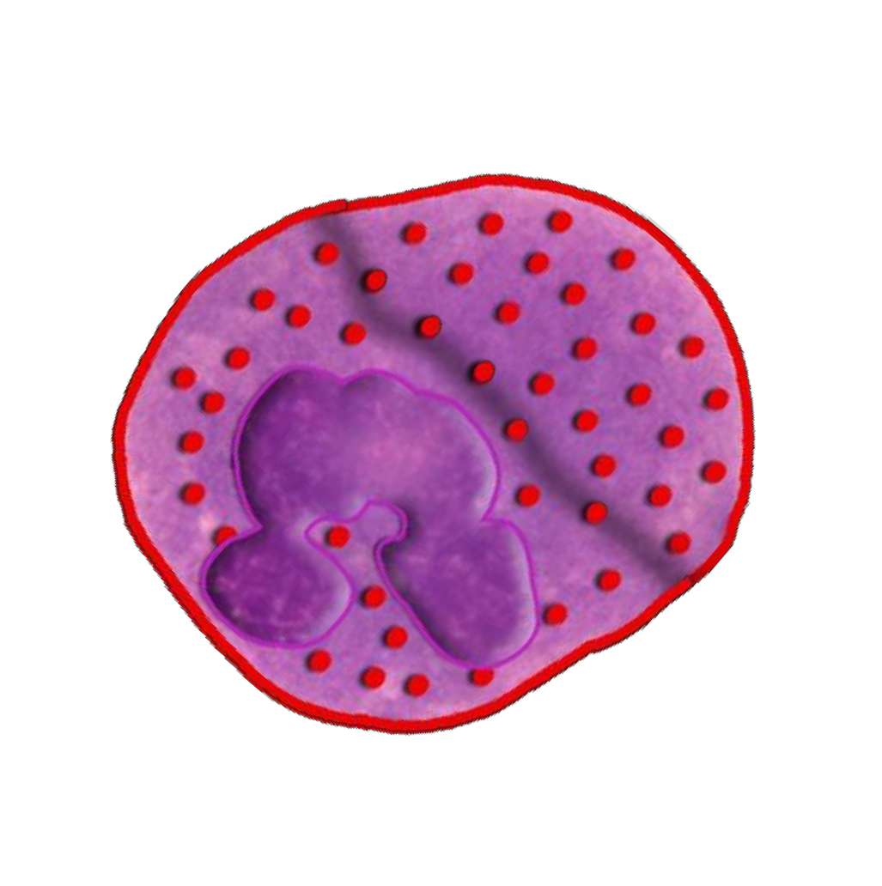
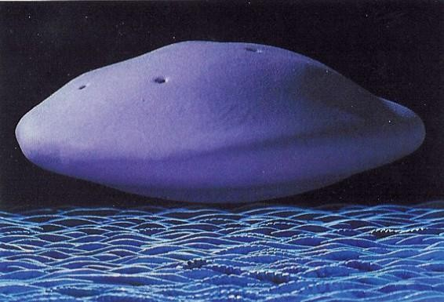
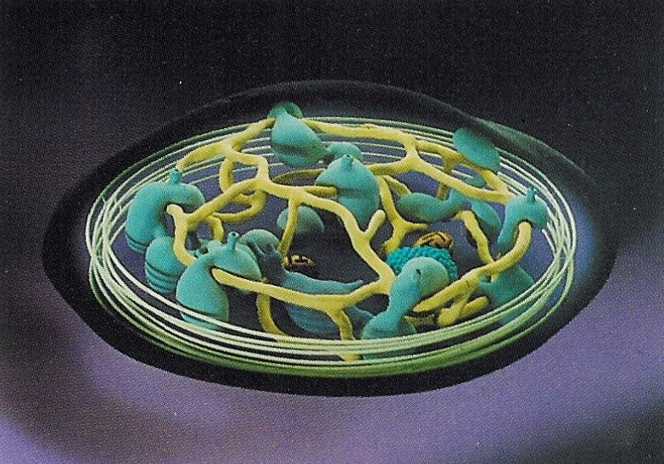

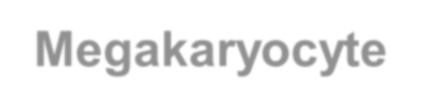
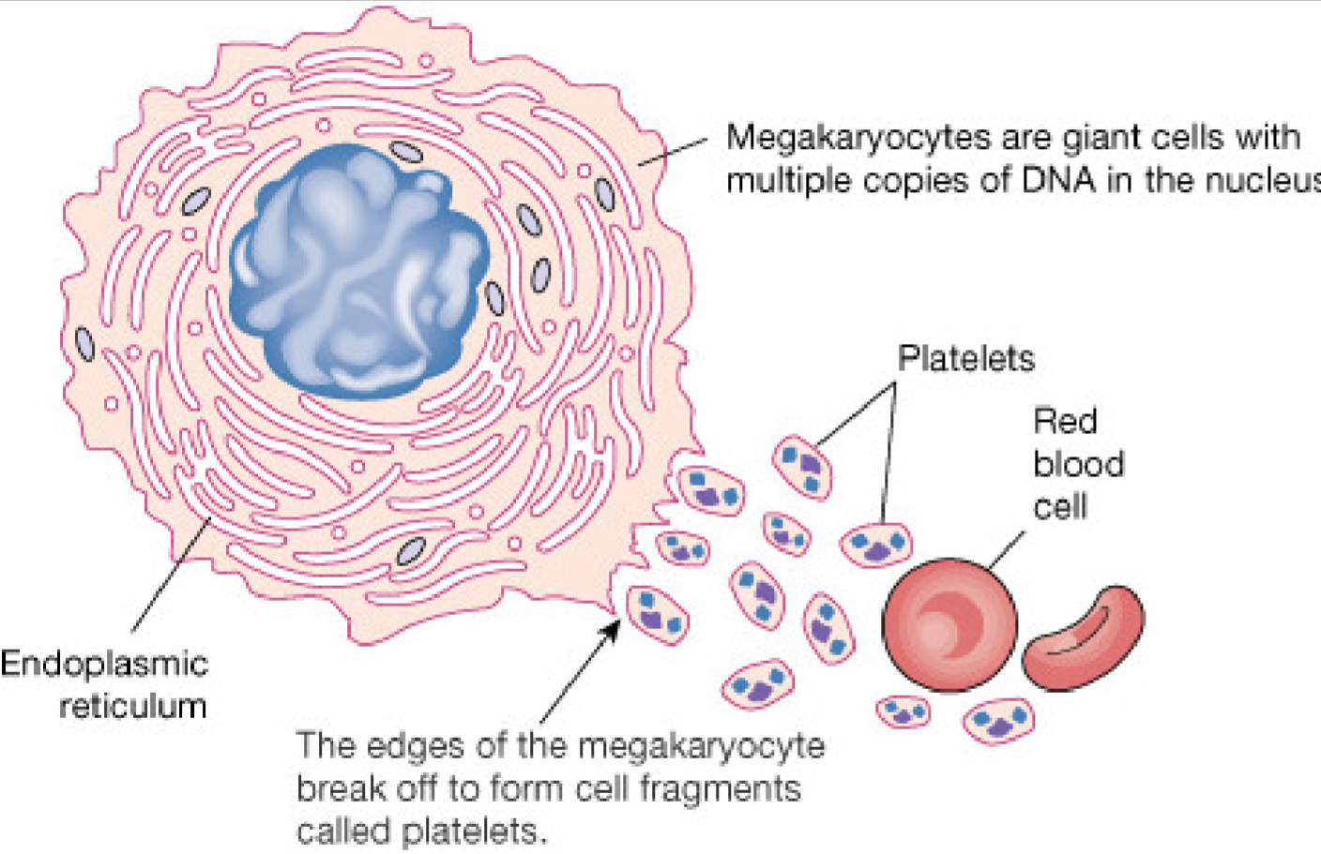
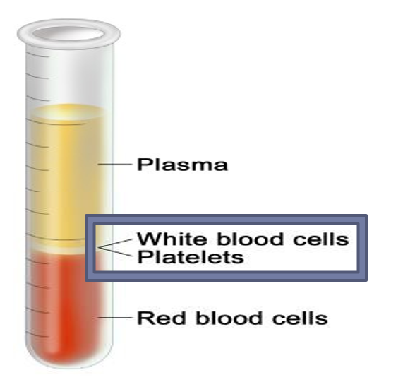
2-Formation of platelet plug (primary hemostasis)
Platelets are small “biconvex” disc shaped cells.
(Remember: RBCs are biconcave discs)
Platelet count: 150x10³ – 300x10³/ml.
Life span: 8 – 12 days.
Contain high calcium content & rich in ADP.
Active cells contain contractile protein.
Thrombocytes are fragments of megakaryocytes in the bone marrow.
Regulation of thrombipoiesis is done by thrombopoietin.
Site of formation: bone marrow, steps:
Stem cell > Megakaryoblast > Megakaryocyte > Platelets.
Importance: enough to stop bleeding from small vascular damage.
Platelet shape:
Bone marrow
Megakaryocyte
مافيها Nucleus زي الـ RBCs بس فيها Enzyme
It also has pores that enable movement of substances from granules to circulation.
Remember: Regulation of Erythropoiesis by Erythropoietin (Erythropoietin is formed in kidney & liver , while Thrombopoietin in liver)
8

Slide 9
Platelet Cont.
Platelet Charactersitics:
shape: minute round or oval discs
size: 1-4 um in diameter
location: 80% in blood & 20% in spleen
Contractile, adhesive, cell fragments.
Store coagulation factors & enzymes
Surface Binding sites: GP Ib (Glyco Protein Ib or 1b on cell membrane of platelets) is a component of GP Ib-IX-V complex that functions as a receptor of vW factor.
FUNCTIONAL CHARACTERISTICS:
• Motile: Actin And Myosin Molecules (for muscle contraction)
• Active: Endoplasmic Reticulum, Golgi Apparatus & Mitochondria
• Enzymes Systems For Synthesis Of Prostaglandins
• Granules
Postglandins: any of a group of compounds with varying hormone-like effects
Platelet Receptors:
-GP Ia, GP VI (adhesion to Collagen)
-GP Ib-IX-V (receptor for vW Factor)
-TPα (for TXA2)
-GP IIb-IIIa (for Fibrinogen, vW Factor)
-P2Y12 (for ADP)
Dense or δ granules contain:
• Serotonin
• ADP
• Ca++
α granules contain:
• Coagulation Factors
Fibrinogen
• PDGF (Platelet-derived growth factor)

Slide 10
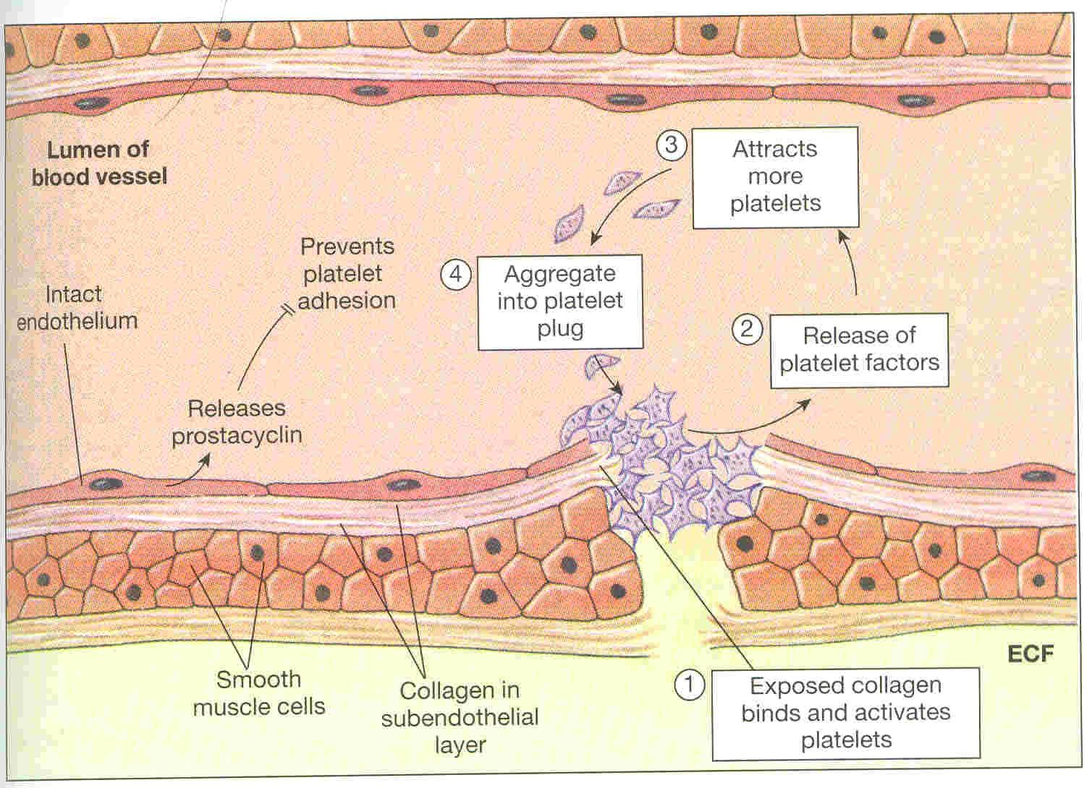
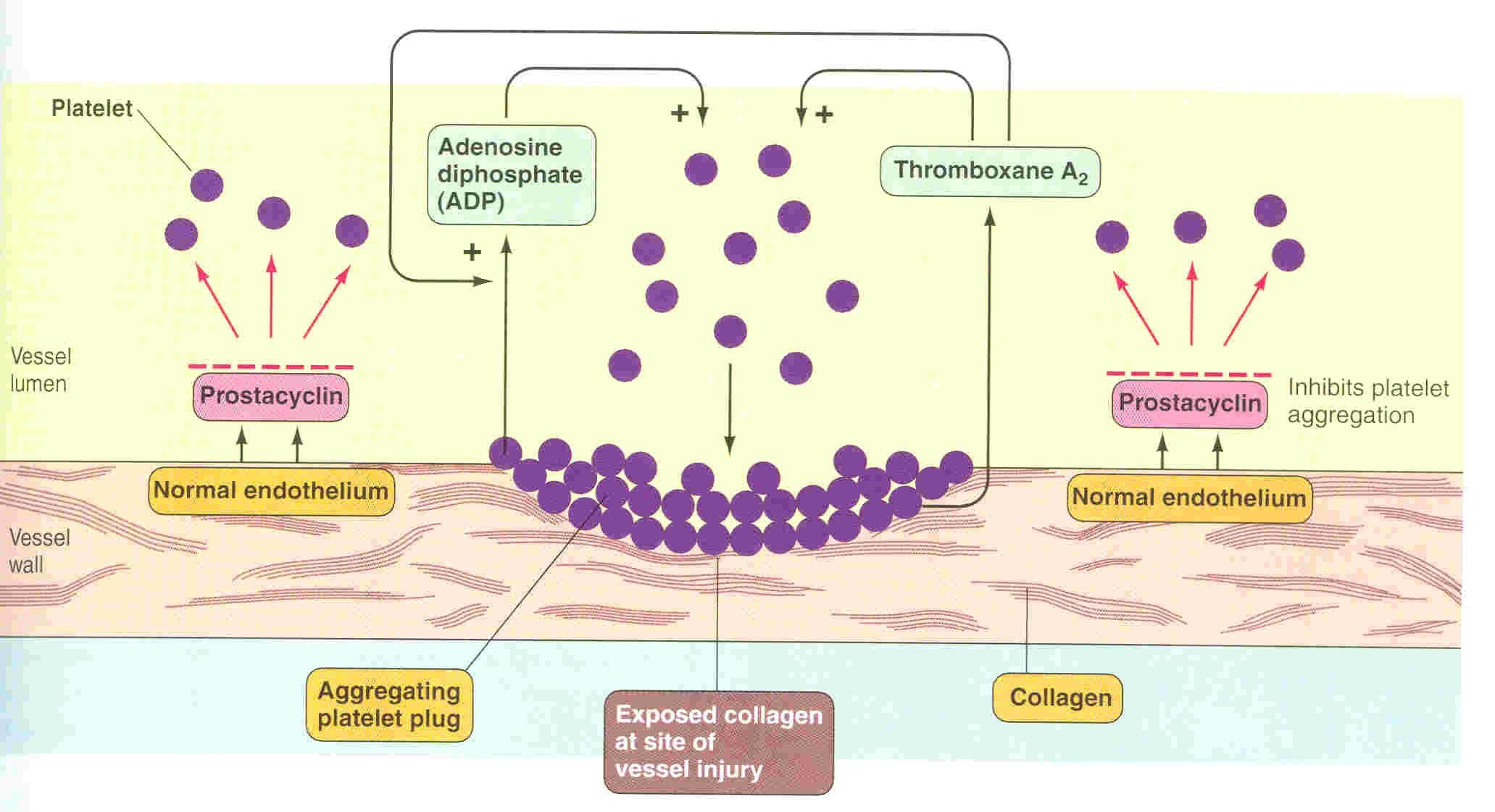
Platelet Plug Formation
(Importance → enough to stop bleeding from small vascular damage.)
Secrete
prostacyclin (PGI2)
NO
ADP phosphatase
Intact (normal) endothelium secret prostacyclin and NO which inhibit aggregation.

Slide 11
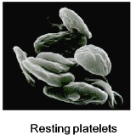
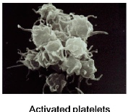
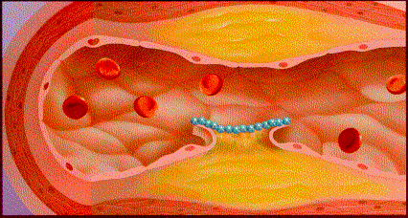
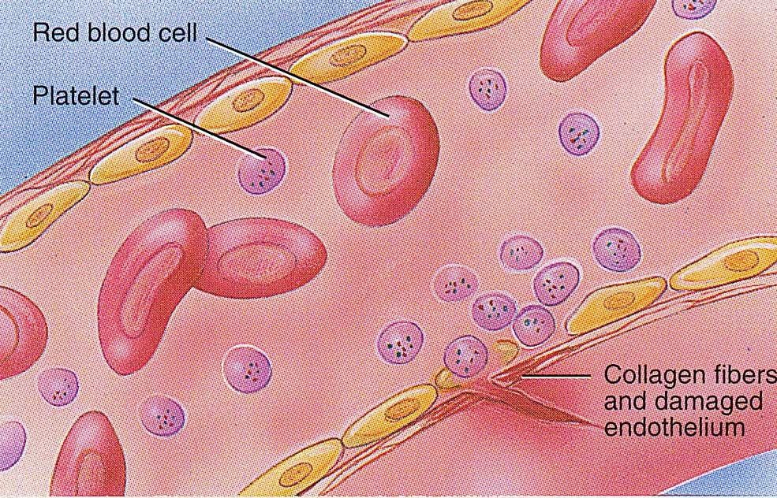
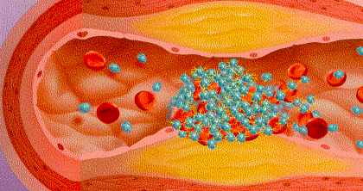
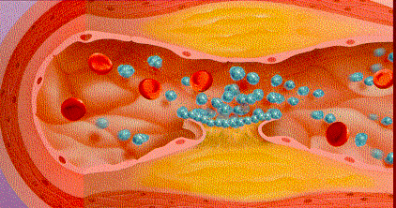
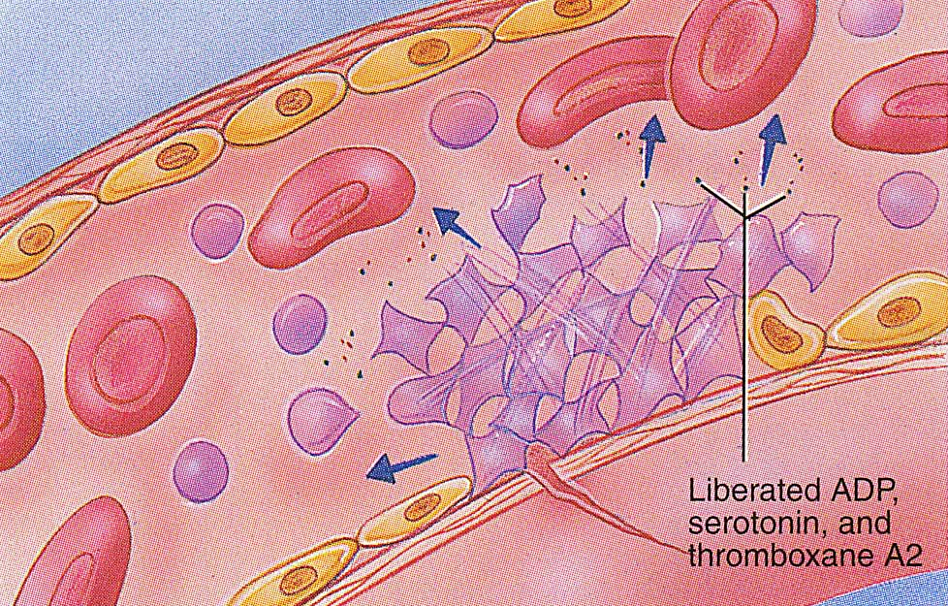
Platelet Function:
Begins With Platelet (Thrombocytes) Activation:
Platelet adhesion | Shape change | Activation and Aggregation* | Release reaction/Secretion | Clot retraction*
Exposed collagen attracts platelets, Platelets stick to exposed collagen (to the sub endothelial layer) (Von WilleBrand Factor) released from the damaged endothelial cells in vessel wall or underlying damaged endothelial cells in vessel wall. |  | Activated platelets stick together and activate new platelets to form a mass called a platelet plug. Plug reinforced مثبّت by fibrin threads formed during clotting process.** *Platelet aggregation: The clumping together of platelets in the blood. **خيوط تسوي زي الشبكة تمسكها (زي السداده) عشان يوقف الدم | Activated platelets (activated by adhesion) extend projections (protrusions) to make contact with each other and release Serotonin, ADP (activating other platelets) & thromboxane A2 (TXA2). Serotonin & TXA2 are vasoconstrictors decreasing blood flow through the injured vessel. 1. ADP & TXA2: increase the stickiness of platelets 2. aggregation is increased. 3. cut vessel is plugged. | Myosin and actin filaments in platelets are stimulated to contract during aggregation further reinforcing the plug and help release of granule contents. *Clot retraction: is the shrinking of a clot over a number of days.
Activated Platelets*
Video ;- https://www.youtube.com/watch?v=9QVTHDM90io

Slide 12
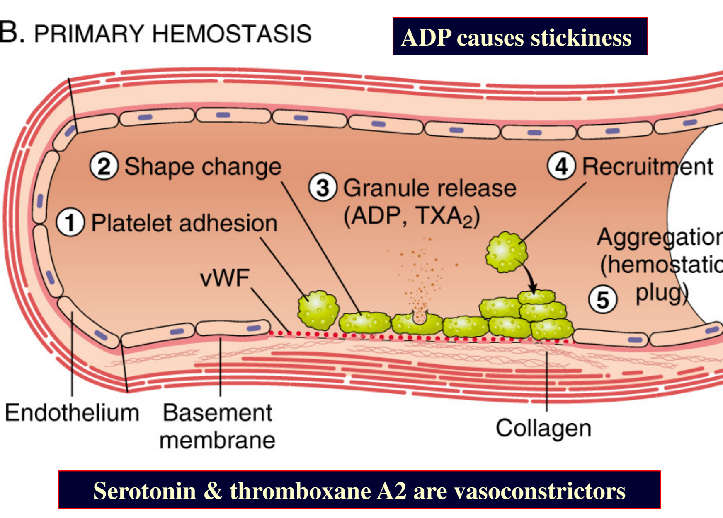
Activated Platelets
(during shape change)
When platelets are activated they secrete:
5HT > causes vasoconstriction.
ADP (Adenosine Di-Phosphate) > stickiness
Platelet phospholipid (PF3) > clot formation.
Thromboxane A2 (TXA2) > a prostaglandin formed from arachidonic acid, and it is inhibited by aspirin. (its function is vasoconstriction and platelet aggregation)
يمنع تكون الجلطات لمقدرته على جعل الدم في حالة سائلة
(Found in the males’ slides)
Further explanation of the process: platelets adhere to damaged endothelium to form a platelet plug (primary hemostasis) and then degranulate Platelets play one of the biggest roles in the hemostatic process. When platelets come across the injured endothelium cells, they change shape, release granules and ultimately become ‘sticky’. Platelets express certain receptors, some of which are used for the adhesion of platelets. When platelets are activated, they express receptors that interact with other platelets, producing aggregation and adhesion. Platelets release cytoplasmic granules such as (ADP), serorotin and thromboxane A2. Adenosine diphosphate (ADP) attracts more platelets to the affected area, serotonin is a vasoconstrictor and thromboxane A2 assists in platelet aggregation, vasoconstriction and degranulation. More chemicals are released more platelets stick and release their chemicals; creating a platelet plug and continuing the process in a positive feedback loop. Platelets alone are responsible for stopping the bleeding of unnoticed wear and tear of our skin on a daily basis. This is referred to as primary hemostasis

Slide 13
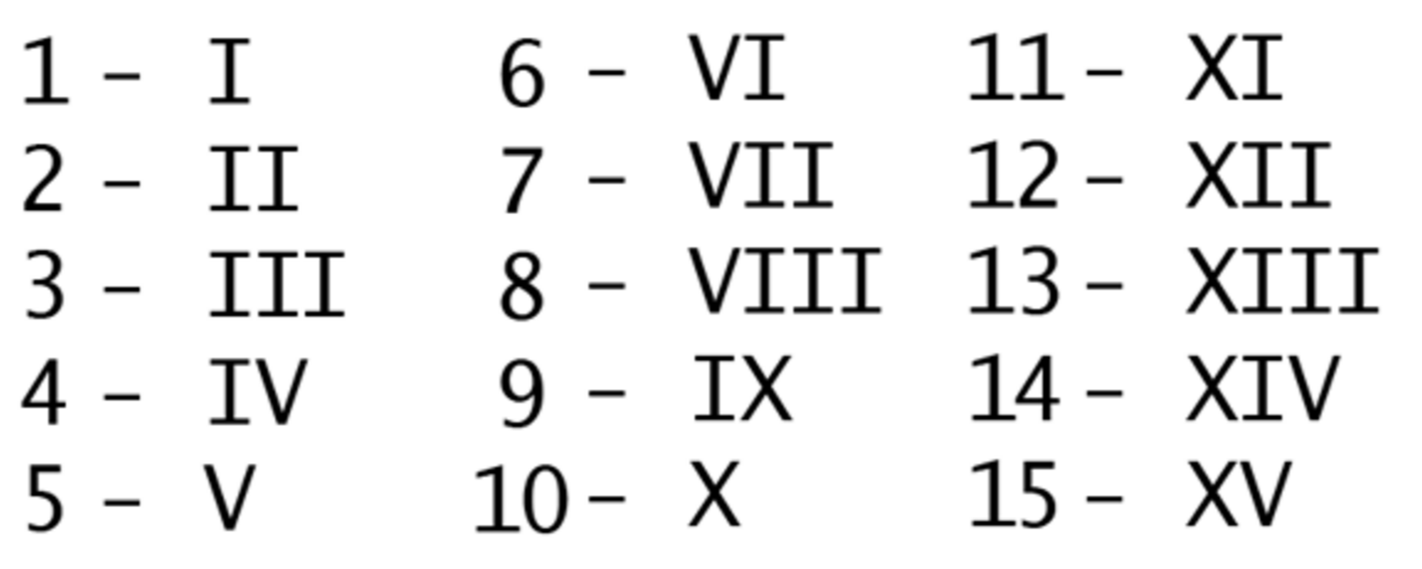
Hemostatic Mechanism (cont.)
3- Blood Coagulation: secondary hemostasis
Factors | Names
I (1) II (2) III (3) IV (4) V (5) VII (7) VIII (8) IX (9) X (10) XI (11) XII (12) XIII (13) | Fibrinogen Prothrombin Thromboplastin Calcium Labile factor Stable factor Antihemophilic factor A Antihemophilic factor B Stuart-Power factor Plasma thromboplastin antecedent (PTA) Hagman factor Fibrin stablizing factors
CLOT is a meshwork of fibrin fibers running in all directions entrapping blood cells, platelets and plasma.
Blood clotting is the transformation of blood (soluble fibrinogen) from a liquid into a solid gel form (insoluble fibrin strands) this fibrin will strengthen the previous Platelet Plug.
Clotting Cascade Pathways: Intrinsic and Extrinsic
Begins to develop in
15-20 sec → MAJOR/SEVERE TRAUMA
1-2 min → MINOR TRAUMA
Clotting Factors
Circulate in plasma in inactive state
*most of them synthesized by the liver

Slide 14
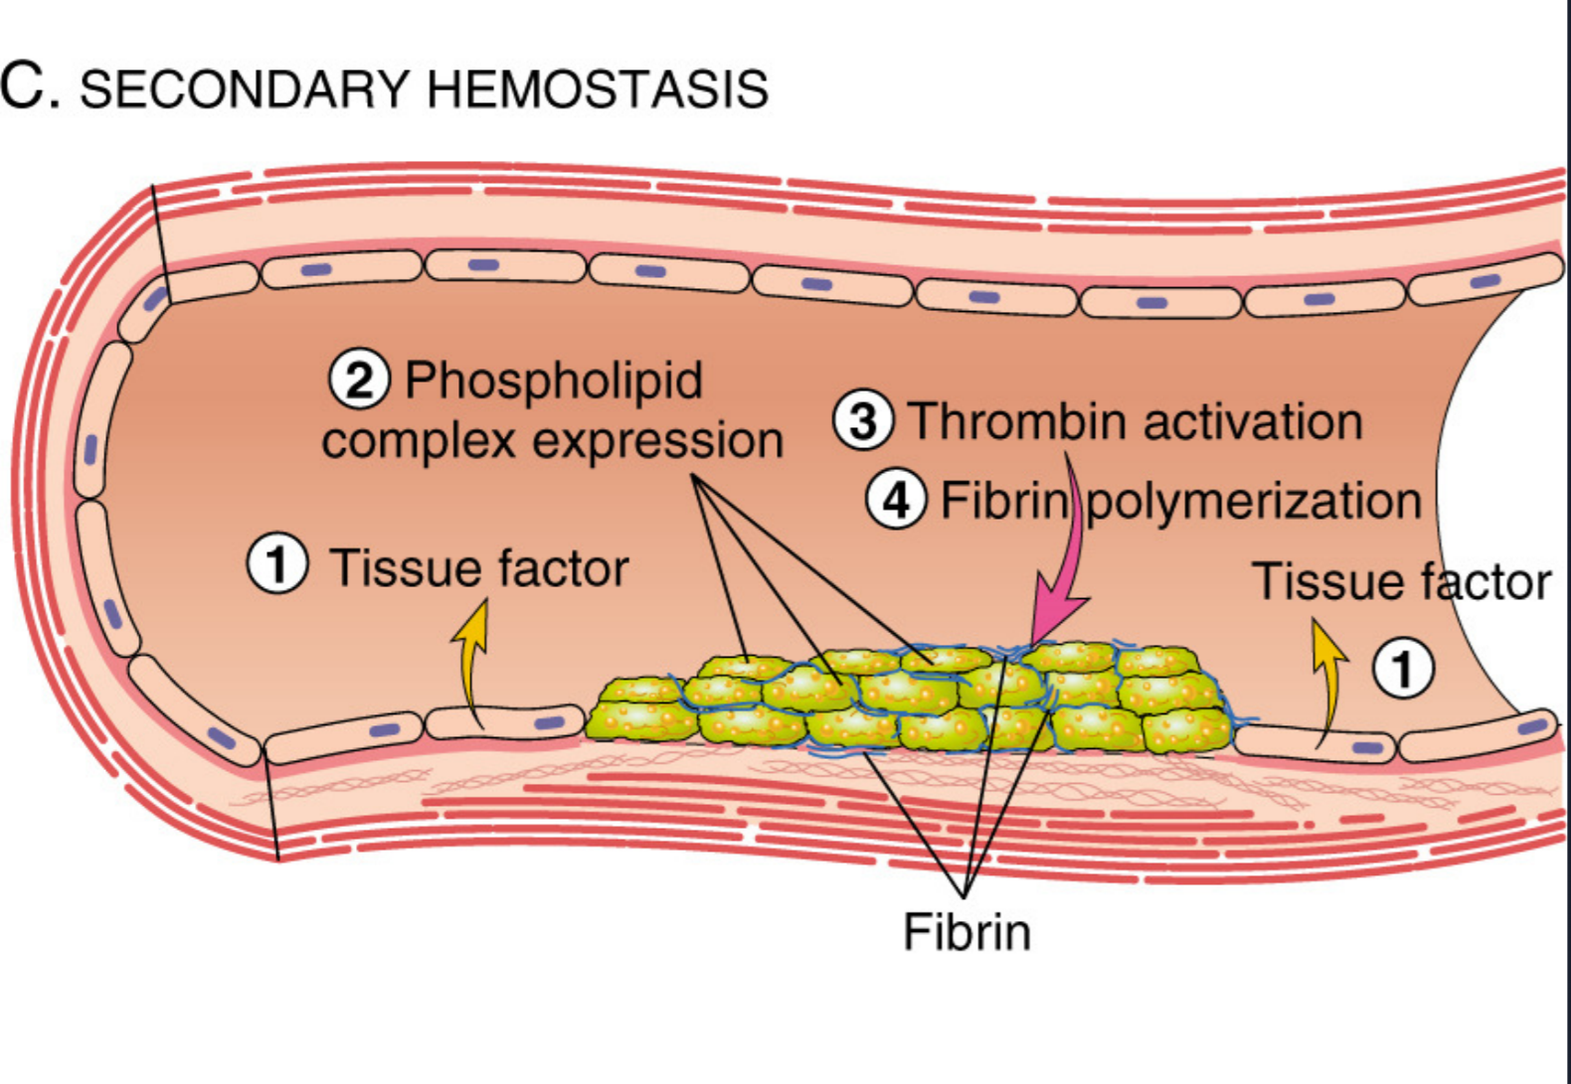
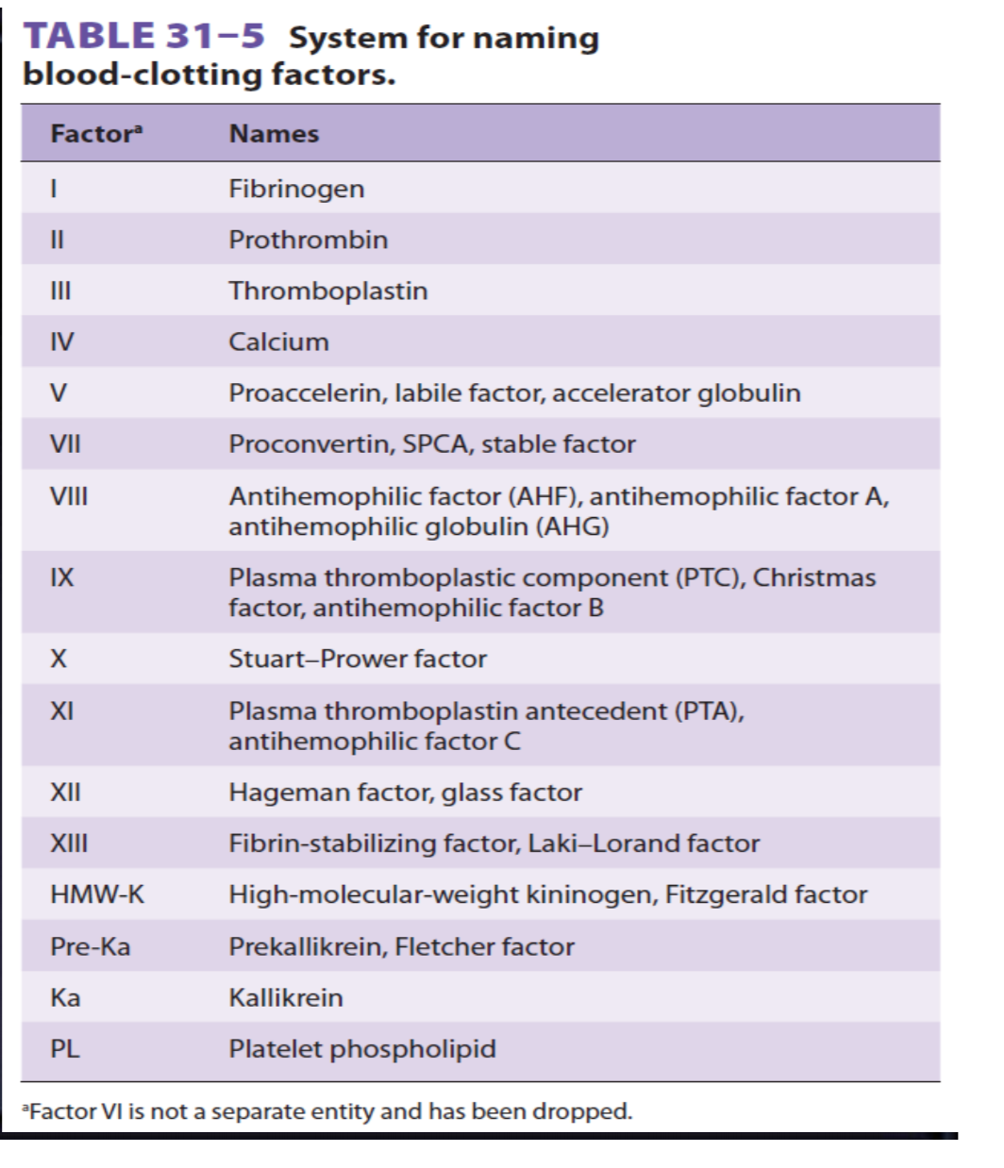
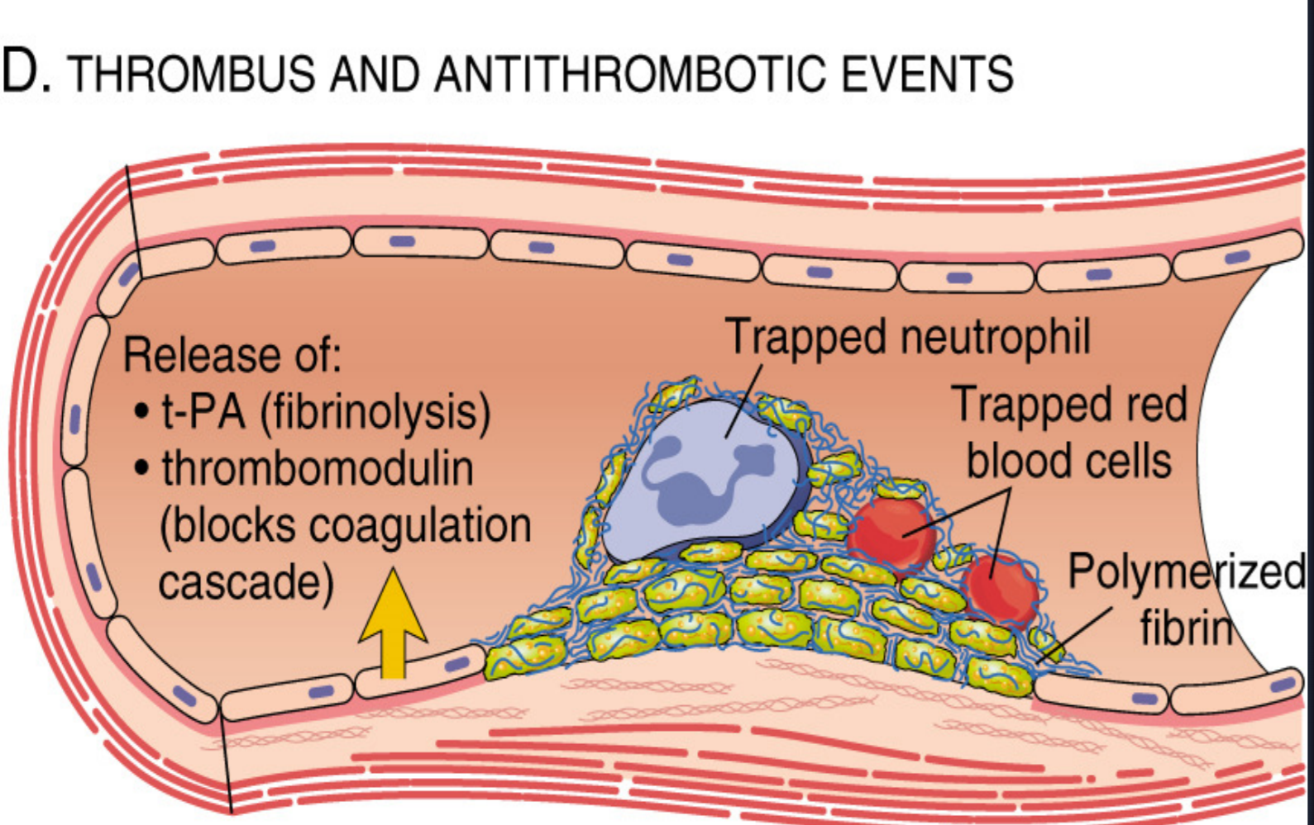
Found in the males’ slides

Slide 15
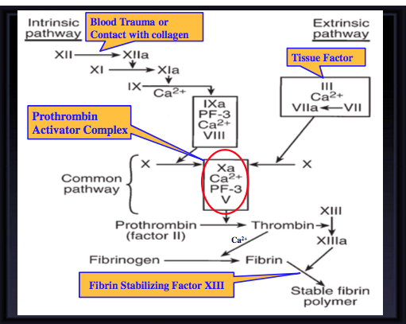
Blood coagulation (clot formation) mechanism (steps)
A series of biochemical reactions leading to the formation of a blood clot
1. Formation of Prothrombin activator complex (Xa+Ca+PF-3+V) by Extrinsic & Intrinsic Pathways → leading to Common Pathway.
2. This reaction leads to the activation of thrombin enzyme from inactive form prothrombin (Conversion of prothrombin (clotting factor II) into thrombin)
Prothrombin (inactive thrombin) is activated by a long intrinsic or short extrinsic pathways
3. Thrombin will change fibrinogen (plasma protein) to fibrin (insoluble protein)
  (Conversion of fibrinogen into fibrin)
4. Fibrin converts to stable fibrin polymer
1- يتنشط الـ
Coagulation system
2- الـ Prothrombin (inactive form) يتنشط عن طريق Intrinsic or short Extrinsic pathways الى ايش ؟ الى
Thrombin (active form enzyme)
3- يجي الـ Thrombin يخلي الـ Fibrogen (plasma protien+soluble in plasma) الموجود بالدم يتحول الى
Fibrin ( insoluble protein)
-4 Blood clot
Explanation:
Clotting Cascade
Found in the males’ slides

Slide 16
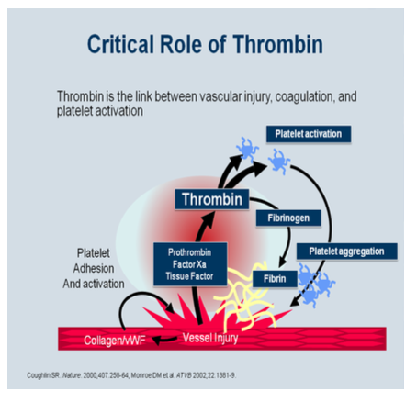
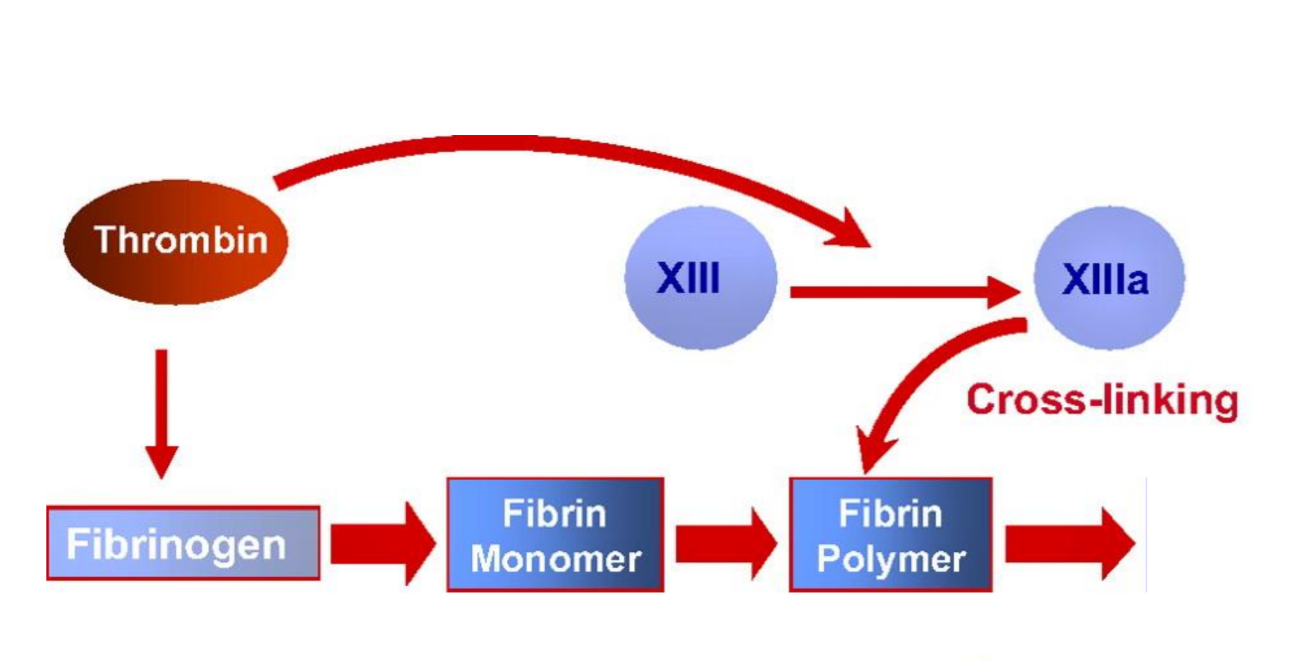
Thrombin
Thrombin changes fibrinogen to fibrin
Activates factor V (proaccelerin or labile factor) and XIII (fibrin stabilizing meshwork)
Thrombin is essential in platelet morphological changes to form primary plug.
Thrombin stimulates platelets to release ADP & thromboxane A2; both stimulate further platelets aggregation.
Explanation: As part of its activity in the coagulation cascade, thrombin also promotes platelet activation and aggregation via activation of receptors on the cell membrane of the platelet.

Slide 17
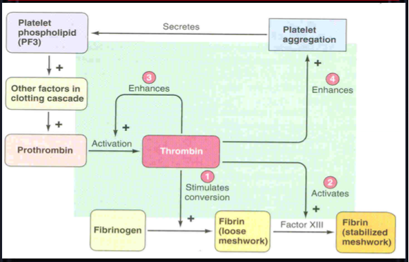
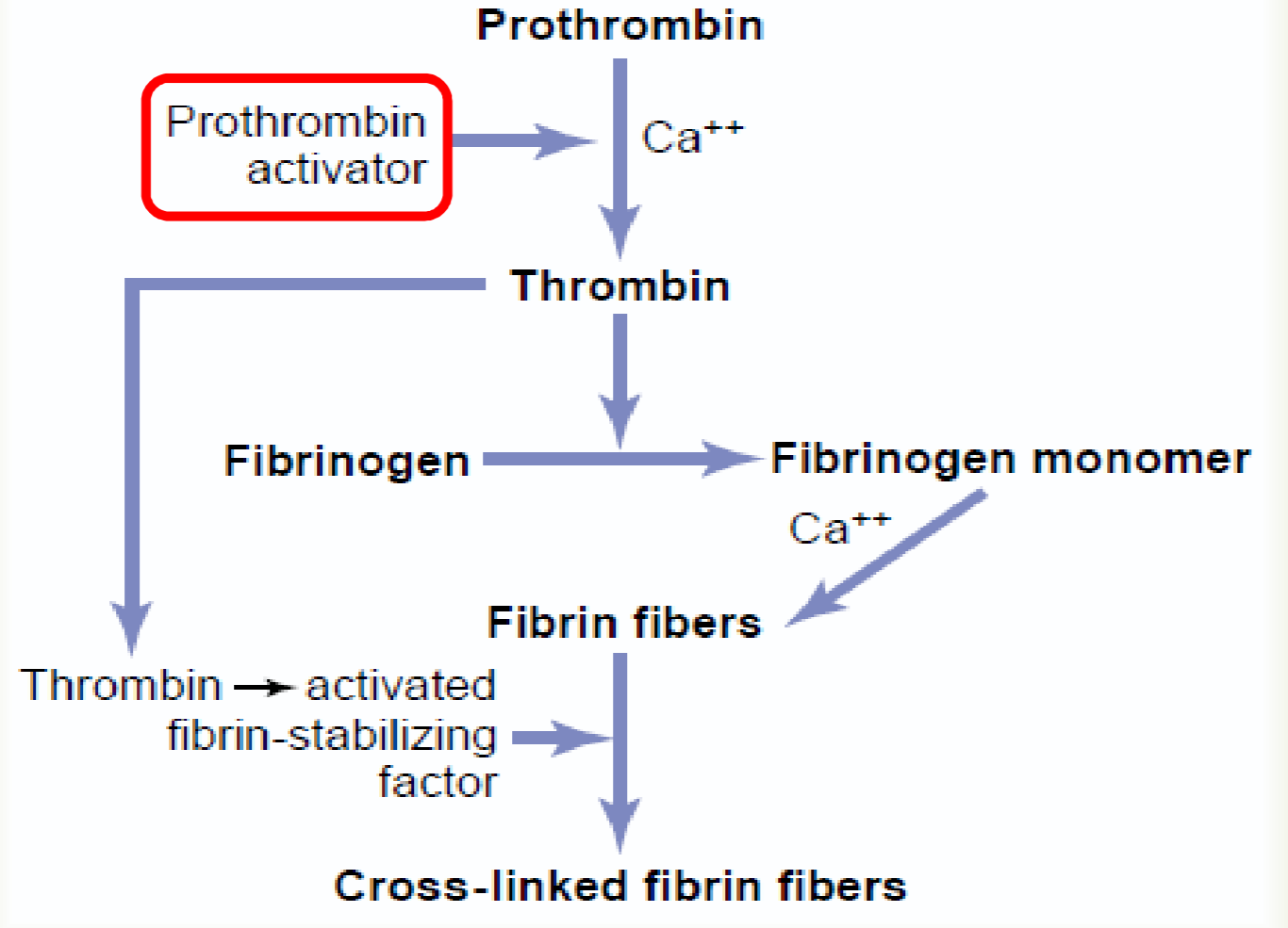
ACTION OF THROMBIN ON FIBRONOGEN TO FORM FIBRIN
ROLES OF THROMBIN IN HEMOSTASIS
Acts as positive feedback to facilitate its own formation
Found in the males’ slides

Slide 18
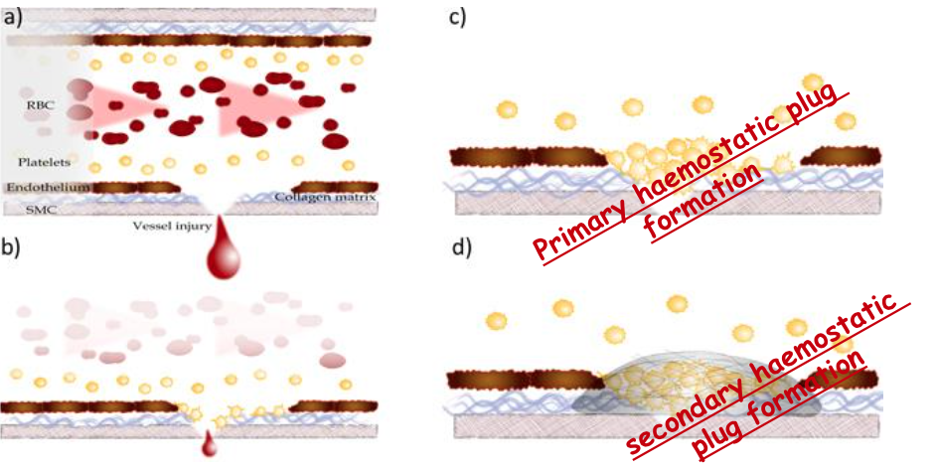
Platelet Haemostatic Plug Formation
Platelet plug formation → primary
blood coagulation → secondary

Slide 19
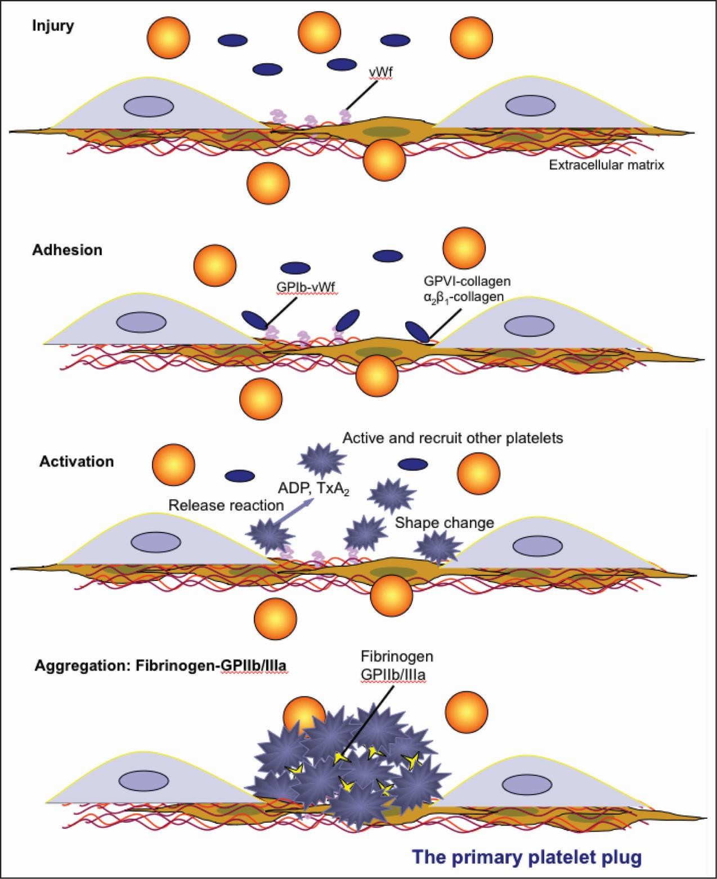

Slide 20
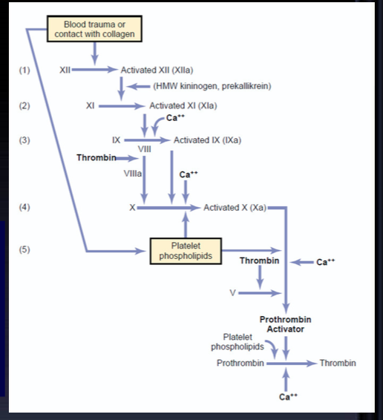
Intrinsic pathway
(intrinsic mechanism for initiating clotting)
The trigger is the activation of factor XII (12) (Hagman factor). This occurs when blood comes in contact with foreign surface (different from normal) such as glass, injured blood vessel and exposed collagen or endothelium.
Activated factor (XIIa) will activate XI (11)
Xla will activate IX (9)
IXa + VIII (8) + platelet phospholipid + Ca activate X
Following this step the pathway is common for both
Trauma to the blood itself or exposure
of the blood to collagen (from a traumatized blood vessel wall), foreign surface/glass
Note: In the blood coagulation pathway, thrombin acts to convert factor XI to Xia (activated form) and VIII to VIIIa, V to Va, fibrinogen to fibrin, and XIIIt o XIIIa.
Found in the males’ slides
Colours are for your understanding ONLY. ☺

Slide 21
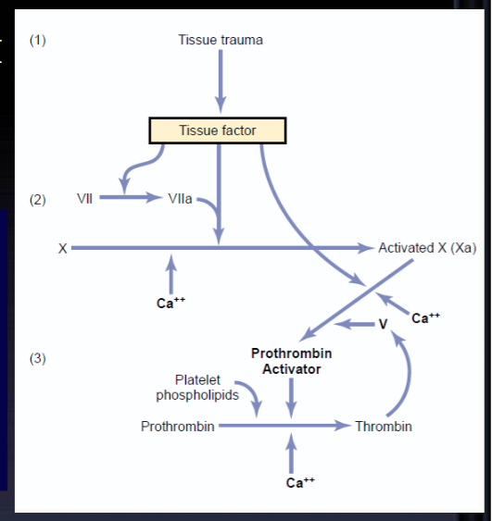
Extrinsic pathway
• Triggered by material released from damaged tissues (tissue thromboplastin)
• tissue thromboplastin + VII (7) + Ca → activate X Common pathway
• Xa + V +PF3 + Ca ( prothrombin activator) it is a
proteolytic enzyme* activate prothrombin to change into thrombin.
Xa: main factor. V: enhances its activity.
Thrombin act on fibrinogen and changes it into insoluble thread like fibrin
Factor XIII (13) (fibrin stabilizing factor) + Ca → strong fibrin (strong clot)
TF or tissue thromboplastin** includes phospholipids from the membranes of the tissue plus a lipoprotein complex that functions mainly as a proteolytic enzyme
. *noun: protease: enzymes that breaks down protein. (Protein here is thromboplastin it broken down.
**Thromboplastin is a plasma protein catalyzes conversion of prothrombin to thrombin
Colours are for your understanding ONLY. ☺

Slide 22
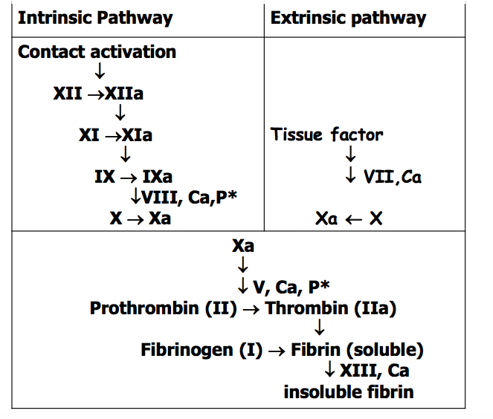
Activation of Blood Coagulation: (2 ways)
Intrinsic Pathway (also known as contact activating pathway): all clotting factors present in the blood. (initiated by injury to the blood vessel)
Extrinsic Pathway (also known as tissue factor pathway): triggered by tissue factor (initiated by trauma to tissue)
Both activate Final Common Pathway
P* = phospholipid from platelets
مـــــــهم
 | Intrinsic | Extrinsic
الاختلاف | LONGER | FASTER&SHORTER
التشابه | Both will be stimulated at the SAME TIME. Both will activate ( Factor 10 ) and the result is the formation of Thrombin which then converts Fibrinogen into Fibrin.

Slide 23
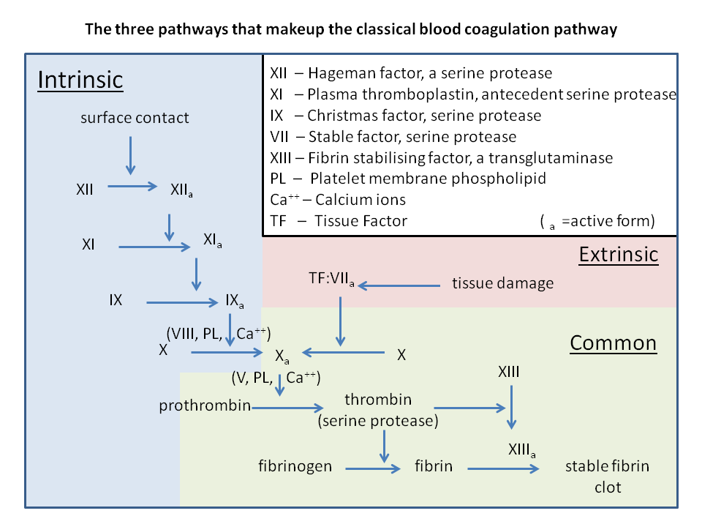

Blood trauma Contact with collagen
Blood clot

Slide 24
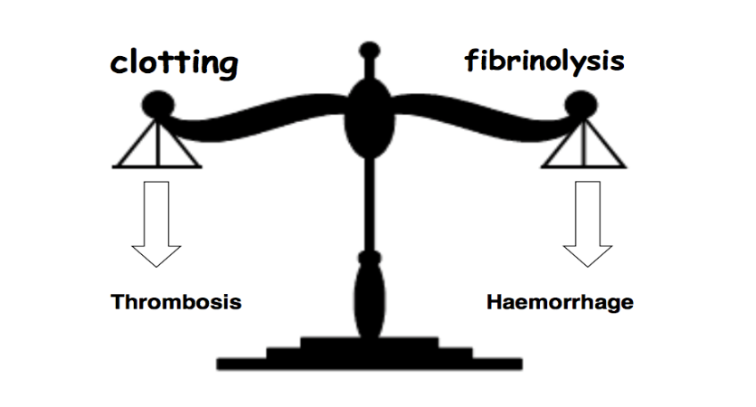
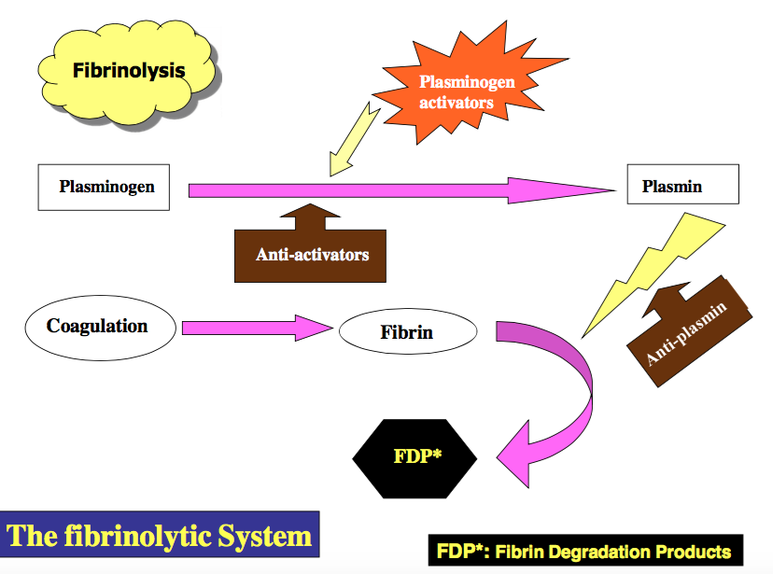
Hemostatic mechanism (cont.)
4- Fibrinolytic system (Fibrinolysis)
Formed blood clot can either become fibrous or dissolve
• Fibrinolysis (dissolving) = Break down of fibrin by naturally occurring enzyme plasmin therefore prevent intravascular blocking.
• There is balance between clotting and fibrinolysis
Examples of imbalance ☹
– Excess clotting → blocking of Blood Vessels
– Excess fibrinolysis → tendency for bleeding

Slide 25
Plasmin
Plasmin is present in the blood in inactive form plasminogen
Plasmin is activated by tissue plasminogen activators (t-PA) in blood.
Plasmin digest intra & extra vascular deposit of Fibrin → fibrin degradation products (FDP)*
Unwanted ☹ effect of plasmin is the digestion of clotting factors
• Plasmin is controlled by:
– Plasminogen-Activator Inhibitor (PAI) – Anti-plasmin from the liver. (inhibits the activation of plasminogen)
– Tissue Plasminogen Activator (t-PA) used to activate plasminogen to dissolve coronary and cerebral clots (activates the activation of plasminogen)
*As a cut heals, the clotting slows down. Eventually the clot is broken down and dissolved by plasmin. When the clot and fibrin net dissolve, fragments of protein are released into the body. These fragments are fibrin degradation products or FDPs.
LYSIS OF BLOOD CLOTS BY PLASMIN
Plasminogen (Profibrinolysin)
↓Antiplasmin from the liver
↑ T-PA (Tissue Plasminogen Activator)
Plasmin (Fibrinolysin)
Lysis of clot

Slide 26
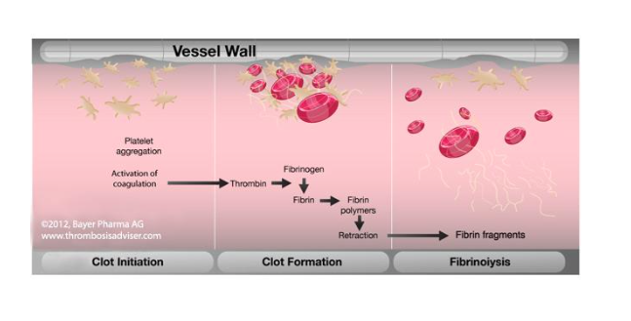
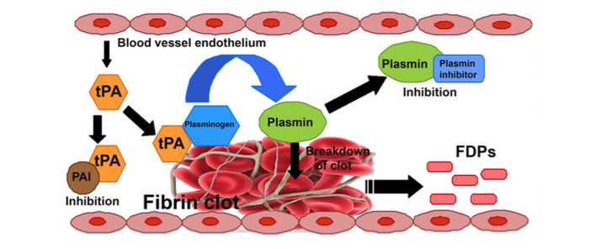
We’ll talk about retraction in the next slides.

Slide 27
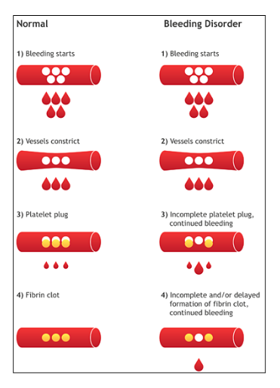
Bleeding disorders (coagulation defects)
Hemophilia:
(To be discussed later –slide#31)
Vitamin K deficiency
Prothrombin, Factor VII, Factor IX, & Factor X require vitamin K for their synthesis.
Hepatic (Liver) Disease
(Almost all coagulation factors are synthesized in the liver. )
e.g. Hepatitis, Cirrhosis
Decreased formation of clotting factors
Increased clotting time
Excessive bleeding can result from:
Platelet defects:
deficiency in number
(thrombocytopenia) or
defect in function.
Coagulation factors defect:
Deficiency in coagulation factors
(e.g. hemophilia).
Thrombocytopenia
Low number of platelets
Vitamin K deficiency.

Slide 28
Only found in males’ slides.
CLOT RETRACTION.
When clot retracts (contracts), it expresses most of the fluid (serum) out from the clot within 20-60 min.
Serum cannot clot.
Role of platelets in clot formation & retraction: they are contractile (capable of or producing contraction.)
ROLE OF CALCIUM IONS IN CLOTTING
No Ca++ → No Clotting (Needed in many steps)
Blood samples are prevented from clotting by:
Citrate ions → Deionization of Ca++
Oxalate ions → Precipitate (creation of a solid from solution) of the Ca++
Heparin molecule: is not active by itself but increases the effect of antithrombin 100–1000-fold, with the added effect of removing activated factors XII, XI, X and IX. (Inhibition of thrombin)
Warfarin (anticoagulant): decrease production of Factors VII, IX and X by liver. (vitamin K-dependent factors) -> Vitamin K antagonist.
EDTA → chelates (binds) calcium ions
Coagulation inhibition
Vitamin K: helps blood clotting by combining with oxygen to activate clotting cascade.

Slide 29
NATURAL INTRAVASCULAR ANTICOAGULANTS
1. Endothelial Surface Factors
The smoothness of endothelial cell surface. (which prevents contact activation of the intrinsic clotting system)
Glycocalyx Layers (which repels clotting factors and platelets)
Thrombomodulin protein:
binds to thrombin
thrombomodulin-thrombin complex activates a plasma protein, protein C, that acts as an anticoagulant by inactivating Factors V and VIII
Increases the formation of plasmin
2. Anti-thrombin action of Fibrin and Antithrombin III
85-90 % Thrombin binds with Fibrin
10-15 % Thrombin binds with Antithrombin III
Antithrombin III is a circulating protease blocking clot factors (It blocks your blood clotting mechanism by turning off the major clotting protein “thrombin.”)
3. Heparin
is a highly negatively (-) charged conjugated polysaccharide
Function: as anticoagulant by increasing the effectiveness of Antithrombin III.
Produced by:
Mast cells
Basophil cells
Most widely used anticoagulant clinically e.g. in stroke
4. Alpha2 – Macrogobulin
Acts as a binding agent for several coagulation factors.
Only found in males’ slides.

Slide 30
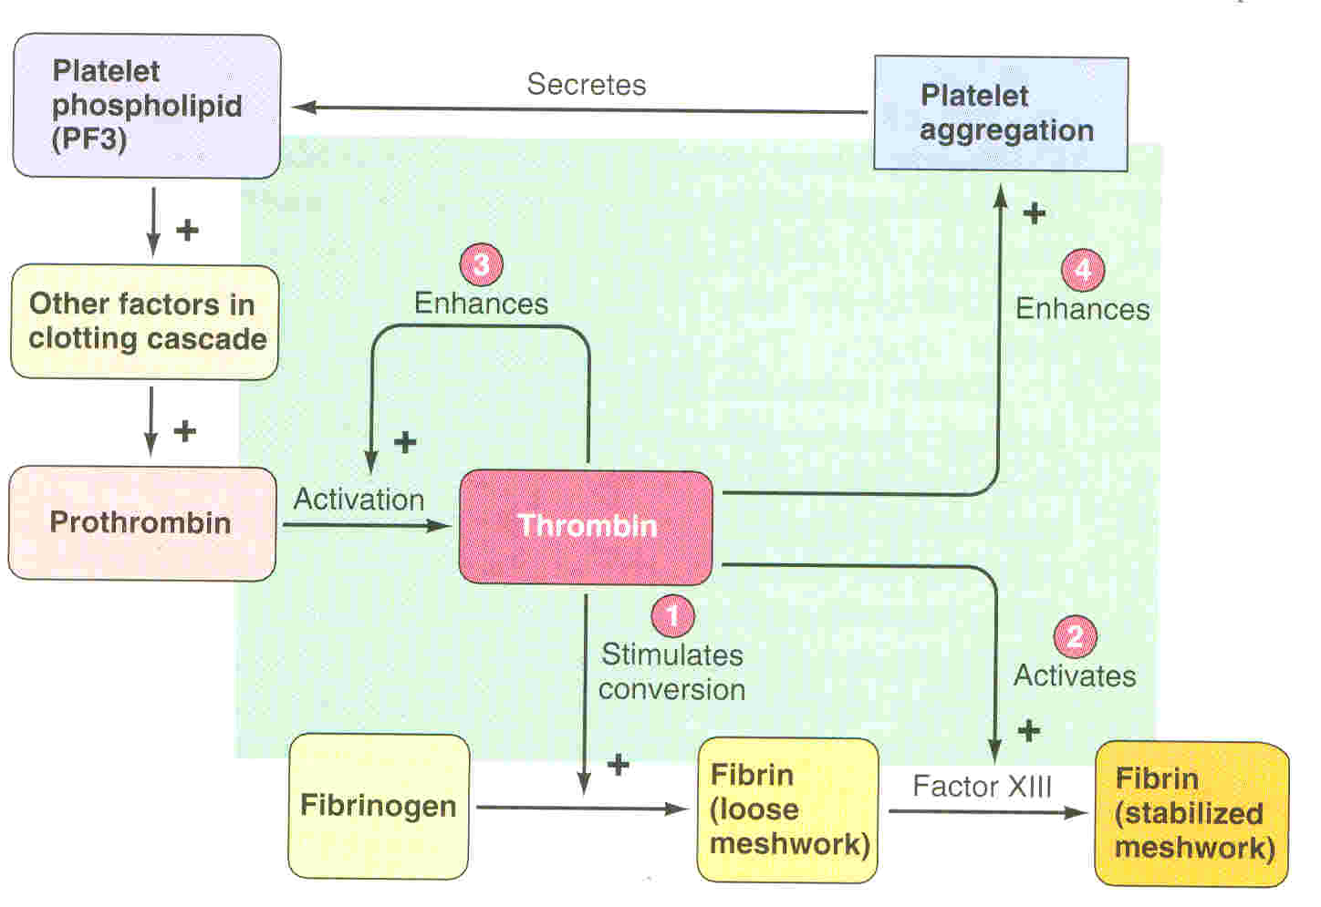
Role of Thrombin in Hemostasis

Slide 31
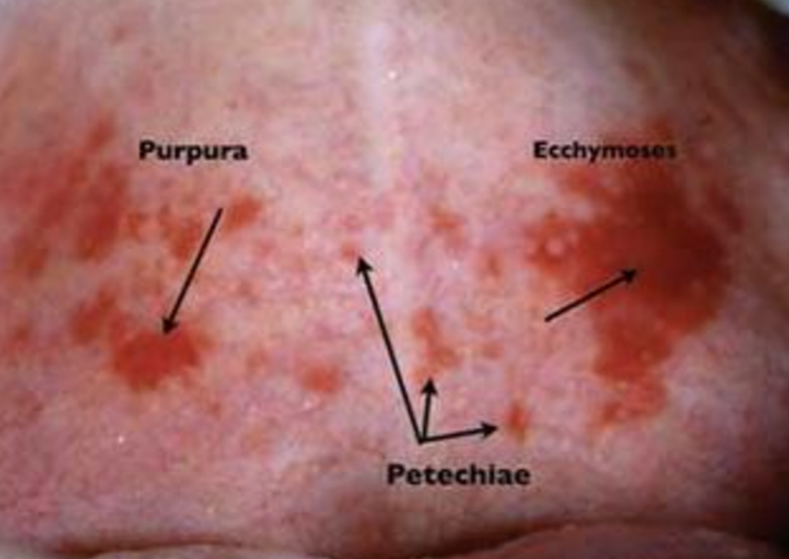
THROMBOCYTOPENIA
Only found in males’ slides.
Diagnosis:
Disorder in which there is a decrease of platelets (PLT or thrombocytes.)
Platelet count up to 50,000 ul→ thrombocytopenia that requires emergency care.
Bleeding time increases.
Less than 10,000 → Fatal.
ETIOLOGY:
Decreased production of platelets due to:
Aplastic anemia
Leukemia
Drugs
Infections (HIV, Measles)
Increased destruction due to:
ITP (immune thrombocytopenia purpura)
Drugs
Infections
Clinical Features
Easy brusability
Epistaxis
Gum bleeding
Hemorrhage after minor trauma
Petechiae/Ecchumosis
Extra
Rx
  Rx of the underlying cause
  PLT concentrates
  Fresh whole blood transfusion
  Splenectomy

Slide 32
Hemophilia
(Rare bleeding disorder in which the blood does not clot normally)
↑ bleeding tendency.
Genetic disorders X-linked disorder.
Transmitted by female chromosome as recessive trait.
Occurs exclusively (affects) in males
Females are carriers
Clinical features:
Easy bruising, massive bleeding after trauma or operation, hemorrhages in joints.
-Rx
Hemophilia A: (Classic)
85% of cases
Deficiency (and therefore we inject) of factor VIII
(hemophilia A , 1/10,000)
Hemophilia B:
15% of cases
Deficiency (and therefore injection) of factor IX
(hemophilia B, 1/100,000)

Slide 33
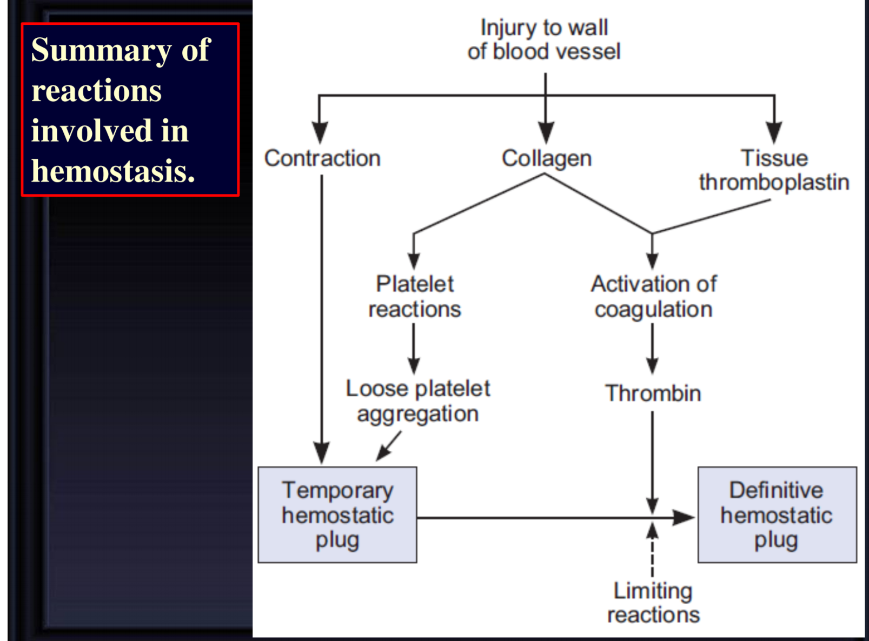

Slide 34
haemostasis
What is it?
Hemostasis mechanism
Bleeding disorders
Platelet defect
hemophilia
Vitamin k deficiency and liver disease
Defect in function
1. vessel wall
2. Platelet plug
3. Blood coagulation
4. Fibrinolytic system
It is the spontaneous
Arrest of bleeding from ruptured blood vessels.
Deficiency in number (thrombocytopenia)
– ↑ bleeding tendency.
– X-linked disease.
– Affects males.
– 85% due to FVIII deficiency (hemophilia A)
- 15% due to FIX deficiency (hemophilia B).
– Almost all coagulation factors are synthesized in the liver.
– Prothrombin, FVII, FIX, & FX require vitamin K for their synthesis.

Slide 35
1. vessel wall
2. Platelets
(thrombocytes)
Hemostasis Mechanism
Components of blood vessel
Localized vasoconstriction
Mechanism
Endothelial cells
Smooth muscle
Collagen
It happen immediately after injury.
2. Nervous factors
3. Local release of thromboxane A2 and 5HT by platelets
Site of formation
What is it ?
Structure and shape
Steps of formation
function
Regulation of platelets
In bone morrow
Platelet Receptors
- Adhesion
- Activation
- Aggregation
- Secretion
By thrombop-oietin
which is formed in liver
It is the fragments of megakaryocytes
- Biconvex disc
- Life span
8-12days
- Do not have nucleus
- Contain high calcium & rich in ADP.
1.
-GP Ia, GP VI Collagen
-GP Ib-IX-V (vW Factor)
-(TPα) TXA2
-GP IIb-IIIa (Fibrinogen, vWF)
-(P2Y12) ADP
2. megakayoblast
3. megakaryocyte
4. platelets
1. Stem cell
1.
Release of adrenaline
To help vessel contraction

Slide 36
3. Blood coagulation(clot formation)
4. Fibrinolytic system (fibrinolysis)
Hemostasis Mechanism
What is it
- it is a series of chemical reactions leading to the formation of a blood clot.
What is it?
It is the break down of fibrin by naturally occurring enzyme plasmin therefore prevent intravascular blocking
Clotting factors
Coagulation pathways
Extrinsic pathway
Intrinsic pathway
Circulate in plasma in inactive state
I (1) Fibrinogen
II (2) Prothrombin
VIII (8) Antihemophilic factor A
IX (9) Antihemophilic factor B
XII (12) Hagman factor
XIII (13) Fibrin stablizing factors
Steps of fibrinolysis
• Plasmin is present in the blood in inactive form plasminogen
• Plasmin is activated by tissue plasminogen activators (t-PA)
• Plasmin digest intra & extra vascular deposit of Fibrin to give fibrin degradation products (FDP)
activation of factor XII “12” (XIIa) will activate XI
• Xla will activate IX
• IXa + VIII + platelet phospholipid + Ca activate X
tissue thromboplastin + VII + Ca will activate X
Chemical reactions
Activate prothrombin (inactive form) by long intrinsic or short extrinsic pathways
To thrombin enzyme (active form)
- change fibrogen to fibrin
- Activate factor V “5”
Common pathway :
• Xa + V +PF3 + Ca will activate prothrombin to give thrombin enzyme
• Thrombin act on fibrinogen and change it to give fibrin (insoluble thread)
• Factor XIII + Ca will make the fibrin strong (strong clot)
- Stimulate platelets to release ADP and thromboxane A2
- Essential in platelet morphological changes to form primary plug

Slide 37
Online Quiz
https://www.onlinequizcreator.com/hemostasis/quiz-221751

Slide 38
Thank you!
اعمل لترسم بسمة، اعمل لتمسح دمعة، اعمل و أنت تعلم أن الله لا يضيع أجر من أحسن عملا.
The Physiology 436 Team:
Lina Alwakeel
Rana Barasain
Heba Alnasser
Munira Aldofayan
Sara Alshamrani
Sundus Alhawamda
Ruba Ali
Rehab Alanazi
Norah Alshabib
Nouf Alaqeeli
Buthaina Almajed
Alaa Alaqeel
Fahad Al Fayez
Ibrahim Al Deeri
Hassan Al Shammari
Abdullah Al Otaibi
Abdullah Al Subhi
Ali Al Subaei
Omar Al Babteen
Foad Fathi
Faisal Al Fawaz
Muhammad Al Aayed
Muhammad Al Mutlaq
Nasser Abu Dujeen
Waleed Al Asqah
Team Leaders:
Qaiss Almuhaideb
Lulwah Alshiha
Contact us:
Physiology436@gmail.com
@Physiology436

