Slide 1
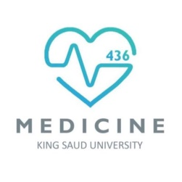
Cell Membrane and Transport
Red: very important.
Green: only found in males’ slides.
Purple: only found in females’ slides.
Gray: notes.
Physiology Team 436 – Foundation block lecture 2
Lecture: If work is intended for initial studying.
Review: If work is intended for revision.

Slide 2
Objectives:
Describe fluid mosaic model, membrane structure & function
Define permeability & factors influencing it
Identify carrier-mediated processes
1) Primary active
2) secondary active
3) facilitated diffusion

Slide 3
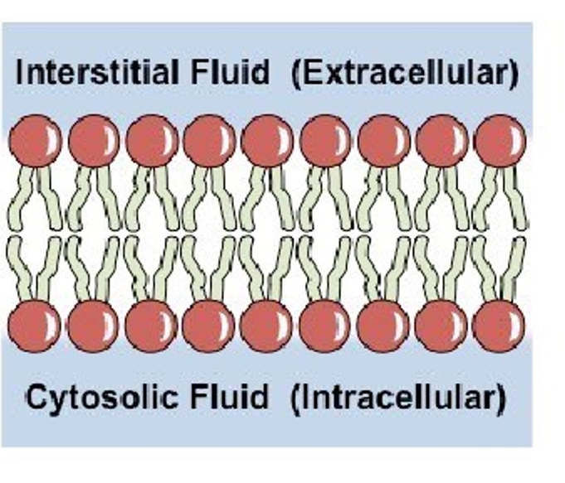
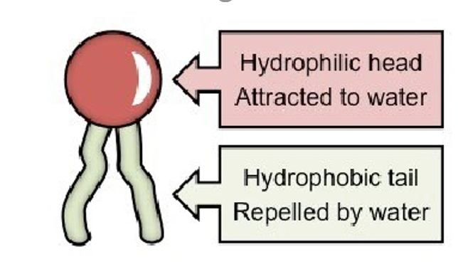
Structure of the cell membrane (Plasma membrane)
Characteristics:
It covers the cell
Thickness: 7.5-10 nm
Selectively permeable
It is fluid, not solid
Composed of:
55% proteins
42% lipids
3% other (Can be carbohydrates)
1-Phospholipids (most abundant) 25%
2-Cholestrol 13%
3-Other 4% (Can be Glycolipid)
Interior of the Phospholipid bi-layer: amphipathic (Hydrophilic head+ hydrophobic tail)
Phospholipid:
Head: Phosphate / Glycerol Tail: fatty acid

Slide 4
REMEMBER
Cell membrane is composed of a lipid bilayer
Cell membrane = plasma membrane

Slide 5
What does Selective Permeability mean?
• The membrane allows some substances to
cross it but not others.
Through proteins: Water-soluble substances (Glucose, ions)
Directly through the bilayer: Fat-soluble substances (O2, CO2, OH)
• This controls the type & amount of
substances entering and leaving the cell.
• It arises from the membrane structure.

Slide 6
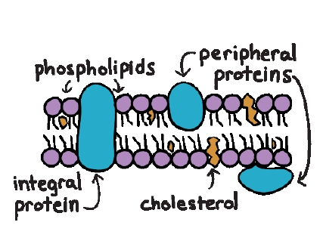
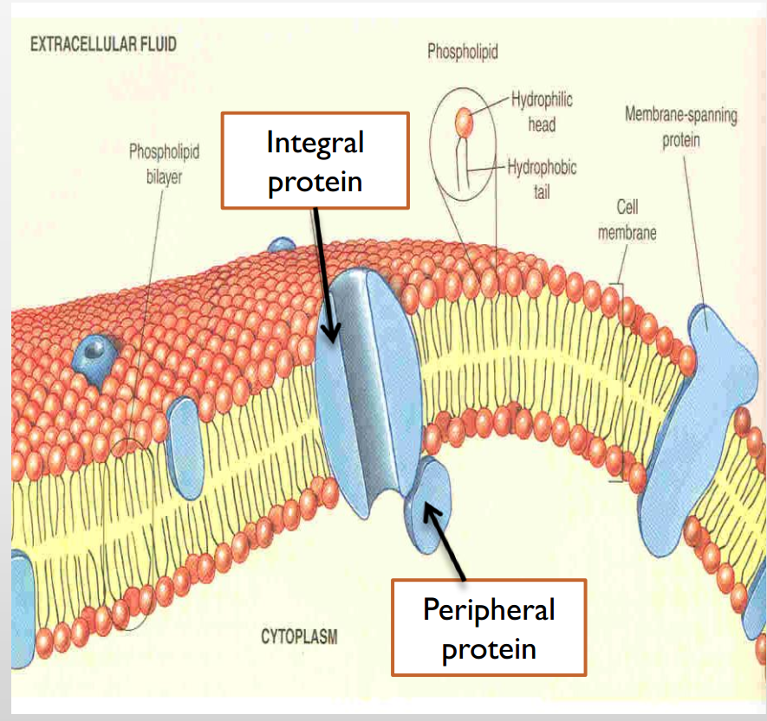
Membrane Proteins (Two categories)
Integral
Peripheral
Span the thickness of the membrane
Function:
Channels (or pores)
Carrier proteins
Receptors
Only attach to the surface of the membrane (or attached to integral proteins)
Function: Hormone receptors and Enzymes

Slide 7
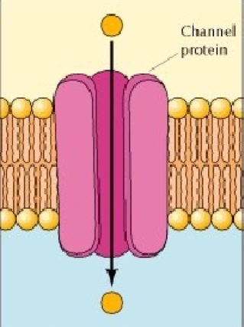
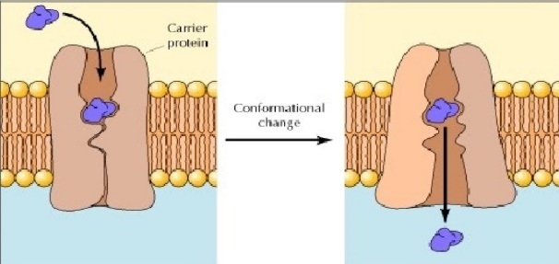
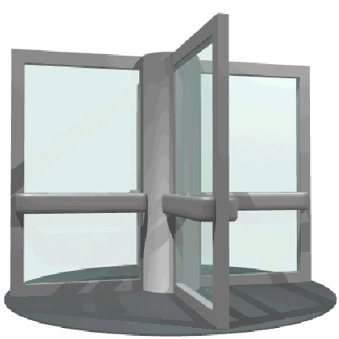
Channel vs. Carrier Proteins
Channel proteins
Form open pores that allow molecules of the appropriate size (e.g. Ions) to pass the membrane.
Similar to a normal door.
Carrier proteins
Selectively bind the small molecule to be transported and then undergo a conformational change to release the molecule on the other side of the membrane.
Similar to electronic door.

Slide 8
Carbohydrates of the Cell Membrane
*Carbohydrates CHO’s* membrane carbohydrates are on the surface bounded to lipids or proteins of the membrane
If attached to Proteins → Glycoproteins (mostly)
Lipids → Glycolipids
If bound together by proteins → Proteoglycans
Function:
Receptors
Attach cells to each other (Cell Adhesion)
Immune reaction (They help protect the cell by differentiating host friendly cells from enemy cells)
Give most of cells overall negative surface
Glycocalyx:
a loose coat of carbohydrate molecules outside the cell.
Functions as a first layer of defense

Slide 9
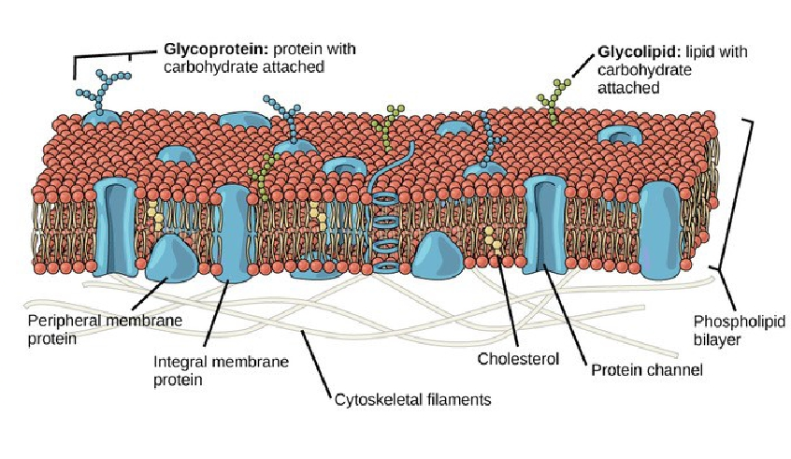
The Fluid Mosaic Model of Plasma Membrane

Slide 10
Types of Membrane Movement:
Passive Transport:
Active Transport:
Simple diffusion
Primary active transport
Facilitated diffusion
Secondary active transport
Osmosis

Slide 11
Transport Mechanisms:
The transport of material between body or cellular compartments can be divided into:
Passive Transport
Active Transport
Molecules move down or along their energy gradient.
Does not require energy.
Molecules move against their energy gradient.
require energy.

Slide 12
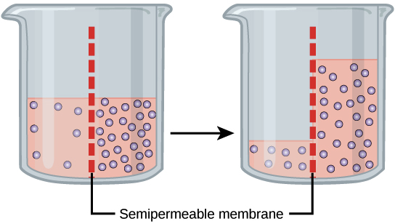
Passive Transport (Osmosis)
Osmosis :
Movement of water from an area of low solute concentration (hypotonic) to an area of high solute concentration (hypertonic)

Slide 13
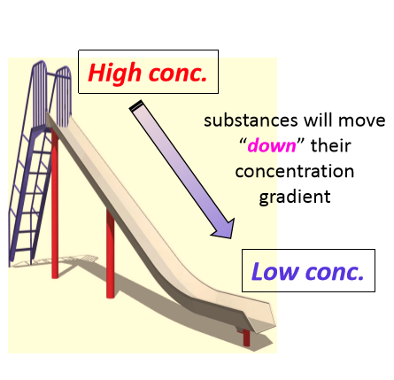
Passive Transport (Diffusion)
Diffusion: Random movement of substance either through the membrane directly or in combination with carrier protein down concentration gradient.
This gradient can be:
Concentration.
Electrochemical.
Pressure.

Slide 14
Passive Transport ( Types of Diffusion)
Simple diffusion
Facilitated diffusion
The movement of molecules through the intermolecular spaces or membrane openings (channels) without the necessity of binding to a carrier protein on the membrane.
The transported molecule binds to a carrier protein which then undergoes a conformational change allowing the molecule to pass through to the other side of the cell membrane.
The carrier facilitates passage of the molecule through the CM.

Slide 15
Amazing video summarizing cellular transport: https://m.youtube.com/watch?v=UgN76naeA1Q

Slide 16
Substances that can cross the Cell Membrane
Cross freely by diffusion
Cross through membrane proteins

Slide 17
Substances that can cross the Cell Membrane
Cross freely by diffusion
Cross through membrane proteins

Slide 18
Substances that can cross the Cell Membrane
Achieved through a trans-membrane protein:
carrier/transporter/channel

Slide 19
Passive Transport (Simple Diffusion):
1-Simple Diffusion:
1- directly through the lipid bilayer
2- through the channel protein
Pass through the interstices of the lipid bilayer
EX : small lipid-soluble substances (uncharged substances, O2, CO2, alcohol, steroid and general anesthetic).
Its require transport protein (channel protein).
EX: 1- Large and lipid-insoluble substances (charged molecule).
2-Water-soluble substances (water, ions) pass through channels that penetrate through the cell membrane.

Slide 20
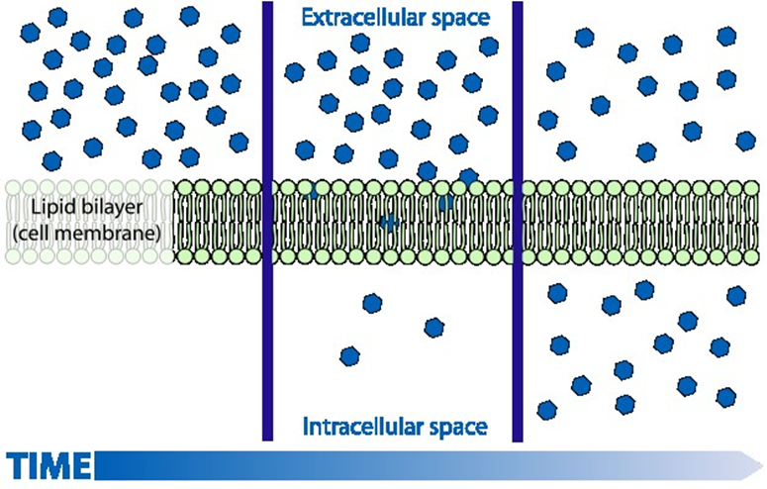
Passive Transport (Simple Diffusion):

Slide 21
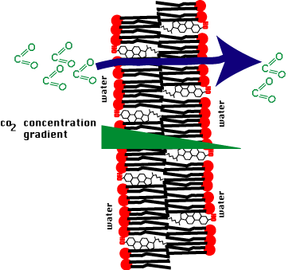
Passive Transport (Simple Diffusion)
• Non-carrier: mediated transport down an electrochemical gradient.
• Diffusion of non-electrolytes: (uncharged) from high concentration to low concentration.
• Diffusion of electrolytes: (charged) depends on both chemical as will as electrical potential difference.
Notes:
??

Slide 22
Passive Transport (Simple Diffusion)
1-Amount of substance available.
2-Number and sizes of opening in the membrane for the substance “pores”(selective gating system)
3-Chemical concentration difference.
Net diffusion= P x A (Co-Ci)
4-Electrical potential difference. EPD=± 61 log C1/C2
Rate of simple diffusion
5-Molecular size of the substance.
6-Lipid solubility
7-Temperature

Slide 23
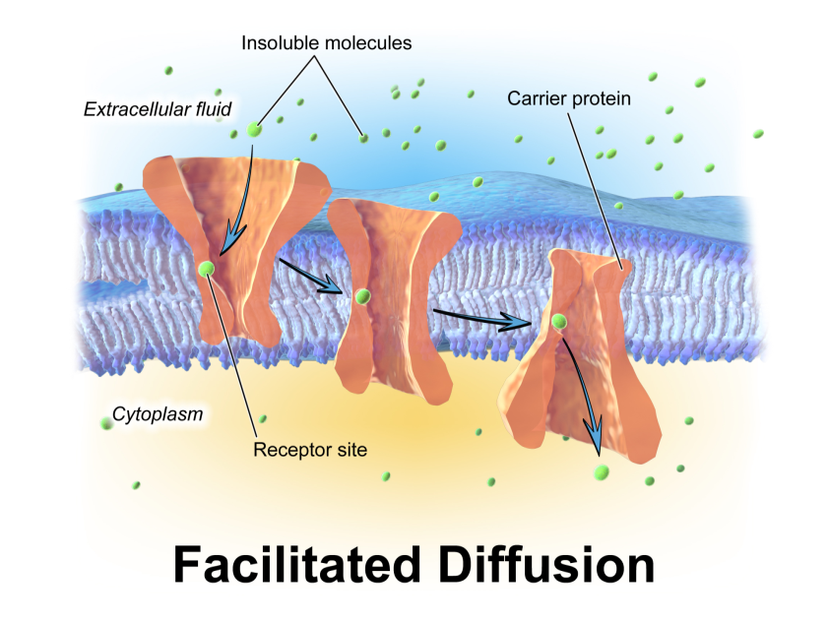
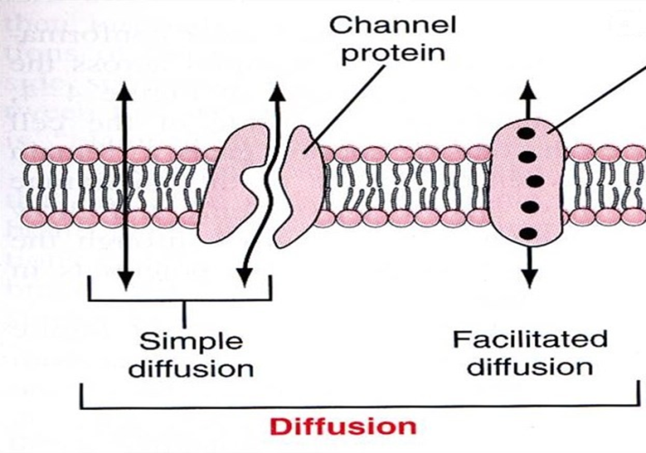
Passive Transport (Facilitated Diffusion)
2- Facilitated diffusion: also called (Carrier mediated diffusion)
Diffusion of a substance is “facilitated” by the use of a specific carrier protein.
Diffusion continues until equilibrium is reached or terminated.
Examples: Glucose, amino acids.

Slide 24
Passive Transport (Facilitated Diffusion)
concentration binding of protein.
If all proteins are occupied we achieve full saturation.
Saturation :
Features Of Carrier Mediated Transport: (Facilitated diffusion)
The binding site recognizes a specific substance D-glucose but not L-glucose .
Stereospecificity :
Chemically similar substances can compete for the same binding site D- galactose / D-glucose.
Competition :
Notes:
??

Slide 25
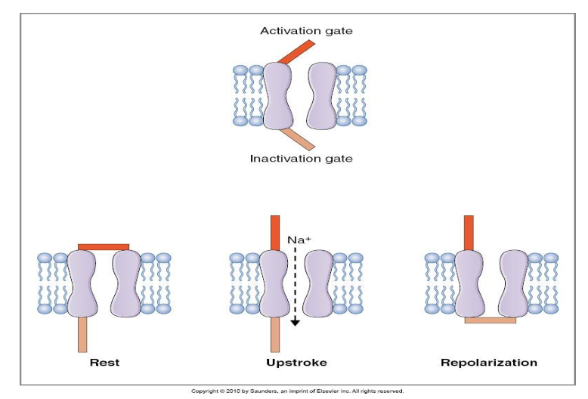
Passive Transport (Facilitated Diffusion)
Substance binding site substance protein complex conformational changes release of substance.

Slide 26
Passive Transport “rate of diffusion” (Simple Vs. Facilitated)
Simple diffusion
Facilitated diffusion
The rate of diffusion increases proportionately with the concentration of the diffusing substance.
The rate of diffusion increases proportionately with the concentration of the diffusing substance until it reaches a maximum Vmax.
At Vmax, an increase in the concentration of the diffusing substance does not increase the rate.

Slide 27
*كل ما زاد التركيز بيزيد معدل دخول الجزيئات، بمجرد يوصل للمرحلة القصوى بيثبت المعدل، لأن هذا النوع يعتمد على الكارير فما راح يقدر يدخل أكثر من طاقتة مهما كان التركيز برا عالي.
The rate at which molecules can be transported by facilitated diffusion depends on the rate at which the carrier protein molecule can undergo conformational change back and forth between its bound and unbound state.

Slide 28
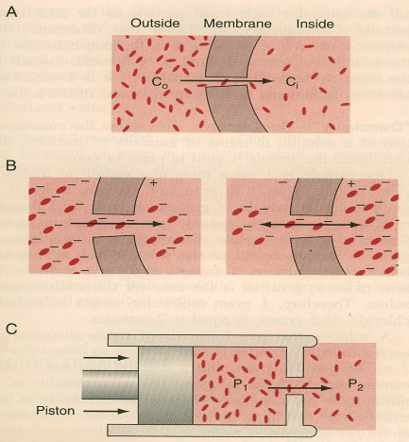
Factors Affecting Net Rate of Diffusion:
Size.
Temperature.
Steepness of the gradient:
1-Concentration difference.
2-Membrane electrical difference.
3-Pressure difference.
Charge.
Pressure.

Slide 29
Active transport
Occurs when a cell membrane moves
molecules or ions “up-hill” against a
concentration gradient
(or “up-hill” against an
electrical or pressure gradient).
Examples include:
Ions like: sodium, potassium, calcium, iron, iodine,
hydrogen ions.
Amino acids, glucose and other sugars.
Requires energy and a carrier protein

Slide 30
According to the source of energy used to facilitate transport, it can be divided into;

Slide 31
Primary Active
• The energy is derived
directly from breakdown
of (ATP) to ( ADP)
this breakdown will release energy
Examples include:
Sodium-Potassium ATPase pump
Calcium ATPase pump.
Hydrogen ATPase pump.

Slide 32
Pump Characteristics: 1- Carrier protein is made of alpha and beta subunits. 2- Na binding site is inside, K binding site is outside. 3- It has ATPase activity In the first body fluid lecture we decided that the intercellular fluid has more K and less Na, also extracellular fluid has more Na and less K. If the cell have more Na inside and more K outside that the cell will burst, therefore, this pump functions by moving 3 molecules of sodium OUT and 2 molecules of potassium INTO the cell both against their concentration gradients to maintain the body fluid balance.
Functions:
• Maintaining Na+ and
K+ concentration
difference.
• Establishes –ve
potential inside the
cell.
• Maintains a normal cell
volume.
• It is the basis of nerve
signal transmission.

Slide 33
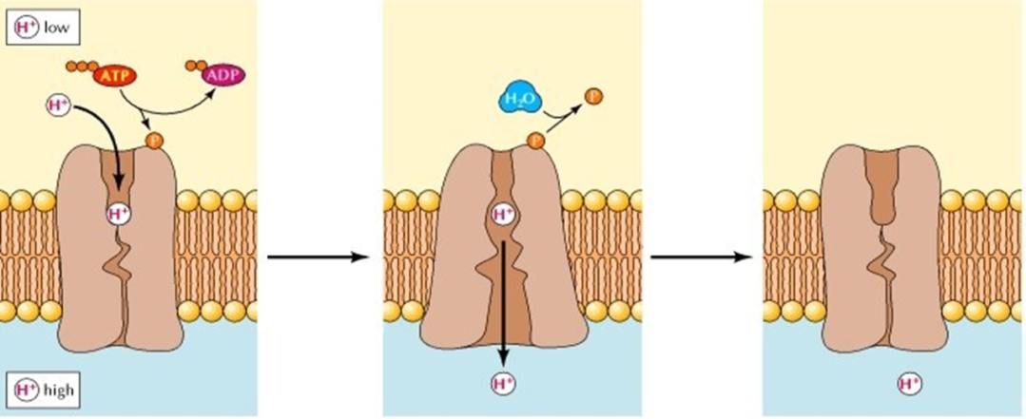
More examples: 1- Ca+2 ATPase Pump • Present in: A) Sarcoplasmic reticulum in muscle cells B) Mitochondria C) Some cell membranes.
Function:
Maintains low Ca+2 concentrations in the cell
2- H+ ATPase (OR H+-K) Pump
Present in:
A) Parietal stomach cells
B) Intercalated cells of distal renal tubule
Function:
A) Secretes HCL in stomach
B) Excretes acids from the body
Generally: Pumps H out of the cell into lumen
H+-K ATPase inhibitors treat ulcer disease (omeprazol)

Slide 34
Secondary Active Transport
Type of secondary active transport
2-Co-Transport
1-Counter-Transport
The energy is derived
indirectly by using the
concentration or
electrochemical gradient
generated by a primary
active transporter.
More Explanation (Co Transport) :
In primary NA-K pump, the concentration of sodium is more outside the cell, therefore the sodium will move into the cell with it’s gradient, and goes back outside to maintain body fluid balance. When Na moves inside, the cell will use energy from the concentration gradient using a carrier, but the carrier has place for another molecule (glucose, against its gradient) to pass with Na, sodium can not move alone.

Slide 35
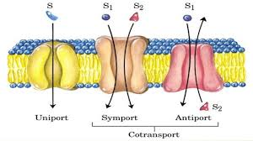
Co-Transport
• When both substances
are transported
together in the same
direction.
Examples: 1- Na+-Glucose
2- Na +-amino acid
3- In the Kidney
Counter-Transport
When one substance is
transported in the
opposite direction to the
other substance.
Examples: 1- Na+-H+ (Kidney)
2- Na+-Ca+2 (Many cell membranes)

Slide 36
Thank you!
اعمل لترسم بسمة، اعمل لتمسح دمعة، اعمل و أنت تعلم أن الله لا يضيع أجر من أحسن عملا.
The Physiology 436 Team:
Lina Alwakeel
Rana Barassain
Heba Alnasser
Munira Aldofayan
Sara Alshamrani
Sundus Alhawamda
Ruba Ali
Rehab Alanazi
Norah Alshabib
Nouf Alaqeeli
Buthaina Almajed
Alaa Alaqeel
Fahad Al Fayez
Ibrahim Al Deeri
Hassan Al Shammari
Abdullah Al Otaibi
Abdullah Al Subhi
Ali Al Subaei
Omar Al Babteen
Foad Fathi
Faisal Al Fawaz
Muhammad Al Aayed
Muhammad Al Mutlaq
Nasser Abu Dujeen
Waleed Al Asqah
Team Leaders:
Qaiss Almuhaideb
Lulwah Alshiha
Contact us:
Physiology436@gmail.com
@Physiology436

