Slide 1


Body Fluids
Red: very important.
Green: only found in males’ slides.
Purple: only found in females’ slides.
Gray: notes.
Physiology Team 436 – Foundation block lecture 3
Lecture: If work is intended for initial studying.
Review: If work is intended for revision.

Slide 2
Objectives
State the water content of the body.
Describe the physiologic factors that determine the body’s water content.
Discuss water balance in the body with regards to intake and output.
Describe the physiologic mechanisms involved in water balance (the role of ADH hormone and thirst mechanism).
Enumerate the different body fluid compartments and state their normal volume.
Describe the composition of the different body fluid compartments.
Define osmolarity and state the normal osmolarity of body fluids.
Explain the effects of placing a cell in solutions with varying tonicity on the cell volume.
Enumerate fluids used in clinical practice and state their tonicity compared to that of normal body fluids.
Describe the effects of infusing IV fluids with different tonicities on the volume of the different body compartments.

Slide 3
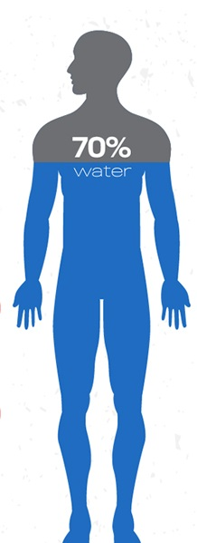
Body Fluid Content
Total body fluids ≈ 60% (50-70%) of total body weight (TBW).
Body fluids = water + dissolved solutes.
  Solutes
Total body water ≈ 60% of TBW.
Kg of water = L of Water
60%
Water
Electrolytes (Na+, K+, Cl-, HCO3-, Mg+2, Ca+2)
Non-electrolytes
(glucose, urea, creatinine)
(Guyton and Hall Textbook of Medical Physiology. 13th ed. Ch-25)

Slide 4
Factors Affecting (TBW)
Physiological:
-Age
-Sex
-Body Fat
Pathological:
-Vomiting
-Diarrhea
-Diseases With Excessive loss of water ( DM = Diabetes Mellitus , excessive Sweating …)
-Blood loss
-Burns
Other:
-Climate
-Habits
-Physical Activity
disturbances in fluid balance

Slide 5








Body Fluid Content
Low body fat
Low bone mass
73% or more water
Higher body fat Smaller amount of skeletal muscles 40-50% water
60% of body weight
is water
Only about 45% of body weight is water

Slide 6
Water Balance
Cells are largely made of water and are surrounded by a “sea” of water.
Water is constantly being exchanged between the cells and surrounding environment.
Keeping a constant volume of water is essential for homeostasis.

Slide 7
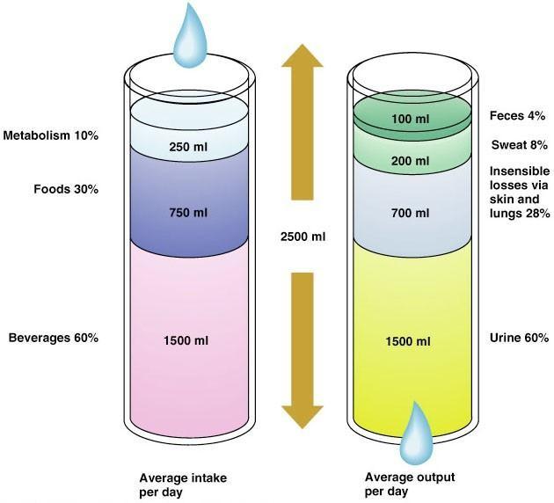
Fluid Intake = Fluid output
the body modifies intake by thirst and output by kidney excretion

Slide 8
Fluid intake:
60% from beverages (major intake)
30% from food
10% from metabolism
Fluid output:
60% from urine (major output)
28% insensible through skin and lungs
8% sweat
4% feces
Definition of insensible through skin and lungs:
الموية الي تطلع من الجسم بدون ما تحس فيها. مثال:
رطوبة الجلد
الموية (بخار الماء) الي يطلع مع التنفس

Slide 9
Regulation of Fluid Balance
Water deficit
Water excess
Input < output.
Leads to:
  Hypovolemia
  Dehydration
Physiologic regulation:
Activates hypothalamic thirst centre → ↑ fluid intake
The hypothalamic thirst centre is activated by:
  ↓ ECF volume (10-15%)
  ↑ ECF osmolarity (1-2%)
↑ ADH secretion by posterior pituitary → ↑ water reabsorption by the kidney.
Input > output
Leads to:
  Hypervolemia.
  Edema.
Physiologic regulation:
↓ ADH secretion →
↓ water reabsorption → ↑ water excretion by kidney.
Decrease thirst

Slide 10
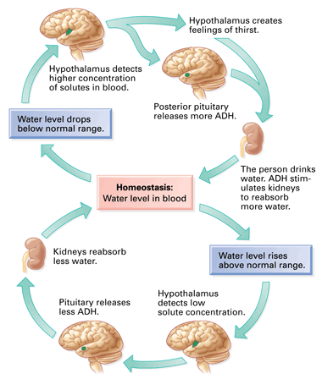

Slide 11
Fluid Compartments
Fluid Compartments
Extracellular fluid(ECF)
Plasma
Intracellular fluid(ICF)
Transcellular
Interstitial fluid

Slide 12
Fluid Compartments
Total Body WATER
ECF
Plasma
Interstitial fluid
ICF
ECF is
20% of Total Body WEIGHT
1/3 of Total Body WATER
Plasma is
25% of ECF
5% of Total Body WEIGHT
Total body Water is 60% of Total Body Weight
ICF is
40% of Total body WEIGHT
2/3 of Total Body WATER
Interstitial Fluid is
75% of ECF
15% of Total Body WEIGHT

Slide 13
Fluid Compartments
Total body water = 60% TBW
*2/3 (40% of TBW)
Intracellular
1/3 (20% of TBW)
Extracellular
¾ (15%) Interstitial Fluid
¼ (5%)
Plasma
Transcellular fluid (specialised type of ECF e.g. synovial, CSF, ocular, pericardial, pleural, peritoneal fluids)= 1-2L
N. B. the fractions refer to its relation with the preceding compartment. While the percentage refers to its relation to Total body WEIGHT)
(Guyton and Hall Textbook of Medical Physiology. 13th ed. Ch-25)

Slide 14
NOTE
Plasma is not a set number nor range for all individuals. It is 5% of total body WEIGHT.
If calculated through total body WATER, we must calculate the percentage of ECF first.

Slide 16
Extracellular Fluid
Extracellular fluid forms 1/3 of TBW and consists of:
Interstitial fluid:
Fluid bathing the cell .
Plasma :
Transcellular fluid:
75% of ECF
15% of total body weight
Ultra filtration of plasma .
contained in a gel-like extracellular matrix .
surrounds all cells except blood cells
Fluid circulating in the blood vessels.
25 % of ECF
5% of total body weight
There is High Protein in Plasma.
small amount.
Examples: digestive secretions and CBS ( cerebrospinal fluid)
The main difference between plasma and interstitial fluids is the presence of protein in large quantities

Slide 17
Intracellular Fluid ( ICF )
  Intracellular fluid forms 2/3 of TBW
  High Concentration of protein
  Inside The cell

Slide 18
How to Calculate Body Fluid Content
Ex. Calculate the total body water content of a 30-year-old 70 kg man?
Total body weight
Percentage
x
Solution:
70 x 60 / 100 = 42 L
Divide
100
Continue next page

Slide 19
Continue..
How many liters in ICF?
42 L x 2/3 = 28 L
Or
70 Kg x 40/100 = 28 L
-------
How many Liters in ECF?
42 L x 1/3 = 14 L
Or
70 Kg x 20/100 = 14 L
Continue next page

Slide 20
Continue..
How many liters in Interstitial fluid?
14 L x 75/100 = 10.5 L
Or
70 Kg x 15/100 = 10.5 L
How many liters in plasma?
14 L x 25/100 = 3.5 L
Or
70 Kg x 5/100 = 3.5 L
Continue next page

Slide 21
Remember
Transcellular Fluid is very little
DON’T CONFUSE TOTAL BODY WATER WITH TOTAL BODY WEIGHT.

Slide 22
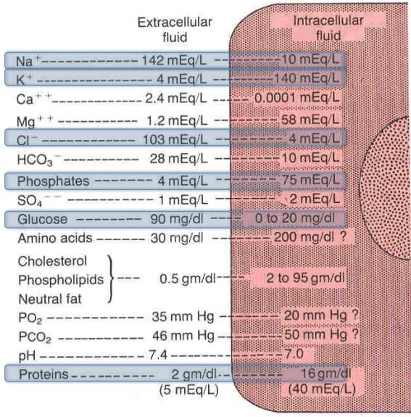
Composition Of Body Fluids
Extracellular fluids :
Intracellular fluids :
Sodium is the chief cation(+)
“Na”
Potassium is the chief
cation(+) “K”
Chloride is the chief anion (-)
“Cl”
Phosphate is the
chief anion(-)
Electro-neutrality :
Each compartment must Have almost the same concentration of positive charge ( cations ) as of negative charge ( anion )
Calcium , chloride , sodium , protein , phosphate , potassium , glucose “IMPORTANT”
Protein is highly concentrated in intracellular fluids and plasma

Slide 23
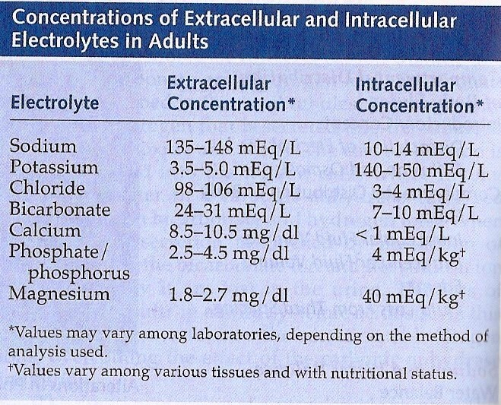
Electrolyte Concentrations
Memorize concentration level averages here rather than ranges: (as averages vary from book to book but the value in the exam will be very close to the average here.)
‎هنا بس طلعوا المتوسط و احفظوه ما يحتاج تحفظون الفترات، لانها مختلفة من كتاب لكتاب لكن خليكم على قيمة المتوسط و في الاختبار راح يجيبون قيم ممكن ما تكون بالضبط نفس المتوسط لكن بيكون جدًا قريب

Slide 24
Normal Ranges cont.
Sodium (Na) : 135 – 145 mEq/L
Chloride (Cl) : 98 – 107 mEq/L
Potassium (K) : 3.5 – 5.1 mEq/L
(The Males’ Doctor focused on these)

Slide 25
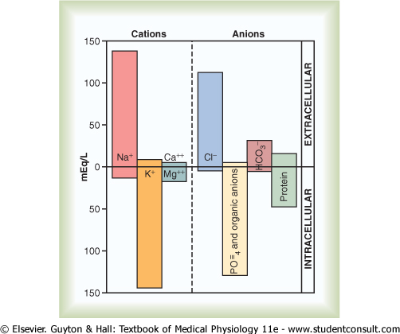
Solute Overview:
Intracellular vs. Extracellular
Ionic composition very different
Total ionic concentration very similar
Total osmotic concentrations virtually identical

Slide 26
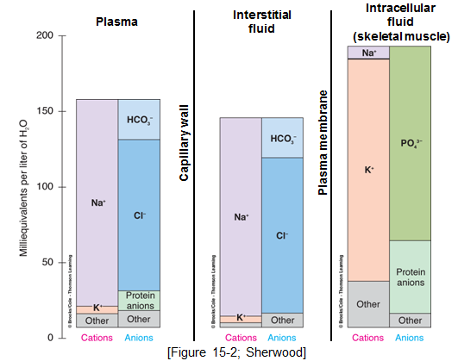
Does the composition of the compartments
differ? (yes)

Slide 27
How is it related to patient care?
Abnormalities in electrolytes can change the osmolarity of ECF and can affect the cells.
  Hypernatremia (↑ Na conc. In ECF)
  Hyponatremia (↓ Na conc. In ECF)
  Hyperkalemia (↑ K conc. In ECF) ( K is 60 – 100% above normal )
  Hypokalemia(↓ K conc. In ECF) (1-2 mEq/L )

Slide 28
Osmolarity
Terms of Concentration
A unit of concentration.
describes the concentration of one solution.
It measures how concentrated or diluted a solution is.
Defined as = the number of osmoles of a solute per litre of solution.
The normal osmolarity of body fluids is ≈ 300 mOsm/L
Osmolarity : Osm / L
Osmolality Osm / Kg
Molarity M/L
In biological solutions
Millimoles per liter (mM / L )
Milliosmoles per liter ( mOsm / L )
m = 1 / 1000

Slide 29
What is Tonicity?
‘reminder’ Osmolarity describes the concentration of one solution.
Tonicity is used to compare between the osmolarities of two or more solutions separated by a semi-permeable membrane
why it is important ?
The difference in tonicity between two different solutions separated by a semi-permeable membrane determines the movement of water.

Slide 30
Tonicity of Solutions: how does it apply to physiology ?
Isotonic solution : - (no swells or shrinking ) - 0.9% solution of sodium chloride - same in and out.
Hypotonic solution : - (swelling) 0.9% - inside the cell is higher than outside the cell.
Hypertonic solution : - (shrinking) 0.9% - outside the cell is higher than inside the cell.
Remember: the cell membrane functions as semi-permeable membrane

Slide 31
Osmosis
Definition :
It is the movement of water(not solutes) across a semi-permeable membrane from a region of low solute concentration to a region of high solute concentration.
The net diffusion of water from a region of high water conc. to low water conc.
Osmotic equilibrium is maintain between ECF and ICF .
Small changes in conc. In ECF can cause huge change in cell volume
Intracellular Osmolarity = Extracellular Osmolarity = 300 mOsm/L

Slide 32
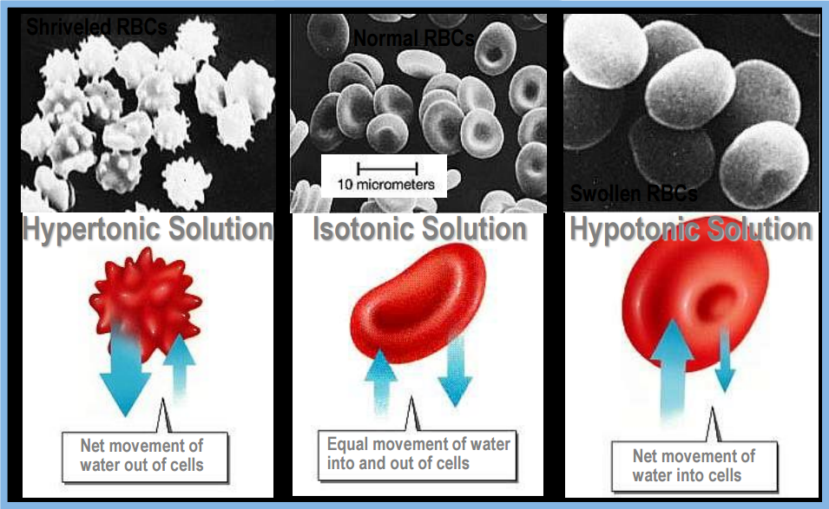
Movement of Water

Slide 33
Intravenous (IV) Fluids
IV Fluids Administration
Glucose and other solutions are administered for nutritive purposes
For people who can not take adequate amount of food.
It is administered slowly into the blood stream.
It is prepared in isotonic solution.
Water is excreted in the process.

Slide 34
Types of Intravenous (IV) Fluids
IV Fluids
Hypotonic
Isotonic
Hypertonic
0.45% Saline
0.9% Saline (NaCl in water)
Dextrose (5% glucose)
Dextrose in 0.9% saline

Slide 35
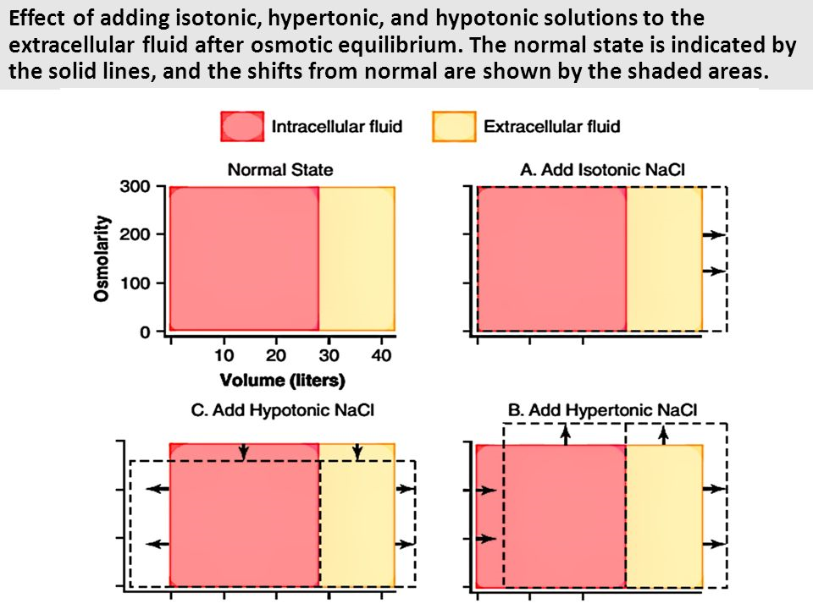
What happens to the different compartments with the administration of IV fluids?

Slide 36
Explanation of Previous Figure:
When Isotonic NaCl is added:
Water volume increases
No change in osmolarity because it’s isotonic
When Hypotonic NaCl is added:
volume in ECF increases
Osmolarity in ECF decreases
Volume in ICF increases
Osmolairity in ICF decreases
When hypertonic NaCl is added:
Osmolarity in ECF will increase
Volume in ECF will increase
Osmolarity in ICF will increase
Volume in ICF will decrease

Slide 37
Thank you!
اعمل لترسم بسمة، اعمل لتمسح دمعة، اعمل و أنت تعلم أن الله لا يضيع أجر من أحسن عملا.
The Physiology 436 Team:
Lina Alwakeel
Rana Barassain
Heba Alnasser
Munira Aldofayan
Sara Alshamrani
Sundus Alhawamda
Ruba Ali
Rehab Alanazi
Norah Alshabib
Nouf Alaqeeli
Buthaina Almajed
Alaa Alaqeel
Fahad Al Fayez
Ibrahim Al Deeri
Hassan Al Shammari
Abdullah Al Otaibi
Abdullah Al Subhi
Ali Al Subaei
Omar Al Babteen
Foad Fathi
Faisal Al Fawaz
Muhammad Al Aayed
Muhammad Al Mutlaq
Nasser Abu Dujeen
Waleed Al Asqah
Team Leaders:
Qaiss Almuhaideb
Lulwah Alshiha
Contact us:
Physiology436@gmail.com
@Physiology436

