Slide 1
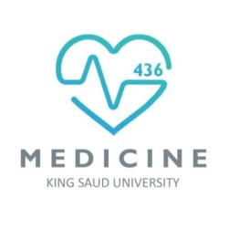
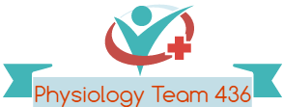
Homeostasis (1+2)
Red: very important.
Green: only found in males’ slides.
Purple: only found in females’ slides.
Gray: notes.
Physiology Team 436 – Foundation block lecture 4
Lecture: If work is intended for initial studying.
Review: If work is intended for revision.

Slide 2
Objectives
Define and discuss the concept of homeostasis and its importance to the living organism.
Discuss the physiologic control mechanisms that enable maintenance of the normal steady state of the body.
Define a feedback mechanism and describe its components.
Differentiate between positive and negative feedback mechanisms and give examples for each in the body.
Apply the knowledge gained in feedback mechanisms to disturbances in the disturbances in ECF volume and osmolarity.
Define Edema and state its various types.

Slide 3
Homeostasis
Homeostasis :
Sameness
standing
Homeostasis is known as :-
- The process by which the body keeps the internal environment constant despite changes in the external environment
Homeo: similar
Stasis: state of equilibrium
- The internal environment of the body (ECF) is in a dynamic state of equilibrium
- All different body system operate in harmony to provide homeostasis
Essentially all the functions of the body organs and tissues aim at keeping the internal environment at a nearly constant state.

Slide 4
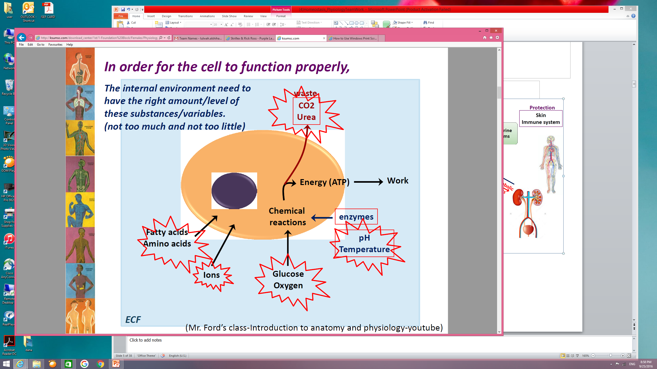

Slide 5
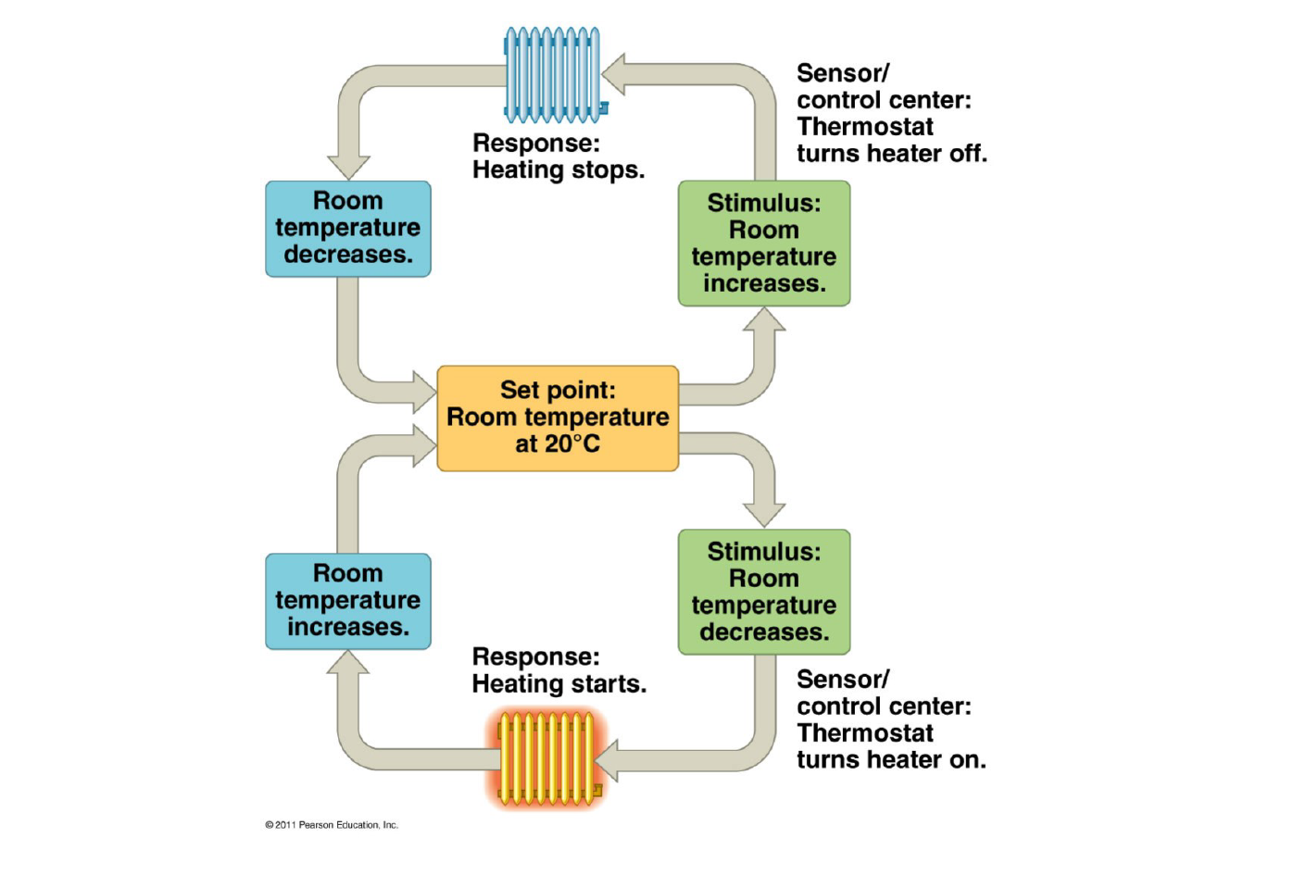
The Thermostat Analogy

Slide 6
Control system ( Teamwork 435)
1. Nervous system
2. Endocrine system
Controls the body activities that requires rapid responses (speed)
Detects and initiates reactions to changes in external environment
(sensory input ,central nervous system ,motor out put)
e.g. regulation of blood pressure upon rising
Regulates the activities that requires duration.
Endocrine gland , Pancreas, thyroid
e.g. parathyroid hormone regulating calcium levels, insulin control glucose level.

Slide 7
Body constituents are normally regulated within a range rather than a fixed value
Mentioned previously in lecture 3: Body Fluids.

Slide 8
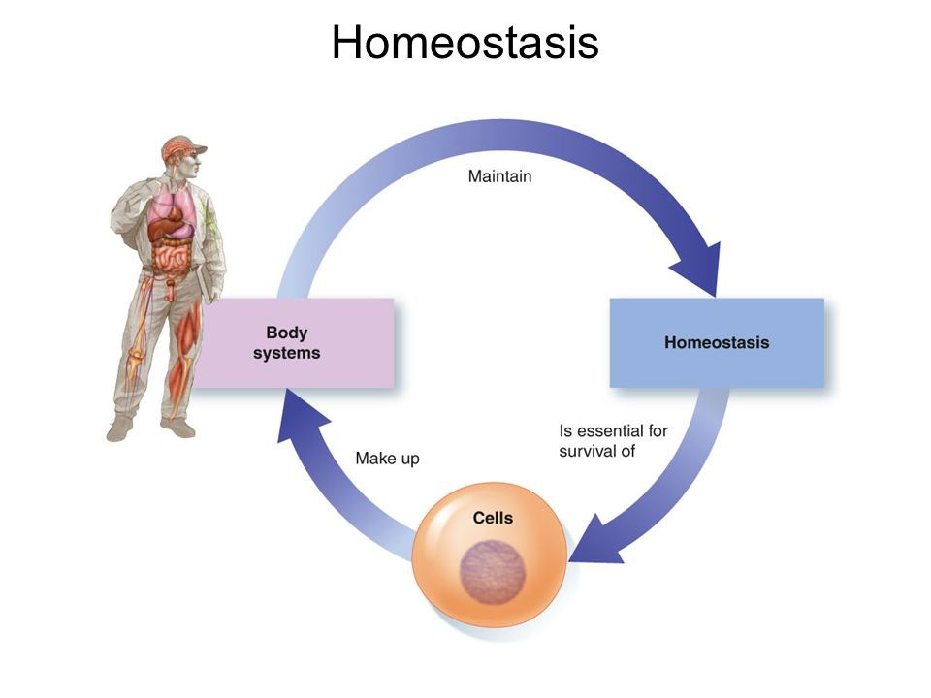
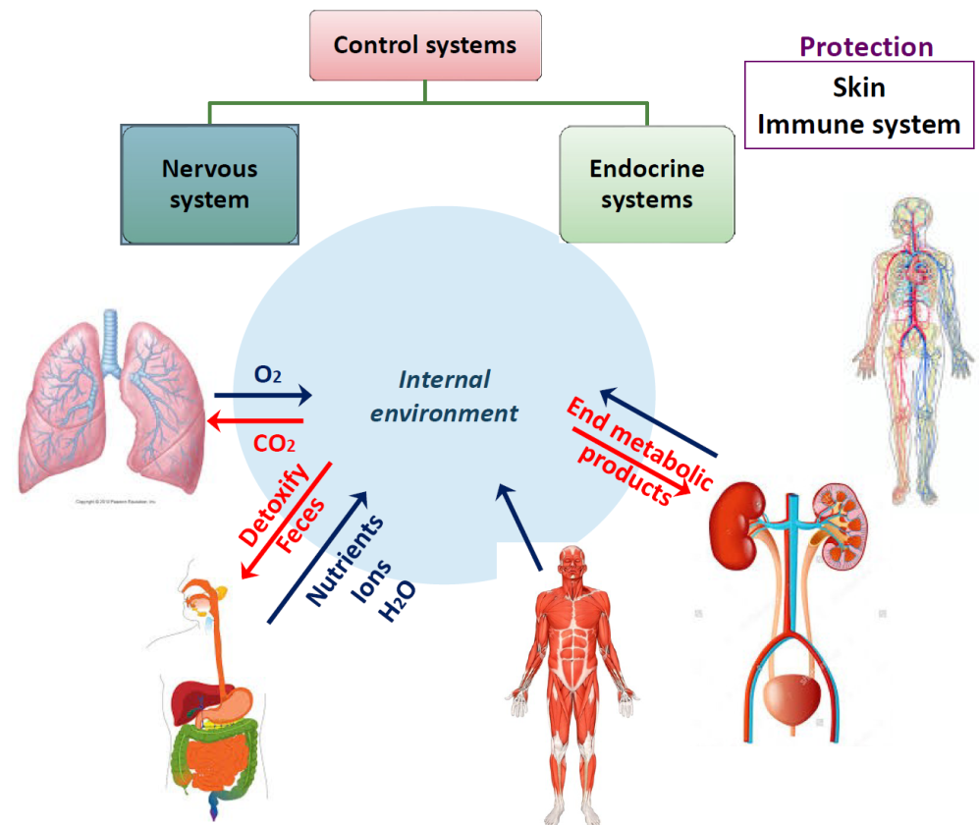
Important Diagrams

Slide 9
Homeostatic control mechanisms
The body maintains homeostasis by using homeostatic control system
The body has thousand of control systems
They function to restore balance when it lost
Control systems operate:
      - Within the organ itself
      - Throughout the body to control interrelation between organs
Control mechanisms
Is achieved by
Feedback mechanisms

Slide 10
Control Mechanism Component ( Team work 345 )
Three independent components of control mechanisms :
Effector | Control center | Receptor
Provide the means to respond to the stimulus تستجيب للمؤثرات لهذه القيم لتعود للحالة الطبيعية | Determine the set point at which the variable is maintained تحديد القيم التي يعود بها الجسم لحالته الطبيعية | Monitor the environments and responds to changes (stimuli) الكشف عن التغيير بواسطة مستقبلات

Slide 11
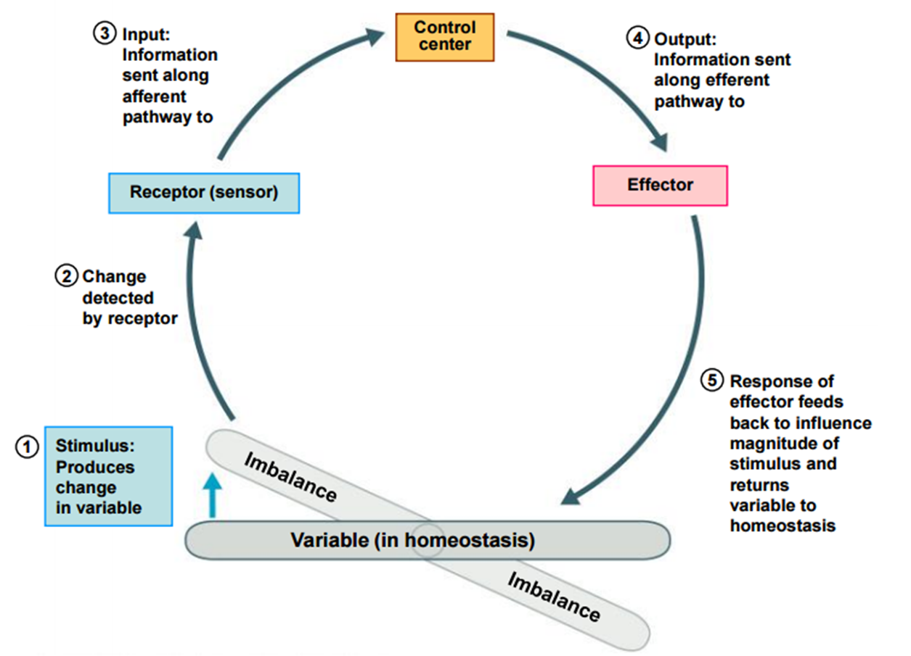
Homeostatic Control Mechanisms

Slide 12
Feedback mechanisms
Feedback mechanisms mean :
Loop system in which the system responds to changes
Positive feedback
Resulting action on the same direction of the stimulus
If stimulus increases ,homeostasis control system activated to cause increase in the stimulus
Negative feedback
original stimulus reversed (resulting action in the opposite direction of stimulus)
most feedback system in the body are negative
If stimulus increases, homeostatic control system activated to cause a decrease in the stimulus and vice versa.

Slide 13
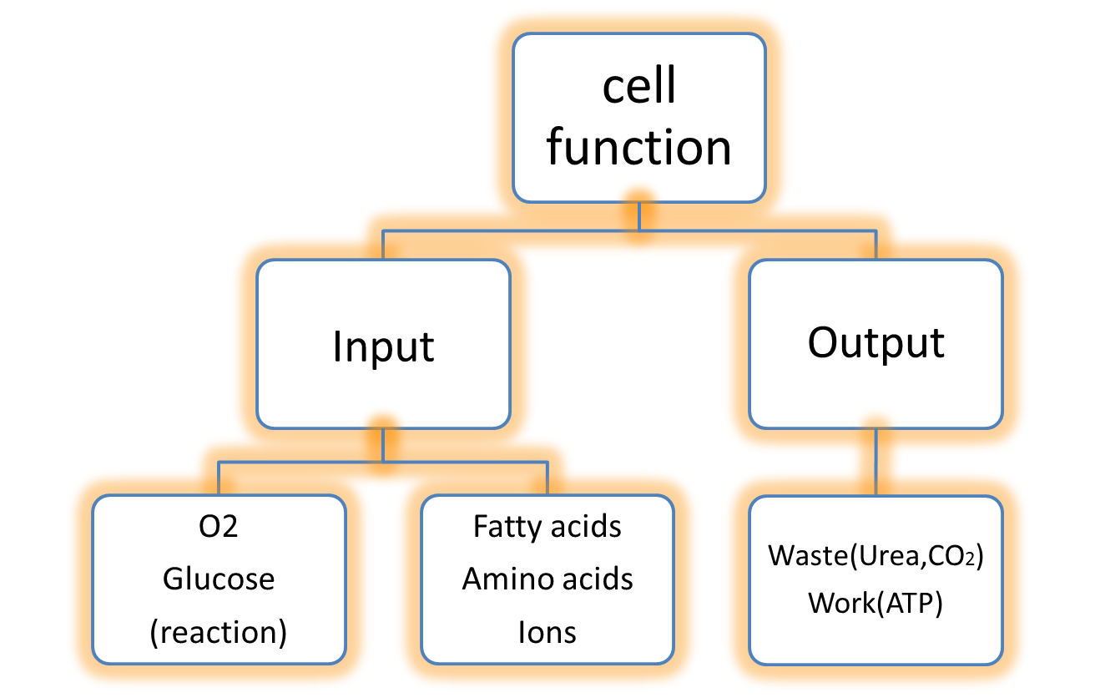
The Internal environment
the internal environment of the body is the extracellular fluid and all body cells live in this environment
It separated from the external environment by the skin
The internal environment must be kept constant in the face of an ever changing external environment.

Slide 14
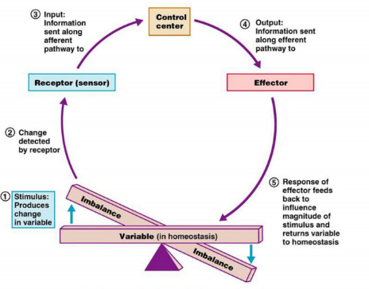
What are the components of a feedback mechanism?
Control center : determines the set point at which the variable is maintained. يتم تحديد القيم التي يعود بها الجسم لحالته الطبيعية
The three interdependent components
of control mechanisms
Nervous system
Sensors
Receptor : monitors the environments and responds to changes (stimuli) : Effector يتم الكشف عن التغير بواسطة المستقبلات
Effector يتم الكشف عن التغير بواسطة المستقبلات provides the means to respond to the stimulus. تستجيب المؤثرات لهذه القيم وتبدأ بالعمل على تطبيقها للعودة للحالة الطبيعية
Muscles and glands
The variable produces a change in the body

Slide 15
Type of feedback mechanisms (Girls’ slides & teamwork435)
Feedback
Negative feedback
Positive feedback
The effector response of the system is in the opposite direction to stimulus that initiated the response.
Most of the control systems of the body act by negative feedback.
The effector response of the system is in the same direction to stimulus that initiated the response.
Only few systems display positive feedback.
مثال لتوصيل الفكره فقط.
High temperature | Make temperature LOWER | Make temperature HIGHER

Slide 16
Negative Feedback | Positive Feedback
A type of homeostatic control system that maintains the variable within a normal range. Variable maintained within a normal level, its set point *fluctuates around the set point. - If stimulus increases, homeostatic control system activated to cause a decrease in the stimulus والعكس صحيح | Not common. WHY? يزيد التأثير ( تزيد المشكلة غالباً). لا يساعد بالـ balance لا يحقق الـhomeostasis Mostly causes vicious circle.
Ex) A high level of in CO2 in the ECF will increase pulmonary ventilation, increasing the amount of CO2 expired which will bring the level of CO2 in ECF down. *ECF= Extra Cellular Fluid https://youtu.be/SRgHeHQ9ud0'4الشرح من دقيقة ' Other examples of negative feedback: withdrawal reflex in response to injury. changing breathing rate in response to increased carbon dioxide. parathyroid hormone release in response to decreased calcium. | Ex) In nerve signaling, entry of a small amount of Na+ into the cell will open more Na+ channels causing more Na+ to enter the cell. Other examples of positive feedback: blood clotting cascade. uterine contractions of labor.
teamwork435

Slide 17
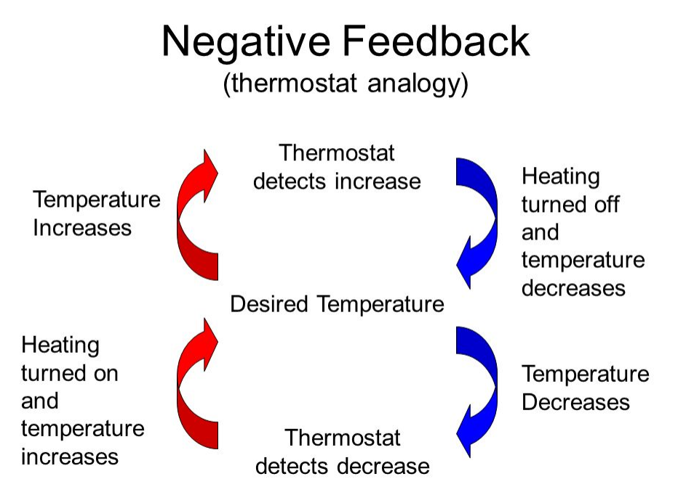
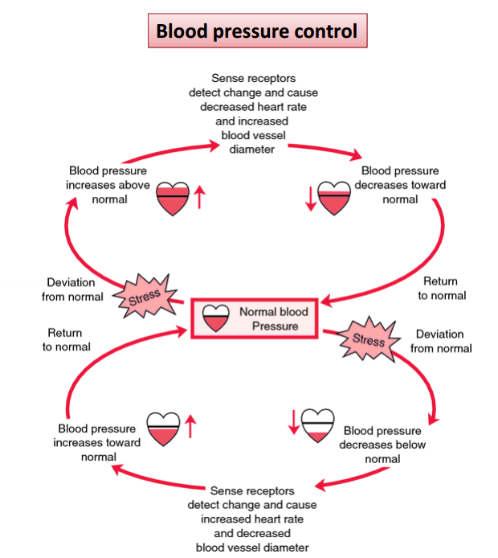
Examples of Negative Feedback Mechanisms

Slide 18
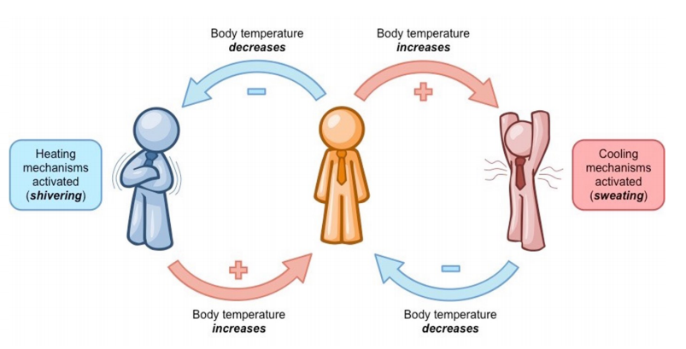
Examples of Negative Feedback Mechanisms
Pituitary gland
thirst
Drink water
)1)
Increase Osmolarity
(2)
Sensor:
Hypothalamus
Decrease
Osmolarity
Ate too much salty food
مثال من الدكتورة
ADH
Keep water (kidney)

Slide 19
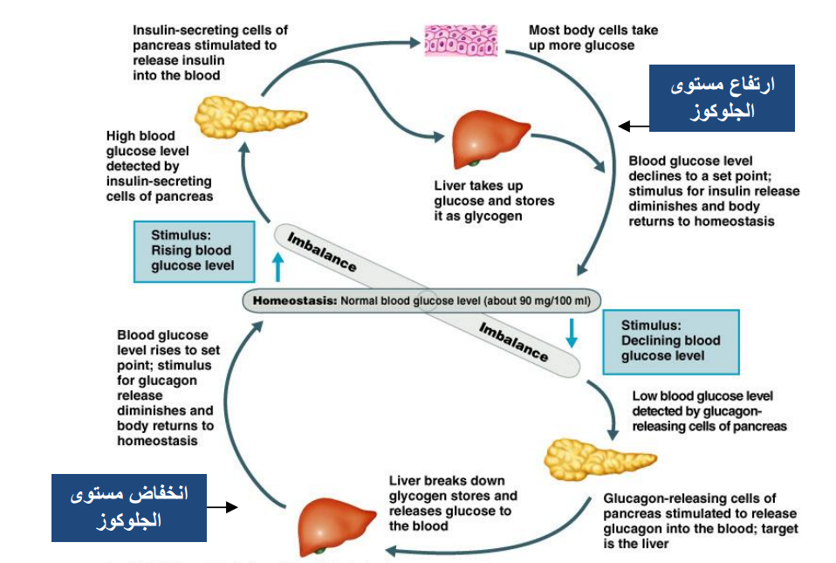
Examples of Negative Feedback Mechanisms (Note)
اذا ارتفع مستوى الجلوكوز في الدم سيتم فرز الانسولين من خاليا البنكرياس لإعادة مستوى الجلوكوز بالدم لحالته الطبيعية
اذا كان مستوى الجلوكوز في الدم منخفض سيتم تحويل الجلايكوجين إلى جولوكوز بواسطة هرمون الجلوكاجون لإعادة مستوى الجلوكوز بالدم لحالته الطبيعية

Slide 20
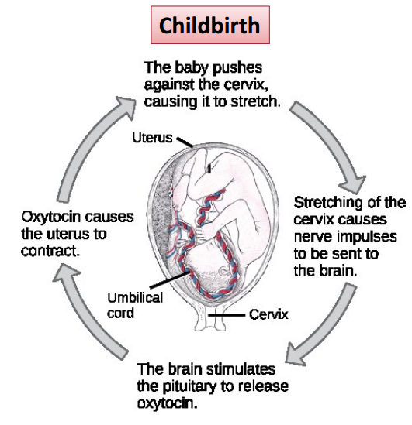
Examples of Positive Feedback Mechanisms
(note)
يكون فيه
Contractions to push baby out
لكن قليله, الى ان يصل رأس الطفل لعنق الرحم يحفز الدماغ الغده النخاميه لترسل هرمون الـ
Oxytocin
وبكذا تزيد الـ
Contractions
ويطلع البيبي.

Slide 21
Homeostatic Imbalance
Disturbance of homeostasis or the body’s normal equilibrium.

Slide 22
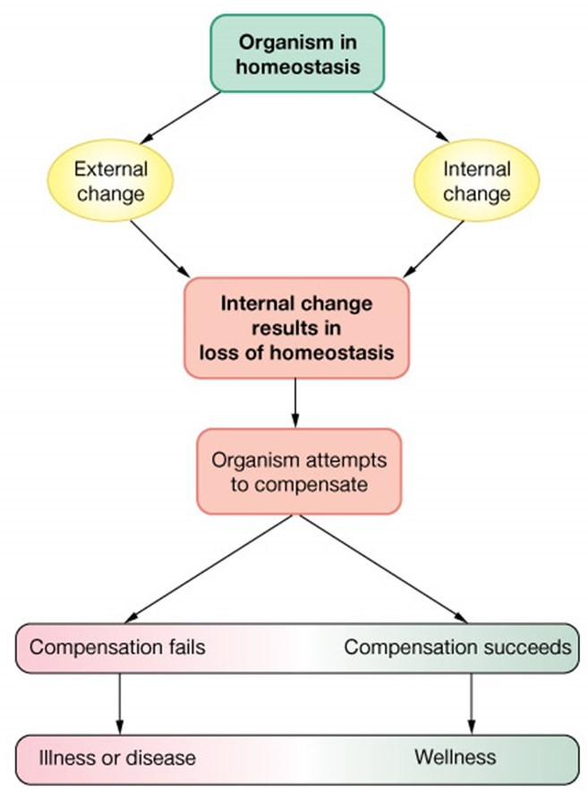
Disease is a state of disturbed homeostasis
Successful compensation
  Homeostasis reestablished
Failure to compensate
  Pathophysiology
    Illness
    Death

Slide 23
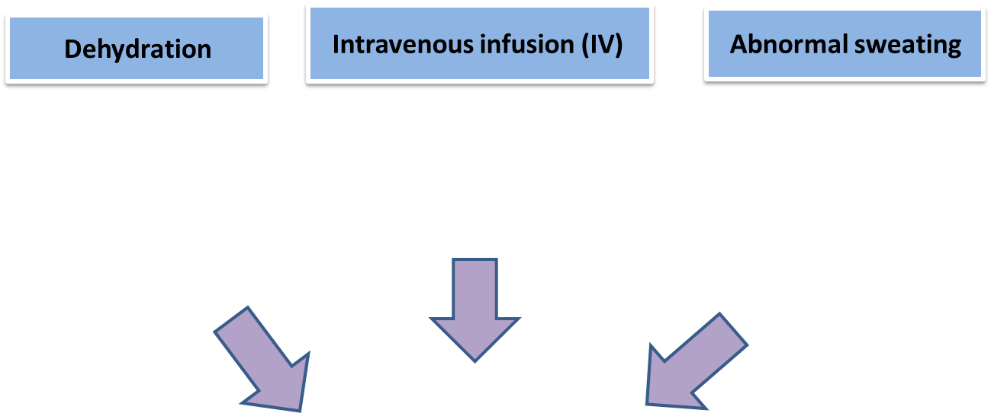
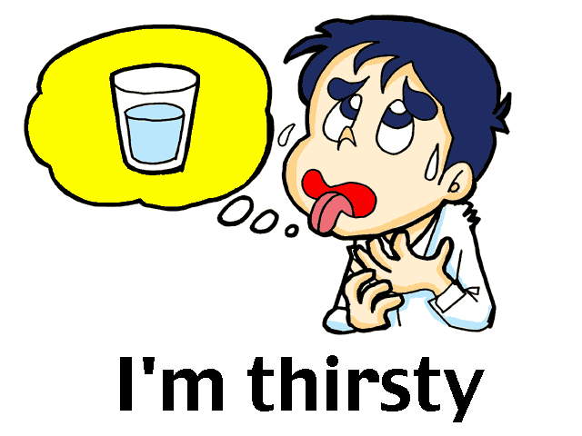
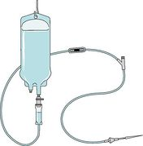
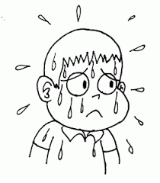
Volumes and osmolarity of ECF and ICF in abnormal state
Factors can cause the change in the volume of ECF and ICF

Slide 24
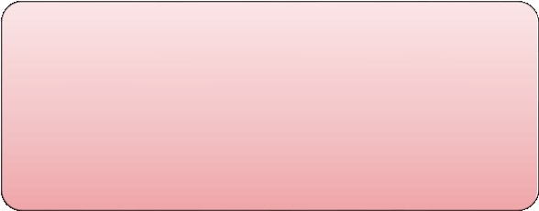
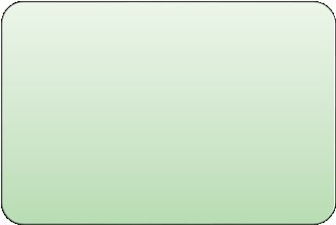
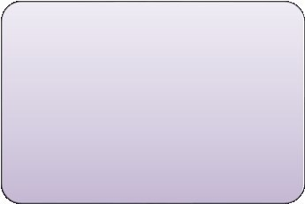

Body Fluid Imbalance
Body Fluid Imbalance
Volume
change
Osmolarity
change
Commonly both
occur together
Volume expansion
Volume contraction
Hyper- osmolarity
Hypo- osmolarity
Decrease output (kidney failure, SIADH)
Increase input (Infusion of excessive IV fluids)
Increase output
( vomiting , diarrhea, diuretics )
Decrease input (low intake)
Excessive salt intake
Loss of water more than solutes
Loss of salts (diuretics)
Gain of water more than solutes (SIADH)

Slide 25
Disturbances in Fluid Balance
Water/fluid intake
Water/fluid output
Intake is variable
Depends on:
  Climate
  Habits
  Physical activity.
Burns
Exercise
Hot weather.
Diarrhea
Vomiting
Blood loss
Diabetes

Slide 26
Volume contraction (Decrease in the ECF volume )
Diarrhea:
Osmolarity of fluid lost ≈ Osmolarity of ECF (loss of isosmotic fluid).
  volume in ECF.
  arterial pressure.
3. Adrenal insufficiency:
Aldosterone deficiency.
  Na in the ECF.
  Osmolarity in both .
  in ECF volume.
  in ICF volume.
  2. Water deprivation:
  Water and NaCl
  Osmolarity in both ECF and ICF
  Volume in both ECF and ICF
  - Hyposmotic fluid ( small NaCl large water )

Slide 27
Volume Expansion
Infusion of isotonic NaCl .
ECF volume.
No change in osmolarity.
Isomotic expansion .
3- Syndrome of inappropriate antidiurtic hormone (SIADH).
- Volume
- Osmolarity
2. High NaCl intake.
eating salt.
Osmolarity in both.
volume of ICF .
volume of ECF .
hyperosmotic volume expansion.

Slide 28
Body Fluid Volume

Slide 29
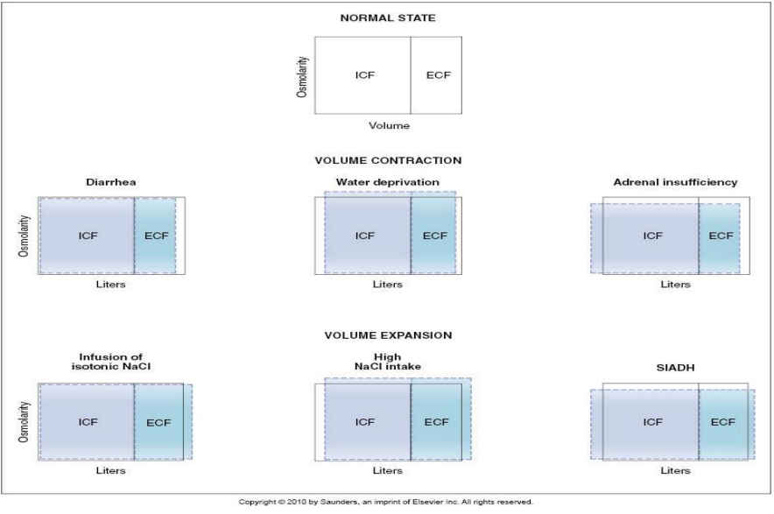
(Girls’ slides)

Slide 30
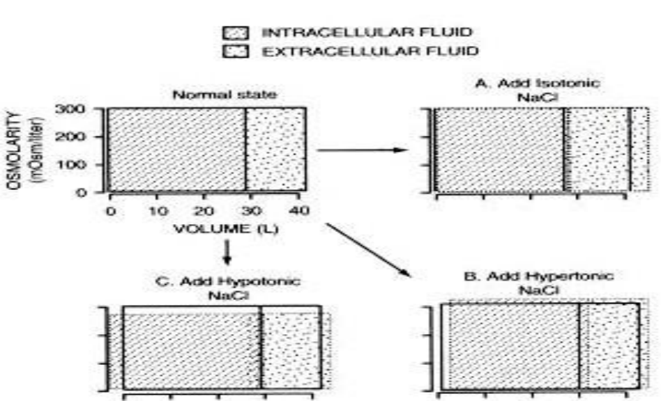
Effect of adding saline solution to the ECF

Slide 31
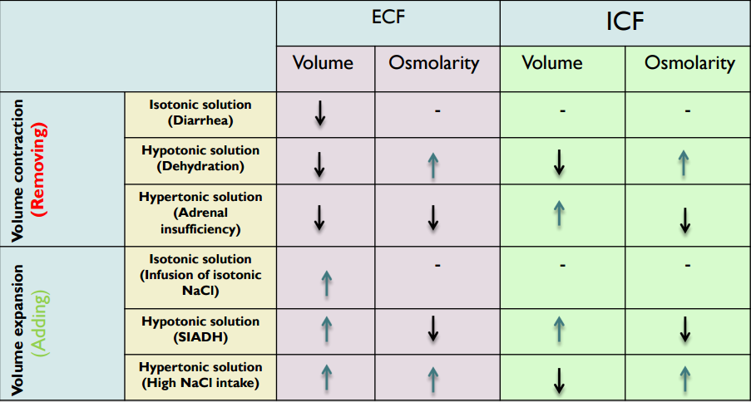
Revision (teamwork 345)

Slide 32
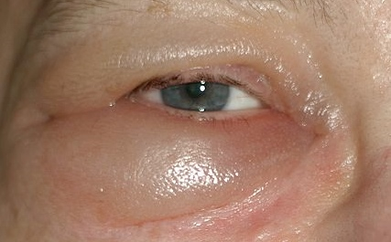
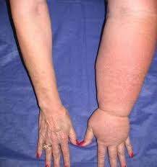
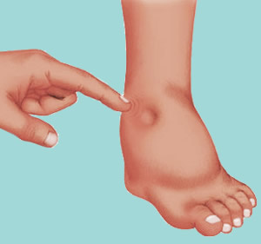
Oedema (Edema)
Oedema:
It is an Excessive fluid in the body tissues.
- Can be Extracellular or Intracellular.
- It occurs mainly in the ECF compartments.
- The common clinical cause is Excessive capillary fluid filtration.

Slide 33
Types Of Oedema
Intracellular Edema:
Extracellular Edema:
Inflammation of tissues
Heart failure
Membrane permeability
capillary pressure
Na inside cells
filtration.
water
Oedema

Slide 34
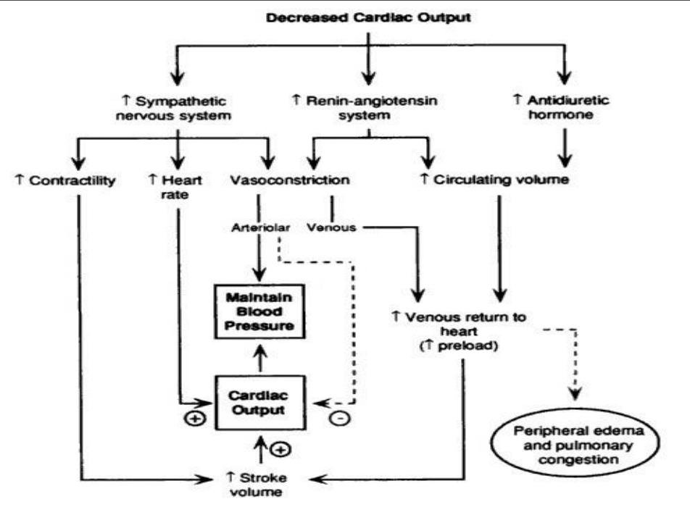
(Boys’ slides)

Slide 35
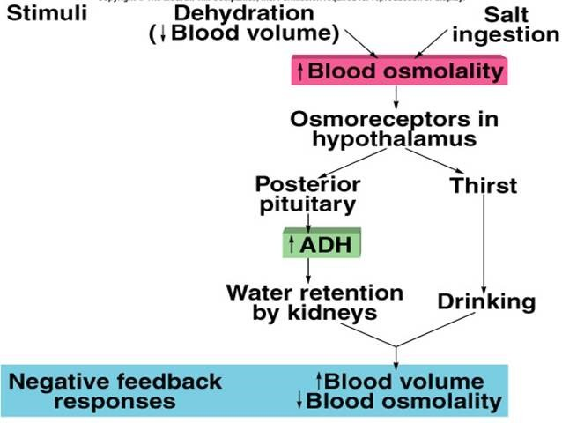
What are the feedback mechanisms operating in Fluid balance control?

Slide 36
Videos
Homeostatic Control Mechanisms : https://youtu.be/kCWCuztw1kk
Homeostasis Positive Feedback Control of Labor Pregnancy: https://www.youtube.com/watch?v=heWOEkjutHc
Homeostasis and Feedback Mechanism: https://m.youtube.com/watch?v=_obgJ2zc3ZU

Slide 37
Thank you!
اعمل لترسم بسمة، اعمل لتمسح دمعة، اعمل و أنت تعلم أن الله لا يضيع أجر من أحسن عملا.
The Physiology 436 Team:
Lina Alwakeel
Dina Aldossary
Rana Barassain
Heba Alnasser
Munira Aldofayan
Sara Alshamrani
Sundus Alhawamda
Ruba Ali
Rehab Alanazi
Norah Alshabib
Nouf Alaqeeli
Buthaina Almajed
Fahad Al Fayez
Ibrahim Al Deeri
Hassan Al Shammari
Abdullah Al Otaibi
Abdullah Al Subhi
Ali Al Subaei
Omar Al Babteen
Foad Fathi
Faisal Al Fawaz
Muhammad Al Aayed
Muhammad Al Mutlaq
Nasser Abu Dujeen
Waleed Al Asqah
Team Leaders:
Qaiss Almuhaideb
Lulwah Alshiha
Contact us:
Physiology436@gmail.com
@Physiology436

