Slide 1
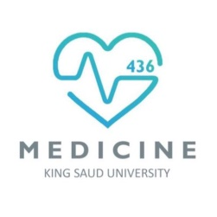
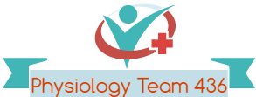
AUTONOMIC NERVOUS SYSTEM (1+2)
Red: very important.
Green: only found in males’ slides.
Purple: only found in females’ slides.
Gray: notes.
Physiology Team 436 – Foundation block – Lectures 6+7
Lecture: If work is intended for initial studying.
Review: If work is intended for revision.

Slide 2
Objectives
o Organization of the Autonomic Nervous System.
o Terminology. o Sympathetic Nervous System (SNS). o Neurotransmitters and Types of Receptors.
o Parasympathetic Nervous System.
o Autonomic Receptors. o a. Adrenoreceptors. o b. Cholinorecptors.
o Prototypes of Agonists and Antagonists to Autonomic Receptors.
o Sympathetic and Parasympathetic Tone. o Function of Adrenal Gland. o Examples of The Effects of Sympathetic and Parasympathetic.

Slide 3
Overview

Slide 4
Nervous System
Central Nervous System
Brain
Spinal Cord
Peripheral Nervous System
Motor
(Efferent)
Sensory
(Afferent)
Autonomic Nervous System
Somatic Nervous System
Sympathetic Nervous System
Parasympathetic Nervous System

Slide 5
Definitions
Afferent Nerve: sensory nerve that carries nerve impulses from receptors or sense organs toward the central nervous system.
Efferent Nerve: a nerve that conveys impulses toward or to muscles or glands.
(للربط : E: Exit Central Nervous System)
Neurotransmitters: A chemical substance, such as acetylcholine or dopamine, that transmits nerve impulses across a synapse.
Synapse: The junction across which a nerve impulse passes. (The process by which information/orders are transmitted)
From: an axon terminal
To: a neuron, muscle cell, or gland cell.
Ganglia : an encapsulated collection of nerve-cell bodies outside the CNS .
Neuron:
a specialized cell transmitting nerve impulses.
Sensory axon:
sensory nerve cell process, conducting impulses from the periphery toward the nerve cell body.
Motor axon :
single nerve cell process, conducting impulses from the nerve cell body toward a muse.
Note : Differentiate between
Afferent: إلى الجهاز العصبي المركزي
من الأعضاء
Efferent: من الجهاز العصبي المركزي إلى الأعضاء

Slide 6
Introduction
- The Central Nervous System (CNS) include of : The brain and spinal cord.
-The Peripheral Nervous System (PNS) Formed by:
neurons & their processes present in all the regions of the body.
- The Peripheral Nervous System (PNS):
Central Vs. Peripheral
Is a structural division of the nervous system
*Somatic vs. autonomic is a functional division of the nervous system.
• Somatic Nervous system
Autonomic nervous system (ANS)
Q) How does the Nervous System monitor and control almost every organ / system?
A) through: a series of positive and negative feedback loops.
-ANS is subdivision of the peripheral nervous system.
-PNS is consists of:
1- cranial nerves arising from the brain
2- spinal nerves arising from the spinal cord.
(الأعصاب مع إنهم يجون من المخ والسباينل كورد بس جزء من الطرفي)

Slide 7
Difference between Motor (Efferent) Pathways of Somatic vs. Autonomic
Composed of a special group of neurons serving:
Cardiac muscle (the heart)
Smooth muscle (walls of viscera and blood vessels)
Internal organs
Skin
Somatic NS
ONE motor-neuron (one axon) Sheathed in spinal nerves, extend all the way to their skeletal muscles.(نوع واحد من الخلايا العصبية يصل مباشرة إلى العضلات الهيكلية )
Autonomic NS
Chains of Two moto-neurons:
1- Pre-ganglionic (from CNS to the ganglion)
2- Post-ganglionic (cell body in ganglion outside CNS)
Control : Involuntary visceral organs (organs generally not under conscious control)
Has ganglia (Ganglia: a cluster of interconnecting nerve cells in the ANS)
Cell bodies of motor reside in CNS (brain & spinal cord )
Slower because its nerve fibers are either lightly-myelinated or unmyelinated.(
(Myelination: a mixture of proteins and phospholipids forming a whitish sheath around nerve fibers)

Slide 8
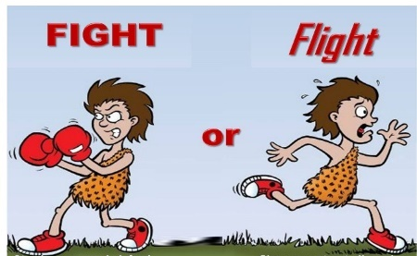
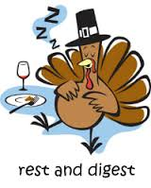
Sympathetic ANS vs. Parasympathetic
Autonomic NS
Sympathetic
Parasympathetic
Sympathetic and parasympathetic : anatomic terms.
Their anatomic origin is : preganglionic neurons in the central nervous system (CNS)
Parasympathetic = Peace.
Sympathetic = Stress.

Slide 9
Sympathetic & Parasympathetic both have Preganglionic fibers and Postganglionic fibers
ANS
activated by:
Center in spinal cord
Brain stem
Hypothalamus
operated by: visceral reflex
1- (PREganglionic) : Axon of 1st neuron leaves CNS synapse with the 2nd neuron (POSTganglionic) , myelinated nerve fiber
2- (POSTganglionic) : Axon of 2nd neuron extends to the organ it serves , unmyelinated nerve fibers
reflexes that occur in the soft tissue organs of the body. Example coughing, sneezing, swallowing and vomiting.
1
2

Slide 10
1- Sympathetic Nervous System (SNS)
1- SNS location : Originate from thoracolumbar lateral horns of the spinal cord segments (T1-L2~L3)
2- (SNS nerve fiber):
Preganglionic neurons: short , lightly myelinated
Postganglionic neurons: long , unmyelinated
3- SNS ganglia:
According to location:
paravertebral ganglia (sympathetic chain)
prevertebral ganglia
• Operates continuously to modulate (adjust) the functions of many organ systems
e.g; heart, blood vessels, gastrointestinal tract, bronchi and sweat glands
• Activated by: Stressful stimulation Which leads to a response called:
“fight or flight” /“E” division
(Exercise, Excitement, Emergency, and Embarrassment)
increased arterial pressure, blood flow, blood glucose, metabolic rate and mental activity
من T1-L2 لكن بعض المراجع مكتوب الى L3
T1 = Thoracic
L2~L3 = Lumber
Paravertebral Ganglia: (sympathetic chain): near vertebral body
على امتداد العمود الفقري. ( جنب العمود الفقري من الجهتين)
Prevertebral Ganglia: Ganglia between Paravertebral Ganglia and the target organ
near large blood vessel in gut :celiac ,superior mesenteric & inferior mesenteric

Slide 11
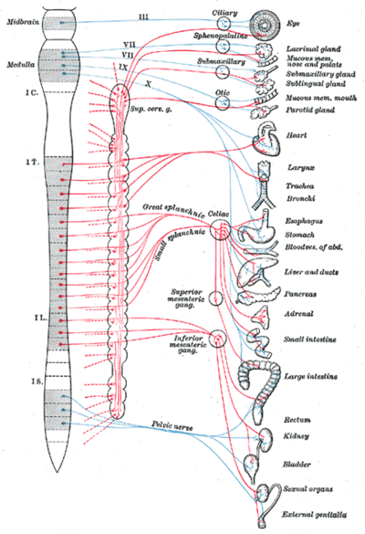
Thoracic and Lumbar Spinal Cord
Locations of Autonomic Ganglia
The picture is for clarification of location and origin only.
(Red: Symp – Blue: Parasymp)
لتوضيح الشريحة السابقة

Slide 12
2- Parasympathetic Nervous System
Responsible for activities that occur when the body is at rest “rest and digest”/ “D” division
(Digestion, Defecation, and Diuresis)
2-(SNS nerve fiber):
1- preganglionic neurons
has long axon
2- Postganglionic neurons
short axon
)Length of Pre and Post is Parasympathetic is the opposite of the sympathetic NS)
3- Ganglia :
in or on the affected organ:
Terminal ganglia
in the wall of organ
1- Location : Their fibers originate from
brain & sacrum (Craniosacral)
cranial nuclei Cell bodies of the motor nuclei of the cranial nerves III, VII, IX and X (3rd,7th.9th.10th) in brain stem (mid brain, pons, medulla)
sacral segments of the spinal cord (S2 -S4)
Gives: (cranio-sacral outflow)
(compare origin to Sympathetic)
axon | neurons
track | Nucleus | Inside CNS
Nerves | Ganglion | Outside CNS

Slide 13
Parasympathetic NS Cont.
The cranial nerves III, VII and IX affect the pupil and salivary gland secretion
Vagus nerve (X) carries fibres to the heart, lungs, stomach, upper intestine and ureter
The sacral fibres form pelvic plexuses which innervate the distal colon, rectum, bladder and reproductive organs.

Slide 14
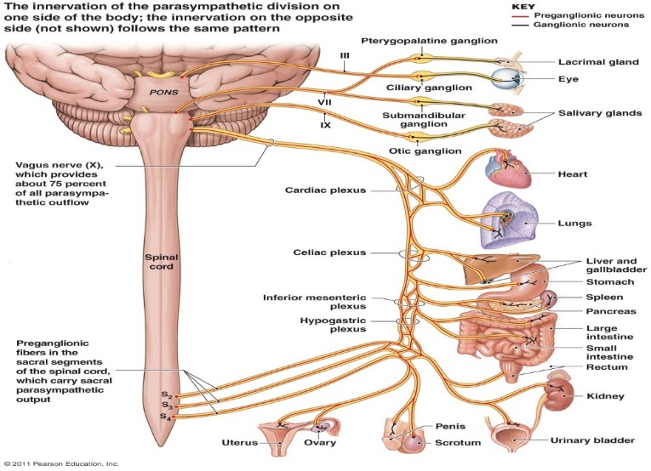
Parasympathetic origin
2
1- pre
2- ganglion
3- Post
1
3

Slide 15
The Autonomic Nervous System Functions 1
Structure | Sympathetic Stimulation | Parasympathetic Stimulation
Iris (eye muscle) | contracts the meridional fibers of the iris to dilate the pupil Meridional Fibers : longitudinal fibers of Ciliary muscle Ciliary muscles : ring of smooth muscles in eye’s middle layer | contracts the circular muscle (ciliary muscle) of the iris to constrict the pupil Iris : القزحية Dilate : يتوسع contract = constrict: يضيق
Salivary Glands | vasoconstriction of the blood vessels to the glands which causes reduction in their secretion. | It is Controlled by parasympathetic Increase their secretion
Oral/Nasal Mucosa | Mucus production reduced | Mucus production increased
Heart | Heart rate and force increased | Heart rate and force decreased
Lung | Bronchial muscle relaxed | Bronchial muscle contracted
Systemic Blood Vessels: & Arterial pressure : | Constricted (Increase the cardiac output and resistance to the blood flow and increase blood pressure) | No effect except in certain areas, such as blushing of the face. (by Decrease cardiac output)

Slide 16
The Autonomic Nervous System Functions 2
Structure | Sympathetic Stimulation | Parasympathetic Stimulation
Stomach | Peristalsis reduced | Gastric juice secreted; motility increased
Small Intes | Motility reduced | Digestion increased
Large Intes | Motility reduced | Secretions and motility increased
Liver | Increased conversion of glycogen to glucose
Kidney | Decreased urine secretion | Increased urine secretion
Adrenal medulla | Norepinephrine and epinephrine secreted
Bladder | Wall relaxed Sphincter closed عضلة دائرية مسؤولة عن حماية أو فتح أو إغلاق أنبوب (مثل الشرج) | Wall contracted (increases peristaltic contraction)(( حركة الأمعاء Sphincter relaxed
Sweat glands secretion: | increased by sympathetic stimulation. | No affect
decreases the activity of GI.
increases the activity of GI .
(Enteric nervous system: (it is the division of the nervous system that controls the function of the gastrointestinal system)

Slide 17
Autonomic Nervous System (ANS): Neurotransmitters & Receptors
#Adrenergic Neuron Vs. #Cholinergic Neuron
* Remmber: ANS motor pathway consists of two neurons:
Preganglionic neuron : inside CNS ( in brain or spinal cord )
Postganglionic neuron : outside CNS (cell body in ganglion outside CNS)
-Neurotransmitter:
Ach
-Cholinergic-Receptors:
1. Nicotinic
2. Muscarinic
Neurotransmitter:
norepinephrine
Adreno-receptors:
alpha 1
alpha 2
Beta 1
Beta 2
مهم
Cholinergic: Relating to nerve cells or fibers that use acetylcholine as their neurotransmitter
Note: they’re named after drugs they’re sensitive to

Slide 18
Sympathetic vs. Parasympathetic Receptors
In Sympathetic Nervous System
Pre receptor: Nicotinic
Post receptor: Adrenoreceptor except in sweat glands where it is Muscarinic
In Parasympathetic Nervous System:
Pre receptor: Nicotinic
Post receptor: Muscarinic
Because the ONLY neurotransmitter in parasympathetic: acetylcholine (Ach)
Sympathetic postganglionic neurons are “adrenergic” except in thermoregulatory sweat glands where they’re cholinergic and the receptor is Muscarinic

Slide 19
Autonomic Nervous System (ANS): Neurotransmitters & Receptors
All preganglionic neurons:
release Acetylcholine (Ach)
Therefore they’re ALWAYS Cholinergic neurons
PRE: Releases Ach which interacts with nicotinic receptors on the (cell body) of POST neurons
*During stressful conditions there is secretion of ? Epinephrine & norepinephrine .
Postganglionic neurons:
(norepinephrine)
Or (Acetylcholine),
either Cholinergic
Or
Adrenergic
Post: Adrenergic
EXCEPT IN thermoregulatory sweat glands where they’re Cholinergic and the receptor is Muscarinic
Because sweat gland release Ach in both pre&postganglionic

Slide 20
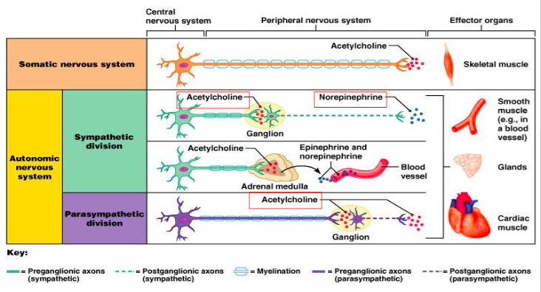
Neurotransmitters
(Spinal Cord)

Slide 21
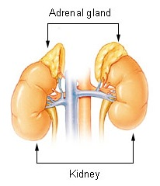
Function of Adrenal Gland
Adrenal gland triggers the Adrenal Medulla to release Epinephrine & Norepinephrine.
Stimulation of sympathetic nerves causes large quantities of Epinephrine and Nor-epinephrine to be secreted in blood by the Adrenal gland.
Adrenal medulla will stimulated during Sympathetic only
The effect of Epinephrine & Nor-epinephrine lasts 5-10 times more than the ones which are secreted from sympathetic.
Epinephrine = Adrenaline
Nor-Epinephrine = Nor-Adrenaline
Adrenal gland = الغدة الكظرية

Slide 22
Adrenoreceptors
alpha1 | Found in vascular smooth muscle, gastrointestinal sphincters and bladder, radial muscle of iris Function: contraction of all these organs “leads to smooth muscle contraction ”
beta1 | Existing in : 1) sinoatrial node(S.A node): increases heart rate 2) Atrioventricular node(A.V node) increases conduction velocity 3) Ventricular muscles: increases contractility 4) Salivary gland: increases secretion (but enzymes production) “leads to smooth muscle contraction (especially in heart)
beta 2 | found in vascular smooth muscle wall of bladder, and wall of GI. Activation of β2 is relaxation β2 is more sensitive to Epinephrine than Nor-epinephrine “ leads to smooth muscle relaxation “
alpha 2 has the same function as alpha 1 and is rarely found in the human body.

Slide 23
Alpha 1

Slide 24
Beta 1-2

Slide 25
Cholinoreceptors
Nicotinic | Function: an ion channel for Na+ and K+ on all postganglionic neurons motor end plate at skeletal muscle and chromaffin cells .
Muscarinic | Works either like a1 adrenoceptors via PKC, DAG and IP3 Or via G protein (which has a1 subunit that binds K+ channel and open it)
DE-POLARIZATION :
A change in a cell's membrane potential that makes it more positive (allowing Na+ to enter the cell or closing K+ pump)
Excites action potential
Hyper-polarization:
is a change in a cell's membrane potential that makes it more negative. (opening K+ channels for it to leave) It inhibits action potentials.
Nicotinic receptors work as activators (cause depolarization = excitation) by allowing Na+ to enter the cell.
Muscarinic receptors can cause
-Hyperpolarization= inhibition by opening K+ pump
-Or Depolarization= excitation by closing K+ pump
IP3 (Inositol trisphosphate) / DAG ( Diacylglycerol) / PKC (Protein kinase C)

Slide 26
Cholinorecepters
#Remember: concentration of Na+ is higher out of the cell and the concentration of K+ is higher in the cell
To help you memorize:
The cell asks more Sodium (Na) to come in but it says “Nah” then Potassium (K) says “oK” and enters!

Slide 27
Summary of ANS
Subdivision | Nerves Employed | Location of Ganglia | Chemical Messenger | General Function
Sympathetic | Thoracolumbar | Alongside vertebral column | Norepinephrine | Fight or flight
Parasympathetic | Craniosacral | On or near an effector organ | Acetylcholine | Conservation of body energy

Slide 28
Prototypes of Agonists and Antagonists to Autonomic Receptors
Receptor | Agonists | Antagonists
Adrenoceptors
α₁ | Norepinephrine | Phenoxybenzamine
 | Phenylephrine | Prazosin
α₂ | Clonidine | Yohimbine
β₁ | Norepinephrine | Propranolol
 | Isoproterenol | Metoprolol
β₂ | Epinephrine | Propranolol
 | Isoproterenol | Butoxamine
 | Albuterol
Cholinoreceptors
Nicotinic | ACh | Curare
 | Nicotine Carbachol | Hexamethonium (blocks ganglionic receptor but not neuromuscular junction)
Muscarinic | ACh | Atropine
 | Muscarine

Slide 29
NOTES
Agonist : A drug (or other chemical substance) that combines with a receptor on a cell to produce a physiologic reaction.
Antagonist : is a chemical substance that interferes with the physiological action of another, especially by combining with its nerve receptor and blocking it.
ملاحظة عن الجدول السابق: الدكتور لمح لنا إن الأساسيات من الأقونست والأنتاقونست هي بس للحفظ. حطيناها باللون الأحمر
ملاحظة ثانية: الجدول مب جاي بالترتيب يعني مثلا نورابينيفرن مب بس الاقنست حق الفا ١. يمديه يشتغل مع كل الريسيبتورز

Slide 30
Sympathetic and Parasympathetic Tone
Their role is to keep the stimulated organs in normal stage.
Examples:
Sympathetic always keeps the blood vessel constricted ½ of its normal diameter.
removal of vagus nerve atony loss of peristalsis (contraction of small intestine) constipation.
Atony: loss of tone

Slide 31
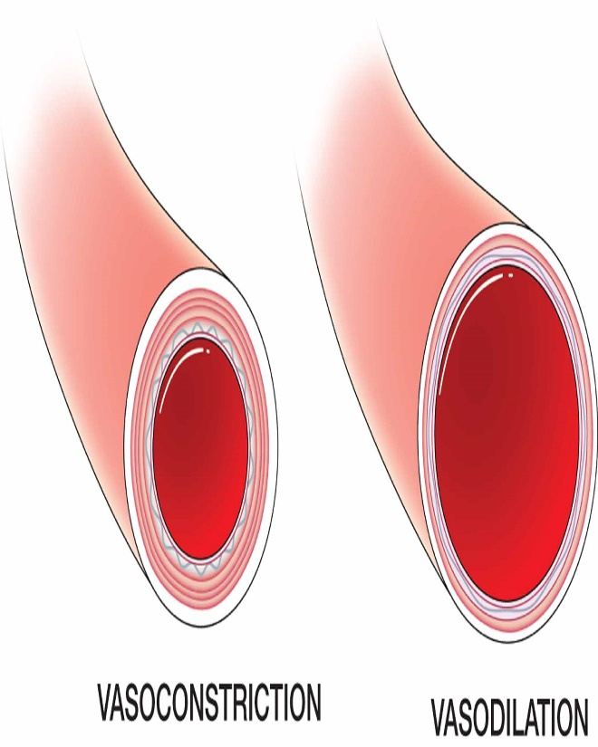
Effect of loss of sympathetic and parasympathetic tone after denervation
Loss of sympathetic tone in blood vessel causes severe vasodilatation but after sometime, intrinsic tone increases by chemical adaptation.
Severe vasodilation:توسع حاد بالأوعية
Intrinsic: منتمي إلى هذا العضو- (هنا نقصد منتمي إلى الأوعية الدموية)

Slide 32
Autonomic Reflexes
Most of the visceral functions of the body are regulated by autonomic reflexes.
Cardiovascular | Gastrointestinal (GI) | Urinary Bladder | Sexual Reflexes
Baro-receptor reflex: - It is a stretch reflex in the main arteries (such as carotid artery) to detect the blood pressure. | The receptors in the nose and mouth send a signal to parasympathetic -to notify the glands of mouth & stomach to secrete the digestive juices. | Initiate the micturition (urination) by parasympathetic innervations. | - erection by parasympathetic. - ejaculation by sympathetic.

Slide 33
Autonomic Reflexes. Example: Urinary Bladder
Filling the bladder:
Detrusor muscle:
B2 is activated: relaxed (increase filling)
Internal sphincter:
A1 is activated : contracted
External sphincter (voluntary): contacted
Emptying of the bladder:
Detrusor muscle: Muscarinic receptor is activated: contraction
Internal sphincter: Muscarinic receptor is activated: relaxation
External sphincter (voluntary): relaxed
Filling the bladder is controlled by Sympathetic Nervous System. Emptying the bladder is controlled by Parasympathetic Nervous System

Slide 34
Autonomic Reflexes
Sympathetic activation:
Occurs in isolated portions such as:
heart regulation.
many sympathetic reflexes that regulate G.I. functions.
Parasympathetic:
Usually: The effect of parasympathetic is specific to a certain organ. (specific localized responses)
But sometimes parasympathetic activity has a common effect: affects the functions of some organs together.
Example: rectal emptying and bladder emptying, salivary secretion and gastric secretion.
- Sympathetic can deal with every single organ alone. - Parasympathetic can do that, but sometimes not, should be two processes together.

Slide 35
THE STRESS REACTION
When stress occurs, the sympathetic nervous system is triggered. Norepinephrine is released by nerves, and epinephrine is secreted by the adrenal glands. By activating receptors in blood vessels and other structures, these substances ready the heart and working muscles for action.
Acetylcholine is released in the parasympathetic nervous system, producing calming effects. The digestive tract is stimulated to digest a meal, the heart rate slows, and the pupils of the eyes become smaller. The neuroendocrine system also maintains the body’s normal internal functioning.

Slide 36
Chronic stress
When glucocorticoids or adrenaline are secreted in response to the prolonged psychological stress commonly encountered by humans, the results are not ideal. Normally, bodily systems gear up under stress and release hormones to improve memory, increase immune function, enhance muscular activity, and restore homeostasis. If you are not fighting or fleeing, but standing frustrated in a supermarket checkout line or sitting in a traffic jam, you are not engaging in muscular exercise.
Yet these systems continue to be stimulated, and when they are stimulated chronically, there are different consequences: Memory is impaired, immune function is suppressed, and energy is stored as fat.

Slide 37
Response to stress

Slide 38
Important question (team 435)
What is the Neurotransmitter of the sympathetic NS ?
(in general) Norepinephrine ( Noradrenaline)
What are the Neurotransmitters that released during sympathetic stimulation?
Norepinephrine & Epinephrine.
What is the Neurotransmitter that released at the Preganglionic fiber during sympathetic stimulation ?
Acetylcholine ( Ach ).
What is the Neurotransmitter of the parasympathetic stimulation ?
Acetylcholine (Ach).
What are is Neurotransmitter of the Preganglionic fiber during parasympathetic stimulation ?
Acetylcholine (Ach).
Quiz : https://www.onlineexambuilder.com/autonomic-nervous-system-physiology/exam-37006

Slide 39
Thank you!
اعمل لترسم بسمة، اعمل لتمسح دمعة، اعمل و أنت تعلم أن الله لا يضيع أجر من أحسن عملا.
The Physiology 436 Team:
Lina Alwakeel
Rana Barassain
Heba Alnasser
Munira Aldofayan
Sara Alshamrani
Sundus Alhawamda
Ruba Ali
Rehab Alanazi
Norah Alshabib
Nouf Alaqeeli
Buthaina Almajed
Alaa Alaqeel
Fahad Al Fayez
Ibrahim Al Deeri
Hassan Al Shammari
Abdullah Al Otaibi
Abdullah Al Subhi
Ali Al Subaei
Omar Al Babteen
Foad Fathi
Faisal Al Fawaz
Muhammad Al Aayed
Muhammad Al Mutlaq
Nasser Abu Dujeen
Waleed Al Asqah
Team Leaders:
Qaiss Almuhaideb
Lulwah Alshiha
Contact us:
Physiology436@gmail.com
@Physiology436

