Slide 1
BLOOD PHYSIOLOGY (1+2) Control of Erythropoiesis, Iron Metabolism and Hemoglobin (3)
Red: very important.
Green: only found in males’ slides.
Purple: only found in females’ slides.
Gray: notes.
Physiology Team 436 – Foundation block lectures 8+9+10
Lecture: If work is intended for initial studying.
Review: If work is intended for revision.

Slide 2
Objectives
Describe : physical and chemical characteristics of blood
Describe: Cellular and non-cellular blood components
Describe: different stages of RBC differentiation.
Describe: features of RBC maturation
Describe: regulation of RBC production and erythro-poietin hormone secretion in response to hypoxia.
Describe: essential elements needed for RBC formation
Describe: the process of Vitamin B12 absorption and its malabsorption.
Describe: the fate of old RBC.
Describe: anemia and its causes
Recognize: blood functions.
Recognize: clinical conditions associated with high level of erythropoietin in the blood.
Recognize: sites of RBC formation at different developmental age.
Recognize: the causes of polycythemia.
Define: Erythro-poiesis; leuco-poiesis, thrombo-poiesis.
Recognize: hemoglobin structure and its functions.
Discuss: Iron metabolism (absorption, storage and transport).
Describe essential elements needed for RBC formation.
Describe the process of Vitamin B12 absorption and its malabsorption .
Recognize hemoglobin structure and its functions .
Discuss iron metabolism (absorption,storage and transport) .
Describe the fate of old RBC .
Describe anemia and its causes .
Recognize causes of polycythemia .
Understand steps of erythropoiesis & its regulation .

Slide 3
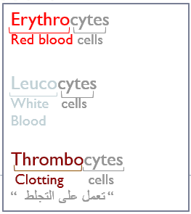
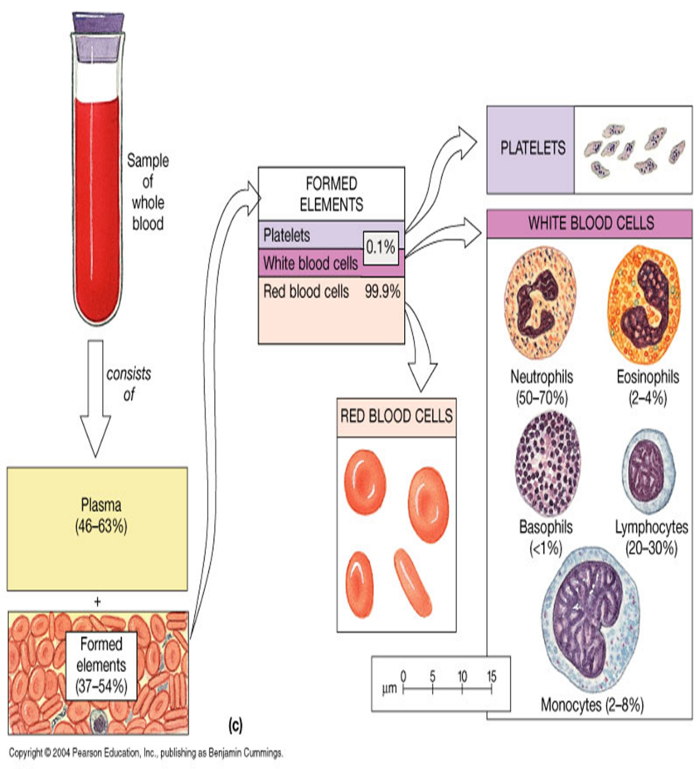
Blood Composition
1.Cellular components:
Red Blood Cells(Erythrocytes)
White BloodCells(Leucocytes)
Platelets (Thrombocytes)
2. Plasma (ECF):
98% water + ions + plasma proteins e.g. (Albumin, globulin, Fibrinogen)
#notice: it’s the same ionic composition as interstitial fluid. (Na, K, PO4, etc)
NOTE: red blood cells are in millions
white blood cells are in thousands.
Platelets are hundred thousands
Note: in males’ slides water is 92%, ions are 7%, and proteins are 1%

Slide 4
Characteristics of Blood
Viscosity
3-4 times than Water.
pH
Slightly alkaline, with a pH of 7.35-7.45.
Temperature
about 37C (slightly higher than normal body temp).
Blood relative viscosity: (4-5) mainly depends on the numbers of RBC.
Plasma relative viscosity: (1.6-2.4) is mainly involved in plasma protein.
It has a salty metallic taste and is Sticky.
Hb acts as blood buffer.
Color
Bright red = O2 rich;
Osmolarity
Plasma osmolality is about 300 mmol/L (Equal to 0.9% NaCl Solution=Isotonic).
Regeneration
Tremendous regenerative capacity.
Dull red = O2 poor

Slide 5
Characteristics of Blood
Plasma osmotic pressure:
Is 300 mmol/L or 770kPa
Specific gravity:
Total blood: (1.050-1.060) more influenced by RBC.
Erythrocyte sedimentation rate (ESR)
Crystal osmotic pressure: results from NaCl and modulates water distribution between inside and outside cells.
Colloid osmotic pressure: results from albumin and regulates water distribution between inside and outside of capillaries.
Plasma: (1.025-1.030) more influenced by plasma protein.
RBC: (1.090-1.092) more influenced by hemoglobin.
It the red blood cell descending distance per hour.
Normal male 0¬15mm/h.
Normal Female 0¬20mm/h.

Slide 6
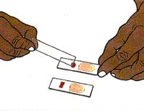
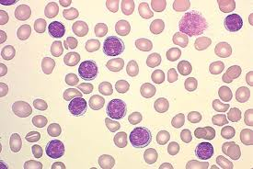
Blood Film
نقطه دم نضعها على الشريحه الأولى ثم نحضر شريحه أخرى ونسحب الدم قليلا ( مثل المناكير لما تسحبينه بالفرشه ).
نستفيد من الـBlood Film :
القدرة على معرفة لو كان هناك انيميا او لا وشكل الـCells
ونستطيع أيضا أن نرى الـWhite blood cells وكم عددها.

Slide 7
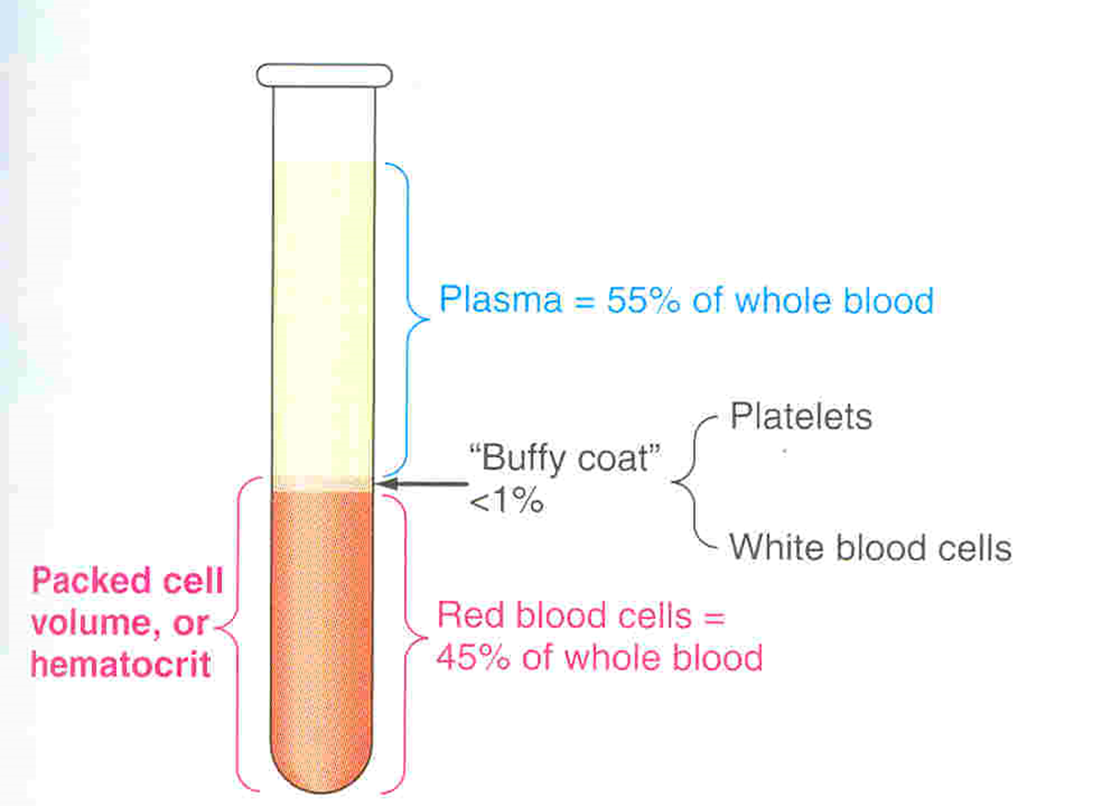
Blood Volume
The volume of blood cells in a sample of blood after it has
been centrifuged (separation of contents).
45% is packed cells volume (PCV).
5 liter in adult
55% is plasma volume.
Plasma: Straw colored liquid that serves as a transport medium for blood and platelets.
It is called Serum when fibrinogen (coagulating factor) is removed after coagulation.
Plasma contains: Electrolytes, clotting factors, antibodies, blood gases, nutrients, and wastes.
Males => 5 to 5.5 L
Females => 4 to 4.5
Because females lose every month half a liter of blood due to menstruation
Ratio of the volume of red blood cells to the total volume of blood.
يساعدنا في التشخيص أشياء كثير زي الانيميا.

Slide 8
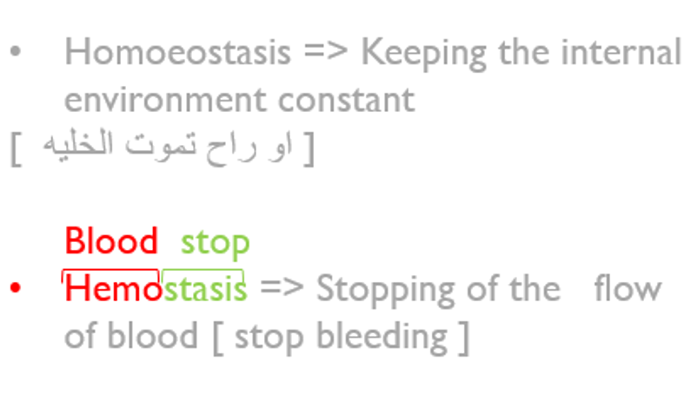
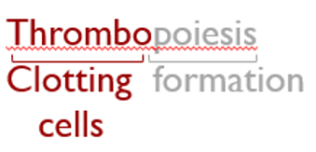
Functions of the Blood
Formation of Blood Cells:
Haemopoiesis
1. Transport
Respiration: O2, CO2
Trophic: nutrients to the tissue
Excretive: waste products (metabolites) from tissues to excretory organs
Regulative: hormones
2. Homoeostasis
Regulation of:
1) Body temperature by redistributing blood between skin and internally
2) ECF pH
Erythro-poiesis:
Formation of RBC (erythrocytes)
Leuco-poiesis:
Formation of WBC (leucocytes)
Thrombo-poiesis:
Formation of platelets (thrombocytes)
3. Protecting against Infections:
White Blood Cells, Antibodies
4. Blood clotting: to prevent
blood loss
* Note: Active cellular marrow is called red marrow; inactive marrow that is infiltrated with fat is called yellow marrow.
Cyte: Mature cell
Blast: Still not mature cell

Slide 9
Red Blood Cells (RBCs)
الوحدات غير مهمه. مو مهم نعرفها لما تجي بالاختبار يجيبون كل الخيارات نفس الوحده. لكن الارقام حفظ.
Transport of: O2 and CO2
Buffer (keeps pH level at 7.4)
Functions
لان الدم فيه هيموجلوبين فهو يحاول يوازن الـ pH
ثلاث مزايا بشكل الـRBCs مهمه جداً :
Flexible so it can go through the capillaries.
Flat biconcave is the best shape to let the gases exchange easily.
Storage: the shape of the RBCs can store big amounts of RBCs so it allows more gas exchange. زي اثاث ايكيا
Shape & Size
Flat Biconcave Disc
Non-nucleated
No mitochondria
Flexible
Diameter 7-8µmx2.5µmx1 µm.
Average volume 90-95 µm3
Number = 4.7 - 5 x106
Hb = 14-16 g/dl in the blood
It is negatively charged
لزيادة مساحة السطح.
وجود النواة في الRBC تلزم في حالة تصنيع البروتين (الهيموجلوبين ), و”بعد النضج التام “تختفي النواة لتنقل أكبر كمية من الاكسجين – على الهيموجلوبين- وبكفاءة اعلى.
هذا عند الـMales
عند الـ Females أقل بسبب الدورة الشهرية.

Slide 10
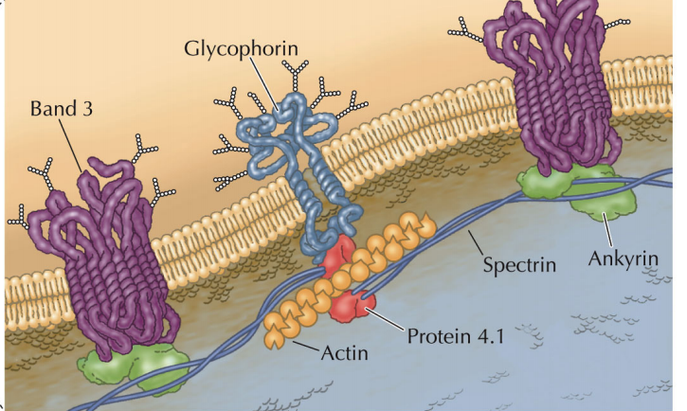
Red Blood Cells Cytoskeleton
Skeletal protein network
• Spectrin
• Actin
• Ankyrin
• Tropomyosin
• Proteins 4.1 and 4.9
The red cell, as it continuously circulates, must be able to undergo extensive passive deformation and to resist fragmentation. These two essential qualities require a highly deformable yet remarkably stable membrane. Blood cells that lyse(breakdown) without difficulty at low ionic strength are a sign of Hereditary Spherocytosis.

Slide 11
RBCs Enzyme- Carbonic Anhydrase
Carbonic anhydrase is an enzyme that catalyzes the reversible reaction between carbon dioxide (CO2) and water to form carbonic acid (H2CO3), increasing the rate of this reaction several thousand fold. It plays a major role in CO2 transport.

Slide 12
Production of RBCs
RBCs are only nucleated in fetus
In-utero:
Early few weeks (1st 4 months) : embryo nucleated RBCs are formed in yolk sac. (nucleus is needed for division)
Middle trimester: mainly in liver & spleen & lymph nodes.
After Birth:
Bone marrow of flat bones (e.g. scapula, skull,..) continue to produce RBC into adult life.
In children: all bones produce RBCs until 5 years old.
Shaft of long bones stop producing RBC at puberty while epiphysis continues.
Last months: RBCs are formed in bone marrow of all bones
In adults: after 20, membranous bones such as vertebrae, sternum, ribs, and ilia produce RBCs

Slide 13
Production of RBC in utero

Slide 14
Note: Children need RBC more than adults for their growth.

Slide 15
As mentioned in the previous slide: (After birth)
-Flat bones (Sternum, Ribs) and the Vertebras (Irregular bones) continue to produce RBCs.
-Shafts of long bones (Femur, Tibia) stop producing RBCs after puberty.
Production of RBC

Slide 16
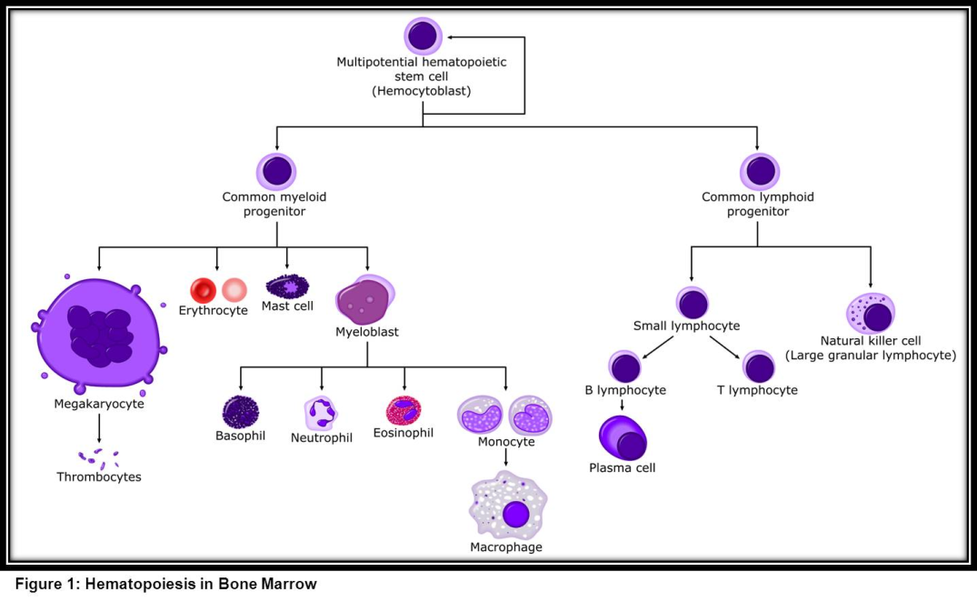
شرح محتوى الصورة:
All blood cells are formed
from (stem cells)
stem cells have two paths:
1- First Path:
“ myeloid“ ➡ that forms
RBCs + some types of WBCs +
2-Second Path:
“ lymphoid“ ➡ that forms lymphocytes (another type of WBC)
*Lymphocytes are always special ;)*
Multipotential = Pluripotent
نفس المعنى
Found in bone marrow and cord blood
There are different growth factors
Note: Stem cells can differentiate into a lot of different cells.
Myeloblast gives white blood cells.

Slide 17
Genesis (Production) of RBCs
Pluri-potential hemato-poietic stem cells: give rise to (create) all the other blood cells
committed cells
Committed stem cells for RBC
Committed stem cells for WBC
Growth of different stem cells are controlled by different growth factors
Note
Colony-Forming Unit CFU:
cells produce colonies of their own type

Slide 18
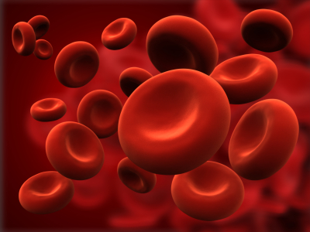
Stages of RBCs Differentiation (development): 7 Days
Committed stem cell:
Proerythro-blast (first identifiable cell)
Basophil erythro-blast
Poly-chromatophil erythro-blast
Ortho-chromatic erythro-blast
Reticulocytes (loses nucleus)
Mature erythrocytes
In cases of rapid *fast* RBC production →
↑ reticlocytes in the circulation
Reticulocytes: First cell to appear in Circulation Matures in 24-48 Hours.
Contain remnants of the Golgi apparatus & mitochondria.
Note: RBC goes into stages to get its concave structure, Reticulo-cyte is the stage where the cell loses its nucleus and is covered by a net.

Slide 19
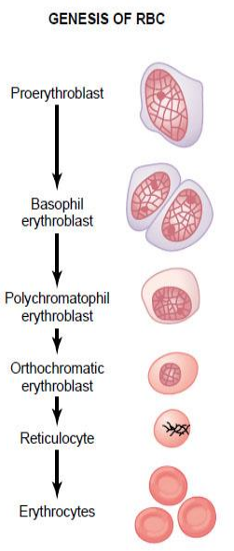
Erythro-poiesis
RBC development is characterized by
Decrease (Reduction) in cell size.
Disappearance of nucleus.
Appearance (Aquisiton) of hemoglobin (Hb)
تختفي النواه عشان الهيموجلوبين حل محل النواة
Memorize steps and shapes in the figure.

Slide 20
Regulation of RBC Production
Erythro-poiesis
stimulated by: erythro-poietin hormone
(which is produced by: the kidney in response to hypoxia (low oxygen in the blood)
لما يكون مستوى الاوكسجين في الدم قليل (وهذا يسمىhypoxia ) تروح الـ kidney تفرز هرمون اسمه Erythropoietin عشان توازن الـ Erythropoiesis
Causes of Hypoxia
Low RBC count (Anaemia)
Hemorrhage
High altitude
Prolong heart failure
Lung disease
الجو مافيه اوكسجين كثير زي فوق الجبال
القلب مايقدر يوزع الدم
نزيف

Slide 21
Tissue oxygenation and RBC formation

Slide 22
Erythro-poietin (Hormone)
Glycoprotein
90% from renal cortex (kidney)
10% from the liver.
Stimulate: the growth of early stem cells.
Does not affect: maturation process of RBCs.
Can be measured in plasma & urine.
Conditions like: anemia, High altitude, Heart failure, Lung Disease result in:
High erythropoietin levels polycythemia
Polycythemia = RBCs level is up Erythropoietin => works when RBCs level is down
أي كلمه تنتهي بمقطع mia
معناها زياده
The hormone controls the early stages of RBC formation (production of proerythroblasts from stem cells), not the middle or last stages, so erythropoietin makes the cells pass more rapidly through the erythroblastic stages and can increase it to 10 or more times than normal.

Slide 23
Role of the kidneys in RBC formation:
Healthy kidneys produce a hormone called erythropoietin and prompts the bone marrow to make red blood cells, which then carry oxygen throughout the body.
Kidney stimulate the production of Erythropoietin

Slide 24
Essential Elements for Formation and Maturation of RBCs
ملاحظة للفهم:
Hemo-globin: Heme: iron. Globin: protein
Other :Vit B6, Riboflavin, nicotinic acid, biotin, Vit C, Vit E
Amino acids (Proteins)
Formation of globin in hemoglobin
Iron
Formation of Hemoglobin.
Heme Synthesis.
Vit C
Iron absorption
Vit B6
RBC Synthesis
Deficiency lead to:
normochromic
normocytic Anaemia
deficiency lead to:
Iron Deficiency
Vitamins: B12 and Folic Acid
Synthesis of nucleoprotein. Synthesis of DNA Cell division
RBC Final maturation
Deficiency leads to
Hormones:
Androgens, Thyroid, cortisol & growth hormones.
Deficiency lead to Anemia.
Essential elements:
Copper, Cobalt, zinc, manganese.
Anemia and Hemoglobino-pathy
Micro-cytic and
hypochromic Anemia
Megaloblastic (macrocytic)
Anemia

Slide 25
Most of this slide is found only in females’ slides.
Vitamin B12 & Folic acid
Important for DNA synthesis and final maturation of RBC.
(Important for all stages of maturation of RBCs)
Dietary source: meat, milk, liver, fat, green vegetables.
Deficiency Leads to
In shape:
Abnormally large & oval shape RBC
In count:
Reduced RBC
count & Hb
(in erythropoiesis)
Failure of:
-nuclear maturation
-division
Type of Anemia:
Macrocytic (megaloblastic) anemia
Short life span

Slide 26
Anemia: Deficiency of hemoglobin.
MACROcytic (Megaloblastic) Anemia
MICROcytic hypochromic Anemia
It is caused by the deficiency of vit B12 and Folic Acid
The RBC's are smaller than normal
Have an increased zone of central pallor.
Increased anisocytosis )variation in size)
Increased poikilocytosis (variation in shape)
Causes: Iron deficiency and Thalassemia.
Note
1- The hyper-segmented Neutrophil (WBC)
2- The RBC are almost as large as the lymphocyte (WBC).
3-There are fewer RBCs.
Most of this slide is found only in females’ slides.

Slide 27
Microcytic hypochromic anemia
MCV: the average volume of RBCs.
MCH: the average mass of hemoglobin per RBC.
smaller size of each RBC
less hemoglobin in each RBC
(MCV<80 fl)
(MCH<27pg)
من تيم 435

Slide 28
This slide is found only in females’ slides.
Mal-absorption of vit.B12
Causes of deficiency
Poor absorption due to Intestinal
disease
Inadequate intake
Pernicious Anemia
الـ Stomach فيه الـ parietal cells وهي اللي تطلع لي الـ Intrinsic factor
VB12 absorption needs intrinsic factor secreted by parietal cells of stomach خلايا جدار المعدة
VB12 + intrinsic factor is absorbed in the terminal Ileum.
لازم الـ VB12 يكون ماسك بالـIntrinsic factor عشان تمتصه .
Terminal ileum = اخر حته في
Small intestine الـ
Poor absorption = decrease in intrinsic factors

Slide 29
Iron Metabolism (Fe):
Iron is needed for the synthesis of hemoglobin, myoglobin cytochrome oxidase, peroxidase & catalase.
Total Iron in the body = 3-5 / 4-5g
65% - 75%.. Haemoglobin (3g)
5% …….. other hems
1% ……. bound to transferrin (betaglobulin) in blood
15-30% …… stored iron in the form of ferritin in the liver, spleen and bone marrow.
Note: Females’ Slides
4% …….. Muscle Hb (myoglobin)
1% ……. Enzymes (cytochrome)
0.1% ……… Plasma iron: (transferrin)
Note: Males’ Slides

Slide 30
عشان كذا لما ناخذ iron ينصحون نشرب معه عصير برتقال (فيتامين سي ) ليه؟ لانه يساعد بالامتصاص
اللي عندهم Stomach diseases عندهم Decrease in vitC ما يقدرون يمتصون الـ iron كويس.
Iron Absorption:
Iron in food is mostly in oxidized form (Ferric, F⁺³)
Better absorbed in reduced form (Ferrous, F⁺² )
Iron in stomach is reduced by gastric acid, Vitamin C.
What does rate of iron absorption depend on?
-The amount of iron stored.
When does rate of iron absorption decrease?
- when iron stores are saturated (When all the apoferritin is saturated).
Vitamin C يساعد في الامتصاص
-Ferritin: intracellular iron-storage protein
-Ferritin that is not combined with iron is called apoferritin.

Slide 31
Transport and Storage of Iron
Iron transportation:
in plasma in the form of Transferrin (apotransferrin + iron).
Normally 30-40 saturated with Fe: (plasma iron 100-130ug/100ml)
When transferrin is 100% saturated with Fe:( plasma iron 300ug/100ml)
Iron storage:
Ferritin : (apoferritin + iron) (Loose bond)
Haemosiderin : insoluble complex molecule, (Ferritin + Ferritin) (Firm bond)
Sites : liver, spleen & bone marrow
Daily loss of iron is 0.6 mg in male & 1.3mg/day in females.
Diet provides 10-20 mg iron per day.
Haemosiderin: Iron storage complex only found in cells (not in circulating blood) appears to be
a complex of ferritin. 2. denatured ferritin. 3. other material.
(not a good supplier of iron when needed)
نفقد الـ Iron عن طريق جرح بالجلد أو قص الأظافر والشعر

Slide 32
Iron excretion
Iron losses
feces: unabsorbed, dead epithelial cells
bile and saliva.
Skin: cell, hair, nail, in sweat.
Urine
Menstruation, pregnancy and child birth

Slide 33
Destruction of RBCs
RBC life span in circulation = 120 days.
Metabolic active cells.
Old cells have a fragile cell membrane, the cell will rupture as it passes in narrow sinusoidal capillaries of the spleen, bone marrow & liver.
Released Hb is taken up by macrophages in liver, spleen & bone marrow:
Hb is broken into its component:
Polypeptide amino acids amino acid pool (protein pool = storage).
Haem:
Iron recycled (reused) iron storage (ferritin form).
prophyrin biliverdin bilirubin (secreted by the liver into bile) (excess destruction of RBC can cause Jaundice)

Slide 34
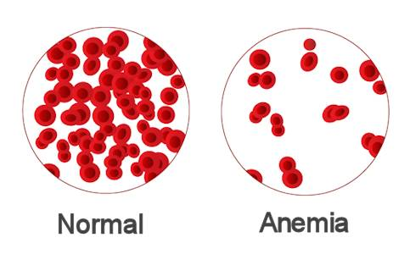
Anemia:
Definition
Decrease number of RBC
Decrease Hb
Normal ranges of Hb:
Men: Hb 13.5 to 17.5 g/dL
Women: Hb 12.0 to 15.5 g/dL
Infants : Hb 14 – 19 g/dL
Symptoms:
Fatigue
Tired
Dyspnea
(shortness of breathing)
Pallor
Tachycardia
heart failure.
Greek word (an-haîma) meaning "without blood"

Slide 35
Causes of Anemia
Causes of anemia
3.Haemo-lytic (excessive destruction)
1- Blood loss
Acute ➡ accident
(RBC return to normal in 3 to 6w)
Chronic ➡ microcytic hypochromic anemia (ulcer, worms)
Abnormal cells or Hb
Spherocytosis
sickle cells
Erythroblastosis fetalis
2- Decrease RBC production
Incompatible blood transfusion
1- Nutritional causes
Iron ➡ microcytic Hypochromic anemia
Vit B12 & Folic acid ➡ megaloblastic anemia
2- Bone marrow failure:
Destruction by cancer, radiation, drugs ➡ Aplastic anaemia.
Spherocytosis =
مشكله بالـ cell membrane تتكسر الـ RBCs بسرعه.
Sickle cells = تغير في شفره وحده فحدثت طفره , وراثي.
Incompatible blood transfusion =
لما يُنقل للشخص دم غير مناسب
Acute = حاد
Chronic = يفقد الدم على فترات زي الدوره الشهريه مثلاً + اللي عنده قرحه بالمعده , بواسير , ديدان بالامعاء

Slide 36
Hct (Hematocrit): is the volume or percentage of RBC in the blood.
Hgb : Hemoglobin
حجم ال RBCs طبيعي ولكن زيادة حجم البلازما أدت الى تقليل Hct .

Slide 37
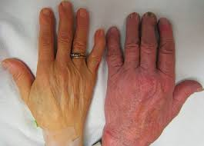
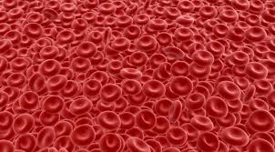
Polycythemia
Polycythemia
“Increased number of RBC or high concentration of Hb (hemoglobin) in the RBCs”
Primary (Polycythemia Rubra Vera - PRV):
uncontrolled RBC production.”
Secondary to hypoxia: high altitude (physiological), chronic respiratory or cardiac disease
Types :
True
Absolute
Hypoxia = نقص الاوكسجين
Primary = بالمناعه (
عند النساء اكثر ) يصير الجلد محمر.
Secondary =
يعني لما يصير hypoxia يحدث polycythemia بمعنى يحدث
نتيجة لسبب اخر , زي هنا يقل الاوكسجين فيحدث Polycythemia

Slide 38
Polycythemia Cont.
Polycythemia is either caused by:
1- Increase in RBC, therefore, increase in hemoglobin.
2- Increase in hemoglobin content of RBC WITHOUT increase in RBC count.
3- Decrease in plasma therefore hemoglobin is more dominant and apparent.
End result always: an increase in hemoglobin.
Relative:
Haemoconcentration
» loss of body fluid in vomiting, diarrhea and sweating.
Note: Polycythemia is always due to an ABNORMAL increase or decrease.

Slide 39
Most of this slide is found only in females’ slides.
مهم معرفه الـStructure
Structure of Hemoglobin (Hb)
Hb molecules is made of 4 chains, each formed of heme & polypeptide chain (globin)
heme
Polypeptide chain (globin)
Hemoglobin chain
Hemoglobin structure:
Protoporphyrin ring + iron (F2+)
Hemoglobin holds/contains:
(4 MOLECULES of hydrogen) OR (8 ATOMS of hydrogen)

Slide 40
Types of Hb
normal
Hb A2 (α₂δ₂)
(2%)
abnormal
Abnormality in the polypeptide chain
abnormal Hb (hemoglobin-pathy) e.g thalassemias, sickle cell (HbS).
Hb A (α₂β₂) 2 alpha, 2 beta chains.
(adult Hb)
Most common (98%)
Hb F (α₂γ₂)
(Hb of intrauterine life).
(80-90%)
Hb F = high nifty of O2
+ يكون بالبيبي , ولما يكبر يتحول الى Hb A
delta
gamma

Slide 41
Function of Hemoglobin
Carbon monoxide :
اول اكسيد الكربون يمسك بالهيموجلوبين ولا يخليه يوّصل الـO2 لانه binds irreversibly
فيصير اختناق زي شب النار بالخيام او الدفايات بغرف مغلقه بدون تهويه .
Hb reversibly binds to O₂ to form oxyhemoglobin, affected by pH, temperature, H+
Function of HB
Carriage of O2
buffer
Carriage of CO2
In smokers:
Hb binds to CO₂= carboxyhemaglobin

Slide 42
Quantity of Hemoglobin in Blood
This slide is found only in males’ slides.
RBCs have the maximum ability to concentrate hemoglobin in the cell fluid up to about 34 grams in each 100 milliliters of cells.
• Each gram of hemoglobin can combine with 1.34 ml of oxygen if Hb is 100% saturated with O2.
O2Carrying Capacity of Blood:
It is the amount of O2 carried by 100 ml of blood.
Calculated by: Hb conc x 1.34.
Example: 16 x 1.34 = 21.4 ml

Slide 43
Different Cell Morphology
Megaloblastic anemia = Macrocytic anemia

Slide 44
Classification of RBCs by Size & Color
Color
Hypochromia
Paler “Decrease Hb”
Normochromia
Normal colored
Size
Microcytes
Small
Normocytes
Normal
Hyperchromia
Darker “Increase Hb”
Macrocytes
Large

Slide 45
RBC Indices
Mean corpuscular Hemoglobin Concentration
(MCHC)
Mean corpuscular Volume (MCV)
Mean corpuscular Hemoglobin (MCH)
(= 80 TO 90 fl OR 83 Cubic um)
(= 27 –32 picogram)
(MCHC= 30 –36 gm/dl)
* Fl : fimto liter *gm/dl : gram per Deci liter

Slide 46
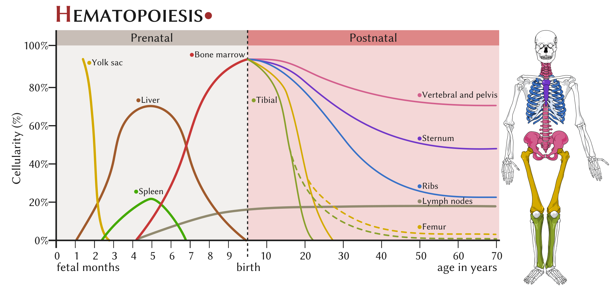

Slide 47
Control of Erythropoiesis

Slide 48
Percentages & Numbers
Blood volume : 5 liter in adult
55%plasma
45% is packed cells volume (PCV)
1% buffy coat
Plasma (ECF): 98% water
Diameter 7-8µmx2.5µmx1 µm.
Average volume 90-95 µm3
Number 4.7 - 5 x106
Hb 14-16 g/dl in the blood
Total Iron in the body 3-4-5 g
Normally: 30-40% saturated with Fe: plasma iron 100-130ug/100ml
When transferrin is 100% saturated with Fe: plasma iron 300ug / 100ml
Daily loss of iron is 0.6 mg in male & 1.3 mg/day in females.
Normal ranges of Hb:
Men: 13.5 to 17.5 g/dL
Women: 12.0 to 15.5 g/dL
Infants : 14 – 19 g/dL

Slide 49
Thank you!
اعمل لترسم بسمة، اعمل لتمسح دمعة، اعمل و أنت تعلم أن الله لا يضيع أجر من أحسن عملا.
The Physiology 436 Team:
Lina Alwakeel
Rana Barassain
Heba Alnasser
Munira Aldofayan
Sara Alshamrani
Sundus Alhawamda
Ruba Ali
Rehab Alanazi
Norah Alshabib
Nouf Alaqeeli
Buthaina Almajed
Alaa Alaqeel
Fahad Al Fayez
Ibrahim Al Deeri
Hassan Al Shammari
Abdullah Al Otaibi
Abdullah Al Subhi
Ali Al Subaei
Omar Al Babteen
Foad Fathi
Faisal Al Fawaz
Muhammad Al Aayed
Muhammad Al Mutlaq
Nasser Abu Dujeen
Waleed Al Asqah
Team Leaders:
Qaiss Almuhaideb
Lulwah Alshiha
Contact us:
Physiology436@gmail.com
@Physiology436

