Slide 1
BONES OF THE
UPPER LIMB
Dr. Jamila El-Medany

Slide 2
OBJECTIVES
At the end of the lecture, students should be able to:
List the different bones of the UL.
List the characteristic features of each bone.
Differentiate between the bones of the right and left sides.
List the articulations between the different bones.

Slide 3
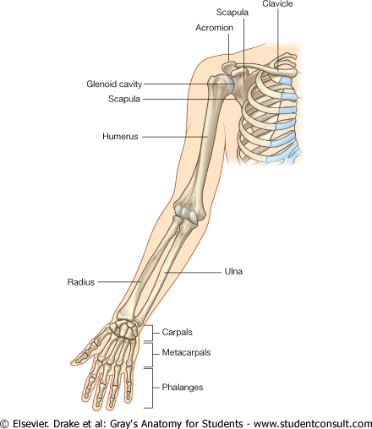
The Bones of UL are:
Pectoral Girdle.
Arm : Humerus.
Forearm : Radius & Ulna.
Wrist : Carpal bones
Hand: Metacarpals & Phalanges

Slide 4
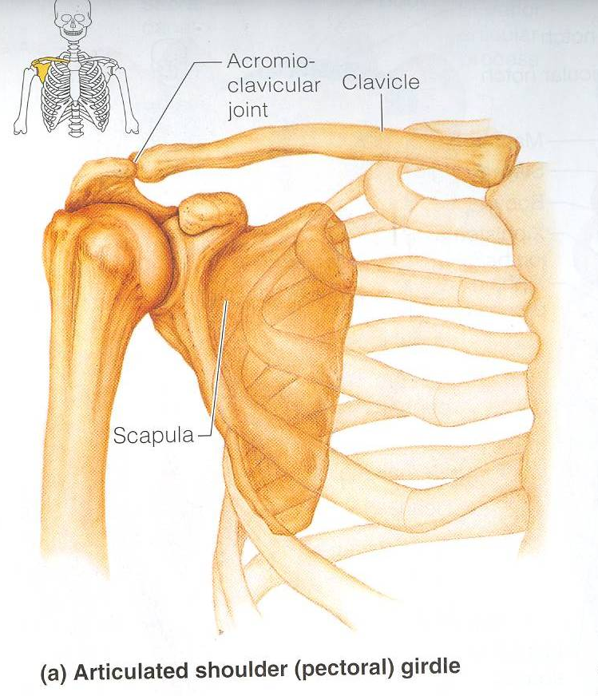
Pectoral Girdle
Formed of Two Bones:
Clavicle (anteriorly) and Scapula (posteriorly).
It is very light and allows the upper limb to have exceptionally free movement.

Slide 5
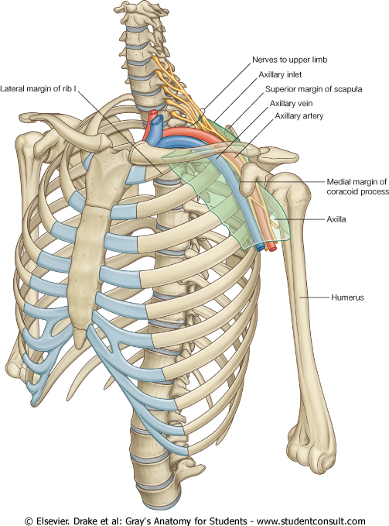
Clavicle
It is a doubly curved long bone lying horizontally across the root of the neck
It is subcutaneous throughout its length.
Functions:
1. It serves as a rigid support from which the scapula and free upper limb are suspended & keep them away from the trunk so that the arm has maximum freedom of movement.
2. Transmits forces from the upper limb to the axial skeleton.
3. Provides attachment for muscles.
4. It forms a boundary of the Cervicoaxillary canal for protection of the neurovascular bundle of the UL.

Slide 6
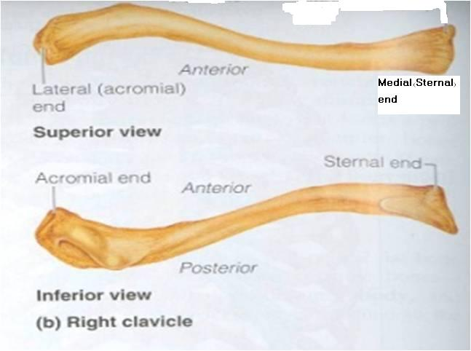
Clavicle
It is a long bone with no medullary cavity.
It has the appearance of an elongated letter Capital (S) lying on one side.
It has Two Ends:
Medial (Sternal) : enlarged & triangular.
Lateral (Acromial) : flattened.
Body (shaft):
Its medial 2/3 is convex forward.
Its lateral 1/3 is concave forward.
Surfaces:
Superior : smooth as it lies just deep to the skin.
Inferior : rough because strong ligaments bind it to the 1st rib.

Slide 7
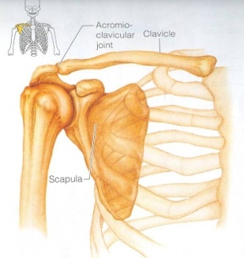
Articulations of Clavicle
Medially with the manubrium at the Sternoclavicular joint .
Laterally with the Scapula at the Acromioclavicular joint
Inferiorly with the 1st rib at the Costoclavicular Joint

Slide 8
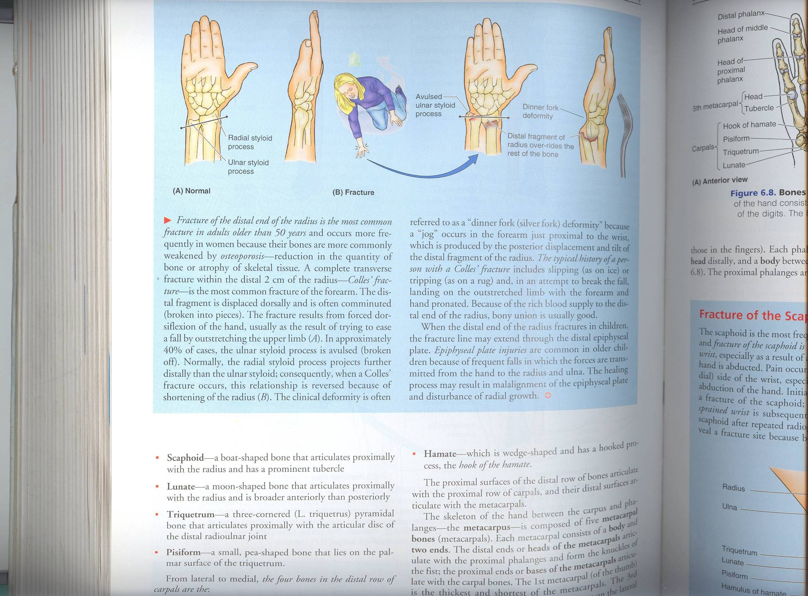
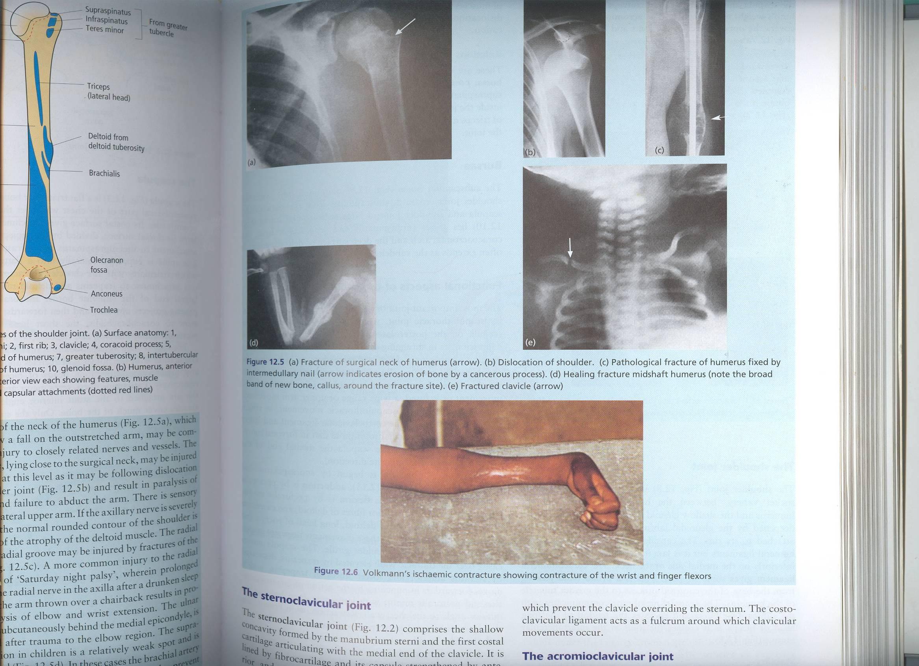
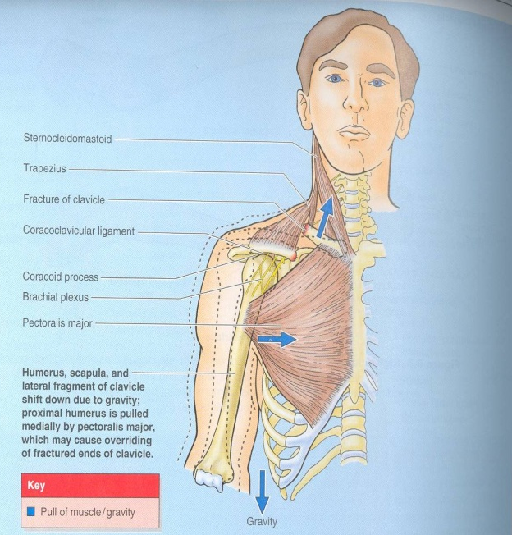
Fractures of the Clavicle
The clavicle is commonly fractured especially in children as forces are impacted to the outstretched hand during falling.
The weakest part of the clavicle is the junction of the middle and lateral thirds.
After fracture, the medial fragment is elevated (by the sternomastoid muscle), the lateral fragment drops because of the weight of the UL.
It may be pulled medially by the adductors of the arm.
The sagging limb is supported by the other.

Slide 9
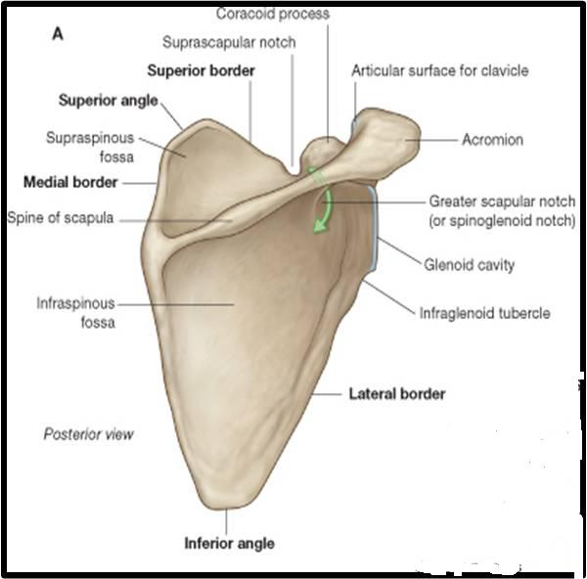
Scapula (Shoulder Blade)
It is a triangular Flat bone.
Extends between the 2nd _ 7th ribs.
It has :
Three Processes:
(1)Spine: a thick projecting ridge of bone that continues laterally.
(2) Acromion : forms the subcutaneous point of the shoulder.
(3) Coracoid: a beaklike process.
It resembles in size, shape and direction a bent finger pointing to the shoulder.
Three Borders: Superior, Medial (Vertebral) & Lateral (Axillary) (the thickest) part of the bone, it terminates at the lateral angle .

Slide 10
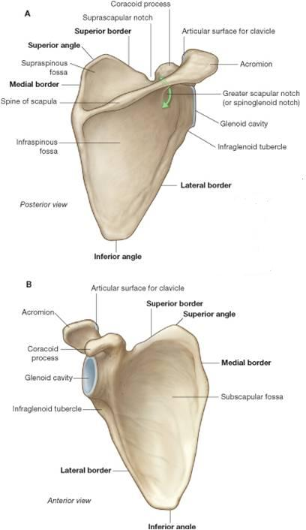
Three Angles :
Superior.
Lateral (forms the Glenoid cavity) : a shallow concave oval fossa that receives the head of the humerus.
Inferior.
Two Surfaces:
Convex Posterior : divided by the spine of the scapula into the
Smaller Supraspinous Fossa
(above the spine) and the
larger Infraspinous Fossa
(below the spine).
2.Concave Anterior (Costal) : it forms the large Subscapular Fossa.

Slide 11
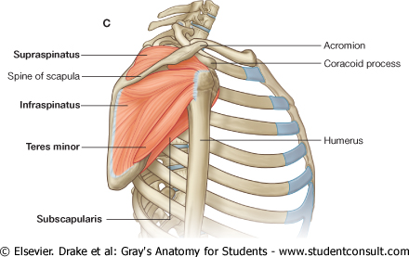
Functions
1. Gives attachment to muscles.
2.Has a considerable degree of movement on the thoracic wall to enable the arm to move freely.
3. The glenoid cavity forms the socket of the shoulder joint.
Because most of the scapula is well protected by muscles and by its association with the thoracic wall , most of its fractures involve the protruding subcutaneous Acromion.

Slide 12
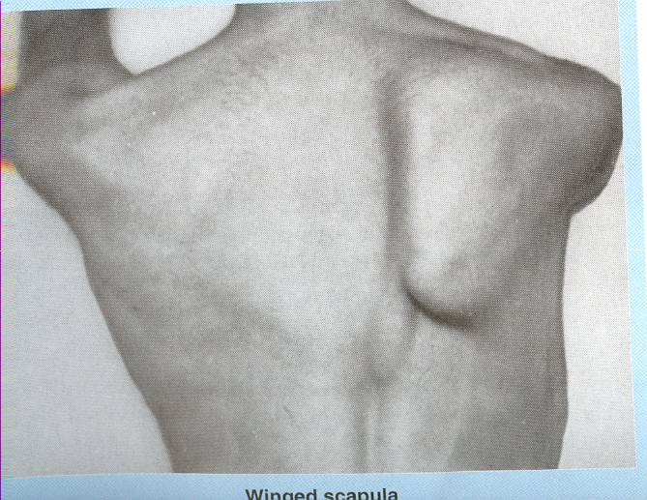
WINGED SCAPULA
It will protrude posteriorly.
The patient has difficulty in raising the arm above the head (difficult in rotation of the scapula).
It is due to injury of the long thoracic nerve (as in radical mastectomy) which causes paralysis of serratus anterior muscle
The medial border and inferior angle of the scapula will no longer be kept closely applied to the chest wall

Slide 13
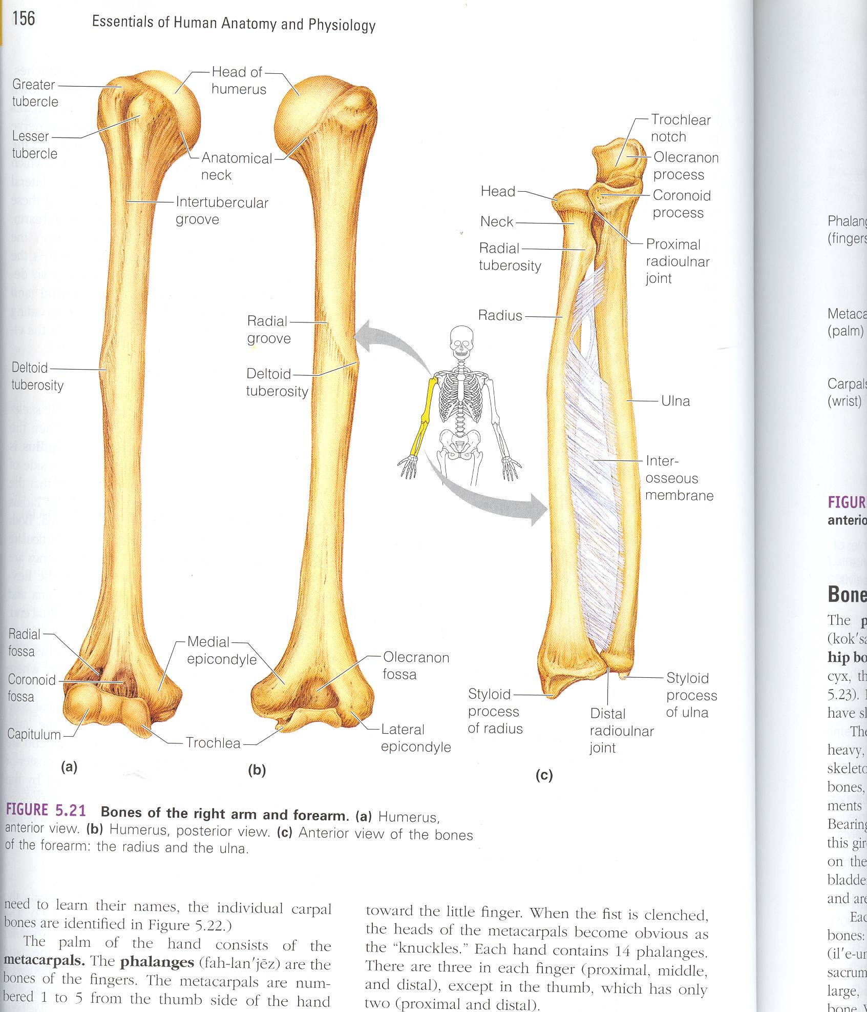
Humerus
  Typical Long bone.
  It is the largest bone in the UL
  Proximal End :
  Head, Neck, Greater & Lesser Tubercles.
  Head: Smooth
  it forms 1/3 of a sphere, it articulates with the glenoid cavity of the scapula.
  Greater tubercle: at the lateral margin of the humerus.
  Lesser tubercle: projects anteriorly.
  The two tubercles are separated by
  Intertubercular Groove.
  Anatomical neck: formed by a groove separating the head from the tubercles
  Surgical Neck: a narrow part distal to the tubercles.
surgical

Slide 14
Shaft (Body):
Has two prominent features:
1. Deltoid tuberosity:
A rough elevation laterally for the attachment of deltoid muscle.
2. Spiral (Radial) groove:
Runs obliquely down the posterior aspect of the shaft.
It lodges the important radial nerve & vessels.
Distal End:
Widens as the sharp medial and lateral Supracondylar Ridges and end in the Medial (can be felt) and Lateral Epicondyles.
They provide muscular attachment.

Slide 15
Structures at Distal end:
Anteriorly:
Trochlea: (medial) for articulation with the ulna
Capitulum: (lateral) for articulation with the radius.
Coronoid fossa :above the trochlea.
Radial fossa: above the capitulum.
Posteriorly:
Olecranon fossa : above the trochlea.

Slide 16
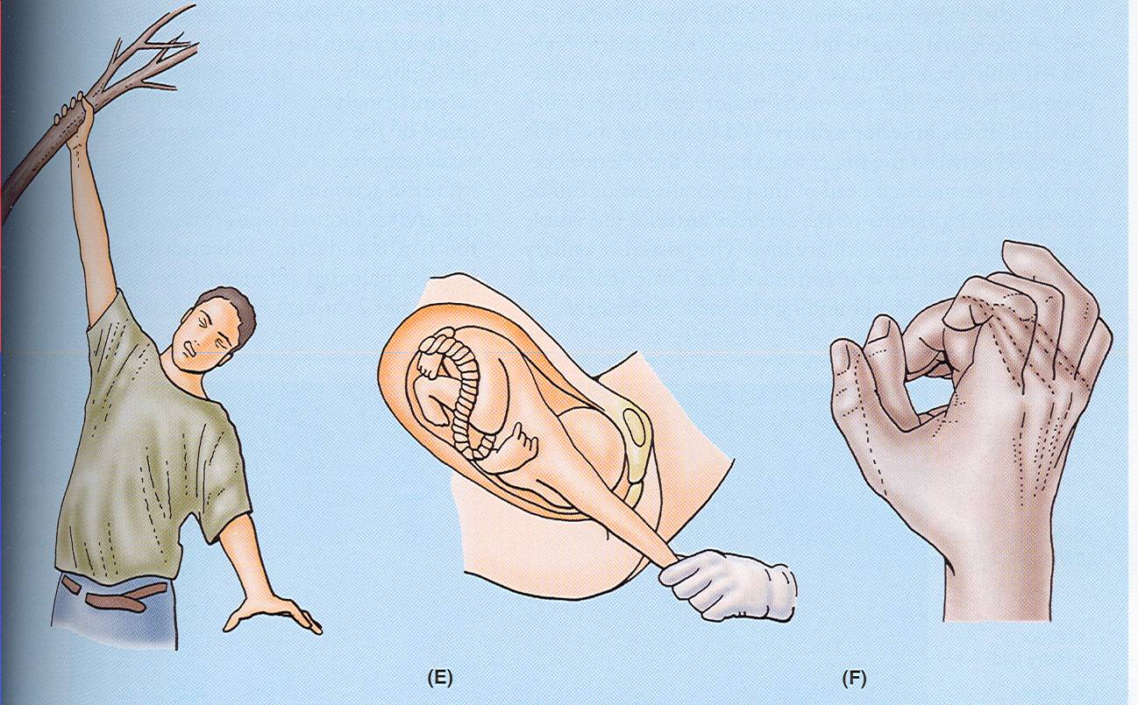
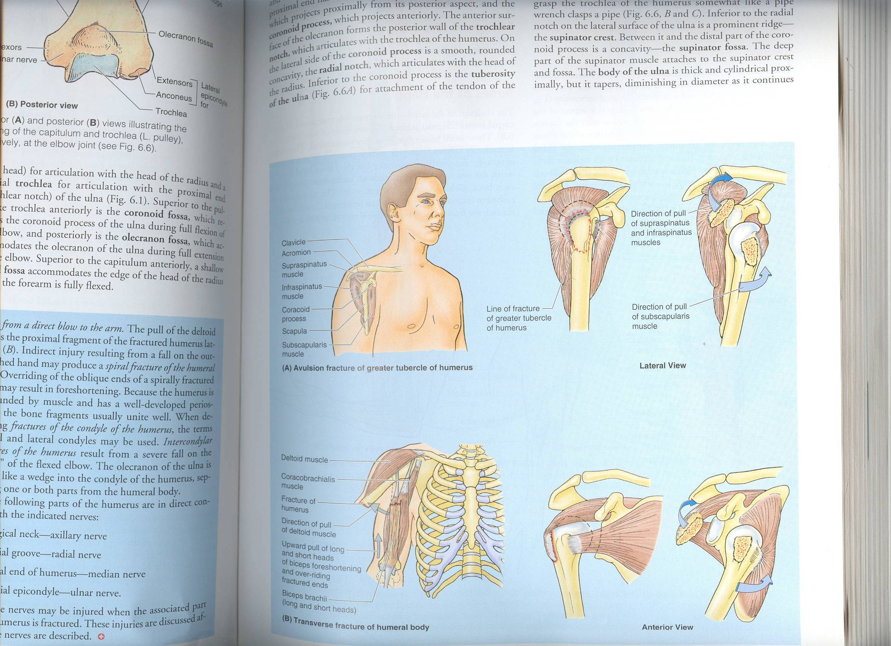
Fractures of Humerus
Most common fractures are of the Surgical Neck especially in elder people with osteoporosis.
The fracture results from falling on the hand (transition of force through the bones of forearm of the extended limb).
In younger people, fractures of the greater tubercle results from falling on the hand when the arm is abducted .
The body of the humerus can be fractured by a direct blow to the arm or by indirect injury as falling on the oustretched hand.

Slide 17
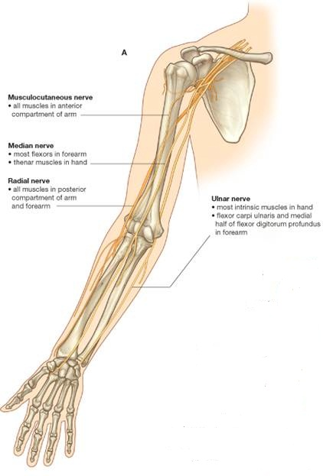
Nerves affected in fractures of humerus
Surgical neck: Axillary nerve
Radial groove: Radial nerve.
Distal end of humerus: Median nerve.
Medial epicondyle : Ulnar nerve.

Slide 18
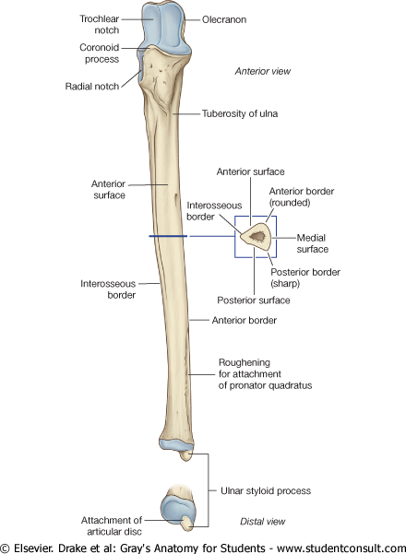
Ulna
It is the stabilizing bone of the forearm.
It is the medial & longer of the two bones of the forearm.
Proximal End
1. Olecranon Process :
projects proximally from the posterior aspect(forms the prominence of the elbow).
2. Coronoid Process :
projects anteriorly.
3.Tuberosity of Ulna:
inferior to coronoid process.
4.Trochlear Notch:
articulates with trochlea of humerus.
5.Radial Notch :
a smooth rounded concavity lateral to coronoid process.

Slide 19
Shaft :
Thick & cylindrical superiorly but diminishes in diameter inferiorly
It has Three Surfaces (Anterior, Medial & Posterior).
Sharp Lateral Interosseous border.
Distal End: Small rounded
1. Head: lies distally at the wrist. .
2. Styloid process: Medial.

Slide 20
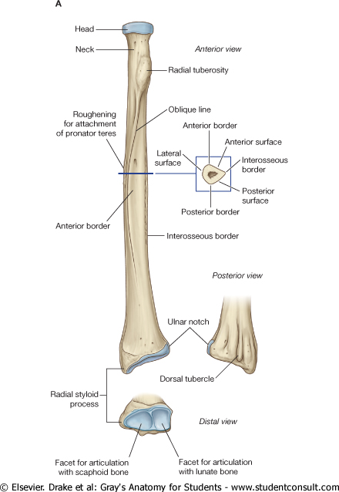
Radius
It is the shorter and lateral of the two forearm bones.
Proximal End:
1. Head: small & circular
Its upper surface is concave for articulation with the Capitulum.
2. Neck.
3. Radial (Biciptal) Tuberosity : medially directed and separates the proximal end from the body.
Shaft:
Has a lateral convexity.
It gradually enlarges as it passes distally.

Slide 21
Radius
Distal (Lower) End: It is rectangular
1. Ulnar Notch : a medial concavity to accommodate the head of the ulna.
2.Radial Styloid process: extends from the lateral aspect.
3.Dorsal tubercle: projects dorsally.

Slide 22
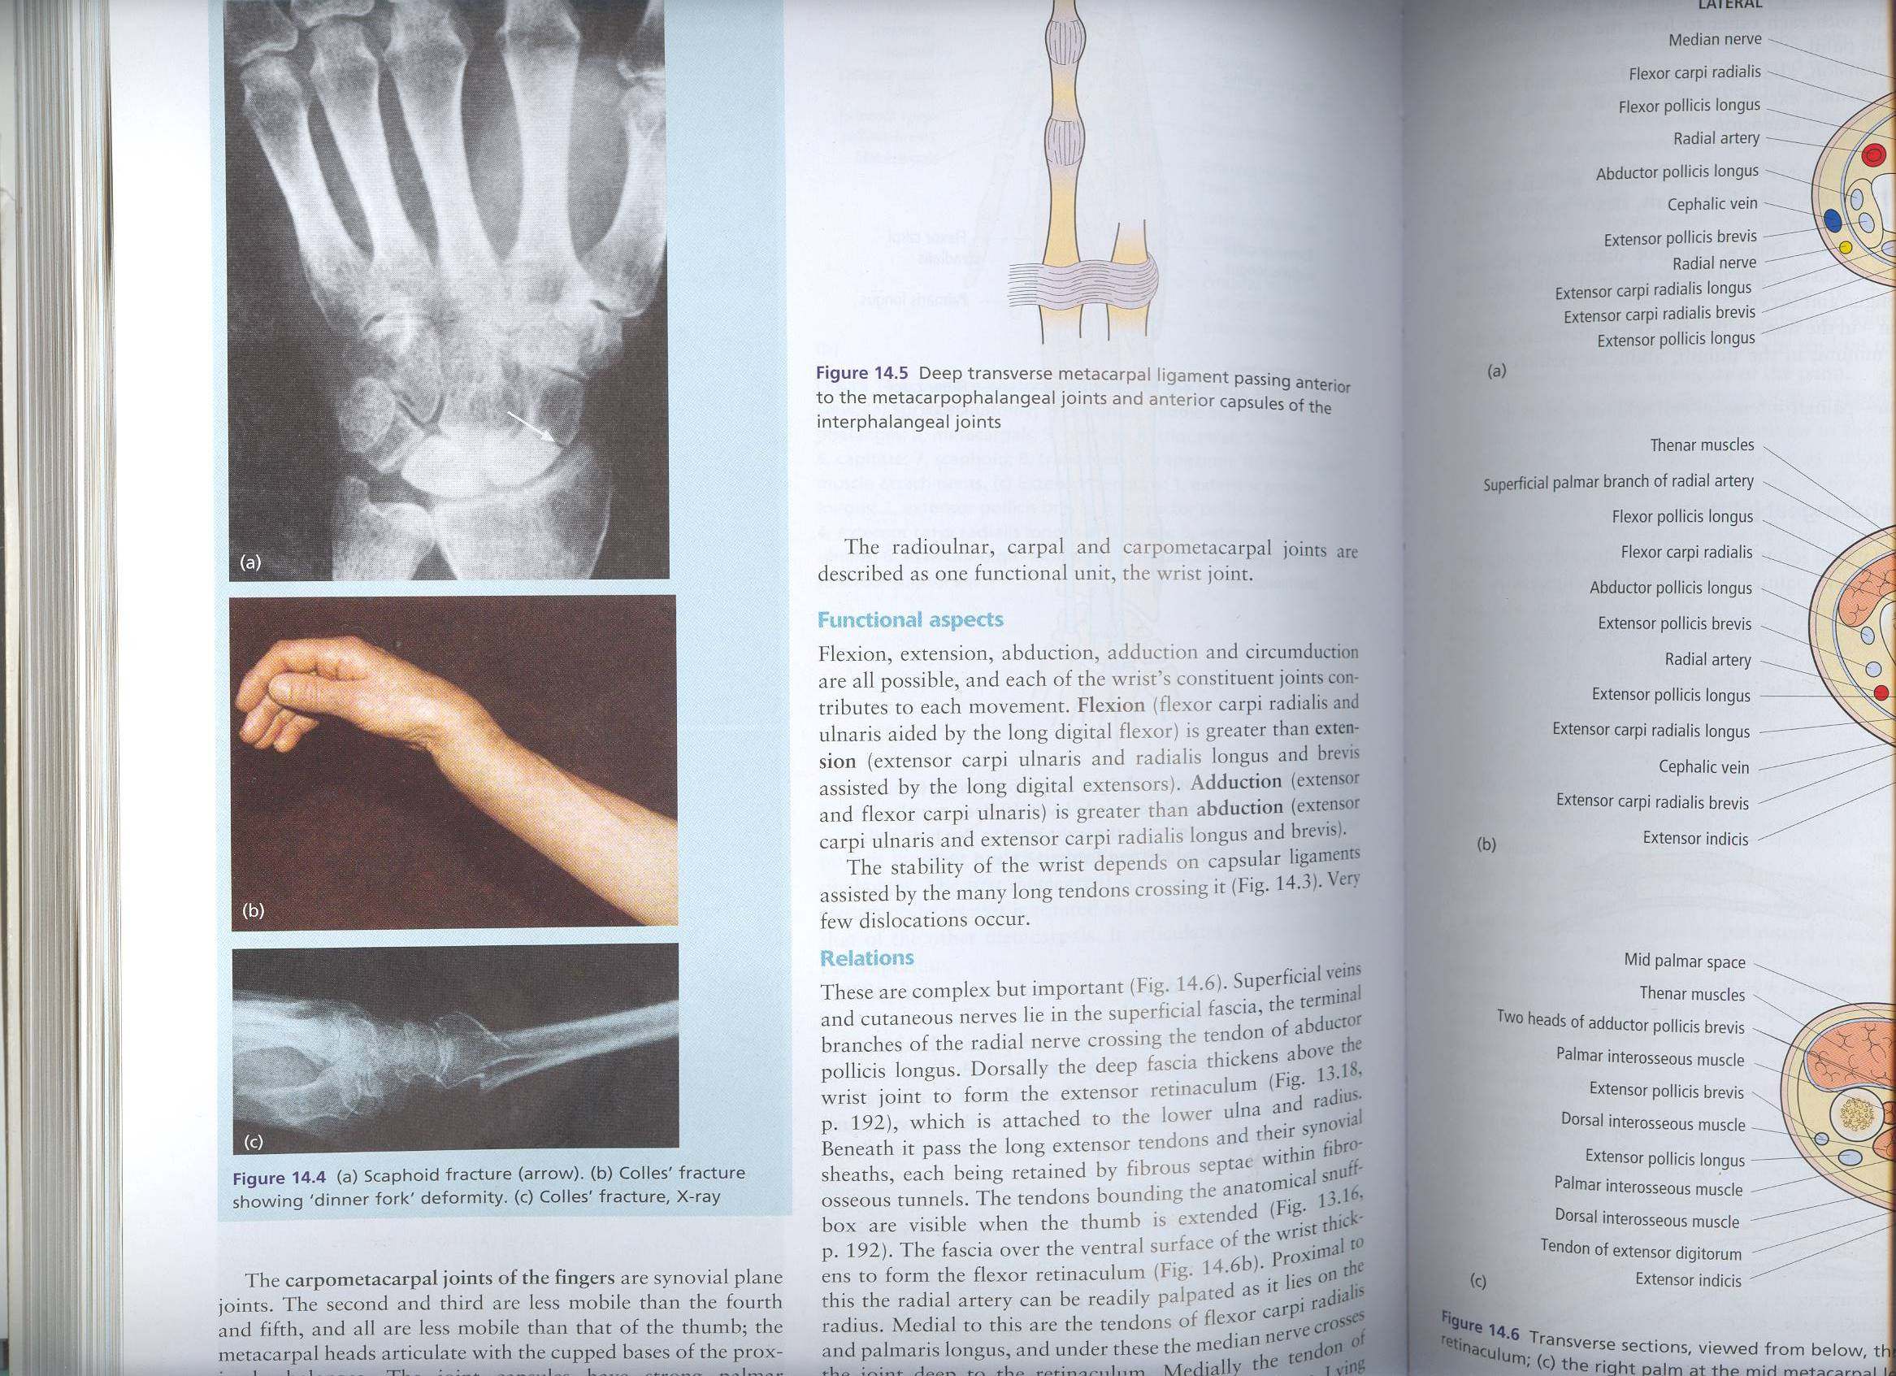
Fractures of radius & ulna
Because the radius & ulna are firmly bound by the interosseous membrane, a fracture of one bone is commonly associated with dislocation of the nearest joint.
Colle’ s Fracture (fracture of the distal end of radius) is the most common fracture of the forearm.
It is more common in women after middle age because of osteoporosis.
It causes dinner fork deformity.
It results from forced dorsiflexion of the hand as a result to ease a fall by outstretching the upper limb.
The typical history of the fracture includes slipping. Because of the rich blood supply to the distal end of the radius, bony union is usually good.

Slide 23
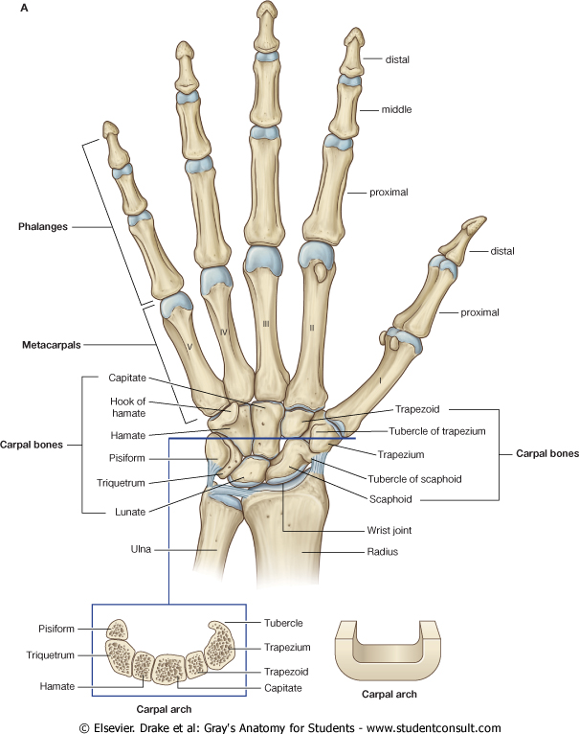
Carpal Bones
Composed of Eight short bones arranged in two irregular rows, Four each.
These Small bones give flexibility to the wrist.
The carpus presents Concavity on their Anterior surface & Convex from side to side Posteriorly.
Proximal row (from lateral to medial):
Scaphoid, Lunate, Triquetral & Pisiform bones.
Distal row (from lateral to medial):
Trapezium, Trapezoid,
Capitate & Hamate.

Slide 24
Fracture of Scaphoid
It is the most commonly fractured carpal bone and it is the most common injury of the wrist.
It is the result of a fall onto the palm when the hand is abducted.
Pain occurs along the lateral side of the wrist especially during dorsiflexion and abduction of the hand.
Union of the bone may take several months because of poor blood supply to the proximal part of the scaphoid.

Slide 25
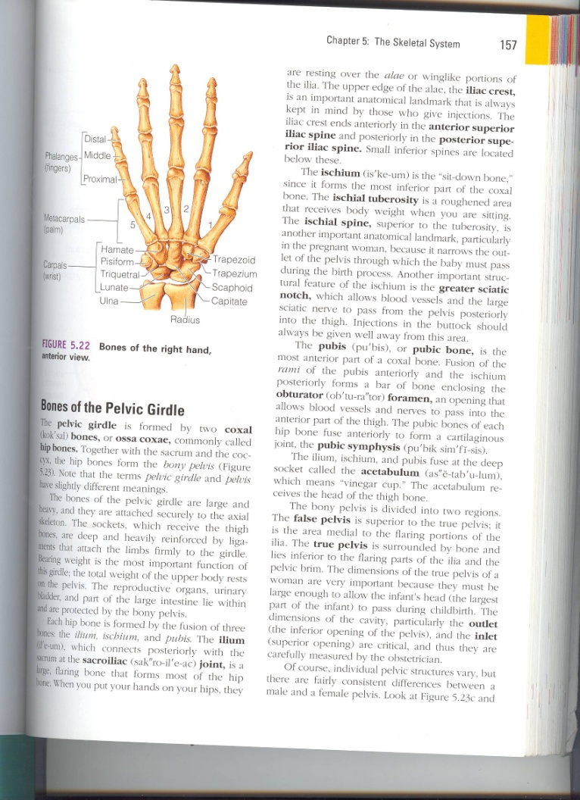
Metacarpal Bones
Form the skeleton of the hand between the carpus and phalanges.
It is composed of Five Metacarpal bones, each has a Base, Shaft, and a Head.
They are numbered 1-5 from the thumb.
The distal ends (Heads) articulate with the proximal phalanges to form the Knuckles of the fist.
The Bases of the metacarpals articulate with the carpal bones.
The 1st metacarpal is the shortest and most mobile.

Slide 26
Phalanges
Each digit has Three Phalanges
Except the Thumb which has only Two
Each phalanx has a Base Proximally, a Head distally and a Body in between.
The proximal phalanx is the largest.
The middle ones are intermediate in size.
The distal ones are the smallest, its distal ends are flattened and expanded distally to form the nail beds.

Slide 27
THANK YOU

