Slide 1
Radial & Ulnar Nerves
Dr. Jamila & Dr. Vohra

Slide 2
Objectives
At the end of the lecture, students should be able to:
Describe the anatomy of the radial & ulnar nerves regarding: origin, course & distribution.
List the branches of the nerves.
Describe the causes and manifestations of nerve injury.

Slide 3
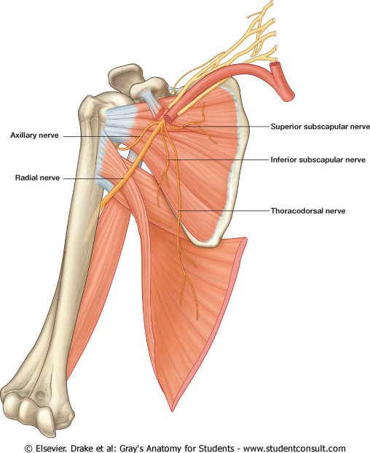
Radial Nerve
Origin:
Posterior cord of the brachial plexus in the axilla (the largest branch)
Supplies:
All Muscles of the posterior compartment of the arm & fore arm

Slide 4
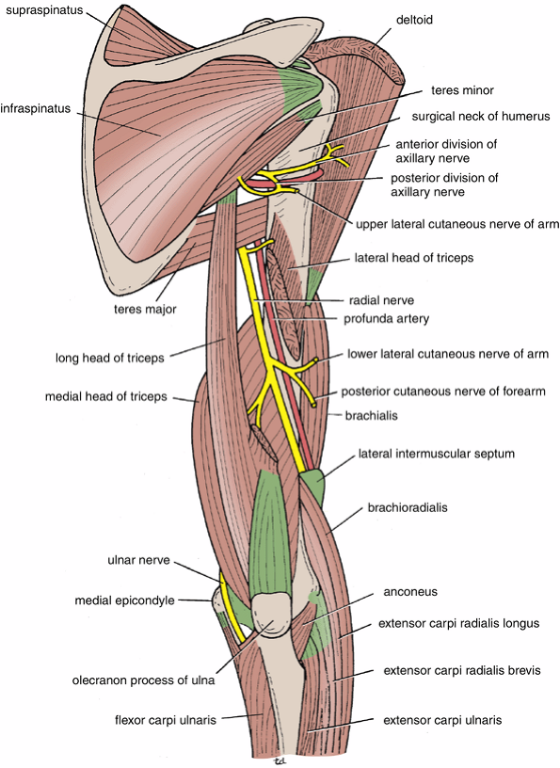
Course & Distribution In the Arm
It winds around the back of the arm in the Spiral Groove on the back of the humerus between the heads of the triceps.
In the spiral groove, the nerve is accompanied by the Profunda Vessels, and it lies directly in contact with the shaft of the humerus (Dangerous Position).
Posterior view of the upper arm

Slide 5
Course In the Forearm
It pierces the Lateral Intermuscular septum.
Descends in front of the Lateral Epicondyle.
Passes forward into the Cubital Fossa
Divides into
Superficial & Deep branches.

Slide 6
Branches
Arising In The Axilla:
Cutaneous:
Posterior cutaneous nerve of arm.
Muscular to:
Long & Medial Heads of Triceps.

Slide 7
Branches
Arising In the Spiral Groove:
Cutaneous:
Lower lateral cutaneous nerve of arm.
Posterior cutaneous nerve of forearm.
Muscular to:
Lateral & Medial heads of triceps.
Anconeus.

Slide 8
Branches
Arising Close to Lateral Epicondyle:
1. Muscular to :
Brachioradialis.
Extensor carpi radialis longus.
Brachialis.
2. Articular to:
Elbow joint

Slide 9
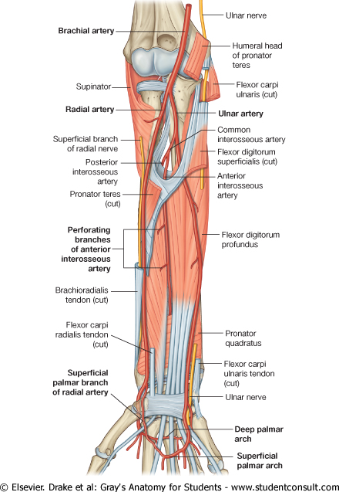
SUPERFICIAL BRANCH OF RADIAL NERVE
Superficial Branch
It descends under cover of Brachioradialis
Lateral to radial artery.
It emerges beneath the brachioradialis tendon.

Slide 10
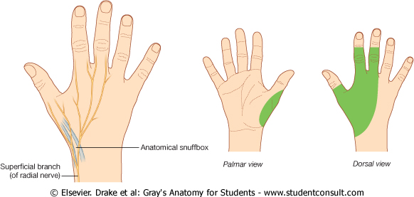
Termination of Superficial Branch
It reaches the posterior surface of the wrist, where it divides into terminal branches that supply the skin on the lateral two thirds of the posterior surface of the hand and the posterior surface over the proximal phalanges of the lateral three and half fingers.
The area of skin supplied by the nerve on the dorsum of the hand is variable.

Slide 11
Deep Branch
It winds around the neck of the radius, within the supinator muscle, and enters the posterior compartment of the forearm.
It supplies :
Extensor carpi radialis brevis.
Extensor carpi ulnaris.
Supinator.
Abductor pollicis longus.
Extensor pollicis brevis.
Extensor pollicis longus.
Extensor indicis.
Extensor digitorum.
Extensor digiti minimi.

Slide 12
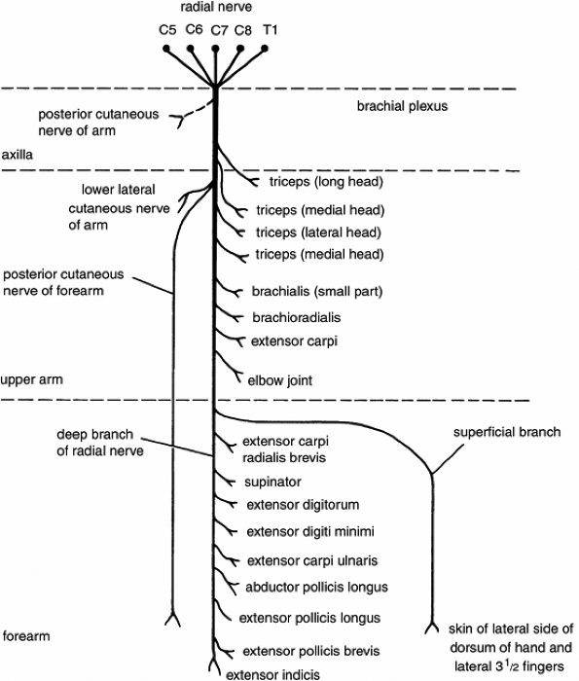
Summary of branches of radial nerve

Slide 13
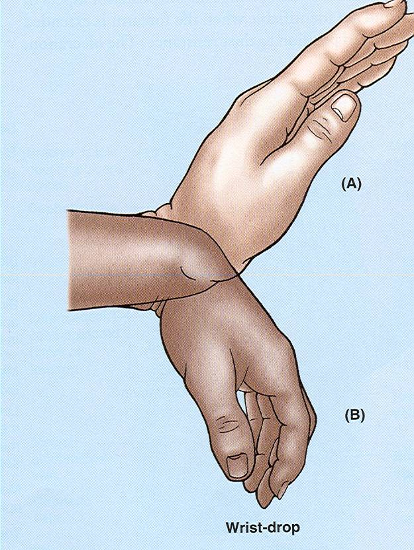
Injuries to the Radial Nerve
In the Axilla:
The nerve can be injured by a drunkard falling asleep with one arm over the back of a chair, also by fractures and dislocations of the proximal end of the humerus.
The triceps, the anconeus, and the long extensors of the wrist are paralyzed.
The patient is unable to extend the elbow & the wrist joints, and the
fingers (Wrist Drop)
In the Spiral Groove:
Injury or fracture of the spiral groove of the humerus, the patient is unable to extend the wrist and the fingers (Wrist Drop).

Slide 14
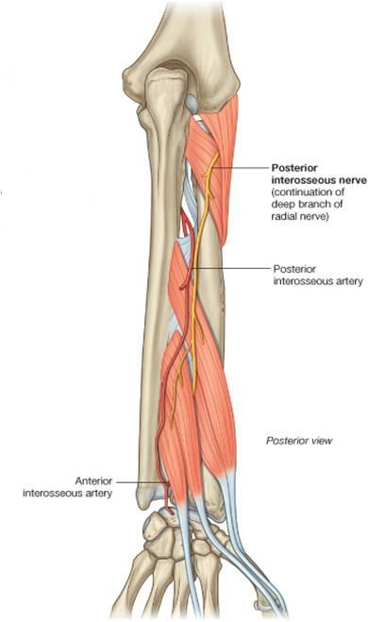
Injuries to the Deep Branch of the Radial Nerve
The deep branch of the radial nerve is PURELY Motor (It supplies the extensor muscles in the posterior compartment of the forearm).
It can be damaged in fractures of the proximal end of the radius or during dislocation of the radial head.
The nerve that supply the supinator and the extensor carpi radialis longus will be undamaged, and because the latter muscle is powerful, it will keep the wrist joint extended,
(No wrist Drop)
No sensory loss

Slide 15
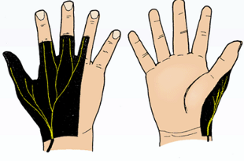
Injuries to the Superficial Branch of the Radial Nerve
Superficial radial nerve, is Sensory nerve
Injury like a stab wound, results in a variable small area of anesthesia over the dorsum of the hand and lateral three and half fingers up to the base of their proximal phalanges.

Slide 16
Ulnar Nerve
Origin:
Medial cord of BP.
Course:
Descends along the medial side of the following arteries:
Axillary,
Brachial.
Pierces the Medial Intermuscular Septum.
Passes Behind the Medial Epicondyle of the humerus.

Slide 17
Course In the Forearm
Enters the anterior compartment through the flex carpi ulnaris.
Descends:
Behind the Flexor Carpi Ulnaris.
Medial to Ulnar Artery.

Slide 18
course At the Wrist
Passes:
Anterior to Flexor Retinaculum.
Lateral to Pisiform bone.
Medial to Ulnar artery.
Divides into :
Superficial & Deep branches.

Slide 19
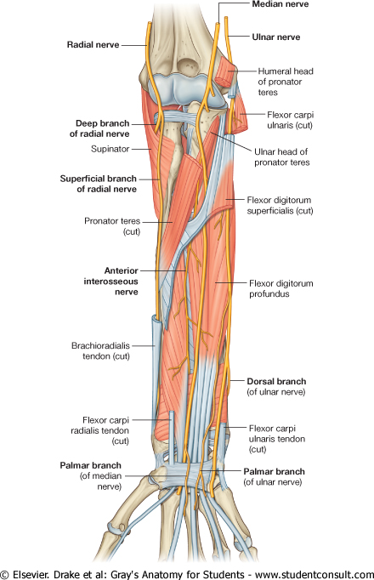
Branches
It has No branches in the arm
In the Forearm:
a. Muscular TO :
(1 & 1/2 muscles):
Flexor Carpi Ulnaris.
Medial 1l2 of Flexor Digitorum Profundus.
b. Articular TO:
Elbow joint.

Slide 20
Branches
c. Cutaneous:
1. Dorsal (posterior) cutaneous:
Supplies the skin over the back of Medial side of the hand & Medial 1+1/2 fingers
2. Palmar cutaneous:
Supplies the skin over the Medial part of the palm.

Slide 21
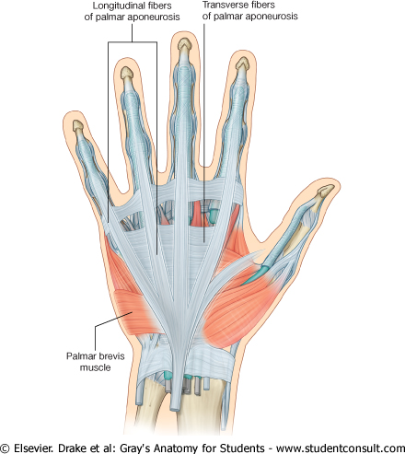
Branches of Superficial Terminal Branch
1. Muscular: Palmaris Brevis.
2. Cutaneous:
Skin over the Palmar aspect of the medial 1+ ½ fingers (including nail beds).

Slide 22
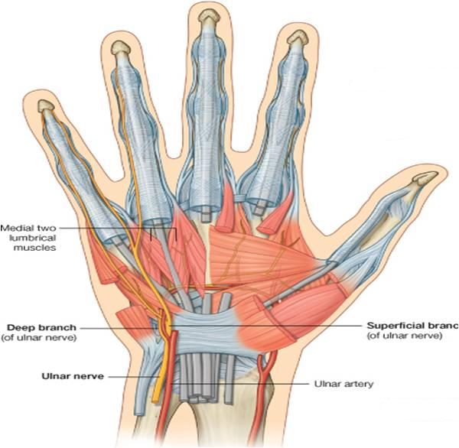
Branches of Deep Terminal Branch
(A) Muscular branches :
Hypothenar Eminence.
All Interossei (Palmar & Dorsal).
3rd & 4th Lumbricals.
Adductor pollicis.
(B) Articular:
Carpal joints.

Slide 23
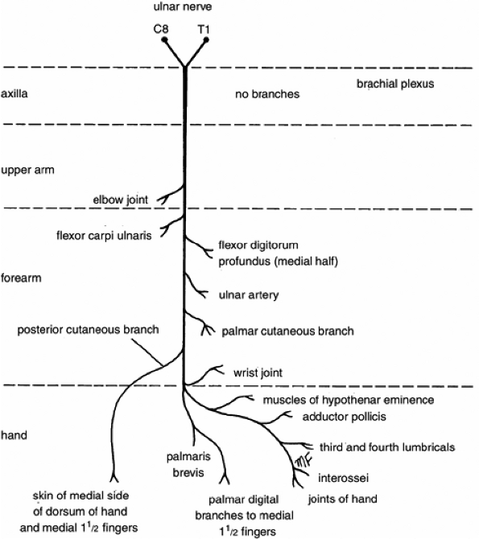
Summary of branches of Ulnar Nerve

Slide 24
Ulnar Nerve Injury
At the
Elbow:
Atrophy of Ulnar side of forearm.
Flexion of the wrist with Abduction.
Claw hand.
Wasting of Hypothenar Eminence.

Slide 25
Ulnar Nerve Injury
At the wrist:
Claw Hand.
Wasting of Hypothenar Eminence.

Slide 26
THANK YOU

