Slide 1
Creatine Metabolism and Collagen Diseases
Sumbul Fatma
Medical Biochemistry Unit
Department of Pathology

Slide 2
Objectives
To study the importance of creatine in muscle as a storage form of energy
To understand the biosynthesis of creatine
To study the process of creatine degradation and formation of creatinine as an end product
To understand the clinical importance of creatinine as a sensitive indicator of kidney function
To study the structure, function, types, and biosynthesis of collagen
To understand different diseases associated with collagen

Slide 3
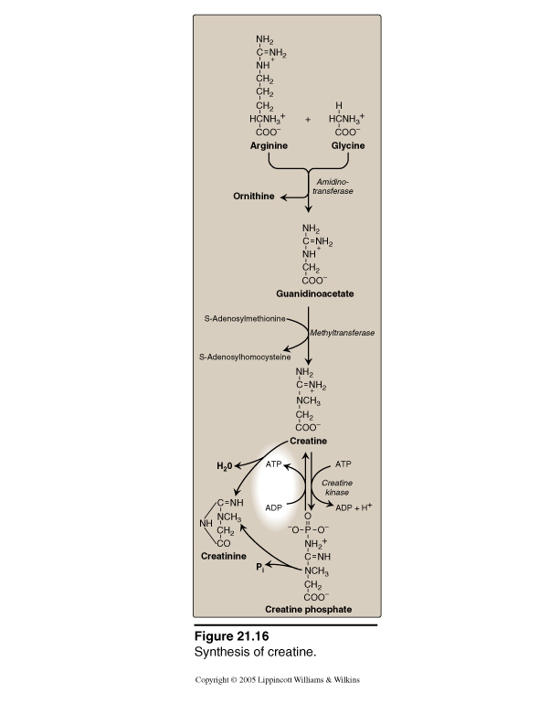
Creatine Metabolism
End product
Energy Source

Slide 4
Creatine Biosynthesis
Three amino acids are required:
Glycine
Arginine
Methionine (as S-adenosylmethionine)
Site of biosynthesis:
Step 1: Kidneys
Step 2: Liver

Slide 5
Creatine Biosynthesis
Arginine + Glycine
Kidneys
Amidino-transferase
Ornithine
Guanidinoacetate
SAM
Liver
Methyltransferase
SAH
Creatine

Slide 6
Distribution of body creatine
From liver, transported to other tissues
98% are present in skeletal and heart muscles
In Muscle, gets converted to the high energy source creatine phosphate (phosphocreatine)
Creatine
ATP
ATP
Creatine Kinase
ADP
ADP + H+
Creatine phosphate

Slide 7
Creatine Phosphate
Is a high-energy phosphate compound
Acts as a storage form of energy in the muscle
Provides a small but, ready source of energy during first few seconds of intense muscular contraction
The amount of creatine phosphate in the body is proportional to the muscle mass

Slide 8
Creatine Degradation
Creatine and creatine phosphate spontaneously form creatinine as an end product
Creatinine is excreted in the urine
Serum creatinine is a sensitive indicator of kidney disease (Kidney function test)
Serum creatinine increases with the impairment of kidney function

Slide 9
Creatine Degradation
Creatine
H₂O
ATP
ATP
Creatinine
Creatine Kinase
ADP
ADP + H+
Pi
Plasma
Creatine phosphate
Glomerular filtration
Urine

Slide 10
Urinary Creatinine
A typical male excretes about 15mmol of creatinine per day
A decrease in muscle mass due to muscular dystrophy or paralysis leads to decreased level of creatinine in urine
The amount of creatinine in urine is used as an indicator for the proper collection of 24 hours urine sample

Slide 11
Creatine Kinase (CK)
CK is responsible for the generation of energy in contractile muscular tissues
CK levels are changed in disorders of cardiac and skeletal muscle
Creatine
ATP
ATP
Creatine Kinase
ADP
ADP + H+
Creatine phosphate

Slide 12
Collagen Diseases

Slide 13
Collagen: Overview
Most abundant protein in the human body
Collagens are highly stable molecules, having half-lives as long as several years
A fibrous protein that serves structural functions
Is a part of connective tissues: bone, teeth, cartilage, tendon, skin, blood vessels
Has a long rigid structure

Slide 14
Collagen structure: The α-chain
Collagen α-chain (~1,000 amino acids long), is rich in proline and glycine
The glycine residues are part of a repeating
sequence, –Gly–X–Y–, where X is frequently proline and Y is often hydroxyproline (–Gly–Pro–Hyp)₃₃₃
(Y can be also hydroxylysine).
Collage consists of three α-chains wound around one another in rope like triple helix
Compare between the 2 examples of secondary structure of proteins: the collagen helix & the α-helix
The three polypeptide chains are held together by hydrogen bonds

Slide 15
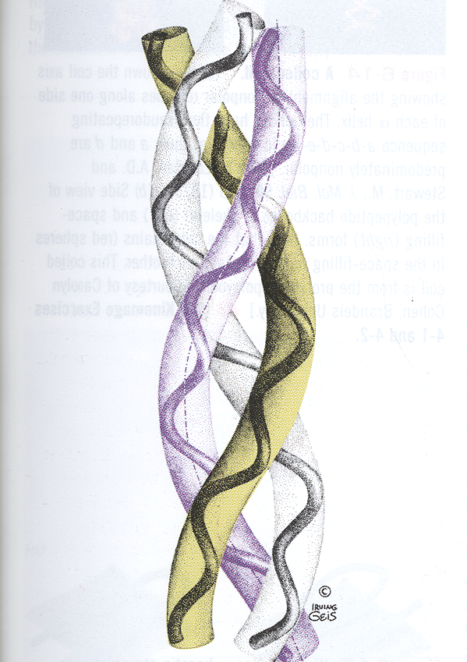
Structure of Collagen
Rich in proline and glycine amino acids
Proline prevents collagen chains to form α-helix because:
It does not have back bone amino group (it is a ring structure with secondary amino group)
Therefore hydrogen bonding within the helix is not possible

Slide 16
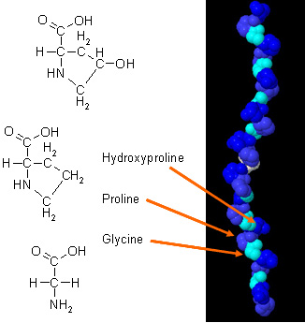
Non-standard amino acids in collagen
Proline and lysine is converted to hydroxyproline and hydroxylysine by hydroxylase enzymes during post-translational modification
The enzyme requires vitamin C for its function

Slide 17
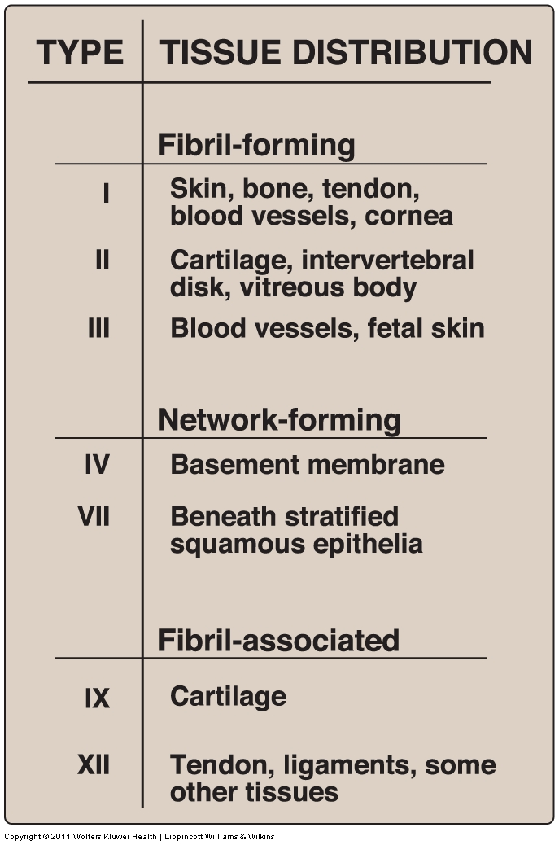
Types of collagen molecules
Type and organization of collagen depends on its function
Variations in the amino acid sequence of α-chains result in different properties e.g.
type I- (α1)₂ α2
Type II- (α1) ₃

Slide 18
Biosynthesis of Collagen
Synthesized in fibroblasts, osteoblasts and chondroblasts (pre-pro- then pro- and finally mature -collagen)
Polypeptide precursors are enzymatically modified and form triple helix which is secreted into the extracellular matrix as procollagen
Procollagen molecules are cleaved by N- and C- procollagen peptidases releasing triple helical tropocollagen molecules
Tropocollagen molecules spontaneously associate to form collagen fibrils

Slide 19
Biosynthesis of Collagen … CONT’D
Glycosylation of some hydroxylysine residues with glucose or galactose
Tropocollagen molecules spontaneously associate to form collagen fibrils

Slide 20
Cross-linking of Collagen fibrils
Lysyl oxidase oxidatively deaminates some of the lysine and hydroxylysine residues in collagen
The produced reactive aldehydes- allysine and hydroxyallysine condense with lysine or hydroxylysine residues in neighbouring collagen molecules to form covalent cross-links
This produces mature collagen fibres

Slide 21
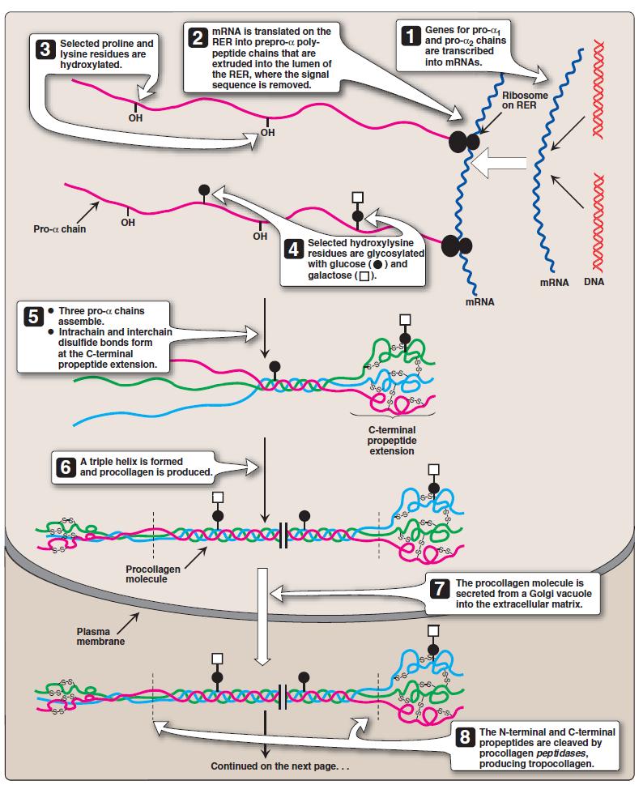

Slide 22
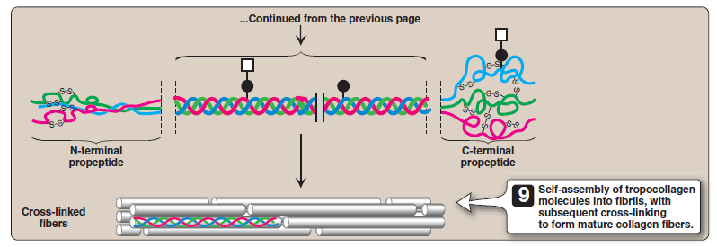

Slide 23
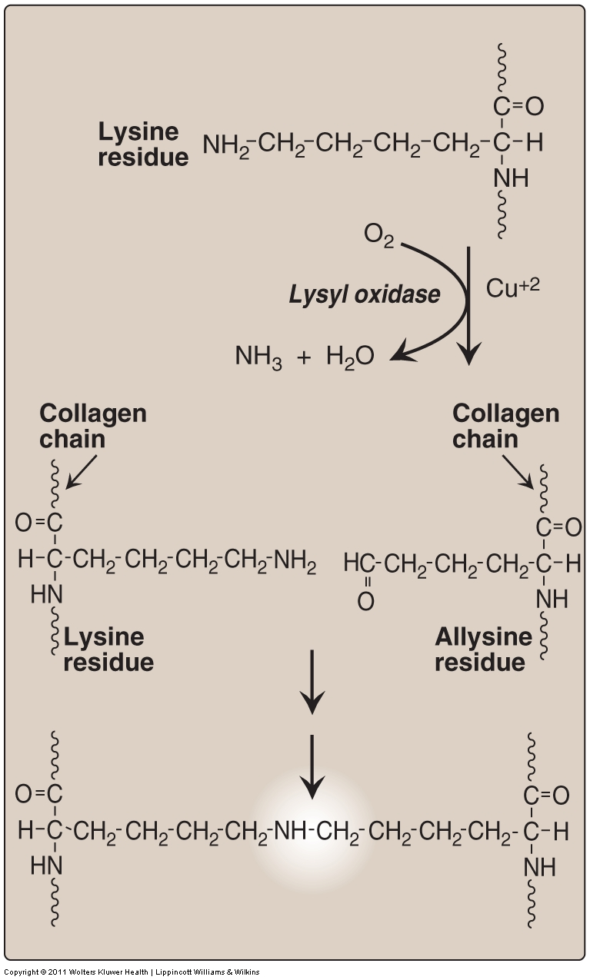

Slide 24
Collagen diseases
Acquired disease:
Scurvy: due to vitamin C deficiency
Genetic, inherited diseases:
Ehlers-Danlos syndromes (EDS)
Osteogenesis imperfecta (OI)

Slide 25
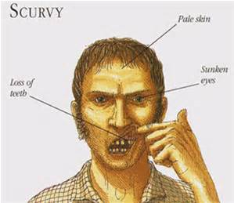
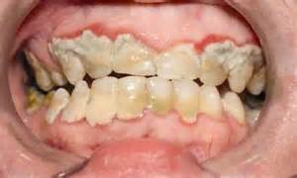
Collagen diseases
Scurvy: due to vitamin C deficiency

Slide 26
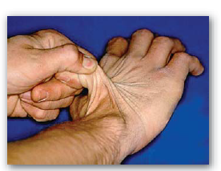
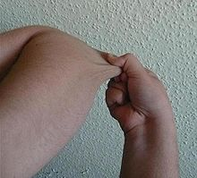
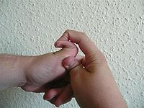
Collagen diseases
Ehlers-Danlos syndrome:
can be caused by
deficiency of lysyl hydroxylase or N-procollagen peptidase,
Mutations in the amino acid sequences of collagen I, III and V.
Characterized by hyperextensibility of joints and skin

Slide 27
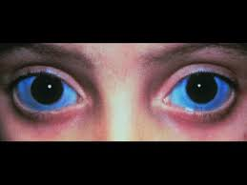
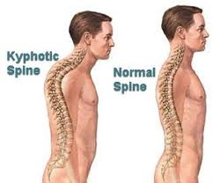
Collagen diseases
Osteogenesis imperfecta (brittle bone disease): Characterized by bones that fracture easily, with minor or no trauma.
Mutations replace glycine with amino acids having bulky side chains preventing the formation of triple helical conformation
Type I- most common, characterized by mild bone fragility, hearing loss and blue sclerae
Type II- most severe form and typically lethal in the perinatal period. Fractures are seen in utero.
Type III- severe form, characterized by multiple fractures at birth, short stature, spinal curvature leading to a humped back (kyphotic) appearance and blue sclerae.

Slide 28
References
Lippincott, pages 43-49 and 287-288
Bishop 6th edition, page 223-227

