Slide 1
MUSCULOSKELETAL BLOCK Pathology Fracture and bone healing
Dr.Amany Fathaddin

Slide 2
Healing of bone fractures
Objectives of this lecture:
Know the different types of fractures
Be aware of the mechanism and stages of fracture healing process
Know the factors affecting healing process and the possible complications of healing process
Appreciate the importance of road traffic accidents as a major cause of disability in Saudi Arabia

Slide 3
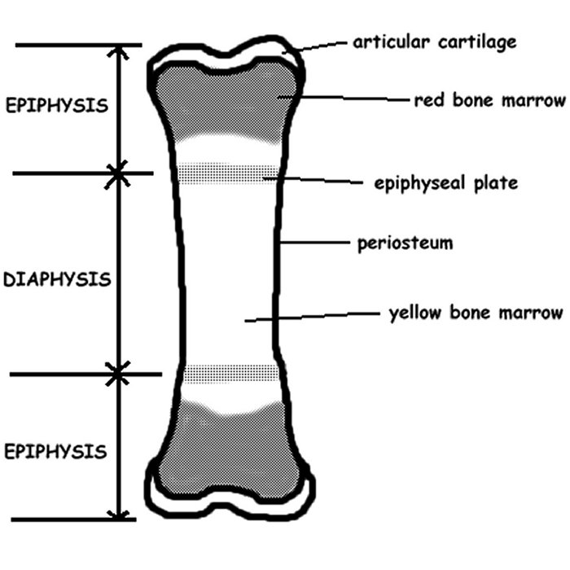
Normal anatomy
Parts of a long bones:
epiphysis (ends of bone, partially covered by articular cartilage)
physis (growth plate)
metaphysis (junction of diaphysis and epiphysis
diaphysis (shaft)

Slide 4
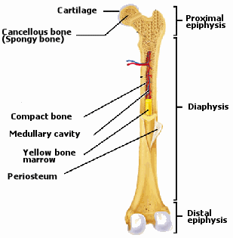
Normal anatomy
Cross section:
Periosteum
cortex (composed of cortical bone or compact bone)
medullary space (composed of cancellous or spongy bone)

Slide 6
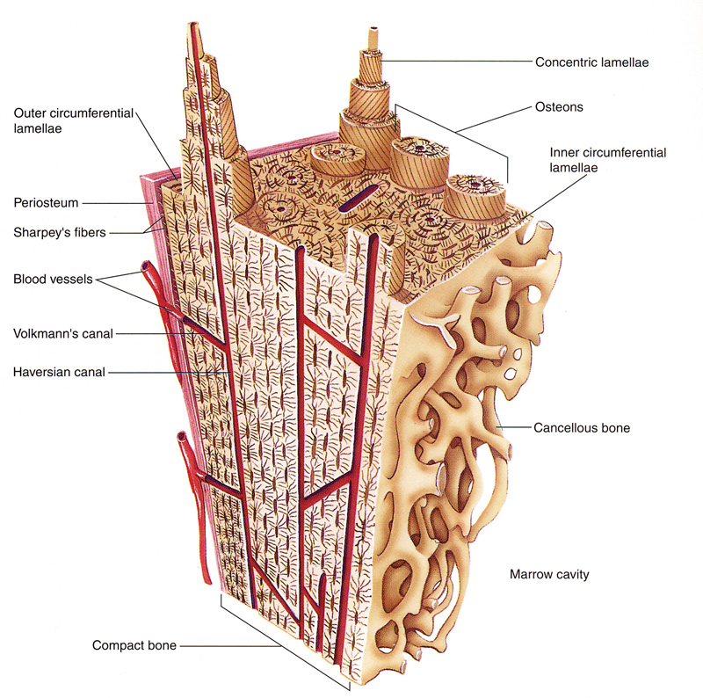
Normal histology
Bone: mineralized osteoid; either lamellar bone or woven bone.
Lamellar bone:
layered bone with concentric parallel lamellae
normal type of bone found in adult skeleton
stronger than woven bone

Slide 7
Bone is composed of specialized collagen (osteoid), which is mineralized by the deposition of hydroxyapatite
Bone is composed of a collagen-containing extracellular matrix (osteoid) synthesized by osteoblasts, which is mineralized by calcium-containing salts

Slide 8
There are two main patterns of bone deposition.
In normal lamellar bone the osteoid collage is deposited in a mechanically strong, parallel stratified pattern.
In woven bone, the osteoblasts deposit osteoid collagen in a haphazard pattern. With its random arrangement of osteoid collagen
fibers, this woven pattern is far less efficient and much weaker than lamellar bone with a greater tendency to fracture under stress.

Slide 9
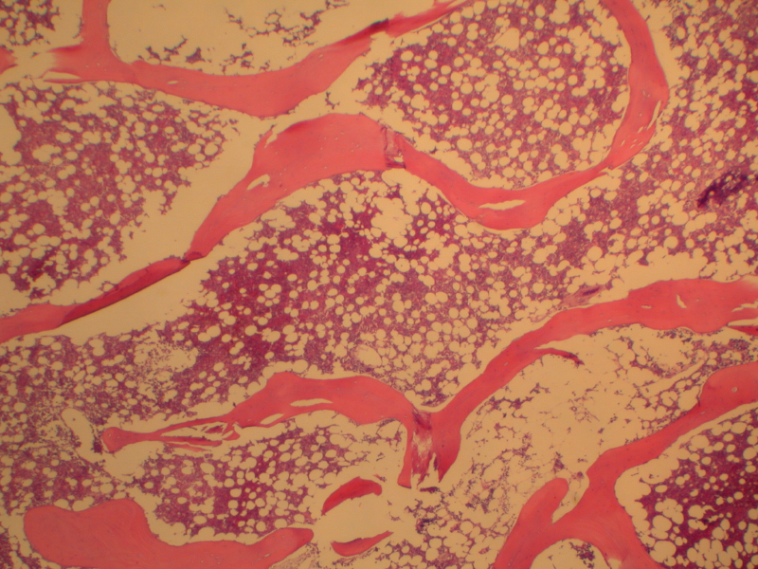

Slide 10
Bone Cells
Osteoblasts: arise from marrow mesenchymal cells; when active, are plump and present on bone surface; eventually are encased within the collagen they produce.
Osteoclasts: large multinucleated cells found attached to the bone surface at sites of active bone resorption.

Slide 11
osteoid is the unmineralized, organic portion of the bone matrix that forms prior to the maturation of bone tissue. Osteoblasts begin the process of forming bone tissue by secreting the osteoid as several specific proteins.
Bone resorption:
Bone resorption is resorption of bone tissue, that is, the process by which osteoclasts break down the tissue in bones

Slide 12
Fracture:- Break in the continuity of bone

Slide 14
Defintions.
Closed fracture (simple).
Open fracture (compound).
Complicated fracture.

Slide 16
Defintions
Closed Fracture (simple ):-
Does NOT communicate with external environment

Slide 17
Defintions.
Open Fracture (compound ):-
Communicate with external environment
Infection !!
COMPOUND # Fracture extend to the skin

Slide 18
Defintions
Complicated Fracture:-
Associated with damage to nerves, vessels or internal organs

Slide 19
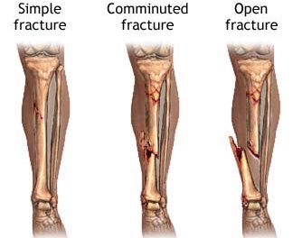
Classification of fractures
Complete or incomplete
Closed or compound
Comminuted
Displaced

Slide 20
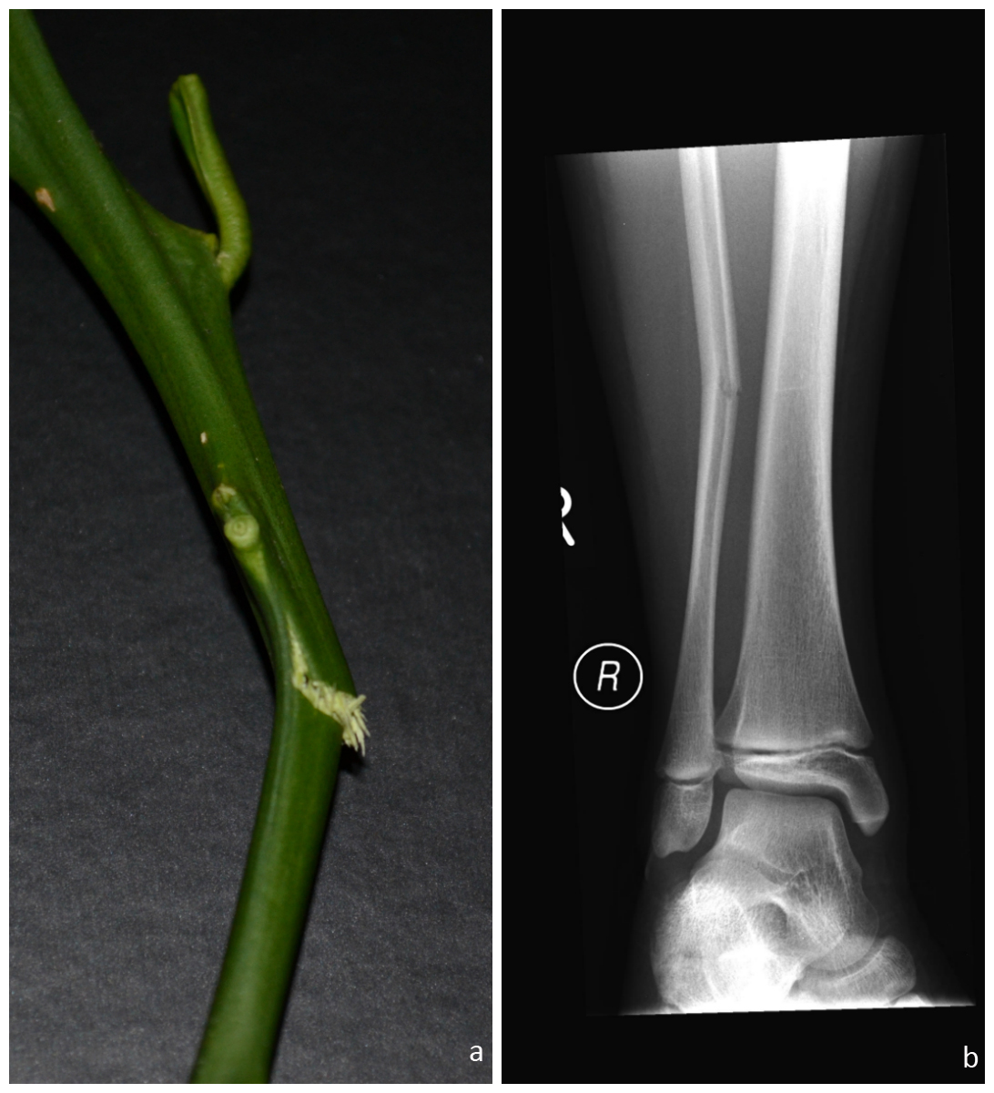
Greenstick Fracture

Slide 21
Causes of fractures
Traumatic fracture: Sever trauma
Pathological fracture
Stress fracture

Slide 22
Causes of fractures
Traumatic fracture: Sever trauma e.g. MVA
Trauma due to motor vehicle accidents is of major cause of bone fracture

Slide 23
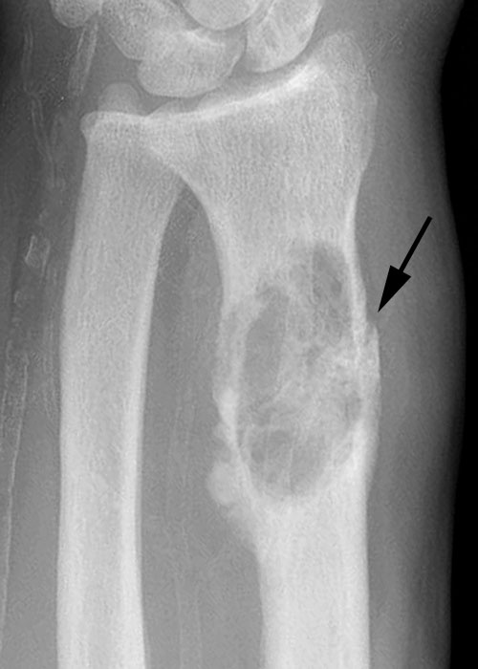
Causes of fractures
Pathological fracture:
Fracture occur with minimal trauma
the underlying bone is abnormal e.g.
Osteoporosis
Osteomalacia
Paget's disease of bone
Primary or metastatic tumor.
Congenital bone disorders
e.g. osteogenesis imperfecta

Slide 24
Stress fracture
A stress fracture is a slowly developing fracture that follows a period of increased physical activity in which the bone is subjected to new repetitive loads.
Stress fractures are most common in the weight-bearing bones of the lower leg and foot. Track and field athletes and military recruits who carry heavy packs over long distances are particularly susceptible

Slide 25
Healing of fractures
1. Reactive Phase
I Hematoma and inflammatory phase
ii. Granulation tissue formation
2. Reparative Phase
iii. Callus formation
iv. Lamellar bone deposition
3. Remodeling Phase
v. Remodeling to original bone contour

Slide 26
How does a fracture heal?

Slide 27
Reactive Phase
Stage 1: Inflammation
Bleeding from the fractured bone and surrounding tissue causes the fractured area to swell due to inflammation induced by chemical mediator produced from macrophages and other inflammatory cells with granulation tissue formation.

Slide 28
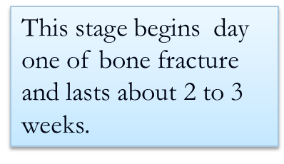

Slide 29
degranulated platelets and migrating inflammatory cells release PDGF, TGF-β, FGF, and other factors, activate osteoprogenitor cells in the periosteum, medullary cavity, and surrounding soft tissues and stimulate osteoclastic and osteoblastic activity.

Slide 30
Reparative Phase
Soft callus by the end of the first week the hematoma is organizing, the adjacent tissue is being modulated for future matrix production, and the fractured ends of the bones are being remodeled. This fusiform and predominantly uncalcified tissue—called soft-tissue callus or procallus
Hard callus
Osteoblasts produce woven bone, resulting in a bony callus that stabilizes the fracture site.

Slide 31
Hard callus

Slide 32
Immobilization promotes bone fracture healing

Slide 33
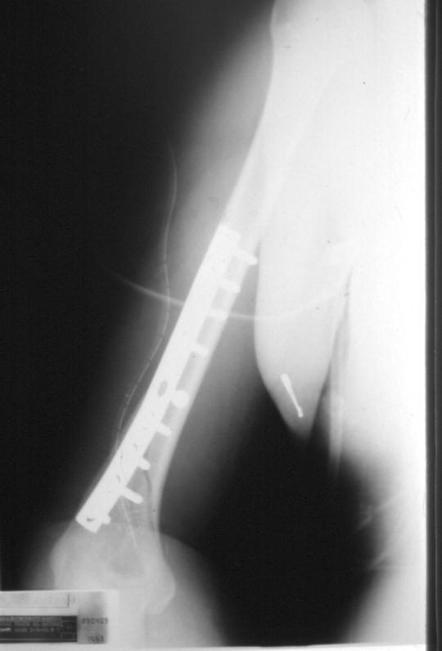

Slide 34
Bone remodeling
Beginning about 8 to 1 2 weeks after the injury, the fracture site remodels itself, correcting any deformities that may remain as a result of the injury. This final stage of fracture healing can last up to several years.

Slide 35
The rate of healing and the ability to remodel a fractured bone vary tremendously for each person and depend on
age
health
the kind of fracture
the bone involved.

Slide 37
Healing of fractures
Factors disrupting healing process:
Displaced and comminuted fractures
Infection
Vascular insufficiency
This is particularly important in certain areas such as the scaphoid bone in the wrist and the neck of the femur, both of which can be associated with avascular necrosis of fracture fragments.
Inadequate minerals and vitamins
Inadequate immobilization

Slide 38
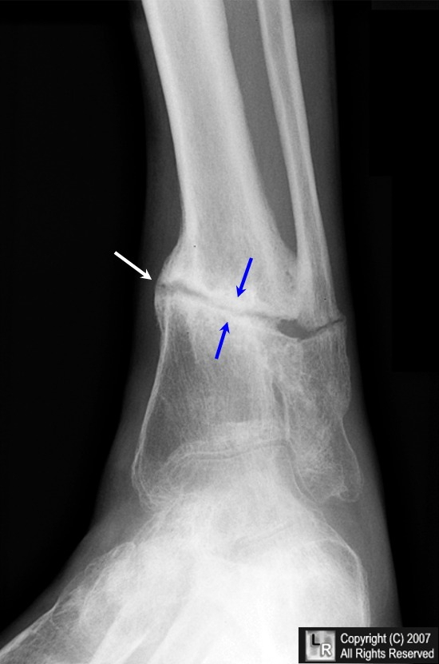
COMPLICATIONS
Delayed union: A fracture that takes longer to heal than expected is a delayed union.
Nonunion: A fracture that fails to heal in a reasonable amount of time is called a nonunion (pseudarthrosis)

Slide 39
COMPLICATIONS
Malunion:-
Malunion: A fracture that does not heal in a normal alignment is called a malunion

Slide 40
COMPLICATIONS
Compartment syndrome:
Severe swelling after a fracture can put so much pressure on the blood vessels that not enough blood can get to the muscles around the fracture.
The decreased blood supply can cause the muscles around the fracture to die, which can lead to long-term disability.
Compartment syndrome usually occurs only after a severe injury.

Slide 41
COMPLICATIONS
Neurovascular injury
Infection: Open fractures can become infected
Post-traumatic arthritis: Fractures that extend into the joints (intra-articular fractures) or fractures that cause the bones to meet at an abnormal angle in the joint can cause premature arthritis of a joint.

Slide 42
COMPLICATIONS
Growth abnormalities: A fracture in the open physis, or growth plate, in a child, can cause many problems.

