Slide 1
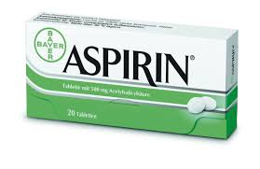
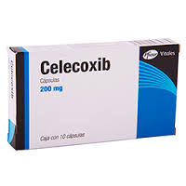
Non-steroidal anti-inflammatory drugs

Slide 2
ILos
At the end of the lecture the students should :
Define NSAIDs
Specify the general mechanism of actions
Classify this group of drugs
Describe the general pharmacological actions
Enumerate the therapeutic uses
Describe the general adverse effects
Describe the general contraindications
Know the difference between the selective & non-selective NSAIDs

Slide 3
Non-steroidal anti-inflammatory Drugs
NSAIDs are group of drugs that share in common the capacity to induce:
Analgesic effect.
Antipyretic effect.
Anti-inflammatory effect.

Slide 4
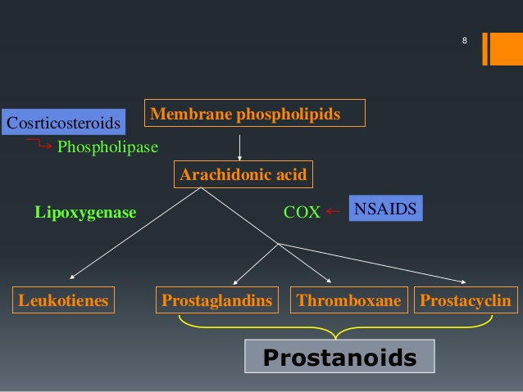
MECHANISM OF ACTION OF NSAIDS
NSAIDs inhibit cyclooxygenase (COX) enzymes responsible for the production of prostaglandins (PGs) which promote inflammation necessary for healing, pain and fever.
As a consequence, ongoing inflammation, pain and fever are reduced by NSAIDs.
Notes:
Phospholipids are acted upon by phospholipase A₂, to produce arachidonic acid. Two important pathways for arachidonic acid metabolism are the cyclooxygenase (COX) and 5-lipoxygenase (5-LO) pathways

Slide 5
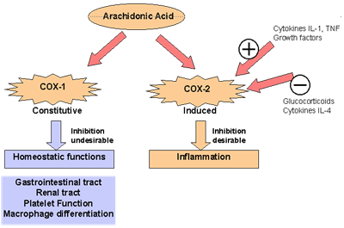
COX isoforms
COX-1 produces PGs that support the blood clotting function of platelets; and protect the lining of the stomach from the damaging effects of acid. NSAIDs which inhibit COX1 can cause ulcers in the stomach and promote bleeding.
COX-2 is expressed at sites of inflammation and produces PGs that mediate inflammation and pain.
COX3 is a new isozyme found in the brain , it is the target for acetaminophen.

Slide 6
Classification of NSAIDs
Nonselective COX-1/COX-2
Inhibitors
Aspirin, Diclofenac
Selective COX-2
Inhibitors
Coxibs
Preferential COX2 inhibitors
Meloxicam
COX3 inhibitors
Paracetamol

Slide 7
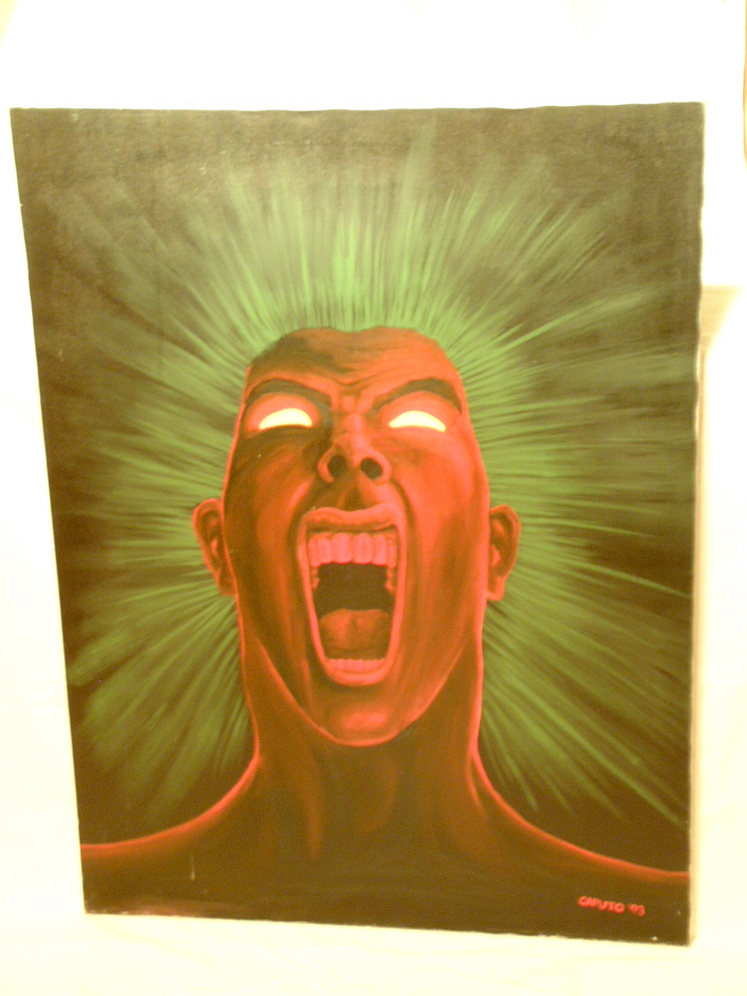
1-ANALGESIC
NSAIDs
Prostaglandins
PGE2 PGF2
Factors
+
Bradykinin
Histamine
Nerve ending of pain
Block PGs production
Sites of action: peripheral tissue
Pain

Slide 8
2-ANTIPYRETIC
Prostaglandins
PGE2
Pyrogen
NSAIDs
Thermoregulatory center
Antipyretic Mechanism
Block PGs production
Sites of action: CNS
Set point ↑
Heat production ↑
Heat dissipation ↓
Fever

Slide 9
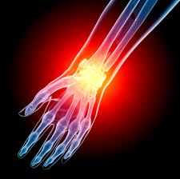
3-Anti-inflammatory
NSAIDs
Prostaglandins
PGE2 , PGF2
Inflammatory factors
+
Bradykinin
Histamine
5-HT
Symptoms of inflammation
Block PGs production
Sites of action: peripheral tissues
Red, swelling,
Heat, pain

Slide 10
Clinical uses
Fever
Headache, Migraine,
Dental pain, Dysmenorrhea
Common cold
Rheumatoid arthritis / myositis

Slide 11
adrs
GIT upsets ( nausea, vomiting)
GIT ulceration & bleeding
Bleeding
Hypersensitivity reactions
Inhibition of uterine contraction
Salt & water retention

Slide 12
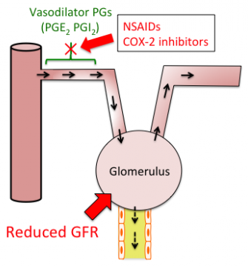
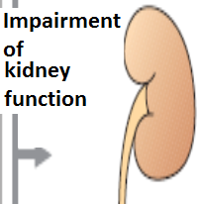
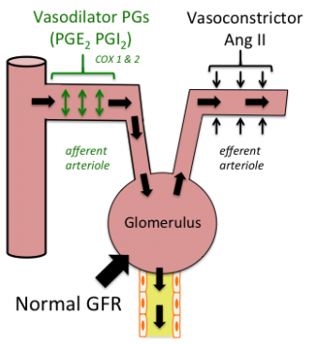
Renal adrs
NSAIDs cause hemodynamically- mediated acute renal failure
Notes:
Prostaglandins normally cause vasodilation of the afferent arterioles of the glomeruli. This helps maintain normal glomerular perfusion and GFR This is particularly important in renal failure where the kidney is trying to maintain renal perfusion pressure by elevated angiotensin II levels. By blocking this prostaglandin-mediated effect, particularly in renal failure, NSAIDs cause unopposed constriction of the afferent arteriole and decreased RPF (renal perfusion pressure).

Slide 13
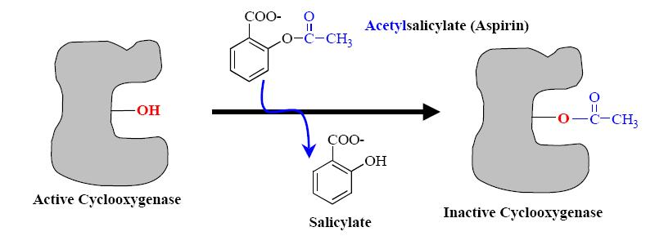
Mechaism of action
Aspirin inhibits COX irreversibly

Slide 14
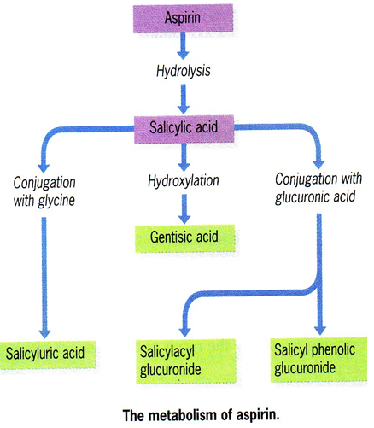
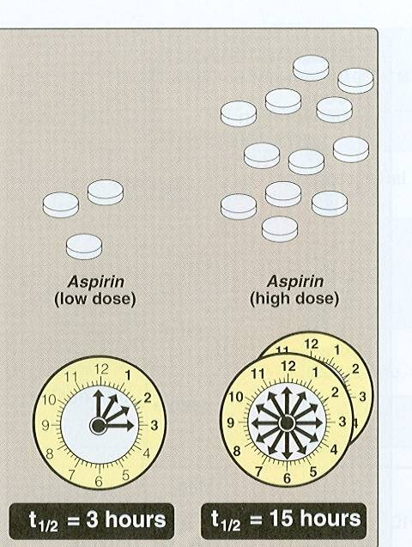
Pharmacokinetics
Metabolized by hydrolysis and then conjugation
Higher dose of aspirin has a long plasma half- life

Slide 15
Clinical uses
Acute rheumatic fever
Reducing the risk of myocardial infarction (cardioprotective)
Prevention of pre-eclampsia
Chronic use of small doses ,
reduce the incidence of colon cancer
Notes:
Low-Dose Aspirin Use for the Prevention of Morbidity and Mortality From Preeclampsia
role of prostaglandins

Slide 16
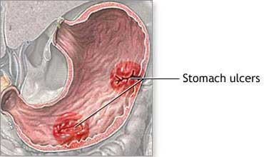
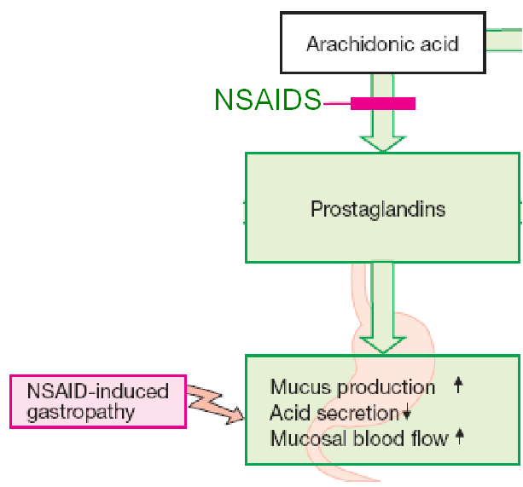
Adrs at clinical doses
Hypersensitivity bronchospasm, rhinitis, conjunctivitis, urticaria
Acute gouty arthritis (low doses)
Reye's syndrome
Impaired haemostasis
GIT side effects, dyspepsia, N, V
Mucosal damage→ hemorrhage
Notes:
Reye's syndrome, a rare but severe illness characterized by acute encephalopathy and fatty liver

Slide 17
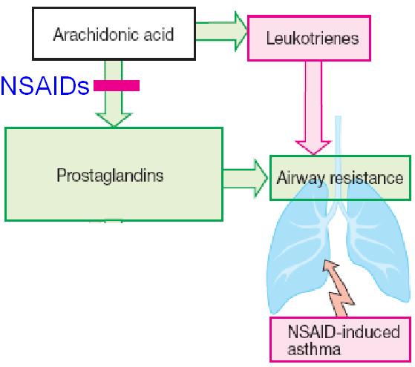
adrs
Bronchospasm in aspirin- sensitive asthmatics

Slide 18
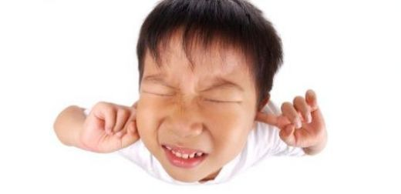
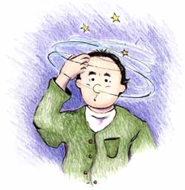
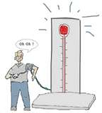
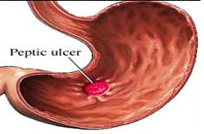
ADRS at overdose
Salicylism ( ringing of ear , vertigo)
Hyperthermia
Gastric ulceration & bleeding

Slide 19
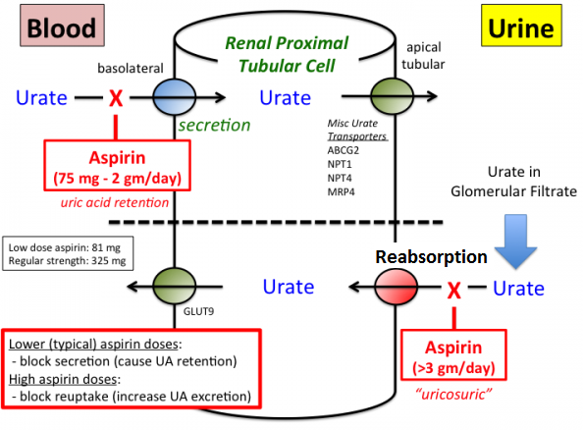
contraindications
Peptic ulcer
Pregnancy
Hemophilic
patients
Patients taking
anticoagulants
Children with
viral infections
Gout ( small doses )
Notes:
Aspirin should be avoided during the third trimester due to possible premature closure of the ductus arteriosus

Slide 20
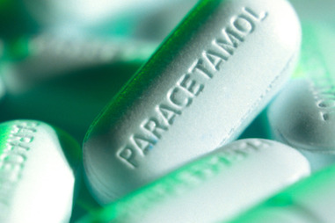
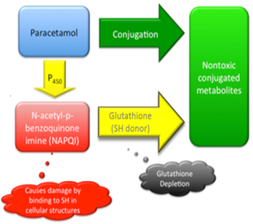
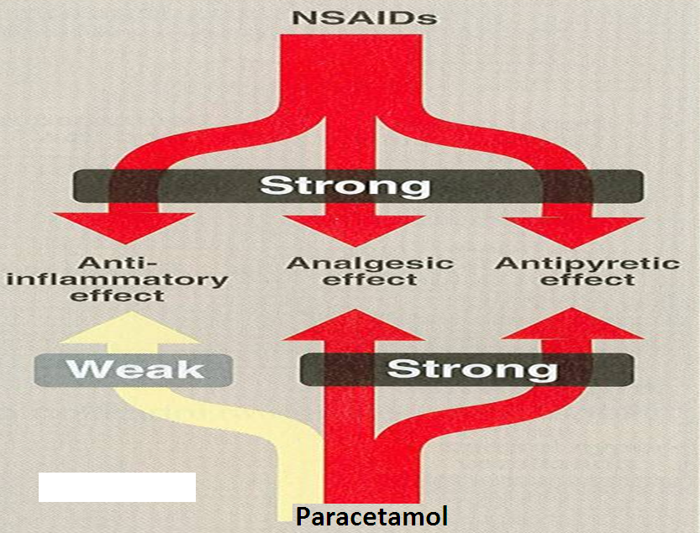
Paracetamol
Weak anti-inflammatory effect
Given orally , well absorbed.
t½=2-4 h
Metabolized by conjugation at therapeutic doses

Slide 21
Clinical uses
Commonly used analgesic antipyretic instead of aspirin in cases of:-
Peptic or gastric ulcers
Bleeding tendency
Allergy to aspirin
Viral infections in children
Pregnancy

Slide 22
ADRS
Mainly on liver due to
its active metabolite
Therapeutic doses
elevate liver enzymes
In large doses it is metabolized into N- acetyl-p-benzoquinone, which causes liver damage.
Treatment of toxicity of paracetamol is by N- acetylcysteine to neutralize the toxic metabolite

Slide 23
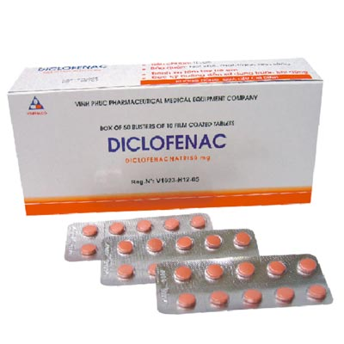
Clinical uses
Analgesic
Antipyretic
Antiinflammatory
Acute gouty arthritis
Locally to prevent post-operative ophthalmic inflammation

Slide 24
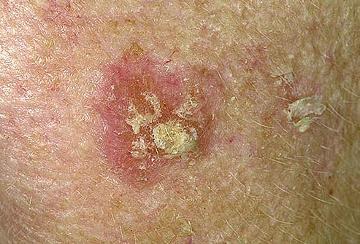
preparations
Diclofenac with misoprostol decreases upper gastrointestinal ulceration , but result in diarrhea.
Diclofenac with omeprazole to prevent recurrent bleeding
0.1% ophthalmic preparation for postoperative ophthalmic inflammation.
A topical gel 3% for solar keratoses.
Rectal suppository as analgesic
Oral mouth wash
Intramuscular preparations

Slide 25
Selective COX-2 inhibitors
Potent anti-inflammatory
Antipyretic & analgesic
Lower incidence of gastric upset
No effect on platelet aggregation ( COX-1)

Slide 26
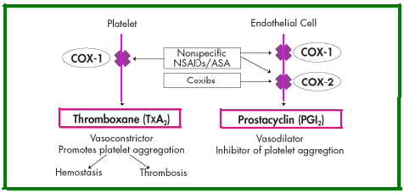
General ADRs
Renal toxicity
Dyspepsia & heartburn
Allergy
Cardiovascular ( do not offer the cardio-protective effects of non-selective group)).
Notes:
COX-2 inhibitors are effective against inflammation and avoid damage to the GI tract. But, unfortunately, they increase the risk of blood clots — which can cause heart attacks and strokes — because they do not block the synthesis of thromboxane A₂ by platelets (which contain only COX-1). So people depending on NSAIDs for their heart protective effects must monitor any use of COX-2 inhibitors carefully.

Slide 27
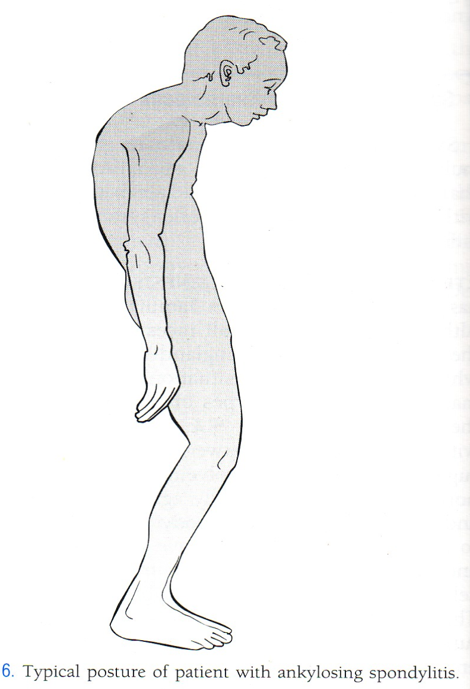
GENERAL CLINICAL USES
Short-term use in postoperative patients
Acute gouty arthritis
Acute musculoskeletal pain
Ankylosing spondylitis
Notes:
Ankylosing spondylitis: inflammation in the joints of spine, leading to pain and stiffness

Slide 28
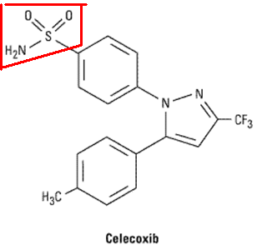
Half-life 11 hours
Food decrease its absorption
Highly bound to plasma proteins

