Slide 1
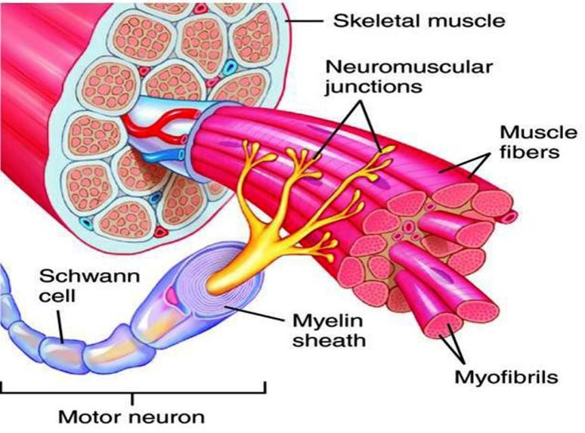
Motor Unit
Dr. Aida Korish
Assoc. Prof. Physiology
KSU

Slide 2
Objectives
At the end of this lecture you should be able to:
Recognise the organization of the nervous system.
Identify the differences between central nervous system
(CNS) & the peripheral nervous system (PNS).
Discuss the functions and recruitment of the motor unit. 4- Interpret the effect of motor units number on motor action performance.

Slide 3
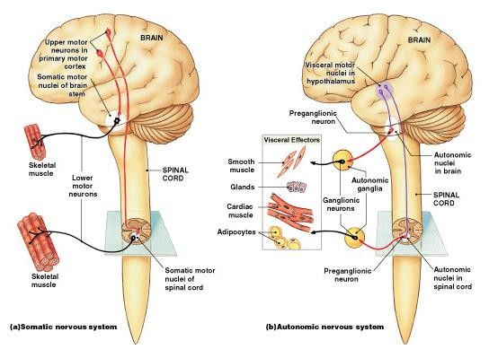
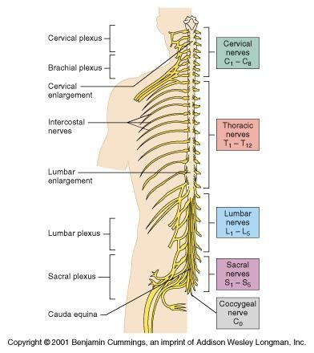
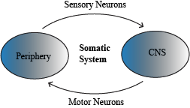
Organization of Nervous
System

Slide 4


Organization of The Nervous System
Central Nervous System(CNS)
(Brain& Spinal Cord)
Peripheral Nervous System (PNS)
Efferent Nerves (Motor) From CNS to periphery |  |  | Afferent Nerves ( Sensory) From Periphery to CNS
Somatic |  |  | Autonomic
Sympathetic
Parasympathetic
Dr.Aida A.Korish( akorish@ksu.edu.sa)
4

Slide 5
Nerve-Muscle Interaction
The nervous system can be divided into central (CNS) and peripheral (PNS).
PNS can be divided in terms of function into motor and sensory activities.
Sensory Neurons: collects information from the various sensors located throughout the body and transmits them to the brain.
Motor Neurons: conducts signals to activate muscle contraction. Skeletal muscle activation is initiated through neural activation.
Sport Books Publisher
5

Slide 6
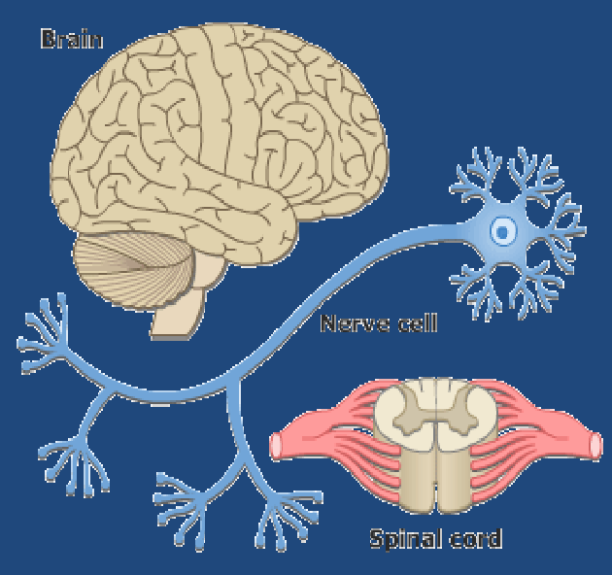
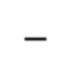
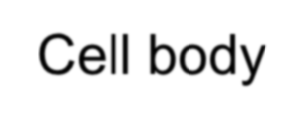
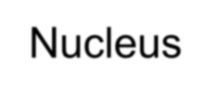


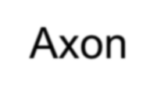
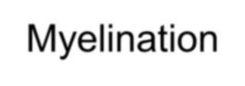
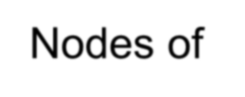
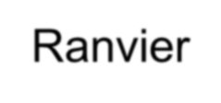
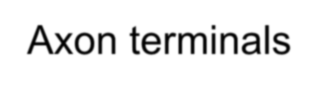
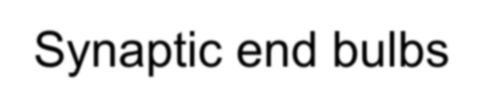
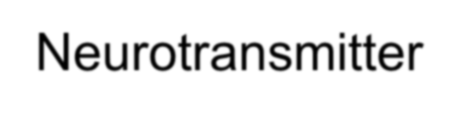
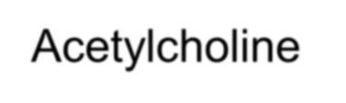
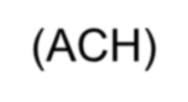
Neurons
The building unit of the nervous system is the neuron which has
Cell body
Nucleus
Dendrites
Axon
Myelination Nodes of Ranvier
Axon terminals
Synaptic end bulbs
Neurotransmitter
Acetylcholine (ACH)

Slide 7
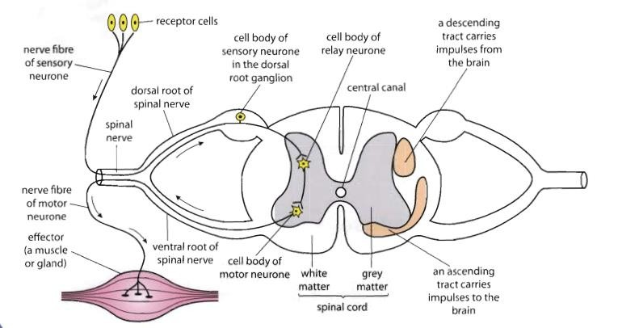
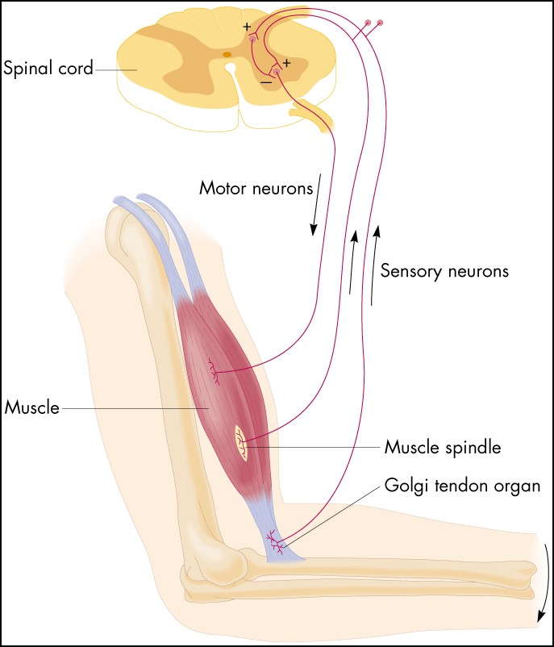
α-motor neuron in the anterior horn cell
A nerve is made up of a group of axons of neurons

Slide 8
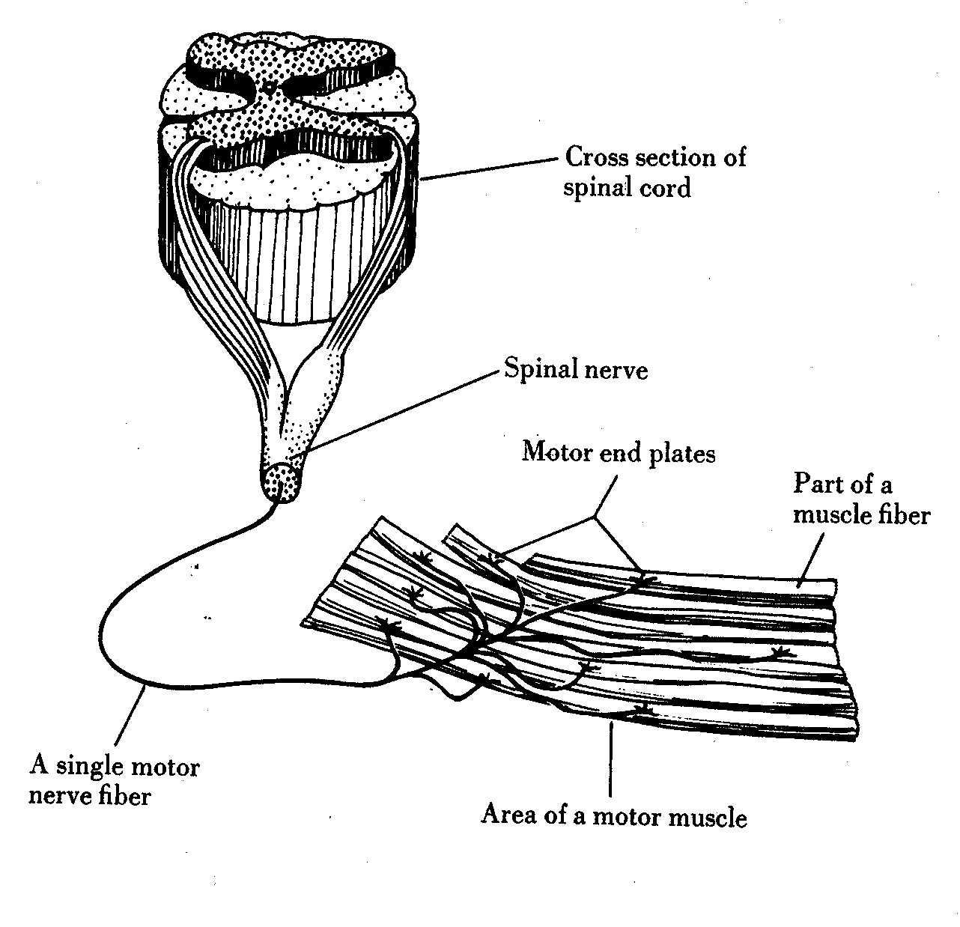
Motor Unit

Slide 9
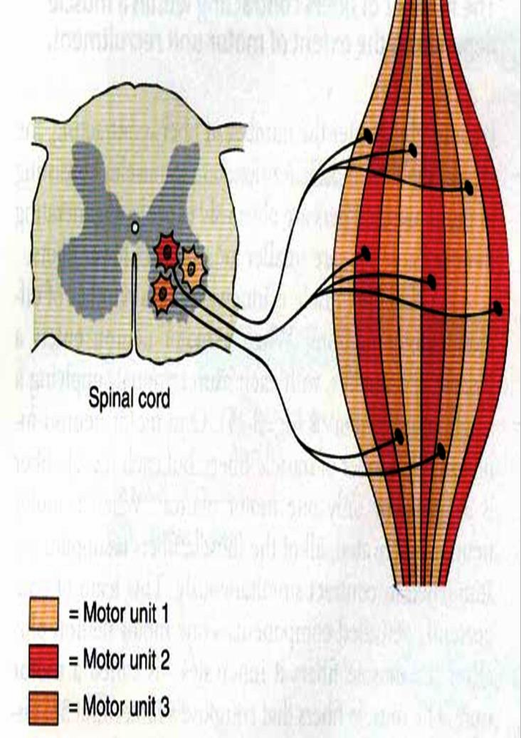
What is a Motor Unit ?
It is the α-motor neuron in the anterior horn cell (AHC) and all the muscle fibers it innervates (supplies) اهيذغت
All of these muscle fibers will be of the same type (either fast twitch or slow twitch).
Each muscle consist of a number of
motor units.
When a motor neuron is activated, all the muscle fibers it innervates are stimulated and will contract.

Slide 10
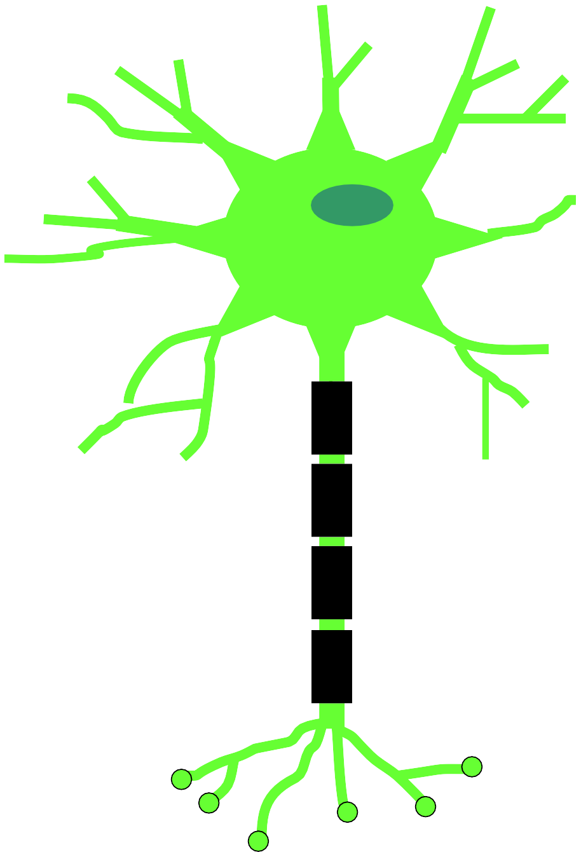
Motor Unit
The number of muscle fibers in a motor unit innervated by one motor neuron varies
Gastrocnemius
2,000 muscle fibers per
motor neuron
Extra ocular muscles
< 10 muscle fibers per motor neuron
Ratio of muscle fibers to
motor neurons
– Affects the precision of movement i.e small number is associated with more precise movements and vice versa.

Slide 11
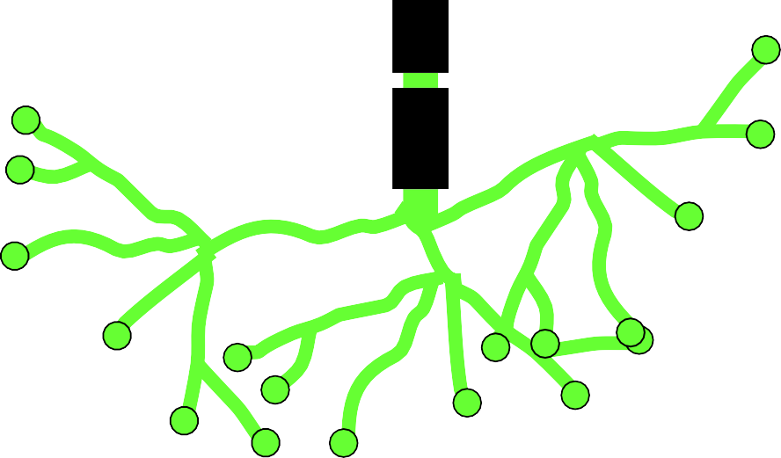
More precise movements
Less precise movements

Slide 12
Groups of motor units often work together to help the contractions of a single muscle.
The number of muscle fibers within each motor unit can vary.
Muscles needed to perform precise movements generally consist of a large number of motor units and few muscle fibers in each motor unit e.g Hands and eyes muscles
Less precise movements are carried out by muscles composed of fewer motor units with many fibers per unit e.g Trunk muscles.
12

Slide 13
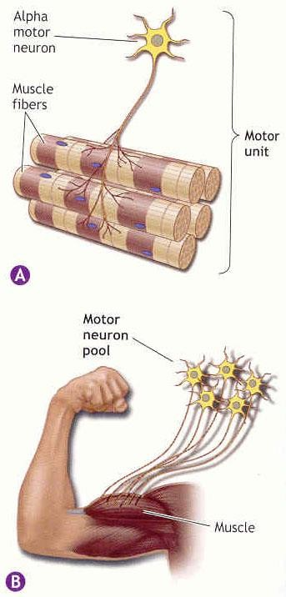
Motor unit recruitment:
The group of motor units supplying a single muscle are called Motor Unit Pool.
▪The two ways the nervous system increases the
force production is through
▪1 -Recruitment of new motor units and
2- Increasing stimulation frequency (rate
coding).
▪The activation of one motor neuron will result
in a weak muscle contraction.
The activation of more motor neurons will result in more muscle fibers being activated, and therefore a stronger muscle contraction.

Slide 14
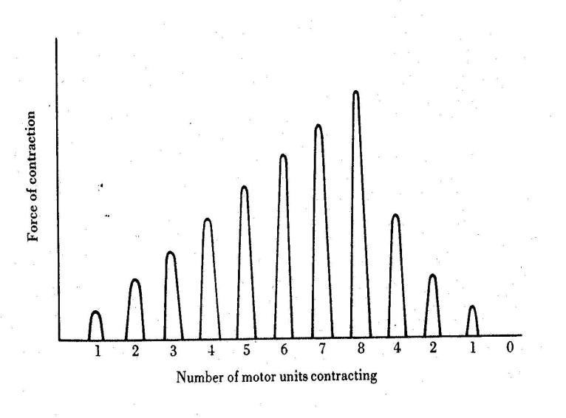
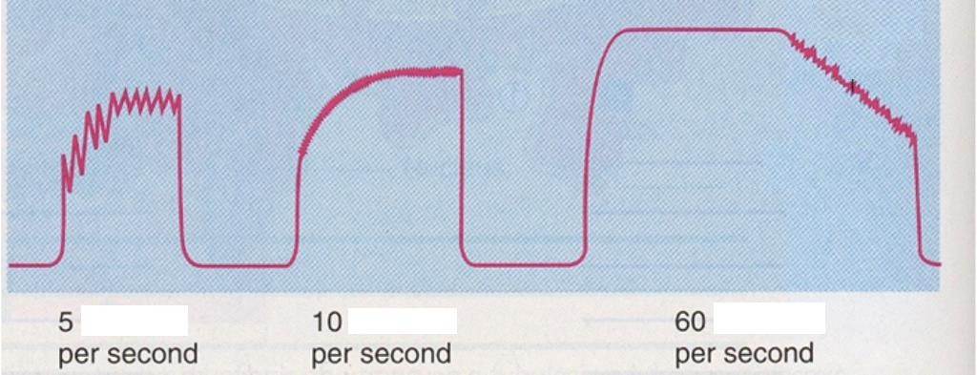
Motor unit recruitment
ةيكرحلا تادحولا فيظوت
Recruitment of motor units is the progressive activation of a muscle by successive recruitment of contractile units (motor units) to accomplish increasing degrees of contractile strength (force).
When the AHC fires at slow rates , motor unit potentials (MUPs) will be at slow rate & the force of muscle contraction is weak.
If AHCs fire at very fast rates → fast
MUPs → stronger contraction.
Increasing frequency of action potentials
resulting in stronger force of
contraction
14

Slide 15
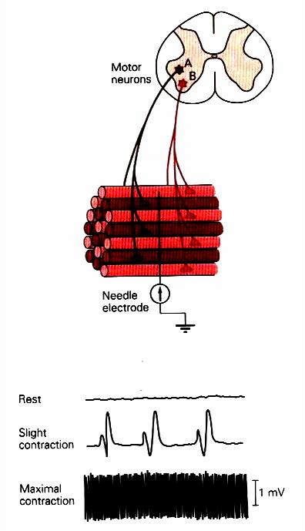
The higher the motor unit recruitment, the stronger the muscle contraction .
The force produced by a single motor unit is determined by →
the number of muscle fibers in
the unit and
the frequency with which the muscle fibers are stimulated by their innervating axon.
Generally, this allows a 2 to 4-
fold change in force.
15

Slide 16
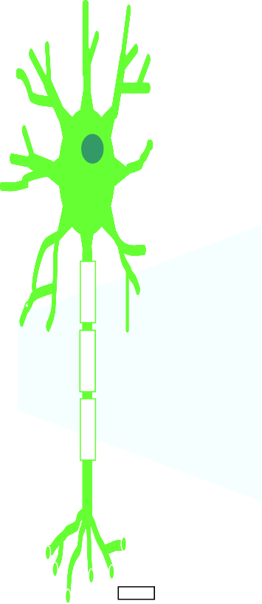
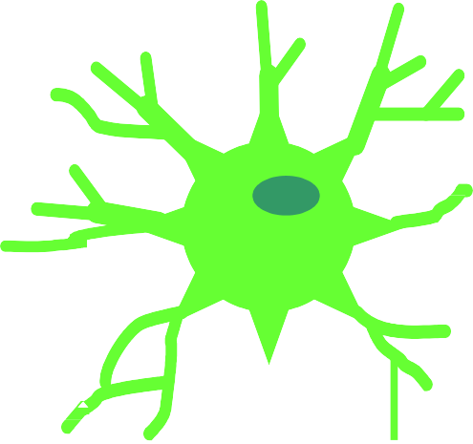



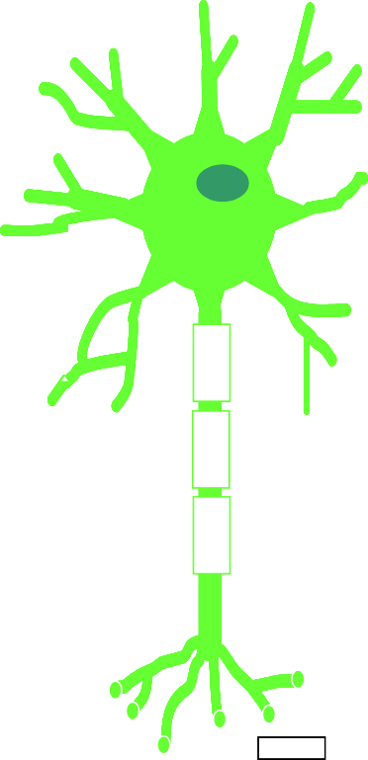



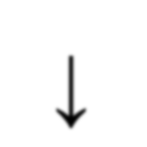
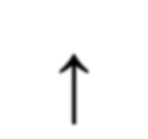
Recruitment
Varying the number of motor units activated.
Number & Size of Motor Units Recruited
Small motor units
Low stimulus threshold
Larger motor units
Higher stimulus threshold
Largest motor units
Highest stimulus threshold
The Size Principle
↓
↑
Amount of Force Required During Movement

Slide 17
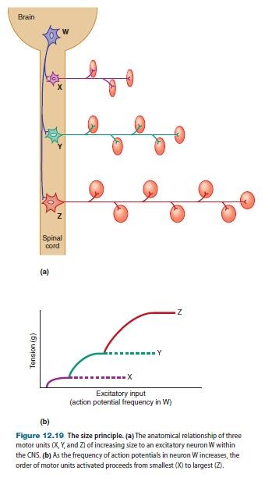
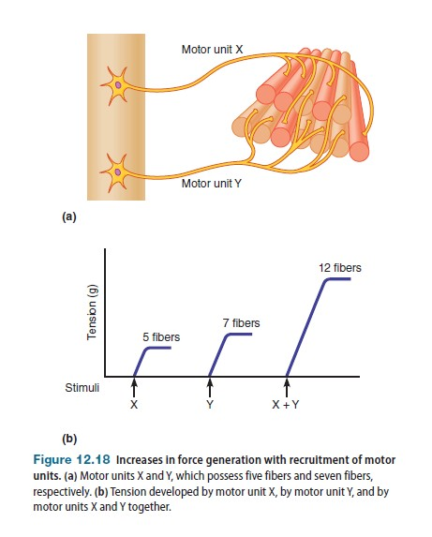
Recruitment and Size Principle

Slide 18
Rate Coding
Rate coding refers to the motor unit firing
rate.
  Active motor units can discharge at higher
frequencies to generate greater tensions.
Recruitment versus rate coding
  Smaller muscles (ex: first dorsal
interosseous) rely more on rate coding.
  Larger muscles of mixed fiber types (ex:
deltoid) rely more on recruitment.

Slide 19
All or non role
Motor Units Follows “all-or-none” principle – impulse from motor neuron will cause contraction in all muscle fibers it innervates or none.
In an electrodiagnostic testing (EMG , electromyography) for a patient with weakness, careful analysis of the motor unit action potential (MUAP) size, shape, and recruitment pattern can help in distinguishing a myopathy from neuropathy.

