Slide 1
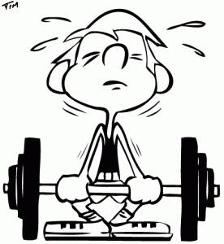

Muscle adaptation to exercise
Dr. Aida Korish Assoc.Prof.Physiology KSU
Dr.Aida Korish (
akorish@ksu.edu.sa)
1

Slide 2

 Define strength, power, and endurance of muscles.
 Analyze the effect of athletic training on muscle structure and
muscle performance.
 Discuss the mechanism of muscle hypertrophy.
 Contrast Fast-twitch and Slow-twitch muscle fibers.
 Explain the respiratory changes in exercise (Oxygen consumption, pulmonary ventilation and VO₂ max).
 Identify the cardiovascular changes in exercise (Work output,
cardiac output, heart hypertrophy).
 Interpret the role of stroke volume and heart rate in increasing the cardiac output.
 Explain the body heat in exercise and the heatstroke.
2

Slide 3



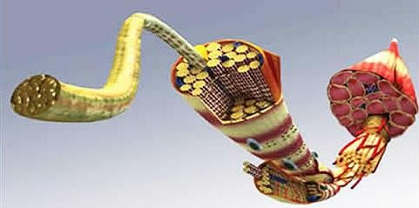
Strength, Power, and Endurance of Muscles
 Muscles strength: Refers to the amount of force (push or pull) a muscle can produce. Size of the muscle influences the maximal contractile force. Normally 3-4 kg/cm² of the cross section of the muscle
e.g. a cross-sectional area 150cm² causes maximal contractile
strength of 525 kilograms.
 Mechanical work of muscle = The force applied by the
muscle x the distance (kg-m).
2

Slide 4



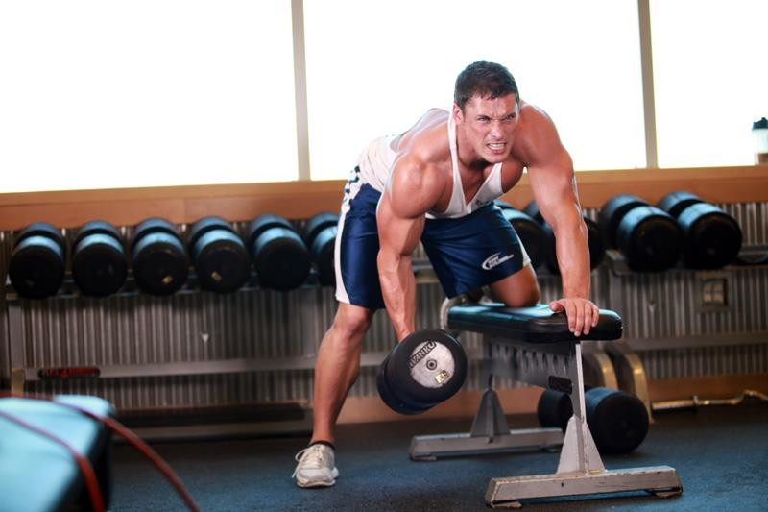
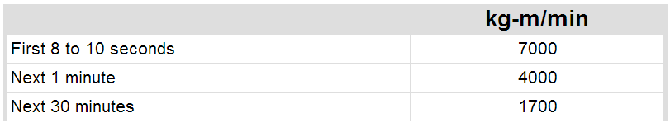
Cont… Strength, Power, and Endurance of Muscles
 Muscles Power: The amount of work the muscle performs in a period of time. It is expressed in (kg- m/min).
The maximal power achievable by all muscles in the body of a highly trained athlete working together is approximately the following:
2

Slide 5
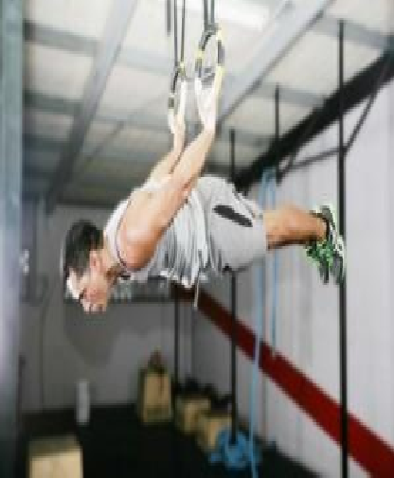


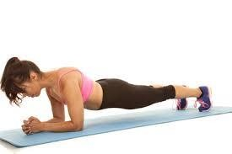

Cont… Strength, Power, and Endurance of Muscles
 Muscles Endurance: The ability of the muscle to sustain repeated contractions against a resistance for a period of time.
 It depends on glycogen stored in the
muscle.
 Dynamic endurance: is defined as the muscle’s ability to contract and relax repeatedly.
 Static endurance: is the muscle’s ability
to remain contracted for a long period.
Dr.Aida Korish ( akorish@ksu.edu.sa)
5

Slide 6


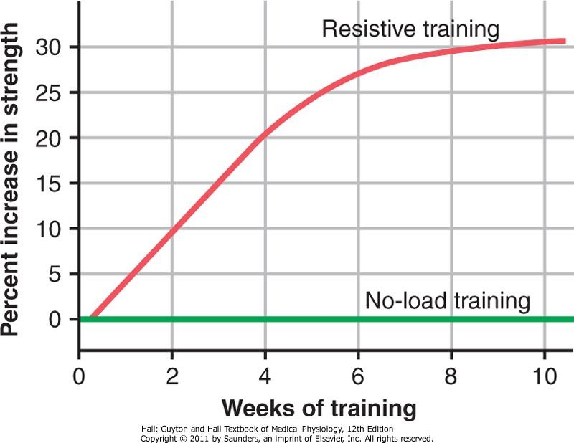
Effect of Training on Muscles and Muscle Performance
 Maximal Resistance Training:
Six nearly maximal muscle contractions performed in three sets 3 days a week give approximately optimal increase in muscle strength, without producing chronic muscle fatigue.
 However Multiple weeks of muscles function under no load will cause little in strength.
Approximate effect of optimal resistive exercise training on increase in muscle strength over a training period of 10 weeks.
Dr.Aida Korish ( akorish@ksu.edu.sa)
6

Slide 7





Muscle Hypertrophy
 With training muscles hypertrophied 30-60 %
 Due to diameter of the muscle fibers with some
increase in number of fibers.
 Changes in the hypertrophied muscle fiber:
 myofibrils numbers.
 120 % in mitochondrial enzymes.
 ATP and phosphocreatine.
 50 % in stored glycogen
 75 -100 % in stored triglycerides.
 Both the aerobic & anaerobic metabolisms
 The efficiency of the oxidative metabolic
system increases by 45 %.
9

Slide 8
Fast-Twitch and Slow-Twitch Muscle Fibers
 Fast-twitch fibers: for forceful and rapid contraction. e.g. gastrocnemius muscle used for jumping.
 Slow-twitch muscle: for prolonged muscle activity e.g. soleus muscle in the
lower leg muscle for standing.
Fast-twitch fibers achieves maximal power in very short periods of time.
Slow-twitch fibers Provide endurance, prolonged strength of contraction
minutes to hours. Is organized for generation of aerobic energy.
 In summary, fast-twitch fibers can deliver extreme amounts of power for a few seconds to a minute or so. Conversely, slow-twitch fibers provide endurance, delivering prolonged strength of contraction over many minutes to hours.
* differences between the fast-twitch and the slow-twitch fibers Read Guyton & Hall: Textbook of Medical Physiology 12E Unite XV chapter 84 page 1036)
9

Slide 9

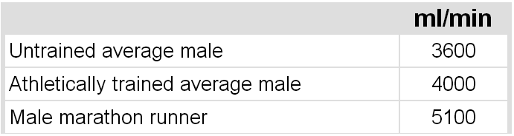
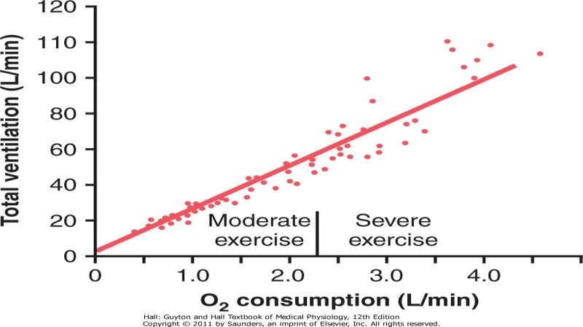
Respiration In Exercise
 Oxygen Consumption (VO2) and Pulmonary Ventilation (VE) in Exercise
 VO2 at rest is about 250 ml/min. However at Maximal efforts can be as
follows:
VO2 and VE increase about 20- fold between the resting state and maximal intensity
Effect of exercise on oxygen consumption and ventilatory rate.)
9

Slide 10
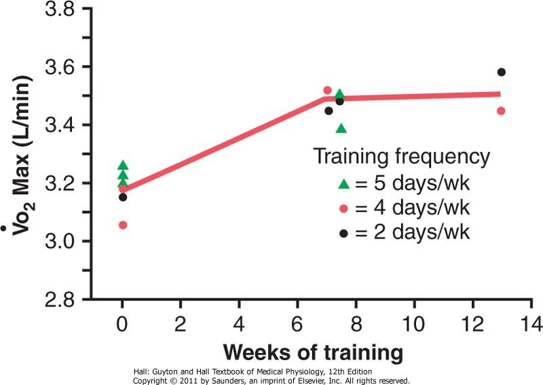
Effect of Training on VO₂ Max
 VO2 Max: The rate of oxygen usage under maximal aerobic metabolism is VO2 Max. In the below study VO₂ Max increased only about 10% by training.
Moreover other factors such as:
 chest sizes in relation to body size
 Increase respiratory muscles
can also increase VO2 Max
Guyton & Hall12E
Unit XV chapter 84 page 1037-38
Increase in Vo2 Max over a period of 7 to 13 weeks of athletic training. (Redrawn
from Fox EL: Sports Physiology. PhilaDdre.AlpidhaiaK:oSriashun( ders College Publishing, 1979.)
akorish@ksu.edu.sa)

Slide 11
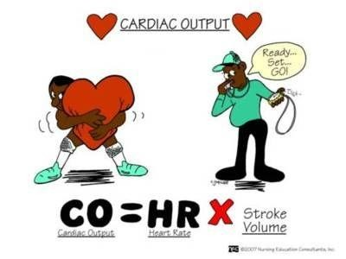
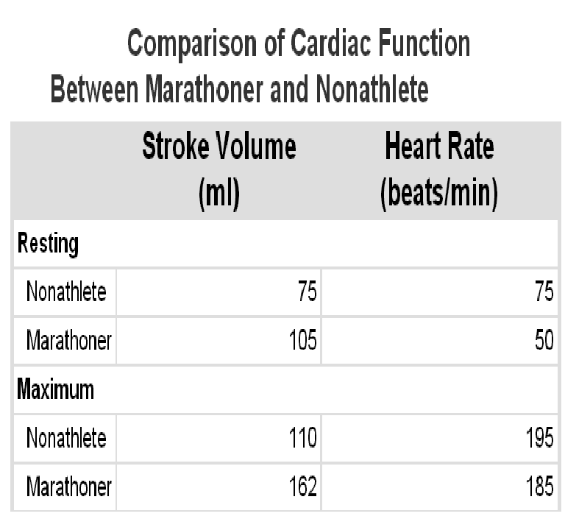
Cardiovascular System in Exercise
 Work Output, Oxygen Consumption, and Cardiac Output (C.O.P) During Exercise are directly related to one another. Muscle work oxygen consumption dilates the muscle blood vessels, thus venous return and
C.O.P .
 Effect of Training on Heart Hypertrophy and C.O.P:
 Training increases C.O.P about 40 %
than in untrained persons.
 Heart chambers of marathoners enlarge about 40% in contrast to non trained.
 Heart size of marathoner larger than
normal person.

Slide 12
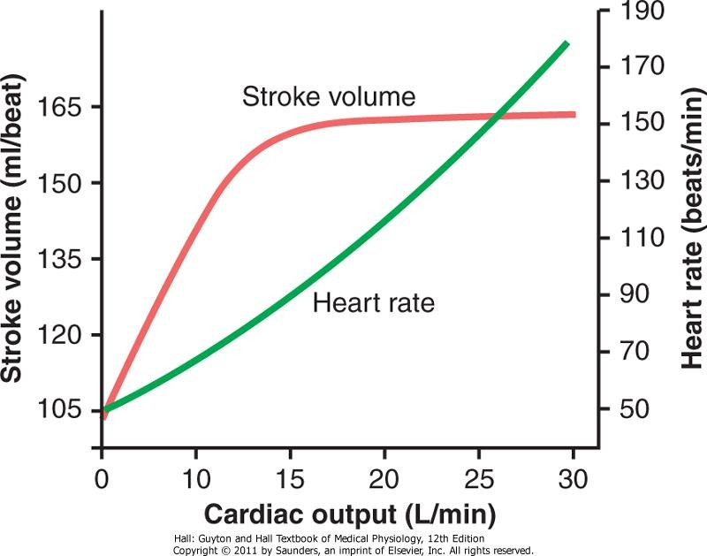
Cardiovascular System in Exercise cont…
In Marathon runner the cardiac output increases from its resting level of about 5.5 L/min to 30 L/min.
The stroke volume increases from 105 to 162 milliliters, an increase of about 50%.
Whereas the heart rate increases from 50 to 185 beats/min, an increase of 270 %.
The heart rate increase a greater proportion of the increase in cardiac
output than does the increase in stroke volume.
Approximate stroke volume output and heart rate at different levels of cardiac output in a marathon athlete.

Slide 13
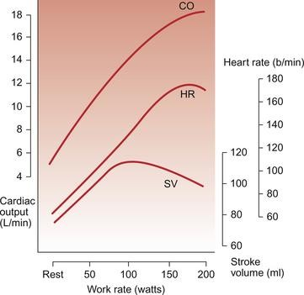

Slide 14

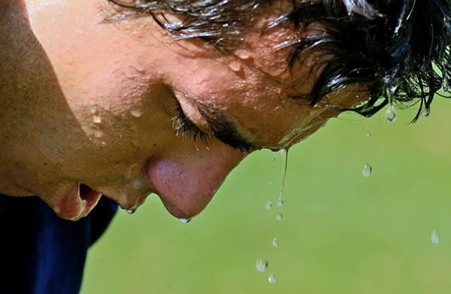


Body Heat In Exercise
 Almost all the energy released by the body's
metabolism is converted into body heat.
 Working muscle use only 20 - 25 %.
 The remainder is converted into heat as result of
Resistance to the movement of the muscles and
joints.
Friction of the blood flowing through the blood vessels,
Muscle contractile converted into heat.
What will happen if sweating mechanism cannot eliminate the heat ???? see
Guyton & Hall12E Unite XV chapter 84
page 1039-40

Slide 15

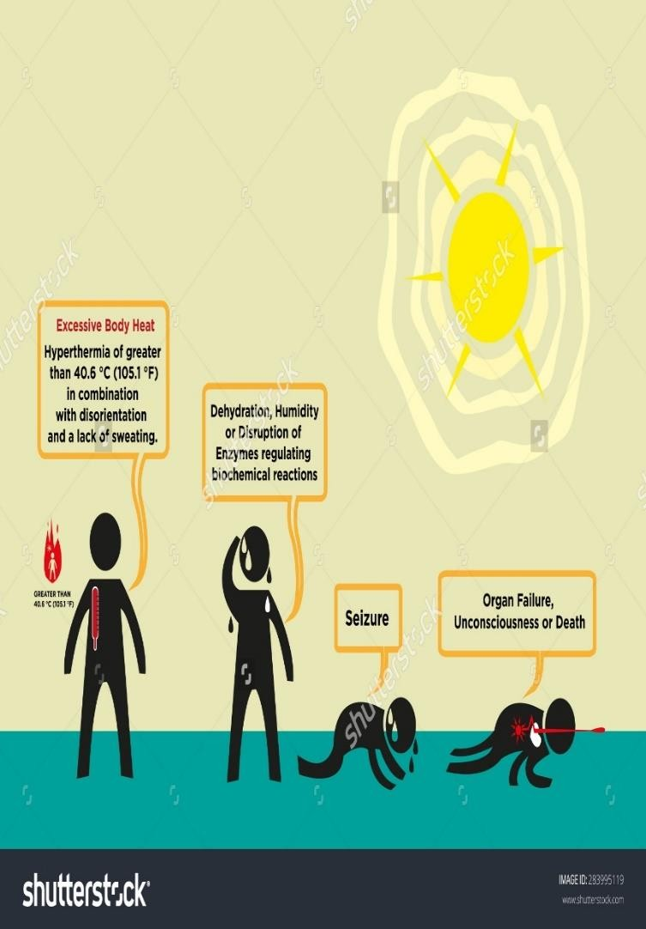
Heatstroke
 During endurance training body temperature rises 98.6° to 102° or 103°F (37° to 40°C)
 In hot and humid conditions body
temperature rise to 106° to 108°F (41° to 42°C)
 High temperature is destructive to tissue
cells mainly (brain cells) .
 Symptoms: Body weakness, exhaustion, headache, dizziness, nausea (disgust), sweating, confusion, uncontrolled gait, collapse, and unconsciousness and may lead to death.

Slide 16
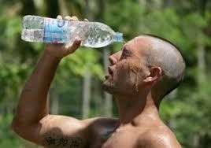

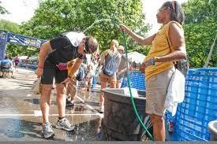
Treatment of heatstroke
The most practical way :
 Remove all clothing
 Maintain a spray of cool water on all surfaces of the body or continually sponge the body.
 Blow air over the body with a fan.
 Physicians prefer total immersion of the body in water containing a mush of crushed ice if available.

Slide 17

Thank you !

