Slide 1
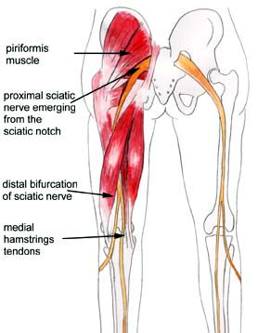
SCIATIC NERVE
Prof. Saeed Abuel Makarem

Slide 2
OBJECTIVES
By the end of the lecture, you should be able to:
Describe the anatomy (origin, course & distribution) of the sciatic nerve.
List the branches of the sciatic nerve.
Describe briefly the main motor and sensory manifestations in case of injury of the sciatic nerve or its main branches.

Slide 3
Origin
From Sacral the Plexus:
(L4,5, S1, 2,3).
It is the largest branch of the plexus.
It is the largest nerve of the body.

Slide 4
Sacral Plexus
Formation:
Ventral (anterior) rami of (L4,5 S1,2,3 & 4)
Part of L4 & whole L5 (lumbosacral trunk) + S1,2,3 and most of S4.
Site:
On the posterior pelvic wall.
In front of Piriformis muscle.
4
5

Slide 5
Course & Distribution
It leaves the pelvis through greater sciatic foramen, below the piriformis.
It passes in the gluteal region (between ischial tuberosity & greater trochanter).
Then it enters the posterior compartment of the thigh.
Termination:
In the middle of the back of the
thigh it divides into 2 terminal branches:
Tibial (medial popliteal).
Common Peroneal, or lateral popliteal or (Fibular).

Slide 6
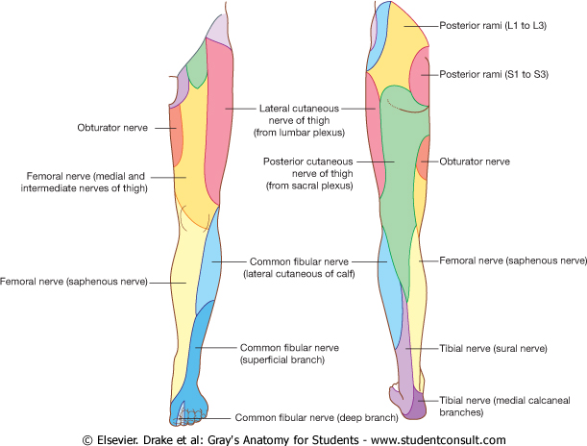
Branches of Sciatic Nerve
1. Cutaneous:
To all leg & foot EXCEPT:
Areas supplied by the saphenous nerve (branch of femoral nerve).

Slide 7
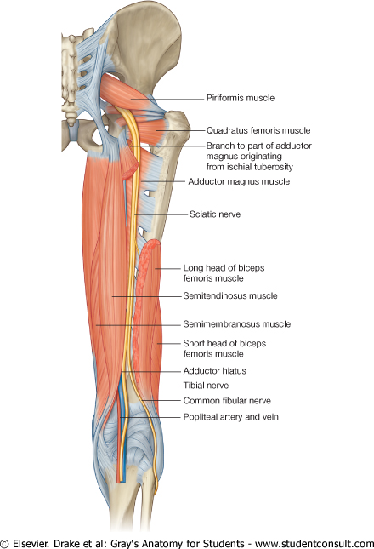
2. Muscular:
To Hamstrings:
(flexors of knee & extensors of the hip).
(through tibial part) to:
Hamstring part of Adductor Magnus.
Long head of Biceps Femoris.
Semitendinosus.
Semimembranosus.
NB. The short head of biceps receives its branch from the lateral popliteal (common peroneal) nerve.

Slide 8
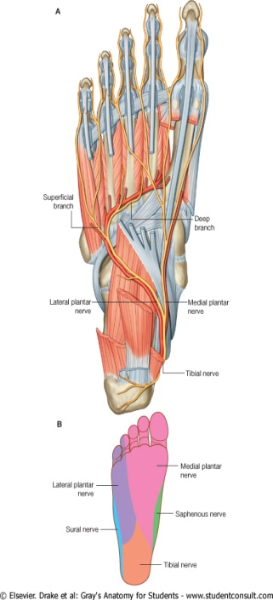
Tibial Nerve
Course:
Bisect the popliteal fossa.
Then descends through the posterior compartment of leg, accompanied with posterior tibial vessels.
Passes deep to flexor retinaculum (through the tarsal tunnel, behind medial malleolus) to reach the sole of foot where it divides into 2 terminal branches (Medial & Lateral planter nerves).

Slide 9
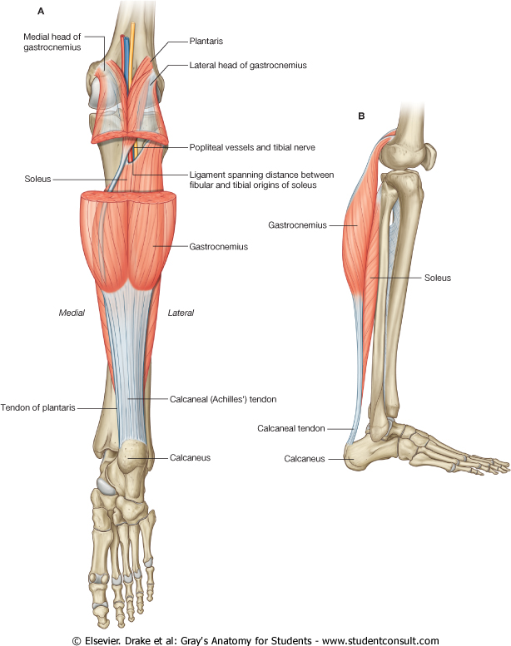
Muscular Branches
Muscles of posterior compartment of leg (Planter flexors of the ankle, Flexors of toes.
Intrinsic muscles of sole.
ONE Invertor of foot (tibialis posterior).

Slide 10
Common Peroneal or Lateral popliteal (Fibular) Nerve
Course:
Leaves the lateral angle of the popliteal fossa & turns around the lateral aspect of neck of fibula, (Dangerous Position).
Then divides into:
Superficial peroneal or
(Musculocutaneous):
which supply the Lateral compartment of the leg.
Deep peroneal or
(Anterior Tibial):
which supply the Anterior compartment of the leg.

Slide 11
Muscular Branches
To the muscles of anterior & lateral compartments of leg:
Dorsi flexors of ankle,
Extensors of toes,
Evertors of foot).

Slide 12
CAUSES OF SCIATIC NERVE INJURY
The sciatic nerve is most frequently injured by…?
I- Badly placed intramuscular injections in the gluteal region.
To avoid this,
injections should be done into the gluteus maximus or medius (into the upper outer quadrant of buttock
Most nerve lesions are incomplete, and in 90% of injuries, the common peroneal nerve is the mostly affected. Why?
- The common peroneal nerve fibers lie superficial in the sciatic nerve.
II-Posterior dislocation of the hip joint

Slide 13
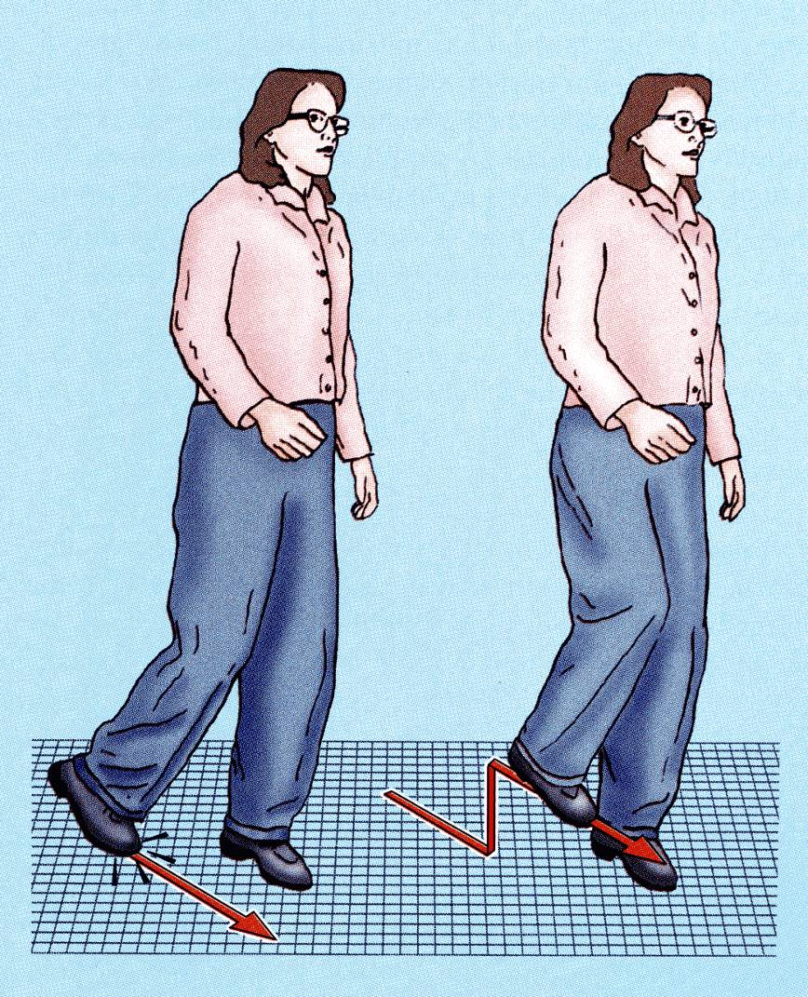
SCIATIC NERVE INJURY
MOTOR EFFECT:
Marked wasting of the muscles below the knee.
Weak flexion of the knee (sartorius & gracilis are intact).
Weak extension of hip (gluteus maximus is intact).
All the muscles below the knee are paralyzed, and the weight of the foot causes it to assume the plantar-flexed position, or Foot Drop.
(High steppage gait).

Slide 14
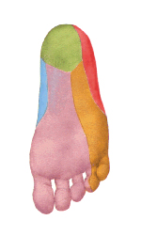
Sensory Loss
Sensation is lost below the knee, except for a narrow area down the medial side of the lower part of the leg (blue) and along the medial border of the foot as far as the ball of the big toe, which is supplied by the saphenous nerve (femoral nerve).

Slide 15
EFFECT OF SCIATIC NERVE INJURY
MOTOR EFFECT | Paralysis of | Movements affected
 | Hamstrings | Flexion of knee &
 |  | Extension of hip
 | All muscles of Leg & Foot | All movements of the leg & Foot
SENSORY EFFECT | Loss of sensation of the areas supplied by sciatic nerve (below knee). | EXCEPT area supplied by the (Saphenous nerve).

Slide 16
SCIATICA
Sciatica describes the condition in which patients have pain along the sensory distribution of the sciatic nerve.
Thus the pain is experienced in the posterior aspect of the thigh, the posterior and lateral sides of the leg, and the lateral part of the foot.

Slide 17
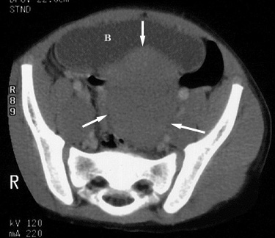
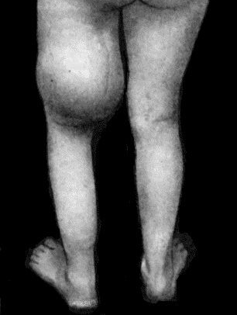
Causes of Sciatica:
Prolapse of an intervertebral disc, with pressure on one or roots of the lower lumbar and sacral spinal nerves,
Pressure on the sacral plexus or sciatic nerve by an intrapelvic tumor,
Inflammation of the sciatic nerve or its terminal branches.

Slide 18
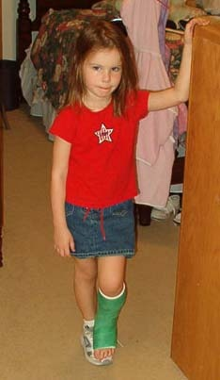
Common Peroneal Nerve Injury
The common peroneal nerve is in an exposed position as it leaves the popliteal fossa through its lateral angle.
Then it winds around neck of the fibula to enter peroneus longus muscle, (Dangerous Position)!!!!!!!!!!!!!
The common peroneal nerve is commonly injured
In Fractures of the neck of the fibula and
By pressure from casts or splints.

Slide 19
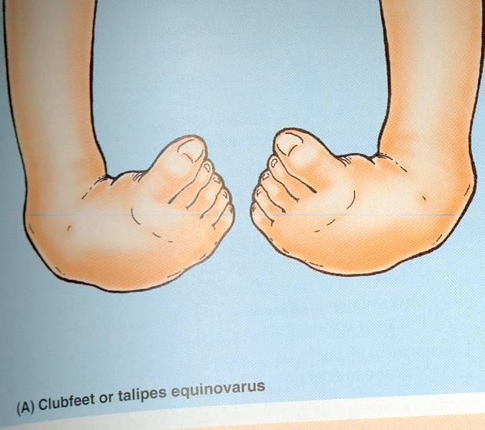
Manifestations of Common Peroneal Nerve Injury
The following clinical features are present:
Motor:
The muscles of the anterior and lateral compartments of the leg are paralyzed,
As a result, the opposing muscles, the plantar flexors of the ankle joint and the invertors of the subtalar joints, cause the foot to be Plantar Flexed (Foot Drop) and Inverted, an attitude referred to as Talipes Equinovarus.

Slide 20
Common Peroneal Nerve Injury
Sensory
Sensation is lost between the first and second toes.
Dorsum of the foot and toes.
Medial side of the big toe.
Lateral side of the leg.
Superficial peroneal

Slide 21
Tibial Nerve Injury
Because of its deep and protected position, the tibial nerve is rarely injured.
Complete division results in the following clinical features:
Motor:
All the muscles in the back of the leg and the sole of the foot are paralyzed.
The opposing muscles Dorsiflex the foot at the ankle joint and Evert the foot at the subtalar joint, an attitude referred to as Taleps Calcaneovalgus.

Slide 22
Tibial Nerve Injury
Sensory loss:
On the Lateral side of the leg and foot & trophic ulcers in the sole.

