Slide 1
BONES OF LOWER LIMB
ANATOMY DEPARTMENT
Dr. Mohammad Saeed Vohra
vohra@ksu.edu.sa

Slide 2
OBJECTIVES
At the end of the lecture the students should be able to:
Classify the bones of the three regions of the lower limb (thigh, leg and foot).
Differentiate the bones of the lower limb from the bones of the upper limb
Memorize the main features of the
Bones of the thigh (femur & patella)
Bones of the leg (tibia & Fibula)
Bones of the foot (tarsals, metatarsals and phalanges)
Recognize the side of the bone

Slide 3
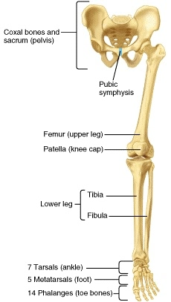
BONES OF THIGH (Femur and Patella)
Femur:
Articulates above with acetabulum of hip bone to form the hip joint
Articulates below with tibia and patella to form the knee joint

Slide 4
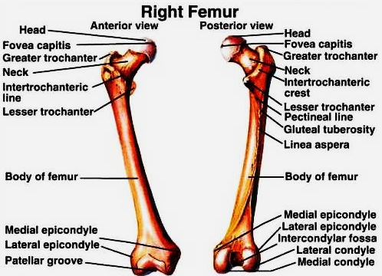
BONES OF THIGH (Femur and Patella)
Femur
Consists of:
Upper end
Shaft
Lower end

Slide 5
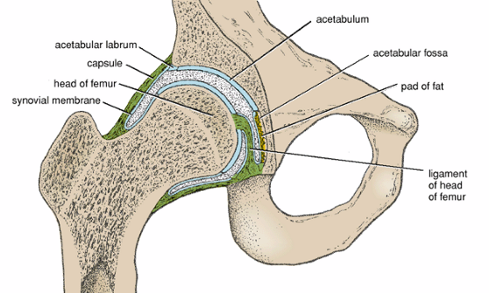
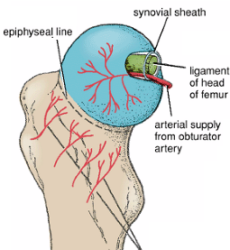
UPPER END OF FEMUR
Head:
It articulates with acetabulum of hip bone to form hip joint
Has a depression in the center (fovea capitis), for the attachment of ligament of the head
Obturator artery passes along this ligament to supply head of femur
Neck:
It connects head to the shaft

Slide 6
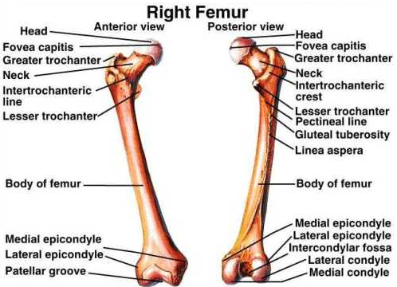
UPPER END OF FEMUR
Greater and lesser trochanters
Anteriorly
connecting the 2 trochanters the inter-trochanteric line, where the iliofemoral ligament is attached
Posteriorly
the inter-trochanteric crest, on which is the quadrate tubercle

Slide 7
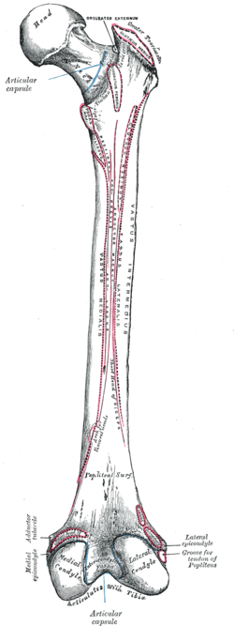
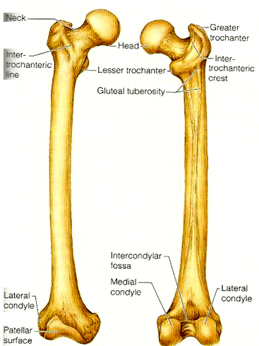
SHAFT OF FEMUR
It has 3 borders
Two rounded medial and lateral
One thick posterior border or ridge called linea aspera
It has 3 surfaces
Anterior
Medial
Lateral

Slide 8
SHAFT OF FEMUR
Posteriorly: below the greater trochanter is the gluteal tuberosity for attachment of gluteus maximus muscle
The medial margin of linea aspera continues below as medial supracondylar ridge
The lateral margin becomes continues below with the lateral supracondylar ridge
A Triangular area, the popliteal surface lies at the lower end of shaft

Slide 9
LOWER END OF FEMUR
Has lateral and medial condyles, separated anteriorly by articular patellar surface, and posteriorly by intercondylar notch or fossa
The 2 condyles take part in the knee joint
Above the condyles are the medial & lateral epicondyles

Slide 10
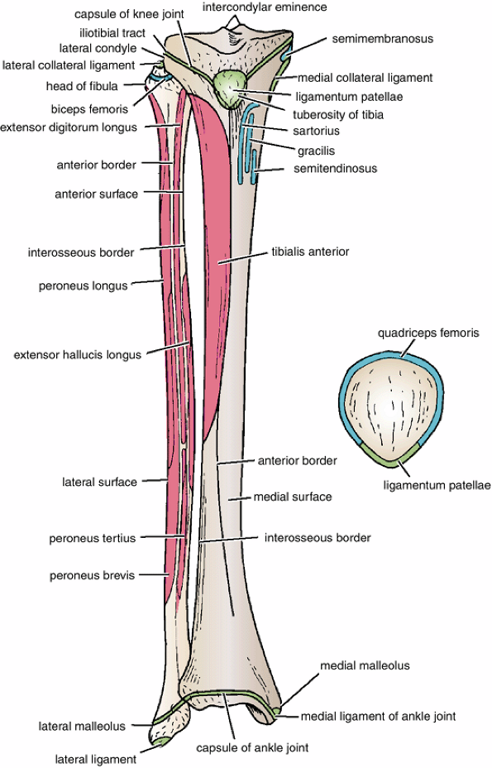
PATELLA
It is a largest sesamoid bone (lying inside the Quadriceps tendon in front of knee joint)
Its anterior surface is rough and subcutaneous
Its posterior surface articulates with the condyles of the femur to form knee joint
Its apex lies inferiorly and is connected to tuberosity of tibia by ligamentum patellae
Its upper, lateral, and medial margins give attachment to Quadriceps femoris muscles

Slide 11
POSITION OF FEMUR (RIGHT OR LEFT)
Head is directed upward & medially
Shaft is smooth and convex anteriorly
Shaft is rough and concave posteriorly

Slide 12
BONES OF LEG (TIBIA AND FIBULA)
Tibia
It is the medial bone of leg
Fibula
It is the lateral bone of leg
Each of them has
upper end
shaft
lower end

Slide 13
TIBIA
Upper end has
Two tibial condyles
Medial condyle
Is larger and articulate with medial condyle of femur. It has a groove on its posterior surface for semimembranosus muscle
Lateral condyle
Is smaller and articulates with lateral condyle of femur. It has facet on its lateral side for articulation with head of fibula to form proximal tibio-fibular joint
Intercondylar area is rough and has intercondylar eminence

Slide 14
TIBIA
Shaft has
Tibial tuberosity
Its upper smooth part gives attachment to ligamentum patellae.
Its lower rough part is subcutaneous
3 borders
Anterior boder is sharp and subcutaneous
Medial border
Lateral border also called interosseous border.
3surfaces
Medial : subcutaneous.
Lateral
Posterior has oblique line, soleal line for attachment of soleus muscle

Slide 15
TIBIA
Lower end
Articulates with talus for formation of ankle joint.
Its medial surface is subcutaneous (medial malleolus)
Its lateral surface articulate with talus
Fibular notch lies on its lateral surface of lower end to form distal tibiofibular joint

Slide 16
POSITION OF TIBIA (RIGHT OR LEFT)
Upper end is larger than lower end
Medial malleolus is directed downward and medially
Shaft has sharp anterior border

Slide 17
FIBULA
It is the slender lateral bone of the leg.
It takes no part in articulation of knee joint.
Its upper end has
Head: articulates with lateral condyle of tibia
Styloid process.
Neck

Slide 18
FIBULA
Shaft has
Four borders & 4 surfaces
Medial
interoseous border gives attachment to interosseous membrane
Lower end forms
Lateral malleolus is subcutaneous
Its medial surface is smooth for articulation with talus to form ankle joint

Slide 19
BONES OF FOOT
Seven Tarsal bones
start to ossify before birth and end
ossification by 5th year in all tarsal bones.
They are
Calcaneum
Talus
Navicular
Cuboid
Three cuneiform bones
Only Talus articulates with tibia & fibula at ankle joint
Calcaneum: the largest bone of foot, forming the heel

Slide 20
BONES OF FOOT
Five Metatarsal bones
They are numbered from medial to lateral.
1st metatarsal bone is large and lies medially.
Each metatarsal bone has a base (proximal) a shaft and a head (distal)
Fourteen phalanges
Two phalanges for big toe (proximal & distal)
Three phalanges for each of the lateral 4 toes (proximal, middle & distal)
Each phalanx has base, shaft and a head.

Slide 21
Bottom line
Skeleton of lower limb consists of:
Femur: is the bone of thigh.
Tibia: is the medial bone of the leg.
Fibula: is the lateral bone of leg.
Skeleton of foot:
Tarsal bones (7 in number), calcaneum is the largest bone forming the heel.
Metatarsal bones (5 in number).
Phalanges (14 in number).
The subcutaneous parts of bones in the lower limb are:
Patella.
Anterior border of the tibia
Tibial tuberosity.
Medial malleolus of tibia.
Lateral malleolus of fibula.
The foot is a complex structure. There are 26 bones in each foot alone. The foot is also well muscled and is supported by ligaments and tissue known as fascia. Support is of prime importance in the foot, as it bears the weight of the body and must adopt different configurations to permit locomotion.

Slide 22
Have Good Day

