Slide 1
Glycogen Metabolism
Clinical Chemistry Unit
Department of Pathology
College of Medicine, King Saud University

Slide 2
Objectives:
By the end of this lecture, students should be familiar with:
The need to store carbohydrates in muscle
The reason for carbohydrates to be stored as glycogen
An overview of glycogen synthesis (Glycogenesis)
An overview of glycogen breakdown (Glycogenolysis)
Key elements in regulation of both Glycogenesis and Glycogenolysis

Slide 3
Location & Functions of Glycogen
Location of glycogen in the body
skeletal muscle & liver
400 g in muscles (1-2% of resting muscles weight)
100 g in liver (~ 10% of well-fed liver)
Functions of glycogen:
Function of muscle glycogen: fuel reserve (ATP)
(during muscular exercise)
Function of liver glycogen: a source for blood glucose
(especially during early stages of fasting)

Slide 4
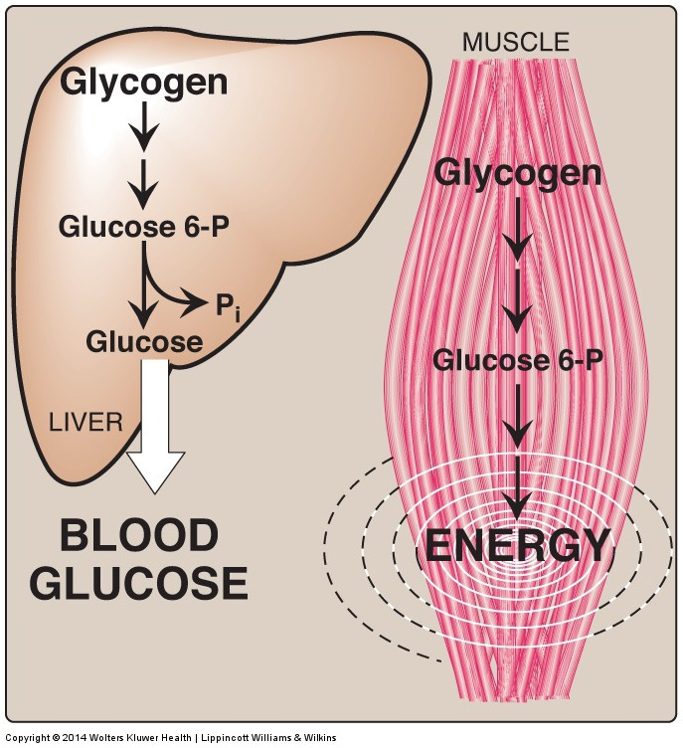

Slide 5
Structure of Glycogen
Glycogen is a branched-chain homopolysaccharide made
exclusively from α- D-glucose
Glucose residues are bound by α(1 - 4) glucosidic linkage
Branches (every 8-10 residue) are linked by α(1-6) glucosidic linkage
Glycogen is present in the cytoplasm in the form of granules which contain most of the enzymes necessary for glycogen synthesis & degradation

Slide 6
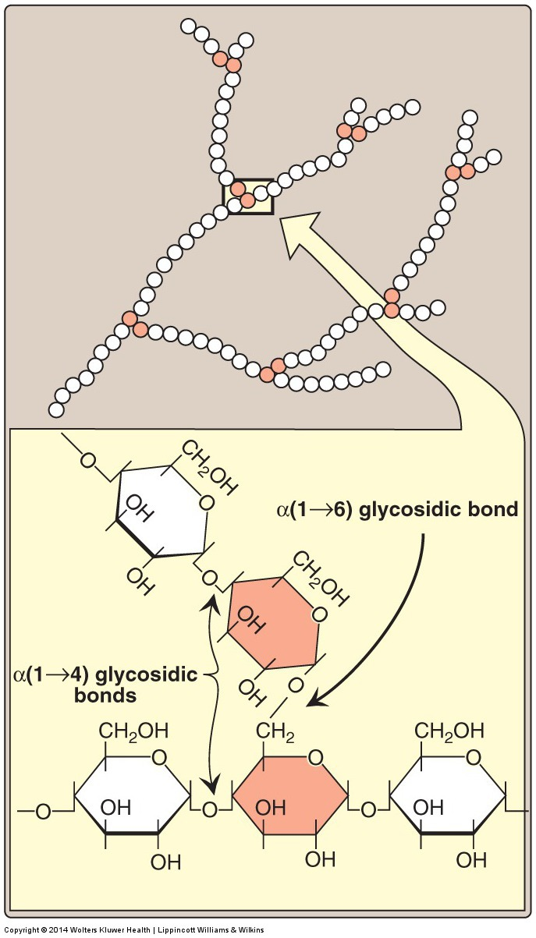
Structure of Glycogen

Slide 7
Metabolism of Glycogen in Skeletal Muscle
Glycogenesis:
Synthesis of Glycogen from Glucose
Glycogenolysis:
Breakdown of Glycogen to Glucose-6-phosphate

Slide 8
GLYCOGENESIS
(Synthesis of Glycogen in Skeletal Muscles)
1- Building blocks: UDP-GLUCOSE
2- Initiation of synthesis:
Elongation of pre-existing glycogen fragment
OR
The use of glycogen primer (glycogenin)
3- ELONGATION: Glycogen synthase (for α1-4 linkages)
4- BRANCHING: Branching enzyme (for α1-6 linkages)
Glycogen synthase cannot initiate synthesis but only elongates
pre-existing glycogen fragment or glycogen primer (glycogenin)

Slide 9
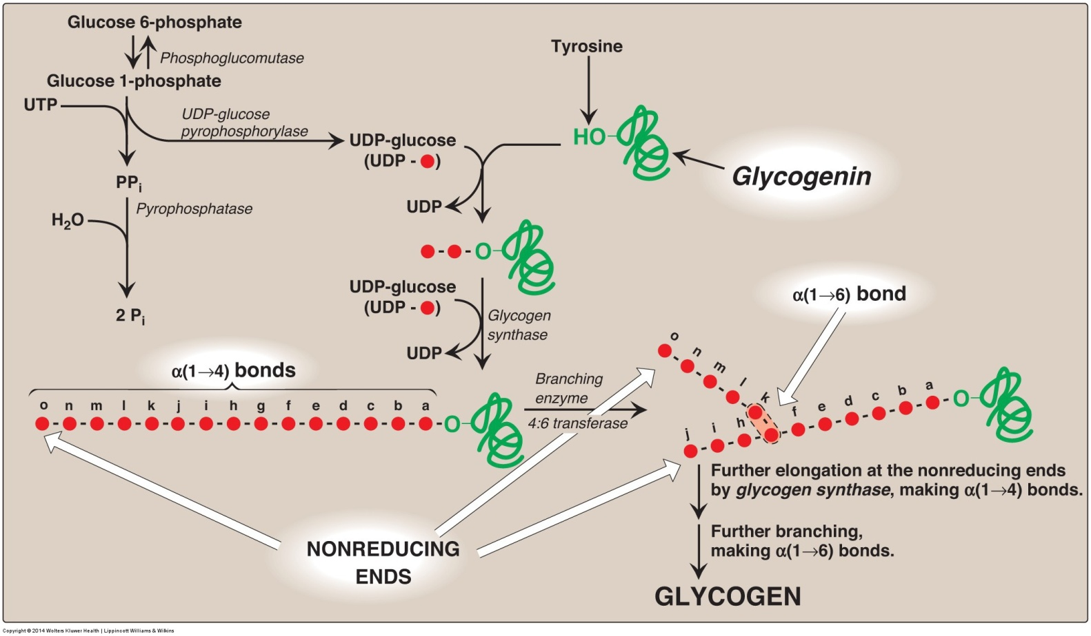
Synthesis of Glycogen

Slide 10
Glycogenolysis
(Breakdown of glycogen in skeletal muscles)
1- Shortening of glycogen chain: by glycogen phosphorylase
Cleaving of α(1-4) bonds of the glycogen chain producing glucose 1-phosphate
Glucose 1-phosphate is converted to glucose 6-phosphate (by mutase enzyme)
2- Removal of branches : by debranching enzymes
Cleaving of α(1-6) bonds of the glycogen chain producing free glucose (few)
3- Fate of glucose 6-phosphate (G-6-P):
- G-6-P is not converted to free glucose
- It is used as a source of energy for skeletal muscles during muscular exercise (by anaerobic glycolysis starting from G-6-P step)

Slide 11
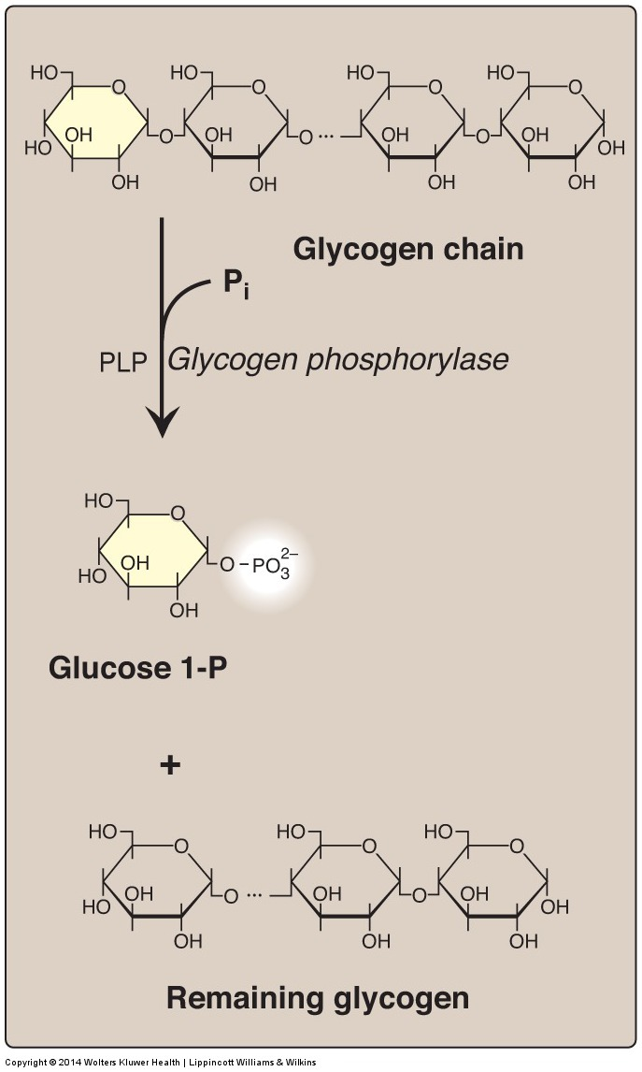
Glycogenolysis
(Pyridoxal phosphate)

Slide 12
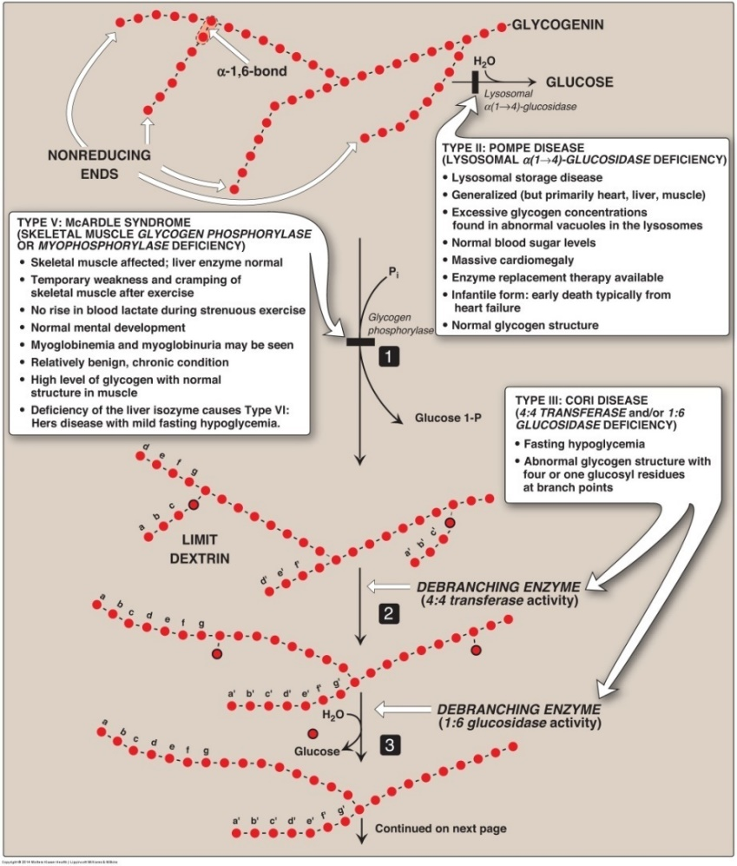
Glycogenolysis

Slide 13
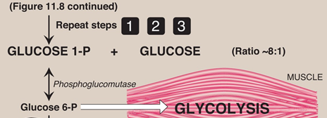
Glycogenolysis

Slide 14
Regulation of
Glycogen Metabolism
Synthesis & degradation of glycogen are tightly regulated
In Skeletal Muscles:
Glycogen degradation occurs during active exercise
Glycogen synthesis begins when the muscle is at rest
Regulation occurs by 2 mechanisms:
1- Allosteric regulation
2- Hormonal regulation (Covalent modification)

Slide 15
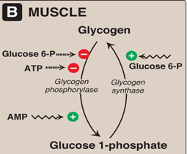
Regulation of Glycogen Metabolism
1. Allosteric Regulation

Slide 16
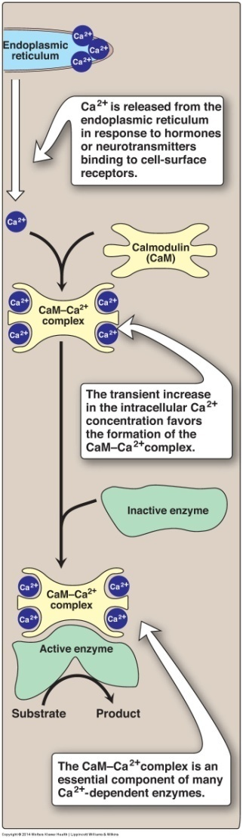
Regulation of Glycogen Metabolism
Increase of calcium during muscle contraction
Formation of Ca²⁺ -calmodulin complex
Activation of Ca²⁺ -dependent enzymes,
e.g., glycogen phosphorylase

Slide 17
Regulation of Glycogen Metabolism:
2. Hormonal Regulation by Epinephrine
Muscle contraction
Epinephrine release
Skeletal muscle: Epinephrine/receptor binding
Second messenger: cAMP
Response: Enzyme phosphorylation
P
P
Glycogen synthase
(Inactive form)
Inhibition of glycogenesis
Glycogen phosphorylase
(Active form)
Stimulation of glycogenolysis

Slide 18
Glycogen Storage Diseases (GSD)
A group of genetic diseases that result from a defect
in an enzyme required for glycogen synthesis or degradation
They result in:
Formation of abnormal glycogen structure
OR
Excessive accumulation of normal glycogen in a specific tissue

Slide 19
Glycogen Storage Diseases
GSD Type V (Mc Ardle Syndrome)
Deficiency of skeletal muscle glycogen phosphorylase

Slide 20
Glycogen Storage Diseases
GSD Type II (POMPE DISEASE)
Deficiency of Lysosomal α(1-4) glucosidase.

Slide 21
Reference
Lippincott’s Illustrated Reviews Biochemistry: Unit II, Chapter 11, Pages 125 - 136.

