Slide 1
Musculoskeletal Block
Pathology of
Musculoskeletal System
Practical
Dr Abdullah Basabein

Slide 2
Muscular Dystrophies
Path. Dept , KSU
Ms-Sk Block

Slide 3
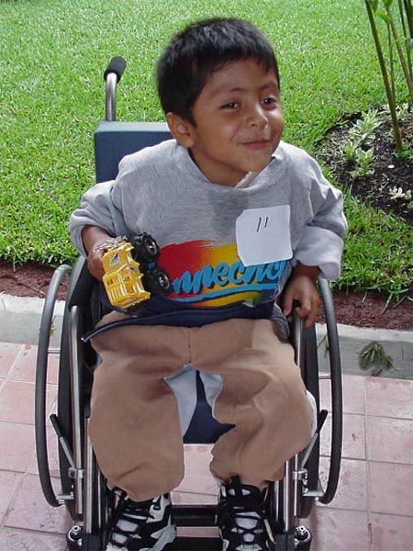
Duchenne Muscular Dystrophy (DMD)
Path. Dept , KSU
Ms-Sk Block

Slide 4
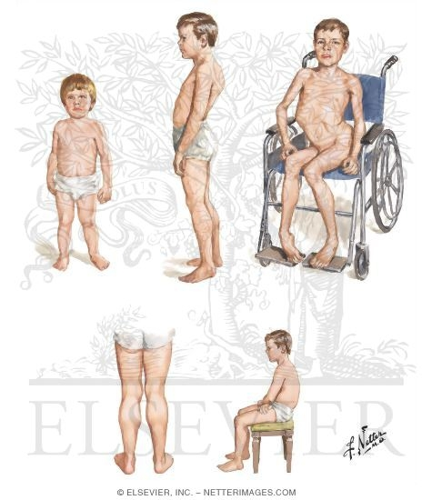
Case # 1
A 3 - year- old boy presented to his pediatrician with complaint of his parents from difficulty in walking , poor balance , and frequent falls .
Laboratory investigation shows elevated creatine kinase .
Muscle biopsy show absence of dystrophin by western blot analysis
What is your provisional diagnosis?
Path. Dept , KSU
Ms-Sk Block

Slide 5
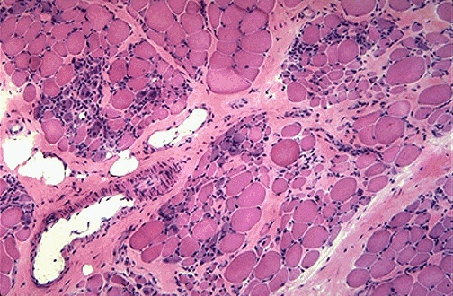
Duchenne Muscular Dystrophy - LPF
Duchenne muscular dystrophy showing variations in muscle fiber size , increased endomysial connective tissue , and regenerating fibers (blue tint)
Path. Dept , KSU
Ms-Sk Block

Slide 6
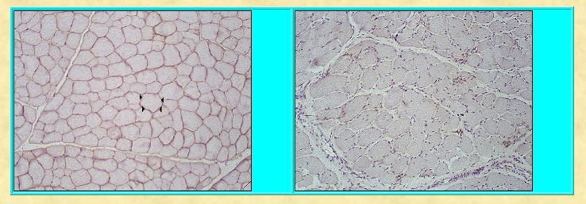
NORMAL Ms
DMD
1
2
In DMD : Dystrophin, an intracellular protein, forms an interface between the cytoskeletal proteins and a group of transmembrane proteins
Path. Dept , KSU
Ms-Sk Block

Slide 7
Dermatomyositis
Path. Dept , KSU
Ms-Sk Block

Slide 8
Case # 2
A 52-year-old woman presents with 6-month history of progressive muscle weakness and a skin rash.
Physical examination is remarkable for a diffuse purple/red discoloration of the skin over her cheeks, nose, and eyelids. Examination confirms proximal muscle weakness.
Laboratory findings show an increase in creatine kinase (10 times the normal).
Path. Dept , KSU
Ms-Sk Block

Slide 9
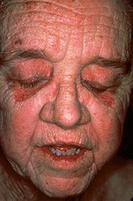
Dermatomyositis
is an autoimmune disorder.
Serological test that is usually abnormal are high CK and increased anti nuclear antibodies (ANA)
Clinically: Purple/red colored discoloration mainly around eyelids
Dermatomyositis can be associated with internal malignancies including a primary in lung, ovary and stomach
Ms-Sk Block

Slide 10
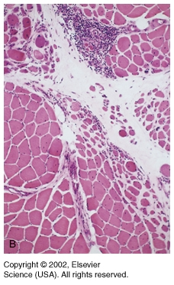
Dermatomyositis
Microscopically:
Perifascicular atrophy of muscle fibers
Chronic inflammation .
Path. Dept , KSU
Ms-Sk Block

Slide 11
NON INFECTIOUS ARTHRITIS
Path. Dept , KSU
Ms-Sk Block

Slide 12
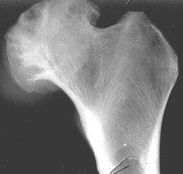
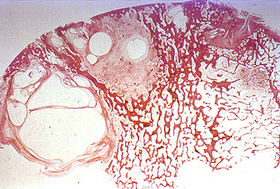
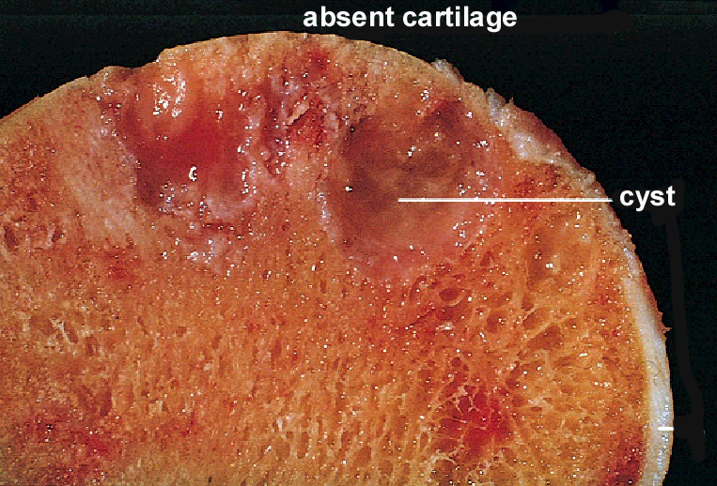
Osteoarthritis
Path. Dept , KSU
Ms-Sk Block

Slide 13
Case # 3
An obese 56-year-old woman presented with bilateral localized pain to her knees, hands and difficulty in walking .
Path. Dept , KSU
Ms-Sk Block

Slide 14
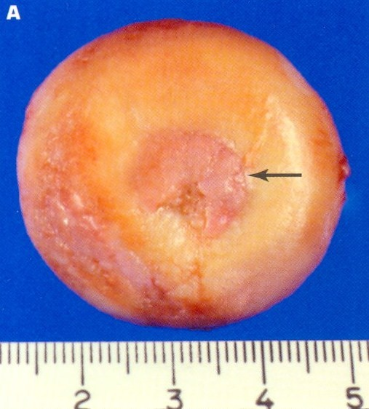
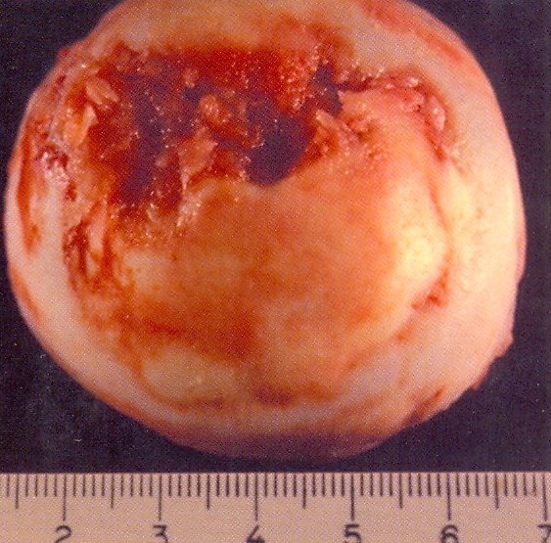
Osteoarthritis - Gross
Progressive erosion of articular cartilage, eburnated articular surface , subchondral cyst and residual articular cartilage (Osteoarthritis)
Path. Dept , KSU
Ms-Sk Block

Slide 15
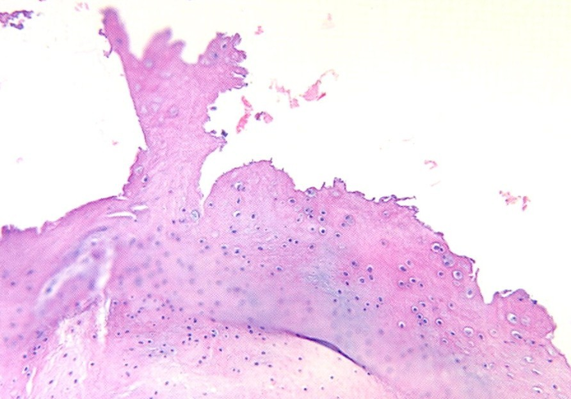
Osteoarthritis - LPF
Mushroom-shaped osteophytes (bony outgrowths ) develop at the margins of the articular surface and are capped by fibrocartilage and hyaline cartilage that gradually ossify . Note the absence of inflammation . (Osteoarthritis)
Path. Dept , KSU
Ms-Sk Block

Slide 16
Case # 4
A 45 -year- old woman complains of low grade fever , malaise and stiffness in her joints each morning .
Path. Dept , KSU
Ms-Sk Block

Slide 17
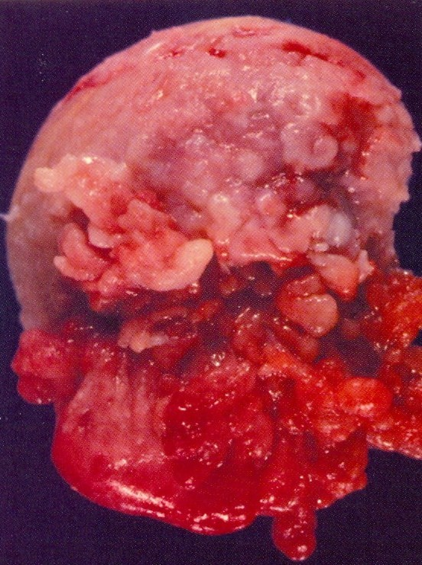
Rheumatoid Arthritis
Affecting the head of the femur.
The synovium becomes edematous, thickened and hyperplastic and transforming its smooth contour to one covered by delicate and bulbous fronds .
Serological tests which are somewhat specific for this disease:
1- Rheumatoid factor (RF)
2- Antibodies to citrullinated peptides in the serum
3- C-Reactive protein (CRP) and ESR (Non specific)
Path. Dept , KSU
Ms-Sk Block

Slide 18
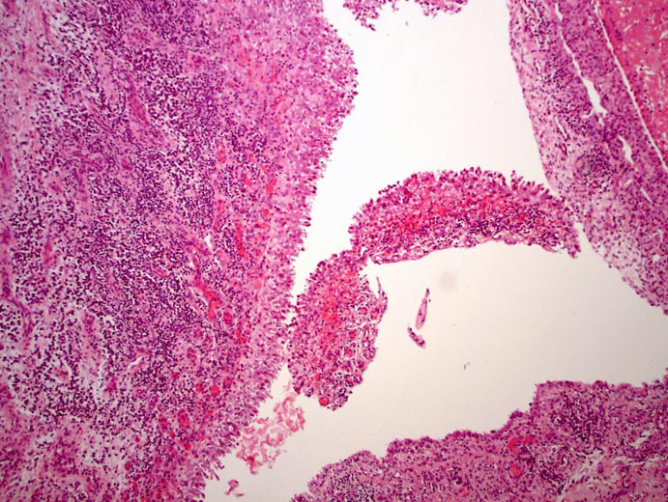
Hyperplastic Synovium - LPF
Hyperplastic synovial lining with villous like projections
Path. Dept , KSU
Ms-Sk Block

Slide 19
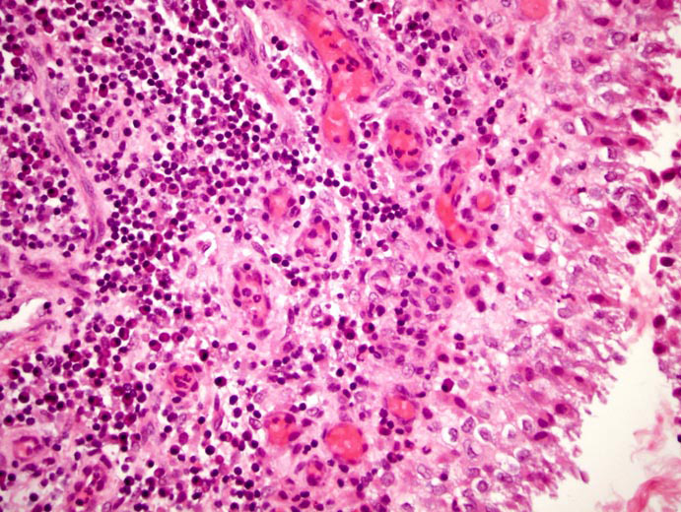
Hyperplastic Synovium - HPF
Hyperplastic synovium with underlying plasma cells and lymphocytes including many congested blood vessels in Rheumatoid arthritis
Path. Dept , KSU
Ms-Sk Block

Slide 20
GOUT
Gout is a syndrome caused by the inflammatory response to tissue deposition of monosodium urate crystals (MSU).
Path. Dept , KSU
Ms-Sk Block

Slide 21
Severe gout in the fingers resulting in large, hard deposits of crystals of uric acid. These deposits are called Tophi
The main cause of this condition is accumulation of uric acid tophi with secondary inflammation.
Path. Dept , KSU
Ms-Sk Block

Slide 22
Acute gouty arthritis on the big toe of an elderly man.
Swelling, Redness and oedema
Path. Dept , KSU
Ms-Sk Block

Slide 23
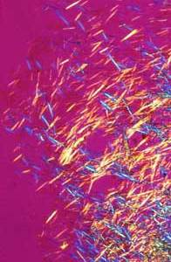
Needle-shaped monosodium uric acid crystals diagnostic of gout from an acutely inflamed joint as seen under polarized microscopy
Path. Dept , KSU
Ms-Sk Block

Slide 24
Gouty Arthritis can be secondary to
Leukemia, Chronic renal diseases, post chemotherapy and drugs like thiazide diuretics.
Syndrome which is responsible for the inherited form of gouty arthritis is:
Lesh-Nyhan syndrome due to lack of HGPRT enzyme.

Slide 25
Osteomyelitis
Path. Dept , KSU
Ms-Sk Block

Slide 26
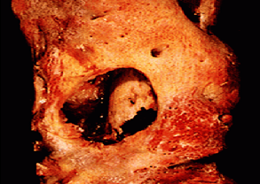
Osteomyelitis
Direct infection of bone.
Bacterial most often
Staphylococcus
Salmonella
Sickle Cell Disease
Tuberculosis
Spine first
Resected femur in a patient with draining osteomyelitis. The drainage tract in the subosteal shell of viable new bone (involucrum) reveals the inner native necrotic cortex (sequestrum)
Path. Dept , KSU
Ms-Sk Block

Slide 27
Case # 5
A 22- year- old male presented with localized pain above his right knee joint with recurrent fever. Later, he had a discharging sinuses from the skin overlying the right knee.
What is the most likely diagnosis ?
Path. Dept , KSU
Ms-Sk Block

Slide 28
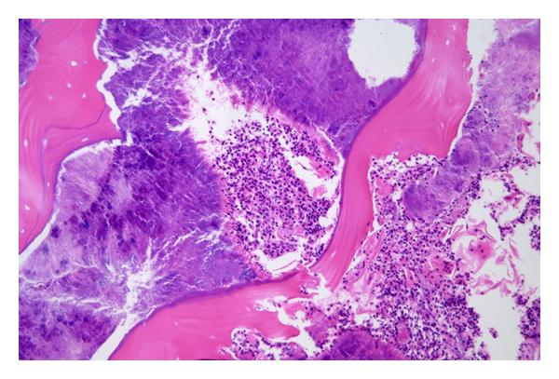
Acute Osteomyelitis - LPF
Acute Osteomyelitis. Bony sequestrae are surrounded by colonies of bacteria as well as purulent infiltrate.
Path. Dept , KSU
Ms-Sk Block

Slide 29
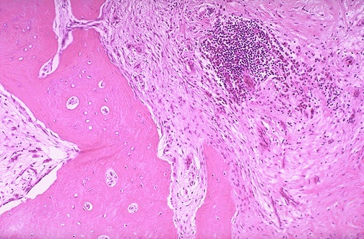
Chronic Osteomyelitis - LPF
Chronic Osteomyelitis. Note the fibrosis of the marrow space accompanied by chronic inflammatory cells. There can be bone destruction with remodeling.
Path. Dept , KSU
Ms-Sk Block

Slide 30
Tuberculous arthritis
Path. Dept , KSU
Ms-Sk Block

Slide 31
Case # 6
A 30 -year-old debilitated man presented to the orthopedic clinic with increasing swelling and pain in right knee joint, low grade fever, marked elevation of sedimentation rate.
The patient has a history of coughing up blood, fever, chills, night sweats, weight loss, pallor, and often a tendency to fatigue very easily.
The biopsy was taken from the synovium.
Path. Dept , KSU
Ms-Sk Block

Slide 32
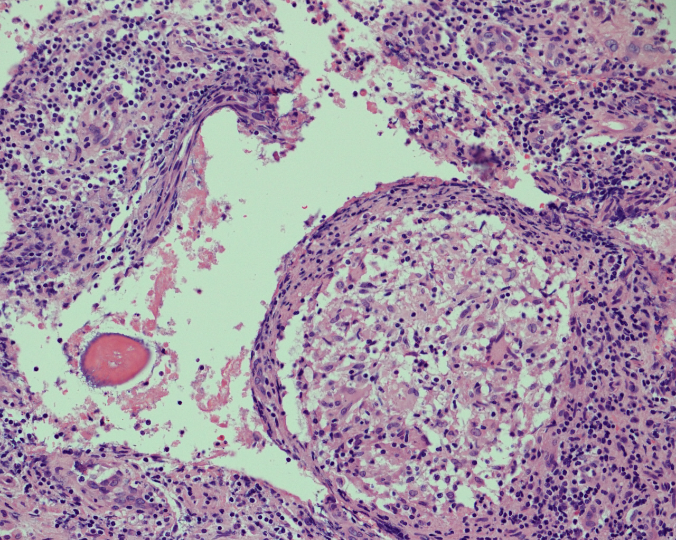
Section of synovial biopsy shows granuloma formation with epithelioid like cells , langhans-type giant cells and rim of lymphocytes
Path. Dept , KSU
Ms-Sk Block
Notes:
Synovial biopsy from knee

Slide 33
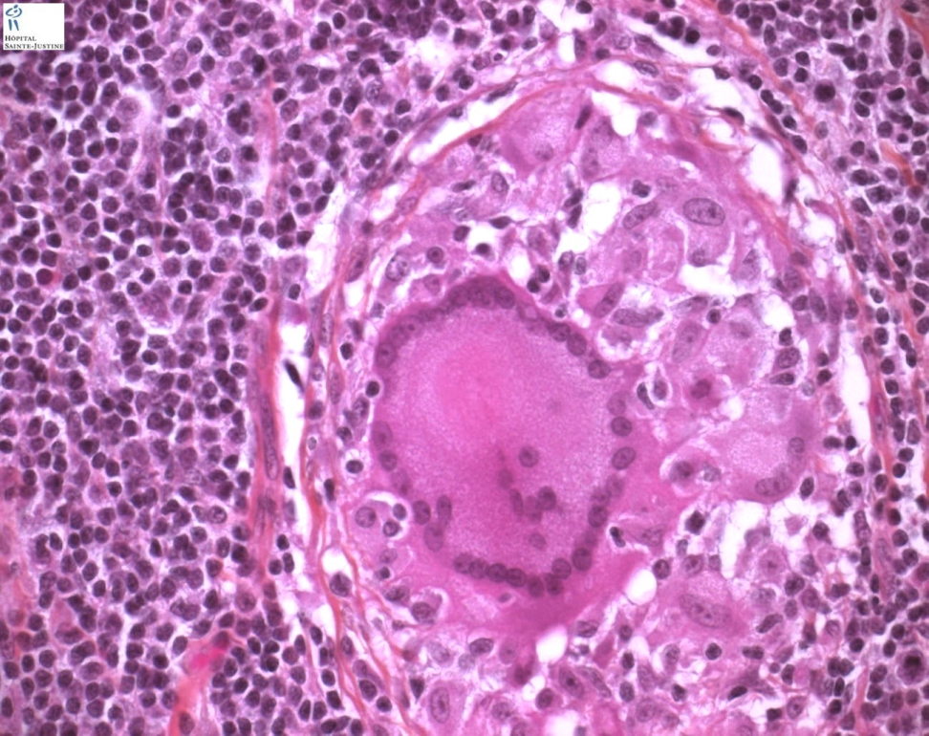
foreign body-type giant cell
Langhans-type giant cell
Bone section shows Epithelioid cells fuse to form giant cells containing 20 or more nuclei. The nuclei arranged either peripherally (Langhans-type giant cell) or haphazardly (foreign body-type giant cell). These giant cells can be found either at the periphery or the center of the granuloma.
Path. Dept , KSU
Ms-Sk Block

Slide 34
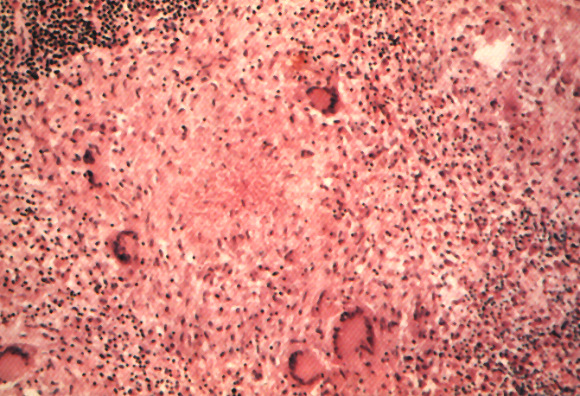
Lymphocytic Rim
Langhans Giant Cell
Lymphocytic Rim
Caseous Necrosis
Caseous Necrosis
Epithelioid Macrophage
Epithelioid Macrophage
Section of bone shows granuloma formation with epithelioid like cells ,
langhans-type giant cells and rim of lymphocytes
Path. Dept , KSU
Ms-Sk Block

Slide 35
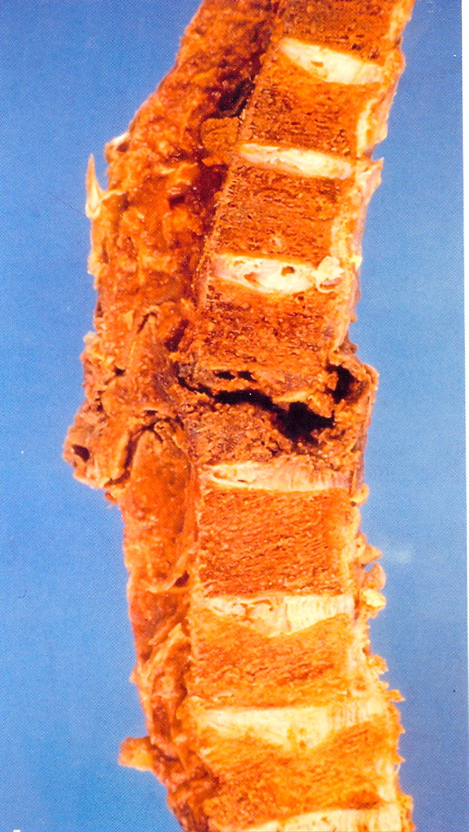
Gross pathology of T.B Osteomyelitis
of the vertebral Column (Pott’s Disease)
Granulomatous necrosis of vertebral column
Path. Dept , KSU
Ms-Sk Block

Slide 36
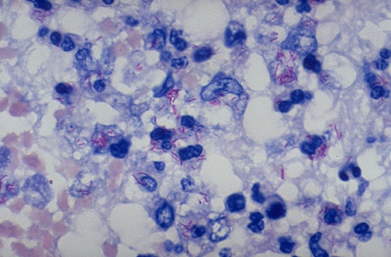
Acid Fast bacilli of Mycobacterium TB in the Lung
A stain for Acid Fast Bacilli (AFB stain) also called Zeil Nelson stain is done to find the mycobacteria . The mycobacteria stain as red rods, as seen here at high magnification.
Molecular test → PCR (Polymerase chain reaction) is also done for acid fast bacilli

Slide 37
BONE TUMORS
Path. Dept , KSU
Ms-Sk Block

Slide 38
Osteochondroma
(osteochondroma exostosis)
Path. Dept , KSU
Ms-Sk Block

Slide 39
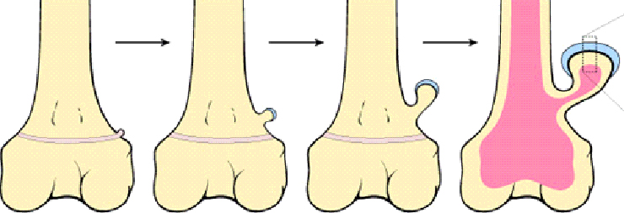
Osteochondroma
(osteochondroma exostosis)
The solitary osteochondroma is the most common benign bone tumors
Seen in patients aged from 10-30 years
Arise during skeletal growth
Equally in males and females
Etiology is unknown
Path. Dept , KSU
Ms-Sk Block

Slide 40
Case # 7
A 16 -year-old male was found to have a small swelling protruding from upper part of his leg with local pain .
Path. Dept , KSU
Ms-Sk Block

Slide 41
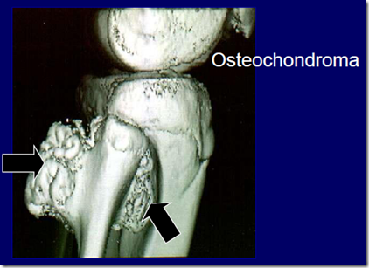
MRI picture showing two osteochondromatous exostosis which are arising from the upper third of fibula .
Path. Dept , KSU
Ms-Sk Block

Slide 42
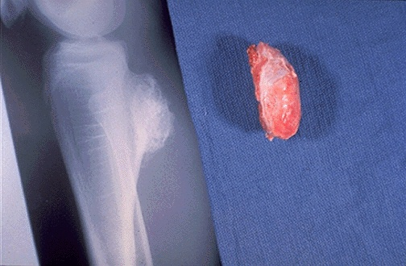
Osteochondroma: Gross & X-ray
Osteocartilagenous protrusion arising from the upper tibial bone
Most are solitary, incidental lesions that may be excised if they cause local pain. There is a rare condition of multiple osteochondromatosis marked by bone deformity and by a greater propensity for development of chondrosarcoma.
Path. Dept , KSU
Ms-Sk Block

Slide 43
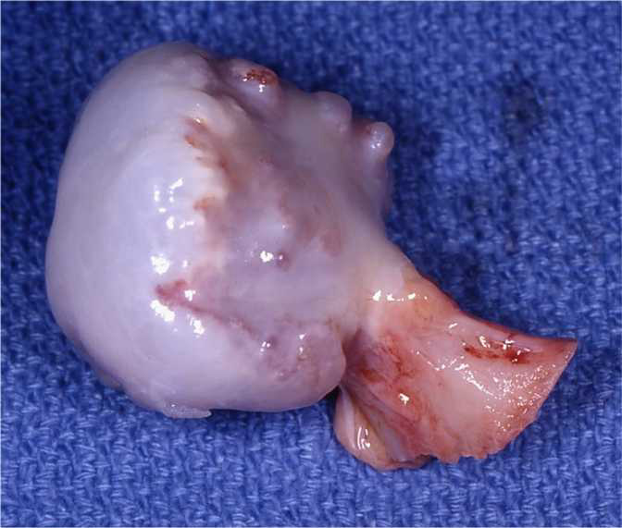
Osteochondroma - Gross
Solitary osteochondroma. Gross osteochondroma specimen at the time of resection. Bone stalk and overlying membrane on cartilage cap.
Path. Dept , KSU
Ms-Sk Block

Slide 44
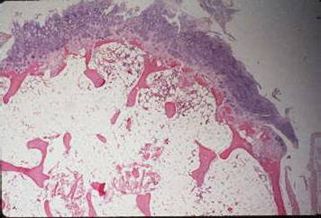
Osteochondroma - LPF
Fibrous cap
Cartilagenous layer
- Bone
The microscopic appearance of an osteochondroma displays the benign cartilagenous cap at the upper and the bony cortex at the left lower.
Prognosis is Excellent
Possible complication : - Chondrosarcoma may occur if these lesions are multiple

Slide 45
Osteosarcoma
Path. Dept , KSU
Ms-Sk Block

Slide 46
Case # 8
An 18-year-old female presented to the rheumatology clinic with 2 months history of pain and swelling in her upper thigh with weight loss .
Path. Dept , KSU
Ms-Sk Block

Slide 47
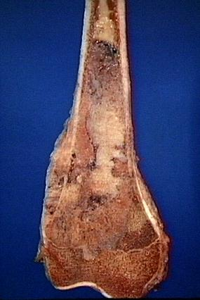
Malignant tumor of mesenchymal origin
2nd most common primary bone tumor
RB gene mutation is seen in 60% of these cases.
In elderly patient, paget’s disease and previous radiation exposure are predisposing factors.
Classical radiological feature seen is CODMAN triangle
The tan-white tumor fills most of the medullary cavity of the metaphysis and proximal diaphysis.
It has infiltrated through the cortex, lifted the periosteum, and formed soft tissue masses on both sides of the bone.
Path. Dept , KSU

Slide 48
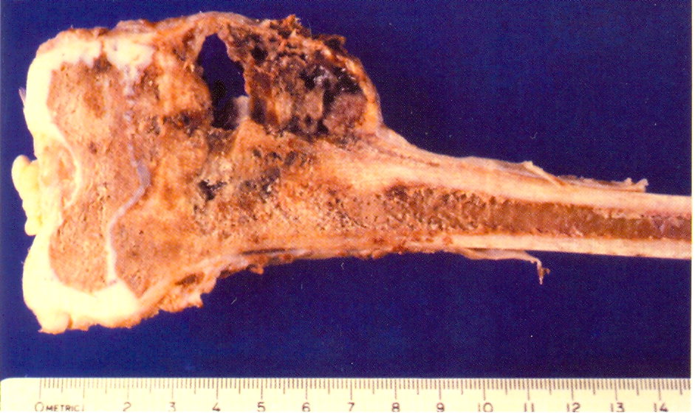
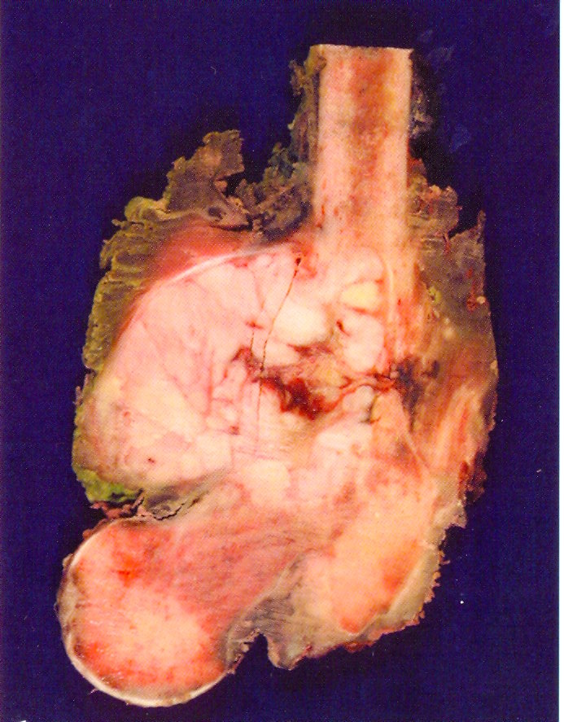
Conventional Osteosarcoma - Gross
Mixture of osteoid, fibrous, cartilaginous, necrotic, hemorrhagic, cystic areas
Path. Dept , KSU
Ms-Sk Block

Slide 49
Osteosarcoma - LPF
Pleomorphic and hyperchromatic nuclei of malignant cells.
Osteoid formation by the tumor cells.

Slide 50
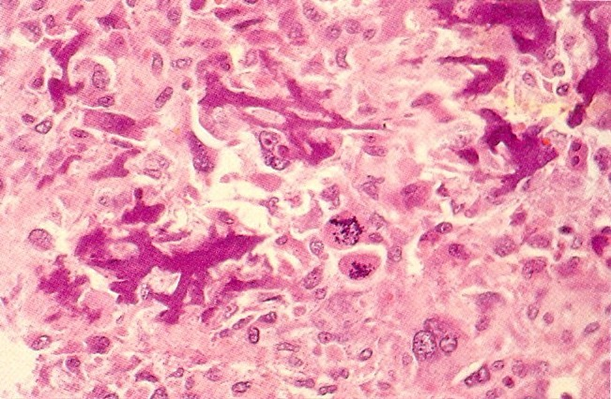
Osteosarcoma - HPF
Malignant osteoid producing Spindle cells, giant cells,
Abnormal Mitosis
Path. Dept , KSU
Ms-Sk Block

Slide 51
THE END

