Slide 1
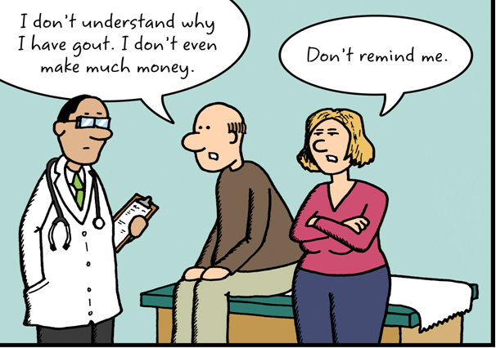
Drugs in gout
epidemiology
Prevalence of hyperuricemia 5%
Prevalence of gout 0.2%
Male to female ratio 10:1

Slide 2
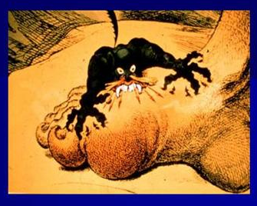
Drugs in gout
ilos
Describe drug and non drug treatment of gout
Outline the stages of gout and the therapeutic objectives in each stage
Identify the mechanism of action of drugs used for treatment of gout
Classify drugs used for treatment of gout
Study in details the pharmacology of drugs used for treatment of gout

Slide 3
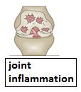
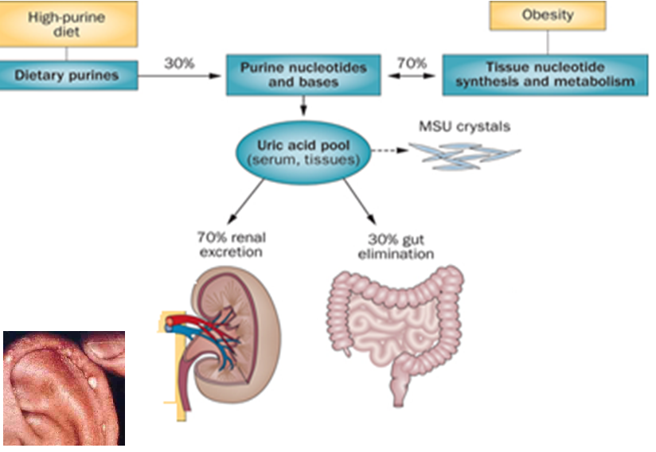
What is
Drugs in gout
Tophi
gout?
Nephrolithiasis

Slide 4
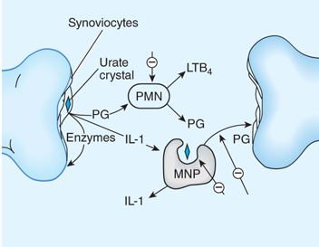
Pathophsiology
Uricostatic
Colchicine
Anti-inflammatory
Uricosuric
Over production
Under excretion

Slide 5
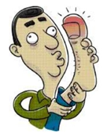
Drugs in gout
Uricostatic
Allopurinol,
Febuxostat
Probenecid,
Sulfinpyrazone
Uricosuric
Anti- inflammatory
NSAIDs, Steroids
Tubulin inhibitors
Colchicine

Slide 6
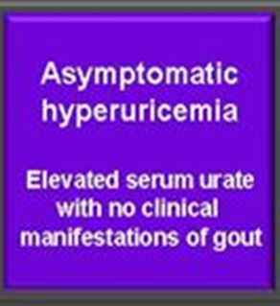
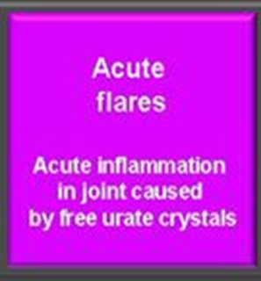
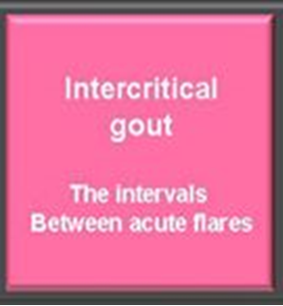
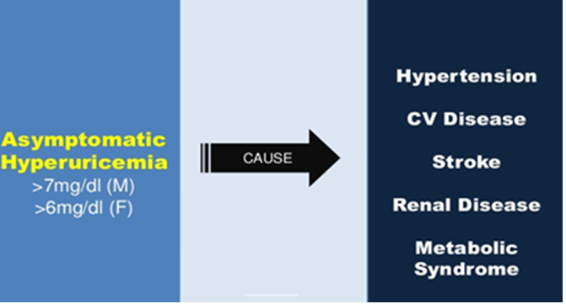
Stages of gout & goal of therapy
Treat or not
to treat?
Terminate
The attack
Prevent recurrent attacks
-Prevent complications
-Lower serum uric acid

Slide 7
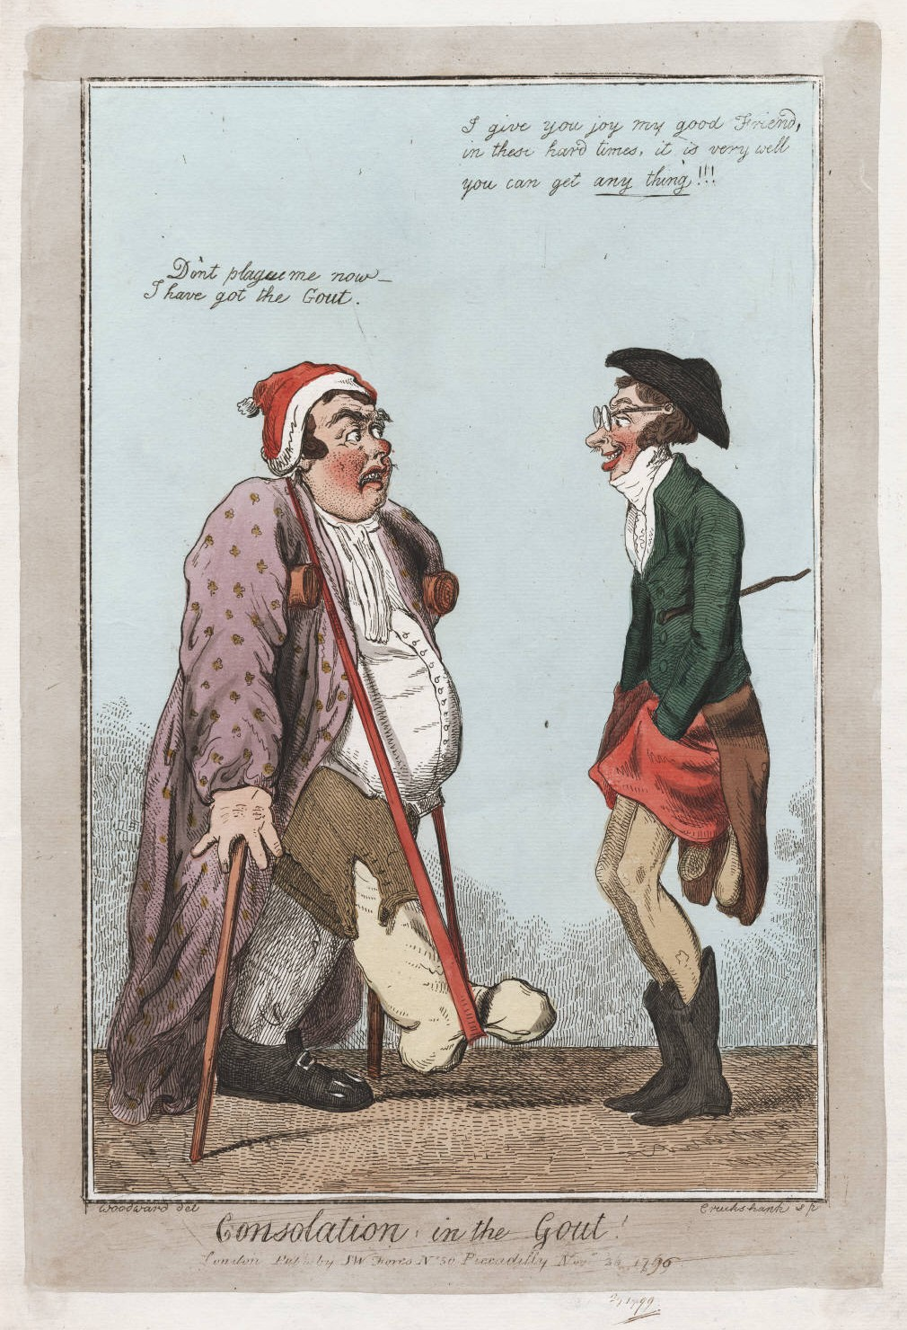
Drugs in gout
Treatment
of gout
Non-pharmacologic
Pharmacologic

Slide 8
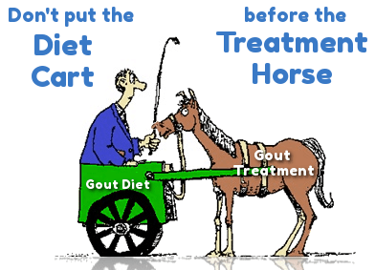
Non-pharmacologic Therapy
Lifestyle modifications
Loss of weight
Excercise
Diet control
Smoking cessation

Slide 9
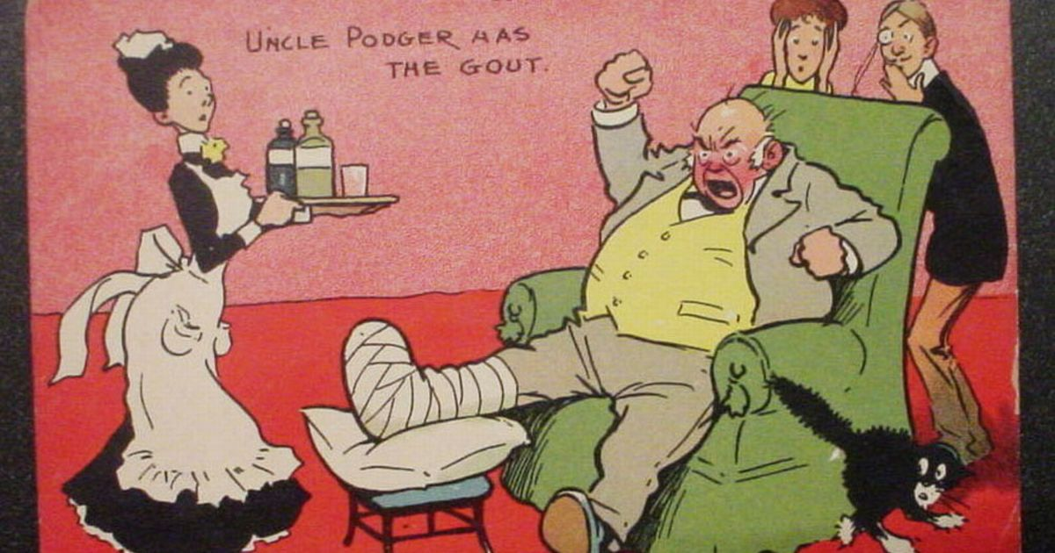
Treatment of acute gout
Acute gouty arthritis
Colchicine
NSAIDs
Corticosteroids

Slide 10
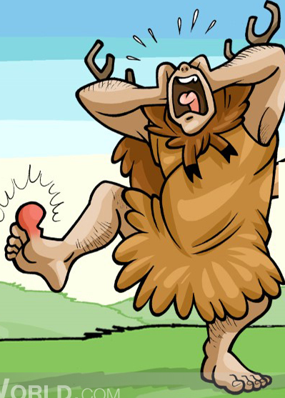
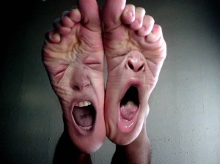
NSAIDS
NSAIDs are the most commonly used first-line treatment
Head-to-head studies show few differences between drugs
Full doses of NSAID should be initiated immediately and tapered after resolution of symptoms
Avoid NSAIDs:
G-I ulcer
Bleeding or perforation
Renal insufficiency
Heart failure
Use of oral anticoagulants

Slide 11
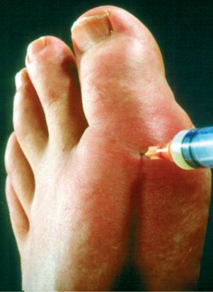
steroids
Corticosteroids are a good alternative where NSAID
and colchicine cannot be used or in refractory cases
Studies showed equal efficacy between corticosteroid
and NSAIDs, with no reported side-effects with
short-term use of corticosteroid
In elderly people, patients with kidney or hepatic impairment, IHD, PUD, hypersensitivity to NSAIDs
-Intra articularly (preferred route if one or two joints affected)
-Orally
-Intramuscularly or intravenously.

Slide 12
colchicine
Alkaloid obtained from autumn crocus (Colchicum autumnale)
Minimal effect on uric acid synthesis , excretion & is not analgesic

Slide 13
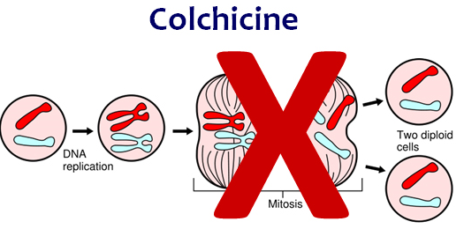
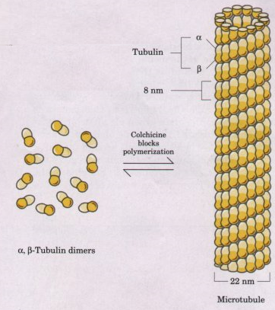
Drugs in gout
mechanism
Binds to microtubules in neutrophils
Inhibits cell division
Inhibits chemotactic factors
Inhibits inflamosomes & IL-1 production

Slide 14
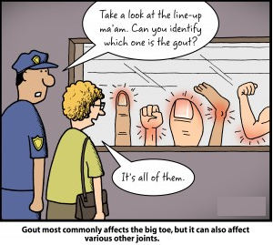
colchicine
pharmacokinetics
Administered orally, rapid absorption from the GI tract
Reaches peak plasma levels within 2 hours
Recycled in the bile and is excreted unchanged in the faeces or urine
Use should be avoided in patients with a creatinine clearance of less than 50 mL/min

Slide 15
colchicine
Clinical uses
2.0
*
Colchicine 0.6 mg twice daily (n=21)
1.5
Placebo (n=22)
Treatment of gout flares
†
1.0
Prophylaxis of gout flares
Mean Number of Flares
0.5
- Treatment of Mediterranean
fever
0.0
0–3
3–6
Time Interval, Months

Slide 16
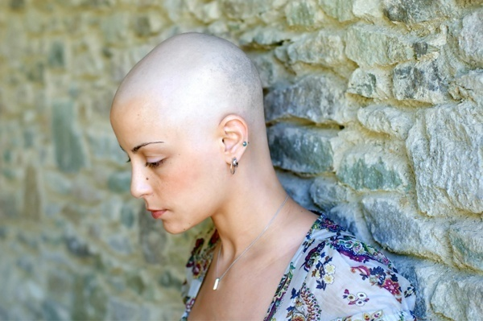
adrs
Diarrhea (sometimes severe)
Nausea
Vomiting
Abdominal cramps
Dehydration
Bone marrow depression:
nadir at 7 days
Less frequent:-
Cardiac toxicity ,Arrhythmia
Vascular collapse
Hepatotoxicity , Alopecia

Slide 17
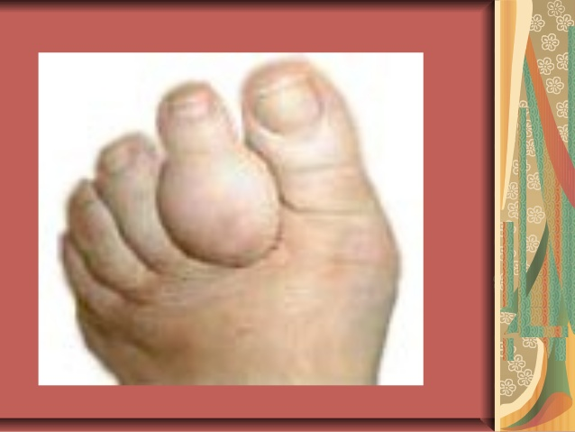
Prevention of recurrent attack
Inhibition of uric acid synthesis
-Allopurinol
-Febuxostat
Uricosuric drugs
-Probenecid
Sulfinpyrazone
Mamalian
Uricase

Slide 18
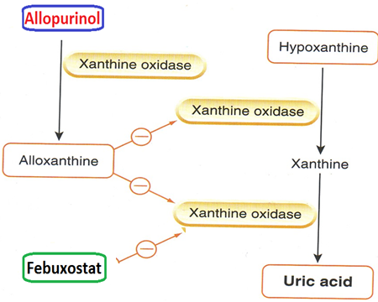
Inhibitors of uric acid synthesis
Inhibit xanthine oxidase
Include allopurinol & febuxostat
Allopurinol is metabolized by xanthine oxidase into alloxanthine (oxypurinol) which is pharmacologicaly active

Slide 19
allopurinol
pharmacokinetics
Absorption 70%
Protein binding negligble, 5%
Hepatic metabolism, 70% converted to active metabolite(oxypurinol)
Oxypurinol is elminated unchaged in urine
Allopurinol Hypersensitivity Syndrome
Xanthine
Oxidase
Allopurinol
Oxypurinol
(Aloxanthine)
Toxic Epidermal Necrolysis
Dress Syndrome

Slide 20
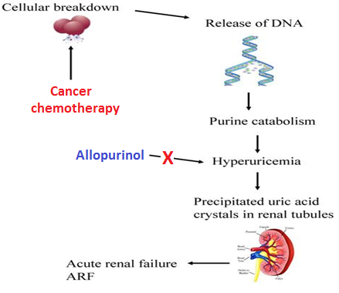
allopurinol
Clinical uses
Management of hyperuricemia of gout
Uric acid stones or nephropathy
It is a drug of choice in patients with
both gout & ischemic heart disease
Severe tophaceous deposits (uric acid deposits in tissues)
Management of hyperuricemia associated with chemotherapy
Prevention of recurrent calcium oxalate kidney stones

Slide 21
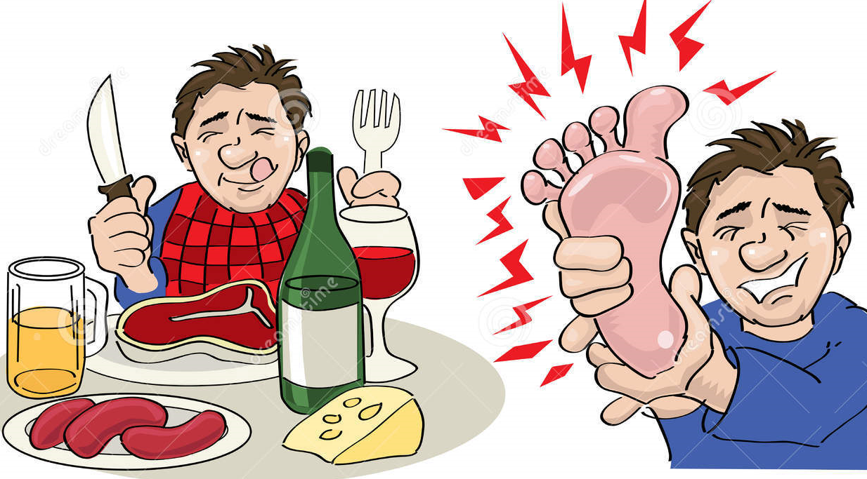
adrs
Diarrhea, nausea, abnormal liver tests
Acute attacks of gout
Fever, rash, toxic epidermal necrolysis,hepatotoxicity, marrow suppression, vasculitis
DRESS syndrome
Drug Reaction, Eosinophilia,
Systemic Symptoms
20% mortality rate

Slide 22
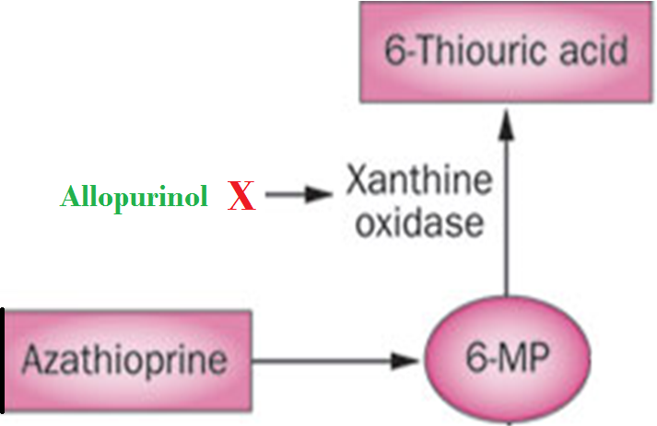
Drug Interactions
Inhibits metabolism of
Warfarin & dicumarol
Reduce the metabolism of
6-mercaptopurine
and azathioprine
With ampicillin : Increases frequency of skin rash

Slide 23
Febuxostat
Oral specific xanthine oxidase inhibitor
Indicated for the chronic management of hyperuricemia in patients with gout
Chemically distinct from allopurinol (non purine)
Can be used in patients with renal disease

Slide 24
Febuxostat
pharmacokinetics
Given orally once daily, well absorbed(85%)
Metabolized in liver , mainly conjugated to glucouronic acid
Given to patients who do not tolerate allopurinol
99% protein bound
t½ 4-18hours

Slide 25
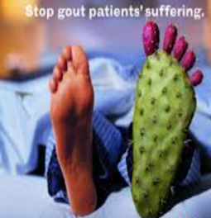
Febuxostat
adrs
Increase number of gout attacks during
the first few months of treatment
Increase level of liver enzymes
Nausea, Diarrhea
Headache
Numbness of arm or leg

Slide 26
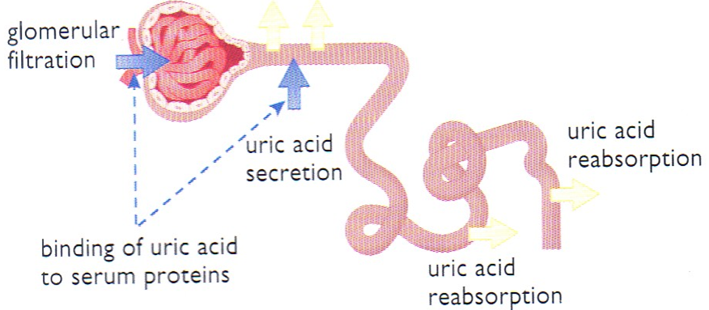
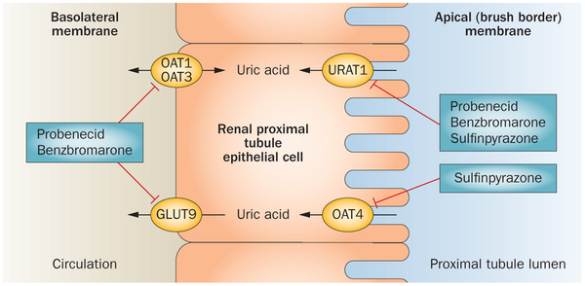
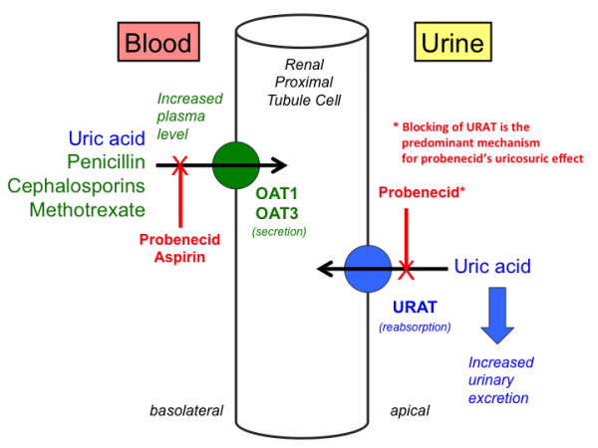
Uricosuric drugs
Mechanism
Blocks tubular reabsorption of uric acid &
enhances urine uric acid excretion
Probenecid inhibits Urate Transporters (URAT1) in the apical membrane of the proximal tubule
It also inhibits organic acid transporter(OAT)→↑plasma concentration of penicilin
Sulfinpyrazol inhibits URAT1 & OAT4

Slide 27
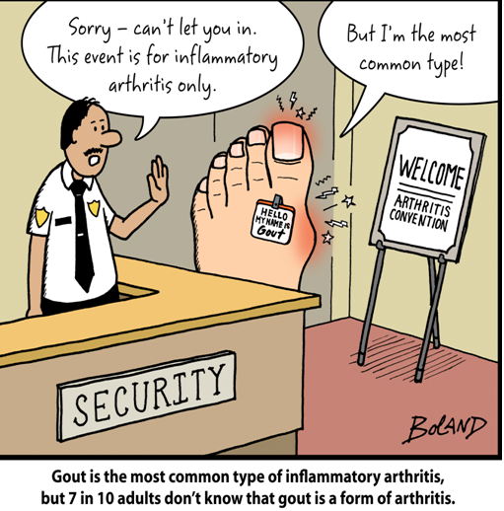
Uricosuric drugs
Control hyperuricemia and prevent tophus formation
Probenecid moderately effective
Increases risk of nephrolithiasis
Not used in patients with renal disease
Some drugs reduce efficacy (e.g. aspirin)

Slide 28
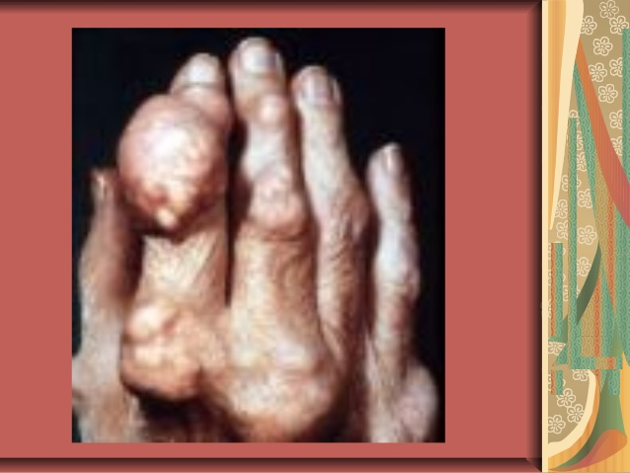
adrs
probenecid
Exacerbation of acute attack
Risk of uric acid stone
GIT upset
Allergic rash

Slide 29
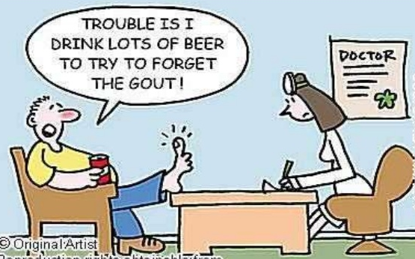
Contra-indications
History of nephrolithiasis
Recent acute gout
Existing renal disease
Less effective in elderly
patients

Slide 30
Drugs in gout
sulfinpyrazone
Sulfinpyrazone can aggravate peptic ulcer disease
Aspirin reduces efficacy of sulfinpyrazone
Sulfinpyrazone enhances the action of certain antidiabetic drugs

Slide 31
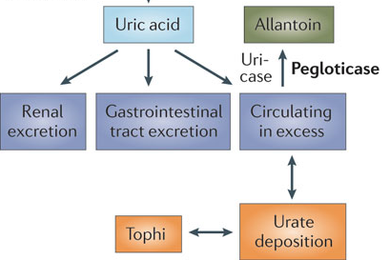
Recombinant mammalian uricase
Pegloticase
A uric acid specific enzyme which is a recombinant modified mammalian uricase enzyme
Converts uric acid to allantoin
Given I.V.➔ peak decline in uric
acid level within 24-72 hours

Slide 32
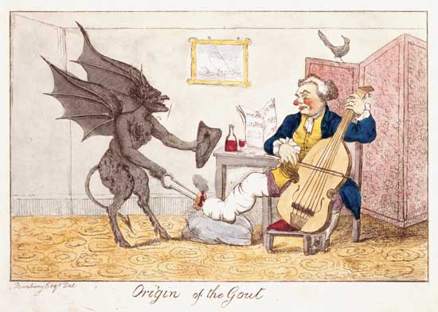
pegloticase
Used for the treatment of chronic gout in adult patients refractory to conventional therapy
ADRS
Infusion reactions
Anaphylaxis
Gout flare
Arthralgia, muscle spasm
Nephrolithiasis

