Slide 1
Resting membrane potential & action potential
TEXTBOOK OF MEDICAL PHYSIOLOGY
GUYTON & HALL 13TH EDITION
UNIT II CHAPTER 5
Dr. Mohammed Alotaibi

Slide 2
Objectives
At the end of this lecture the student should be able to:
Discuss the resting membrane potential and its genesis.
Know the ionic channels involved in resting membrane potential.
Describe the function Na+-K+ pump and the stages of action potential.
Explain the threshold Potential, local Response and action Potentials.
Describe the electrical changes in membrane potential during the action potential, their chemical bases and excitability changes.
Describe conduction along nerve fibers, role of myelination and how nerve fibers are classified.

Slide 3
What are excitable tissues?
Definition of resting membrane potential (RMP).
Measurement and normal value of RMP.
Origin of RMP: contribution of K+, Na+, and Na-K pump

Slide 4
What are excitable tissues?
Nerve and muscles.
What does that mean?
The tissue has the capability to respond to an adequate stimulus.

Slide 5
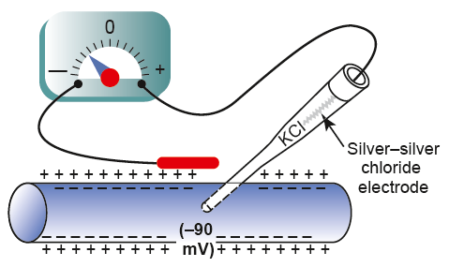
RESTING MEMBRANE POTENTIAL (RMP)
DIF: it is the potential difference across the membrane during rest (without stimulation) between the inner side & outer side of the membrane, and it is relatively –ve inside.
Measurement of RMP: Using VOLTMETER.
Normal Values: - 70 mV in medium sized nerve and -90 mV in large sized nerve.

Slide 6
K⁺
Na⁺
Cl⁻
Na⁺
Na⁺
Cl⁻
Na⁺
Na⁺
Cl⁻
Na⁺
Cl⁻
+
+
K⁺
Cl⁻
+
_
+
Cl⁻
Na⁺
_
_
K⁺
Proteins⁻
Na⁺
Cl⁻
Na⁺
K⁺
K⁺
Cl⁻
K⁺
Cl⁻
Na⁺
Proteins⁻
+
K⁺
K⁺
_
+
Na⁺
_
Cl⁻
Proteins⁻
Leakage
Channel
K⁺
K⁺
Na⁺
K⁺
Proteins⁻
Na⁺
K⁺
_
+
K⁺
Proteins⁻
K⁺
K⁺
3Na⁺
+
_
K⁺
Proteins⁻
Cl⁻
Proteins⁻
K⁺
K⁺
Na⁺/K⁺ ATPase Pump
K⁺
K⁺
Na⁺
K⁺
2K⁺
+
_
Proteins⁻
K⁺
K⁺
K⁺
_
Cl⁻
_
+
K⁺
Gated
Channel
+
Cl⁻
Na⁺
_
_
Na⁺
+
+
Na⁺
+
Cl⁻
Na⁺
K⁺
Cl⁻
Na⁺
K⁺
Cl⁻
Na⁺
Cl⁻
Na⁺

Slide 7
Origin of RMP:
1- Contribution of K+ diffusion potential:-
K+ diffusion contributes far more to membrane potential
K+ leak channels: K+ OUTFLUX to the OUTSIDE causing –ve inside from high concentration inside to outside carrying +ve charge with it → electropositivity outside & electronegativity inside.
E.M.F (mV) = - 61 log K+ Conc. Inside = -94 mV K+
z Conc outside

Slide 8
2- Contribution of Na+ diffusion potential:-
Na+ leak channels :- Slight membrane permeability to Na ions in leak channels from outside to inside.(why slight?)
E.M.F (mV) = +61 mV Na+
Using this value in the Goldman equation gives a potential inside the membrane of −86 millivolts.

Slide 9
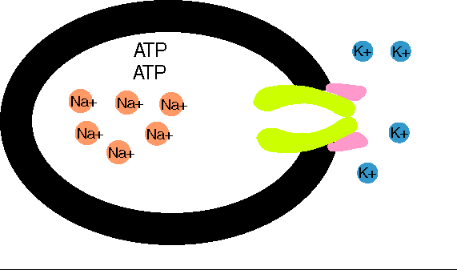
3- Contribution of Na+-K+ PUMP:
- This is a powerful electrogenic pump on the cell membrane.
It pumps 3 Na+ to outside & 2 K+ to inside, causing what?
- A net loss of +Ve ions from inside, returning the nerve fibre to the resting state (-4 mV).
Outside
So the NET MEMBRANE POTENTIAL would be :-
Diffusion potential (caused by K+ & Na+ diffusion) + Electrogenic Na+/K+ pump
(-86 mV ) + (- 4mV) = -90 mV

Slide 10
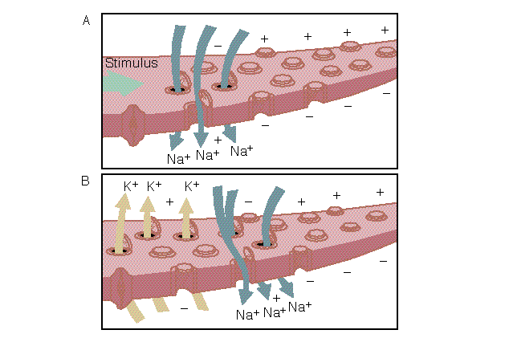
Neuron Action potentials

Slide 11
The action potential
Nerve signals are transmitted by action potentials, which are rapid changes in the membrane potential that spread rapidly along the nerve fiber membrane to produce physiological effects such as:
Transmission of impulse along nerve fibres
Release of neurotransmitters
Muscle contraction
Activation or inhibition of glandular secretion

Slide 12
Each action potential begins with a sudden change from the normal resting negative membrane potential to a positive potential and ends with an almost equally rapid change back to the negative potential.
Stages of the action potential:
Resting Stage. It is the resting membrane potential before the action potential begins. The membrane is “polarized”.
Depolarization Stage.
Repolarization Stage.

Slide 13
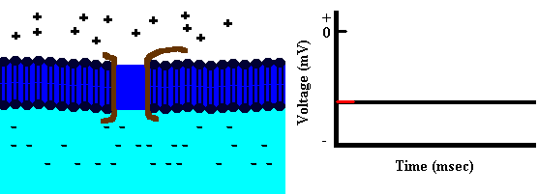
Depolarization
Na+
Depolarization: The membrane suddenly becomes permeable to Na+ ions, allowing tremendous numbers of positively charged Na+ to diffuse to the interior of the axon (Upstroke).

Slide 14
Repolarization
Na+
K+
Repolarization: Na+ channels begin to close and the K+ channels open. Rapid diffusion of K+ ions to the exterior re-establishes the normal negative resting membrane potential.

Slide 15
Threshold stimulus:
The membrane potential at which occurrence of the action potential is inevitable.
Acute subthreshold potential:
Stimulus that results only in local depolarisation (acute local potentials) when stimulus is below the threshold.
Local Responses
All-or-nothing principle:
Once threshold value for excitation is reached a full AP is produced, its intensity can not be increased by increasing stimulus intensity.

Slide 16
Types of transport channels through the nerve membrane:
Voltage gated Na+ channels
Voltage gated K+ channels

Slide 17
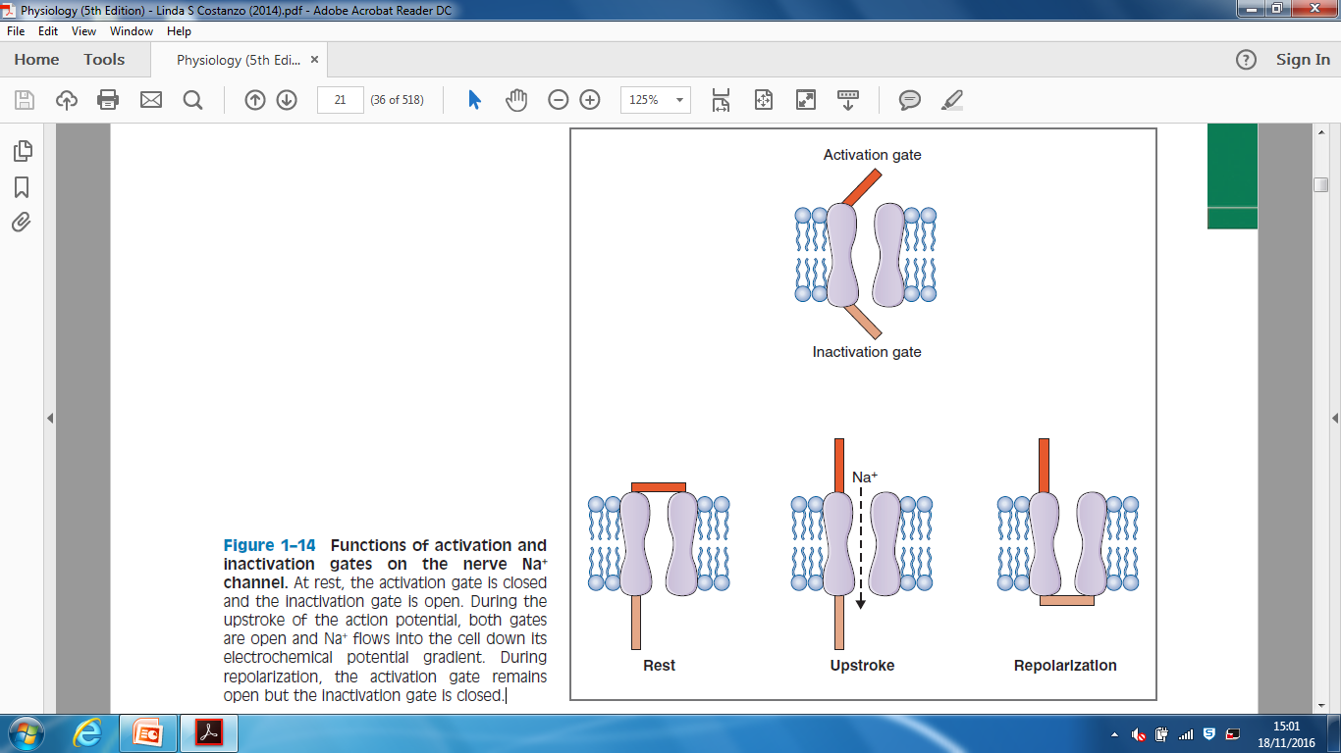
Voltage gated Na+ channels

Slide 18
The Voltage-Gated K+ Channel
Has one gate only .
During the resting state, the gate of the potassium channel is closed and potassium ions are prevented from passing through this channel to the exterior.
Shortly after depolarization, when the sodium channel begins to be inactivated, the potassium channel opens.
→ K+ exits (Efflux) → Repolarization

Slide 19
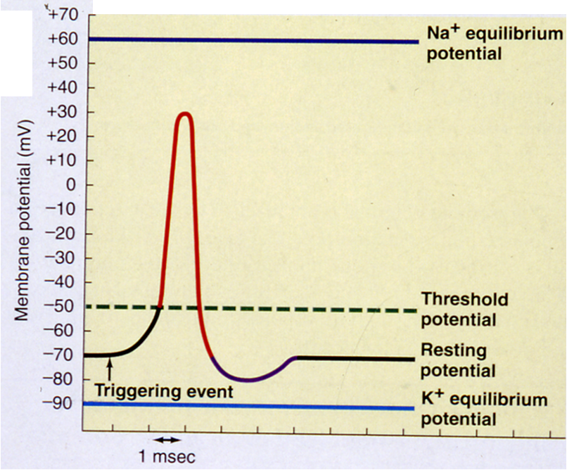
Hyperpolarization: Why?
For a brief period following repolarization, the K+ conductance is higher than at rest.
Na-K pump now starts to move Na+ out & K+ in against their concentration gradient.
Na-K Pump brings MP back to its resting value
Hyperpolarization

Slide 20
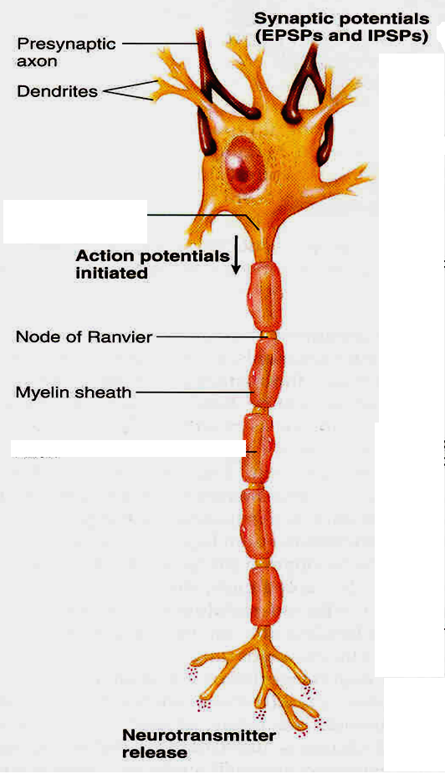
Propagation of the action potential
Artificial Electrical Stimulation
Under Artificial condition of electrical stimulation in the laboratory, the AP propagates in both directiions .
But normally AP starts in axon hillock & propagates distally in one directions

Slide 21
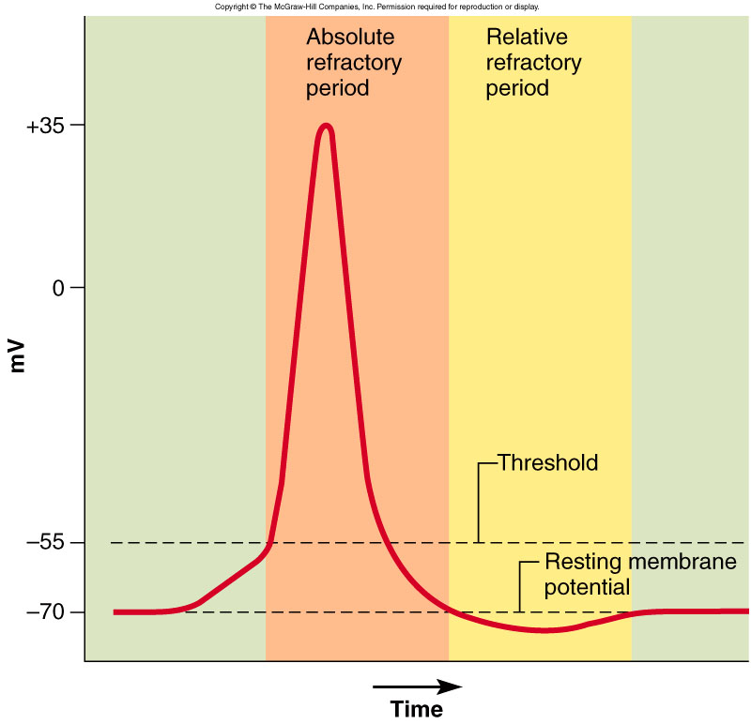
Refractory Period
Two stages
Absolute refractory period
The period during which a second action potential
cannot be elicited, even with a strong stimulus.
Relative refractory period
Can trigger new action potential if stimulus is very strong.
Higher K+ conductance than is present at rest
Closure of the inactivation gates of the Na+ channel

Slide 22
Conduction Velocity
It is the speed at which action potentials are conducted (propagated) along a nerve or muscle fiber.
Mechanisms that increase conduction velocity along a nerve:
1- Nerve diameter.
The larger the diameter, the faster the transmission, Because:
-Large fiber offers Less resistance to local current flow & more ions will flow.
Faster conduction
Slower conduction

Slide 23
Conduction Velocity
Mechanisms that increase conduction velocity along a nerve:
2- Myelination.
Myelin is an insulator that makes it more difficult for charges to flow between intracellular and extracellular fluids.
The layers of Schwann cell membrane contain the lipid substance sphingomyelin which is excellent electrical insulator that decreases ion flow through the membrane.
- Node of Ranvier: small uninsulated area where ions can flow with ease.

Slide 24
Saltatory Conduction
It is the jumping of action potentials from one node of ranvier to the next as they propagate along a myelinated fiber.
Value:-
1- Increases conduction velocity.
2- Conserves energy for axon because only nodes depolarize.

Slide 25
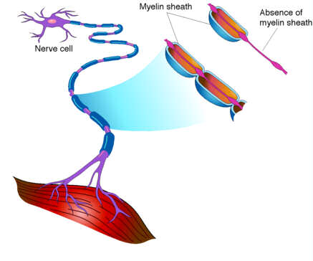
What happens if myelination is lost?
Multiple sclerosis
Autoimmune disease (Immune system attacks the myelin sheaths surrounding axons as well as the axons themselves).
Usually young adults
Blindness, problems controlling muscles
Ultimately paralysis
Scar tissues (scleroses) replaces some damaged cells.

Slide 26
The End

