Slide 1
Contraction of Skeletal Muscle
Textbook of medical physiology Guyton & Hall (13th edition)
UNIT II CHAPTER 6
Dr. Mohammed Alotaibi

Slide 2
Objectives of the lecture
At the end of the lecture the student should be able to:
Know and describe the followings:
The physiologic anatomy of the skeletal muscle.
The general mechanism of skeletal muscle contraction.
The molecular mechanism of skeletal muscle contraction & relaxation.
Sliding filament mechanism.

Slide 3
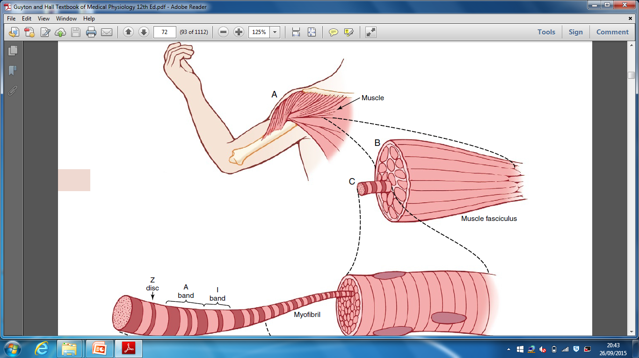
Organization of skeletal muscle
40% of the body are skeletal muscles
Sarcolemma
Muscle fiber
several hundred
to several thousand

Slide 4
Physiological Anatomy of Skeletal Muscle
Sarcolemma (plasma membrane) is a thin membrane enclosing a muscle fiber.
Myofibrils are composed of actin and myosin.
Sarcoplasm is the ICF between myofibrils.
Sarcoplamic reticulum is a specialized endoplasmic
reticulum of muscle cells.

Slide 5
3000 Actin
Responsible for the actual muscle contraction
1500 Myosin
Cross-bridges

Slide 6
Myosin
Actin
M line
Myofibril
The light and dark bands give skeletal and cardiac muscle their striated appearance.

Slide 7
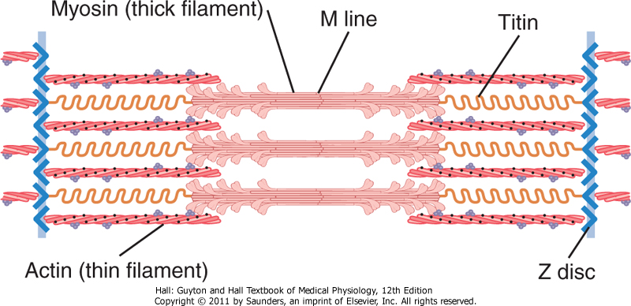
Fig. 6.3 Organization of proteins in a sarcomere
Titin filaments keep the myosin and actin filaments in place.

Slide 8
General Mechanism of Skeletal Muscle Contraction
An action potential travels along a motor nerve to the
motor end plate.
The nerve secretes acetylcholine (Ach).
The Ach binds to sarcolemma and opens gated channels.
Large amounts of Na⁺ enter the cell and initiates and AP.
AP travels along the sarcolemma the same as in a nerve cell.
AP causes depolarization and triggers release of Ca⁺⁺ from
the sarcoplasmic reticulum.
Ca⁺⁺ initiates the contraction cycle.
After contraction, Ca⁺⁺ ions are reabsorbed by the sarcoplasmic reticulum.

Slide 9
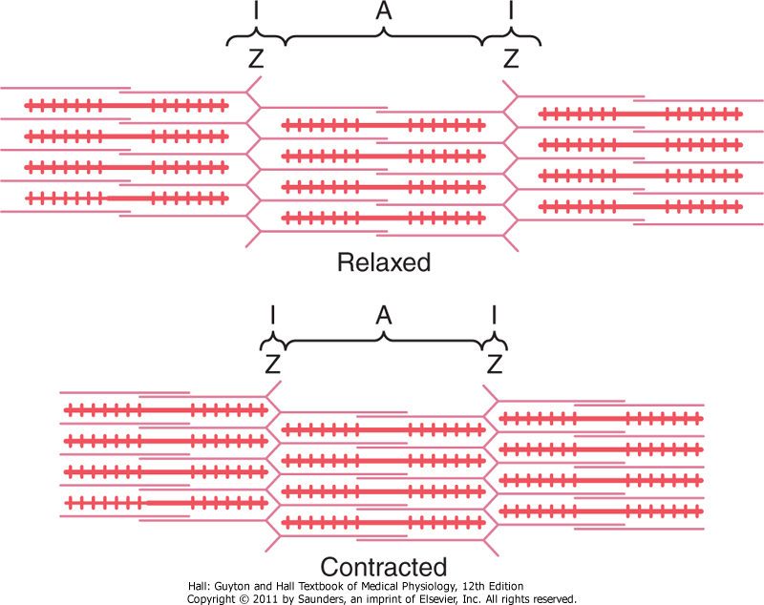
Molecular Mechanism of Muscle Contraction
Muscle Contraction Occurs by a Sliding Filament Mechanism
Figure 6-5. Relaxed and contracted states of a myofibril.

Slide 10
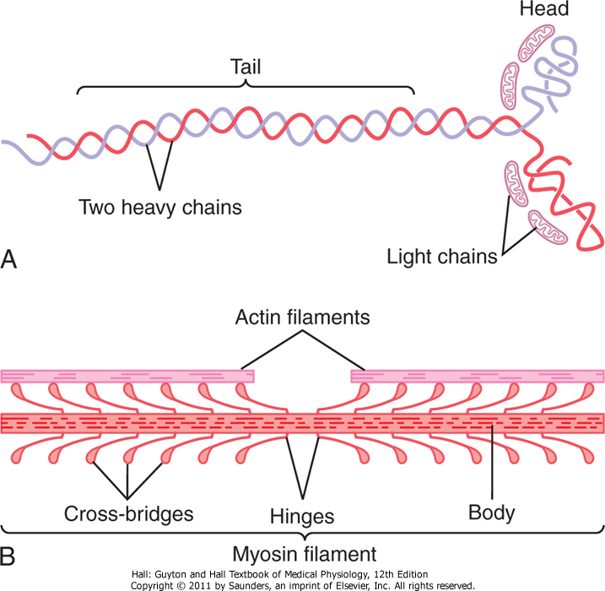
Molecular Characteristics of the Contractile Filaments
Myosin filaments are composed of multiple myosin molecules.
Each Myosin molecule has:
(1) Head
( 2 ) Tail
(3) Hinge (joint )
Each myosin head contains:
(1) Actin binding site
(2) Myosin ATPase site

Slide 11
Molecular Characteristics of the Contractile Filaments
Actin filaments are composed of actin, tropomyosin and troponin
Double-Stranded: backbone of the actin filament
Fig. 6.7 Actin filament

Slide 12
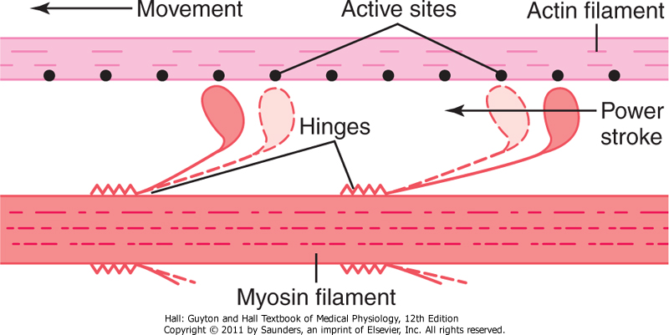
Molecular Mechanism
Fig. 6.8 “Walk-along” mechanism for muscle contraction.
The heads of the cross-bridges bend back and forth and step by step walk along the actin filament, pulling the ends of two successive actin filaments toward the center of the myosin filament.

Slide 13
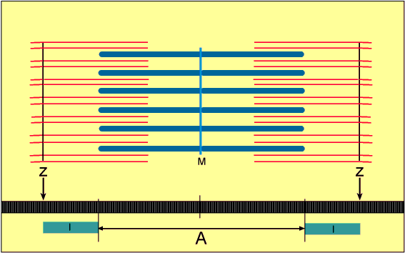
Sliding Filament Mechanism
But what causes the actin filaments to slide inward among the myosin filaments?
Forces generated by interaction of the cross-bridges from the myosin filaments with the actin filaments

Slide 14
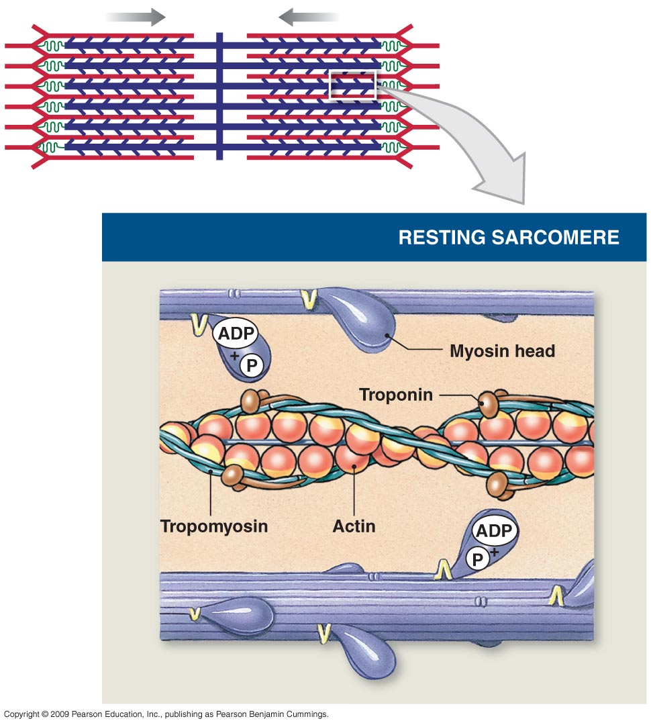
Forces are inactive
The heads of the cross bridges bind with ATP. The ATPase activity of the myosin head immediately cleaves the ATP but leaves the cleavage products, ADP plus phosphate ion, bound to the head.

Slide 15
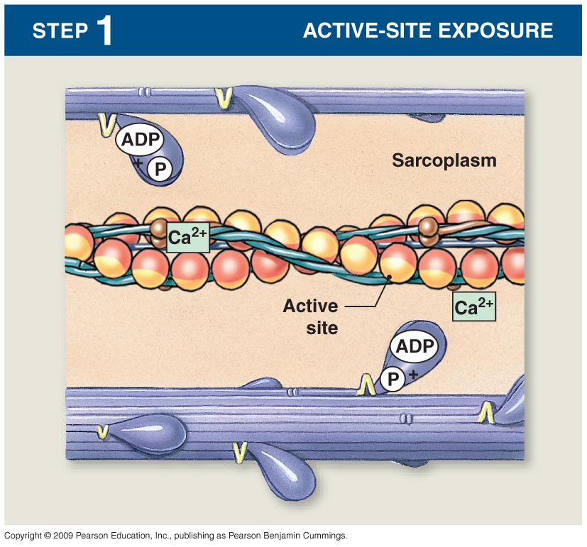
When the troponin-tropomyosin complex binds with calcium ions, active sites on the actin filament are uncovered and the myosin heads then bind with these sites.

Slide 16
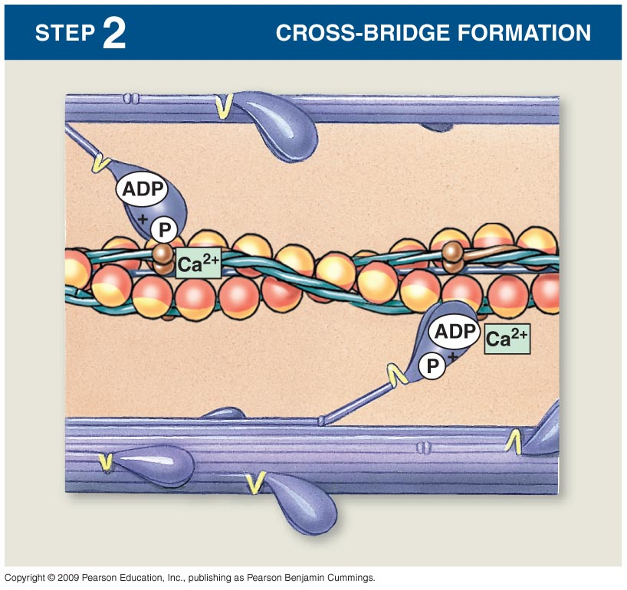
With the active sites on the actin exposed, the myosin heads bind to the actin, forming cross-bridges.

Slide 17
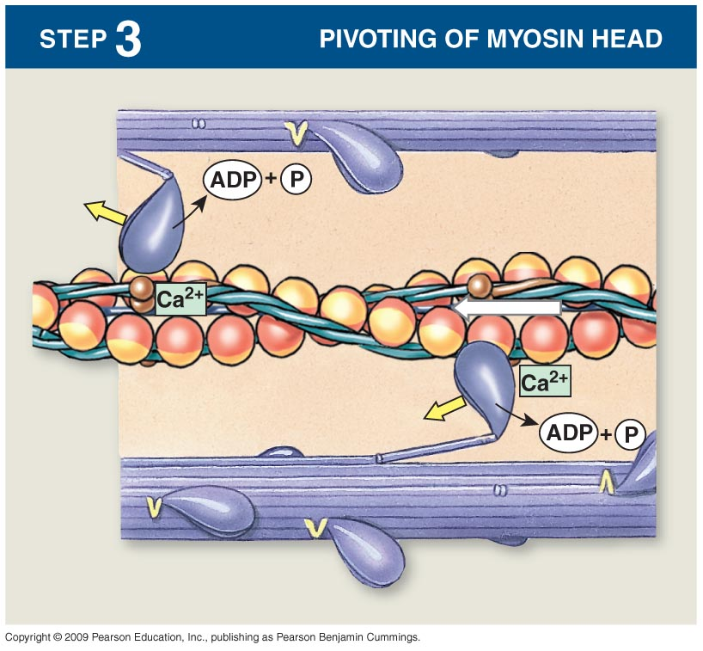
Binding the head of the cross-bridge with the active site causes a conformational change in the head, prompting the head to tilt toward the arm of the cross-bridge and providing the power stroke for pulling the actin filament.
Notes:
After cross-bridge formation, the ATP present in the myosin is used to “cock” (the opposite direction from its resting state). As the ATP is used and the ADP + P is released, the “power stroke” occurs as the myosin pivots toward the M line.

Slide 18
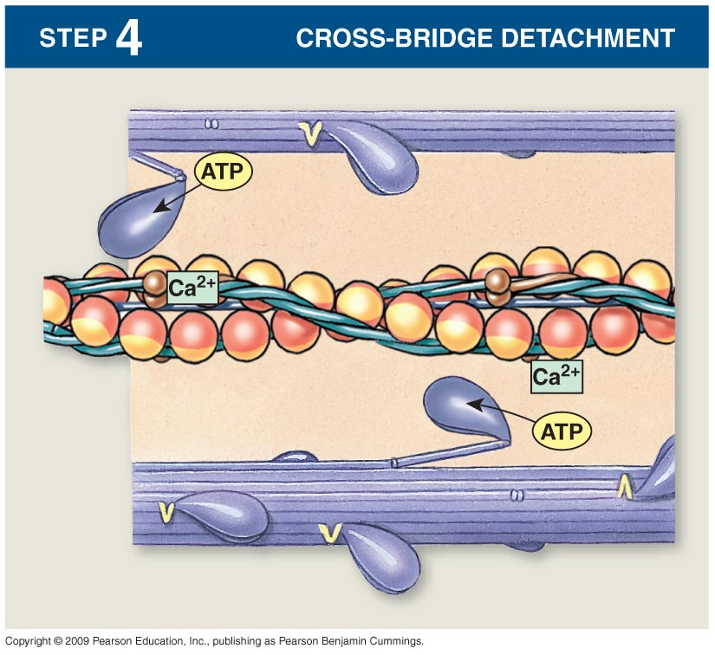
Once the head of the cross-bridge tilts, ADP and phosphate ion are released and new molecule of ATP binds. This binding of new ATP causes detachment of the head from the actin.

Slide 19
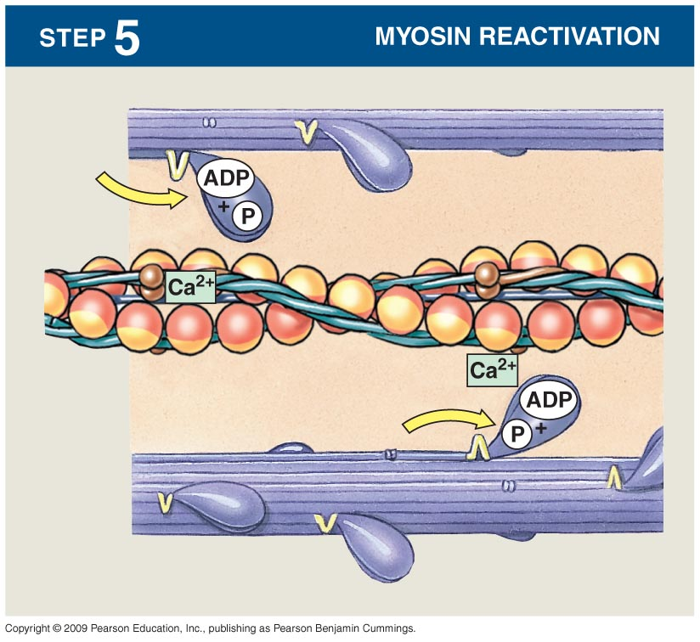
The new ATP is cleaved to begin the next cycle which “cocks” the head back to its perpendicular condition, ready to begin the new power stroke cycle.

Slide 20
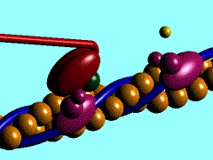
What is Rigor Mortis ?
The contracture of skeletal muscles that begins several hours after death due to the loss of ATP.

Slide 21
Excitation of Skeletal Muscle: Neuromuscular Transmission and Excitation-Contraction Coupling
Textbook of medical physiology Guyton & Hall (13th edition)
UNIT II CHAPTER 7
Dr. Mohammed Alotaibi

Slide 22
Objectives of the lecture
At the end of the lecture the student should be able to:
Know and describe the followings:
- The physiologic anatomy of Neuromuscular Junction (NMJ).
- Motor end plate, synaptic trough/ gutter/ cleft.
Motor End Plate potential and how action potential and excitation-contraction coupling are generated in skeletal muscle.
- Drugs/ diseases affecting the neuromuscular transmission.

Slide 23
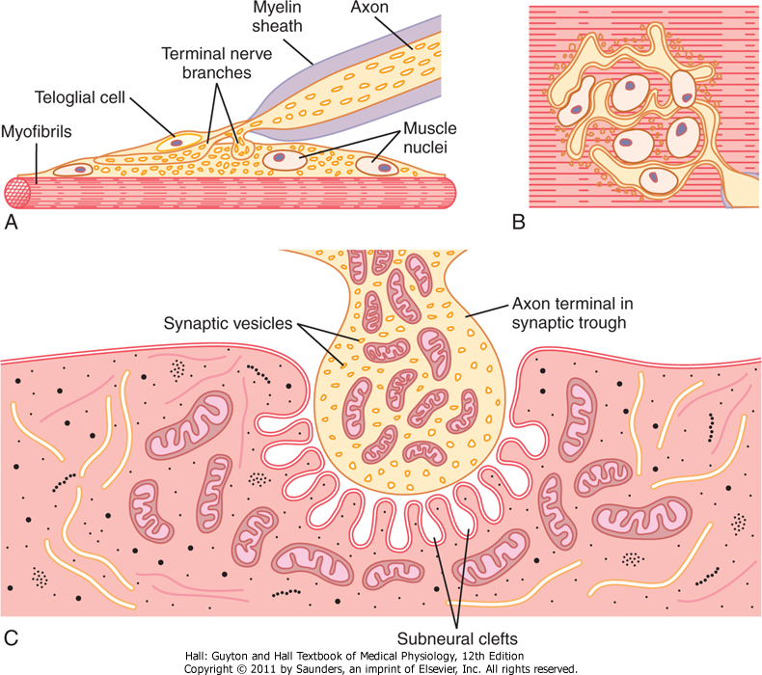
Physiologic Anatomy of the Neuromuscular Junction
Motor End Plate
Synaptic trough/ gutter
Presynaptic terminal
Postsynaptic terminal
Synaptic space/cleft
Subneural cleft
Acetylcholine (Ach)
Synaptic vesicles
Acetylcholinesterase
Fig. 7.1

Slide 24
Transmission of impulses from nerve endings to skeletal muscle fibers occurs via:
THE NEUROMUSCULAR JUNCTION (NMJ)

Slide 25
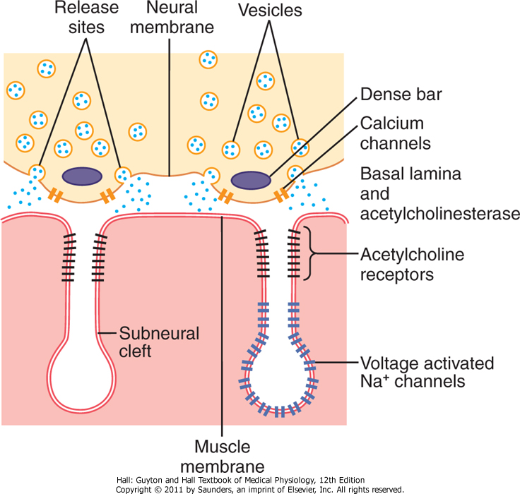
Secretion of Acetylcholine by the Nerve Terminals
125 vesicles of Ach are released.
Voltage-gated calcium channels.
Acetylcholine receptors (Ach-gated ion channels).
Voltage-gated Na+ channels.
Fig. 7.2

Slide 26
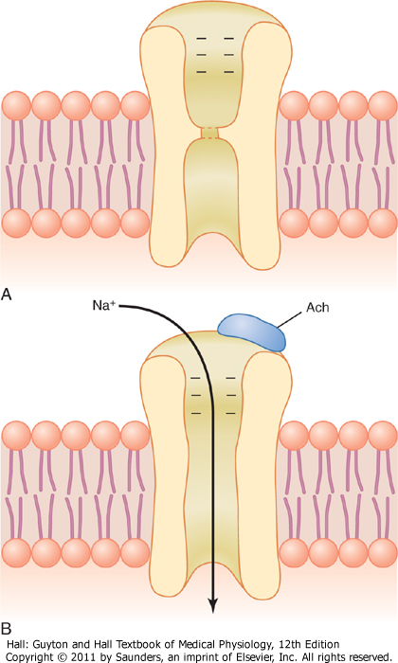
Effect of Ach on the Postsynaptic Muscle Membrane
Two molecules of Ach must attach to the receptor.
Ach-channels open and allow Na⁺, Ca⁺, or K⁺ ions to move through easily; but not negative ions such as Cl⁻
More Na+ ions will pass through which creates a local positive potential change inside the muscle fiber membrane, called the end plate potential (EPP).
EPP spreads along the muscle membrane
Fig. 7.3 Acetylcholine gated channels
A. Closed B. After AcH attaches

Slide 27
EPP opens Voltage gated Na+ Channels
Sudden influx of Na⁺ when Ach-gated channels open increases electrical potential in the positive direction as much as 50-75 mV and creates a local EPP. This will open voltage gated Na+ channels.

Slide 28
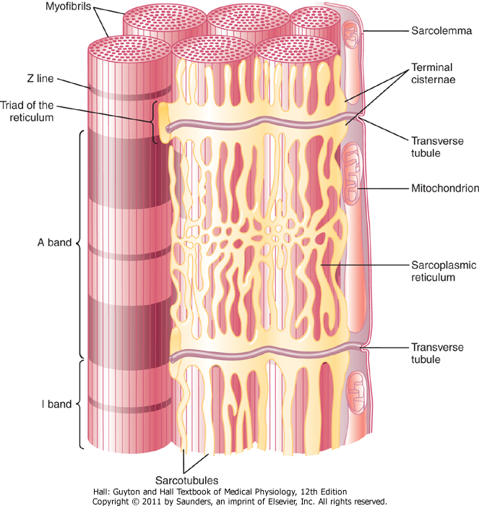
Excitation-Contraction Coupling
Spread of the AP via Transverse Tubules
T-Tubule-Sarcoplasmic Reticulum System.
T-tubules are small and run transverse to the myofibrils.
- The sarcoplasmic reticulum is composed of 2 parts:
(1) large chambers called terminal cisternae
(2) long longitudinal tubules
The T tubule action potentials cause Ca++ release inside the muscle fiber in the immediate vicinity of the myofibrils, and this Ca++ then cause contraction. This overall process is called excitation-contraction coupling.

Slide 29
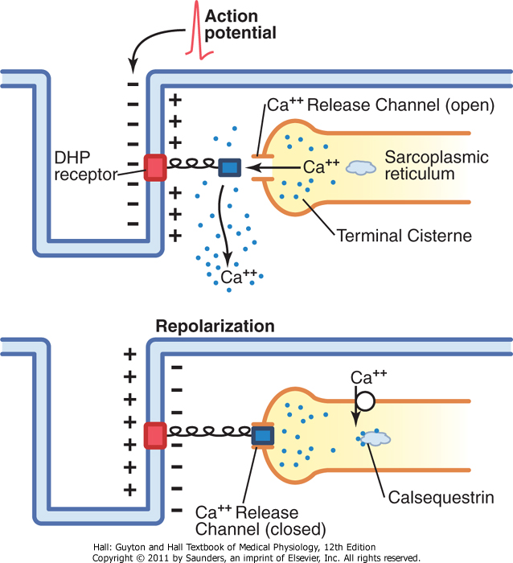
Release of Calcium Ions by the Sarcoplasmic Reticulum
As the AP reaches the T-tubule, the voltage change is sensed by dihydropyridine receptors (DHP) linked to calcium release channels (Ryanodine receptors) which triggers the release of Ca⁺⁺ initiating contraction.
Calcium pump removes calcium ions after contraction occurs.
Calcium binds to calsequestrin.
Fig. 7.6 Excitation-contraction coupling in skeletal muscle.

Slide 30
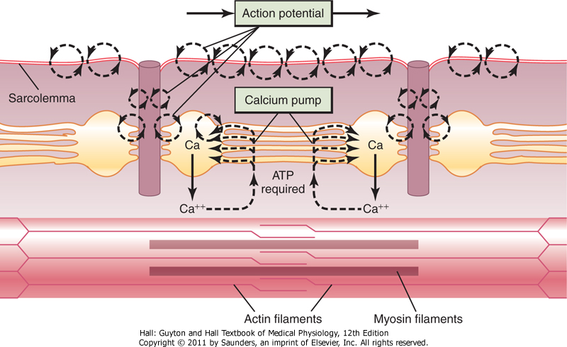
Fig. 7.7 Excitation-contraction coupling in the muscle showing (1) an AP that causes the release of Ca ions from the
sarcoplasmic reticulum and then (2) re-uptake of the calcium ions by the calcium pump.

Slide 31
Destruction of the Released Acetylcholine
Most of the Ach is destroyed by the enzyme acetylcholinesterase into acetate ion and choline.
[choline is reabsorbed actively into the neural terminal to be reused to form new acetylcholine]
A small amount diffuses out of the synaptic space.

Slide 32
Safety factor for transmission at the neuromuscular junction
Fatigue of the Junction
Each impulse that arrives at the junction causes about
3X as much EPP as required to stimulate the muscle fiber.
Therefore, the normal NMJ is said to have a high safety factor.
Overstimulation, however, diminishes the number of Ach vesicles.
This situation is called fatigue of the NMJ.
Fatigue of the NMJ occurs rarely and only at exhausting levels of muscle activity.

Slide 33
Muscle Action Potential (AP)
 | Skeletal Muscle | Large Nerves
Resting Membrane Potential | -80 to -90 mV | -80 to -90 mV
Duration of the Action Potential | 1-5 milliseconds | 0.2-1.0 milliseconds
Velocity of Conduction | 3-5 m/sec | 39-65 m/sec

Slide 34
Drugs That Enhance or Block Transmission at the
Neuromuscular Junction
Drugs That Stimulate the Muscle Fiber by Ach-Like Action:
Methacholine, Carbachol, and Nicotine.
They act for minutes or hours—are not destructed by cholinesterase.
Drugs That Stimulate the NMJ by Inactivating Acetylcholinesterase:
Neostigmine, Physostigmine [inactivate acetylcholinesterase for several hours]
Diisopropyl fluorophosphate (nerve gas poison) [inactivates acetylcholinesterase for weeks -------can cause death because of respiratory muscle spasm]

Slide 35
Drugs That Enhance or Block Transmission at the
Neuromuscular Junction
Drugs That Block Transmission at the NMJ
Curare & Curariform like-drugs.
Prevent passage of impulses from the nerve ending into the muscle by blocking the action of Ach on its receptors.
Botulinum Toxin.
Bacterial poison that decreases the quantity of Ach release by the nerve terminals.

Slide 36
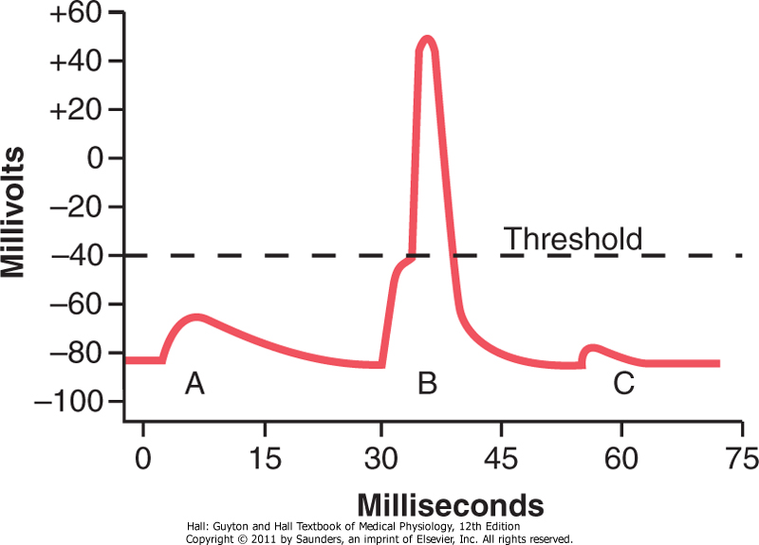
EPP and Excitation of the Skeletal Muscle Fiber
Three separate EPP:
End plate potentials A
End plate potentials B
End plate potentials C
Curare
Botulinum toxin
Fig. 7.4 End Plate Potentials in mV. A & C: weakened end potential in a muscle too weak to elicit an AP; B: Normal end plate potential eliciting an AP.

Slide 37
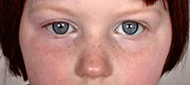
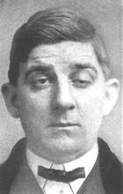
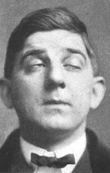
Myasthenia Gravis
Disease of adult females affects eyelid, extra ocular bulbar and proximal limb muscles.
Presents with ptosis, dysarthria, dysphagia, and proximal limb weakness in hands& feet.

Slide 38
Myasthenia Gravis
Autoimmune disorder [patients develop antibodies which block or destroy their own Ach receptors].
Occurs in about 1 in every 20,000 persons.
Causes muscle weakness because of the inability of the NMJ to transmit enough signals from the nerve fibers to the muscle fibers.
The EPP that occur in the muscle fibers is mostly too weak to initiate opening of the voltage-gated sodium channels.
Patient may die of respiratory failure.

Slide 39
Myasthenia Gravis
Treatment:
Administration of anticholinesterase drugs such as Neostigmine which allows larger than normal amounts of Ach to accumulate in the synaptic space.
Corticosteroids and Immunosuppressant drugs to inhibit the immune system, limiting antibody production.

Slide 40
The End

